Slide 1
LSI-VC & CARD4L Background & Status
Matt Steventon
LSI-VC Sec

Slide 2
CEOS LSI-VC
Land Surface Imaging Virtual Constellation (LSI-VC)
Progressing analysis-ready data - minimising the need for end users to understand satellite/pass/sensor-specific processing.
Draw together validated requirements identified by downstream land user communities to identify opportunities to better optimize, and increase resilience of, land surface imaging programs & identify current and potential data gaps.
Encourage Moderate Resolution Interoperability (MRI) for complementarity and compatibility.
LSI-VC leads the CEOS Analysis-Ready Data (ARD) initiative

Slide 3
CARD4L Definition
CEOS Analysis Ready Data for Land (CARD4L) are satellite data that have been processed to a minimum set of requirements and organized into a form that allows immediate analysis with a minimum of additional user effort and interoperability both through time and with other datasets.
http://ceos.org/ard/

Slide 4
CARD4L Framework
CARD4L Definition
Product Family Specifications (PFS)
Detail specific 'Threshold' and 'Target' requirements for:
General & Per-pixel Metadata
Radiometric, Atmospheric & Geometric Corrections
Self-Assessment
Carried out by the data provider that is seeking to have their dataset classified as CARD4L
Data provider fills out table in PFS and submits to LSI-VC Secretariat along with sample data and metadata
Peer Review
WGCV reviews submitted materials and confirms level of compliance with PFS
Dataset Recognised as CARD4L
Added to register of datasets on ceos.org/ard, etc.

Slide 5
CARD4L Status
Three Product Family Specifications (PFS) endorsed at LSI-VC’s February 2019 meeting:
Surface Reflectance (SR)
Surface Temperature (ST)
Normalised Radar Backscatter (NRB)
Additional SAR PFS in development
June 2019: Streamlined PFS (v4.1) and LSI-VC side of assessment process
ESA (Sentinel-2, SR), USGS (Landsat, SR&ST) and JAXA (ALOS, NRB) completing self-assessments

Slide 6
Some Next Steps
Completion of ESA (Sentinel-2, SR), USGS (Landsat, SR&ST) and JAXA (ALOS, NRB) product assessments.
LSI/CEOS Agencies to trial production and supply of CARD4L (including to third party data hosts/analysis platforms)
User access trials
e.g., SDCG-led trial for GFOI focusing on Digital Earth Africa (Data Cube) as a user.
Investigation into COGs and STAC for CARD4L usability and discoverability and impact on PFS
Ongoing annual maintenance of the CARD4L PFS
SAR Definition Team developing new SAR PFS
Promote and communicate CARD4L to CEOS Agencies, and engage with other sectors (commercial, users, research).
CEOS ARD Strategy (explained later)

Slide 7
WGCV CARD4L Peer Review Process & Status
Medhavy Thankappan

Slide 8
2020-21 SIT Chair Priorities & CEOS ARD Strategy
Matt Steventon
2020-21 SIT Chair Team

Slide 9
2020-21 SIT Chair Priorities
CSIRO/GA will serve as the SIT Chair for 2020-21
Intention for the term is to escalate, elevate and encourage accomplishment of ongoing pieces of CEOS work
Three priority areas:
CEOS ARD
Carbon and Biomass
UN Sustainable Development Goals

Slide 10
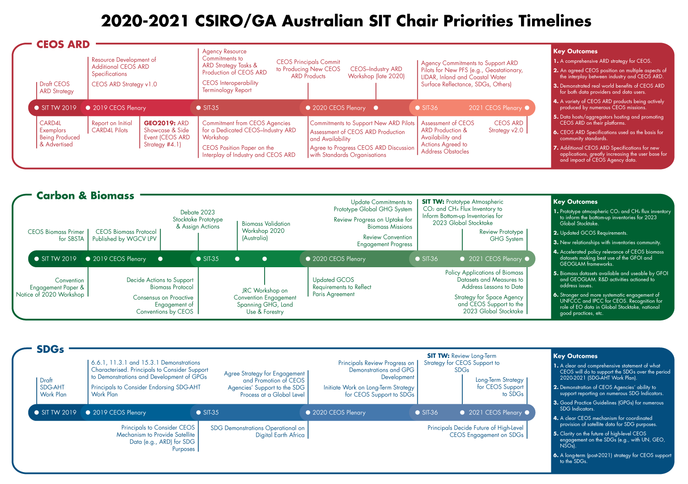

Slide 11
Key Outcomes
A comprehensive ARD strategy for CEOS
An agreed CEOS position on multiple aspects of the interplay between industry and CEOS ARD
Demonstrated real world benefits of CEOS ARD for both data providers and data users
A variety of CEOS ARD products being actively produced by numerous CEOS missions
Data hosts/aggregators hosting and promoting CEOS ARD on their platforms
CEOS ARD Specifications used as the basis for community standards
Additional CEOS ARD Specifications for new applications, greatly increasing the user base for and impact of CEOS Agency data

Slide 12
CEOS ARD Strategy
Work of LSI-VC on CARD4L is the foundation for this strategy
CEOS has acknowledged the need to broaden efforts beyond the PFS work, and beyond the land domain.
Main objectives of the strategy:
to ensure effective engagement of the three key stakeholder groups (producers, hosts, users);
to manage expectations of all stakeholders as to the status and outlook for ARD availability – so that all might plan and invest with confidence in capabilities to best exploit the CEOS Agency ARD;
to establish priorities for which products and applications might follow on from the current CARD4L PFS – forming a rational and orderly queue for future efforts;
to ensure appropriate organisational responsibilities across the CEOS structure for the definition and execution of the way forward on ARD.

Slide 13
CEOS ARD Strategy
4 Pillars:
CEOS ARD User Needs & Specifications
Assured Production and Access
Pilots and Feedback
Communication & Promotion
Foreseen as an informal collection of ARD-related activities across the CEOS structure, with light oversight and coordinated reporting supported by SIT.
Will be shared with the CEOS community shortly for review, ahead of planned endorsement later this year at Plenary – all feedback is very welcome!

Slide 14
Thanks! Questions? More info: http://ceos.org/ard/ lsi@lists.ceos.org matthew@symbioscomms.com Medhavy.Thankappan@ga.gov.au

