Slide 1
AC-VC Activities
David Crisp (Jet Propulsion Laboratory, California Institute of Technology, CEOS AC-VC GHG Lead)
July 16, 2019
© 2019 California Institute of Technology. Government sponsorship acknowledged.

Slide 2
Overview of AC-VC Actions Items and Activities
Contribute to CMRS-25, implementation of GHG monitoring system
  Led by CEOS-CGMS Working Group on Climate (WGClimate)
  Establish roadmap for development of a GHG monitoring system [Q3 2019]
  Develop a prototype GHG monitoring system [Q3 2021]
  Develop initial operational GHG monitoring system [Q3 2026]
VC-2, Ozone dataset validation/harmonization [Q4 2020]
  Peer-reviewed papers on ozone profile intercomparisons
VC-3, Air Quality (AQ) Constellation Coordination [Q1/2019]
  Document on validation needs for the AQ Constellation will be presented for endorsement 6/2019 during AC-VC-15
I will focus primarily on the AC-VC/WGCV interactions for the GHG activity

Slide 3
Objectives of the AC-VC GHG White Paper
The CEOS Chair commissioned the Atmospheric Composition Virtual Constellation (AC-VC) to write a white paper that Defines the key characteristics of a global architecture for monitoring atmospheric CO₂ and CH₄ concentrations and their natural and anthropogenic fluxes from instruments on space-based platforms to:
  reduce uncertainty of national emission inventory reporting;
  identify additional emission reduction opportunities
  provide nations with timely and quantified guidance on progress towards their emission reduction strategies and pledges (Nationally Determined Contributions, NDCs); and,
  track changes in the natural carbon cycle caused by human activities (deforestation, degradation of ecosystems, fire) and climate change

Slide 4
The CEOS Architecture for Monitoring Atmospheric CO₂ and CH₄ Concentrations
The CEOS Atmospheric Composition Virtual Constellation (AC-VC) white paper defines a global architecture for monitoring atmospheric CO₂ and CH₄ concentrations from instruments on space-based platforms
166-page document, 88 authors from 47 organizations
Executive Summary (2 pages)
Body of report (75 pages)
Technical Appendices (42 pages)
http://ceos.org/document_management/Virtual_Constellations/ACC/Documents/CEOS_AC-VC_GHG_White_Paper_Publication_Draft2_20181111.pdf

Slide 5
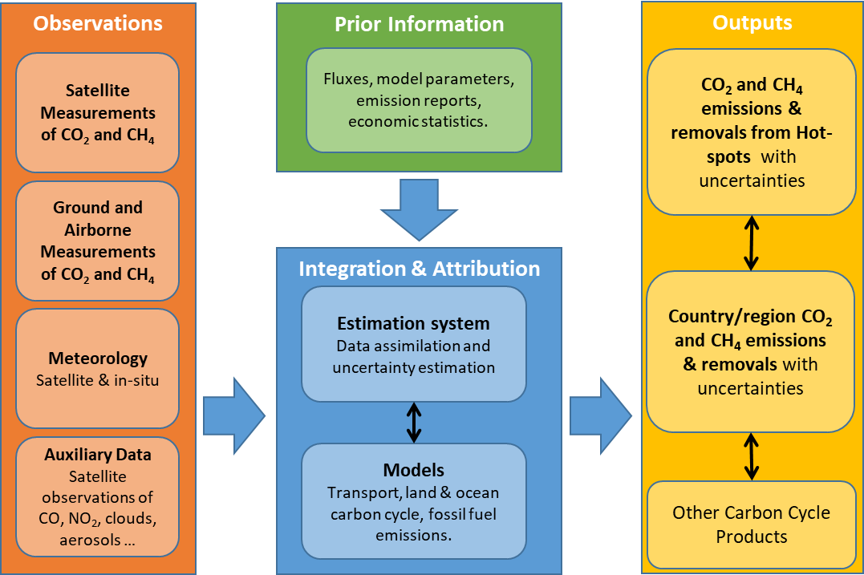
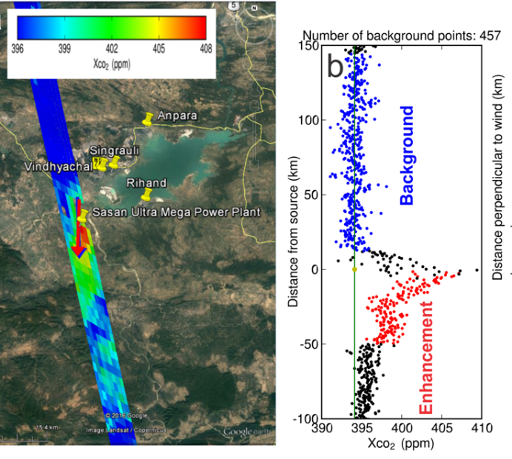
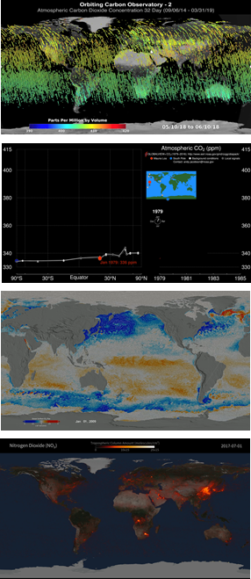
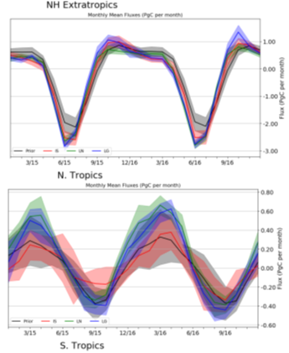
Role of Space-based Measurements in an Atmospheric GHG Inventory System
WGCV Supports this activity

Slide 6
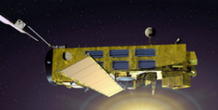
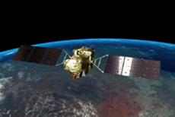
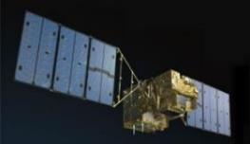

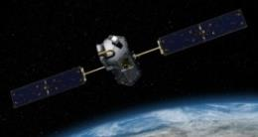
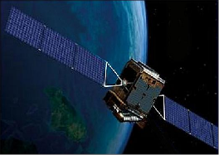
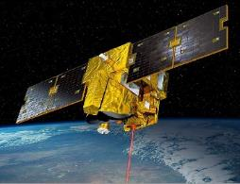
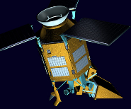
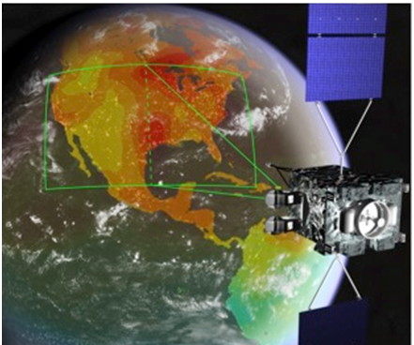
Collecting GHG Observations from Space: The Evolving Fleet
Space agencies have supported several pioneering space-based GHG sensors :
  ESA’s ENVISAT SCIAMACHY,
  Japan’s GOSAT TANSO-FTS, NASA’s OCO-2, China’s TanSat AGCS, Feng Yun-3D GAS and Gaofen-5 GMI, Copernicus Sentinel 5 Precursor TROPOMI.
Other sensors just added to the fleet:
  Japan’s GOSAT-2 TANSO-FTS-2 and NASA’s ISS OCO-3
Others are under development:
  CNES MicroCarb, CNES/DLR MERLIN, NASA’s GeoCarb

Slide 7
The GHG Constellation Time Line

Slide 8
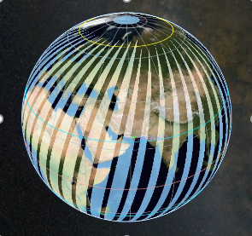
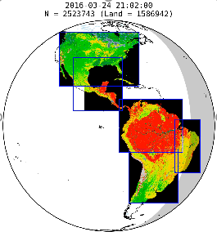
A Candidate Operational CO₂/CH₄ Constellation Architecture
The coverage, resolution, and repeat frequency requirements could be achieved with a constellation that incorporates:
A constellation of 3 (or more) satellites in LEO with
  Broad (> 250 km) swaths with a footprint size < 4 km²
  Single sounding random error < 0.5 ppm
  Vanishing small regional scale bias (< 0.1 ppm)
  Ancillary sensors to identify plumes (CO, satellites NO₂)
A constellation with 3 (or more) GEO satellites
  Stationed over Europe/Africa, Americas, and East Asia
  Diurnally varying processes (e.g. rush hours, photosynthetic uptake)
Possible augmentations include:
  Active (lidar) satellites in LEO for night-time/polar night coverage
  Satellites in HEO for improved high latitude coverage and repeat frequency

Slide 9
Developing Atmospheric GHG Inventories
The CEOS AC-VC GHG White Paper recommends the following approach:
Refine requirements and implementation plans for atmospheric flux inventories
  Foster collaboration between the space-based and ground-based GHG measurement and modeling communities and the bottom-up inventory and policy communities
Produce a prototype atmospheric CO₂ and CH₄ flux inventory that is available in time to inform the bottom-up inventories for the 2023 global Stocktake
  Exploit capabilities of CEOS), Coordination Group on Meteorological Satellites (CGMS) and the WMO Integrated Global Greenhouse Gas Information System (IG3IS)
Use the lessons learned from this prototype flux product to refine the requirements for a future, purpose-built, operational, atmospheric inventory system
  more completely addresses the inventory process in time to support the 2028 global Stocktake.

Slide 10
Endorsement and Next Steps
The 2018 CEOS Plenary endorsed the AC-VC GHG White Paper
  WGClimate commissioned to form a dedicated task group on GHG monitoring, with resources and activities designed to address the actions identified in the White Paper
  WGCV was enlisted to support the definition of the calibration and validation needs
  AC-VC was enlisted support GHG constellation development and synergistic GHG and atmospheric composition observations and modelling efforts
The first step in this process is to write a comprehensive Roadmap for the GHG activities to be conducted by WGClimate, WGCV, and AC-VC
  A dedicated GHG Roadmap Meeting was held in Nakano, Tokyo on 9 June 2019

Slide 11
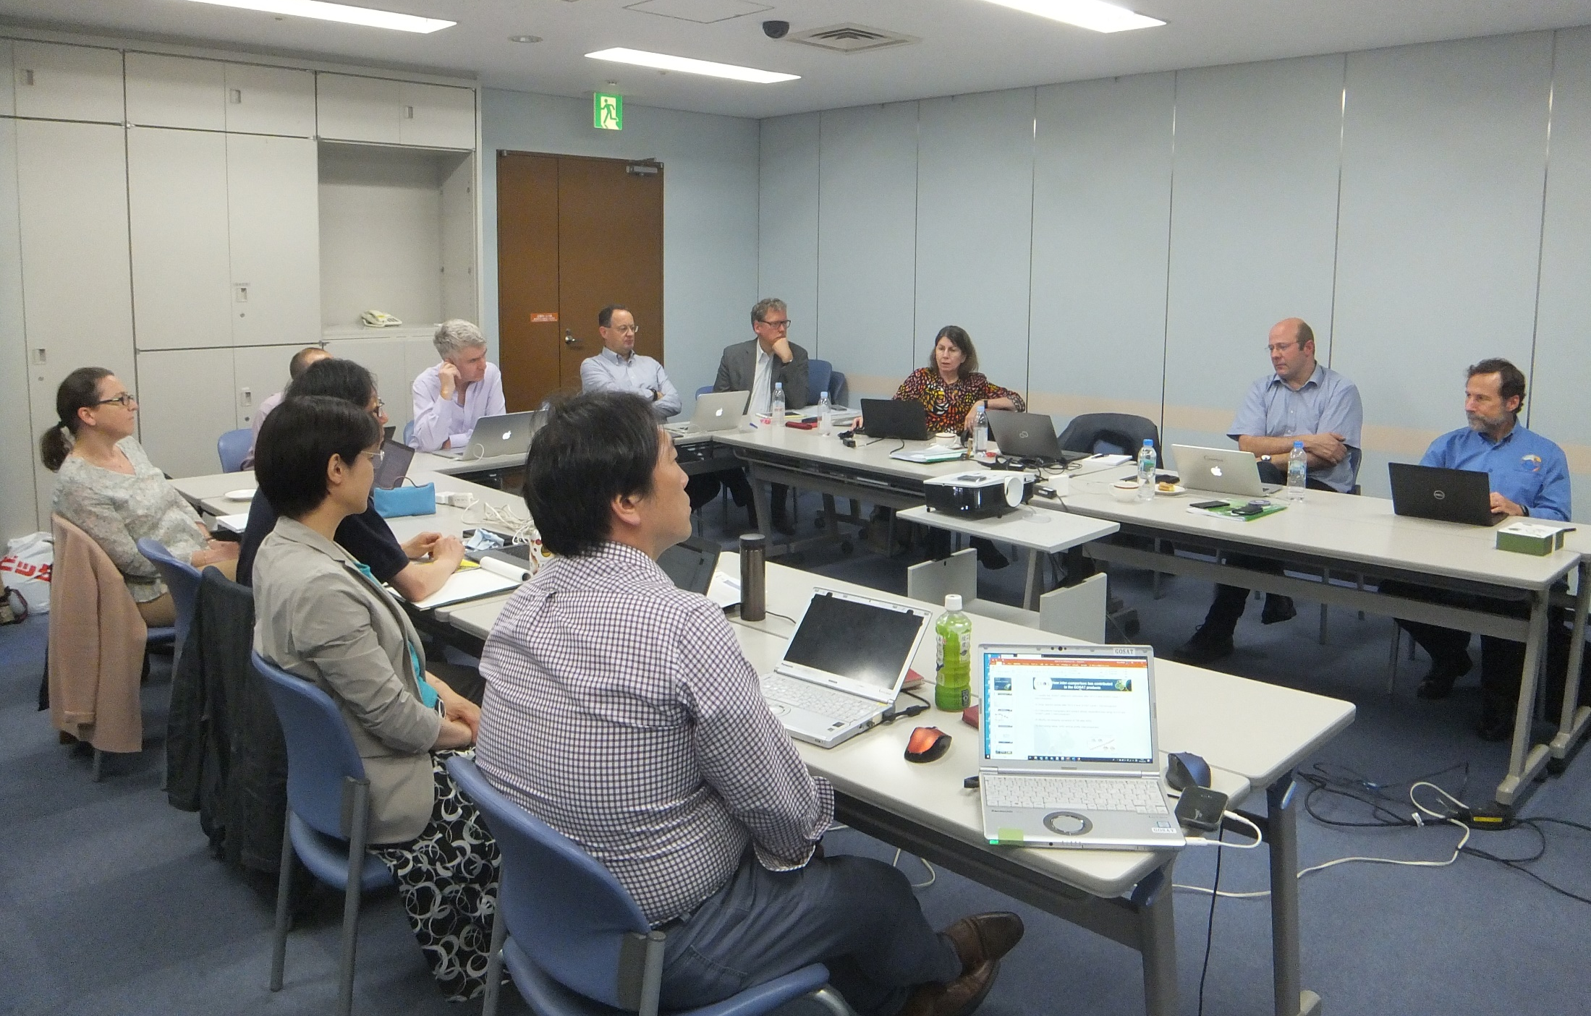
CEOS GHG Roadmap Meeting Participants
Local Participants
Albrecht von Bargen (DLR, WGClimate&GHG Dep. Lead)
David Crisp (JPL/Caltech, CEOS AC-VC GHG Lead)
Mark Dowell (EC/JRC, CEOS GHG Task Lead)
Valerie Fernandez (ESA, CO2M)
Mariko Harada (JAXA)
Akihiko Kuze (JAXA, WGCV ACSG GOSAT)
Rosemary Munro (EUMETSAT, CGMS/GSICS)
Masakatsu Nakajima (JAXA, GOSAT, GOSAT-2)
Yuko Nakamura (JAXA)
Nobuko Saigusa (NIES, GOSAT, GOSAT-2)
Kei Shiomi (JAXA, GOSAT, GOSAT-2)
Hitoshi Tsuruma (JAXA)
Stephen Ward (for JAXA)
Ben Veihelmann (ESA, CEOS AC-VC Co-Lead)
Claus Zehner (ESA, S5P)
Hugo Zunker (EC)
Remote Contributors
Bojan Bojkov (EUMETSAT, WGCV ACSG)
Robert Husband (EUMETSAT, WGClimate)
Osamu Ochiai (JAXA, CEOS POC)
Joerg Schulz (EUMETSAT, WGClimate Lead)

Slide 12
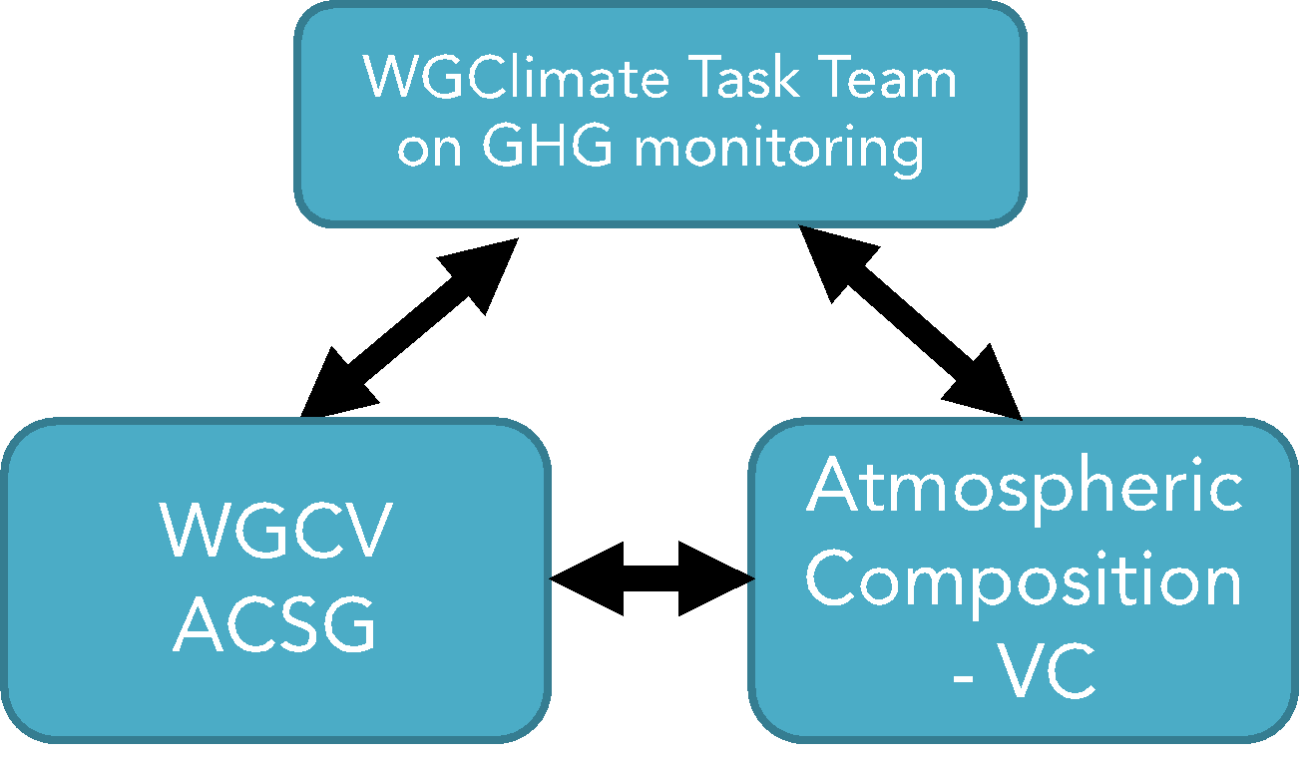
CEOS/CGMS GHG Roadmap Report Outline
SCOPE AND OBJECTIVE OF ROADMAP
CONTEXT
APPROACH
CEOS AND CGMS IMPLEMENTATION ENTITIES AND THEIR ROLES
  Role of Joint WGClimate GHG Task Team
  Role of CEOS Atmospheric Composition – Virtual Constellation
  Role of WGCV/ACSG and GSICS
  Role of other entities in CEOS and CGMS
ROADMAP ACTIONS TO 2021 AND 2025
  Actions for Joint WGClimate GHG Task Team
  Actions for Atmospheric Composition – Virtual Constellation
  Actions for WGCV/ACSG and GSICS
EXPECTED OUTCOMES
RESOURCE IMPLICATIONS
HIGH-LEVEL TIMELINE
The roadmap document will be complemented by a representation of the roadmap in a project planning tool that is maintained by the WGClimate Task Team. This allows a close follow up of achievements and emerging risks during implementation.

Slide 13
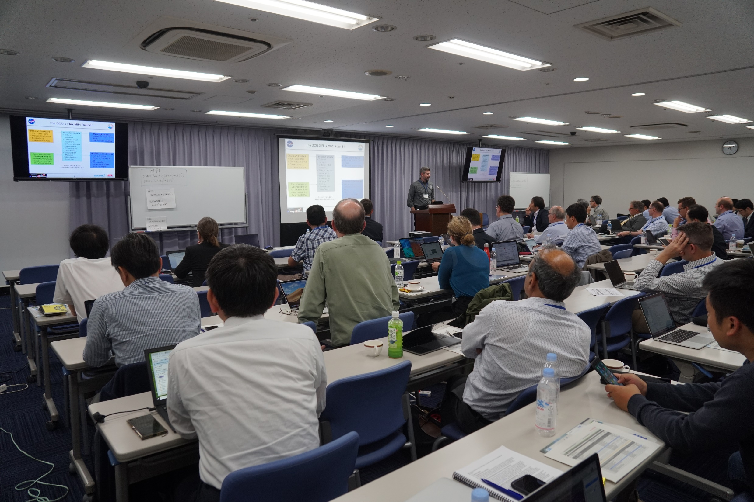

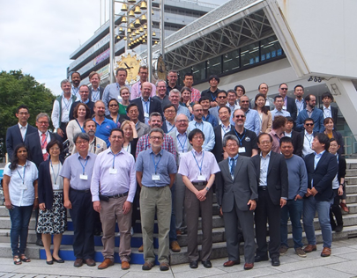
GHG Roadmap Refined at 15th Annual AC-VC Meeting: Nakano, Tokyo 10-12 June 2019
Day 1:
  GHG Mission Status Reports
  Cal/Val of GHG Missions
  GHG Inventories -Preparing for the 2021 Stocktake
Day 2:
  Synergies between Air Quality (AQ) and GHG OSSEs
  AC-VC Leadership and Interdisciplinary topics
  AQ Mission Status reports
    S5P reports including Cal/Val Lesson Learned
Day 3:
  AQ Validation activities
  AQ Aerosol measurements
  Tropospheric Ozone products, status and plans

Slide 14
Calibration Advances Needed to Support GHG Constellations
Space based sensors for CO₂ and CH₄ must be:
  Calibrated to unprecedented levels of accuracy to detect and quantify the small XCO₂ and XCH₄ changes associated with surface fluxes
  Cross-calibrated against internationally-accepted standards prior to launch and in orbit so that their measurements can be integrated into a harmonized data product that meets the accuracy, precision, resolution, and coverage requirements for CO₂ and CH₄
Efforts by the ACOS and GHG-CCI teams have demonstrated the feasibility of this approach for SCIAMACHY, GOSAT, and OCO-2
  Rigorous pre-launch and in-orbit calibration methods demonstrated
  GOSAT-2, OCO-3, and S5P TROPOMI now being integrated into system
Working actively with CEOS WGCV and GSICS to meet the much more demanding requirements of anthropogenic emissions monitoring
  Cross-calibrating a more diverse range of spacecraft sensors
  Reducing calibration-related biases across multiple spacecraft

Slide 15
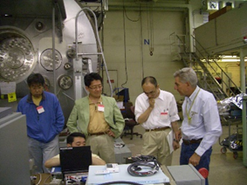
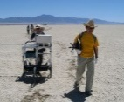
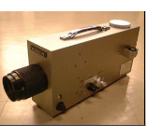
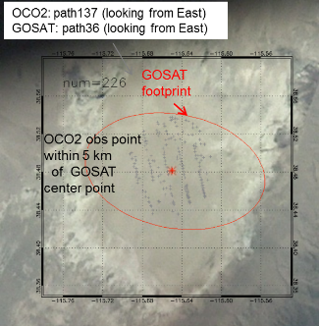
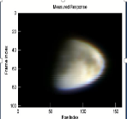
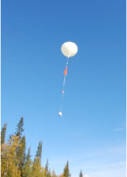

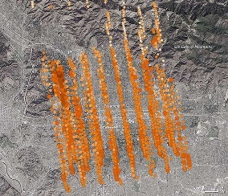

Cross-Calibrating Observations from Greenhouse Gas Constellation
High accuracy requirements for GHG measurements (< 0.1%) impose stringent constraints on the calibration individual instruments and cross-calibration of data from different instruments
Lessons learned from the GOSAT, OCO collaboration suggest the following minimum requirements for cross calibrating GHG sensors:
  Pre Launch:
    Exchange information on best practice for pre-launch instrument characterization
    Cross calibrate pre-launch radiometric and spectroscopic standards against internationally-recognized (Si-Traceable) standards
  Post Launch:
    Exchange solar and lunar standards and best practices for solar and lunar observations and analysis
    Conduct joint vicarious calibration campaigns and coordinate observations of pseudo-invariant Earth targets
  A. Kuze will discuss these needs in greater detail later this afternoon

Slide 16
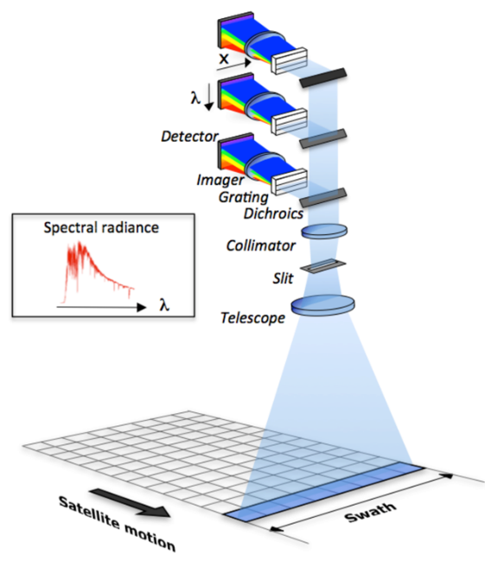
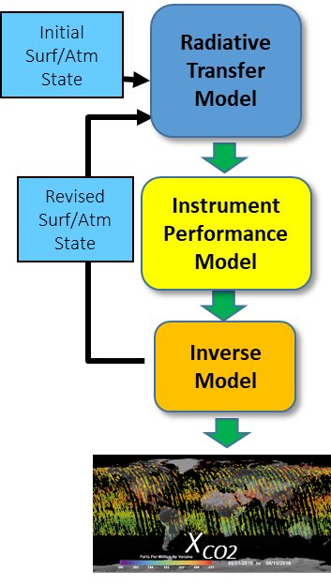
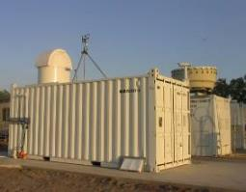

Other Tools Needed to Develop and Maintain Atmospheric GHG Inventories
Improved precision, spatial resolution, and coverage
  Accuracy/Precision: Improved calibration
  Resolution/Coverage: LEO and Geo GHG constellations
Improved remote sensing retrieval algorithms
  Optical properties: gas absorption and aerosol scattering
  Retrieval methods: Optimized to analyze solar spectra
Better coordination with ground-based/aircraft networks
  Vicarious Calibration: RadCalNet, Railroad Valley
  Validation: TCCON, EM27-Sun, AirCore, Aircraft
  Complementary coverage: polar regions, cloudy regions
Improved atmospheric inversion models
  Transport: Adequate resolution of mesoscale transport
  Assimilation techniques: Incorporating ground-, aircraft-, and space-based GHG data and transport fields

Slide 17
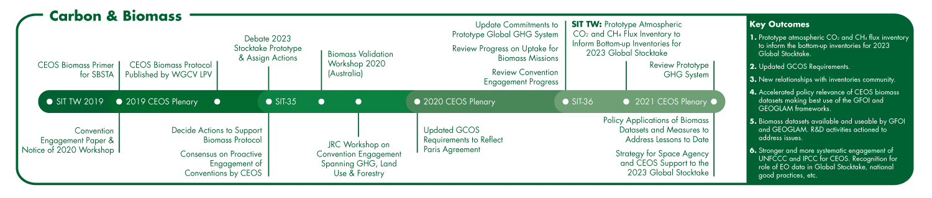
2020-2021 CSIRO/GA Australian SIT Chair Priorities – Role of Carbon and GHG
Carbon and GHGs are one of 3 CEOS Chair Priorities for 2020-2021
Supporting the GHG Roadmap process – escalating, elevating, and accelerating progress towards major milestones, including for 2023 Global Stocktake. 2021 prototype flux products.
Reflecting $4Bn+ investment (2018-2024) in Above-Ground Biomass missions and seeking to accelerate the policy relevance of these new data (GFOI, GEOGLAM…)
Encouraging stronger and more systematic engagement by CEOS of convention frameworks – building on IPCC outreach

Slide 18
Near-term Plans
Summer 2019 – Completing the GHG Roadmap
  Rough draft nearly complete
4-6 September – Joint CEOS/CGMS WGClimate Meeting in Anchorage, AK
  Plan vetted by WGClimate
9-12 September – CEOS SIT Technical Workshop, Fairbanks, AK
  Plan Roadmap approved by the SIT, and promoted to Plenary for endorsement
14-16 October – CEOS Plenary, Hanoi, Vietnam
  Endorsement of Roadmap by CEOS Plenary

