Slide 1

Capacity Building
Activities at SANSA
Committee on Earth Observation Satellites
Phila Sibandze
Agenda Item #7
CEOS 6th Working Group for Capacity Building and Data Democracy (WGCapD)-6 Annual Meeting
DLR Oberpfaffenhofen, Germany
27th-29th March, 2017

Slide 2
WGCapD-6 Annual Meeting 2017
DLR Oberpfaffenhofen, Germany
27th-29th March 2017
Presenter Guidance
Note the time allocated for your topic and match the number of slides accordingly.
For the Agency, WG, GEO presentations (Agency numbers 6 – 22):
  Summarize 2016 accomplishments
    In capacity building for your agency
    In capacity building as a contribution to WGCapD
  Summarize 2017 accomplishments & plans
    In capacity building for your agency
    In capacity building as a contribution to WGCapD
    Please fill out schedule template also
  Summarize 2018-2019 plans (tentative schedules by quarter)
    In capacity building for your agency
    In capacity building as a contribution to WGCapD
    Please fill out schedule template also
Presentation materials should be sent to kim.e.holloway@nasa.gov no later than Monday 20th March for inclusion on the meeting website.

Slide 3
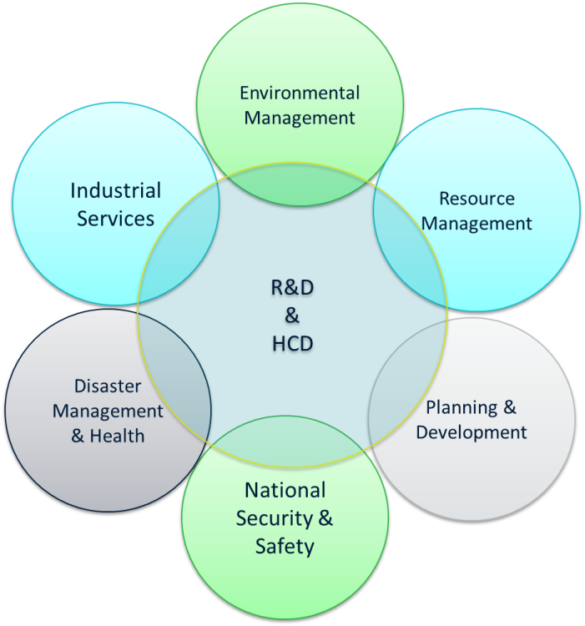
SANSA Capacity Building Accomplishments 2016-2017

Slide 4
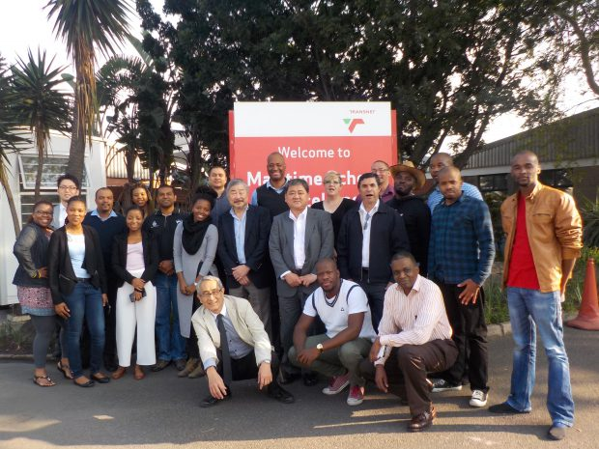
SANSA Capacity Building Accomplishments 2016-2017
Synthetic Aperture Radar (SAR) - for the Maritime Environment.
Transnet Maritime School of Excellence in Durban
25 – 27 May 2016
20 Participants
RESTEC & Tokyo University
Target Group: Government Officials

Slide 5
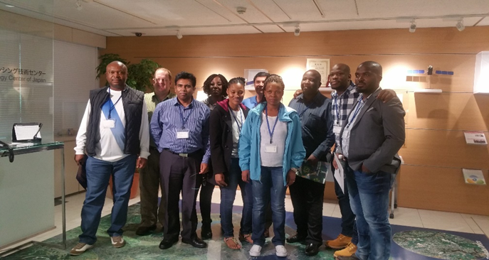
SANSA Capacity Building Accomplishments 2016-2017
Japan Tour and Synthetic Aperture Training
Different Institutes in Japan (RESTEC, Space Solutions, JAXA, JICA)
10 June- 10 July 2016
10 Participants
JICA
Target Group: Government Officials

Slide 6
SANSA Capacity Building Accomplishments 2016-2017
Geoscience Information for Teacher (GIFT)
Cape Town Iziko Museum
27 -28 August 2016
30 Participants
Target Group: Academics & Government Officials

Slide 7
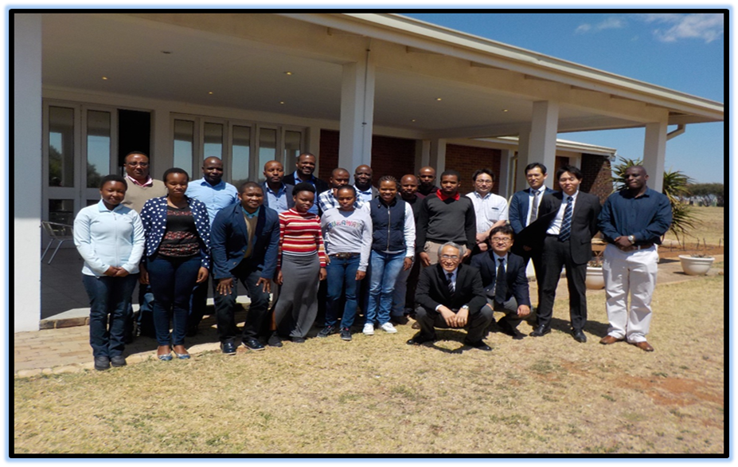
SANSA Capacity Building Accomplishments 2016-2017
Synthetic Aperture Radar (SAR) - for Crop Yield Estimate.
SANSA-Space Operations
4 – 6 October 2016
18 Participants
RESTEC & Tokyo University
Target Group: Government officials

Slide 8
SANSA Capacity Building Accomplishments 2016-2017
Introduction to Remote Sensing Workshop-COGTA.
COGTA-Durban
20 – 21 October 2016
18 Participants
SANSA
Target Group: Government officials

Slide 9
SANSA Capacity Building Accomplishments 2016-2017
Introduction to Remote Sensing Workshop-Magalakwena Muni.
Office of the Premier-Limpopo
November 2016
12 Participants
SANSA
Target Group: Government officials

Slide 10
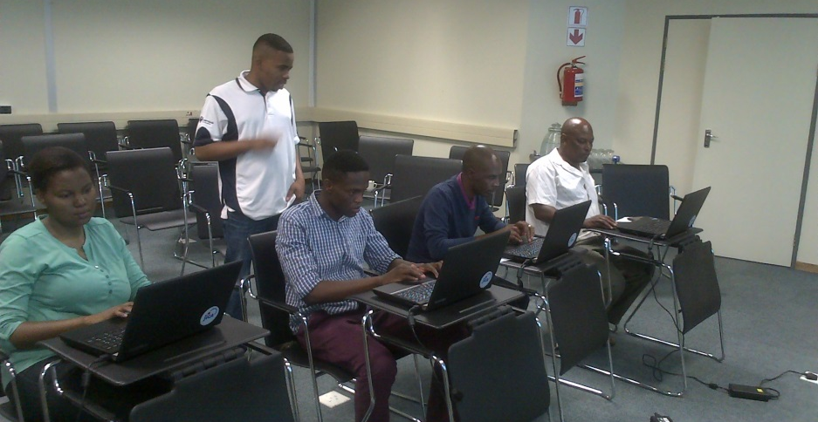
SANSA Capacity Building Accomplishments 2016-2017
Introduction to Human settlements mapping and interpretation of Human Settlement Layer
Nationa Human Settlement Department-Pretoria
November 2016
4 Participants
SANSA
Target Group: Government officials

Slide 11
SANSA Capacity Building Accomplishments 2016-2017
CEOS-SAR Training-Zambia Workshop
University of Zambia, Lusaka
10 -14 October 2016
12 Participants
ESA-Copernicus, UNOOSA, UNIZAM, UF-JENA, Delft-UniTech, SAREDU, DLR,
Target Group: Academic

Slide 12
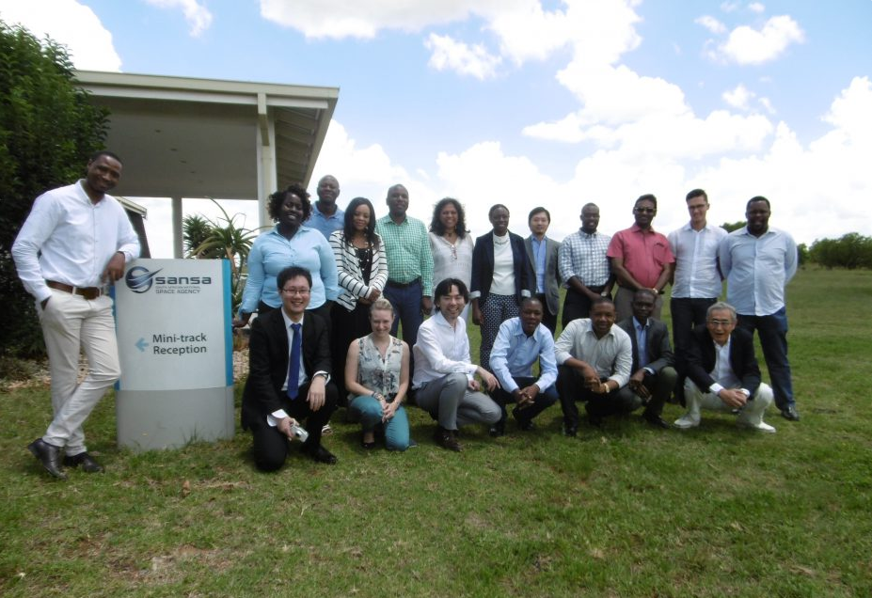
SANSA Capacity Building Accomplishments 2016-2017
CEOS-JICA Radar Remote Sensing Training Workshop
SANSA-Space Operations
20 – 24 January 2017
19 Participants
JICA
Target Group: Government officials and Academic Officials

Slide 13
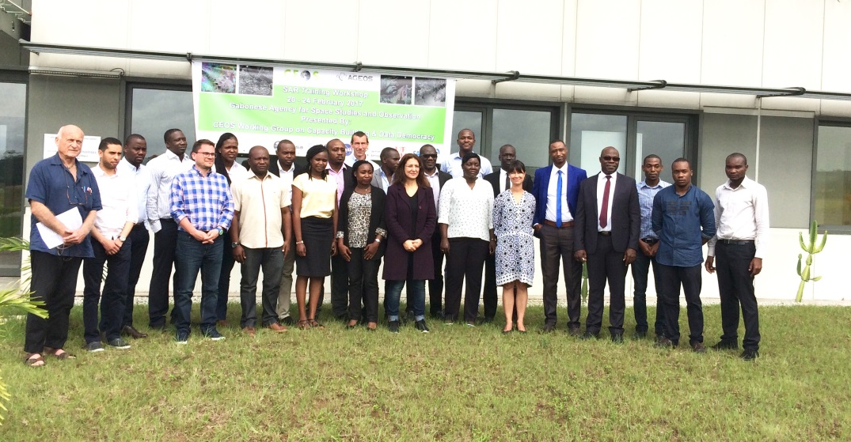
SANSA Capacity Building Accomplishments 2016-2017
CEOS-SAR Gabon
10 -14 October 2016
23 Participants
ESA-Copernicus, UNOOSA, AGEOS, SAREDU, DLR,
Target Group: Academics and Government Officials.

Slide 14
SANSA Capacity Building Accomplishments 2016-2017
12 Training courses
172 participants
47 organizations capacitated
15 Countries

Slide 15
Thank You

