Slide 1
SRTM/DEM Release and Future Workshops
Pat O’Brien WGCapD-3
Dehradun, India 23-25 April 2014

Slide 2
Introduction
DEMs underpins a myriad of applications using EO data. A few areas of interest for CB:
Water flow / flood mapping
Avalanches
Glaciers
Landslides
Precision farming
Forestry
Biodiversity mapping
More accurate DEM --> more accurate predictions and better decision making

Slide 3
Objectives
Support All Four Data Democracy Pillars:
Access: Removal of restrictions to global SRTM-2 (and other high res DEMs)
Dissemination: ensure targeted users in developing countries obtain SRTM-2 (and other high res DEMs)
Software & Tools: Regional workshops
Training & Education: Regional workshops

Slide 4
Current Status – Access / Dissemination
Previoulsy, SRTM-2 data released on case-by-case basis for certain countries
NGA required agreements with US agencies that data would only be given to specified foreign agencies
Currently, awaiting decision by NGA for release of dissemination restrictions GLOBALLY

Slide 5
Current Status – Software & Tools / Training & Education
One workshop held: RCMRD, Nairobi, 2013
Focus: hydrologic modelling, esp. flash floods
Software: NASA/SERVIR’s Coupled Routing and Excess Storage (CREST) model
Unfortunately, only S. Sudan and Somalia SRTM-2 data released, despite attendance of others

Slide 6
Way Forward
After decision to release SRTM-2:
Internal US Gov’t deliberations
Public Announcement
Dissemination through USGS/EROS (or NASA/JPL)
RCMRD workshop participants
Plan workshops
ICIMOD – earliest possible Oct/Nov
CRECTEALC – early 2015?
West Africa?

Slide 7
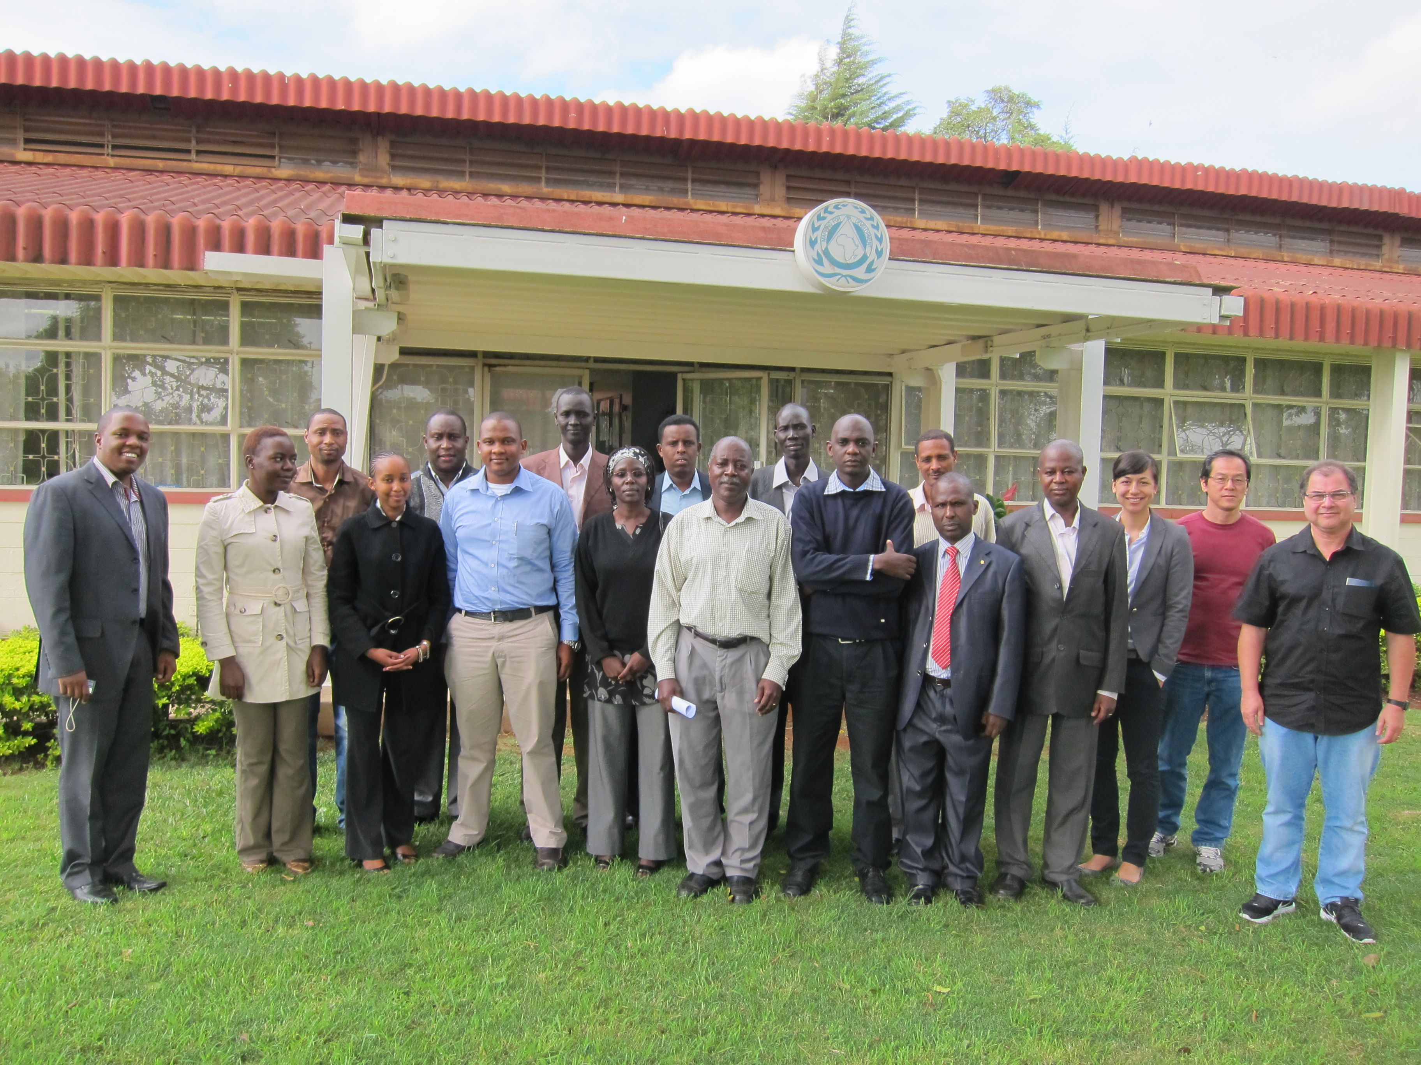
Feedback from RCMRD Workshop
Positive Feedback
Drew on many agencies’ expertise
WGCapD representative present (SWF)
Technical (not policy-level) participants
Step-by-step instructions for hands-on exercises
Closing ceremony, certificates
Focus on one case study
Local partner is critical
Take home materials
Opportunity for feedback

Slide 8
Feedback from RCMRD Workshop (cont.)
Room for improvement
CapD Rep present (US Gov’t travel issues)
One defined facilitator
Clarify objective of workshop at outset
Harmonize presentations
Facilitators and trainers: better to arrive early
Structure of agenda – DEM introduction should have been 1st
Hands on exercises – two rather than one
Data release (several participants left without promised SRTM-2 data)!

Slide 9
Other Opportunities
Synergize efforts to access various DEM datasets – SRTM, TanDEM-X, SPOT-DEM, etc.
Liaise with other CEOS bodies
WGDisasters
WGCV
GFOI
If SRTM is not released globally, reassess…

