Slide 1
CEOS Visualization Environment (COVE)
Committee on Earth Observation Satellites
Kim Holloway
Agenda Item # 07
CEOS 7th Working Group for Capacity Building and Data Democracy (WGCapD) Annual Meeting
INPE São José dos Campos, Brazil
6-8th March, 2018

Slide 2
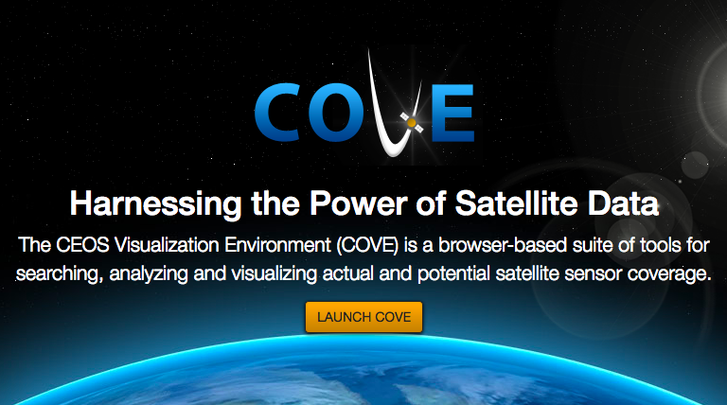
CEOS-COVE.ORG
Notes:
The COVE Tool Suite, found at ceos-cove.org, repesents CEOS’ attempt to reduce many of the barriers that users face when attempting to obtain useful satellite data. COVE provides users with four main tools.

Slide 3
Presentation Agenda
The 4 COVE Suite Tools
The Acquisition Forecaster
The Coverage Analyzer
The Data Browser
The Data Policy Portal
COVE Training Proposal
Notes:
Those four tools are 1. The Acquisition Forecaster, 2. The Coverage Analyzer (historical data assessment) 3. The Data Browser (data availability) & 4. The Data Policy Portal (data accessibility). I’ll go over what each of these do very briefly and try to show you what that looks like… I can’t show you that live today because our tool is undergoing some renovations and our lead developer is on maternity leave... But you’ll get the idea. And then, finally, I’ll go over what a COVE Training might look like.

Slide 4
The Acquisition Forecaster
Notes:
This tool allows users to predict the future data acquisitions of satellite instruments.
In the simplest form, users can select an instrument on any satellite and a time range up to three months into the future and see the ground footprint of the sensor swath as a colored tile on the globe. And, this analysis can be run on a particular region of interest. Now, our COVE frameework doesn’t have access to individual mission’s image acqusition plans… so these swath footprints are only *possibilities* - the instrument may or may not actual acquire data in that spot when the time comes... But this does allow users to see where acquisitions are possible in the future.
This tool will, in the future, also allow users to select more than one satellite instrument and predict coincident observation opportunities between them for a specific time frame, over a specific region – super valuable if you’re interested in acquring or comparing data from more than one instrument.

Slide 5
The Coverage Analyzer
Cov
Notes:
This tool helps users understand historical satellite coverage of a region. Users can select an instrument or multiple instruments from various satellites, a region of interest, and a time period in order to learn the number of acquisitions that have occurred over that area.
Users can cilck a block on the map to view the scene metadata for all the scenes that touch the location clicked. For some missions, namely Landsat, Sentinel, and potentially CBERS though I’d have to check on that... that metadata table includes links to view the full browse image and order the scene.
Then, if desires, the query done here in coverage analyzer can be “sent” to our next tool.

Slide 6
Data Browser
This tool allows users to predict when CEOS Agency satellite instruments mi
Notes:
The Data Browser. This tool allows users to take a look at their results on a scene by scen basis. Since COVE is connected to mutliple data archives within th CEOS community, Data Brrowser helps users search for scenese from mutltiple missions and instturments from right here within the tool.
The scenese returned by the query are displayed on the map and a results panel will open. Users can hover over the scene to see a browse image and its location, including the associated metadata and URLs for viewig the full browse iage and – for some missions - scene ordering (for some missions).

Slide 7
The Data Policy Portal
Notes:
And finally, this interactive database tracks the primary archvies and data access policieis of all CEOS missions. It includes every mission launched since 1990 and is updated bi-annually with:
What organizations are involved with the mission.
The location of the primary data archive.
And the general accessibility of the dataset – from completely open, to open with a simple registration requiremetn, to open with advanced protocols, to restricted… which means they require a fee to obtain them or are not avaialble to teh general public... And then, some that allow no access.
Users can check the data policy portal to see whether a dataset they’re interested in might be readily accessible for access and use.

Slide 8
CEOS-COVE.ORG
Notes:
Each of these tools can solve a certain set of problems for users across all applications…
From needing to find Landsat data over a region and wondering about how often data might be acquired over their area of interest, or even to preview the actual scenes already acquired...
To ascertaining data availability and coverage in cloudy regions...
And the tool sare useful for anyone that takes land ground validation sample data that need to be correlated with satellite data...
So our thought was that perhaps we could dvelop esomething like...
A live webinar series of 5 weekly modules that combine the use of recorded demos/lecture materials with live Q & A sessions – e.g. Each module would comprise of a 10-min recorded lecture, 10-min interactive Case Study Solving an Actual Problem, and a 5 to 10-min Q&A.
Modules:
1. Overview of CEOS, CEOS Tools, and the COVE Tool Suite.
2. The COVE Tool: Acquisition Forecaster | Lecture + Case Study + Q&A
3. The COVE Tool: Coverage Analyzer | Lecture + Case Study + Q&A
4. The COVE Tool: Data Browser | Lecture + Case Study + Q&A
5. COVE Application Showcase: Tying it all together with a Case Study
And then, at the end, we send users away with a problem they can solve on their own using the cove tool, with the promise to post the answer in a few days (or something like that).
I should also take this time to note that COVE is in a re-development phase that has been delayed for the next 6 months due to our primary programmers being on maternity leave, so developing this training will not be possible for at least another six months, and then…
I will be moving to a part-time employment status at NASA next month – which is good for me personally – but I will have even less time to dedicate to our CEOS activtiies and may not be able to contribute much to the work of WGCapD. So the timeline of completing an activity like this is quite long, if I’m to do it on my own as time allows. But I would like to add that the SEO will be looking for ways to continue engaging with the WGCapD going forward, it just may take some time to figure that out.

Slide 9
Comments? Questions?

