Slide 1
Update on SAR, EO & Disaster Trainings in Vietnam
Committee on Earth Observation Satellites
Vietnam National Space Center (VNSC)
CEOS WGCapD-8 Annual Meeting
Activities – Technology, Tools & Methods
Working Group on
Capacity Building & Data Democracy
Indian Institute of Remote Sensing
Indian Space Research Organisation
Dehradun, India
March 06th – 08th, 2019

Slide 2
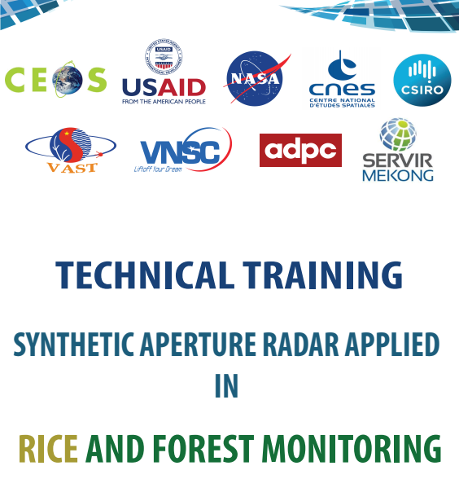
WGCapD-8 Annual Meeting
IIRS, Dehradun, India March 06th – 08th, 2019
Training objectives
Building capacity for Vietnamese remote sensing technical experts from academies and universities in applying SAR data and processing technology support rice monitoring, and forest monitoring, under coordination and support of CEOS WGCapD

Slide 3
WGCapD-8 Annual Meeting
IIRS, Dehradun, India March 06th – 08th, 2019
Information
Participants: more than 40 young researchers (Vietnamese Academy, ministries and universities: VNSC, FIPI, National Center for remote sensing (MONRE), STI, NIAPP, VNU, Can Tho University, Da Nang University, Viettel Corporation,… & 2 foreigners - SERVIR)
Duration: 3 days (20-22 Feb. 2019)
Location: VNSC-Building A6, 18 Hoang Quoc Viet, Hanoi

Slide 4
WGCapD-8 Annual Meeting
IIRS, Dehradun, India March 06th – 08th, 2019
Expected outcome
Understand the physical information content of SAR data and statistical properties of SAR images applied in rice and forest monitoring;
Access and download available SAR data portal and free software;
Able to perform exercises with general SAR pre-processing and processing steps;
Able to conduct time series processing with Sentinel – 1 data for rice monitoring or forest monitoring.

Slide 5
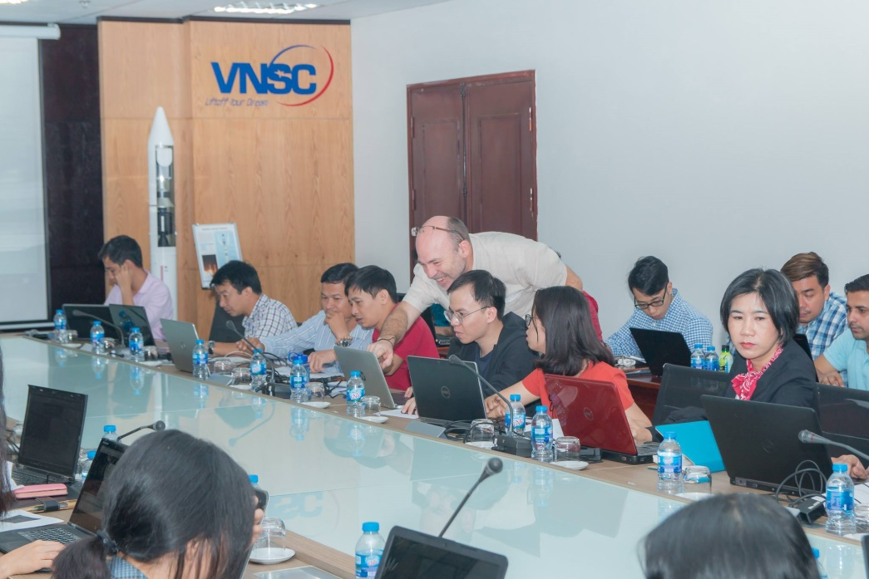
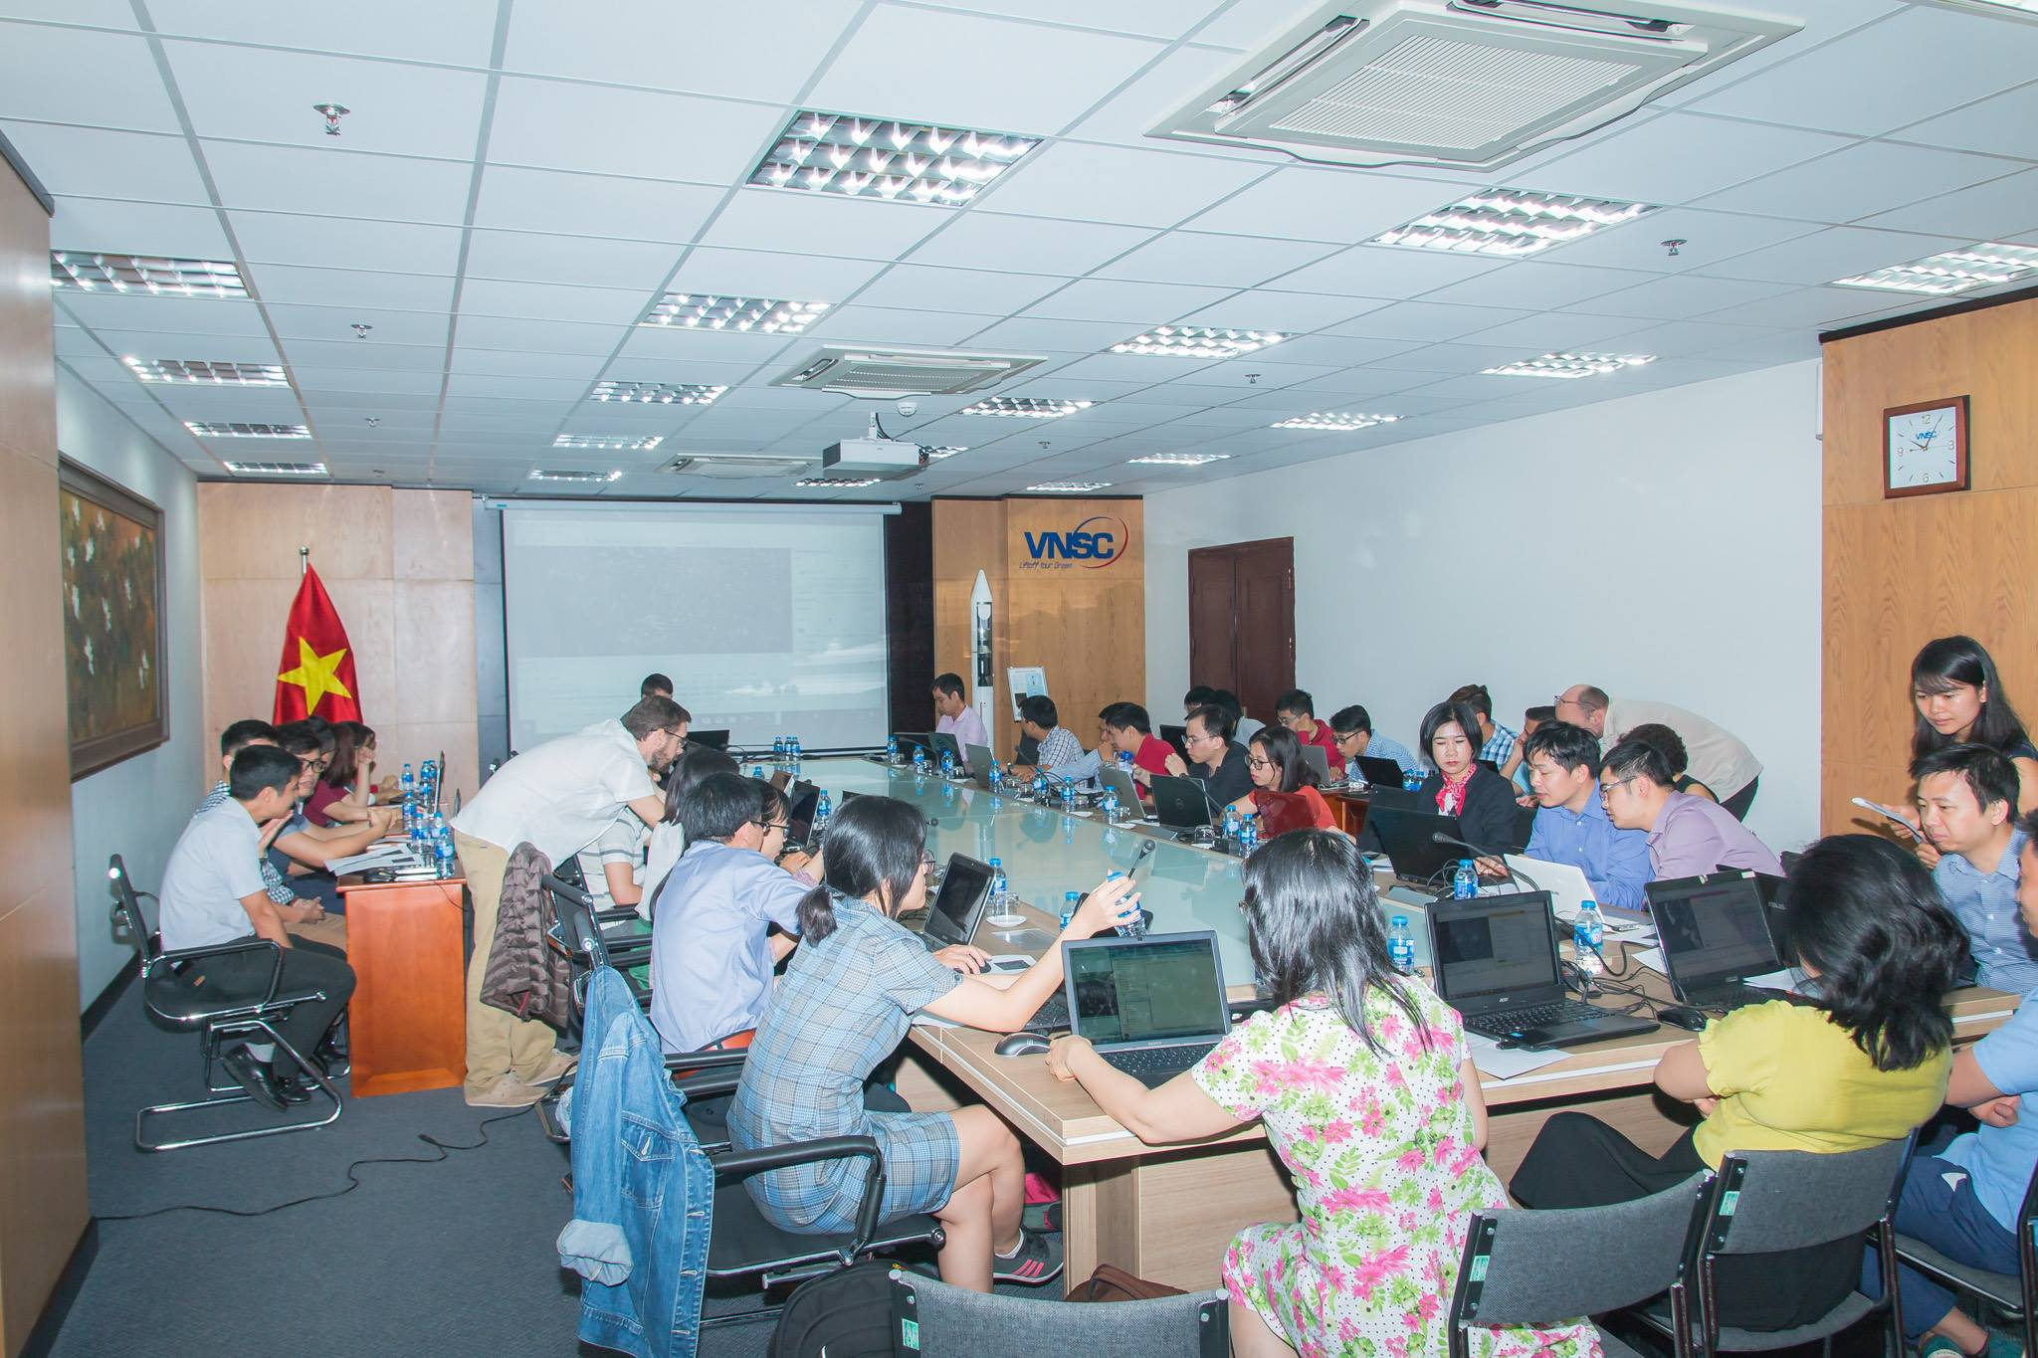
WGCapD-8 Annual Meeting
IIRS, Dehradun, India March 06th – 08th, 2019
Expert team: Alexandre Bouvet¹, Thierry Koleck^{1,2}, Stéphane Mermoz³, Hoa Phan¹
CESBIO, Toulouse, France; 2. CNES, Toulouse, France; 3. GlobEO, Toulouse, France

Slide 6
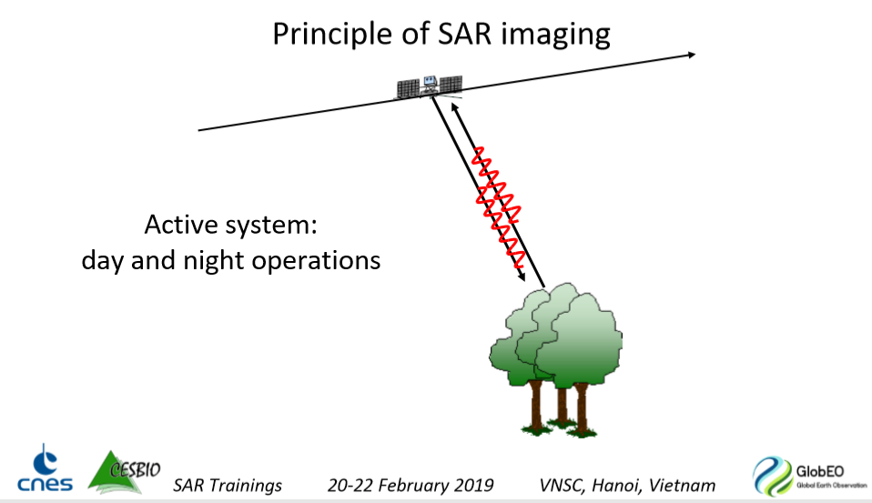
WGCapD-8 Annual Meeting
IIRS, Dehradun, India March 06th – 08th, 2019
Main Results
Understand the physical content and statistic properties of SAR data;
Get familiar with SAR images (Sentinel-1);
Understand characteristic of rice and forest with SAR data;
Perform basic SAR preprocessing (calibration, geocoding, filter…) with the free and open softwares Orfeo ToolBox, QGIS.
Applications
Rice mapping in Thái Bình Province;
Forest monitoring in Bình Dương / Tây Ninh / Bình Phước Provinces.

Slide 7
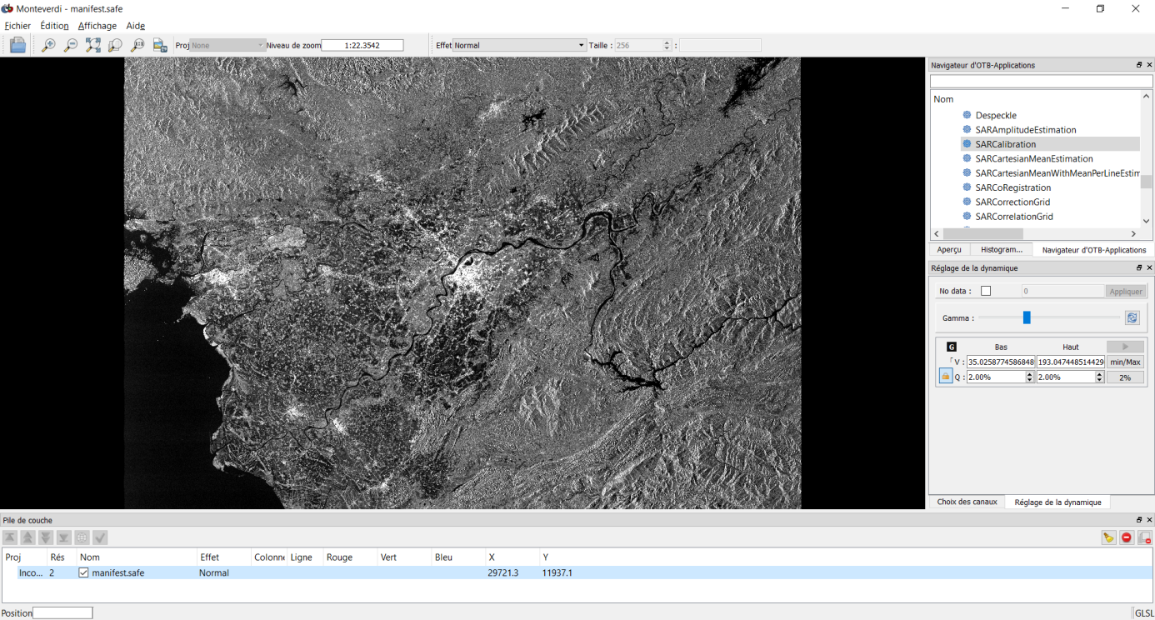
WGCapD-8 Annual Meeting
IIRS, Dehradun, India March 06th – 08th, 2019
Main Results: Rice monitoring
Material:
12 dates of Sentinel-1 (9 Feb, 21 Feb, 5 Mar, 17 Mar, 29 Mar, 10 Apr, 22 Apr, 4 May, 16 May, 28 May, 9 June, 21 June) - rice season in 2017
Thái Bình Province, Vietnam
VH and VV.

Slide 8
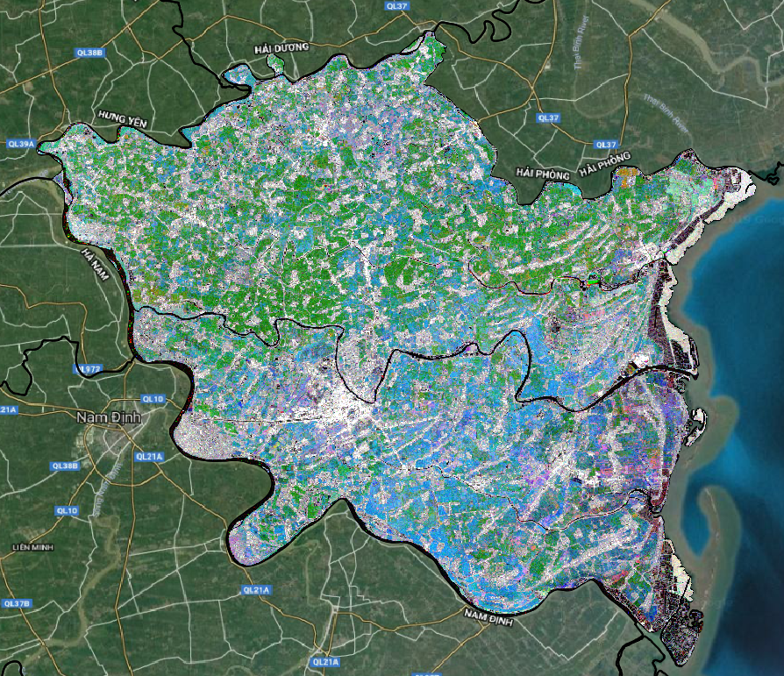
WGCapD-8 Annual Meeting
IIRS, Dehradun, India March 06th – 08th, 2019
Color composite of VH on 9 February (Red), 10 April (Green) and 9 June (Blue) over the Thai Binh Province
Classification: urban/forested – rice - water
Photo from Training material

Slide 9
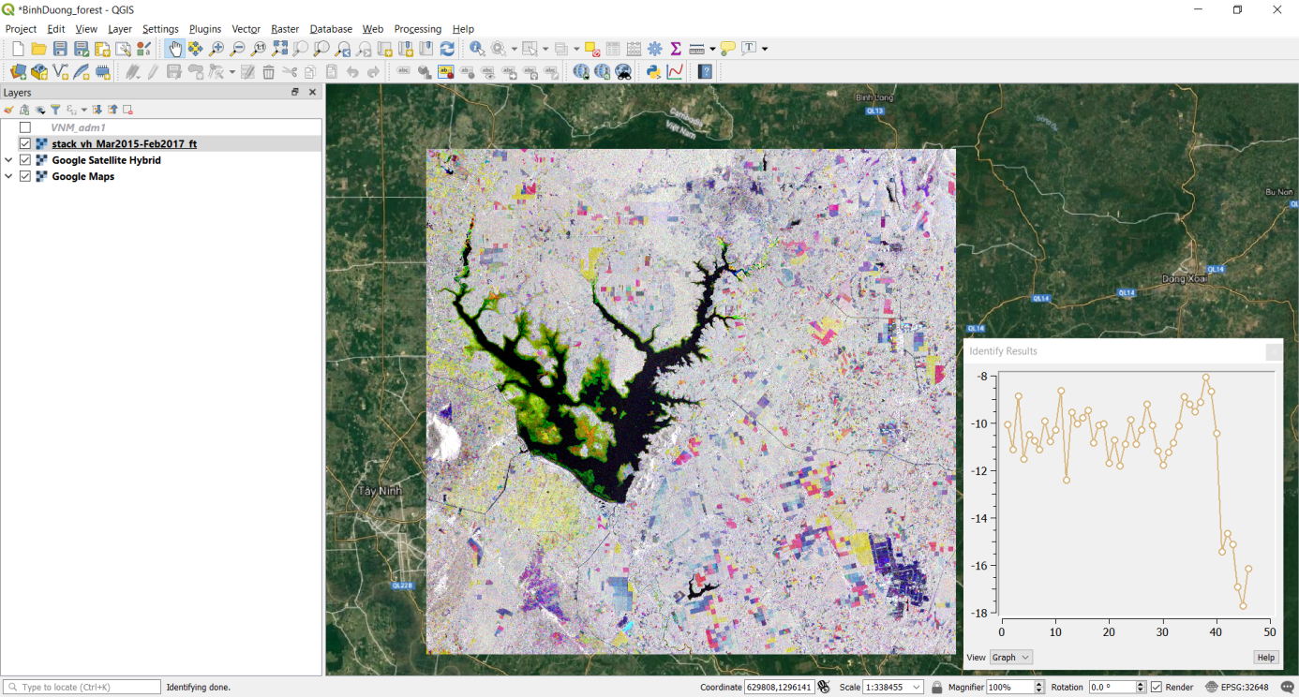
WGCapD-8 Annual Meeting
IIRS, Dehradun, India March 06th – 08th, 2019
Main Results: Forest monitoring
Material:
46 dates of Sentinel-1 (March 2015 to February 2017).
Bình Dương, Tây Ninh and Bình Phươc Provinces, Vietnam
Result:
Forest/Non-forest mask of reference period
Near-Real-Time detection of logging
Photo from Training material
Notes:
The data is already preprocessed, reprojected to 20m resolution, transformed to dB values, and a multitemporal speckle filter has been applied.
Only the images in VH polarization is provided and used.

Slide 10
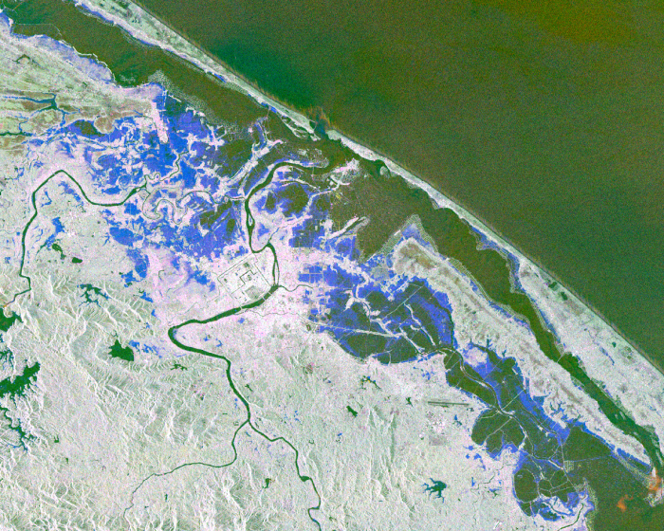
WGCapD-8 Annual Meeting
IIRS, Dehradun, India March 06th – 08th, 2019
Future targets
More SAR training on
Flood mapping / disaster monitoring
Subsidence
NASA color coded SAR based flood detection maps reveal extensive flooding in areas of Vietnam. The SAR data used in analysis are Copernicus Sentinel data (2017), processed by ESA.
Ref.: https://disasters.nasa.gov/typhoon-damrey-2017/esa-copernicus-sentinel-1-sar-used-flood-detection-maps

Slide 11
WGCapD-8 Annual Meeting
IIRS, Dehradun, India March 06th – 08th, 2019

