Slide 1
ESA innovative tools for EO Education and Training
Session 1: Spotlight on Innovation
ESA
Francesco Sarti, Amalia Castro Gomez
CEOS WGCapD-9 Annual Meeting
Sunnyvale, California
10-12 March 2020

Slide 2
MOOCs, educational web-based tools, TEPs and data cubes, new Education and dedicated platform
MOOC’s (already in preparation and for the future)
New EO Education
Dedicated EO Education Platform
web-based image analysis for teachers
Next Generation ESA School Atlas (hybrid, web-based)
Training via data-cubes and TEPs → see session 8 (Data Democracy)
Φ Experience at ESRIN

Slide 3
Please visit: https://eo4society.esa.int/training-education/

Slide 4
Previous ESA EO MOOCs (occasionally subject to re-run and updates):

Slide 5
Two Ongoing ESA EO MOOCs:
One additional associated mini-MOOC in in preparation:
“Canadian” Applications of SAR
based on CSA experience
Please refer to R. Eckardt (Jena) for further information

Slide 6
Two Ongoing ESA EO MOOCs:
EARTH OBSERVATION – DISRUPTIVE TECHNOLOGY AND NEW SPACE
See: https://www.imperativemoocs.com/courses/disruptingeo
Short MOOC with a series of interviews with leading experts across EO and related technologies. This MOOC also acts as an additional section for the ‘Earth Observation from Space: The Optical View’ MOOC.
The explosion in EO data has created one of the greatest ‘big data’ challenges in the world today. The MOOC includes technologies such as AI, 3D data visualisation, cloud computing technologies and blockchain, explaining how they are meeting the needs of the ever growing data analytics and data navigation challenges in EO.

Slide 7
ESA MOOCs in preparation:
ESA MOOC Atmospheric Remote Sensing
for Atmosphere scientific studies, societal applications and services
Expected launch: summer 2020, two runs
ESA Land MOOC
One core MOOC about the principles and the general Land applications of Remote Sensing. Four associated mini-MOOCs (or runs) will follow, with different focus (incl. regional applications for Africa).
Expected launch: end 2020, five runs
ESA Cryosphere MOOC
Explaining EO-based Cryosphere monitoring to non-specialists
Role of the Cryosphere in our climate system
Sea ice
Ice sheets and ice shelves
Mountain glaciers, river/lake ice and snow
Expected launch: end 2020, 4-week duration

Slide 8
Future ESA MOOCs:
MOOC Earth Observation for Computer Scientists
This MOOC will be intended for Computer Scientists: students or practitioners in the field of Computer Vision that wish to understand EO data and the typical scientific approaches to process them and extract relevant information. It should enable them to apply their knowledge to build suitable machine learning models allowing AI-based solutions to typical Earth System Science challenges.
MOOC Ocean Remote Sensing
MOOC Climate Change
“New Education in EO”
New generation of ESA open science education and training activities, exploiting recent developments in ICT, maximizing the use of modern education methods, advanced visualization techniques, community tools, hackathons, serious games, on-line education channels and the stimulation of an open science community promoting debate & discussions
dedicated ESA platform hosting all developed EO e-learning material
“EO Education platform”

Slide 9
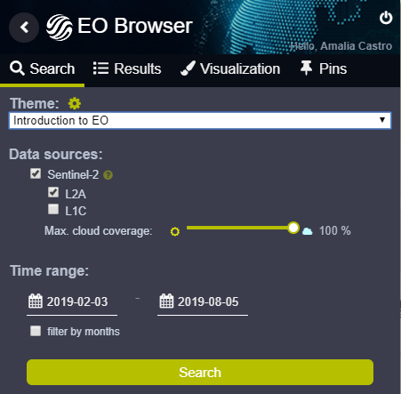
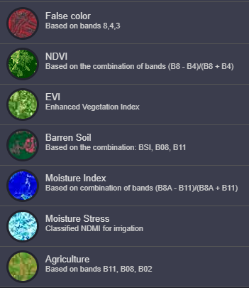
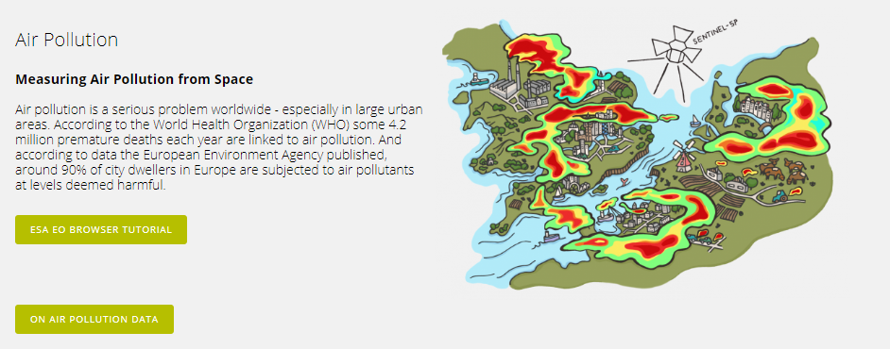
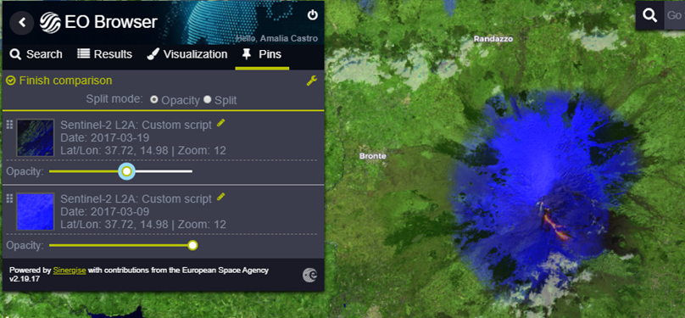
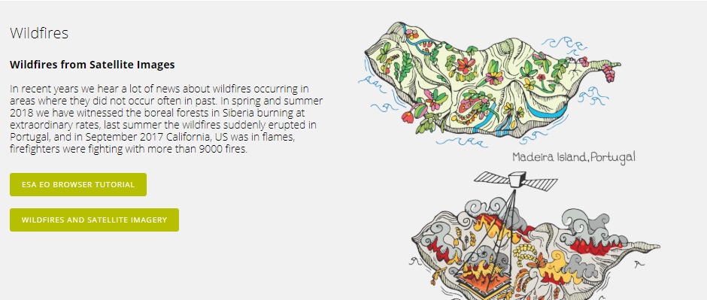
Sentinel Hub and associated EO Browser with an educational mode & pre-selected topics/products: web-based image analysis for school teachers
https://www.sentinel-hub.com/explore/education
Custom Scripts and Use Cases:
Face-to-face exercises (teachers, students, young professionals..)

Slide 10
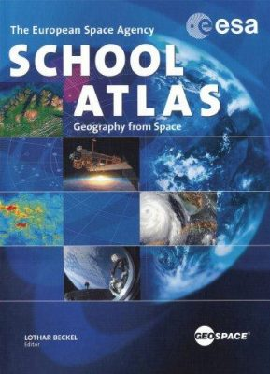
Future ESA EO education toolbox for schools (and beginners) in preparation:
Next Generation ESA School Atlas
(2-year procurement, starting now)
Development of a hybrid version (electronic plus hardcopy) of a new ESA School Atlas, including interactive web-based exercises for secondary schools.
Old ESA School Atlas

Slide 11
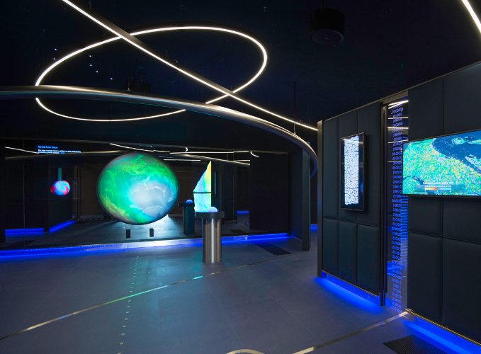
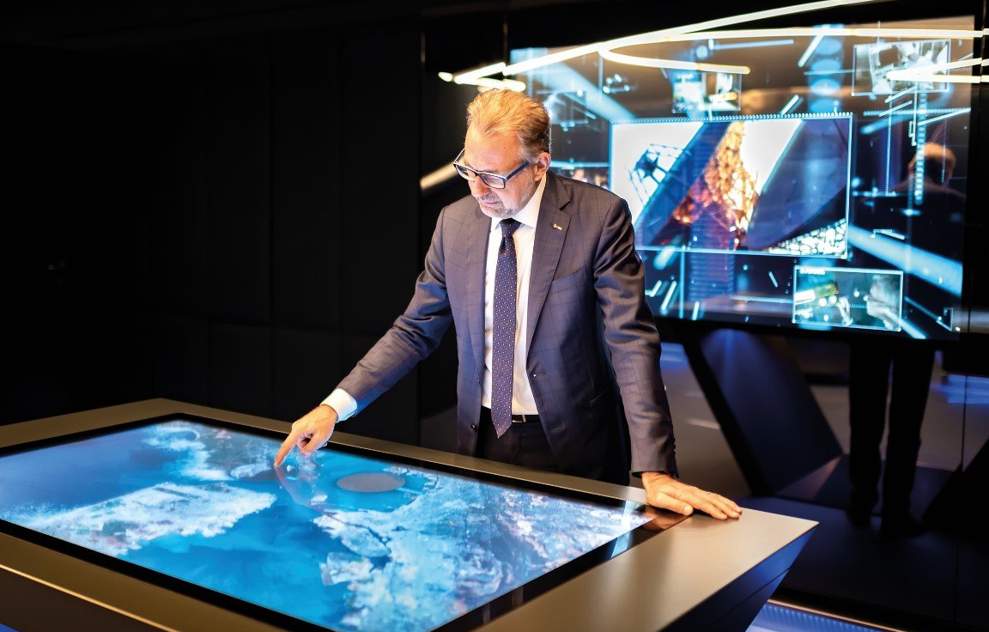
ESA/ESRIN: Φ Experience a possible EO outreach model for inspiration
a recently installed, unique, impressive, permanent interactive exhibition, with constantly updated content
presenting ESA EO missions and results in a way that is easily understandable by the general public, though scientifically correct
4 installations, featuring a variety of scenarios about EO Satellites, Earth Science and illustrating new results both in research and operational / societal applications of EO

