Slide 1
NASA Work in Asia (SERVIR and SARI)
Regional Spotlight: Asia-Oceana
NASA
Daniel E. Irwin
CEOS WGCapD-9 Annual Meeting
Sunnyvale, California
10-12 March 2020

Slide 2


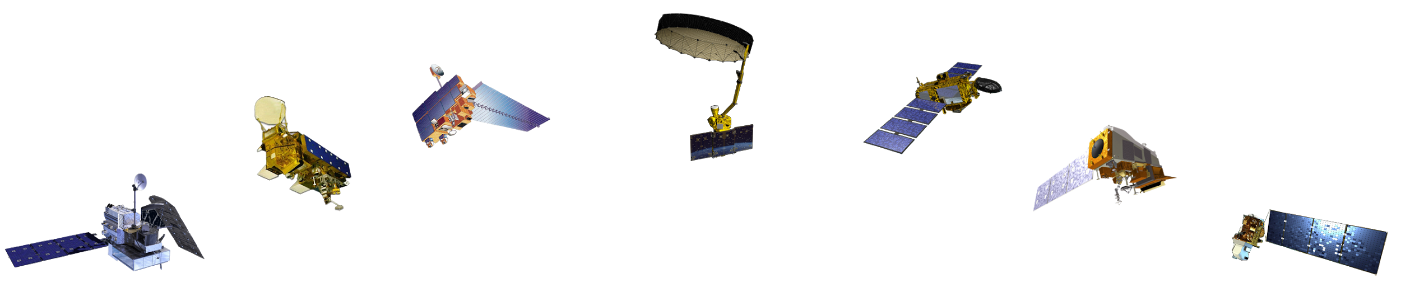





SERVIR connects space to village by helping developing countries use satellite data to address critical challenges in food security, water resources, weather and climate, land use, and natural disasters.
A partnership of NASA, USAID, and leading technical organizations, SERVIR develops innovative solutions to improve livelihoods and foster self-reliance in Asia, Africa, and the Americas.

Slide 3



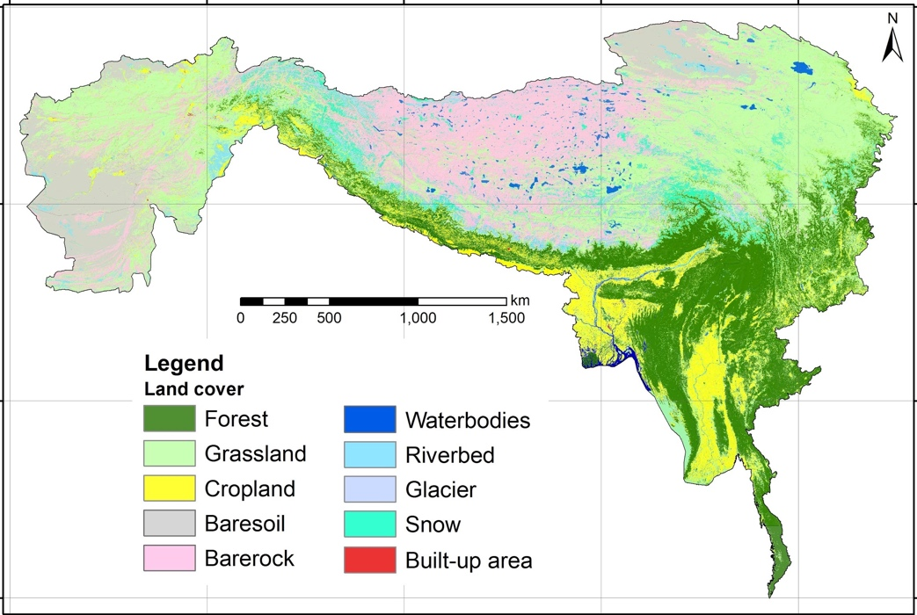




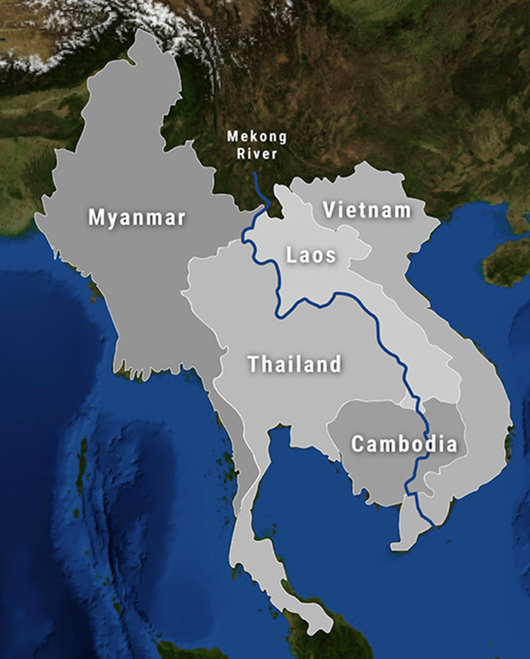
Current activities
https://servir.icimod.org
https://servir.adpc.net
SERVIR-Mekong is a partnership between USAID and NASA working in the Lower Mekong Region to address climate change and implications on land use, agriculture, biodiversity, disasters, forests, health, water, and weather through the use of Earth observations.
Countries: Myanmar, Thailand, Laos, Vietnam, and Cambodia
SERVIR-Mekong is a consortium led by the Asian Disaster Preparedness Center (ADPC) and comprised of the Spatial Informatics Group, Stockholm Environmental Institute, and Deltares.
Countries supported:
Afghanistan
Bangladesh
Myanmar*
Nepal
Pakistan
*Myanmar is also supported by past SERVIR-Mekong services

Slide 4
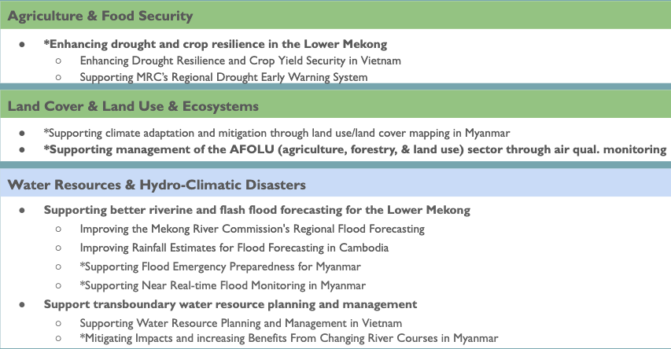
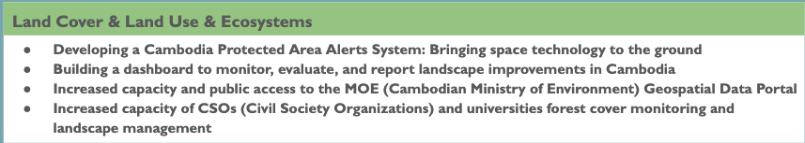
Current activities
Agriculture & Food Security
Regional Drought Monitoring and Early Warning System
Agro-Met Advisory Service for National/Local Level Planning in Nepal and Bangladesh
Food Security Vulnerability Information System of Nepal
Land Cover & Land Use & Ecosystems
Regional Land Cover Monitoring System
Climate Resilient Forest Management System
Water Resources & Hydro-Climatic Disasters
Enhancing Flood Early Warning System in HKH
Weather & Climate
Monitoring Extreme Weather in HKH

Slide 5
Notable outcomes
How many people/institutions have you reached?
HKH: 1,200 individuals trained from 2016-2019
Mekong: 1,045 individuals trained from 2016-2019
What capacities have been or are being built?
Capacity developed in both hubs in SERVIR’s 4 thematic areas (ag & food security; land cover, land use, ecosystems; water & related disasters; weather & climate)
Have you seen these capacities being applied?
Capacity development has translated into service implementation -> 7 in HKH, 17 in Mekong
What were key success factors?
Co-development, large global network, subject matter experts, backstopping
Can these outcomes be scaled or replicated elsewhere?
SERVIR model has always sought to upscale results
  e.g. RLCMS was expanded from Mekong to HKH, also being piloted in W. Africa, Amazonia
  e.g. surface water mapping tool from Mekong adapted for W. Africa ephemeral service

Slide 6
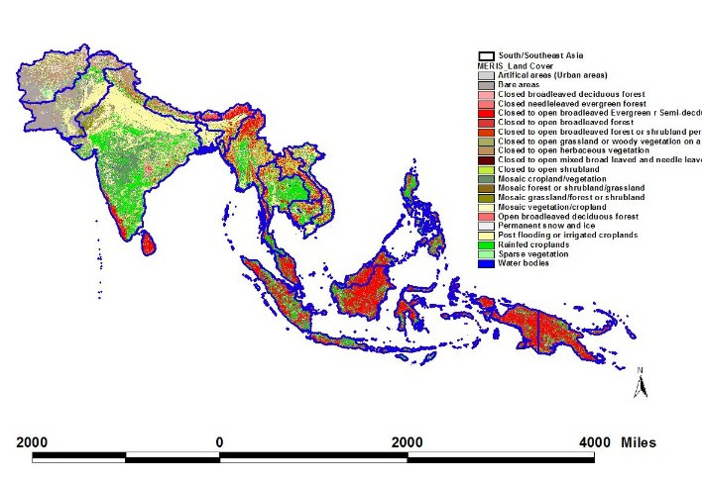
South-Southeast Asia Research Initiative (SARI) -
Funded by the NASA LCLUC Program (2015-current)
SARI - An innovative research, education, and capacity building program involving state-of-the-art remote sensing, natural sciences, engineering and social sciences to enrich Land Use/Cover Change Science in South/Southeast Asia.
35 LCLUC SARI research projects on-going involving US + Regional country scientists
SARI Focuses on building research collaborations between the US and regional scientists
Meetings/Workshops help in identifying Needs and Priorities for the region
Training events are integral to SARI promoting capacity building activities in Asia

Slide 7


Land-Cover/Land-Use Change Program
LCLUC is an interdisciplinary scientific theme within NASA’s Earth Science program. The ultimate vision of this program is to develop the capability for periodic global inventories of land use and land cover from space, to develop the scientific understanding and models necessary to simulate the processes taking place, and to evaluate the consequences of observed and predicted changes
Characterizing Land Cover
Quantifying LC Change
Drivers of LCLUC
  Natural Drivers
  Anthropogenic Drivers
    Socio-Economic Drivers
Carbon Cycle
Surface Hydrology
Atmosphere
Social Systems
Food, Energy, Water
Political Drivers
Landscape Modification
Scenarios of Future Change

Slide 8
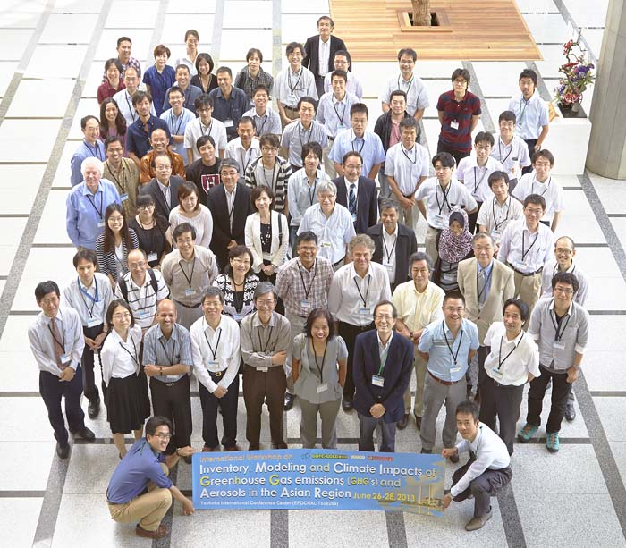
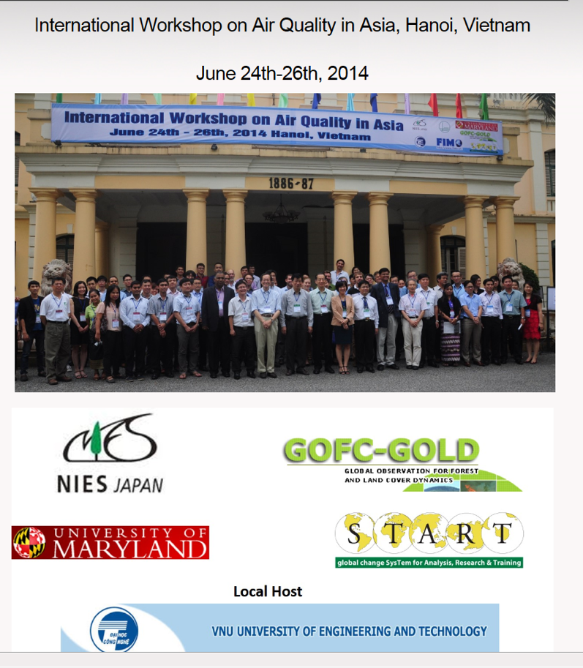
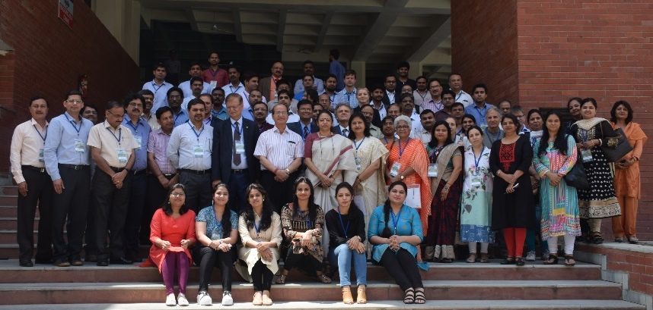
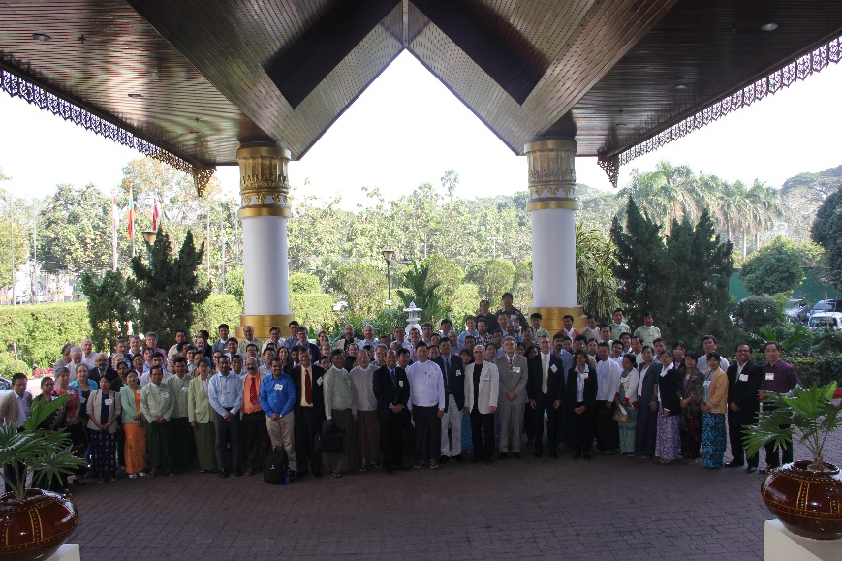
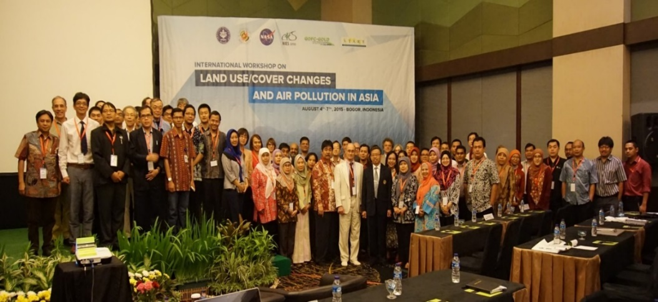
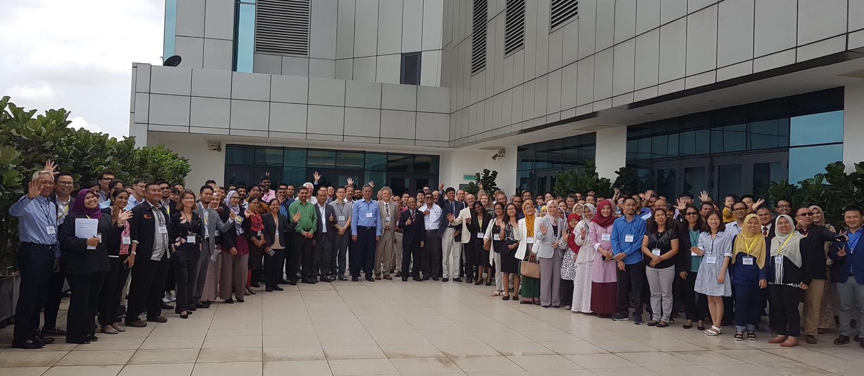
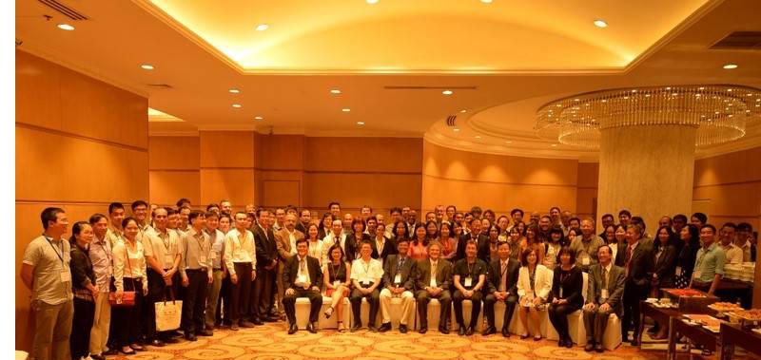
SARI-Lead Dr. Vadrevu hired at NASA MSFC-SERVIR (2016)
SERVIR-SARI Integrated Events – 3-4 events per year in Asia
Training Events Focused on Remote Sensing and Geospatial Technologies for Land Remote Sensing

Slide 9
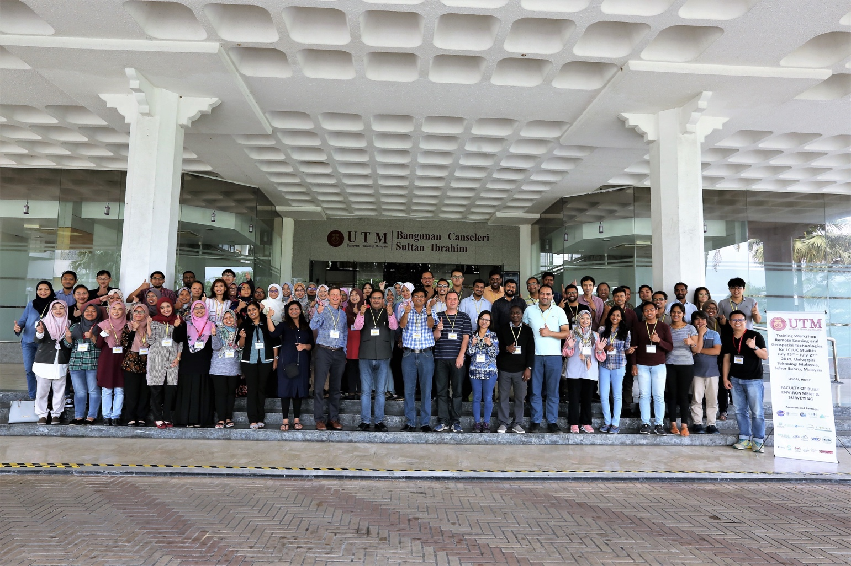
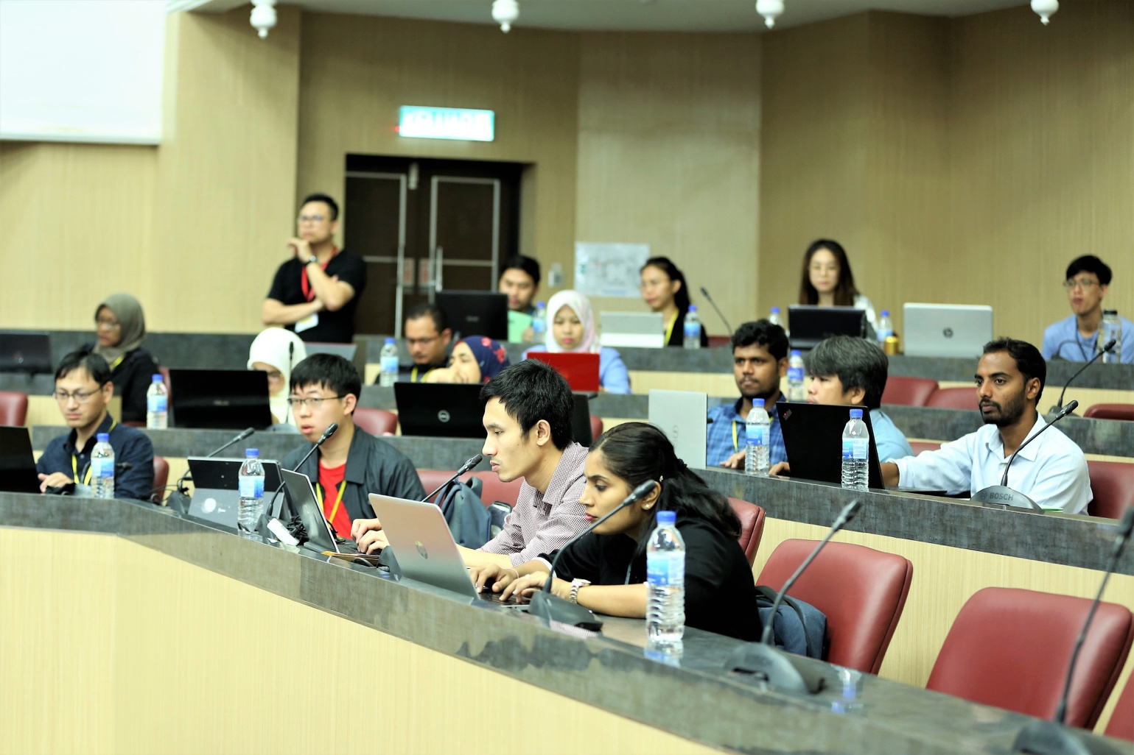
SERVIR-SARI WGCapD Integrated Training Events
Since 2019
Through WGCapD, we are bringing different capacity building programs under one umbrella to coordinate training events in different regions of the world.
Joining hands with other programs has significant benefits
  On leveraging funding
  Involving expert trainers from multiple organizations
  Involving not only Space Agencies, but also Universities, other govt and non-govt organizations to do the events effectively
Sharing one of the recent success stories in the next slide

Slide 10
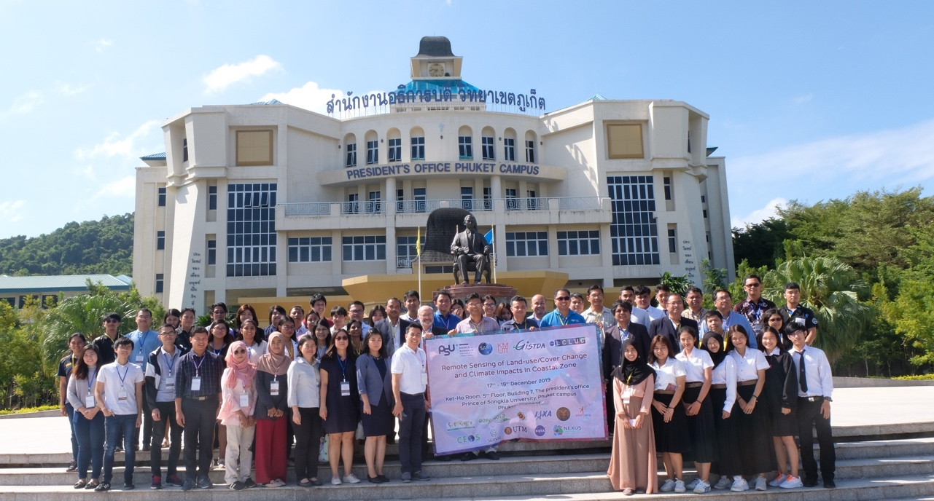
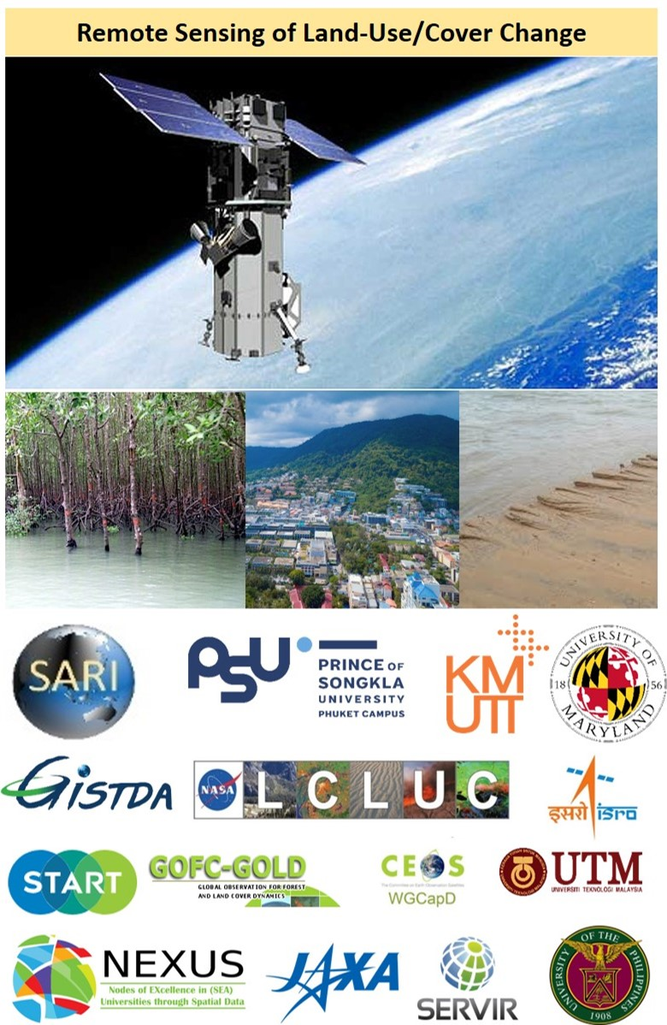
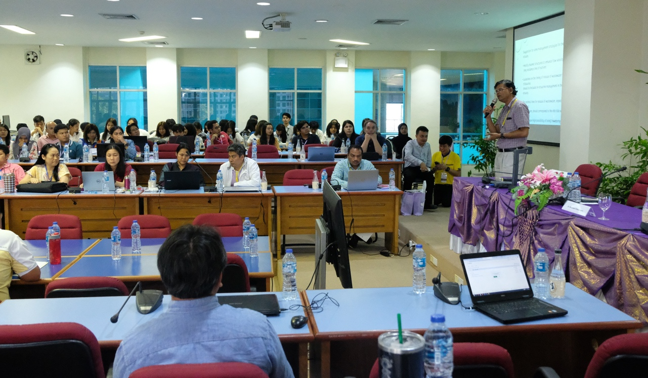
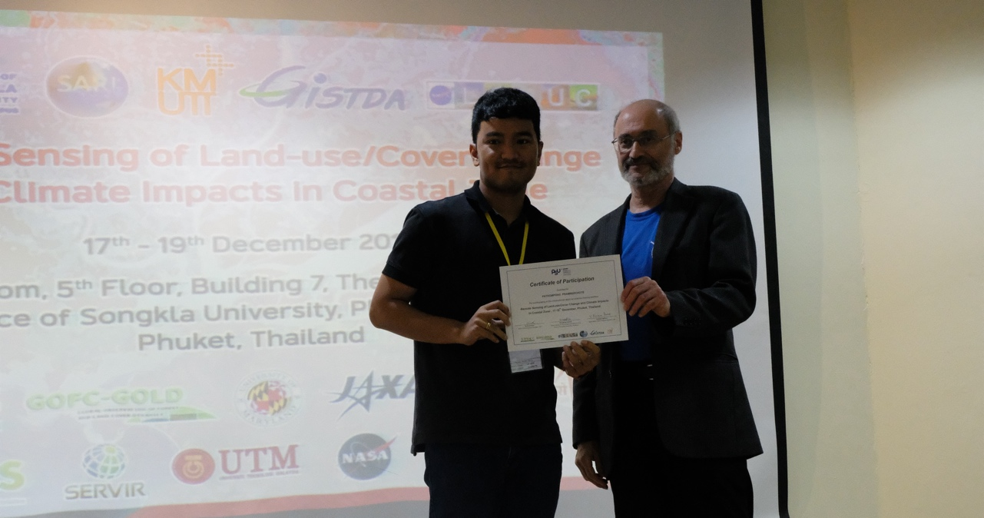
Recent Example on the Integrated WGCapD Training Event
Remote Sensing of Land-Use/Cover Change and Climate Impacts In Coastal Zone
17-19th December, Phuket, Thailand
15 different partners came together to organize a training event in Phuket, Thailand - all under WGCapD Umbrella
Involving SARI, SERVIR, Local Universities, Government, Non-Government, International and Regional Organizations
It is mandatory to have at least 2 space agency involvement in WGCapD events. Through effective coordination, we brought trainers from 4-different space agencies: NASA + ISRO + GISTDA + JAXA
Funding: cost-shared by multiple partners
Total Days: 3 + 1-day field trip
Total Participants: 85 (university students, govt and non-govt agencies)
Costs to participants: None/ free training including food to all participants for 3-days
Pre-and post evaluation surveys to get feedback for improving the training events
Coordination is the Key for Success

Slide 11
Challenges – and the path to overcoming them
Identify immediate and long-term obstacles, barriers or risks to your activities, and how you have tried to address them.
Use of the service planning approach -> theories of change which force us to document assumptions + conditions required for success
Do you have recommendations on how to anticipate and/or avoid challenges? Were there any things you learned not to do?
Recommendation: Be systematic in approaching CB -> service planning approach
Learned not to try to do CB in everything -> prioritization of thematic areas, others
What gaps do you see, e.g. in capacity building methodologies, training topics, etc.?
For our SERVIR hubs in general, cloud computing has represented a paradigm shift, and has not always been addressed in capacity building activities

Slide 12
Backup

Slide 13
Key takeaways and lessons learned
What has worked?
  Co-development approach
How did collaboration affect the outcomes?
  Active engagement of those being ‘trained’ + more tailored
What best practices are emerging?
  Co-development; service planning approach for service deployment
What capacity building approaches and methodologies are most effective?
  Co-development
What has changed since the capacity building work began?
  SERVIR Service Planning Toolkit launched in 2017
Are any particular EO, models or data products becoming more relevant?
  SAR (ALOS PALSAR, Sentinel-1), spaceborne LiDAR (GEDI, ICESat-2)

Slide 14
Priority needs and areas for collaboration
Priority needs:
Capacity building + exposure re: new products (e.g. upcoming BIOMASS mission products)
Continued capacity building in use of SAR, LiDAR
Support in cloud-based computing (paradigm shift)
Overall CB in SERVIR’s 4 thematic areas -> supports service deployment
Areas for potential collaboration:
Synergies w/ the various space agencies
Joint SERVIR / CEOS WGCapD activities, e.g. AOGEO Week
Targeted ARSET courses
Coordination on training calendar, database, surveys

Slide 15
LCLUC is a global program supported through regional partnerships to enhance
  Regional scientists’ access to NASA assets
  NASA scientists access to national data and facilitate field data collection
LCLUC is a catalyst for regional science initiatives through
  Networks by leveraging national/local knowledge and resources and strengthening NASA research projects
  Workshops focused on societal priorities, advanced research and policy-relevant land-use science
LCLUC is a promoter of regional capacity building through
  NASA data-use training
  International data sharing
4

