Slide 1
JAXA Agency Report
Keiji Imaoka
Japan Aerospace Exploration Agency (JAXA)
CGMS-CEOS Joint Working Group on Climate
Darmstadt, Germany
March 5, 2014

Slide 2
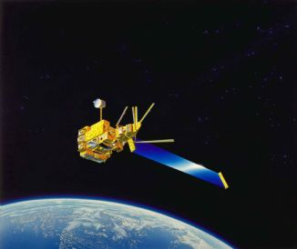
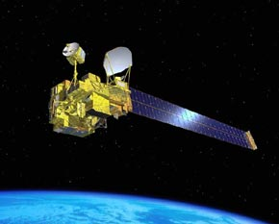
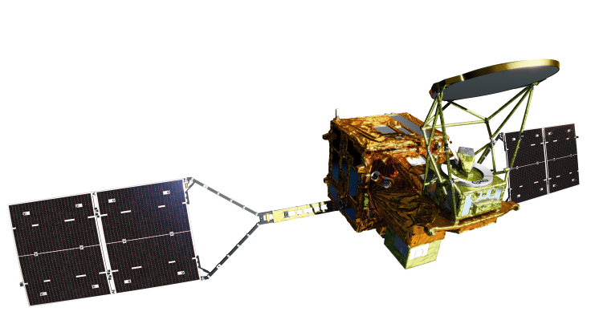
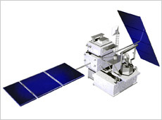
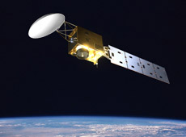
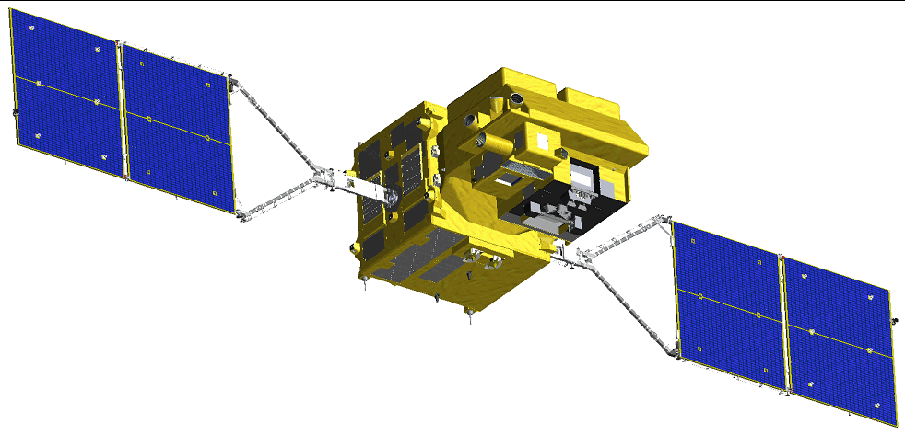
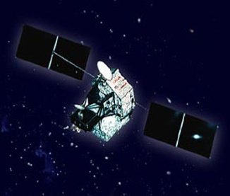
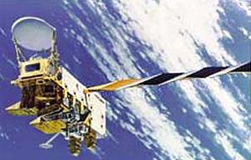
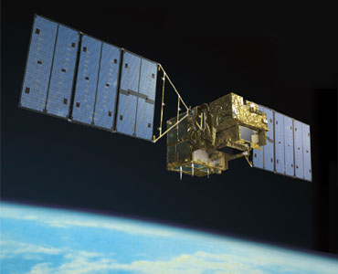
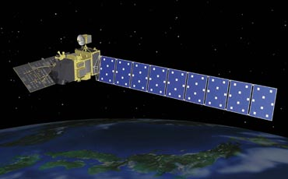
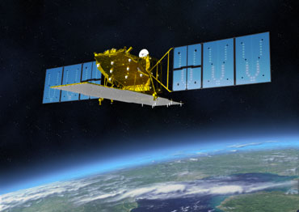
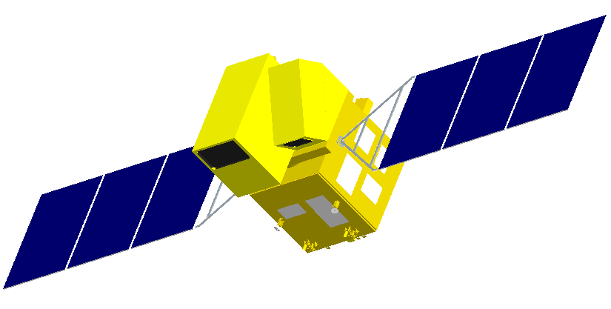
JAXA Satellite Programs
Late 1990s
2000s
2003 (JAXA established)
Earth Observation
Climate Change/Water
ADEOS
GPM/DPR
EarthCARE/ CPR
ADEOS-Ⅱ
GCOM-W
GCOM-C
TRMM/PR
Aqua/
AMSR-E
GOSAT
Global Warming
GOSAT-2
Land Use
ALOS
Disaster
Monitoring
ALOS-2
Next Gene.
(optical)
Communications
COMETS
DRTS
WINDS
Technology
Development
Positioning
QZSS
ETS-Ⅵ
ETS-Ⅶ
OICETS
ETS-Ⅷ
2
Notes:
As you may know, Advanced Land Observing Satellite, ALOS was launched successfully on January 24th in 2006, and renamed Daichi.
Calibration and Validation were done in the following months after the launch, and its regular operation started on October 24.
ALOS is a follow-on satellite to the Japanese Earth Resources Satellite-I, JERS-I and the first Advanced Earth-Observing Satellite, ADEOS, with significantly enhanced land-observation capability and technology.
ALOS has three remote-sensing instruments, PRISM, PALSAR and AVNIR-2 that enable precise land-coverage observation.
It will be used for disaster monitoring, cartography, and regional observation and resource surveying, and will address global warming.

Slide 3
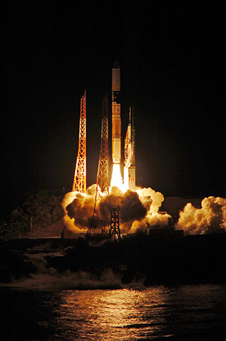
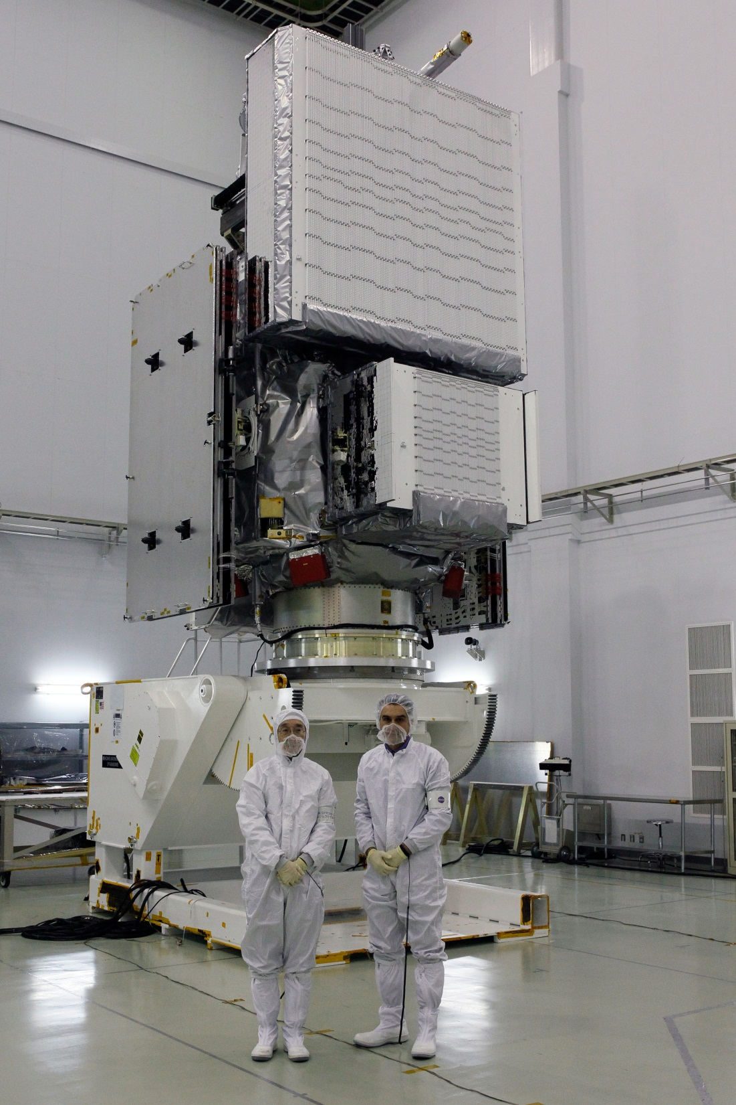
GPM Core Observatory was successfully launched on February 28, 2014 (JST)
3
Notes:
GPM core observatory is nearly ready for launch at the Tanegashima Space Center in Japan. The satellite was transported by a large aircraft from the United States, shipped via sea to the Tanegashima Island, and transported to the Tanegashima Space Center by land. This is the photo of the GPM core observatory with two project managers from NASA and JAXA. The large and small rectangular boxes are Ku- and Ka-band radar, respectively.

Slide 4
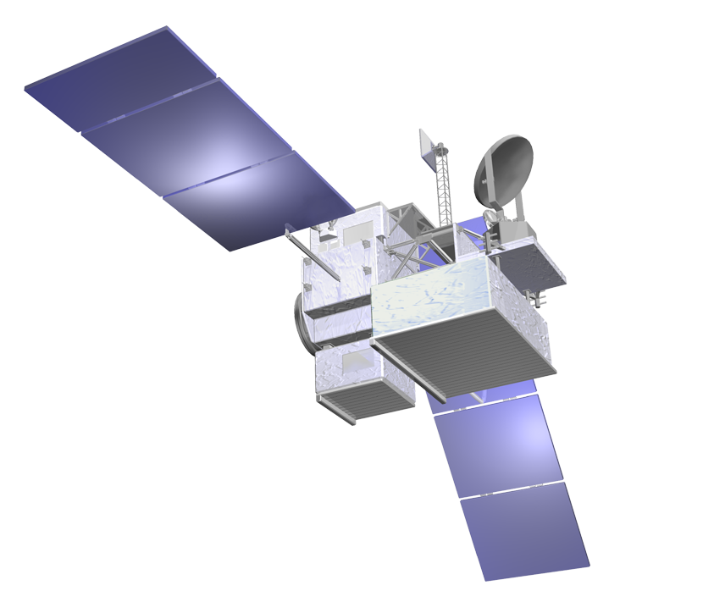
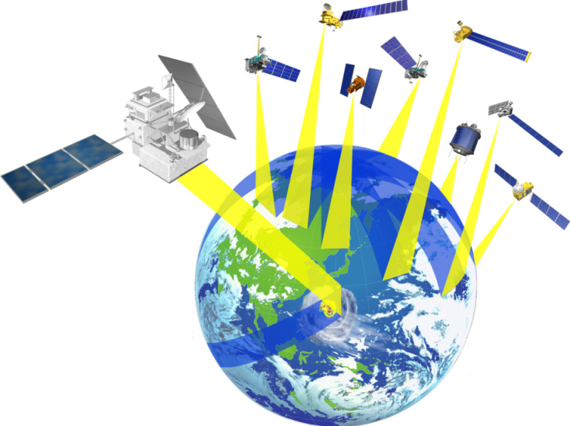
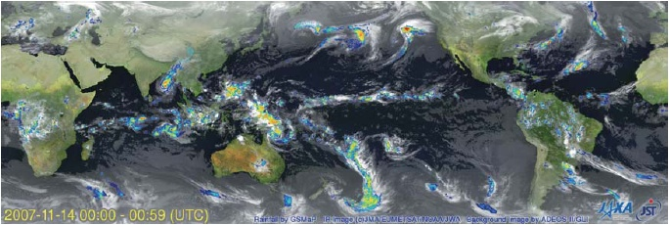
Global Precipitation Measurement (GPM)
GPM Core Observatory
International mission for high accurate / frequent global precipitation observation.
Core Observatory: developed under NASA and JAXA equal partnership.
Constellation Satellites: utilization of international partners’ satellites with precipitation measurement capability.
Dual-frequency Precipitation Radar (DPR)
Developed by JAXA and National Institute of Information and Communications Technology （NICT）
DPR is composed of KuPR and KaPR
GPM Core Observatory will be launched on February 27th 2014 (UTC).
GMI (Microwave Imager)
KuPR: 13.6GHz radar (phased array)
KaPR: 35.5GHz radar (phased array)
Constellation
Satellites by international partners
Core
Observatory by NASA-JAXA
Notes:
Global Precipitation Measurement (GPM) is the follow up mission to TRMM. GPM is not the name of a single satellite, but the name of the mission consisting of GPM core observatory and constellation satellites for high accurate and frequent global precipitation observation. The GPM core observatory has been developed under an equal partnership between NASA and JAXA. As constellation satellites, we will utilize the international partners’ satellites with precipitation measurement capability. GPM is equipped with the most sophisticated spaceborne radar, the Dual-frequency Precipitation Radar (DPR) developed by JAXA and the National Institute of Information and Communications Technology (NICT), to observe 3-dimensional structure of rainfall. While TRMM/PR only uses a Ku-band radar (at approximately 13 GHz), GPM/DPR will add Ka-band radar (at approximately 36 GHz) to increase its sensitivity to weak rainfall and solid precipitation like snow. NASA provides the GPM microwave imager (GMI), which is a passive microwave radiometer, to obtain wide-area distribution of rainfall. GPM core observatory will be launched on February 27, 2014 (UTC).

Slide 5
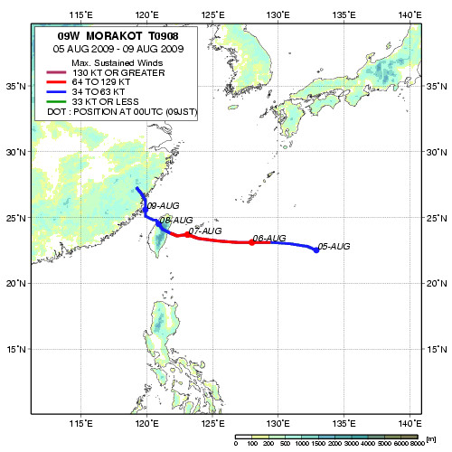
GSMaP
Typhoon MORAKOT (09W): Aug. 5 – 10, 2009 (Big impact in Chinese Taipei)
Rapidly changing precipitation phenomena need frequent observations.
Global rainfall map merging TRMM, polar orbiting microwave radiometer/sounders, and geostationary infrared radiometers.
http://sharaku.eorc.jaxa.jp/GSMaP/
5

Slide 6
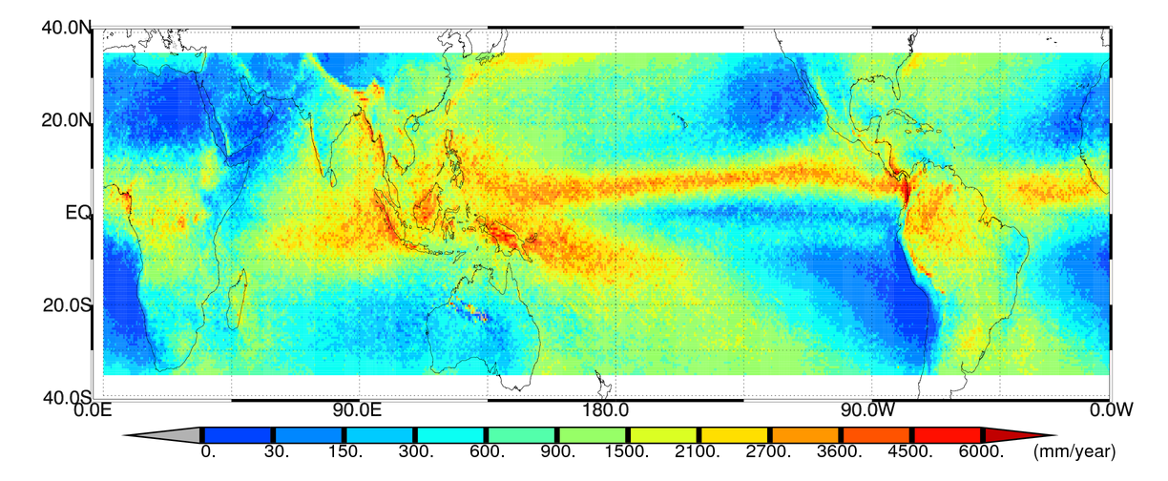
Rainfall Climatology by TRMM/PR
14 year-mean (from Jan. 1998 to Dec. 2011) surface rain observed by TRMM/PR
6
Notes:
This is an example of TRMM results, showing the rainfall climatology over the tropics during a 14 year TRMM/PR observing period. This is really a breakthrough result, since there have been virtually no accurate precipitation observations over oceans. Considering the original design life of TRMM, which was just 3 years, we needed a follow up mission to continue this important observation from space.

Slide 7
Rainfall Climatology by TRMM/PR
Variation of precipitation by TRMM/PR (Jan. 1998 – Jun. 2012)
To be extended by GPM to longer time period and mid/high latitudes
Ocean
Land

Slide 8
GCOM 1st Generation Satellites
2 types of medium-sized satellites and 3 generations: 10-15 years observation
“SHIZUKU”
GCOM-W1 (Water)
GCOM-C1 (Climate)
Instrument | Advanced Microwave Scanning Radiometer-2
Orbit | Sun Synchronous orbit Altitude：699.6km (on Equator) Inclination: 98.2 degrees Local sun time: 13:30+/-15 min
Size | 5.1m (X) * 17.5m (Y) * 3.4m (Z) (on-orbit)
Mass | 1991kg
Power gen. | More than 3880W (EOL)
Launch | May 18, 2012
Design Life | 5-years
Instrument | Second-generation Global Imager
Orbit | Sun Synchronous orbit Altitude：798km (on Equator) Inclination: 98.6 deg. Local sun time: 10:30+/- 15min
Size | 4.6m (X) * 16.3m (Y) * 2.8m (Z) (on orbit)
Mass | 2093kg
Power gen. | More than 4000W (EOL)
Launch | JFY 2016
Design Life | 5-years
8

Slide 9
Overview of GCOM Products
land
cover
cloud
proper-
ties
land
surface
tempera-
ture
C
Atmosphere
Land
Carbon
Cycle
aerosol
proper-
ties
water
vapor
primary
produc-
tion
C
cloud
liquid
water
soil mois-
ture
Radiation
Budget
snow
ice
distribu-
tion
precipi-
tation
above-
ground
bio-
mass
snow
depth
sea
surface
wind
speed
snow
surface
proper-
ties
sea ice
concen-
tration.
PAR
snow
surface
temp.
ocean
color
Cryosphere
Ocean
W
sea
surface
temp.
Water &
Energy
Cycle
9

Slide 10
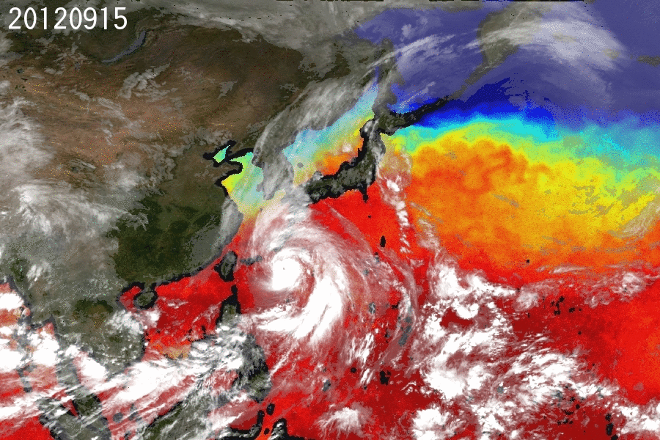
Depression of SST by Typhoon passage
10

Slide 12
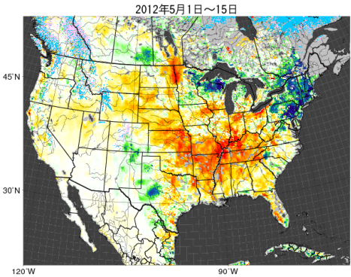
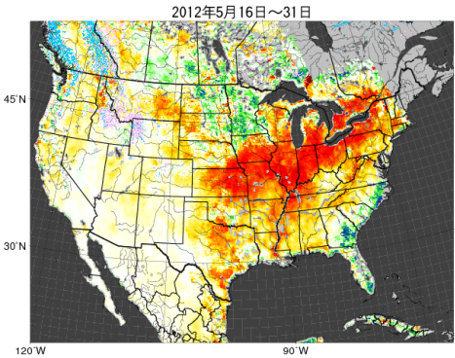
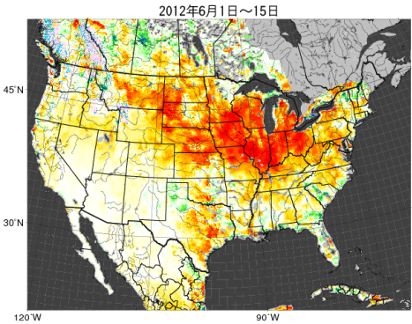
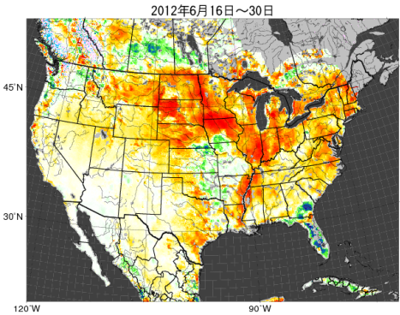
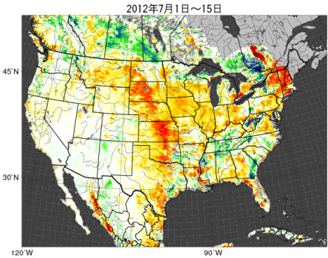
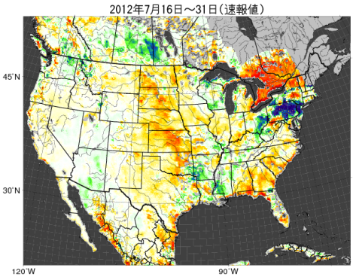
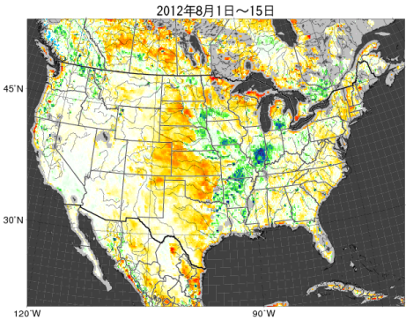
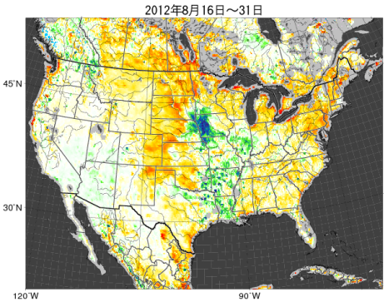
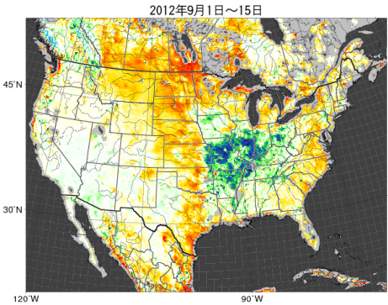
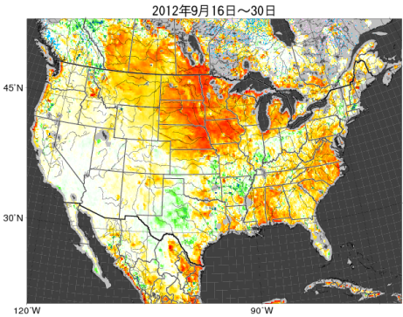
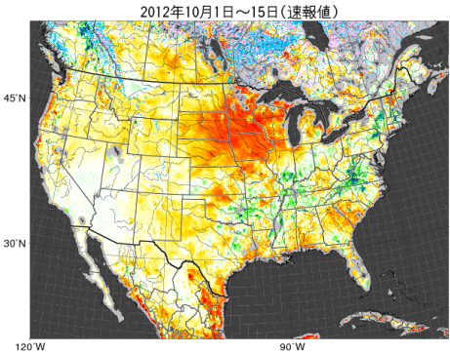
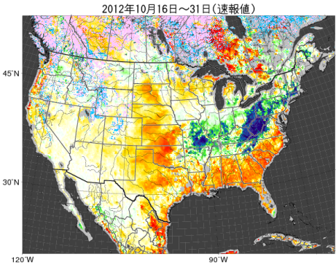
Soil Moisture Anomaly over
North America
May 1-15, 2012
May 16-31, 2012
June 1-15, 2012
June 16-31, 2012
July 1-15, 2012
July 16-31, 2012
August 1-15, 2012
August 16-31, 2012
WindSat
AMSR2
September 1-15, 2012
September 16-30, 2012
October 1-15, 2012
October 16-31, 2012
Snow Area by MODIS
Dry Snow
Soil Moisture Anomaly Ratio by Microwave
300
200
150
120
100
90
70
30
0
[%]
Wet Snow
Wet
Dry
12

Slide 13
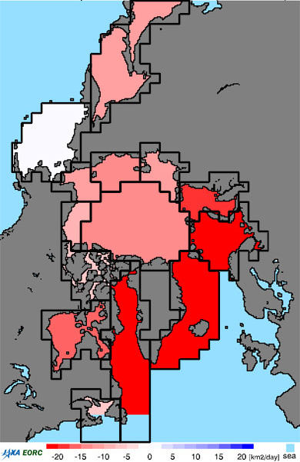
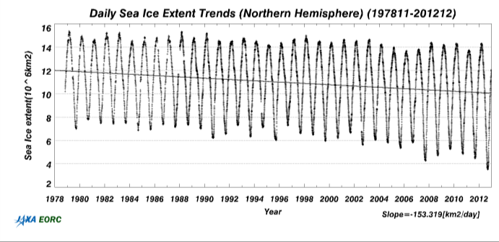
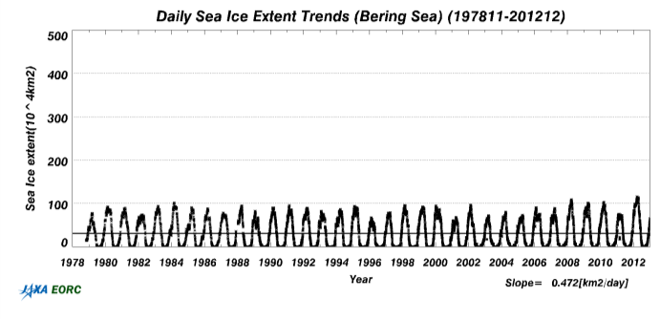
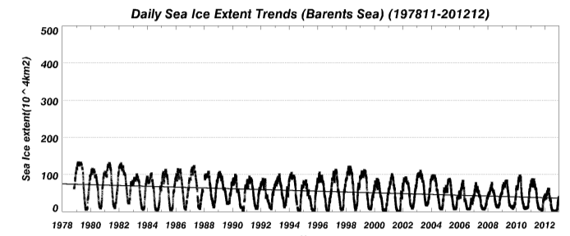
Long-Term Dataset of Arctic Sea Ice
Combining histrical dataset and AMSR-E/AMSR2
Patific
Northern Hemisphere：-153km²/day
Bering Sea：+0.5km²/day
Barents Sea：-30km²/day
Atlantic
http://kuroshio.eorc.jaxa.jp/JASMES/climate/index.html
13

Slide 14
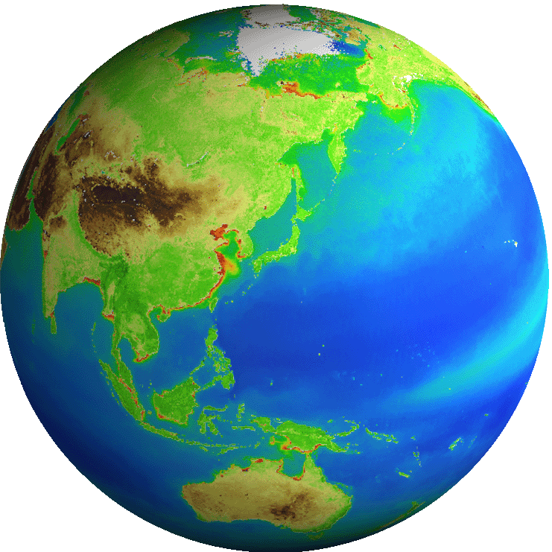
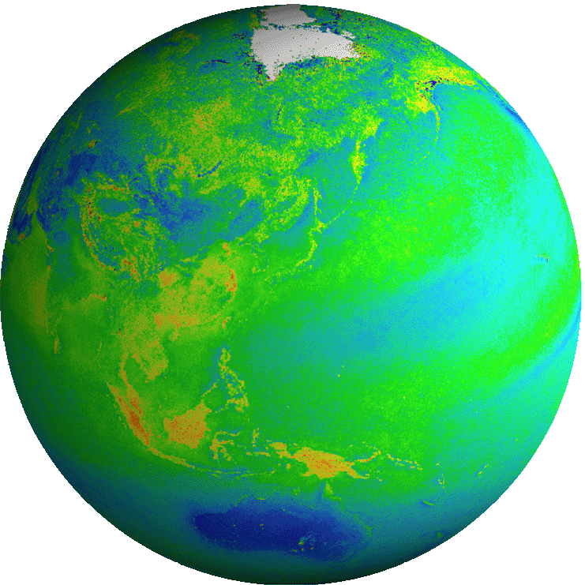
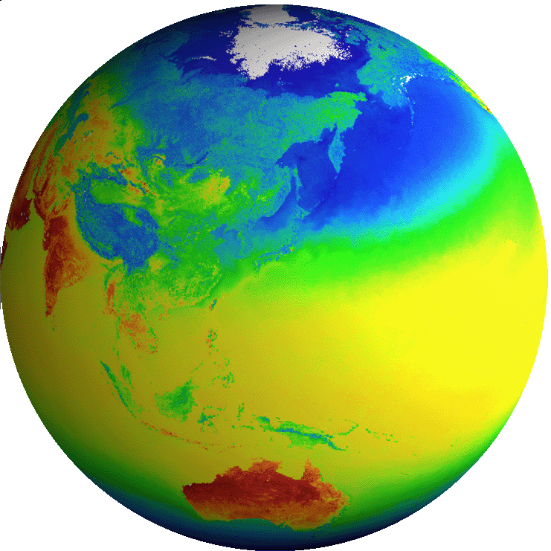
Future GCOM-C Products
Common
Radiance | TOA radiance (including system geometric correction)
Blue: standard products
Red: research products
Radiation budget by the atmosphere-surface system
Carbon cycle in the Land and Ocean
Land
Surface reflectance | Precise geometric correction
 | Atmospheric corrected reflectance
Vegetation and carbon cycle | Vegetation index
 | Above-ground biomass
 | Vegetation roughness index
 | Shadow index
 | Fraction of Absorbed Photosynthetically available radiation
 | Leaf area index
Temp. | Surface temperature
Application | Land net primary production
 | Water stress trend
 | Fire detection index
 | Land cover type
 | Land surface albedo
Atmosphere
Cloud | Cloud flag/Classification
 | Classified cloud fraction
 | Cloud top temp/height
 | Water cloud optical thickness /effective radius
 | Ice cloud optical thickness
 | Water cloud geometrical thickness
Aerosol | Aerosol over the ocean
 | Land aerosol by near ultra violet
 | Aerosol by Polarization
Radiation budget | Long-wave radiation flux
 | Short-wave radiation flux
Ocean
Ocean color | Normalized water leaving radiance
 | Atmospheric correction parameter
 | Photosynthetically available radiation
 | Euphotic zone depth
In-water | Chlorophyll-a conc.
 | Suspended solid conc.
 | Colored dissolved organic matter
In-water | Inherent optical properties
Temp. | Sea surface temp.
Application | Ocean net primary productivity
 | Phytoplankton functional type
 | Redtide
 | multi sensor merged ocean color
 | multi sensor merged SST
Cryosphere
Area/ distribution | Snow and Ice covered area
 | Okhotsk sea-ice distribution
 | Snow and ice classification
 | Snow covered area in forest and mountain
Surface properties | Snow and ice surface Temperature
 | Snow grain size of shallow layer
 | Snow grain size of subsurface layer
 | Snow grain size of top layer
 | Snow and ice albedo
 | Snow impurity
 | Ice sheet surface roughness
Boundary | Ice sheet boundary monitoring
ECV
ECV
ECV
ECV
ECV
ECV
ECV
ECV
ECV
ECV
ECV
ECV
ECV
ECV
14

Slide 15
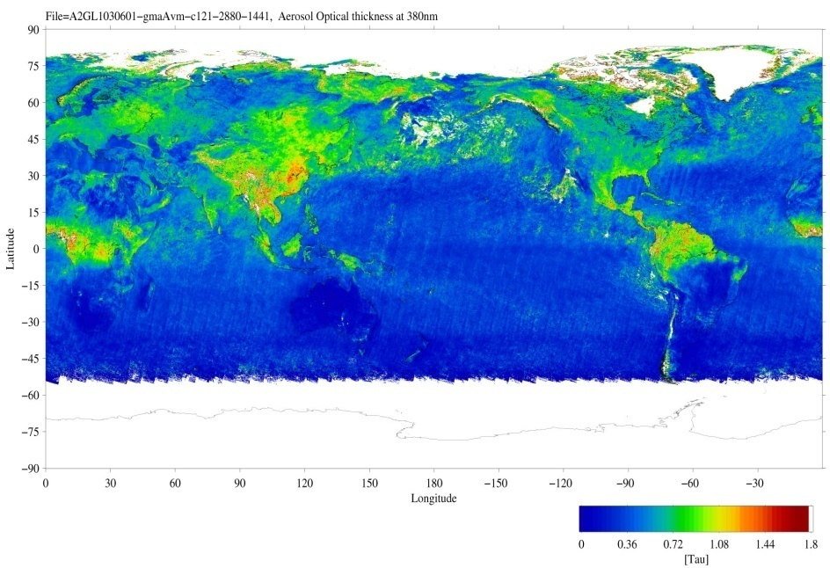
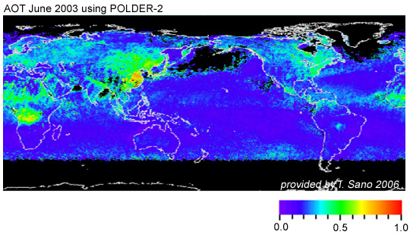
Future GCOM-C Products
- Land Aerosol by NUV and Polarization -
Not only over the ocean, SGLI will estimate land-area aerosols using near-UV (380nm) and polarization channels which are more sensitive to atmosphere scattering rather than land surface reflection
Combination of aerosol absorption by Near-UV and fine-mode aerosol properties by polarization
They will improve the atmospheric correction
Near-UV aerosol
Polarization aerosol
JAXA/EORC
Global aerosol optical thickness in June 2003 using the GLI Near-UV (380nm) channel (NIR is used for the ocean area)
Global aerosol optical thickness in June 2003 using POLDER-2 polarization reflectance (provided by T. Sano, Kinki Univ.)
15

Slide 16
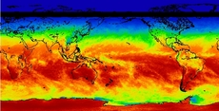
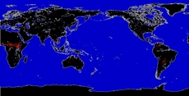
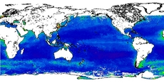
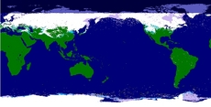
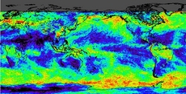
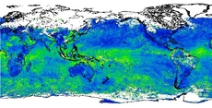
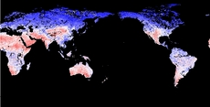
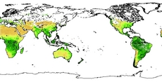
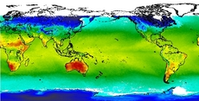
http://kuroshio.eorc.jaxa.jp/JASMES/index.html
Photosynthetically Available Radiation
Hot Spots of Wild Fire
Chlorophyll-a
Snow Cover Extent
Cloud Cover Rate
Aerosol Optical thickness
Plant Water Stress Trend
Activity of Vegetation (NDVI)
Ocean and Land Surface Temperature
16

Slide 17
Greenhouse Gases Observing SATellite (GOSAT)
Monitoring global distribution of Greenhouse Gases (CO2, CH4) from space.
Joint project by JAXA, NIES, and MOE.
Launch: 23 January 2009 by H2A launch vehicle
TANSO-FTS (Fourier Transform Spectrometer)
TANSO-CAI
(Cloud and Aerosol Imager)
TANSO = Thermal And Near infrared Sensor for carbon Observation
17
Notes:
1

Slide 18
Five-year CO₂ ,CH₄, and the flux estimate data from GOSAT
Monthly Global Map of the CO₂ column-averaged volume mixing ratios in 2.5 deg by 2.5 deg mesh in August 2013 (Ver.02.21)
http://www.gosat.nies.go.jp/index_e.html

Slide 19
Earth Cloud, Aerosol and Radiation Explorer (EarthCARE)
To reduce the uncertainties in global warming prediction by measuring the three dimensional structure of clouds and aerosols, which are most uncertain parameter in the numerical climate models.
Instrument
CPR (Cloud Profile Radar)
ATLID (Atmospheric LIDAR)
MSI (Multi-Spectral Imager)
BBR (Broad Band Radiometer)
Joint Mission by Europe and Japan
Launch in 2016
3 years lifetime
400 km altitude
Sun-synchronous orbit (Local time: 14:00)
19

Slide 20
Concept of ALOS F/O Mission
Wide-swath and high-resolution data of ALOS series to contribute to disaster monitoring, land management, and solution of global environment issues, etc.
To promote public-private partnership
2006
2011
2014
ALOS
(Optical & SAR)
ALOS-2 (SAR)
Next Gene. (Optical )
Wide-swath (Max 490km), High-resolution (1-3m)
L-band SAR (PALSAR-2)
ALOS
(Optical & SAR)
(2006～2011)
ALOS-2 (SAR) (Launch: 2014)
Panchromatic imager with wide-swath (50km) and high-resolution (0.8m)
obtain global 3D geospatial information
Next Gene. (Optical)
Notes:
・ JAXA is planning new satellites as a post-ALOS mission.
・ ALOS-2 and ALOS-3.
・ ALOS-2 will carry L-band SAR, and ALOS-3 will carry optical imagers.
・ Tomorrow morning, Suzuki-san from JAXA will introduce about ALOS-2.
・ ALOS-3 will take over the global land observation by PRISM and AVNIR-2 on board ALOS, as well as ・・・

