Slide 1
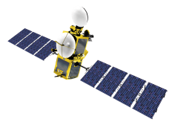
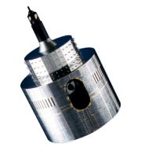
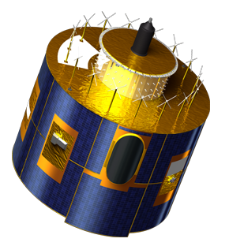
Scientific and Process oriented Evaluation of Climate Data
(Results of The CORE-CLIMAX Assessment Workshop)
Jörg Schulz
EUMETSAT

Slide 2
Content
Introduction
Evaluation and Quality Control for Climate Data;
Scientific quality;
Process quality;
Fitness for purpose?;
Relation to GCOS Guidelines and Monitoring Principles
Conclusion

Slide 3
A Quote That Has it All ...
GCOS-WCRP Letter, 12 May 2010 to many agencies:
“However, there is currently no systematic international approach to ensure transparency, traceability and sound scientific judgement in the generation of climate data records across all fields of climate science and related Earth observations, and there are no dedicated sustained resources in place to support such an objective. For example, there are currently eight sea-ice concentration products produced by different organizations globally that differ significantly in providing an estimate of sea-ice extent and concentrations, mostly due to differences in methodology and not the variability or dynamics of underlying phenomenon. It is very confusing and frustrating for the non experts as to which one of these products they can use in their research and analysis, and the necessary documents to describe their attributes in a comparative manner akin to the global model inter-comparisons do not exist.”

Slide 4
Value Adding Chain of Climate Data
Data users converting data into relevant information
UERRA
CLIPC
Uncertainty
Uncertainty
Uncertainty/Risk
Requirements
Requirements
Requirements
Logical view from the Architecture for Space-based Climate Monitoring developed by space agencies.

Slide 5
Architecture for Climate Monitoring from Space
Architectures states: “There is an imperative need to ensure traceability from taking observations to a climate data record along harmonised practises”.
Two usage scenarios are contained:
Promotion of common understanding for implementation of climate monitoring requirements;
Support an assessment of the degree to which current and planned systems meet requirements;
Essential is to assess what exists, what degree of completeness and sustainability as well as quality the existing has.

Slide 6
Evaluation and Quality Control for Climate Data

Slide 7
QA4ECV Approach to E and QC
Users need clear info on validity of EO/climate data records
Climate Data Records available, but need info on strength/weakness and fitness for purpose
Need objective system
Need guidance
web portal
Quality Assurance System
Provides traceable quality info on EO/climate data;
Tied to international standards;
QA processes and tools to support user community in tracing quality;
Quality assured multi-decadal Climate Data Records of GCOS ECVs (includes all inputs, such as FCDRs into it).
Notes:
Users = scientists, public and commercial customers
Some records are suitable for one particular application, but not for others
Traceable quality info: Considers all aspects of the process from instrument calibration, applied retrieval schemes, used models, validation data.
Tied to international standards: We need to speak the same language – Metrology is sometimes hard but it pays off in better understanding
QA processes: Includes scientific Assessments employing e.g., WCRP bodies. Shall also include internal and external review cycles but also audit type evaluations.
QA Tools: Can be software that supports data analysis but also quantifiable metrics that assess the quality of the production and analysis systems. The latter being important to support decisions in which we finally invest.

Slide 8
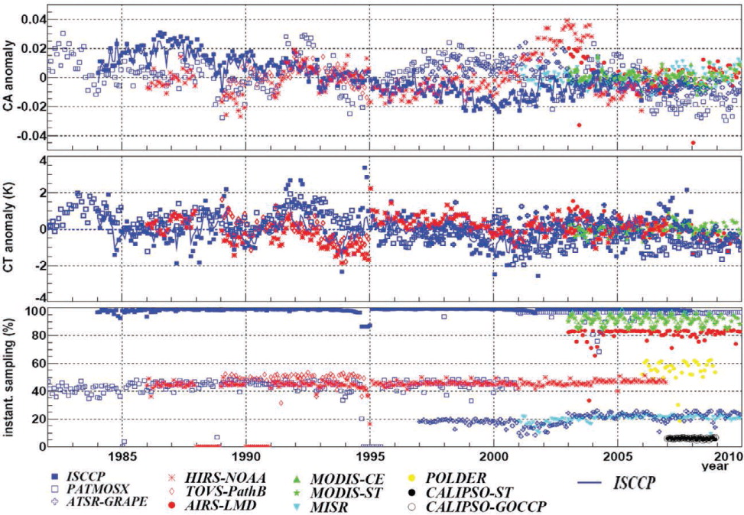
GEWEX Assessment of Cloud Data Records
"An assessment of long-term variations in global-mean cloud amount from nine different satellite datasets by Stubenrauch et al. (2013) found differences between datasets were comparable in magnitude to the inter-annual variability. Such inconsistencies result from differences in sampling as well as changes in instrument calibration and inhibit an accurate assessment of global-scale cloud cover trends."
IPCC, Chapter 2, AR5, 2013
Stubenrauch et al., BAMS, 2013
Notes:
Fig. 6. Time series of global CA and CT anomalies as well as of monthly mean instantaneous sampling fraction of the globe (at a specific local observation time) of the participating datasets. For each dataset the period covered in the GEWEX cloud assessment database is shown, with local observation time at 1330 LT (1500 LT for ISCCP, 1030 LT for ATSR-GRAPE, and 1030 LT for MISR). ISCCP anomalies are also shown using the whole diurnal time statistics (blue line).

Slide 9
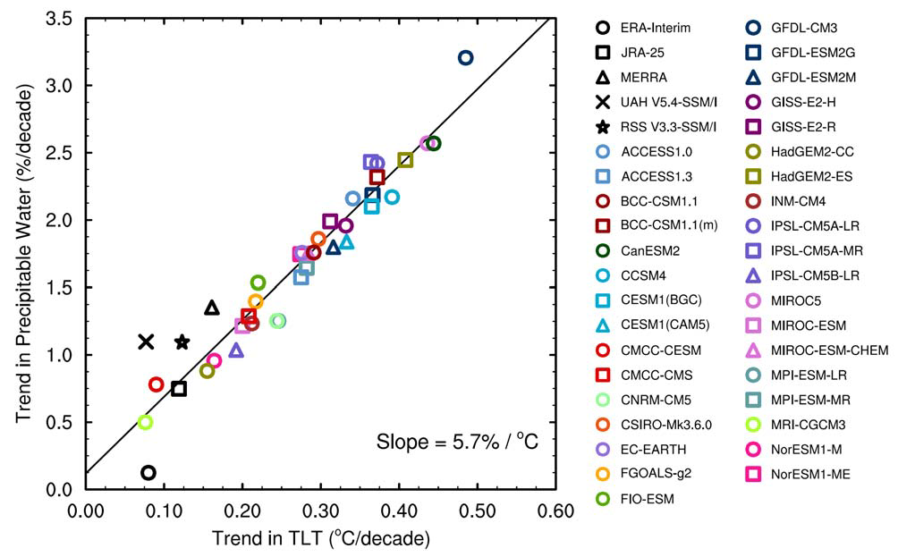
Trends in Tropical Precipitable Water and TLT
“It is not known whether these discrepancies are due to remaining inhomogeneity in the observational data and/or reanalysis results, or due to problems with the climate simulations. All of the observational and reanalysis points lie at the lower end of the model distribution, consistent with the findings of (Santer et al., 2013).”
IPCC, Chapter 9, AR5, 2013, Updated from (Mears et al., 2007)
Notes:
Figure 9.9 (updated from (Mears et al., 2007) shows the relationship between 25-year (1988–2012) linear trends in tropical precipitable water and lower tropospheric temperature for individual historical simulations (extended by appending RCP8.5 simulations after 2005, see (Santer et al., 2013)). As described by (Mears et al., 2007) the ratio between changes in these two quantities is fairly tightly constrained in the model simulations and similar across a range of time scales, indicating that relative humidity is close to invariant in each model. In the updated figure, the RSS observations are in fairly good agreement with model expectations, and the UAH observations less so. The points associated with two of the reanalyses are also relatively far from the line, consistent with long-term changes in relative humidity. It is not known whether these discrepancies are due to remaining inhomogeneity in the observational data and/or reanalysis results, or due to problems with the climate simulations. All of the observational and reanalysis points lie at the lower end of the model distribution, consistent with the findings of (Santer et al., 2013).

Slide 10
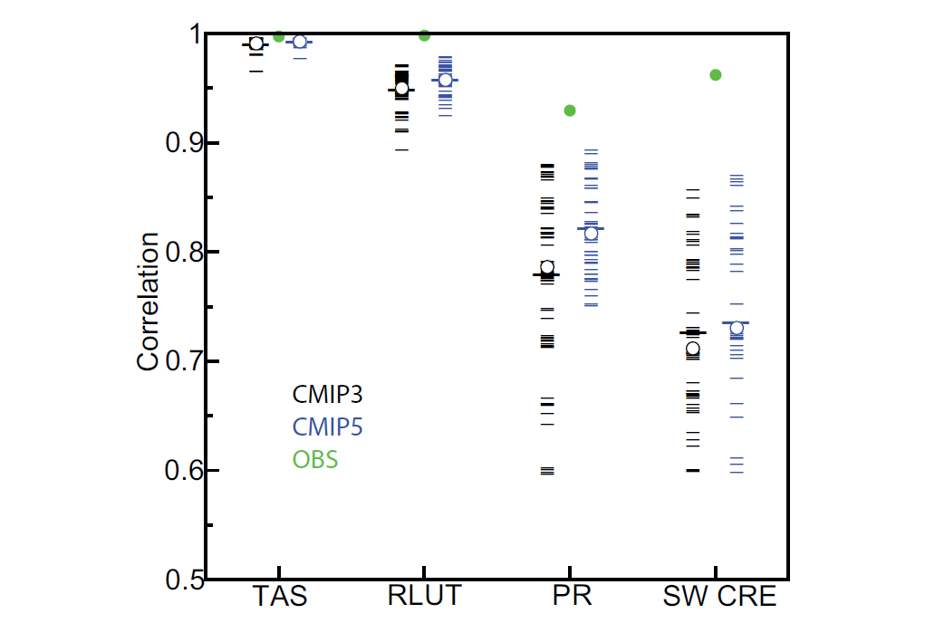
Annual Mean Pattern Correlation (Models vs. Obs)
IPCC, Chapter 9, AR5, 2013
Notes:
Figure 9.6 | Centred pattern correlations between models and observations for the annual mean climatology over the period 1980–1999. Results are shown for individual CMIP3 (black) and CMIP5 (blue) models as thin dashes, along with the corresponding ensemble average (thick dash) and median (open circle). The four variables shown are surface air temperature (TAS), top of the atmosphere (TOA) outgoing longwave radiation (RLUT), precipitation (PR) and TOA shortwave cloud radiative effect (SW CRE). The observations used for each variable are the default products and climatological periods identified in Table 9.3. The correlations between the default and alternate (Table 9.3) observations are also shown (solid green circles). To ensure a fair comparison across a range of model resolutions, the pattern correlations are computed at a resolution of 4º in longitude and 5º in latitude. Only one realization is used from each model from the CMIP3 20C3M and CMIP5 historical simulations.

Slide 11
Motivation for Process QC
Climate Change is a highly applied scientific field with major aspects related to regulation and societal wellbeing;
Increasingly complex observing systems require more process control to ensure quality, access, and preservation;
Software Engineering is also increasingly complex and process management is required to optimize cost, schedule, productivity and quality;
The stakes in climate change are too high to assume a standard research approach to the creation of CDRs. Society is demanding more documentation, openness, and transparency;
It is imperative that Climate Services respond with quantifiable metrics that inform society of both the scientific quality and process maturity of CDRs.
Courtesy: John Bates

Slide 12
User Perspective
Adapted form Folkert Boersma, KNMI

Slide 13
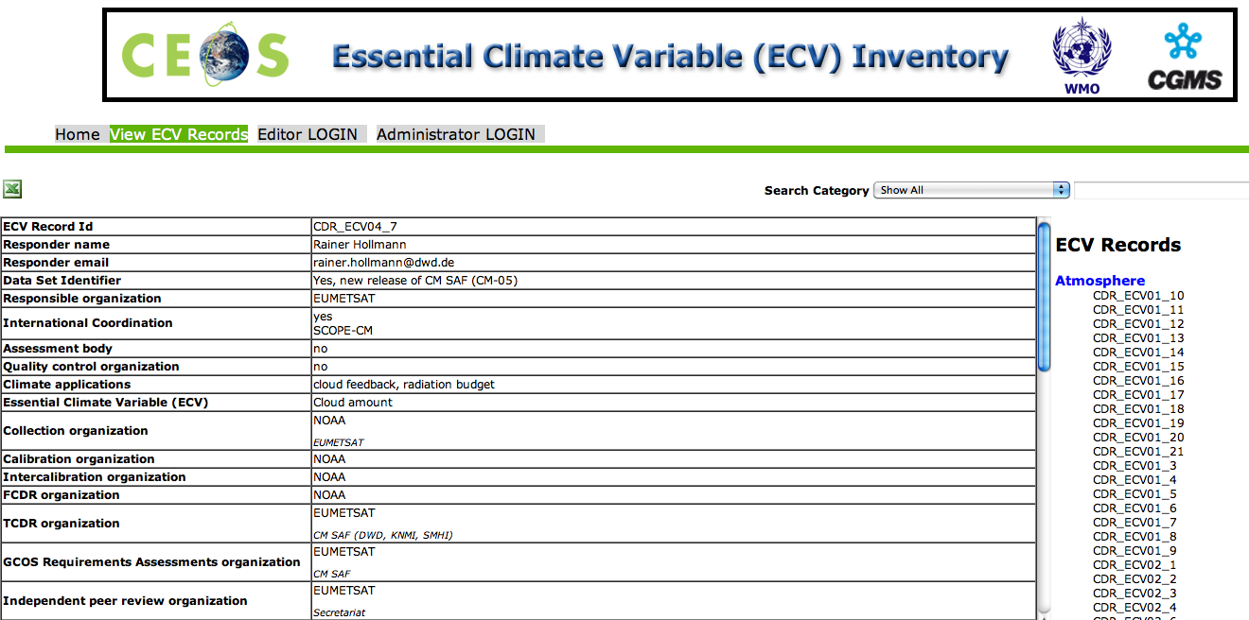
ECV Inventory @ http://www.ecvinventory.com

Slide 14
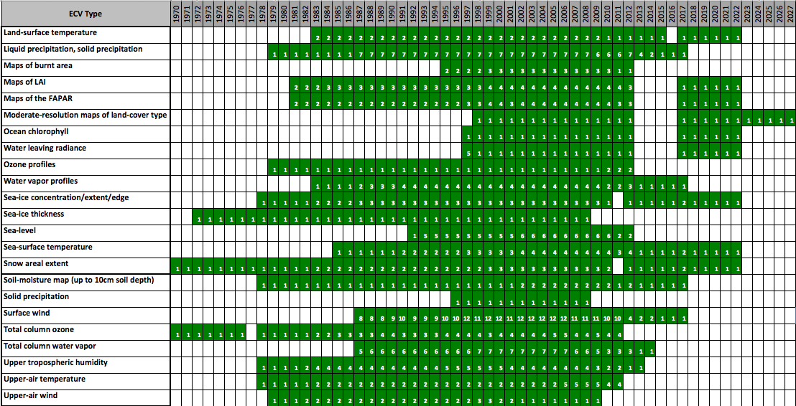
ECV Inventory Statistics – TCDR Timelines

Slide 15
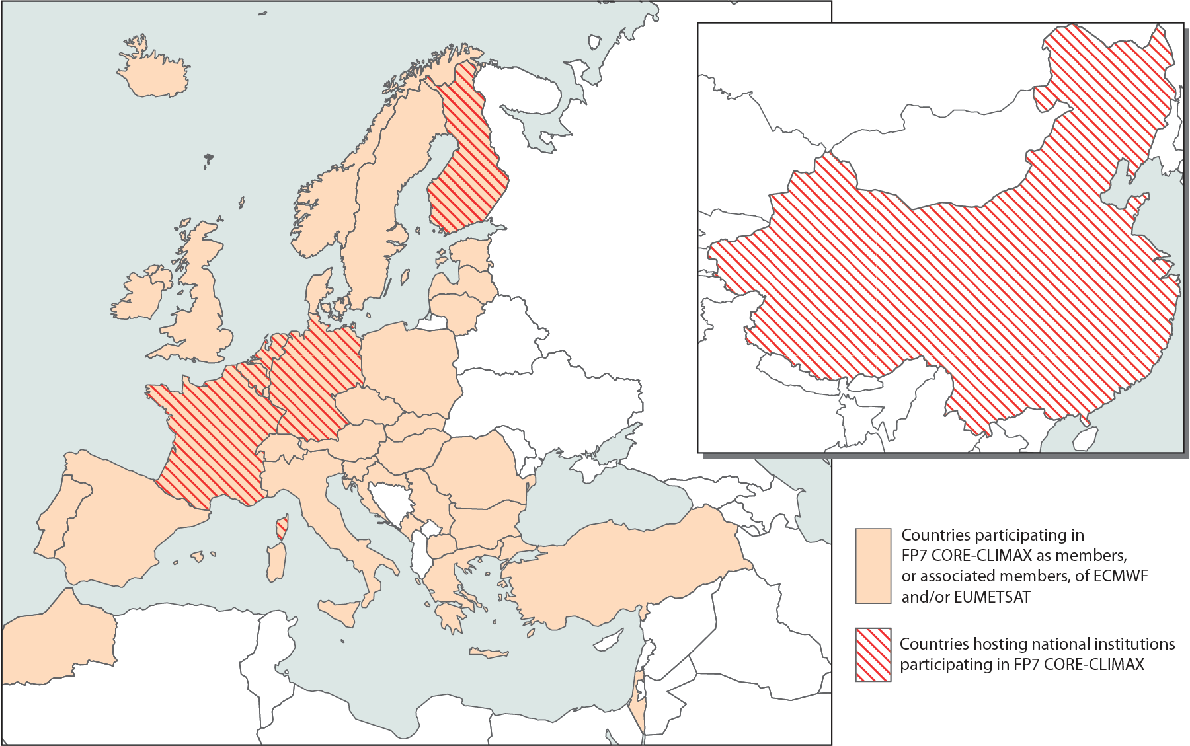
CORE-CLIMAX COordinating Earth observation data validation for RE-analysis for CLIMAte ServiceS

Slide 16
CORE-CLIMAX work packages

Slide 17
EU FP7 CORE-CLIMAX Assessment of European Capacity for CDRs
Benefits of the assessment:
Provides consistent view on strengths and weaknesses of the process to generate, preserve and improve CDRs to each individual CDR producer, agencies and EC;
Provides information to the user community on:
Status of individual records;
Collective state of all records;
Provides this information for the first time across different observing and production systems (satellite, in situ and reanalysis);
Increases transparency and openness towards the user;
Repeated assessments help to monitor progress towards completeness;
Potentially supports selection of CDRs for Copernicus Climate Change Service;
Supports Europe’s contribution to the next Obs4Mips activity in the framework of the Climate Model Inter-comparison (CMIP-6) by providing consistent information on CDRs produced in Europe.

Slide 18
EU FP7 CORE-CLIMAX Assessment of European Capacity for CDRs
The capacity is assessed using three support tools developed by the project:
Data Record Descriptions (DRD)
Contain technical specifications and links to documented information on quality;
Provides consistent and coherent information about CDRs produced in Europe (serves as input to CMIP-6 obs4mips activities).
System Maturity Matrix (SMM)
Evaluates if the production of a CDR follows best practices for science and engineering and is assessing if data records are used and feedback mechanisms are implemented;
The SMM can be used in self assessment mode or in an audit type assessment.
Application Performance Metric (APM)
Evaluates the performance of a CDR with respect to a specific application;
Might be implemented as an interactive App that convolves user requirements with product specification information in a database.
Notes:
App also points to data, documentation, “product reviews” uploaded by earlier app users, and is further linked via CHARMe metadata.

Slide 19
CORE CLIMAX Assessment Workshop
Workshop held at EUMETSAT 21-23 January 2014, 40 participants;
Performed self assessment of 30 CDRs (23 satellite, 6 in situ and one reanalysis) prior to the workshop;
Developed common understanding on the developed System Maturity Matrix (SMM);
Recommended to CORE-CLIMAX needed improvements to the SMM and instruction manual;
Discussed results of self assessments;
Discussed and agreed on way forward for external/independent assessment;
Discussed value and potential of the Application Performance Metric concept and its implementation;

Slide 20
Data Set Description
Each CDR provider is asked to provide a Data Set Description
INTENT OF THE DOCUMENT Brief description of CDR presented
POINT OF CONTACT Information on CDR provider
DATA FIELD DESCRIPTION Information on the technical product specifications (format, fields etc)
DATA ORIGIN Description of the input data used (stations, satellites, etc)
VALIDATION AND UNCERTAINTY ESTIMATE Description of the validation procedure adopted
CONSIDERATIONS FOR CLIMATE APPLICATIONS Description of limitations to be considered
INSTRUMENTS OVERVIEW Detailed description of the measurement system
REFERENCES

Slide 21
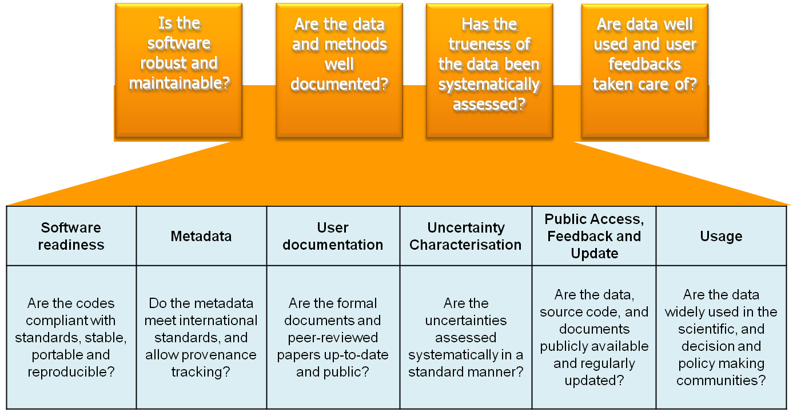
Maturity Matrix Concept

Slide 22
Maturity Matrix NOAA (Bates & Privette, EOS 2012)
Courtesy: John Bates (NOAA)
Maturity | Software Readiness | Metadata | Documentation | Product Validation | Public Access | Societal Impacts
1 | Conceptual development | Little or none | Draft ATBD | Little or None | Restricted to a select few | Little or none
2 | Significant code changes expected | Research grade | ATBD Version 1+ | Minimal | Limited data availability to develop familiarity | Limited or ongoing
3 | Moderate code changes expected | Research grade; Meets int'l standards: ISO or FGDC for collection; netCDF for file | Public ATBD; Peer-reviewed algorithm and product descriptions | Uncertainty estimated for select locations/times | Data and source code archived and available; caveats required for use. | Provisionally used in applications; assessments have demonstrated positive value.
4 | Some code changes expected | Exists at the file level. Stable. Allows provenance tracking and reproducibility of dataset. Meets international standards for dataset | Public ATBD; Draft Operational Algorithm Description (OAD); Peer-reviewed algorithm and product descriptions | Uncertainty estimated over widely distributed times/location by multiple investigators; Differences understood. | Data and source code archived and publicly available; uncertainty estimates provided; Known issues public | Used in applications and assessments demonstrating positive value.
5 | Minimal code changes expected; Stable, portable and reproducible | Complete at the file level. Stable. Allows provenance tracking and reproducibility of dataset. Meets international standards for dataset | Public ATBD, Review version of OAD, Validation Plan; Peer-reviewed algorithm, product and validation articles | Consistent uncertainties estimated over most environmental conditions by multiple investigators | Record is archived and publicly available with associated uncertainty estimate; Known issues public. Periodically updated | Operationally used in applications and assessments demonstrating positive value; may be used by other investigators
6 | No code changes expected; Stable and reproducible; portable and operationally efficient | Updated and complete at the file level. Stable. Allows provenance tracking and reproducibility of dataset. Meets current international standards for dataset | Public OAD; product, algorithm, validation, processing and metadata described in peer-reviewed literature | Observation strategy designed to reveal systematic errors through independent cross-checks, open inspection, and continuous interrogation; quantified errors | Record is publicly available from Long-Term archive; Regularly updated | Used in published applications and assessments by other investigators; may be used by industry

Slide 23
What the CORE-CLIMAX Project did to the SMM
Made it applicable for in situ data records and other data sources such as reanalysis (we took out a lot of satellite specific language);
Made it more easy applicable for agencies worldwide (we took out agency specific language);
Accommodated the feedback provided by the CEOS Working Group Climate, ESA CCI, EUMETSAT SAFs and NOAA in recent discussions of the maturity approach;
Concentrated it on the question of completeness in a sense of following best practices in science and engineering that developed over several decades;
Made the Maturity Matrix independent of individual applications;
Use a cumulative approach for increasing maturity and improved consistency between main and sub-matrices and among sub matrices.

Slide 24
Core-Climax: System Maturity Matrix
Maturity | SOFTWARE READINESS | METADATA | USER DOCUMENTATION | UNCERTAINTY CHARACTERISATION | PUBLIC ACCESS, FEEDBACK, UPDATE | USAGE
1 | Conceptual development | None | Limited scientific description of the methodology available from PI | None | Restricted availability from PI | None
2 | Research grade code | Research grade | Comprehensive scientific description of the methodology, report on limited validation, and limited product user guide available from PI; paper on methodology is sumitted for peer-review | Standard uncertainty nomenclature is idenitified or defined; limited validation done; limited information on uncertainty available | Data avaliable from PI, feedback through scientific exchange, irregular updates by PI | Research: Benefits for applications identified DSS: Potential benefits identified
3 | Research code with partially applied standards; code contains header and comments, and a README file; PI affirms portability, numerical reproducibility and no security problems | Standards defined or identified; sufficient to use and understand the data and extract discovery metadata | Score 2 + paper on methodology published; comprehensive validation report available from PI and a paper on validation is submitted; comprehensive user guide is available from PI; Limited description of operations concept available from PI | Score 2 + standard nomenclature applied; validation extended to full product data coverage, comprehensive information on uncertainty available; methods for automated monitoring defined | Data and documentation publically available from PI, feedback through scientifc exchange, irregular updates by PI | Research: Benefits for applications demonstrated. DSS: Use occuring and benefits emerging
4 | Score 3 + draft software installation/user manual available; 3rd party affirms portability and numerical reproducibility; passes data providers security review | Score 3 + standards systematically applied; meets international standards for the data set; enhanced discovery metadata; limited location level metadata | Score 3 + comprehensive scientific description available from data provider; report on inter comparison available from PI; paper on validation published; user guide available from data provider; comprehensive description of operations concept available from PI | Score 3 + procedures to establish SI traceability are defined; (inter)comparison against corresponding CDRs (other methods, models, etc); quantitative estimates of uncertainty provided within the product characterising more or less uncertain data points; automated monitoring partially implemented | Data record and documentation available from data provider and under data provider's version control; Data provider establishes feedback mechanism; regular updates by PI | Score 3 + Research: Citations on product usage in occurring DSS: societal and economical benefits discussed
5 | Score 4 + operational code following standards, actions to achieve full compliance are defined; software installation/user manual complete; 3rd party installs the code operationally | Score 4+ fully compliant with standards; complete discovery metadata; complete location level metadata | Score 4 + comprehensive scientific description maintained by data provider; report on data assessment results exists; user guide is regularly updated with updates on product and validation; description on practical implementation is available from data provider | Score 4 + SI traceability partly established; data provider participated in one inter-national data assessment; comprehensive validation of the quantitative uncertainty estimates; automated quality monitoring fully implemented (all production levels) | Score 4 + source code archived by Data Provider; feedback mechanism and international data quality assessment are considered in periodic data record updates by Data Provider | Score 4+ Research: product becomes reference for certain applications DSS: Societal and economic benefits are demonstrated
6 | Score 5 + fully compliant with standards; Turnkey System | Score 5 + regularly updated | Score 5 + journal papers on product updates are and more comprehensive validation and validation of quantitative uncertainty estimates are published; operations concept regularly updated | Score 5 + SI traceability established; data provider participated in multiple inter-national data assessment and incorporating feedbacks into the product development cycle; temporal and spatial error covariance quantified; Automated monitoring in place with results fed back to other accessible information, e.g. meta data or documentation | Score 5 + source code available to the public and capability for continuous data provisions established (ICDR) | Score 5 + Research: Product and its applications becomes references in multiple research field DSS: Influence on decision and policy making demonstrated

Slide 25
Sub Matrix – Software Readiness
SOFTWARE READINESS | METADATA | USER DOCUMENTATION | UNCERTAINTY CHARATERISATION | PUBLIC ACCESS, FEEDBACK, UPDATE | USAGE
Coding standards | Software Documentation | Numerical Reproducibility and Portability | Security
No coding standard or guidance identified or defined | No documentation | Not evaluated | Not evaluated
Coding standard or guidance is identified or defined, but not applied | Minimal documentation | PI affirms reproducibility under identical conditions | PI affirms no security problems
Score 2 + standards are partially applied and some compliance results are available | Header and process description (comments) in the code, README complete | PI affirms reproducibility and portability | Submitted for data provider’s security review
Score 3 + compliance is systematically checked in all code, but not yet compliant to the standards. | Score 3 + a draft Software Installation/User Manual | 3rd party affirms reproducibility and portability | Passes data provider’s security review
Score 4 + standards are systematically applied in all code and compliance is systematically checked in all code. Code is not fully compliant to the standards. Improvement actions to achieve full compliance are defined. | Score 4 + enhanced process descriptions throughout the code; software installation/user manual complete | Score 4 + 3rd party can install the code operationally | Continues to pass the data provider’s review
Score 5 + code is fully compliant with standards. | As in score 5 | Score 5 + Turnkey system | As in score 5
❶
❷
❸
❹
❺
❻

Slide 26
Sub Matrix – Meta Data
SOFTWARE READINESS | METADATA | USER DOCUMENTATION | UNCERTAINTY CHARATERISATION | PUBLIC ACCESS, FEEDBACK, UPDATE | USAGE
Standards | Collection level | File level
No standard considered | None | None
No standard considered | Limited | Limited
Metadata standards identified and/or defined but not systematically applied | Sufficient to use and understand the data independent of external assistance; Sufficient for data provider to extract discovery metadata from meta data repositories | Sufficient to use and understand the data independent of external assistance
Score 3 + standards systematically applied at file level and collection level by data provider. Meets international standards for the dataset | Score 3 + Enhanced discovery metadata | Score 3 + Limited location (pixel, station, grid-point, etc.) level metadata
Score 4 + meta data standard compliance systematically checked by the data provider | Score 4 + Complete discovery metadata meets international standards | Score 4 + Complete location (pixel, station, grid-point, etc.) level metadata
Score 5 | Score 5 + Regularly updated | Score 5
❶
❷
❸
❹
❺
❻

Slide 27
Sub-Matrix - Uncertainty
SOFTWARE READINESS | METADATA | USER DOCUMENTATION | UNCERTAINTY CHARATERISATION | PUBLIC ACCESS, FEEDBACK, UPDATE | USAGE
Standards | Validation | Uncertainty quantification | Automated Quality Monitoring
None | None | None | None
Standard uncertainty nomenclature is identified or defined | Validation using external reference data done for limited locations and times | Limited information on uncertainty arising from systematic and random effects in the measurement | None
Score 2 + Standard uncertainty nomenclature is applied | Validation using external reference data done for global and temporal representative locations and times | Comprehensive information on uncertainty arising from systematic and random effects in the measurement | Methods for automated quality monitoring defined
Score 3 + Procedures to establish SI traceability are defined | Score 3 + (Inter)comparison against corresponding CDRs (other methods, models, etc) | Score 3 + quantitative estimates of uncertainty provided within the product characterising more or less uncertain data points | Score 3 + automated monitoring partially implemented
Score 4 + SI traceability partly established | Score 4 + data provider participated in one inter-national data assessment | Score 4 + temporal and spatial error covariance quantified | Score 3 + monitoring fully implemented (all production levels)
Score 5 + SI traceability established | Score 4 + data provider participated in multiple inter-national data assessment and incorporating feedbacks into the product development cycle | Score 5 + comprehensive validation of the quantitative uncertainty estimates and error covariance | Score 5 + automated monitoring in place with results fed back to other accessible information, e.g. meta data or documentation
❶
❷
❸
❹
❺
❻

Slide 28
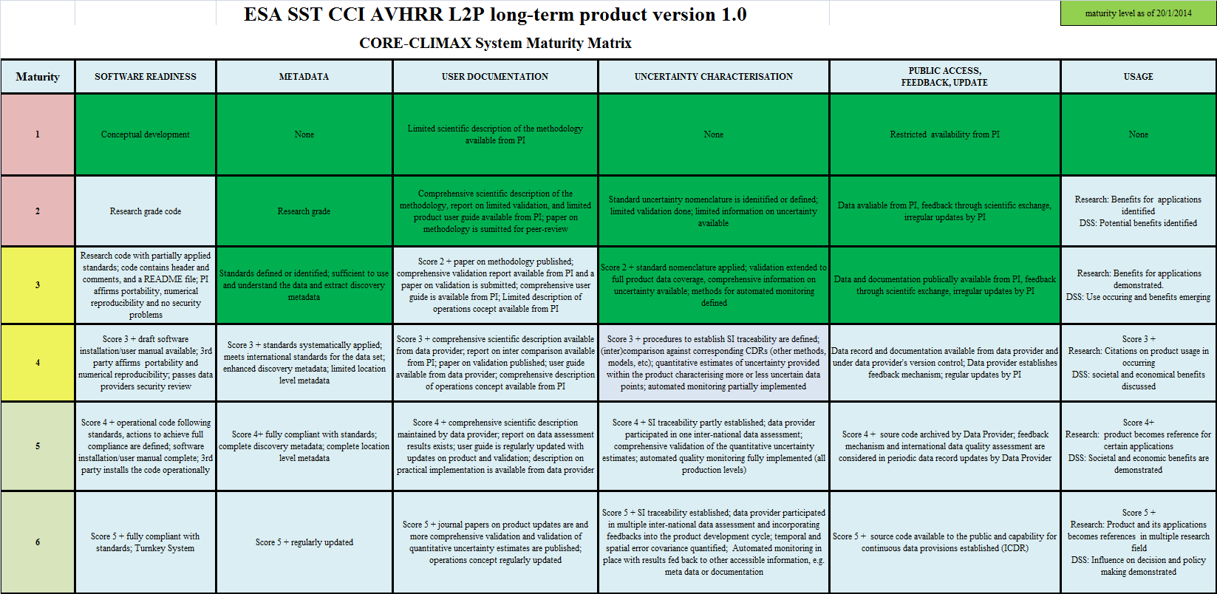
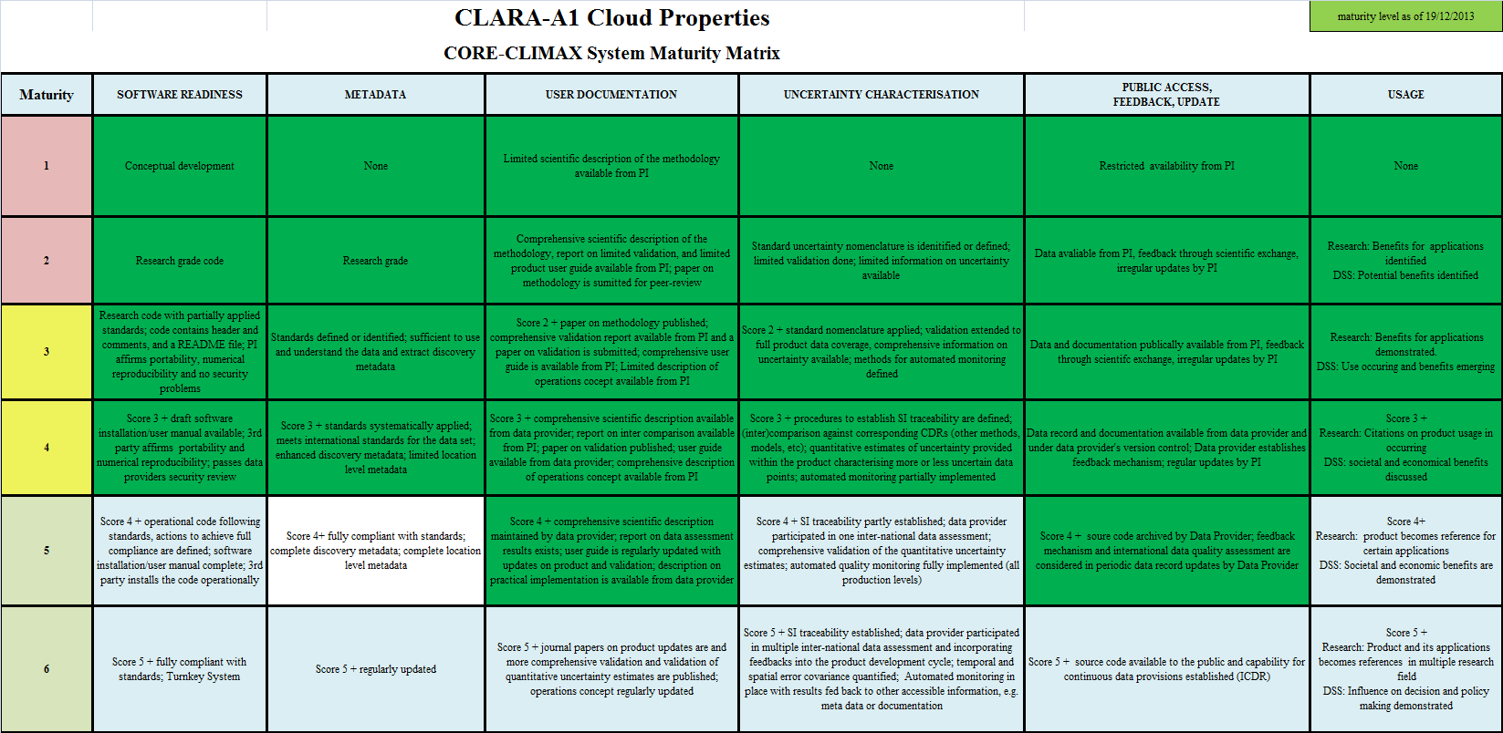
Maturing Takes Time The SMMs need to be applied regularly
TCDR ESA-CCI SST (~5 years)
MATURITY | SOFTWARE READINESS | METADATA | USER DOCUMENTATION | UNCERTAINTY CHARATERISATION | PUBLIC ACCESS, FEEDBACK, UPDATE | USAGE
1
2
3
4
5
6
MATURITY | SOFTWARE READINESS | METADATA | USER DOCUMENTATION | UNCERTAINTY CHARATERISATION | PUBLIC ACCESS, FEEDBACK, UPDATE | USAGE
1
2
3
4
5
6
TCDR CM-SAF Clouds (~12 years)

Slide 29
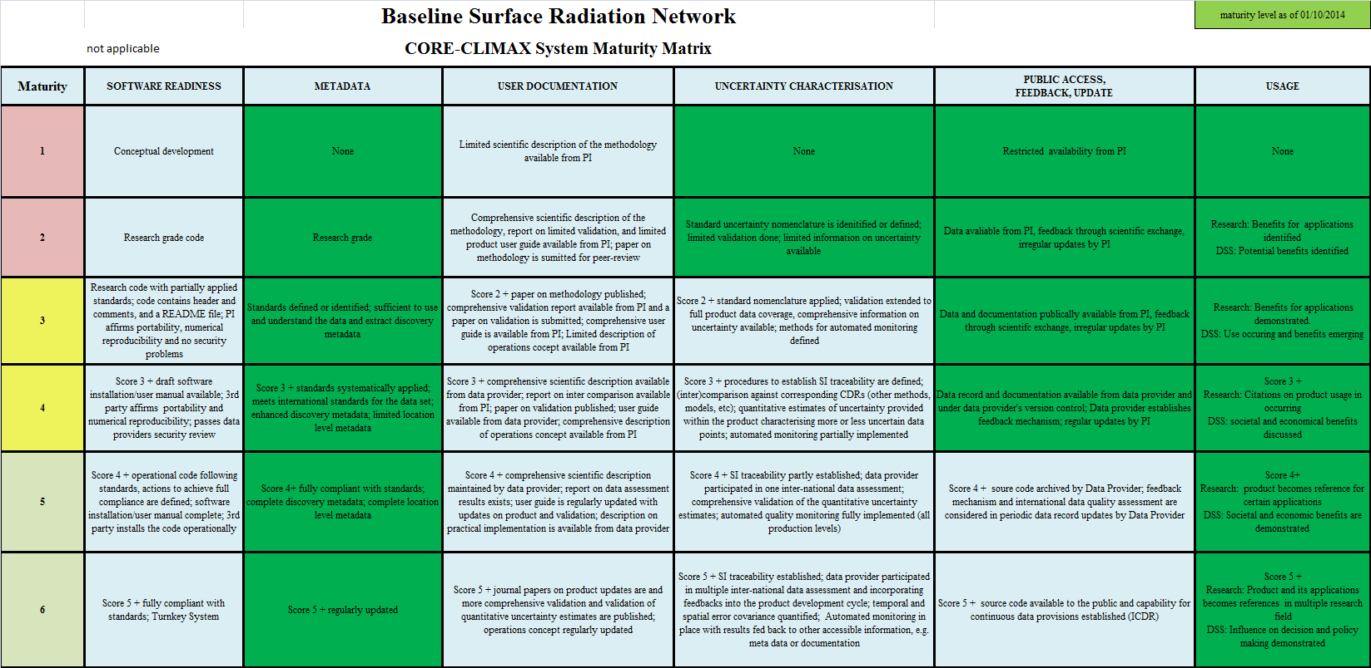
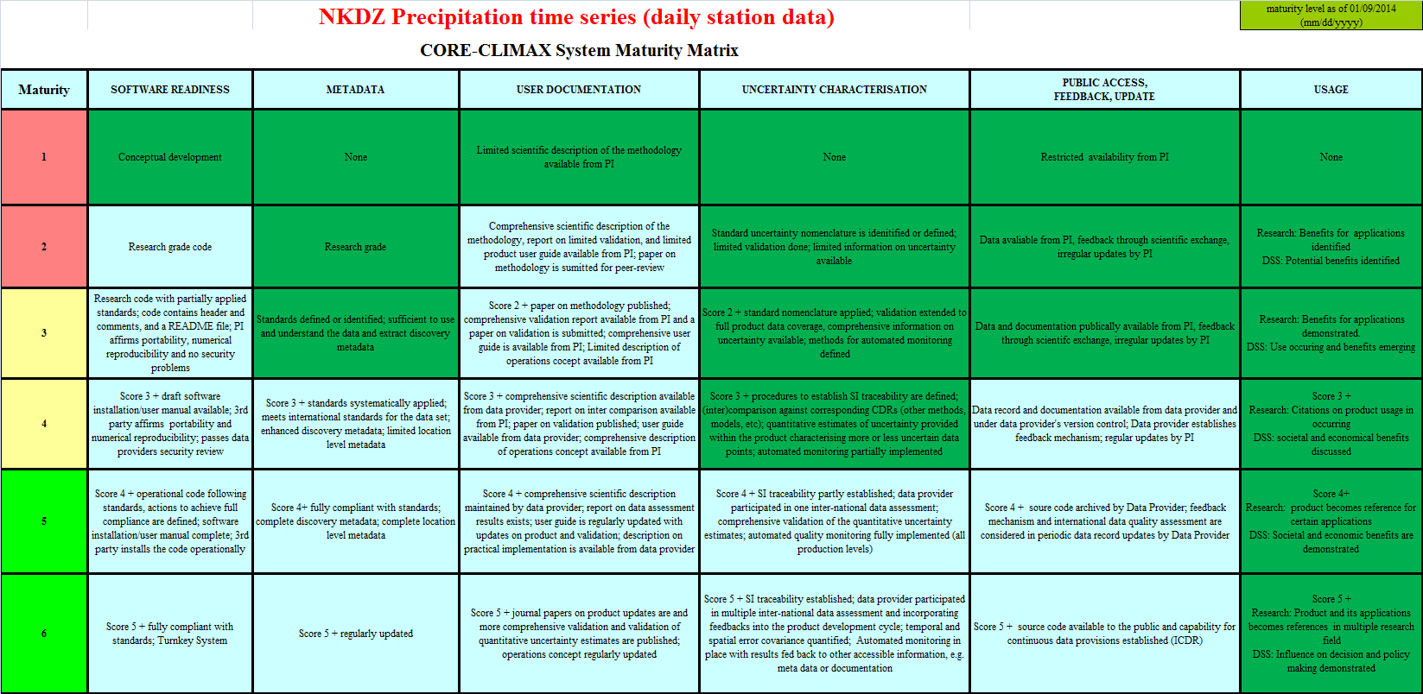
Is the Core-Climax SMM concept generally applicable? (In-situ, Satellite, and Reanalysis CDRs)
Baseline Surface Radiation Network (BSRN)
NKDZ Precipitation time series
Providers of SMMs for In-Situ CDRs initially indicated that the Software Readiness and User Documentation categories are not applicable to their data.

Slide 30
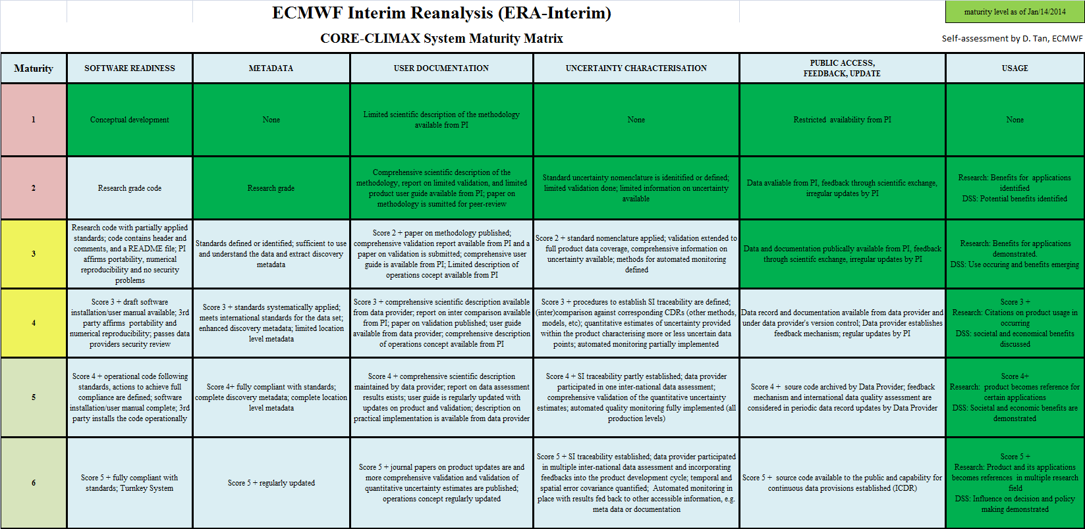
ERA-Interim (ECMWF)

Slide 31
Fitness for Purpose? Motivation for Application Performance Metric (APM)
SMM provides assessment of whether the data set can be sustainable in terms of engineering, science, archive, and usage aspects;
There is no guarantee that a data set with high System Maturity is suitable for all applications!
For example, data set X with over all System Maturity FIVE/SIX that provides DAILY mean humidity values is NOT suitable for assessing DIURNAL cycle of humidity in climate models;
How do we assess the performance of a data set for a particular application?

Slide 32
Support User’s to Select Data
User requirements collection exercises show a large variability in the stated requirements of users with nominally similar applications;
But a core set of typical questions may always be isolated:
Does the coverage of the record suffice ?
Are the observations of adequate quality ?
How does the quality vary in time ?
Is there sufficient level of detail ?
What methods were used to create the product?
What original observations were used in the product?
Coverage | Sampling | Uncertainty | Stability
Are the record length and spatial coverage meeting the application’s requirements? | Do the spatial and temporal sampling meet the applications requirements? | Do the random and systematic uncertainties meet the requirements? | Do the temporal and spatial stability meet the requirements?

Slide 33
General Concept of APM
Application Specific User Requirements
Database of CDR
Product Specification Tables
Boost the ECV Inventory?
CDRs matching the URs best
Notes:
Search through (query) a database to pick the right data for the application
Technical specifications of ECVs (e.g., ECV inventory)
User requirements Table

Slide 34
Workshop Exercise on Application Performance Metric
The Ocean breakout group considered the policy maker question: “Are there trends in North Sea Temperature over last 15 years that could affect fisheries?“
The question towards the APM is: “Which are the data records suited to analyse trends in this rather small region?”

Slide 35
Question-specific URT

Slide 36
Product Specification Table
Global value over 140 years
Tropical Pacific, 1995 to 2010

Slide 37
Scoring results
Score 1: matching threshold;
Score 2: matching target/breakthrough;
Score 3: matching optimum/goal
\* = treat with caution
Group concluded that for users “able to elucidate their requirements to a reasonable extent”, this table is actually the useful output
Suggestions of datasets they can look into further
Points them towards the trade-offs they need to think about in choosing between them

Slide 38
EU FP7 CORE-CLIMAX Assessment of European Capacity for CDRs
Events and activities after the CORE-CLIMAX workshop:
Project will continue to collect CDR self assessments from satellite and in situ data record providers until June 2014;
Project will evaluate the assessment results and report to the EC by December 2014;
ESA CCI endorsed the CORE-CLIMAX concept, stopped its own development and will provide self assessments of all CCI data records (50% of the projects delivered at WS);
Concept was presented by us at ECMWF Copernicus Climate Change Workshop, 17-18 February 2014, recommended to be further developed during Stage 0 of CCCS and used for the assessment of system performance in the CCCS in the EQC pillar.

Slide 39
Relation to GCOS Guidelines and Monitoring Principles

Slide 40
How well do we cover GCOS-143 Guidelines?
GCOS Guideline | Covered in
Full description of all steps taken in the generation of FCDRs and ECV products, including algorithms used, specific FCDRs used, and characteristics and outcomes of validation activities | Inventory and SMM on if its done
Application of appropriate calibration/validation activities | Inventory and SMM on if its done
Statement of expected accuracy (uncertainty), stability and resolution (time, space) of the product, including, where possible, a comparison with the GCOS requirements | Inventory or database for APM, SMM
Assessment of long-term stability and homogeneity of the product | SMM is informing if it has been done, APM is informing if sufficient quality has been reached
Information on the scientific review process related to FCDR/product construction (including algorithm selection), FCDR/product quality and applications7 | Inventory and Product Quality in APM
Global coverage of FCDRs and products where possible | Inventory and APM
Version management of FCDRs and products, particularly in connection with improved algorithms and reprocessing | SMM
Arrangements for access to the FCDRs, products and all documentation | SMM
Timeliness of data release to the user community to enable monitoring activities | Inventory and SMM
Facility for user feedback | SMM
Application of a quantitative maturity index if possible | Self evident
Publication of a summary (a webpage or a peer-reviewed article) documenting point-by-point the extent to which this guideline has been followed | Information in the Inventory and provided by SMM is almost the summary

Slide 41
Link to GCOS Climate Monitoring Principles
Nr. | GCOS Principle | Covered In
1. | The impact of new systems or changes to existing systems should be assessed prior to implementation. | Different Process
2. | A suitable period of overlap for new and old observing systems is required. | Inventory (ECV and FCDR), Impact in APM
3. | The details and history of local conditions, instruments, operating procedures, data processing algorithms and other factors pertinent to interpreting data (i.e., metadata) should be documented and treated with the same care as the data themselves. | SMM and Inventory
4. | The quality and homogeneity of data should be regularly assessed as a part of routine operations. | SMM, Impact in APM
5. | Consideration of the needs for environmental and climate-monitoring products and assessments, such as IPCC assessments, should be integrated into national, regional and global observing priorities | Different process
6. | Operation of historically-uninterrupted stations and observing systems should be maintained. | Different process, Impact in APM
7. | High priority for additional observations should be focused on data-poor regions, poorly-observed parameters, regions sensitive to change, and key measurements with inadequate temporal resolution. | Different process, Impact in APM
8. | Long-term requirements, including appropriate sampling frequencies, should be specified to network designers, operators and instrument engineers at the outset of system design and implementation. | Different process, Impact in APM
9. | The conversion of research observing systems to long-term operations in a carefully-planned manner should be promoted. | Different process
10. | Data management systems that facilitate access, use and interpretation of data and products should be included as essential elements of climate monitoring systems. | SMM

Slide 42
GCOS Principles Satellite Specific
Nr | GCOS Principle | Covered In
11. | Constant sampling within the diurnal cycle (minimizing the effects of orbital decay and orbit drift) should be maintained. | Different process, Impact in APM
12. | A suitable period of overlap for new and old satellite systems should be ensured for a period adequate to determine inter-satellite biases and maintain the homogeneity and consistency of time-series observations. | Different process, Impact in APM
13. | Continuity of satellite measurements (i.e. elimination of gaps in the long-term record) through appropriate launch and orbital strategies should be ensured. | Different process, Impact in APM
14. | Rigorous pre-launch instrument characterization and calibration, including radiance confirmation against an international radiance scale provided by a national metrology institute, should be ensured. | Different process, Impact in APM
15. | On-board calibration adequate for climate system observations should be ensured and associated instrument characteristics monitored. | Different process, Inventory (FCDR) has information, Impact in APM
16. | Operational production of priority climate products should be sustained and peer-reviewed new products should be introduced as appropriate. | Inventory, SMM and APM
17. | Data systems needed to facilitate user access to climate products, metadata and raw data, including key data for delayed-mode analysis, should be established and maintained. | SMM
18. | Use of functioning baseline instruments that meet the calibration and stability requirements stated above should be maintained for as long as possible, even when these exist on de-commissioned satellites. | Inventory (FCDR)
19. | Complementary in situ baseline observations for satellite measurements should be maintained through appropriate activities and cooperation. | Inventory
20. | Random errors and time-dependent biases in satellite observations and derived products should be identified. | SMM

Slide 43
Conclusion
Evaluation and Quality Control needs to consider both scientific and process quality expressed as maturity;
International data quality assessments performed/guided by research organisations such as WCRP, Future Earth and others need further support;
The set of tools (DRD, SMM and APM) provide consistent descriptions of Climate Data Records, allow for an assessment of completeness and supports users in the selections of data records for an application;
Because the SMM always needs interpretation it shall not be used for a beauty contest by adding up or averaging scores and ranking;
Metrics for scientific and process oriented assessments need further development;
Process maturity should periodically be assessed for ECV Climate Data Records entering climate (change) services;
Process maturity indicators for the subgroups might be added to the ECV inventory;
The ECV inventory might be changed into the searchable APM data base directly supporting users but not corrupting the gap analysis capability.

Slide 44
FUN
http://www.youtube.com/watch?v=IY2Sr8o9Jvk&index=5&list=PLzZYQ6ymGYEnv89_pTUUOFWKmN8LgOx4O

Slide 45
SPARE SLIDES

Slide 46
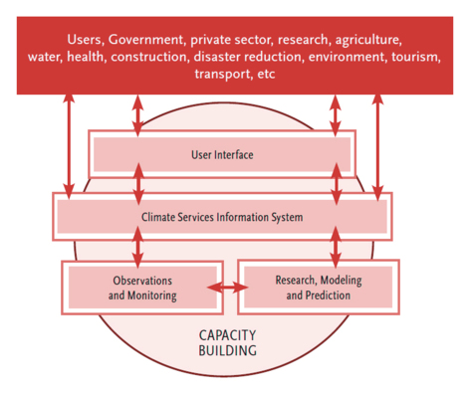
GFCS and Strategy for Space Based Climate Monitoring
Written by representatives from CEOS, CGMS and WMO;
Reviewed by GCOS, GEO and WCRP;
Intended audience: Space agencies, political and budget authorities, international coordinating mechanisms, and national/international programmes with a climate-related mandate.

Slide 47
Mapping European Potential for GCOS ECVs
Atmosphere |  | Ocean |  | Terrestrial
Composition |  | Surface
Aerosol Properties |  | Sea Surface Temperature |  | Land Cover
Methan & Long Lived GHGs |  | Sea Level |  | Fire Disturbance
Ozone |  | Sea Ice |  | Soil Moisture
Carbon Dioxide |  | Ocean Colour |  | Glacier and Ice Caps
Precursors (for Aerosol & O3) |  | Sea State |  | Ice Sheets
Upper Air |  | Current |  | Snow Cover
Cloud Properties |  | Sea Surface Salinity |  | Albedo
Temperature |  | Carbon Dioxide Partial Pressure |  | Leaf Area Index
Water Vapour |  | Phytoplankton |  | FAPAR
Wind Speed and Direction |  | Ocean Acidity |  | Lakes
Earth Radiation Budget |  | Sub Surface |  | Above Ground Biomass
Surface |  | Carbon |  | Permafrost
Surface Air Pressure |  | Current |  | Ground Water
Surface Air Temperature |  | Nutrients |  | River Discharge
Surface Precipitation |  | Ocean Acidity |  | Soil Carbon
Surface Radiation Budget |  | Oxygen |  | Land Surface Temperature
Water Vapour (Surface Humidity) |  | Salinity
Near-surface Wind Speed |  | Temperature
 |  | Tracers
 |  | Global Ocean Heat Content
EUMETSAT
CCI Started
CCI Scope

Slide 48
Sub Matrix – User Documentation
SOFTWARE READINESS | METADATA | USER DOCUMENTATION | UNCERTAINTY CHARATERISATION | PUBLIC ACCESS, FEEDBACK, UPDATE | USAGE
Formal description of scientific methodology | Formal Validation Report | Formal Product User Guide | Formal description of operations concept
Limited scientific description of methodology available from PI | None | None | None
Comprehensive scientific description available from PI and Journal paper on methodology submitted | Report on limited validation available from PI | Limited product user guide available from PI | None
Score 2 + Journal paper on methodology published | Report on comprehensive validation available from PI; Paper on product validation submitted | Comprehensive User Guide available from PI | Limited description of operations concept available
Score 3 + Comprehensive scientific description available from Data Provider | Report on inter-comparison to other CDRs, etc. Available from PI and data Provider; Journal paper on product validation published | Score 3 + available from data provider | Comprehensive description of operations concept available
Score 4 + Comprehensive scientific description maintained by data provider | Score 4 + Report on data assessment results exists | Score 4 + regularly updated by data provider with product updates and/or new validation results | Operations concept and description of practical implementation available
Score 5 + Journal papers on product updates published | Score 5+ Journal papers more comprehensive validation, e.g., error covariance, validation of qualitative uncertainty estimates published | Score 5 | Score 5 + Operations concept regularly updated
❶
❷
❸
❹
❺
❻

Slide 49
Sub Matrix – Public Access,
Feedback and Update
SOFTWARE READINESS | METADATA | USER DOCUMENTATION | UNCERTAINTY CHARATERISATION | PUBLIC ACCESS, FEEDBACK, UPDATE | USAGE
Public Access/Archive | Version | User Feedback Mechanism | Updates to Record
Data may be available through request to PI | None | None | None
Data available through PI | Preliminary versioning by PI | PI collects and evaluates feedback from scientific community | Irregularly by PI following scientific exchange and progress
Data and documentation archived and available to the public from PI | Versioning by PI | PI and Data provider collect and evaluate feedback and from scientific community | Irregularly by PI following scientific exchange and progress
Data and documentation archived and available to the public from Data Provider | Version control institutionalised | Data provider establishes feedback mechanism such as regular workshops, advisory groups, user help desk, etc. and utilises feedback jointly with PI | Regularly by PI utilising input from established feedback mechanism
Score 4 + source code archived by Data Provider | Fully established version control considering all aspects | Established feedback mechanism and international data quality assessment results are considered in periodic data record updates | Regularly operationally by data provider as dictated by availability of new input data or new methodology following user feedback
Score 5 + source code available to the public from Data Provider | Not used | Score 5 + Established feedback mechanism and international data quality assessment results are considered in continuous data provisions (Interim Climate Data Records) | Score 5 + capability for fast improvements in continuous data provisions established (Interim Climate Data Records)
❶
❷
❸
❹
❺
❻

Slide 50
Sub Matrix - Usage
SOFTWARE READINESS | METADATA | USER DOCUMENTATION | UNCERTAINTY CHARATERISATION | PUBLIC ACCESS, FEEDBACK, UPDATE | USAGE
Research | Decision Support System
None | None
Benefits for research applications identified | Potential benefits identified
Benefits for research applications demonstrated by publication | Use occurring and benefits emerging
Score 3 + Citations on product usage occurring | Score 3 + societal and economical benefits discussed
Score 4 + product becomes reference for certain applications | Score 4 + societal and economical benefits demonstrated
Score 5 + Product and its applications becomes references in multiple research field | Score 5 + influence on decision (including policy) making demonstrated
❶
❷
❸
❹
❺
❻

