Slide 1
Committee on Earth Observation Satellites
Gap Analysis
Robert Husband & John Dwyer

Slide 2
GAP ANALYSIS
CONTENTS
Endorsement of Gap Analysis Guidelines (RH)
Gap Analysis in Action (JD)
Schedule for Cycle #2 Gap Analysis (RH)
Gap Analysis Cycle #2 Implementation Roles (JD)

Slide 3
ENDORSEMENT OF
GAP ANALYSIS GUIDELINES
BACKGROUND
In 2015 several “Thin Slice” gap analyses were performed on subsets of the ECV Inventory
A reference Gap Analysis Guide has now been defined that combines the original vision for the gap analysis with the experiences of the “Thin Slice” gap analyses
The Gap Analysis Guide was distributed in advance of the meeting as, we need an agreed way forward for the implementation of the Cycle #2 gap analysis as an outcome of this meeting, i.e.:
Endorsement of Gap Analysis and Questionnaire Guides (interlinked)
Agreement on Gap Analysis Schedule (gap analysis to be completed before next WG meeting!)
Agreement on Gap Analysis implementation roles

Slide 4
ENDORSEMENT OF
GAP ANALYSIS GUIDELINES
CONTENTS OF GAP ANALYSIS GUIDELINES
Based on a slightly re-worked version of the contents of the ECV inventory (as reflected in the ECV Inventory Questionnaire Guide)
General intention is to expose in a systematic way the degree of compliance of the ECV Inventory Records with the GCOS requirements
Slightly different gap analysis processes are defined for the current and future components fof the ECV Inventory
Guidelines have been designed to feed into, and partially anticipate, the next step in the cycle – the development of the Coordinated Action Plan
The gap analysis process has been partially validated through a re-mapping of the output of the “Thin Slice” gap analysis results, and was judged “fit-for-purpose”

Slide 5
ENDORSEMENT OF
GAP ANALYSIS GUIDELINES
CONTENTS OF GAP ANALYSIS GUIDELINES - CTD
#2: Gap Typologies and Hierarchies (Gap Trees for Current and Future components of the Inventory)
#3.1: General constraints/considerations on gap analysis implementation process (completeness consistency of the inventory, maintaining a log of gap analysis experiences/lessons learnt, inputs to coordinated action plan, grouping of ECV products, standardisation of approach, use of tools)
#3.3: Gap analysis process - current component of ECV Inventory
#3.4: Gap analysis process - future component of ECV Inventory
#4: Documentation of Results
#5: Potential issues to be addressed in the Cycle #3 gap analysis

Slide 6
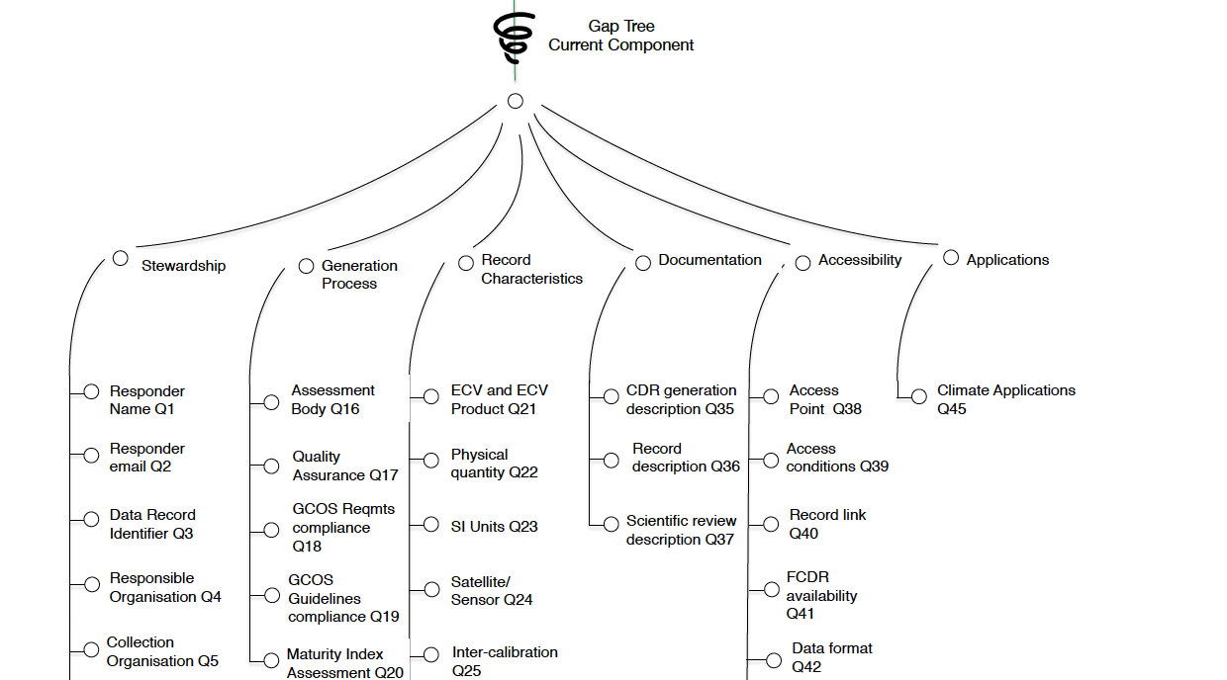
ENDORSEMENT OF
GAP ANALYSIS GUIDELINES
CONTENTS OF GAP ANALYSIS GUIDELINES - CTD

Slide 7
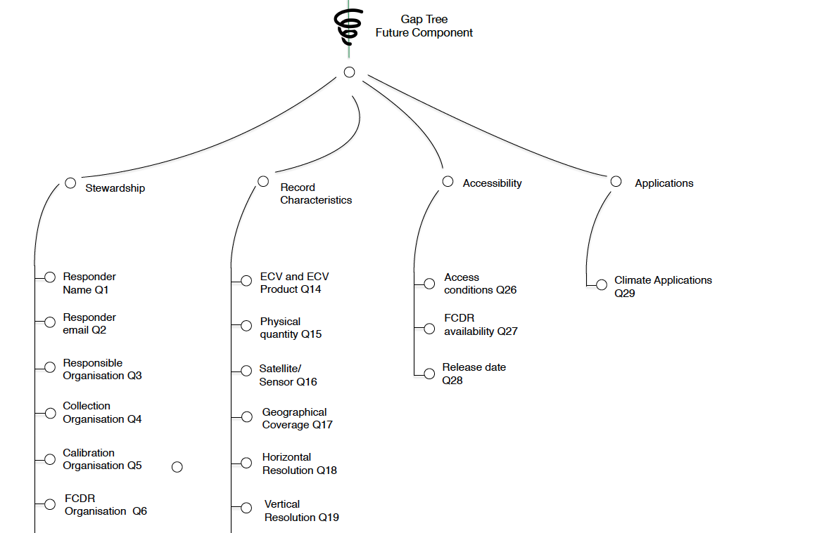
ENDORSEMENT OF
GAP ANALYSIS GUIDELINES
CONTENTS OF GAP ANALYSIS GUIDELINES - CTD

Slide 8
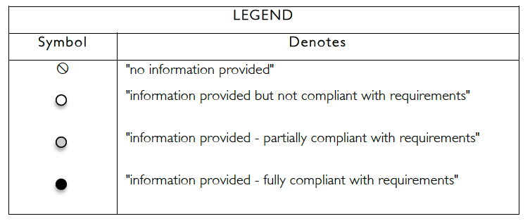
ENDORSEMENT OF
GAP ANALYSIS GUIDELINES
CONTENTS OF GAP ANALYSIS GUIDELINES - CTD

Slide 9
ENDORSEMENT OF
GAP ANALYSIS GUIDELINES
COMMENTS/QUESTIONS…..
ENDORSEMENT OF GUIDELINES?
(recognising that there is a lesson learnt process to feed the future evolution of the guidelines ….. they are not “cast-in-stone”)

Slide 10
GAP ANALYSIS IN ACTION
Gap Analysis in Action – Mapping of the Thin Slice Gap Analysis Results onto the Gap Analysis Guidelines

Slide 11
GAP ANALYSIS IN ACTION
Landsat Land Surface Temperature
CDR Family
CDR_TM_LST (Landsat 4 & 5)
CDR_ETM_LST (Landsat 7)
CDR_TIRS_LST (Landsat 8)
Gap category: Future Records

Slide 12
GAP ANALYSIS IN ACTION
Stewardship
Responder: John Dwyer, U.S. Geological Survey (USGS)
Responder’s email: dwyer@usgs.gov
Responsible organization: USGS
Collection organization: USGS
Calibration organization: USGS and NASA
FCDR organization: USGS
Inter-calibration Organization: USGS and NASA
TCDR organization: USGS
GCOS compliance organization: Unknown
Independent peer-review organization: Unknown
Archiving organization: USGS
User service organization: USGS
User feedback organization: USGS

Slide 13
GAP ANALYSIS IN ACTION
Record Characteristics
ECV and ECV product: Land surface temperature
Physical quantity: Kelvin
Satellite/sensor combination: Landsat 4 & 5 TM
Landsat 7 ETM+
Landsat 8 TIRS
Geographic coverage: North America (constrained by available atmospheric characterization data, NARR). Global coverage using MERRA under consideration.
Horizontal resolution: CDR_TM_LST – 120m
CDR_ETM_LST – 60m
CDR_TIRS_LST – 100m
*Products are resampled to 30m resolution for compatibility with solar reflective bands
Vertical resolution: NA

Slide 14
GAP ANALYSIS IN ACTION
Record Characteristics (continued)
Temporal resolution: 16-days (for each platform/sensor)
8-days (two platforms/sensors in operation)
Accuracy: to be determined
Stability: to be determined
Vertical Resolution: NA
Start date: CDR_TM_LST – July, 1982
CDR_ETM_LST – April, 1999
CDR_TIRS_LST – March, 2013
End date: CDR_TM_LST – November, 2011
CDR_ETM_LST – present
CDR_TIRS_LST – present
TCDR heritage: CDR_TM_LST – new release
CDR_ETM_LST – new release
CDR_TIRS_LST – new release

Slide 15
GAP ANALYSIS IN ACTION
Accessibility
Access conditions: free and open access
FCDR availability: yes, free and open access
Release date: TBD; release is phased as provisional (stakeholder evaluation) then operational (on-demand)

Slide 16
GAP ANALYSIS IN ACTION
Climate Applications
Evapotranspiration modeling
Irrigation consumptive water sue
Energy balance modeling
Ecosystem modeling
Drought impacts and response

Slide 17
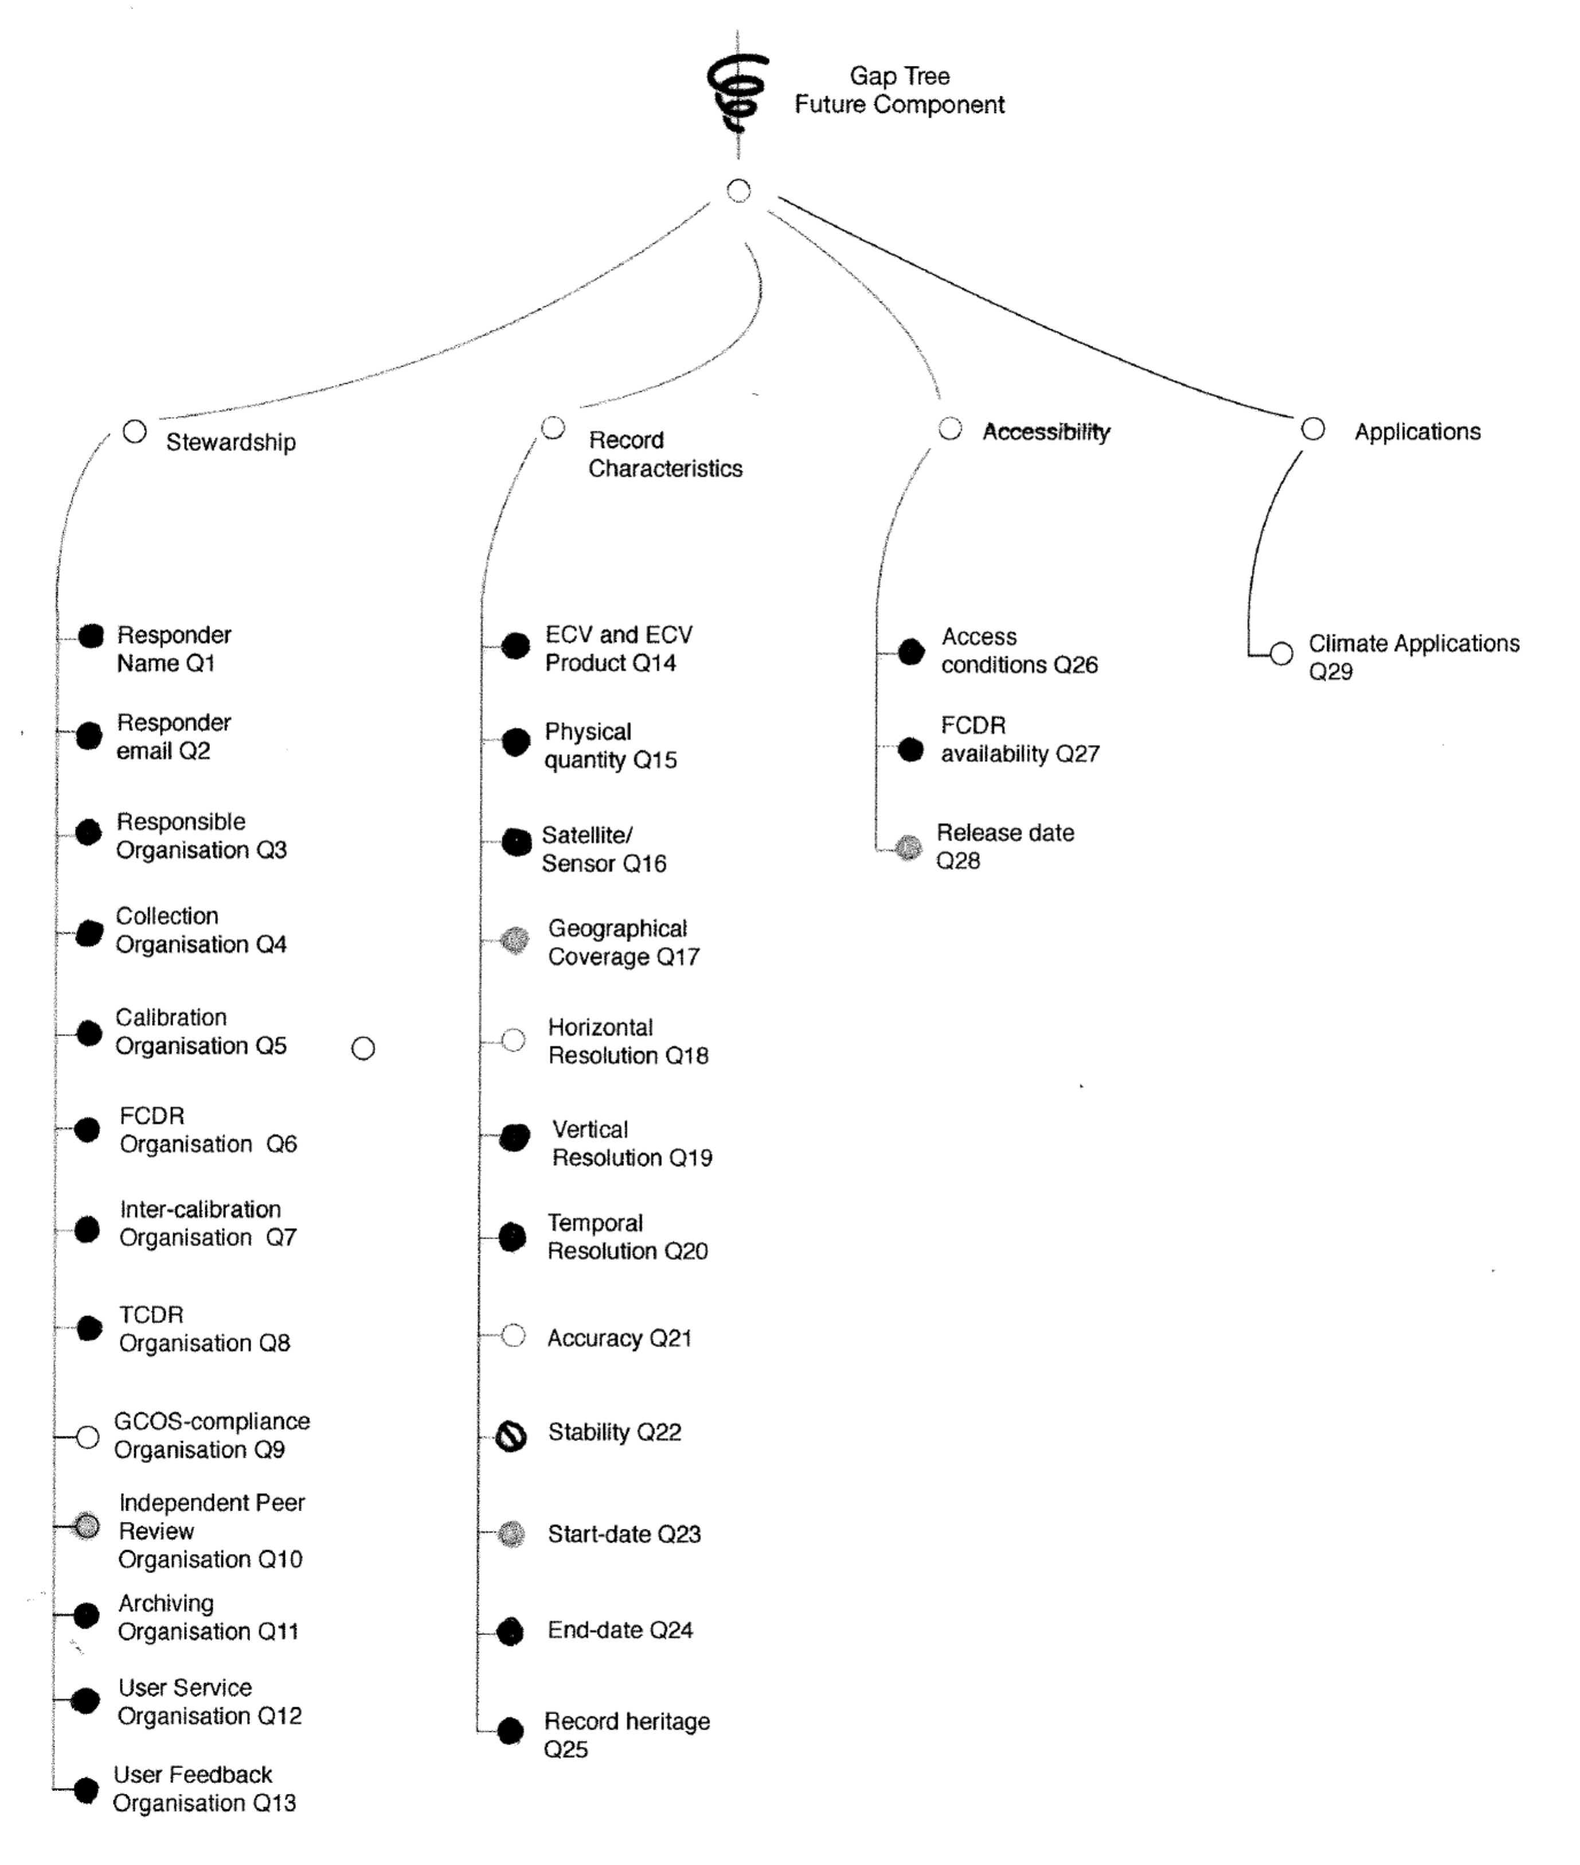
GAP ANALYSIS IN ACTION

Slide 18
SCHEDULE FOR CYCLE #2 GAP ANALYSIS
Until mid-Sept 2016: Collection of updated information from data providers
Mid-Sept to 1 Nov 2016: Quality control of information from data providers and ingestion into inventory
1 Nov 2016 to end-Feb 2017: Performance of Gap Analysis
1 March 2017 to June 2017: Generation of a Coordinated Action Plan

Slide 19
CYCLE #2 GAP ANALYSIS
IMPLEMENTATION ROLES
Need to define the Gap Analysis implementation team as an outcome of this meeting, i.e.:
Overall Gap Analysis Coordinator – oversees the whole gap analysis process, ensures consistency of approach across teams (i.e. as per #3.1.5 of the guidelines), integrates team outputs into an overall Gap Analysis Report (i.e. as per #4 of Guidelines) – this role will be filled by the Chair Team
Domain Gap Analysis Team Leaders – responsible for coordinating the gap analysis activities (i.e. implementation of #3.3 and #3.4 of guidelines) for ECV products falling within their allocated domain – domain assumed to be Land, Ocean and Atmosphere – but to be confirmed
Domain Team Members: responsible for implementing the gap analysis process (i.e. implementation of #3.3 and #3.4 of guidelines) for the records associated to their allocated ECV products

Slide 20
CYCLE #2 GAP ANALYSIS
IMPLEMENTATION ROLES
What do we have so far?
Gap Analysis Coordinator: to be supplied from the Chair Team
Land: John Dwyer, WGCV LPV (Pascal to investigate), EC/JRC (Mark to investigate), Isabel Trigo (Joerg to investigate), Stephan Bojinsky (if needed), Global Cryosphere Watch +……..?
Atmosphere: Stephan Bojinsky (TBC), Wenying Su, Rainer Hollmann (TBC), + (EUM SAFs, CGMS WGs, SCOPE-CM – Joerg to investigate these 3 options), Daniel Vila, Raj Kumar (placeholder) + ……?
Oceans: Chris Merchant (TBC), Rosa Barciela (TBC), Raj Kumar (placeholder) + …….?
+ VC Constellation Participation and other CEOS participation (to be investigated by Pascal at SIT)

Slide 21
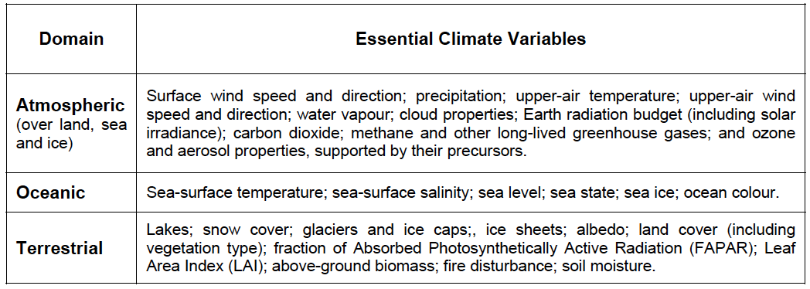
CYCLE #2 GAP ANALYSIS
IMPLEMENTATION ROLES
Extract of table from GCOS 2011 Satellite Supplement:

