Slide 1
Sustained, Co-Ordinated Processing of Environmental Satellite Data for Climate Monitoring: Status, Implementation Plan
Marie Doutriaux-Boucher
EUMETSAT and SCOPE-CM Secretariat
Ed Kearns
NOAA-NESDIS and SCOPE-CM Chair

Slide 2
SCOPE-CM background
The aim of the Sustained, Co-Ordinated Processing of Environmental Satellite Data for Climate Monitoring (SCOPE-CM) is to enable a network of facilities ensuring continuous and sustained provision of high-quality dataset for climate monitoring.
The foundation of SCOPE-CM is the network of relevant space agencies and other organizations (including GSICS) with the aim to develop, extend and preserve the capabilities and skills of generating and re-generating Climate Data Records (CDR).

Slide 3
SCOPE-CM background
Users
UNFCCC
GCOS
Consolidated requirements
WG
Climate
Inventory ECVs/CDRs

Slide 4
Conceptual view of the end-to-end system for the exploitation of satellite observations for climate monitoring
SCOPE-CM is one component of an end-to-end system with the final objective of climate monitoring having the satellite observations represented by the WMO Integrated Global Observing System at one end and the CDR user community at the other end.
CDR is defined as a time series of measurements of sufficient length, consistency, and continuity to determine climate variability and change.
FCDR = a homogeneous long-term dataset of radiances/BT/bending angles encompassing different sensors and platform with spatial and temporal overlaps.
TCDR = geophysical variables derived from the FCDR that can be understood as a satellite product associated with an ECV.

Slide 5
WMO’s SCOPE-CM initiative
Coordinated international network to produce CDRs from multi-agency mission data in operational environment addressing GCOS requirements
Current Participants of the SCOPE-CM Network
Operational Satellite operators:
EUMETSAT, NOAA, JMA, IMD, CMA, KMA
Stakeholders:
WMO Space Programme, GCOS, CEOS, GEO, CGMS/GSICS, WCRP/GEWEX, ESA (observer)

Slide 6
SCOPE-CM two phases project
Phase 1 (2009-2013) – Establishing international collaborations, network and structure and establishing the standards
→ successfully completed
Phase 2 (2014-2019) – Sustained production of Climate Data Records
→ in progress…
Identify connections to User Requirements
Seek efficiencies in CDR production through collaborations

Slide 7
Phase 2: Sustained production of CDR
Objectives:
Establish a systematic approach to increase the sustainability (maturity) of CDR generation capabilities;
Establish structures for sustainable generation of Fundamental CDRs and Thematic CDRs.
Mechanisms:
Initiate Phase-2 projects;
Generate SCOPE-CM CDR products;
Increase coverage of products in terms of ECVs, time and spatial dimension;
Foster extension of the network to additional partners.
Benefits for space agencies (and associated institutes):
Ensures their role in the field of climate data stewardship;
Improves their capacity to deliver data services for Global Climate Services;
Improves their capacity to serve the scientific community.
Serves their national’s and international user requirements

Slide 8
Project life cycle
SCM project proposal
Maturity matrix model
Algorithms & documents
SEP
decision
CDR
Maturity assessment review
CDR with assigned maturity
SCM project activities
SEP
decision

Slide 9
System maturity matrix for assessing the generation system of CDRs with respect to its sustainability
Is the software robust and maintainable?
Are the data and methods well documented?
Has the uncertainties of the data been systematically assessed?
Are the data well used and user feedbacks taken care of?
The MM does not describe the CDR quality per se, but the quality of the CDR generation capabilities with respect to its sustainability. The quality of the CDR depends on the intended application.

Slide 10
SCOPE-CM CDR life cycle based on maturity matrix
High maturity
The CDR life cycle is iterative, with improved understanding and utility as maturity increases
6
High Maturity
SCOPE-CM Projects
(Full Operations Capability)
5
4
Moderate Maturity
SCOPE-CM Projects
(Operations Capability)
3
2
Initial Maturity
SCOPE-CM Projects
(Research Capability)
1
Low maturity

Slide 11
FCDRs addressed in phase 2 projects
(5+ years project)
EUMETSAT CM-SAF
(SMHI, KNMI)
NOAA/NESDIS
ESA-CLOUD-CCI
ESA-SST-CCI
AVHRR GAC
MODIS
HIRS
5
Improved AVHRR FCDR
(5 years project)
HIRS,AIRS,IASIMETEOSAT
GOES
MTSAT
FY-2
EUMETSAT
CM-SAF (DWD)
NOAA NCDC
JMA
CMA
IMD
KMA
6
GEO FCDR (VIS, IR, WV)
(5 years project)
CHAMP, COSMIC, Metop/GRAS
+ECMWF (ERA Interim)
ROMSAF(DMI) Met Office
ECMWF Moog
EUMETSAT UCAR
GFZ SS&E
WEGC
RO
8

Slide 12
TCDR addressed in phase 2 projects
EUMETSAT
CM-SAF (Meteo Swiss)
NOAA-NCDC
JMA
(5 years project)
METEOSAT
GOES
HIMAWARI
Surface albedo
(GEO)
3
CMSAF-FMI
NOAA
Univ. Massachussetts
EUMETSAT
(3 years project)
AVHRR
MODIS
Surface albedo
(LEO)
2
Notes:
LEO Terikhi Manninen

Slide 13
TCDR addressed in phase 2 projects
(4 years project)
NOAA-NESDIS
Kiruna Univ
NCAR
Met Office
DWD
Miami Univ
HIRS
AMSU/B
MHS
MVIRI
SEVIRI
UTH/FTH
1
ROMSAF(DMI) Met Office
ECMWF Moog
EUMETSAT UCAR
GFZ SS&E
WEGC
(5 years project)
CHAMP, COSMIC, Metop/GRAS
+ECMWF (ERA Interim)
RO
8

Slide 14
TCDR addressed in phase 2 projects
(5+ years project)
NOAA NCEI
JMA, MSC
EUMETSAT
CMA
INPE
City College New York
GEO and LEO (VIS and IR)
Cloud product (ISCCP)
9
JMA
MSC
EUMETSAT
NOAA NCDC
(5 years project)
LEO and GEO
AMV
ASR
CSR
10

Slide 15
TCDR addressed in phase 2 projects
NOAA
CSU
EUMETSAT CM-SAF
(3 years project)
MODIS/AMSR/CloudSat
SSM/I SSMIS
GPM
LWP & RWP
from MW
7

Slide 16
Projects interactions
GSCIS
IOGEO (VIS IR FCDR)
AVHRR FCDR
6
5
UTH/FTH
1
Albedo (GEO)
Albedo (LEO)
3
2
ISCCP
9
AMV, ASR, CSR
10
RO
8
USERS
LWP RWP
7

Slide 17
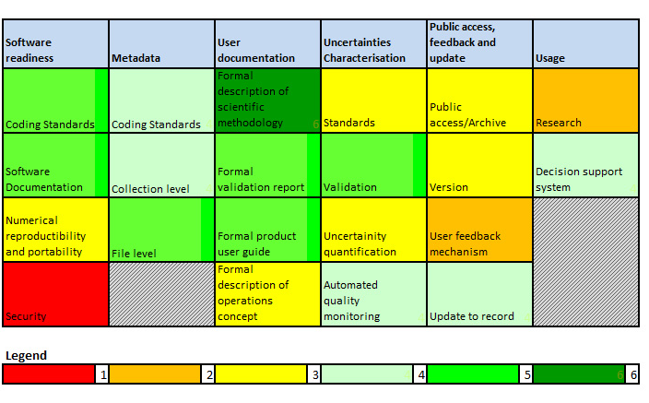
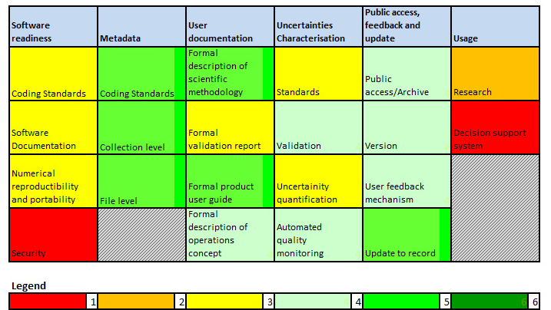
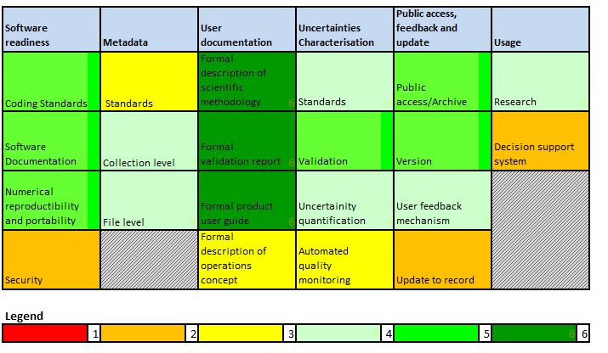
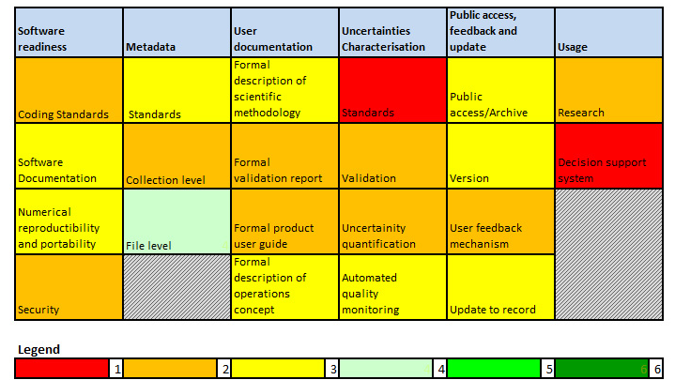
Projects maturity – self assessment
SCM01 UTH polar TCDR
SCM01 UTH MeteosatTCDR
SCM03 Albedo GEO TCDR
SCM05 AVHRR FCDR

Slide 18
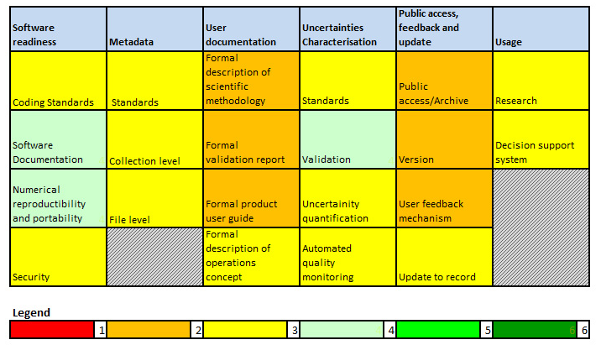
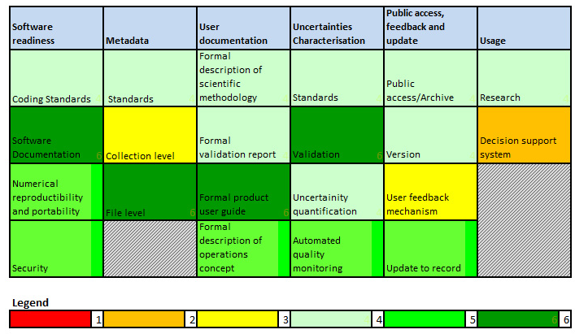
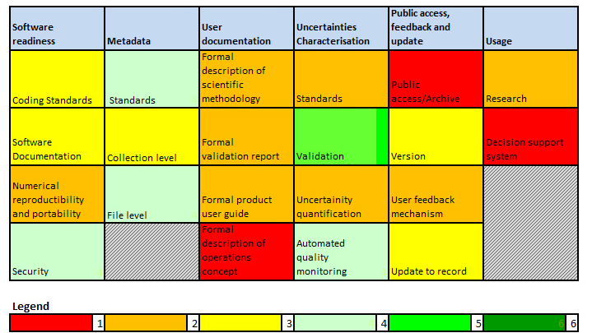
Projects maturity – self assessment
SCM06 VIS/IR FCDR
SCM08 RO TCDR
SCM10 AMV TCDR

Slide 19
Conclusion
The SCOPE-CM phase-2 is successfully entering its third year. 7 TCDR are/will be generated.
The SCOPE-CM Projects are developing 3 FCDRs that will both have a useful past record and are sustainable given the anticipated observing system of the future:
GEO-Ring IR and Visible FCDR (30+ years)
AVHRR IR and Visible FCDR (30+ years)
RO Bending Angles (13 years)
There are also a number of other FCDRs from SCOPE-CM collaborators that are available but not as SCOPE-CM collaborative products (e.g. HIRS Ch 12 BT, SSMI-SSMI/S).
The SCOPE-CM ECVs/TCDRs that depend on these include many from ISSCP, albedo, UTH, etc. but there are many more candidates (LST, SST, sea ice, snow cover). We can help call these out in the WG Climate analysis.
It s very important that SCOPE-CM activities continued to be supported.
It is crucial to be able to have access to additional existing satellite data (e.g. Indian Ocean GEO data) to close gaps in coverage.

Slide 20
Future plan
SCOPE-CM has a unique value to foster multi-agency collaboration and sustainability of processing.
Next phase/direction for SCOPE-CM are being setup in 2016 (next SEP meeting in September 2016 during the EUMETSSAT conference).
To prove that SCOPE-CM has establish structures for sustainable generation of multiagency Fundamental CDRs and Thematic CDRs – project FCDR/TCDR delivery –
To consider the feasibility of operational production of sustained ICDRs to meet emerging requirements – latency, quality –
To identify future CDRs Based on the CEOS-WGC recommendation

Slide 21
Thank you !

