Slide 1
Agile Development and the Scaled Agile Framework
July 31, 2018
Dana Shum
Software Engineering Manager

Slide 2
Agenda
Agile Development Overview
Agile Manifesto
Scrum Key Concepts
Scaled Agile Framework
Roles
Flow of Work
Program Increment Planning

Slide 3
Agile Development Overview
Notes:
~29% of waterfall projects failed
Software is hard
After watching project after project finish late, with bugs and with features that were not used, it was time for a change.
Around 2000, Agile Manifesto was written to attempt to rethink how we were doing software.

Slide 4
Agile Manifesto
We are uncovering better ways of developing software by doing it and helping others do it. Through this work we have come to value:
Individuals and interactions over processes and tools Working software over comprehensive documentation Customer collaboration over contract negotiation Responding to change over following a plan
That is, while there is value in the items on the right, we value the items on the left more.
http://agilemanifesto.org/

Slide 5
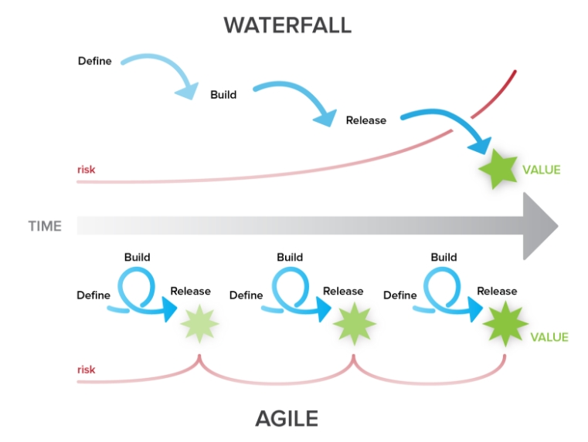
Scrum Key Concepts
Iterative Development
Two week “sprints” consist of planning, implementation, integration and testing
Daily 15 minute team “scrums” to remove blockers
Teams demo working software at the end of every sprint
Teams evaluate their product and their processes at the end of every sprint to make adjustments
https://blog.ganttpro.com/en/waterfall-vs-agile-with-advantages-and-disadvantages/
Notes:
Many flavors of Agile, for our program, we chose to use the very popular “Scrum” methodology

Slide 6
Scrum Key Concepts (Cont.)
Rethink requirements
Rephrase what needs to be done
Requirements - “The system shall <do something>”
User Story - “As a <user>, I want to <do something> so that I can <accomplish a goal>”
As a scientist, I want to search by the name of a lake so that I can quickly find only the data relevant to my research.
Allows developers to understand the systems from the user’s perspective
Use “Story Points” instead of hours to estimate in order to account for uncertainty and risk
Notes:
Many flavors of Agile, for our program, we chose to use the very popular “Scrum” methodology

Slide 7
Scrum Key Concepts (Cont.)
Cross-Functional Teams
Ideal team size is 7 +/- 2 people
Team Roles
Product Owner: Customer or end user representation in the team
Scrum Master: Focuses on efficiencies and process
Developers: Write code
Tester: Tests the code
DevOps: Ensures code is easily deployed and operational
Systems Engineer and/or Architect are often included in the team

Slide 8
Solving Harder Problems Faster
Our program was fairly good at using agile methodologies inside of 1 team working on 1 system, but we struggled to get multiple teams aligned to accomplish the more complex and powerful features that the Earth Science community needs
Scaled Agile Framework (SAFe) claimed to help us take agile methodologies to the enterprise level to solve harder problems, faster, with better quality
Notes:
Had problems: Didn’t understand the bigger picture. Missed dependencies. Silo’d teams. Problems discovered late.
We wanted: Vision. Open communication at all levels. Collaborative work environment.
Current SAFe Process
EED system/software development centric, meeting the needs of EED development efforts as intended
Executing for over a year and a half with continual evolutions
One very large 100+ person train and growing, not all participating projects have connections to coordinate in this process

Slide 9
SCALED AGILE FRAMEWORK

Slide 10
The Claims
10-50% happier, more motivated employees
30-75% faster development
25–75% defect reduction
20-50% increased productivity
https://www.scaledagileframework.com/case-studies

Slide 11
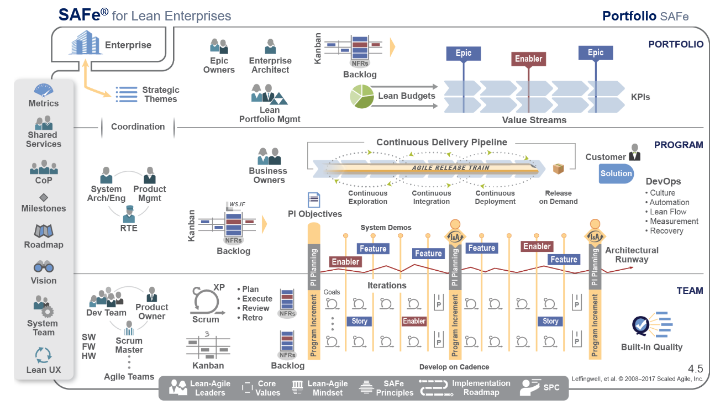
The Scaled Agile Framework (SAFe)
SAFe is a “lean-Agile software and systems development process at the enterprise scale. SAFe synchronizes alignment, collaboration, and delivery for large numbers of Agile teams.”
http://www.scaledagileframework.com
11
Notes:
OVERVIEW: In this slide, you can explain that, at first glance, the Framework may appear complicated. However, you can provide assurance that you will take them through it in a logical manner.
This is what is referred to as the “SAFe Big Picture”. At first, it may look complicated, but as we will see, it is actually a very straight-forward and logical representation.
We will see that roles, artifacts, and activities are clearly defined based on proven principles and practices.
Decomposing the SAFe Big Picture into it’s constituent parts, we’ll discover that it’s a simple, powerful and easily understood framework for managing complex software and systems development.
Core Values:
Alignment: vision, cadence
Built in Quality: CI/CD, Automated Test, refactoring
Transparency: full JIRA visibility, honest communication, frequent demos and integrations
Program Execution: Deliver working code!

Slide 12
Lean-Agile Mindset
http://www.scaledagileframework.com/lean-agile-mindset

Slide 13
SAFe Roles
Flow of Work
Program Increment Planning

Slide 14
Levels of SAFe
Cross-Train Coordination
Train Coordination
Agile Team Coordination
(Normal)
Notes:
OVERVIEW: Introduce the Portfolio, Value Stream, Program, and Team levels. The Enterprise icon is highlighted to represent the connection between the enterprise business strategy and a SAFe Portfolio
SAMPLE SPEAKER NOTES:
Here we see the threelevels of SAFe: Portfolio, Program, and Team.
In the small to midsize enterprise, one SAFe portfolio can typically be used to govern the entire technical solution set. In the larger enterprise (those with more than 500 – 1,000 technical practitioners), there can be multiple SAFe portfolios, one for each line of business.
Each SAFe portfolio contains a set of Value Streams and the additional elements necessary to provide funding and governance for the products, services, and Solutions that the Enterprise needs to fulfill some element of the business strategy.
The Value Stream Level is intended for builders of large and complex solutions that typically require multiple ARTs, as well as the contribution of Suppliers. It is intended for enterprises that face the largest systems challenges, building multidisciplinary and cyber-physical systems that contain software, hardware, electrical and electronic, optics, mechanics, fluidics, and more. Not all organizations will need the Value Stream Level. (NOTE: If you are able to access the Scaled Agile Framework website, this would be a good time to demo the expand/collapse button)
The Team and Program Levels make up the long-lived, self-organizing virtual organization known as the Agile Release Train (ART). Without teams, there can be no program. The ART plans, commits, and executes together. The “Agile Release Train” metaphor is used to communicate several key concepts:
The train departs the station and arrives at the next destination on a reliable schedule, which provides for fixed cadence, standard ART velocity, and predictable planning (and in many cases, cadence-based releases).
All “cargo,” including prototypes, models, software, hardware, documentation, etc., goes on the train.

Slide 15
SAFe Roles – Team Level
Scrum Master
Facilitates team ceremonies, drives efficiencies and protects the team from outside disturbances. Represents the team at Scrum of Scrums.
Product Owner
Defines and accepts user stories. Represents the voice of the stakeholders to answer development questions quickly. Develops roadmaps which enable the team to meet stakeholders needs.
Development Team
Help define user stories and plan sprints. Design, implement and test the functionality in addition to maintaining their operational system
Notes:
Team: software developers, Sas, security experts, DBAs, systems engineers, operations

Slide 16
Team Structure
Organize teams to reduce external dependencies and handoffs. Two successful ways to do this are:
Component Teams
Feature Teams
Teams can be reorganized based on the features needing to be built.
Dependencies and Handoffs
Productivity

Slide 17
SAFe Roles – Train Level
Release Train Engineer (RTE)
Serves as Chief Scrum Master for the train. The RTE locates and squashes inefficiencies and drives the SAFe ceremonies.
Product Manager
Works with customer and product owners to define and prioritize “what” Features are needed and then works with the teams to drive them to completion.
System Architect
Determines “how” features are implemented in relation to the larger architecture. Provides technical guidance to teams, ensuring features are implemented in a consistent manner across teams.
Business Owners
Own final business and technical solution developed by teams on the train. These are normally government stakeholders.

Slide 18
SAFe Roles – Portfolio Level
Epic Owners
Define high level functionality and goals which the trains need to implement. Provides business case and helps to ensure all necessary resources are provided.
Enterprise Architect
Provides architectural guidance and technical coordination to release trains.
Lean Portfolio Mgmt
Provides oversight and approval or deconfliction of priorities.
Notes:
make ESDIS services WCS 2.0 compliant.

Slide 19
SAFe Roles
Flow of Work
Program Increment Planning

Slide 20
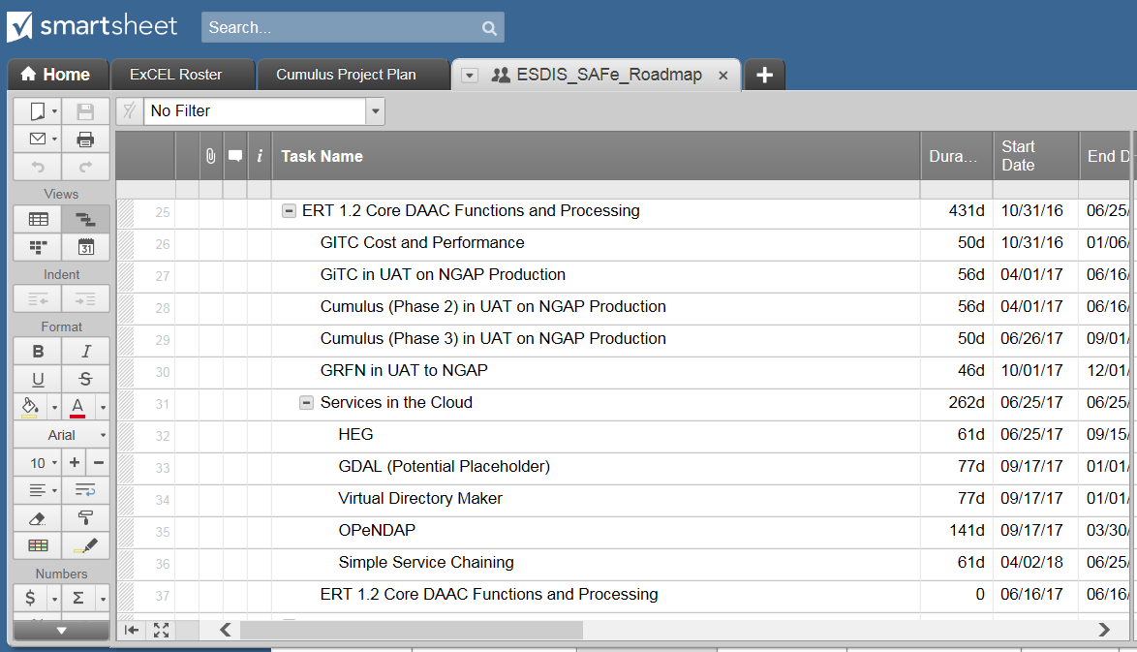
Defining the Work
1) Customer maintains key initiative goals and associated milestones
2) Epic Owners decompose milestones into 1 or more Epics (very high level use case) with descriptions and success criteria.
JIRA Epic
JIRA Epic
JIRA Epic
3) Each Train’s Product Manager works with Epic Owners to decompose Epics into Features and assign an individual Feature to trains
JIRA Feature
JIRA Feature
JIRA Feature
JIRA Feature
4) Features are prioritized by the Product Manager with input from Business Owners. Features are assigned to 1 or more teams on a train who decompose them into implementable stories
Note: Non-cross train features can be added as needed to a train by the train’s Product Manager, Business Owners or Product Owners
Notes:
OVERVIEW: Here, you can introduce the Enterprise Backlog Model consisting of the Portfolio, Value Stream, Program, Team, and Sprint backlogs. You can also elaborate on the artifacts and roles which influence the creation and prioritization of the backlog items, such as Strategic Themes, the Vision, and the Roadmap.
SAMPLE SPEAKER NOTES:
There are four levels of backlogs which comprise the Enterprise Backlog Model: the Portfolio Backlog which contains Epics, Solution Backlog which contains capabilities, the Program Backlog which contains Features, and the Team Backlog which contains Stories
The backlogs contain prioritized functionality and enablers. Enablers are the exploration, architecture, and infrastructure needed to support the functionality.
Epics are identified and progressively elaborated as they flow through the Portfolio Kanban System. The Kanban System makes the strategic business initiatives visible and brings a structured analysis process driven by economics. There are Kanban Systems at the Value Stream and Program Levels, as well.
Epics are broken down into Capabilities. Prioritization is guided by the Vision and Roadmap. We’ll take about prioritization later.
Capabilities are broken down into Features.
Features are then broken down into Stories which are executed by the Agile teams.
However, this isn’t a strict hierarchy. A Capability, Feature, or Story may emerge within the context of the Value Stream, Program, or Team and not have a parent.

Slide 21
Scheduling the Work
1) Customer maintains key initiative goals and associated milestones
2) The Product Manager maintains a Release Train Roadmap.
3) Product Owners maintain a roadmap for their product

Slide 22
Statusing the Work
1) Customer, Epic Owners and each Train’s Product Manager and RTE meet weekly to discuss progress, challenges, update schedules and plan future work
2) The RTE , Product Manager, Scrum Masters and Product Owners for each train meet regularly (twice a week) to discuss PI progress and blockers.
3) The Product Manager, Business Owners and Product Owners for each train/team meet periodically to update roadmaps and plan next PI’s work
4) Product Owners, Scrummaster and Team meet daily to discuss sprint progress and resolve blockers

Slide 23
SAFe Roles
Flow of Work
Program Increment Planning

Slide 24
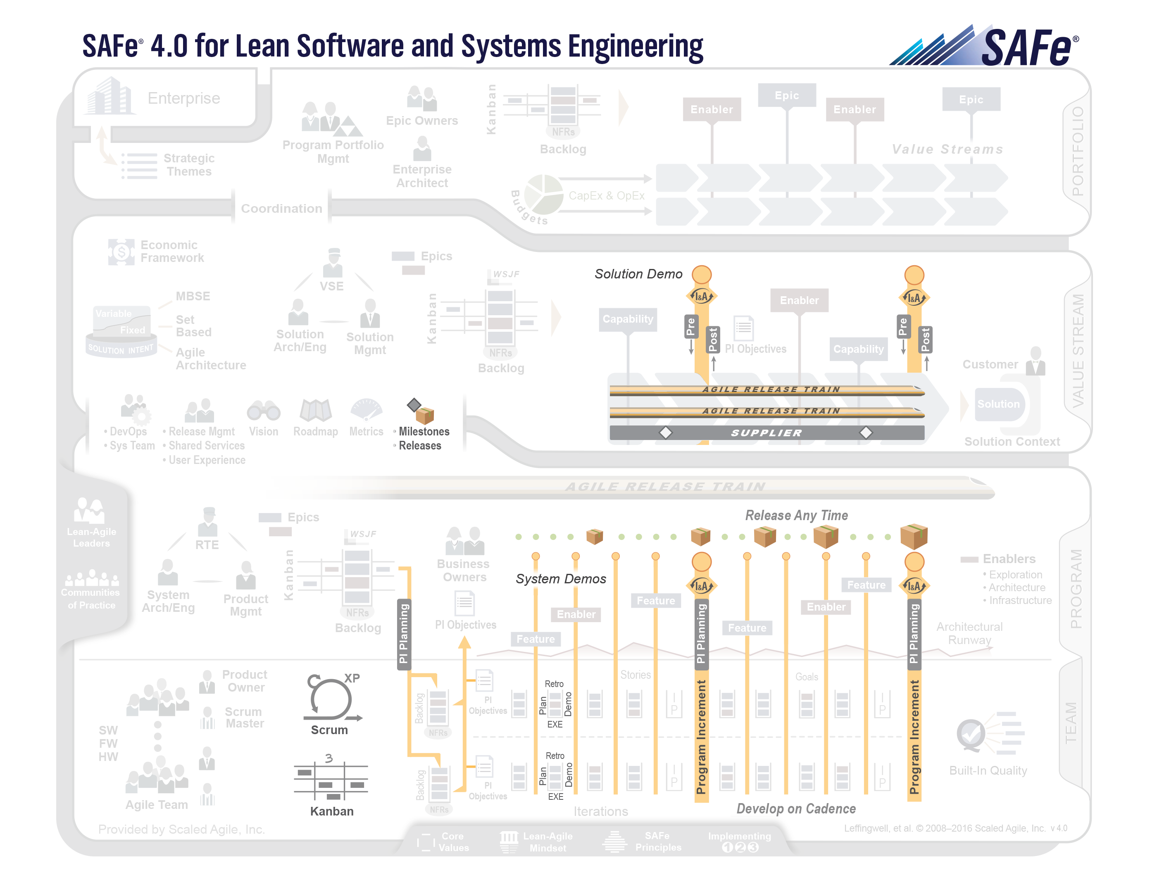
One Cadence
All teams on the Agile Release Trains work in 12 week increments, called Programs Increments, or PIs.
At the Team Level, the teams work in two week increments called Sprints.
Each PI has 5 sprints plus a 2-week IP (Innovation and Planning Sprint)
While the teams develop on cadence, they can release any time based on business needs.
Notes:
OVERVIEW: Here, you can discuss the Iteration at the Team Level and the Program Increment, or PI, and Program Level
SAMPLE SPEAKER NOTES:
At the Team Level, the teams work in two week increments called Iterations. They begin each Sprint with planning and end with a demo and a retrospective
At the Program Level, the teams on the Agile Release Train work in 8 – 12 week increments, called Programs Increments, or PIs. A PI begins with a higher level planning event, called PI Planning, and ends with a demo and retrospective known as “Inspect and Adapt.”
The teams on the Agile Release Train develop on cadence, but can release any time based on business needs.
At the Value Stream Level, additional coordination activities may be required to align all Agile Release Trains (and Suppliers) in the Value Stream.
Are there any other questions about cadence and synchronization for alignment?

Slide 25
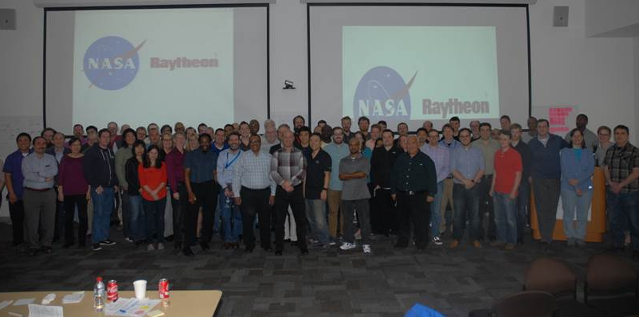
PI Planning
Two day planning session for:
Demoing recent accomplishments
Retrospective of past PI
Discuss next PI top features
Ensure alignment to customer goals

Slide 26
Example Agenda – Day 1
Time | Topic | Presenter
9:00 | Welcome | Release Train Engineer
9:20 | PI Retrospective | Release Train Engineer
10:00 | Business Talk* | Business Leader
10:30 | BREAK
10:45 | Customer Talk | Customer
11:15 | Architecture Talk | Architect
11:45 | Product Vision | Product Manager
12:00 | Planning Context | Release Train Engineer
12:15 | LUNCH
1:00 | Team Breakouts | All
4:00 | Draft Plan review | All
5:00 | Management Review and Problem Solving | Leadership
* Or Hackfest Demos!!
Notes:
Discuss the morning activities; state that we are doing a couple of things different this time –based on the feedback that the morning session was to heavy
Dependency board is all TAPE
Moved a lot of the Planning Context material to handouts

Slide 27
Example Agenda – Day 2
Time | Topic | Presenter
9:00 | Planning Adjustments | Product Manager
9:30 | Team Breakouts | All
11:30 | Final plan and review | All
12:30 | LUNCH
1:00 | Program Risks | Release Train Engineer
2:00 | Confidence Vote | Release Train Engineer
2:30 | Plan rework if necessary | All
3:00 | Plan retrospective and moving forward | All

Slide 28
Outcomes of PI Planning
Clear set of objectives for each team, backed by detailed estimated tickets assigned to a specific sprint
List of identified dependencies
List of risks to be managed
Commitment

Slide 29
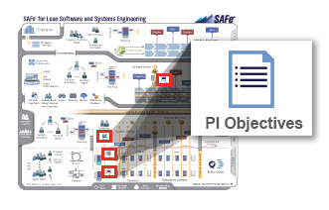
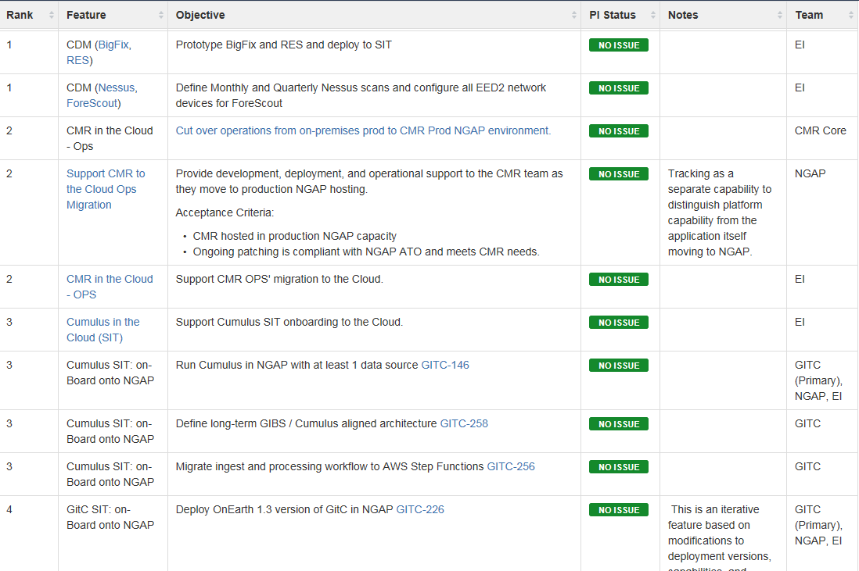
PI Objectives
Objectives are a summarized description of the business and technical goals that a team intends to achieve in the upcoming PI.
Notes:
Each team must develop a set of objectives for the entire 5 sprints.
An objective must be aligned to a single Feature/Epic.
An objective explains how the selected stories meet the goal(s) of the Feature.
Objectives must have success criteria (what does done mean)

Slide 30
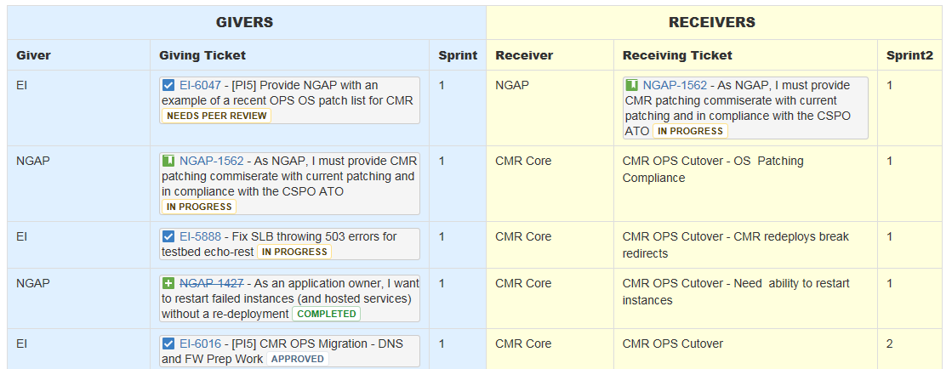
Dependencies
Notes:
During the meeting, we track dependencies on a wall (stickies and tape)
Post planning, put them on the wiki.
Looking at getting Big Picture to make this whole thing easier

Slide 31
Risks
RISKS
Identify risks on the pink post-it notes
Write your team’s name on the risk
Ensure the risk clearly identifies the problem and the consequence: IF …. THEN …
At the end of Day 2, all risks will be reviewed together to be dispositioned¹:
Resolved: no longer a concern
Owned: cannot be resolved or mitigated right now, so it is assigned an owner who will work to resolve or mitigate the risk during the PI
Accepted: either this is just a fact or it is outside of our control to influence or mitigate
Mitigated: a team identified a way to mitigate the probability or impact of this risk and built it into their PI Plan
¹ http://www.scaledagileframework.com/pi-planning/

Slide 32
Successes So Far
Increased understanding of NASA goals and priorities
Improved communication between our teams and with NASA
Reduction is status meetings for coordination
Focused team efforts on important initiatives
More consistent metrics and root cause analysis of missed objectives

Slide 33
Questions?

Slide 34
This material is based upon work supported by the National Aeronautics and Space Administration under Contract Number NNG15HZ39C.

Slide 35
BACKUP

Slide 36
Planning Overview
Teams calculate the following:
Capacity: How many story points are available once you factor in vacations, holidays, etc.
Maintenance Reserve: Historically, how many points has your team needed to allocate to bugs, user requests, technical debt, outages, etc. each sprint. Also factor in reserve in later sprints for the unknown and for PI-9 planning
Available Velocity: Capacity – Maintenance Reserve
Plan stories into sprints based on available velocity
Start with stories relating to the highest priority Top 20 Feature your team can contribute to
After contributing all you can to Top 20 Features, pick up work from your approved Team level Roadmap

