Slide 1

WGISS Infrastructure Project (WISP) Report
Committee on Earth Observation Satellites
September 28, 2015
WGISS-40
Oxford, UK

Slide 2

Support Team
Lead
  Martin Yapur (martin.yapur@noaa.gov)
Team
  Anne Kennerley (anne.kennerley@noaa.gov)
  Kim Holloway (kim.e.holloway@nasa.gov)
  Michelle Piepgrass (mvpiepgrass@gmail.com)
  For any technical CEOS server requests, contact: it@ama-inc.com

Slide 3
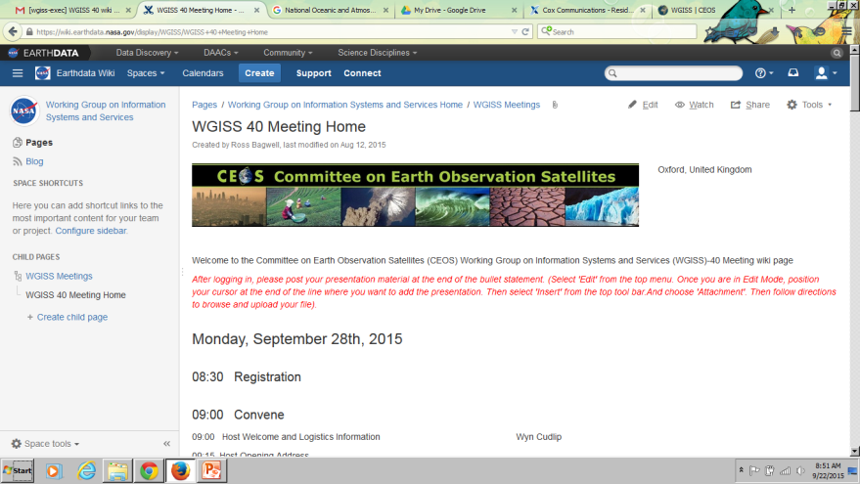
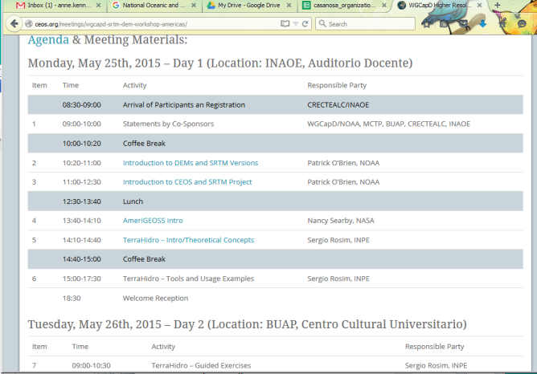
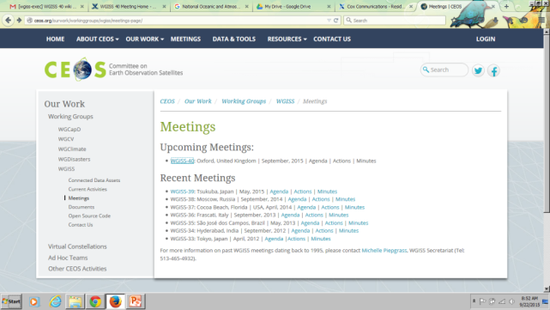
WGISS-40 Presentations
The link to the wiki where presentations
are/can be loaded is here:
https://wiki.earthdata.nasa.gov/display/
WGISS/WGISS+40+Meeting+Home
All the presentations will be migrated to the Google drive for viewing/archiving after the conference.
They will also be accessible from the agenda on the WGISS
page (similar to this one)

Slide 4
File Format
Presentations
  Date_Time_Title (ie. 09.28_10.35_WISPREPORT)
  Remember to submit your presentation
  BEFORE YOU START!
Methods
  If you have access to the wiki, upload directly OR
  Send email with presentation to Michelle at mvpievgrass@gmail.com and Anne at anne.kennerley@noaa.gov

Slide 5
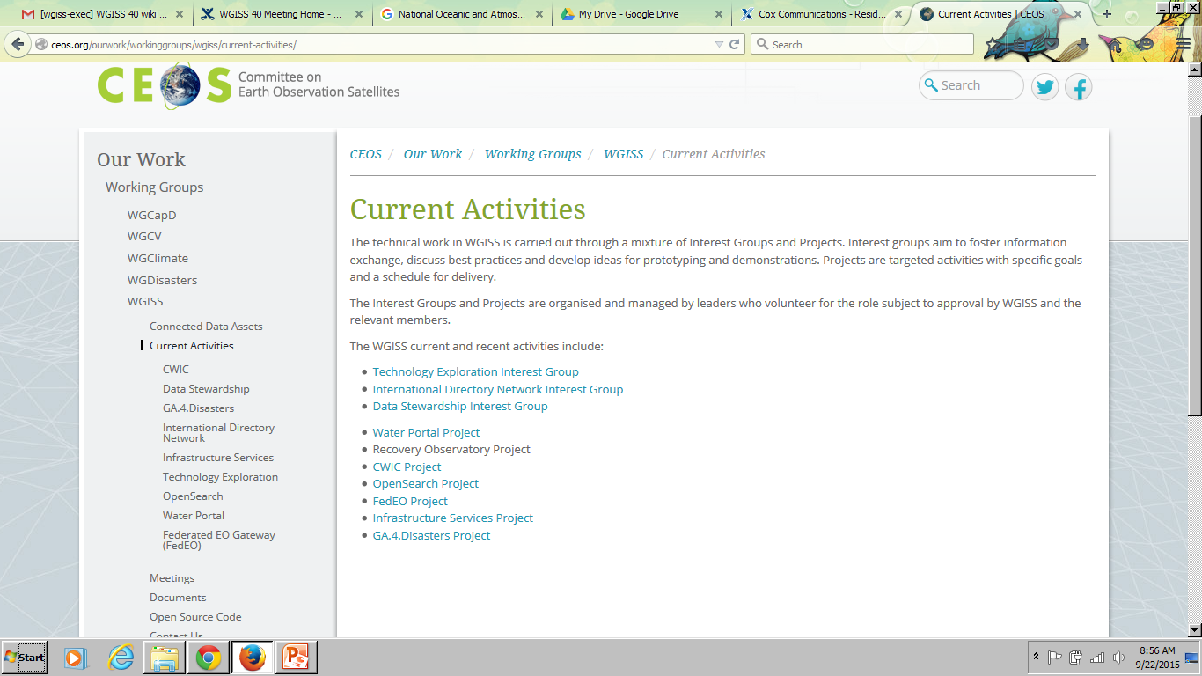
Recent Activities
Re-organization of WGIS webpage
menu to include
“Current Activities”
Organization/upload of documents to
the new Document Management
System (DMS) for archival – all the
documents from the old pages are available on the DMS

Slide 6

Recent Activities (continued)
Overhaul of WGISS Mailing Lists – it has
been awhile since the lists have been
looked at
              Would like everyone to peruse the WGISS-All list and see if anyone has been missed from the list OR if email does not belong

Slide 7
The Future of WISP
WISP seeks your support to:
Continue managing the main content of the WGISS website and the mailing lists
Generate and support outreach materials

