Slide 1
Committee on Earth Observation Satellites
WGIS / WGCapD Cooperation Topics
Eric C. Wood, USGS
Jane Olwoch, SANSA
CEOS WGISS - 40
Harwell, Oxfordshire, UK
28 September – 2 October, 2015

Slide 2
Outline
Purpose of this session
Working Group on Capacity Building and Data Democracy (WGCapD) - Background
Our perception of “what WGISS does”
Summary of what WGCapD might be able to provide WGISS in capacity and awareness building
Discussion

Slide 3
Purpose of this session
WGCapD is exploring ways to support WGISS in its Capacity / Awareness Building activities.
Making CEOS aware of what WGISS is doing
Making member institutions aware of what WGISS is doing
Making the general public aware of what WGISS is doing
Addressing WGISS mandates
Develop capacity (in CEOS or general public) to utilize WGISS products or processes

Slide 4
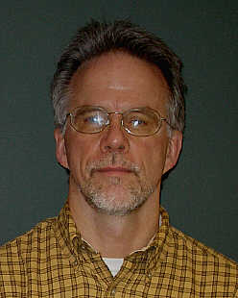
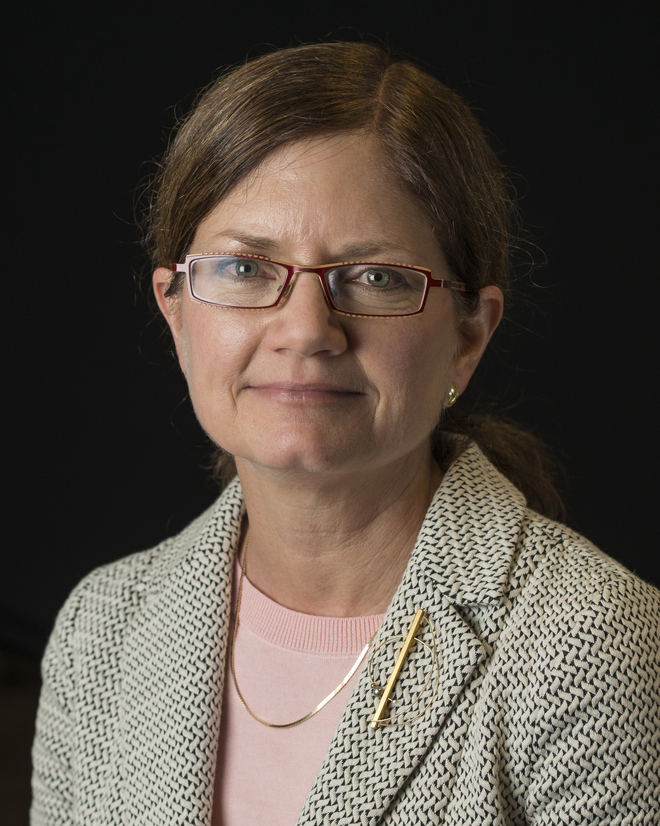
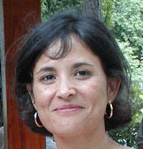
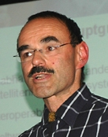
WGCapD – Some of the Players
Chairs (2014-2015)
Chair, Eric Wood, USGS, Physical Scientist
Vice Chair, Jane Olwoch, SANSA, Managing Director of Earth Observation
Team Members
Brent Smith, NOAA/NESDIS, International and Interagency Affairs
Nancy Serby, NASA, Capacity Building Program Manager
Hilcea Ferreira, INPE, Senior Technologist, GEO Rep
Dieter Hausamann, DLR, Head DLR EO School Lab
Francesco Sarti, ESA/ESRIN, Scientific Coordinator of Education and Training
S.P. Aggarwal, ISRO, Head of Water Resources/IIRS

Slide 5
Very Brief History of WGCapD
In 2010 reorganized WGEdu to Working Group on Capacity Building and Data Democracy (WGCapD) with new mandates:
Reaching more people(including those in underserved communities) e.g., explore Internet based delivery systems
Better meeting needs of CEOS, members, WGs, VCS
More emphasis on all aspects of data democracy

Slide 6
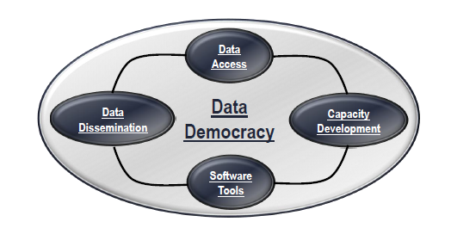
The 4 Pillars of CEOS Data Democracy

Slide 8
What we did in 2014/2015 in response to last year’s VC/WG Day
Workshops:
SRTM 30m Elevation Data in Disaster Response Management (focus on flood modeling)
South Africa (hosted by SANSA)
Mexico (hosted by CRECTEALC)
Webinars
8 session series : Webinar Series on Remote Sensing Technology for DIsaster Management
GEO Support
GEOCAB
SRTM (AfriGEOSS)
VC / WG support
SST-VC collaboration
WGDisasters

Slide 9
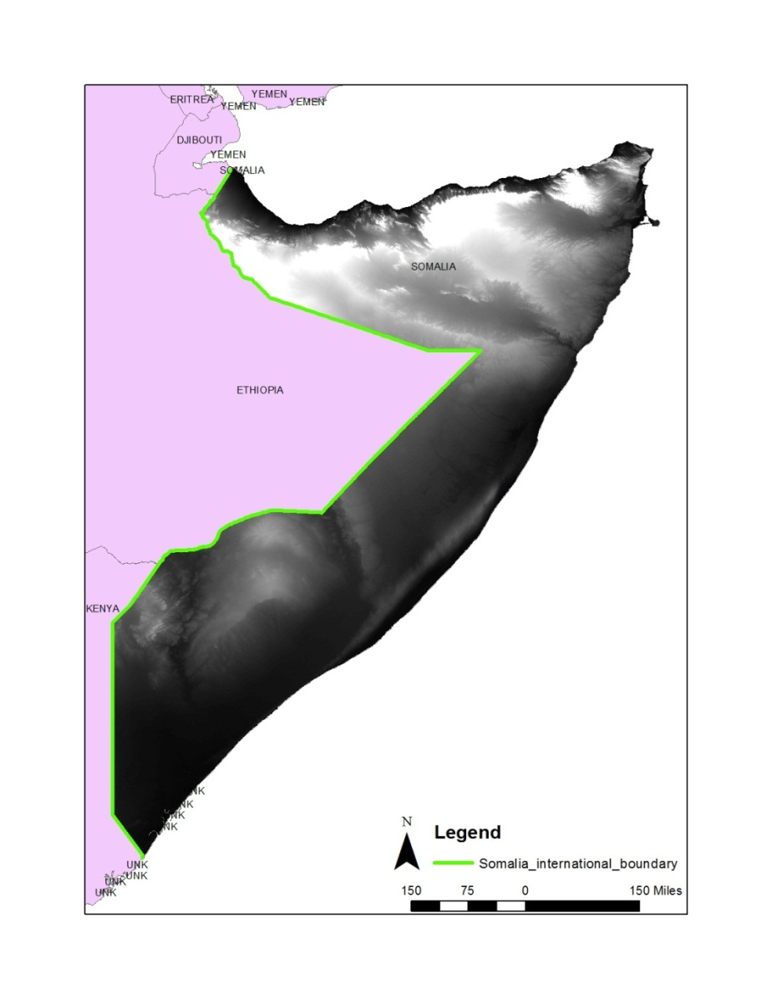
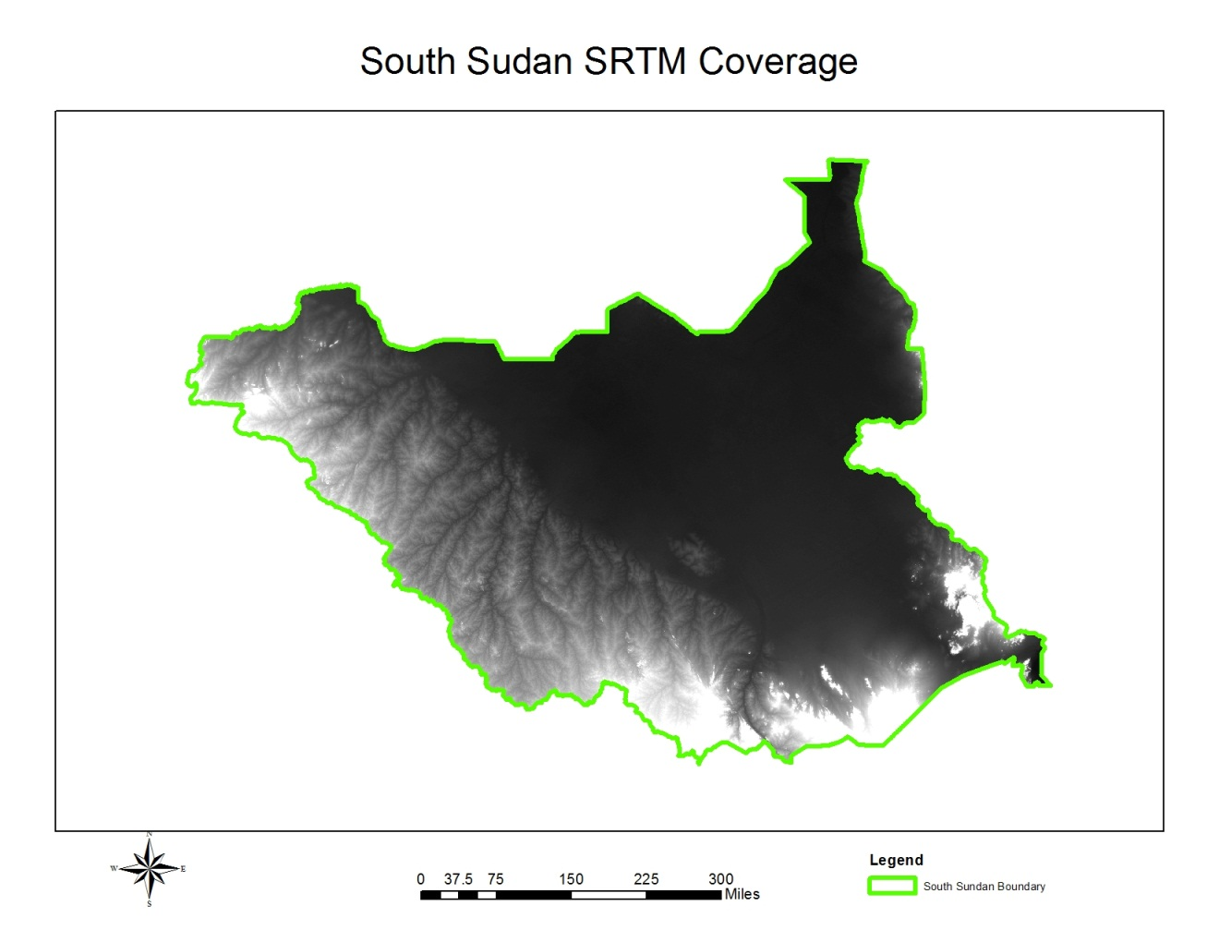
Initial Efforts to Release SRTM-2 30m Data
NASA Shuttle Radar Topographic Mission (SRTM) - 11 day mission to map most of the world in February 2000 on Space Shuttle Endeavor
There were many attempts to have SRTM 2 30m data released by NGA to the public for the entire Earth
US consortium of agencies worked together to secure the release of the data.
CEOS, GEO actively lobbied for the release with NOAA recently serving as the POC for WGCapD
South Sudan and Somalia released as pilot projects

Slide 11
Global SRTM Released September, 2014
SRTM-2 30 meter data released as part of President Obama’s speech at UN Climate Summit on September 23, 2014
UN Side event on September 24, 2014 about The United States’ Efforts to Boost Climate Resilience in Developing Nations included demonstration of newly available elevation data for Africa

Slide 12
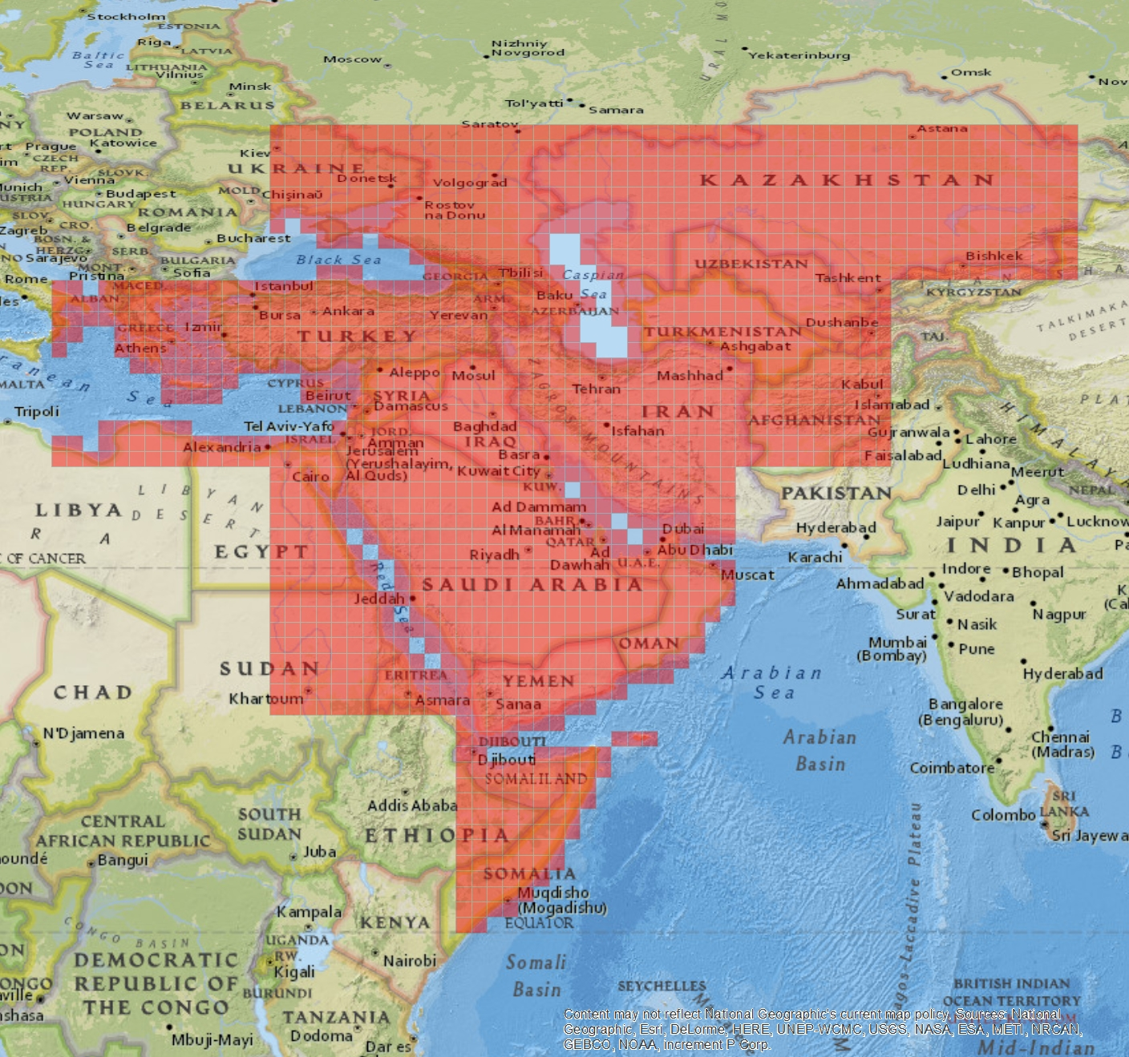
Final SRTM Data Release
4TH and final release of NGA’s 30m SRTM elevation data
“Middle East”

Slide 14
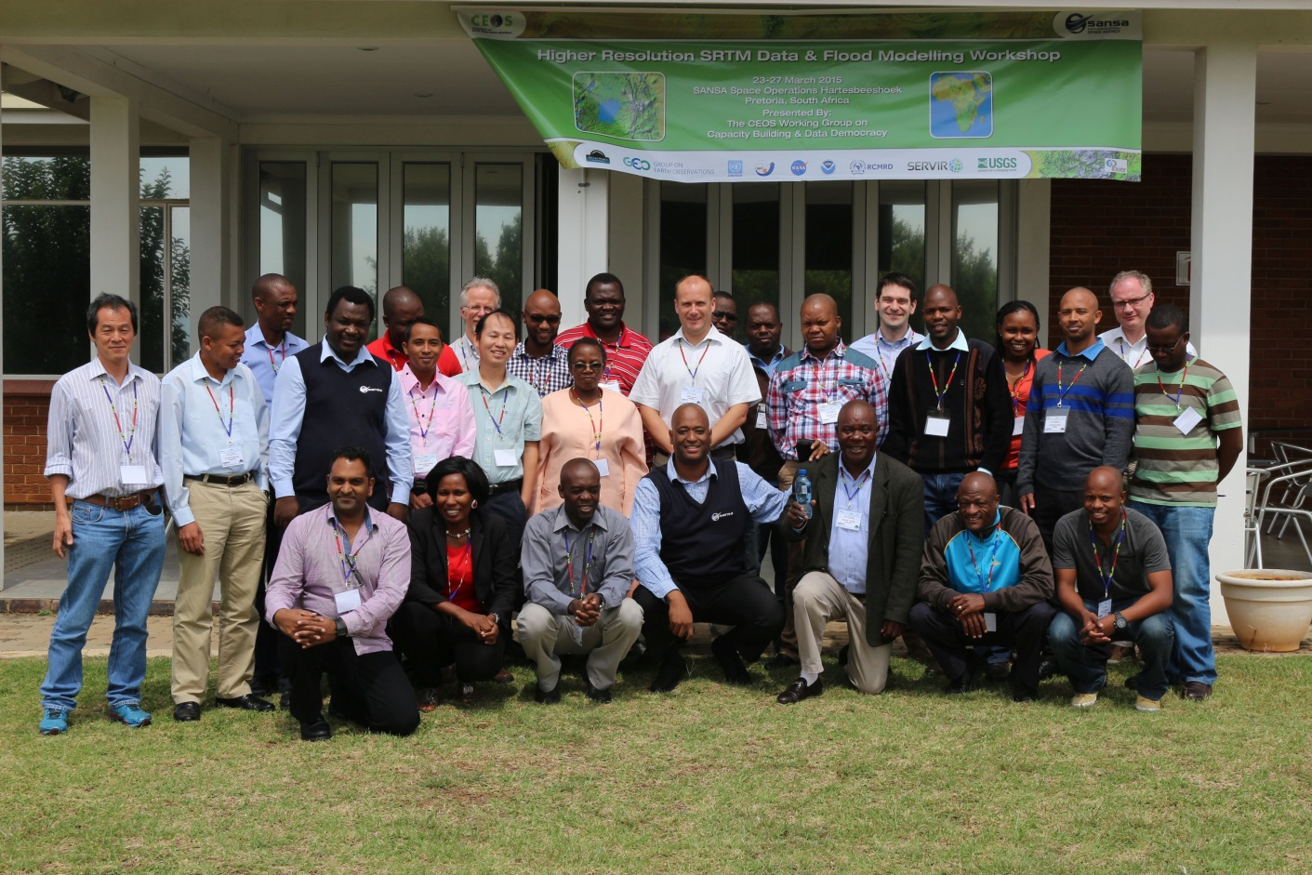
SRTM Workshop , Pretoria, South Africa
23 -27 March, 2015
22 participants,
18 from outside South Africa.
Sponsors are SWF, GEO Secretariat, and UNOOSA
Thanks to Patrick O’Brien (NOAA), Phila Sibandze (SANSA), and the CEOS Team

Slide 15
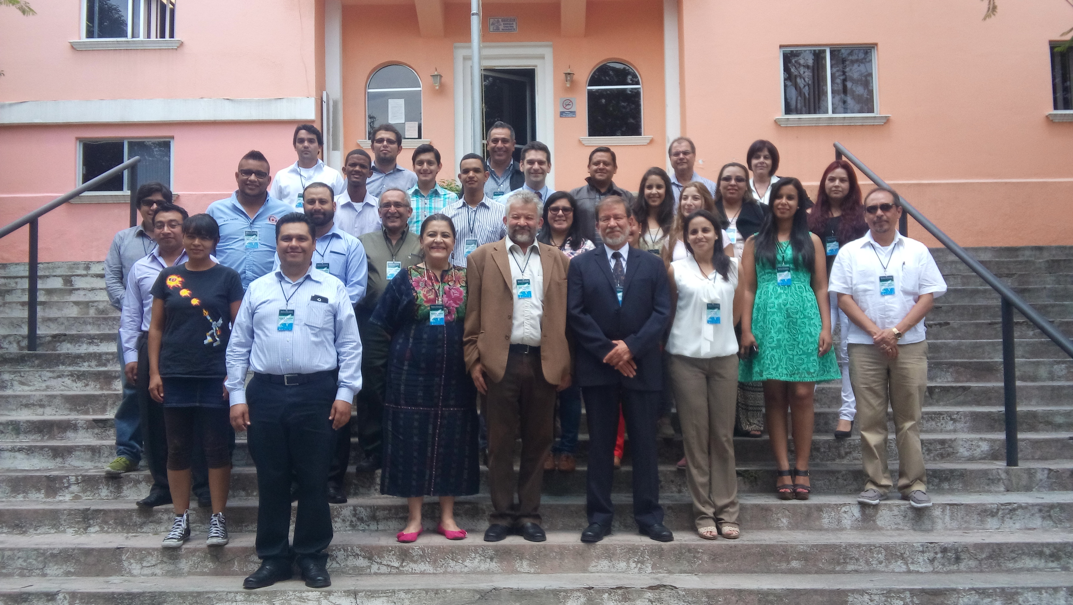
SRTM Workshop , Puebla, Mexico
25 -29 May, 2015
Attended by 27 participants from 11 countries in Latin America
Sponsors are MCTP, SWF, GEO Secretariat, CRECTEALC, and INAOE

Slide 16
CEOS WGCapD SRTM-2 Workshops
 | Host
Date | Institution | Location
March 23-27, 2015 | SANSA | Pretoria, South Africa
May 25-29, 2015 | CRECTEALC | Puebla, Mexico
Spring, 2016 | ICIMOD/SERVIR (??) | Kathmandu, Nepal
TBD, 2016 | TBD (AGEOS, Gabon??) | Central Africa

Slide 17
Developing an Online Approach to Capacity Building

Slide 18
Webinar Series
WGCapD & WGDisasters Distance Education Course
Webinar Series on Remote Sensing Technology for Disaster Management
(INPE and ISRO)
http://ceos.org/meetings/wgcapd-distance-education-2015/
Comprehensive series of 8 introductory webinars that address the use of remote sensing technology for DM.
What makes this course unique?
Offered free of charge
Provides access to expertise from space agencies around the world
Links participants to a global network of experts and policymakers
Creates awareness about CEOS and the International Charter for Space and Major Disasters
Provides access to datasets and useful tools available from CEOS Members
Builds skills on Disaster Management (DM)

Slide 19
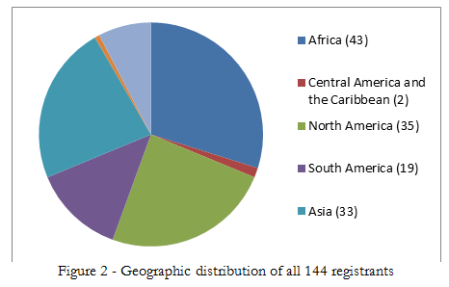
Developing an Online Approach to Capacity Building
Webinar Course Development - 2015

Slide 20
GEO Capacity Building (ID-02)

Slide 21
Lessons Learned from those Activities t
WGCapD’s limited by its resources – funding, people
Often our activities are as much “awareness” as “capacity” building.
Can’t successfully support VCs or WGs without true collaboration. Has been supply driven, but needs to be demand driven
Should there be more focus on CEOS as an organization? At cost of support to VCs and WGs? To GEO?
We have to bring something worthwhile to CEOS, CEOS members. Provide something they wouldn’t have without WGCapD inputs.
ARD will change how we do business. How exactly?

Slide 22
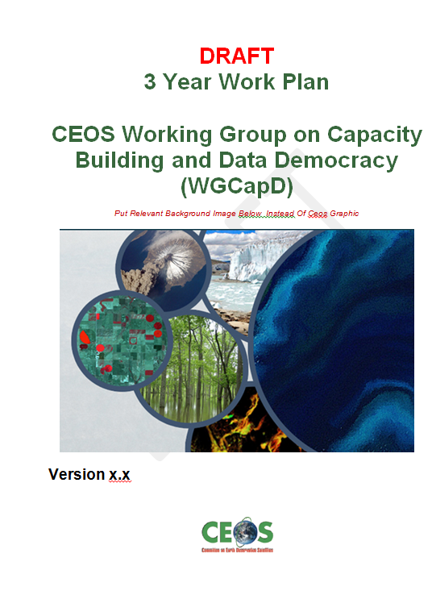
WGCapD Strategic Planning
In response to lessons learned, we have begun a strategic planning exercise that will result in a 3 Year Work Plan and a basic restructuring of the WG.

Slide 23
Preliminary WGCapD Restructuring - Goals
To highlight (build awareness of) new CEOS missions and datasets, and how to use the latter within the context of existing datasets or in support of CEOS/GEO projects;
To increase the ability of the WGs/VCs to provide their own capacity building (vs CapD doing it for them);
To improve communications and coordination between member agency and WG/VC/CapD capacity building and education activities as well as related international activities/practitioners
To continue to increase access to data, products, and tools and ability to use them (data democracy);

Slide 24
…with new Examples for 2015/16
Highlight CEOS
SRTM/Elevation data workshops continued
CEOS Exhibit at GEO Plenary / Ministerial
ESA/DLR webinar series on European SB EO (under consideration)
Support to VCs and WG
e.g., WGISS, LSI, SST VCSEO and other ARD/data cube partners
Collaborate with other CB activities/practitioners
CSA, CRETEALC , VLAB, ESA, GEO, WGs and VCs
Data democracy
AfriGEOSS, AmeriGEOSS
Final SRTM workshops addressing regional issues
Directed webinar series

Slide 25
New Activities
Highlight CEOS:
CEOS Exhibit at GEO Plenary / Ministerial
ESA/DLR webinar series on European SB EO (proposed)
Support VC WG
e.g., WGISS,LSI, SEO and other ARD/data cube partners
Collaborate with other CB activities/practitioners
CSA, Civil Security: Understanding the Risks, Preventing Disasters, and Mitigating the Impacts with Earth Observation
CRETEALC , VLAB, ESA, GEO, WGS and VCs
Data Democracy;
AfriGEOSS, AmeriGEOSS
Directed webinar series

Slide 26
WGISS Background
Stimulates, coordinates, monitors, and promotes collaboration for development of systems and services that manage and supply satellite Earth observation data and information
Assists CEOS Agencies with providing easy access to and application of the data they provide
Aids development of simpler and wider access to resources
Emphasizes creation and use of demonstration prototypes and projects involving user groups to solve interoperability issues
Tools, standards, and services that assist users with access to and use of data resources available online
Most of the technical work of WGISS is carried out by WGISS Interest Groups and Projects

Slide 28
DISCUSSION

Slide 29
Key Questions
What capacity building has WGISS done recently?
What awareness building WGISS done recently?
Demo : WGISS CWIC (AB and CB) https://www.youtube.com/watch?v=-hXfcNI-654&feature=youtu.be
What capacity building requirements does WGISS have in the near future and what are your plans for meeting them?

Slide 30
Thank you
Eric Wood
Chair
Jane Olwoch
Vice Chair

