Slide 1
CEOS Water Portal Project
Satoko Horiyama MIURA
Space Applications and Operations Center (SAOC)
JAXA

Slide 2
Session Agenda
Status
Input to the GEOSS Community Portal Discussion
Discussion

Slide 3
1. CEOS Water Portal
Overview and Status Update
Satoko Horiyama MIURA / JAXA
Akari YONEYAMA / JAXA
Kaori KUROIWA / RESTEC

Slide 4
Contents
Overview (just a reminder…)
Updates
Activity Plan in 2015
Notes:
.

Slide 5

1. Overview
1.1 Concept
CEOS Water Portal is ;
  A distributed data system component of DIAS (Data Integrated Analysis System)-Program
  To provide “Easy to Access” service to users
  To provide access to a whole variety of hydrological data and water relevant data scattered over the world
  To connect the existing components like data centers, scientists and wide users.
Multiple types of data are available such as;
  In-situ data
  Satellite data
  Model output data
Notes:
4

Slide 6
1. Overview
1.2 Services
  Dataset Search
    Category Search/Map Search
    Connecting to 11 data centers and 2 catalog broker system
  Dataset Access
  (Depend on the Server side function,
  ex. OPeNDAP server)
      Data Subset (time, variables)
      Data Download/Format conversion (NetCDF, ascii, GRIB (Modeloutput only))
  Sharing Use Case
    Use Case registration/browsing

Slide 7








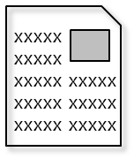
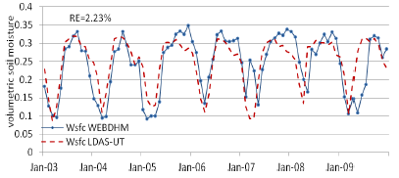
1. Overview
1.3 Goal
Data, use case, etc
Useful information
Data centers
(All over the world)
interface
non-Water Data (DEM)
In-situ data
Various Users
In-situ data
e.x.) river administrators
CEOS
Water Portal
In-situ data
Satellite data
Facilitate communications among communities
Users (researchers)
input
Model calculation
Model Output Data
Analysis
Register a Use case

Slide 8

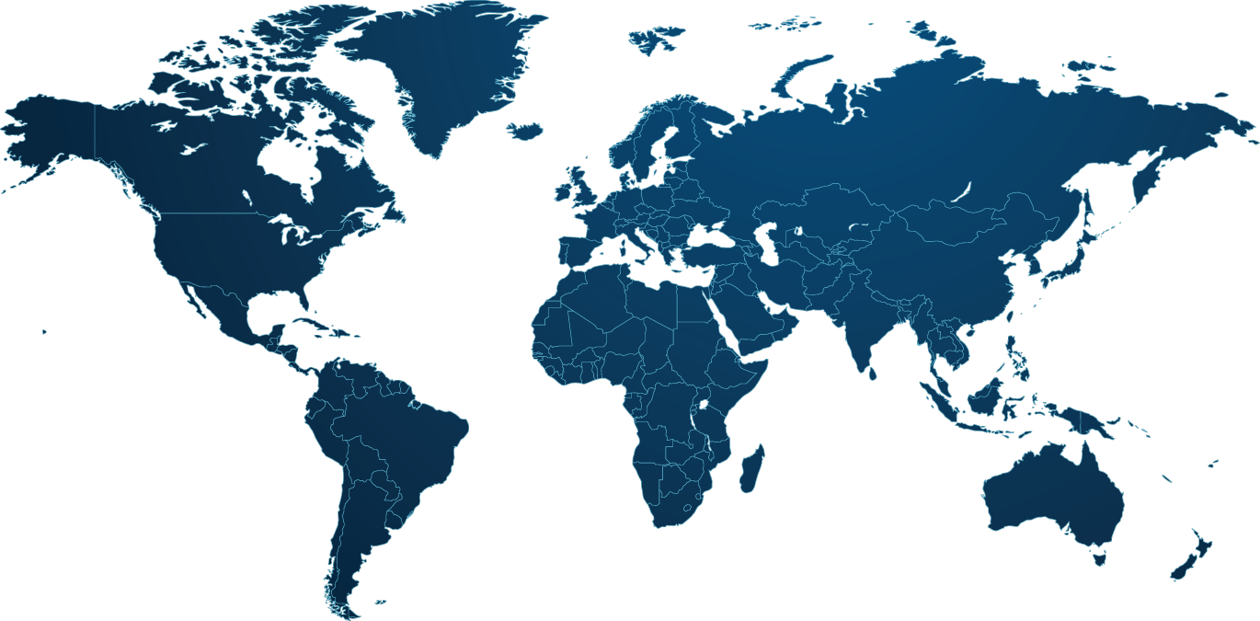


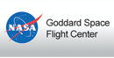










1. Overview
1.4 Data Partners
GEMS/Water
In-situ data
NASA/ORNL
IN-situ (FLUXNET) data
NASA/JPL (PO.DAAC)
Satellite Data
NOAA /ESRL
In-situ(GPCC ) data
NASA/GSFC
Satellite Data
NOAA /NCEI (New)
In-situ data
Search
Download
Use Case Registration/Browsing
CEOS
Water Portal
NCAR
In-situ data
Users
MPI
Model Output data
NASA/ECHO
Satellite data
In-situ data
Model Output data
In-situ data
Satellite data
GLOWASIS
Satellite data
Model Output data
GEO DAB
In-situ data
CUAHSI
In-situ data

Slide 9
1. Overview
1.5 Available Data List (1/2)
Data Partners | Data Types | Variables | Server type | Server Locations
CEOP | Satellite | PR, TMI, AMSR, AMSR-E, MODIS,GLI, SSMI, VISSR | Hyrax | University of Tokyo (Japan)
 | Model (MOLTS) | surface pressure, skin temperature, precipitation amount in hour, brightness temperature surface, specific humidity, u-component of wind, v-component of wind, etc | THREDDS | MPI (Germany)
 | Model(Gridded) | Air pressure, surface air pressure, air temperature, precipitation rate, snowfall amount, etc | Jblob | MPI (Germany)
 | In-situ | Surface Meteorological and Radiation Data Set Flux Data Set Soil Temperature and Soil Moisture Data Set Meteorological Tower Data Set | http link | NCAR (USA)
AWCI | Model(MOLTS) | surface pressure, skin temperature, precipitation amount in hour, brightness temperature surface, specific humidity, u-component of wind, v-component of wind, etc | THREDDS | MPI (Germany)
 | In-situ | Precipitation amount, River discharge, River water level, etc | Hyrax | University of Tokyo (Japan)
NASA | Satellite | Airs level 3 data | Hyrax | NASA (GSFC)
NOAA (GPCC) | In-situ | Precipitation data | THREDDS | NOAA (USA)

Slide 10
1. Overview
1.5 Available Data List (2/2)
Data Partners | Data Types | Variables | Server type | Server Locations
NASA | Satellite | GRACE Level 3 data | THREDDS | NASA/JPL(PO.DACC)
FLUXNET | In-situ | FLUX data Fluxes of carbon dioxide, water vapor, and energy exchange, etc | THREDDS | NASA (ORNL DAAC)
GEMS/Water | In-situ | Instantaneous Discharge , Dissolved Oxygen , Temperature, etc | WFS | GEMS/Water (CANADA)
GLOWASIS | Satellite Model(Gridded) | Precipitation, Air temperature | THREDDS | Deltares (Netherland)
ECHO Broker Service | In-situ Satellite Model | Various types of data via ECHO broker | OpenSearch | NASA（GSFC)
CUAHSI | In-situ | precipitation, humidity, discharge, oxygen, etc | REST/WaterML2, WaterOneFlow/WaterML1 | CUAHSI (USA)
GEO DAB/ GRDC | In-situ | River Discharge via GEO DAB | OpenSearch | GEO
NOAA/NCEI | In-situ | Air temperature, Precipitation, Air Pressure | THREDDS | NOAA/NCEI
(Adding some new dataset）

Slide 11
2. Updates
2.1 Visitors & Users
New CEOS water portal site has been available from May 12th,2015.
Registration User is over 290.
2015

Slide 12
2. Updates
2.2 New Architecture Development
Purposes
Less time and labors on adding data partners
Integrated operation flow (search -> download)
Easier operation

Slide 13











New System Architecture
1
CWP Catalog Management Component
Operation Flow
CEOS Water Portal
(CWP)
Client Component
Dataset
Dataset level catalog CMP
(GI-Cat)
1
→
2
→
3
Detail
- DIF
Data Centers
CWP Catalog Broker CMP
(GI-Cat)
2
New Partners and updates for some datasets
Granule
Legacy catalog CMP
-CEOP Gridded Model
-CUAHSI Europe
-GEMS/Water
-CEOP MOLTS
-AWCI MOLTS
-CEOP Satellites (~2013)
Harvest
(Automatic registration & updates)
OPeNDAP Server
-NASA AIRS
-NASA GRACE
-NOAA
-GLOWASIS
-FLUXNET
ISO19115/19139
-AWCI In-situ
Users
Search
Broker Service & Catalog Service
1
2
(External)
New Data Centers
ISO-19115/19139
OPeNDAP
W*S
OpenSearch, etc
DAB
NASA
ECHO
CUAHSI
HIS
Download
3
Data Access
Subset(html) or File
@each data center
File
Other than OPeNDAP
Catalog
Interface
OpenSearch
WaterOneFlow (WOF)
CSW (view detailed catalog)
Data Access
HTTP files
OPeNDAP

Slide 14
3. Activity plan in FY2015
Integrated with DIAS(*) Catalog system (the end of Feb. 2016)
  Develop the common dataset level catalog database
  Use GI-cat software
Changing the User Authentication Function (the end of 2015)
  SSO among DIAS
  Using a CAS (Central Authentication Service) software
Adding new dataset (the end of Feb. 2016)
  NOAA/NCEI(National Centers for Environmental Information):
  Adding some In-situ data based on a priority made by prof. Koike.
  (*) Data Integration Analysis System :
  http://www.editoria.u-tokyo.ac.jp/projects/dias.old/english/index.html

Slide 15
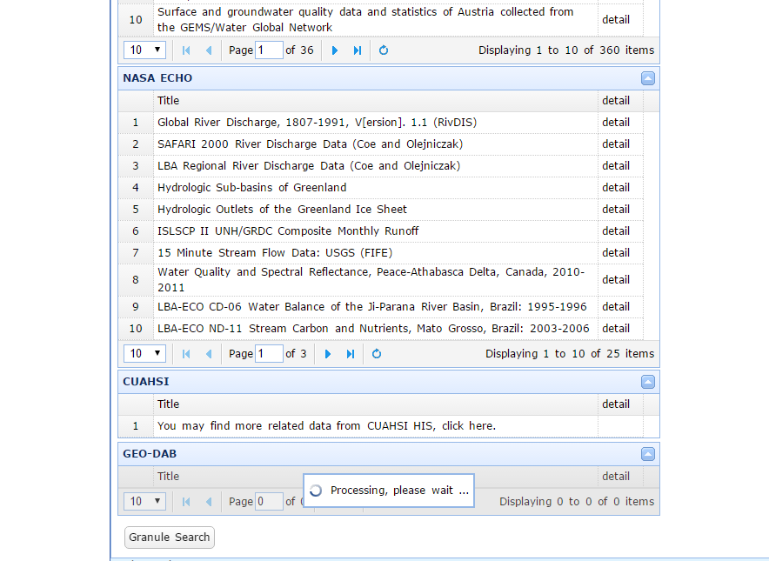
3. Activity plan in FY2015
Modifying the User I/F for GEO-DAB response (the end of Oct. 2015)
  According to river discharge catalog data server was integrated to one server, it takes more time to generate the time range view graph.
  Develop the Cache server for archiving the GEO-DAB/GRDC catalog.
Dataset search result image
It takes several minutes to get the OpenSearch response from GEO-DAB.

Slide 16
3. Activity plan in FY2015
Choosing a more useful Download URL for users. (the end of Dec. 2015)
  There are some download URLs in the OpenSearch response provided by GI-cat server which is harvesting the OPeNDAP server.
  However the some download URLs in the response does not use for downloading the data .
  So we will choose the more useful URL for downloading a data for user.
Modifying the CEOS Water portal page of WGISS website based on discussion of WGISS-39 (completed)
Closing the CEOS Water Portal Project (the end of Mar. 2016)
DIAS will take over the Water portal system operation in FY2016.

Slide 17
2. Input to the GEOSS Community Portal Discussion
~ Telecon on August 18th~
Satoko Horiyama MIURA
Space Applications & Operations Center
JAXA

Slide 18
1. System Architecture
1
CWP Catalog Management Component
Operation Flow
CEOS Water Portal
(CWP)
Client Component
Dataset
Dataset level catalog CMP
(GI-Cat)
1
→
2
→
3
Detail
- DIF
Data Centers
CWP Catalog Broker CMP
(GI-Cat)
2
New Partners and updates for some datasets
Granule
Legacy catalog CMP
-CEOP Gridded Model
-CUAHSI Europe
-GEMS/Water
-CEOP MOLTS
-AWCI MOLTS
-CEOP Satellites (~2013)
Harvest
(Automatic registration & updates)
OPeNDAP Server
-NASA AIRS
-NASA GRACE
-NOAA
-GLOWASIS
-FLUXNET
ISO19115/19139
-AWCI In-situ
Users
Search
1
2
3
Broker Service & Catalog Service
1
2
(External)
New Data Centers
ISO-19115/19139
OPeNDAP
W*S
OpenSearch, etc
DAB
NASA
ECHO
CUAHSI
HIS
Download
3
Data Access
Subset(html) or File
@each data center
File
Other than OPeNDAP
Catalog
Interface
OpenSearch
WaterOneFlow (WOF)
CSW (view detailed catalog)
Data Access
HTTP files
OPeNDAP

Slide 19
2. Available Data
Data Partners | Data Types | Variables | Server type
GEO DAB/ GRDC^{*1} | In-situ | River Discharge via GEO DAB | OpenSearch
^{*1} GRDC = Global River Discharge Center
Registered GRDC Datasets (and its servers) are as follows;
Global River Discharge Datasets (GRDC/GEOWOW) - Kisters AG
Global River Discharge Datasets (GRDC/GEOWOW) - 52 degree North

Slide 20
3. Implementation
GEO DAB can be accessed by “OpenSearch”, “OGC Catalog Service for Web (CSW)” and “OAI-PMH”. We selected “OpenSearch”, considering our experience and its simplicity.
Based on the user requests, our target is GRDC/River discharge data. So, by identifying GRDC data server, response time could be shortened.

Slide 21
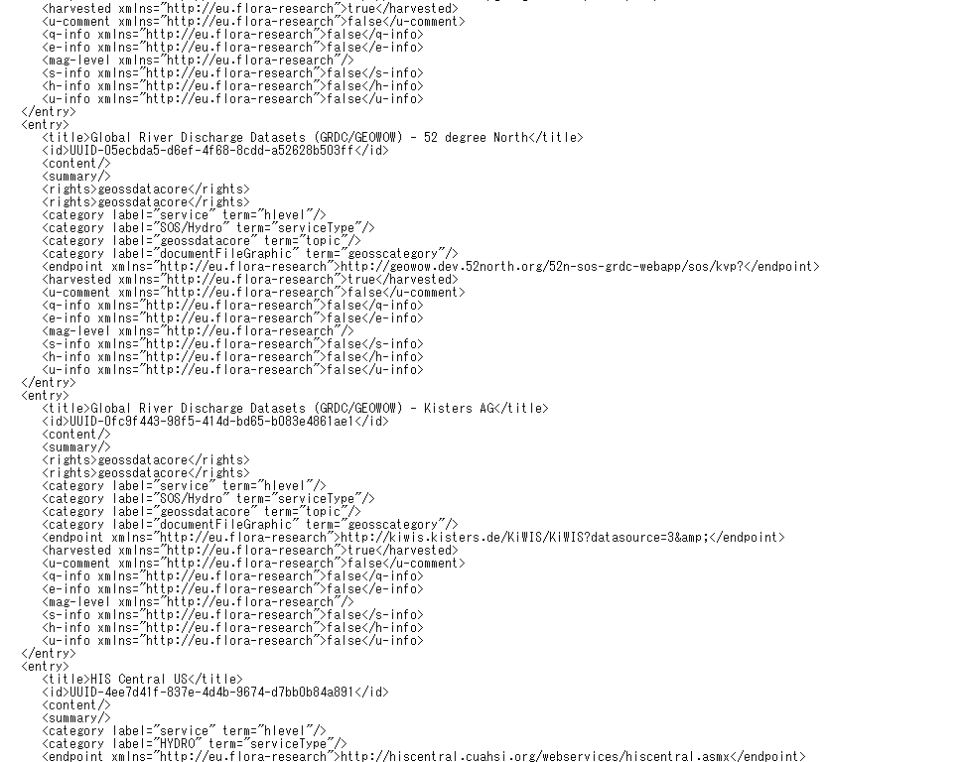
Identifying GRDC Data Server (source)
    http://production.geodab.eu/gi-cat-StP/services/opensearch?getContent&id=ROOT
GRDC/GOWOW 52 degree North
GRDC/GOWOW Kisters AG

Slide 22
GEO DAB Open Search Description Document (OSDD)
<OpenSearchDescription><ShortName>GI-cat</ShortName><LongName>GI-cat OpenSearch Catalog service</LongName><Description>GI-cat interface for the OpenSearch support.
*** Note about the OpenSearch plugin for Firefox toolbar ***.
Url templates with "text/html" type are required in order to enable the Firefox plugin ( at least one is required ) but the actual returned mimetype
is always GeoAtom. For more info see https://developer.mozilla.org/en/Creating_OpenSearch_plugins_for_Firefox
</Description><Contact>fabrizio.papeschi@cnr.it</Contact><Image height="16" type="image/x-icon" width="16">http://essi-lab.eu/projects/gi-cat-favicon/favicon.ico</Image><Url template="http://production.geodab.eu/gi-cat-StP/services/opensearch?si={startIndex?}&ct={count?}&st={searchTerms?}&bbox={geo:box?}&loc={geo:name?}&ts={time:start?}&te={time:end?}&targetId={essi:identifier?}&parents={essi:parents?}&sources={essi:sources?}&uselim={essi:useLimitation?}&other={essi:otherAccConst?}&lac={essi:legalAccConst?}&luc={essi:legalUseConst?}&legalOp={essi:legalOperator?}&hl={essi:hierarchyLevel?}&gdc={essi:gdc?}&sba={essi:sba?}&searchFields={essi:searchFields?}&handler={essi:queryhandler?}&aggregate={essi:aggregate?}&sensor={essi:sensor?}&outputFormat=text/html" type="text/html"/>
<Url template="http://production.geodab.eu/gi-cat-StP/services/opensearch?si={startIndex?}&ct={count?}&st={searchTerms?}&bbox={geo:box?}&loc={geo:name?}&ts={time:start?}&te={time:end?}&targetId={essi:identifier?}&parents={essi:parents?}&sources={essi:sources?}&uselim={essi:useLimitation?}&other={essi:otherAccConst?}&lac={essi:legalAccConst?}&luc={essi:legalUseConst?}&legalOp={essi:legalOperator?}&hl={essi:hierarchyLevel?}&gdc={essi:gdc?}&sba={essi:sba?}&searchFields={essi:searchFields?}&handler={essi:queryhandler?}&aggregate={essi:aggregate?}&sensor={essi:sensor?}&outputFormat=application/atom+xml" type="application/atom+xml"/>
<Url template="http://production.geodab.eu/gi-cat-StP/services/opensearch?si={startIndex?}&ct={count?}&st={searchTerms?}&bbox={geo:box?}&ts={time:start?}&te={time:end?}&targetId={essi:identifier?}&parents={essi:parents?}&sources={essi:sources?}&searchFields={essi:searchFields?}&sensor={essi:sensor?}&sensorResolutionMax={essi:sensorResolutionMax?}&sensorResolutionMin={essi:sensorResolutionMin?}&sarPolCh={essi:sarPolCh?}&sarPolMd={essi:sarPolMd?}&outputFormat=application/json" type="application/json"/><Query geo:box="-180,-90,180,90" role="example"/><Query geo:box="-20,-10,10,20" geo:relation="overlaps" role="example"/><Query geo:box="-20,-10,10,20" geo:relation="contains" role="example"/><Query geo:box="-20,-10,10,20" geo:relation="disjoint" role="example"/><Query geo:locationString="italy" role="example"/><Query role="example" time:end="2010-01-01T23:39:59" time:start="1990-01-01T00:00:00"/><Developer>fabrizio.papeschi@cnr.it</Developer><Developer>enrico.boldrini@cnr.it</Developer><SyndicationRight>open</SyndicationRight><AdultContent>false</AdultContent><Language>en-us</Language><OutputEncoding>UTF-8</OutputEncoding><InputEncoding>UTF-8</InputEncoding></OpenSearchDescription>

Slide 23
Used Parameters in OSDD
Parameter | Contents
startIndex | Start number of response entry
Count | Maximum hit numbers per one page (or one feed, if using Atom)
searchTerms | Free text
geo:box | Rectangular area specifying “Longitude (West), Latitude(South), Longitude(East), Latitude(North)”
geo:name | Character string specifying search target place
time:start | Search target date/time (start)
time:end | Search target date/time (end)
essi:sources | Unique ID for each GEO DAB source server

Slide 24
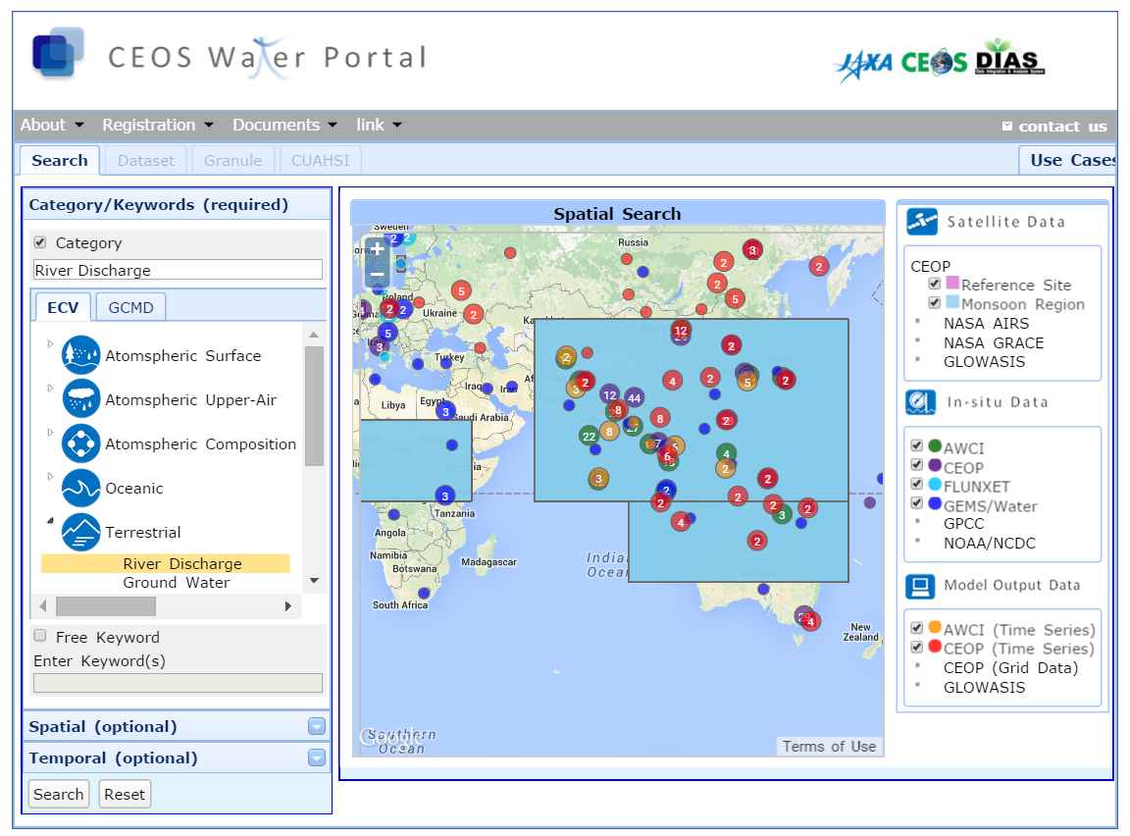
1

Slide 25
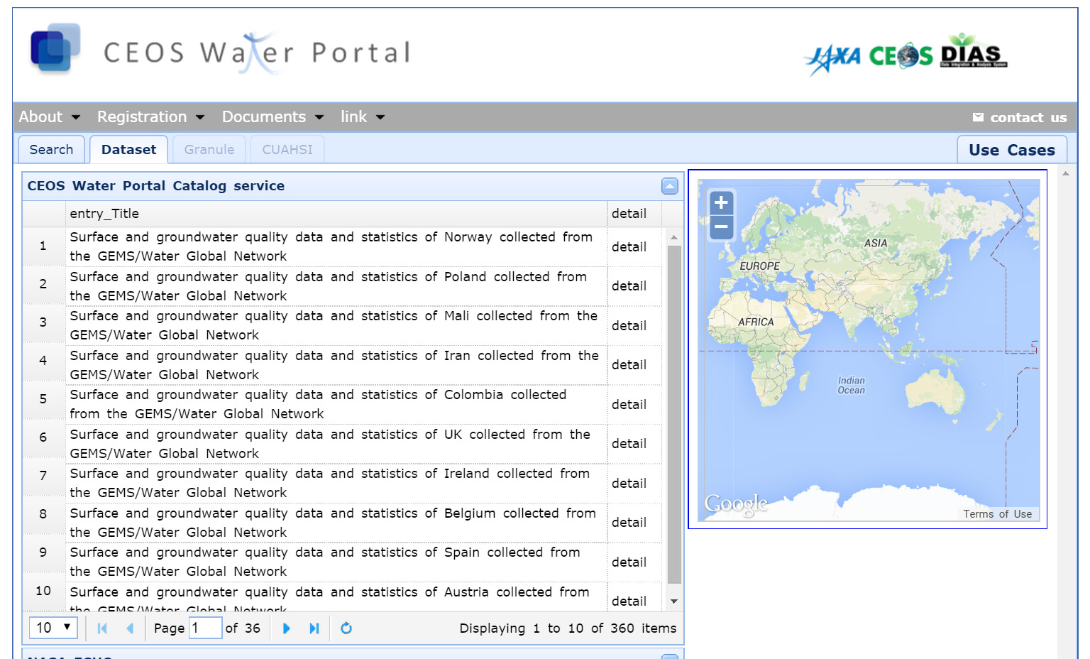
1

Slide 26
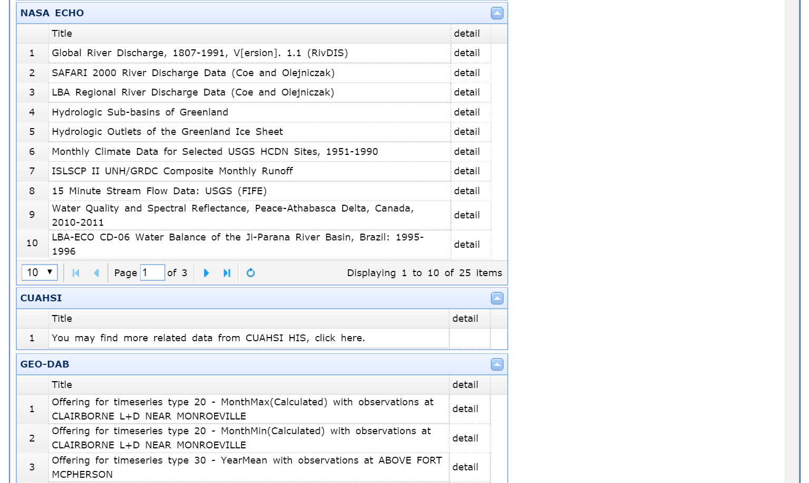
1
It takes 2~3 minutes to retrieve the GEO-DAB search results.

Slide 27
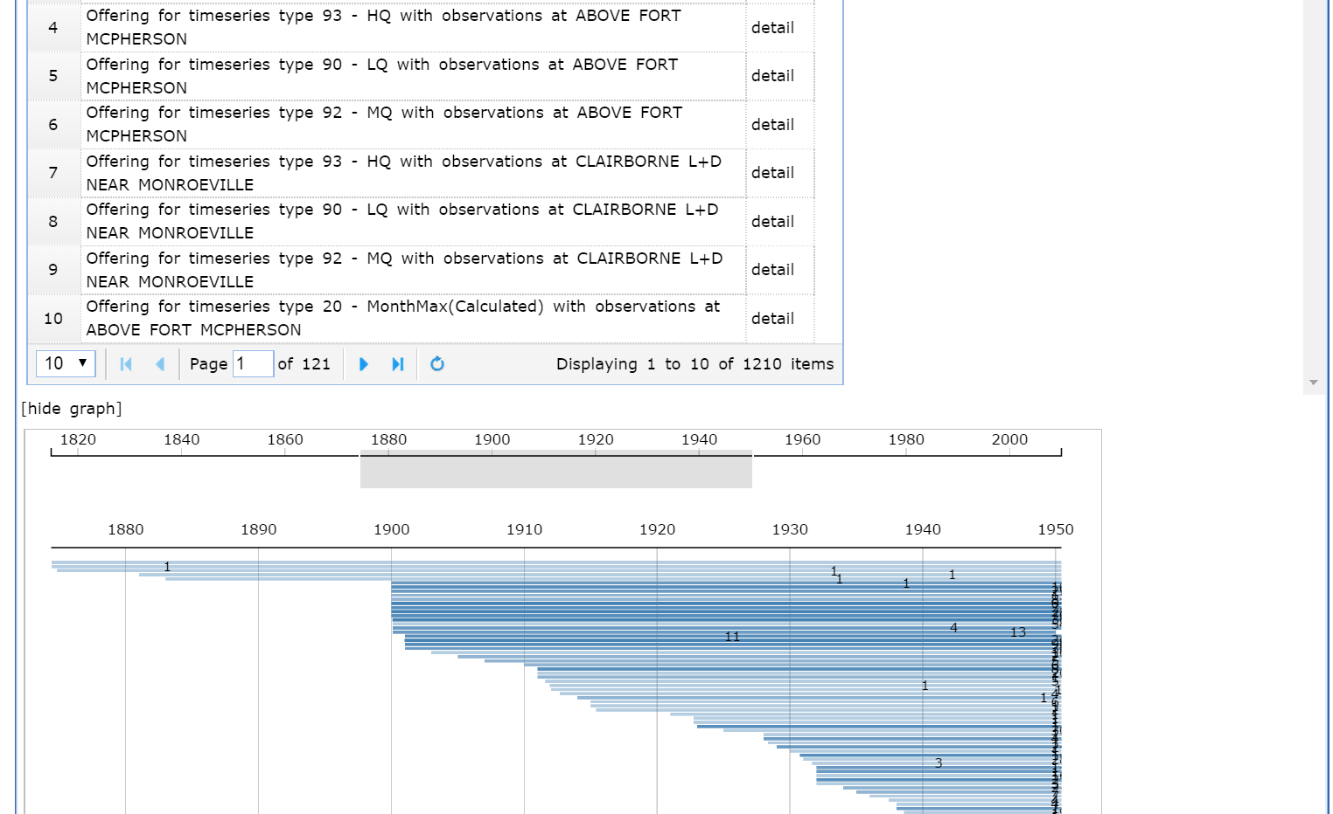
1
This was “96” in June, 2015.

Slide 28
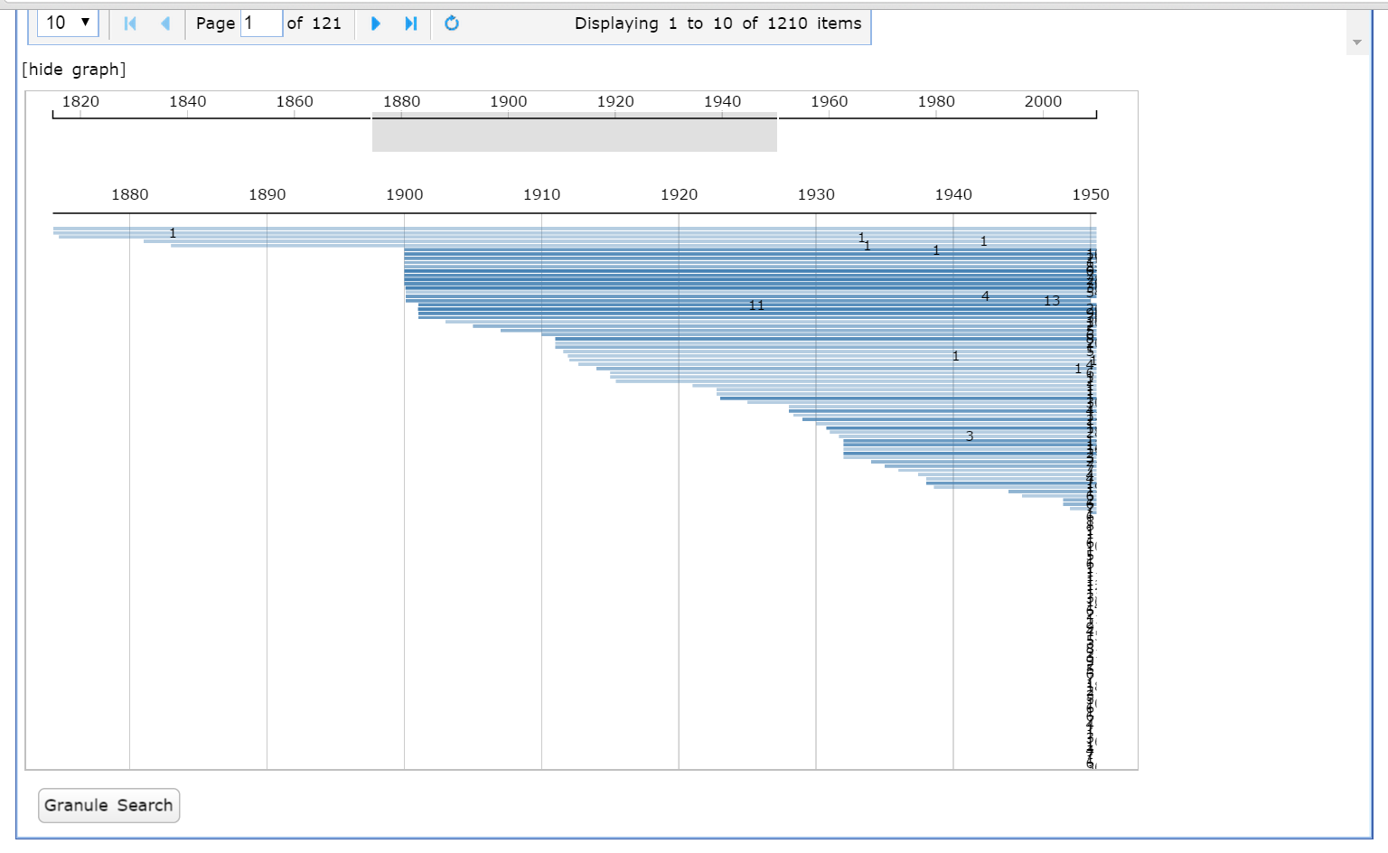
1
In order to improve usability (how to grasp each dataset time range), this graph can be used.
But to prepare this graph, it is needed to download all the search results, which cause long time response time.

Slide 29
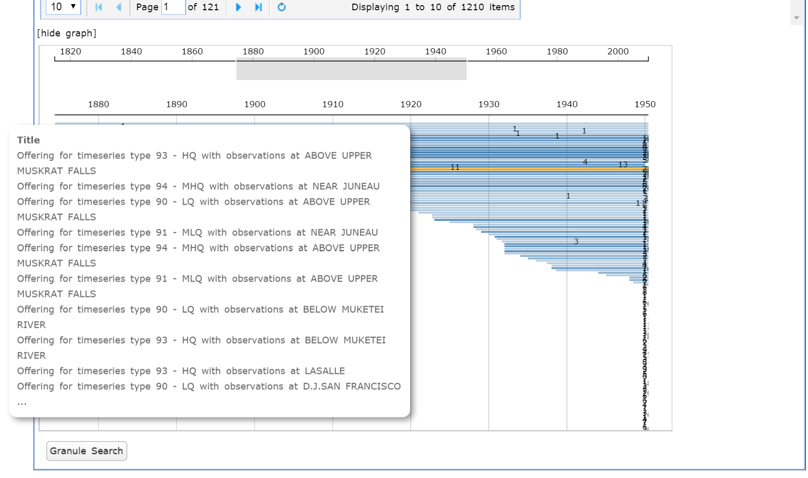

Slide 30
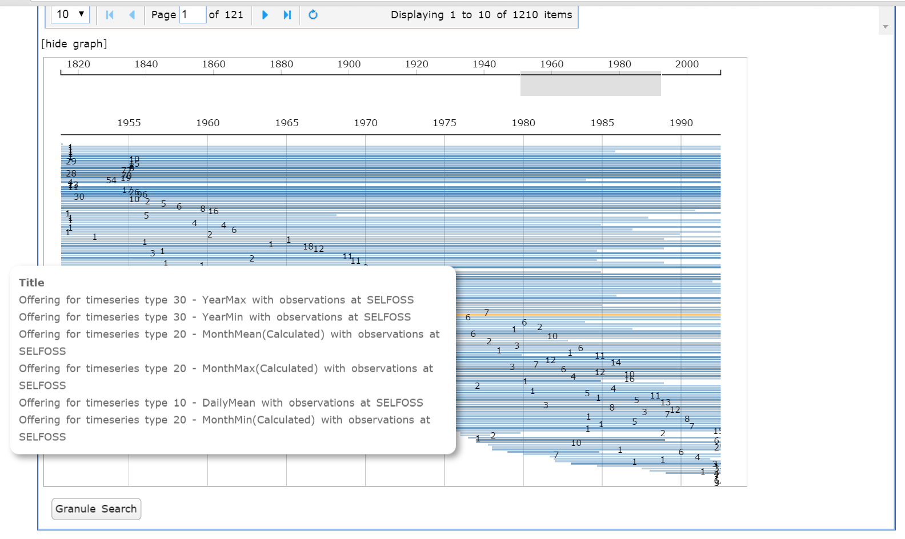

Slide 31
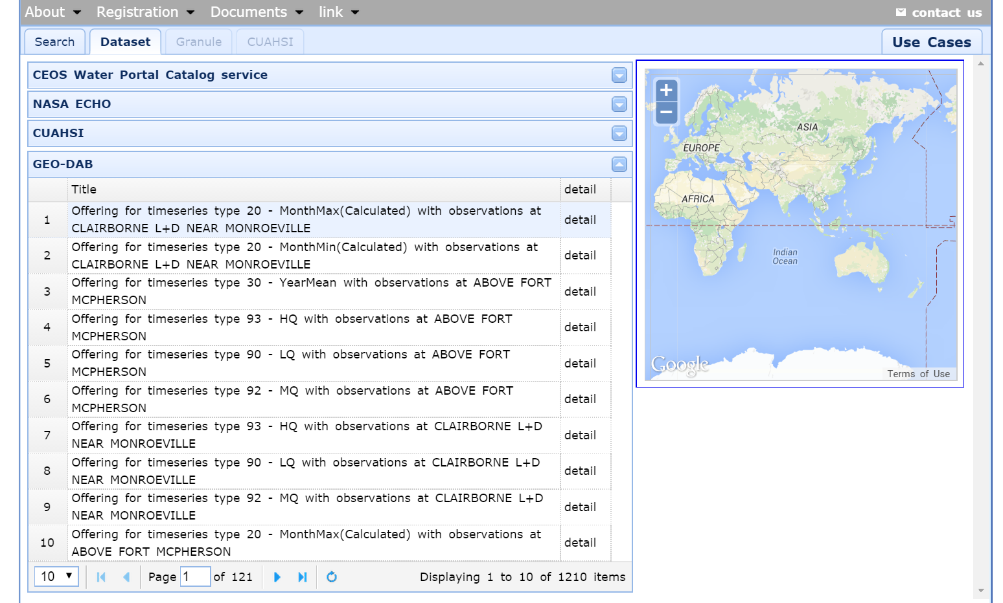
2

Slide 32
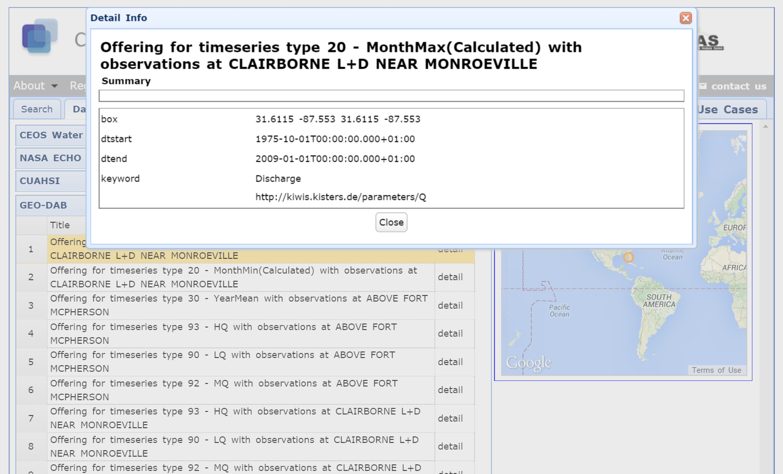
2

Slide 33
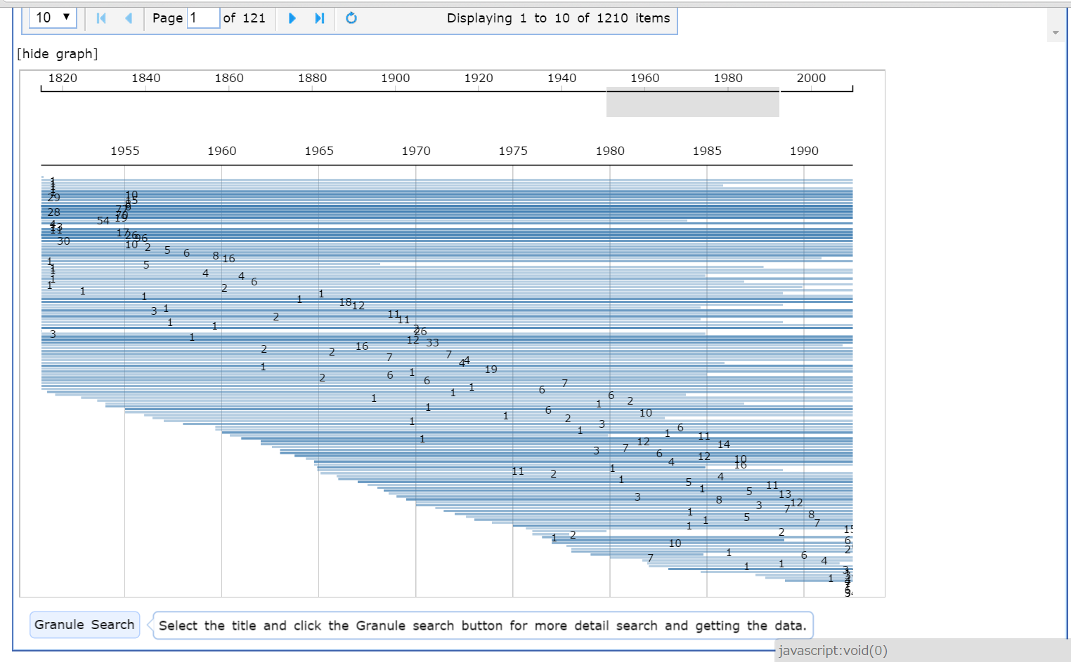
3

Slide 34
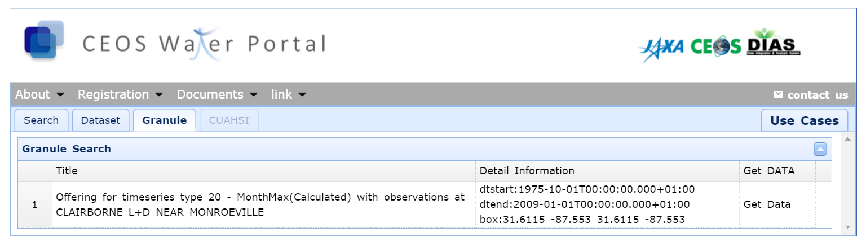
3
Data should be downloaded in WaterML2 format as shown in the next slide, but sometimes does not work.

Slide 35
<sos:GetObservationResponse xmlns:wml2="http://www.opengis.net/waterml/2.0" xmlns:xsi="http://www.w3.org/2001/XMLSchema-instance" xmlns:gml="http://www.opengis.net/gml/3.2"xmlns:sos="http://www.opengis.net/sos/2.0" xmlns:om="http://www.opengis.net/om/2.0" xmlns:sa="http://www.opengis.net/sampling/2.0" xmlns:sams="http://www.opengis.net/samplingSpatial/2.0"xmlns:xlink="http://www.w3.org/1999/xlink" xsi:schemaLocation="http://www.opengis.net/sos/2.0 http://schemas.opengis.net/sos/2.0/sos.xsd http://www.opengis.net/waterml/2.0 http://schemas.opengis.net/waterml/2.0/waterml2.xsd">
<extension xmlns="http://www.opengis.net/swes/2.0">
<wml2:SOSProfileExtension>
<wml2:metadata>
<wml2:DocumentMetadata gml:id="Ki.DocMD.1">
<wml2:generationDate>2015-08-17T06:40:21.499+00:00</wml2:generationDate>
<wml2:generationSystem>KISTERS KiWIS</wml2:generationSystem>
</wml2:DocumentMetadata>
</wml2:metadata>
</wml2:SOSProfileExtension>
</extension>
<sos:observationData>
<om:OM_Observation gml:id="Ki.OM_Obs.1">
<om:phenomenonTime>
<gml:TimePeriod gml:id="Ki.ObsTime.1">
<gml:beginPosition>1999-01-01T00:00:00.000+01:00</gml:beginPosition>
<gml:endPosition>2008-12-01T00:00:00.000+01:00</gml:endPosition>
</gml:TimePeriod>
</om:phenomenonTime>
<om:resultTime>
<gml:TimeInstant gml:id="Ki.resTime.1">
<gml:timePosition>2008-12-01T00:00:00.000+01:00</gml:timePosition>
</gml:TimeInstant>
</om:resultTime>
<om:procedure xlink:href="http://kiwis.kisters.de/tstypes/Month.Max" xlink:title="20 - MonthMax(Calculated)"/>
<om:observedProperty xlink:href="http://kiwis.kisters.de/parameters/Q" xlink:title="Q"/>
<om:featureOfInterest xlink:href="http://kiwis.kisters.de/stations/4149401" xlink:title="CLAIRBORNE L+D NEAR MONROEVILLE"/>
<om:result>
<wml2:MeasurementTimeseries gml:id="Ki.Ts.1348042">
<wml2:defaultPointMetadata>
<wml2:DefaultTVPMeasurementMetadata>
<wml2:qualifier xlink:href="http://kiwis.kisters.de/qualifiers/1064" xlink:title="1064"/>
<wml2:uom code="cumec"/>
<wml2:interpolationType xlink:href="http://www.opengis.net/def/waterml/2.0/interpolationType/ConstPrec" xlink:title="Constant in preceding interval"/>
</wml2:DefaultTVPMeasurementMetadata>
</wml2:defaultPointMetadata>
<wml2:point>
<wml2:MeasurementTVP>
<wml2:time>1999-01-01T00:00:00.000+01:00</wml2:time>
<wml2:value>3398.022</wml2:value>
</wml2:MeasurementTVP>
</wml2:point>
<wml2:point>
<wml2:MeasurementTVP>
<wml2:time>1999-02-01T00:00:00.000+01:00</wml2:time>
<wml2:value>4049.309</wml2:value>
</wml2:MeasurementTVP>
</wml2:point>
<wml2:point>
<wml2:MeasurementTVP>
<wml2:time>1999-03-01T00:00:00.000+01:00</wml2:time>
<wml2:value>2251.189</wml2:value>
</wml2:MeasurementTVP>
<wml2:time>2000-05-01T01:00:00.000+02:00</wml2:time>

Slide 36
L&L, Issues, etc (1/2)
How to/Manual/Guide are needed for CP developers.
  From the GEOSS top page, it’s very difficult how we(CP) can contribute/connect to the GEOSS portal.
Implementation of Opensearch interface is simple and not so difficult.
Since CP is (mainly) focused on the specific area (e.g., water, land, biodiversity, etc), using “essi:sources” in the OSDD and decreasing search results is recommended.

Slide 37
L&L, Issues, etc (2/2)
Receiving “too many search results” causes several issues on the CP side.
  Just showing the results as they are, users have lots of difficulties to find their preferable data. As a result, it is very likely that users will not use the CP again.
  Ranking maybe a good idea, but how to rank?
  Some GUI tips may be helpful, but the scalability is necessary!
Quality control/Service level
  “Data access” sometimes does not work. The CP has no idea what is wrong (data provider system trouble, interface trouble or CP system failure/bag).
  “System maintenance information” is not available.
  Data quality is not guaranteed. Users may want to know the data quality information before downloading/using data.

Slide 38
Feedback from the GCI team and other CPP team members
    In response to the “Too many results” issue : A number of efforts by the DAB to support user views and rank the relevance of results.
    On problems access the data : the DAB does some checking but it is costly to be thorough.
    On data quality : there are pertinent recommendations in both the GEO Data Management and Data Sharing Principles.
    The large result sets are a problem for many groups and maybe a focus group to develop guidelines to address the issue would be useful.
    GEOSEC/Osamu used the example of the DIAS-CEOS Water Portal to raise the idea of GEO branding of community portals. A common approach to referencing GEOSS or even a common look and feel for GEO community portals might be recommended.

