Slide 1
Data Stewardship Interest Group WGISS-40 Meeting
DSIG Overview & Updates
CEOS Best Practices Status
Harwell, Oxfordshire, UK (UKSA)
28 September – 02 October, 2015
Mirko Albani, European Space Agency

Slide 2
Background - DSIG Activities (1)
Sharing Information & experiences during WGISS meetings:
Reporting from CEOS agencies about their investigations, developments, studies, and lessons-learned relating to EO data management and stewardship
Dedicated Sessions on specific topics
Drafting common cross-agency best practices or guidelines on data management and stewardship for possible adoption by WGISS:
Preservation Workflow
EO Data Generic Consolidation Process
Persistent Identifiers
Data Preservation Guidelines
Preserved Data Set Content
Purge Alert Procedure
EO Data Stewardship Definitions
Appraisal Procedure
Archived data media transcription

Slide 3
Background - DSIG Activities (2)
Conducting Joint Activities and/or Pilot Projects on specific data stewardship topics
Contributing to GEO and Standardization activities through:
Specific tasks in the GEO Work-plan (Component C1 - Advances in Life-cycle Data Management within Task IN-02 Earth Data Sets) and future GEO Work Programme.
Proposing WGISS best-practices as input to standardization bodies (e.g. OGC/CCSDS) when relevant.

Slide 4
DSIG sessions during this meeting
Overview and Updates
CEOS Best Practices Status
Dedicated Session on Preservation of Software and Documents at CEOS Agencies:
Approaches and lessons learned in other domains
FITS Standard
CEOS Agencies Approaches and Lessons Learned
Discussion and recommended way forward

Slide 5
Feedback from GEO
Data Management Principles Task Force
DMP-TF

Slide 6
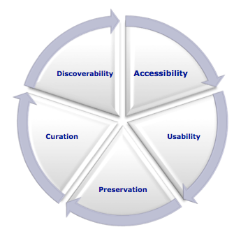
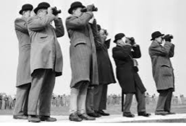
Data Management Principles – Background (1)
The value of each EO is maximized through data life-cycle management, including five foundational elements.
Discoverability
DMP-1 Data and all associated metadata will
be discoverable through catalogues
and search engines, and data access
and use conditions, including licenses,
will be clearly indicated.
Accessibility
DMP-2 Data will be accessible via online services,
including, at minimum, direct download but
preferably user-customizable services for
visualization and computation.

Slide 7
Data Management Principles – Background (2)
Usability
DMP-3 Data will be structured using encodings that are widely accepted
in the target user community and aligned with organizational
needs and observing methods, with preference given to non-
proprietary international standards.
DMP-4 Data will be comprehensively documented, including all elements
necessary to access, use, understand, and process, preferably via
formal structured metadata based on international or community-
approved standards. To the extent possible, data will also be
described in peer-reviewed publications referenced in the
metadata record.
DMP-5 Data will include provenance metadata indicating the origin and
processing history of raw observations and derived products, to
ensure full traceability of the product chain.
DMP-6 Data will be quality-controlled and the results of quality control
shall be indicated in metadata; data made
available in advance of quality control will be
flagged in metadata as unchecked.

Slide 8
Data Management Principles – Background (3)
Preservation
DMP-7 Data will be protected from loss and preserved for
future use; preservation planning will be for the
long term and include guidelines for loss
prevention, retention schedules, and disposal or
transfer procedures.
DMP-8 Data and associated metadata held in data
management systems will be periodically
verified to ensure integrity, authenticity and
readability.
Curation
DMP-9 Data will be managed to perform corrections
and updates in accordance with reviews,
and to enable reprocessing as appropriate;
where applicable this shall follow
established and agreed procedures.
DMP-10 Data will be assigned appropriate
persistent, resolvable identifiers to enable
documents to cite the data on which they
are based and to enable data providers to
receive acknowledgement of use of their data.

Slide 9
DMP TF current tasks and way forward in 2016
Current DMP-TF task:
Develop the “DMP Implementation Guidelines” which will be submitted to the GEO-XII in November for information.
After accomplishment the DMP Task Force will be terminated.
Assumptions and Next Steps:
“DMP Implementation Guidelines” will be updated for acceptance at GEO-XIII in 2016
Metrics to be developed (as a separate document) for monitoring the GEO community implementation of the DMP Implementation Guidelines.
Transit DMP Task Force to a standing WG in 2016 whose mandate includes support for Guidelines Implementation in the GEO community
Current version of the GEO 2016 Transitional Work Program includes a task on Data Sharing Working Group (GD1 task - Advancing GEOSS Data Sharing Principles) whilst the DMP TF activities are proposed within Task GD7 (GCI Development). Further discussions needed.

Slide 10
Upcoming Conferences

Slide 11
PV 2015 Conference: 3-5 November, EUMETSAT

Slide 12
PV 2015 Conference: 3-5 November, EUMETSAT
OBJECTIVES
Share knowledge, experiences, lessons learnt and best practices as well as foster Cooperation in the area of Data Preservation and archived data Stewardship
Address prospects in the domain of high volume, high-velocity, high-variety scientific and technical data preservation together with value adding to these data
Provide a forum for organisations dealing with preservation of own data and value adding to present the status of their activities, plans and expectations

Slide 13
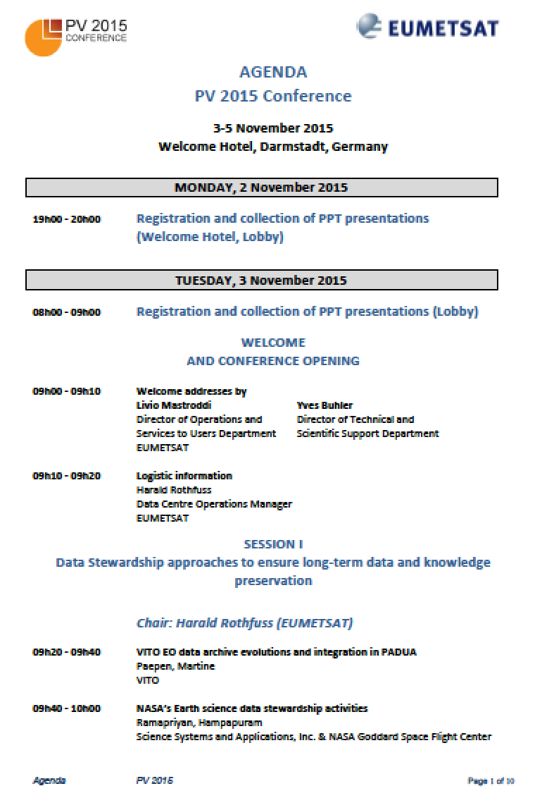
PV 2015 Conference: Main Sessions
Session 1: Data Stewardship approaches to ensure long-term data and knowledge preservation
Session 2: Adding value to data and facilitation of data use
Session 3: Metadata, formats, standards and interoperability
Session 4: Data preservation lessons learnt and future prospects
Programme Available and Registration Open:
http://www.eumetsat.int/website/home/News/ConferencesandEvents/DAT_2447480.html

Slide 14
Big Data From Space – BiDS’16
http://congrexprojects.com/2016-events/16m05/introduction

Slide 15
Big Data From Space – BiDS’16 Objectives
Identify priorities for research, technology development and innovation;
Widen competences and expertise of universities, research institutes, labs, SMEs and industrial actors;
Foster networking of experts and users towards better access and sharing of data, tools and resources;
Leverage innovation, spin-in and spin-off of technologies, and business development arising from research and industry progress;
Increase and promote the value stemming from the huge quantity of data made available nowadays (and in the future);
Contribute to the EO innovation for Europe, as one of the main pillars for the Ground Segment evolution strategy.

Slide 16
Big Data From Space – BiDS’16 Deadlines
Abstract Submission
Authors are invited to submit two-pages abstracts: deadline for abstract submission is 30 October 2015.
Submitted papers will be peer-reviewed by the Program Committee.
Notification of Acceptance as oral presentation or poster will be provided to authors by 20 December 2015.
After acceptance of contribution, authors will be invited to prepare a final 4-page proceedings paper addressing the comments of the reviewers, and to register on the conference web site (see the section registration).
Registration opening: 15 February 2016

Slide 17
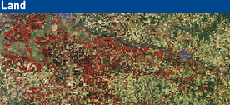
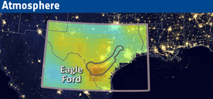
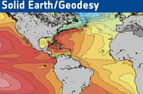
Living Planet Symposium 2016
Prague, Czech Republic
9-13 May 2016
http://lps16.esa.int/

Slide 18
Living Planet 2016 – Dates & Objectives
Present progress and plans for the implementation of ESA EO strategy and the relevance of ESA's EO Programme to societal challenges, science and economy.
Provide an international forum to scientists, researchers and users to present and share state of the art results based on ESA's EO &TPM data.
Review the development of Earth Observation applications.
Present the Copernicus space component and operational services.
Report on ESA’s Exploitation Programmes.
Introduce the current and future planned Earth Observation missions.
Outline ESA’s international cooperation in the field of Earth Observation.
Provide dedicated thematic tutorials and demonstrations.

Slide 19
Living Planet 2016 Data Preservation Session
LTDP Session being organized
“Historical Data for the Continuous Record of our Planet: Valorise the Past to better understand the future”
Keywords:
Data Preservation, Long Time Data Series, Data Curation, Data Valorisation, Data Management, Data Stewardship and Multi-disciplinary Applications.
CEOS WGISS members are invited, if interested, to submit abstracts dealing with utilization of long time data series: abstract to be application focused (not technical).

Slide 20
CEOS Best Practices Status

Slide 21
Data Stewardship Best Practices Document Tree
Policy Documents
Individual organizations' policies (stewardship, access, ...)
EO Data Stewardship Cooperative Framework
Applied to
CEOS EO Space Data Sets
Data Purge Alert Procedure
High level framework documents
Applied to
Technical Documents
Preservation Workflow
EO Data Stewardship Definitions
General guidelines and best practices
Support
Guidelines and best practices on specific topics
Persistent Identifiers Best Practice
EO Data Preservation Guidelines
Preserved Data
Set Content
…
Technical implementation procedures
EO Data Set Consolidation Process
…

Slide 22
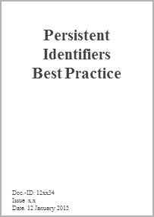
Data Stewardship Best Practices/Guidelines Drafting/Approval Cycle
Japan
USA
Brazil
Spaceborne Earth Observation
Europe
CEOS
Other
Spaceborne,
airborne, and in-situ Earth Observation
ESA LTDP Team and GSCB
LTDP WG
CEOS
CEOS-WGISS DSIG
GEO
DRAFT
?
?
NEEDS
OGC
CCSDS

Slide 23
Persistent Identifiers Best Practice
Issue 1.0: Provides recommendations on the use of Persistent Identifiers to EO mission data, allowing globally unique, unambiguous, and permanent identification of a digital object.
Content
Choosing a PID system
PID numbering
Permanence
Resolving
Granularity
Documentation
Interoperability
A special note on DOI and on registration agents
Use case and scenarios

Slide 24
Additional Comments on PID Best Practices and Way Forward
Issue to be discussed: Assigning PIDs to NRT products?
Is that PID different from the one assigned to archived time series products?
CEOS Persistent Identifier Best Practices: No PIDs are assigned to a dataset series that is not intended for long-term archiving.
EUMETSAT: Not use DOIs for NRT data, only assign to permanent data holdings.
NOAA: No, only archived data are eligible for a NOAA DOI. (From “NOAA Data Citation Procedural Directive v 1.0” document and NOAA Environmental Data Management Wiki site).
ESA (S5P NRT Ozone product): a huge amount of scientific work is based on NRT data and for specific missions like S5P it should be considered a DOI also for NRT. Request coming from users.
Possible approaches for discussion:
Should we include an extension of the relevant recommendation in the CEOS Persistent Identifier Best Practices in order to consider DOI also for NRT data when archived (e.g. S5P)?
NRT DOI could point to a dedicated NRT data landing page.
To grant traceability of data products over the time, DOI should be put in the products metadata (after a repackaging) or in alternative, only one DOI should be considered for a given NRT “collection”.
E.g. S5P NRT Ozone product assigned with a singe DOI which remains unchanged and independent of version number. DOI different from the one assigned to consolidated or reprocessed data which should have different DOIs per major release/version).
[WGISS 39-15]: Closed

Slide 25
Documents for adoption today
Assessment of Drafting Status and Discussion
Issue to DSIG for Review
Comments & Feedback
Final Presentation and Formal Approval
v
EO Data Preservation Guidelines
Preserved Data Set Content
EO Data Stewardship Glossary*
v
v
Final Issue to WGISS
v
REVIEW
FINALIZATION
WGISS#38
WGISS#40
10/14
05/15
06/15
07/15
08/15
09/15
10/15
05/15
06/15
07/15
08/15
09/15
* As contribution to CEOS WGISS Definitions

Slide 26
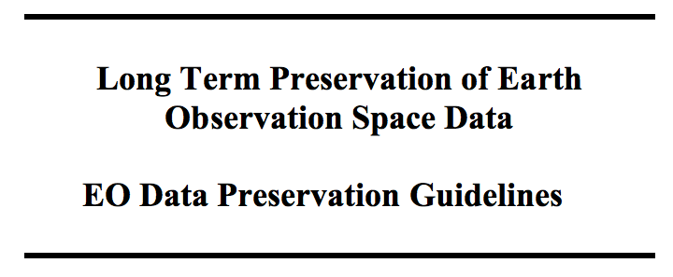
EO Data Preservation Guidelines

Slide 27
EO Data Preservation Guidelines
Implementation Steps of the Workflow Procedure
“Key guidelines” to be applied to data for preservation, accessibility and usability
Guidelines have been aligned and linked to GEO Data Management Principles
Comments received during WGISS review incorporated in the latest version
PRESERVED DATA SET CONTENT DEFINITION AND APPRAISAL
ARCHIVE OPERATION AND
ORGANIZATION
ARCHIVE SECURITY
DATA INGESTION
ARCHIVE MAINTENANCE
DATA ACCESS AND INTEROPERABILITY
Proposal to adopt document today and issue as CEOS Best Practice
DATA EXPLOITATION AND REPROCESSING
DATA PURGE PREVENTION

Slide 28
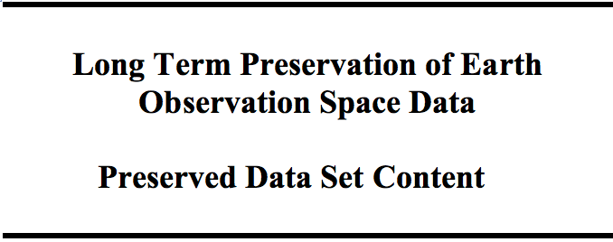
Preserved Data Set Content
It provides a description of the composition of the EO “Preserved Data Set Content (PDSC)” indicating what to preserve in terms of data and associated knowledge during all phases of an EO mission.
It supports some steps of the “Preservation Workflow”
Document shortened and made more user friendly for practical use
Comments received during WGISS review incorporated in the latest version
Proposal to adopt document today and issue as CEOS Best Practice

Slide 29
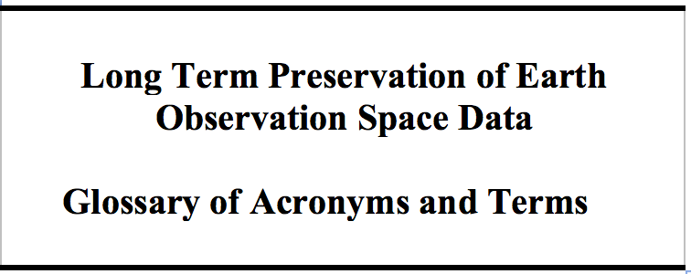
Data Stewardship Glossary
It provides a list of definitions for frequently used acronyms and terms in the field of Earth observation data stewardship.
It has been circulated to WGISS for review and received comments were embedded in the updated version of the document.
Next steps for the document ?
Contribution to the wider “WGISS Glossary of Terms” or adopt/issue as is ?

Slide 30
Data Purge Alert Procedure

Slide 31
Data Loss Prevention
WGISS realizes that it is a responsibility of all organizations holding EO space data to assess the relative value of their holdings and to preserve them for the long term.
Sometimes an organization must make the decision to Purge* one or more datasets that could be important to help meeting the mission requirements of another organization.
The “Data Purge Alert Procedure” aims at preventing, or at least minimizing, the loss of EO space data and is intended to replace the “Purge Alert Service” established in the past by WGISS (John Faundeen) but currently not maintained.
It should be applied by “Purging” organizations to inform other organizations with the goal to trigger a possible transfer of preservation responsibility to another interested entity.
*Data Purge: to permanently and irrecoverably remove all copies of an EO dataset held in an organization.

Slide 32
Data Purge Alert Procedure
Dataset appraisal
Positive purge decision
Dataset holder is owner?
Contact owner/preservation responsible and discuss way forward
No
Yes
Dataset unique?
Dataset unique?
Contact second copy holder(s) and discuss way forward
No
No
Yes
Transfer dataset and/or purge
Contact owner/preservation responsible and discuss way forward
Intersted in taking over responsibility?
Yes
Transfer dataset and purge
Interested in taking over dataset responsibility?
No
No
Contact CEOS
Yes
Yes
Transfer responsibility and knowledge (if any) and purge
Discuss way forward with interested organizations
Procedure varies depending on dataset uniqueness and purging organization responsibility versus the dataset (e.g. ownership).
Transfer dataset, knowledge and responsibility and/or purge

Slide 33
Data Purge Alert - Paths
Path 1- Dataset Holder is owner and Dataset is unique:
Contact CEO Secretary
Discuss way forward with interested organizations
Transfer dataset, knowledge and responsibility and/or purge
Path 2 - Dataset Holder is owner and Dataset is not unique:
Contact second copy holder(s) and discuss way forward
If the second copy holder(s) is not interested in taking over responsibility then the path 1 is followed
If the second copy holder(s) is interested in taking over responsibility then transfer responsibility and knowledge (if any) and purge.
Path 3 - Dataset Holder is not owner and Dataset is unique:
Contact owner/preservation responsible and discuss way forward
If the owner/preservation responsible is interested in taking over dataset responsibility then transfer dataset, together with the knowledge, (also knowledge??) and purge
If the owner and preservation responsible are not interested in taking over dataset responsibility then the Path 1 shall be followed
Path 4 - Dataset Holder is not owner and Dataset is not unique:
Contact owner/preservation responsible and discuss way forward
Transfer dataset and/or purge

Slide 34
Purge Alert Information
The following information should be provided by the initiator when contacting organizations:
Data Records description as a minimum in terms of: mission/sensors characteristics, products specifications, temporal coverage, geographical coverage, dataset size, media of storage, archiving format, IPRs, ownership and access policies.
List of available associated knowledge (e.g. tools, information)
Results and documentation of a Data Record Appraisal (e.g. http://eros.usgs.gov/government/ratool/)
Overview of constraints and conditions if any
Point of Contact

Slide 35
Purge Alert Response & Implementation
Organisations contacted in the frame of the Purge Alert procedure (e.g. dataset owners, copy holders or entities interested to take on the responsibility for the preservation of a dataset) should respond to the “Data Purge Alert” within three months to start conducting negotiations/assessment with the alert initiator.
CEOS shall be involved when needed through CEOS Executive Officer.

Slide 36
Data Purge Alert – CEO
For activating the procedure:
Contact the CEOS Executive Officer (CEO) through the ad-hoc email (XXX);
The email should contain the following subject: <mission> Dataset to be purged and including a description of the case.
CEO will forward it to the mailing list containing all organizations;
Any interested agencies should respond within three months to start conducting negotiations/assessment with the alert initiator.

Slide 37
CEOS Involvement and Open Points
CEOS should be informed through CEO (TBC) which should:
Inform all CEOS agencies principals about the planned purge asking feedback if interested
Publish a “Purge Alert News” on the CEOS Web Site
Establish contact between “purger” and interested entity(es)
Open Points:
Contacts for CEO (own email address or dedicated one)?
Endorsement of Procedure at CEOS Plenary? What/how/when?
Visibility of Purge Alert Procedure on CEOS and WGISS Web Sites?
Involvement of Commercial Data Owners (data at highest risk, in particular old ones)? How (through National Space Agencies)?
“Purge Alert White Paper” being drafted for publication on WGISS web site; communications and outreach.

Slide 38
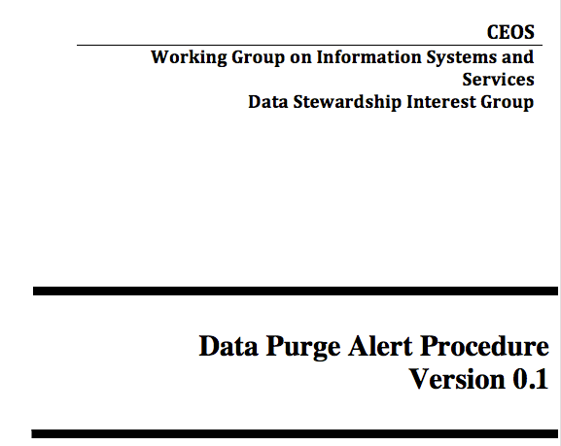
DRAFT Data Purge Alert White Paper
The “Data Purge Alert” procedure aims at preventing, or at least minimizing, the loss of EO space data. Organizations intending, for whatever reason, to purge an EO dataset should apply the procedure (before purging the data) in order to inform other organizations, with the goal to trigger a possible transfer of preservation responsibility to another interested entity.
UNDER CONSOLIDATION
Timeline to be decided: do we need it by next CEOS Plenary ?

Slide 39
Document Management Table
Document name | Custodian | Document ID | File name | Current version | Date | Status | Planned release date
EO Data Preservation Cooperative Framework (DSIG Plan) | M. Albani, ESA | None | Presentations |  |  | Updated at each WGISS meeting
Preservation Workflow | I. Maggio, ESA | CEOS/WGISS/DSIG/PW | Preservation Workflow | 1.0 | 03/2015 | Under approval CEOS | Q2/2015
EO Data Stewardship Glossary | I. Maggio, ESA | CEOS/WGISS/DSIG/GLOS | EO-DataStewardshipGlossary | 1.0 | 09/2015 | Under approval CEOS | Q3/2015
EO Data Preservation Guidelines | M. Albani, ESA | CEOS/WGISS/DSIG/EODPG | EO Data Preservation Guidelines | 1.0 | 09/2015 | Under approval CEOS | Q1/2016
EO Data Set Consolidation Process | R. Cosac, ESA | CEOS/WGISS/DSIG/GEODSCP | Generic Earth Observation Data Set Consolidation Process | 1.0 | 03/2015 | Under approval CEOS | Q2/2015
Preserved Data Set Content | R. Leone, ESA | CEOS/WGISS/DSIG/EOPDSC | EO Preserved Data Set Content | 1.0 | 09/2015 | Under approval CEOS | Q1/2016
Persistent Identifiers Best Practice | T. Christensen, DLR | CEOS/WGISS/ DSIG/PIDBP | CEOS Persistent Identifier Best Practices | 0.7 | 12/2014 | Under approval CEOS | Q2/2015
Data Purge Alert | M. Albani, ESA | CEOS/WGISS/DSIG/DPA | Presentation; to be published on WGISS web site. White paper | 0.1 | n/a | Update ongoing | Q4/2015

Slide 40
Thanks you for your attention !!!
Questions ??

Slide 41
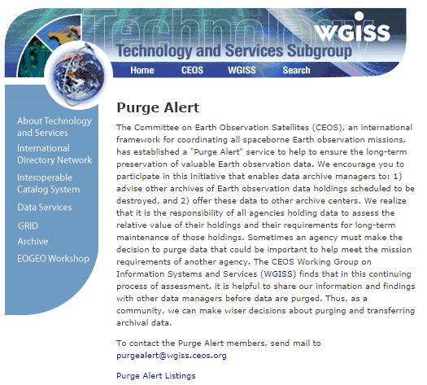
CEOS Purge Alert service
http://wgiss.ceos.org/purgealert/

Slide 42
APPRAISAL PROCEDURE
The data appraisal procedure consists in performing an assessment of an EO space data set under evaluation (for example in case of possible preservation discontinuing) through answering to a set of categorized questions extracted from the USGS EROS Appraisal Online Tool (http://eros.usgs.gov/government/ratool/) or from the CEOS online questionnaire http://wgiss.ceos.org/archive/index.html.
The list of questions should cover:
Mission relevancy
General policy (ISO Standard)
Physical properties (Media)
Metadata
Cost / benefit analysis.
When performing the appraisal, an appraisal report should be produced in order to properly document the different steps performed in the appraisal procedure and the final results. The appraisal report should be provided, in case of purge decision, to other data holders and archive owners together with a description of the data set when applying the data alert procedure.
A link to a template document containing the list of questions and to generate the appraisal report is provided hereafter: http://eros.usgs.gov/government/ratool/export.php?blank

Slide 43
Future documents timeline proposal
Assessment of Drafting Status and Discussion
Issue to DSIG for Review, comments and feedback
Final Presentation and Formal Approval
v
v
Data Purge Alert (White Paper)
Appraisal Procedure
Media Transcription
Final Issue to WGISS
v
REVIEW
FINALIZATION
WGISS#40
WGISS#41
09/15
10/15
11/15
12/15
01/16
02/16
03/16
04/16
05/16

