Slide 1
CEOS – WGISS-40
CNES Technical Work
To Feed the IDN
Martine LARROQUE (CNES)
Véronique PAYOT (AKKA)
1 october 2015

Slide 2
CNES Technical Work
To Feed the IDN
Current status and GOAL
Technical work
Presentation
Creation of CNES metadata for the IDN
Examples
Future achievements
SUMMARY

Slide 3
CURRENT STATus and goal
Current status
CNES metadata repository from various thematics
Available on http://reflecs.cnes.fr/
About 200 metadata online (mission levels included)
Format : ISO19115
CNES Thesaurus based on a tree view
Thematic > Sub-thematic > CNES Scientific category > Scientific keyword
Goal
Import CNES metadata from Earth Observations (~70) into IDN
Technical work : tests with 7 CNES missions (~20 metadata)
Difficulty : mapping between CNES keywords (from CNES thesaurus) and IDN keywords (from IDN thesaurus)
Delivery ISO metadata to convert them to DIF format by IDN technical team

Slide 4
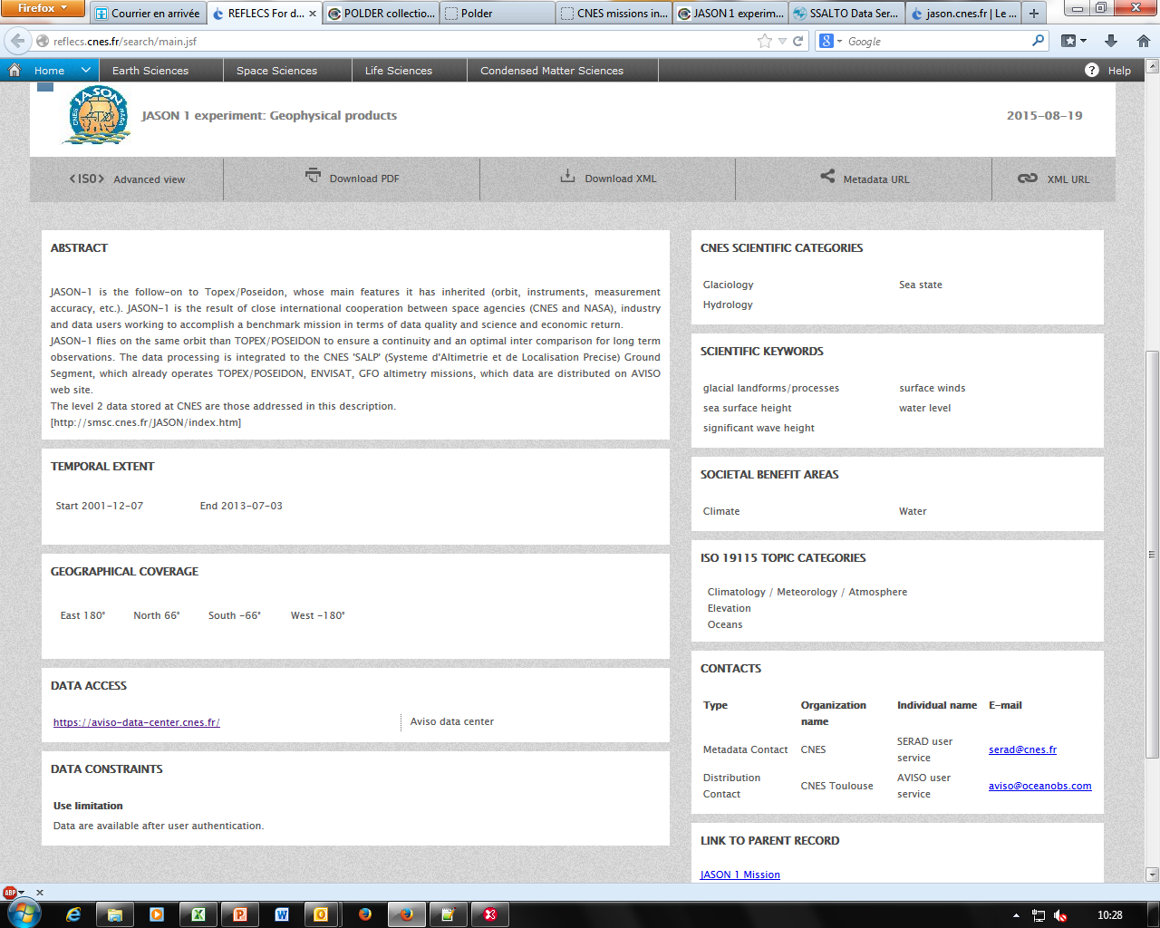
Un contenu texte
CNES Metadata in REFLECS
Texte
Ancillary keywords (IDN)
Science keywords (IDN)
Ancillary keywords (IDN)
ISO Topic category (IDN)

Slide 5
Technical work : presentation
7 reviewed projects
IASI, JASON1, JASON2, PARASOL, POLDER, SPOT,
VEGETATION (working version)
Research of CNES keywords // IDN keywords mapping
Collaborative work with projects managers (CNES) and Michael Morahan (IDN)
MISSION | IDN Metadata
IASI | 1 (mission level)
JASON1 | 1
JASON2 | 1
PARASOL | 6
POLDER | 9
SPOT | 4
OK
Correspondences incorporated directly
into the mapping file
Comparative analysis
CNES // IDN keywords
2014
NOK
Correspondences validated
OK
Temporary correspondences validated
Pending integration in the next version of IDN Thesaurus scheduled for march 2016
Request on going for the new issue of IDN thesaurus
IDN Thesaurus
2015 (march) v8.1
NOK
Keywords mapping OK for all reviewed projects

Slide 6
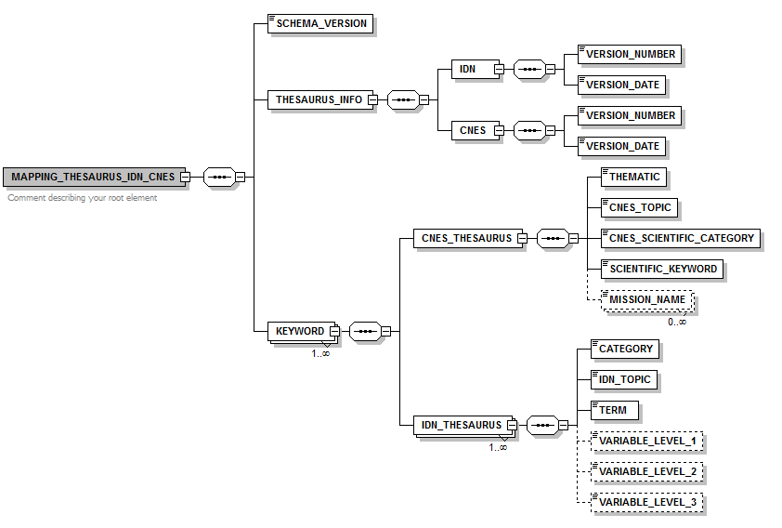
CREATION OF CNES METADATA FOR THE IDN
CNES metadata name for the IDN
The same as CNES metadata for REFLECS + ‘_IDN’ suffix (ex: 54736f5916e9134386cb9725dbbe67ae_IDN.xml)
Creation of a script run_inventory_IDN.sh
Based on a mapping file for keywords
Keywords processing (CNES//IDN)
Mapping file (XML)
Parent terms tree taken into account
1 CNES keyword → 1…N IDN keyword(s)
1 CNES keyword → Different correspondences depending on the mission
Examples

Slide 7
EXAMPLES : keywordS MATCHES
1 CNES keyword → 1…N IDN keyword(s)
1 CNES keyword → Different keywords depending on the mission
urban (EARTH_SCIENCES>LAND_SURFACES>LAND_USE_PLANNING)
URBAN LANDS (EARTH SCIENCE>BIOSPHERE>TERRESTRIAL ECOSYSTEMS)
URBAN AREAS (EARTH SCIENCE>HUMAN DIMENSIONS>HUMAN SETTLEMENTS)
IDN
CNES
glacier topography/ice sheet topography
glacier topography/ice sheet topography (EARTH_SCIENCES>LAND_SURFACES>GLACIOLOGY)
CRYOSAT *
JASON
EARTH SCIENCE>CRYOSPHERE>GLACIERS/ICE SHEETS
EARTH SCIENCE>TERRESTRIAL HYDROSPHERE>GLACIERS/ICE SHEETS
* unprocessed for now

Slide 8
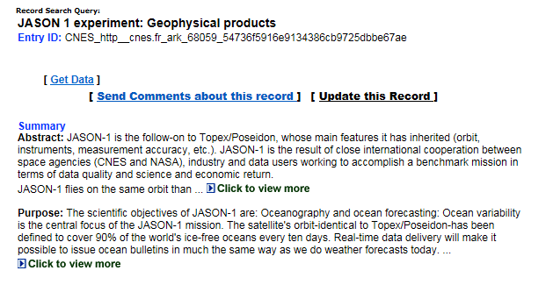
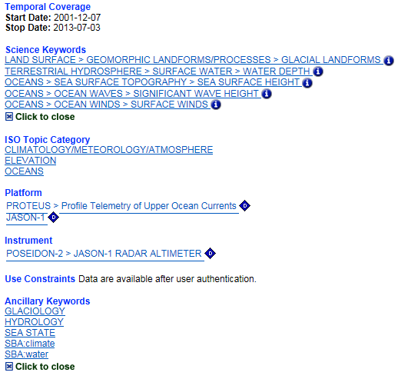
Example of
CNES Metadata (JASON1) in IDN catalog
= Results of CNES//IDN keywords mapping
= ISO Topic category (CNES)
= CNES Scientific Categories (CNES)
= Societal Benefit Areas (CNES)

Slide 9
FUTURE ACHIEVEMENTS
THESAURUS EVOLUTION
IDN Thesaurus
New versions planned : march 2016 (v8.2) and october 2016 (v8.3)
Keep CNES informed of IDN evolutions to upgrade the keywords mapping file (modification, addition, deletion)
NEXT ACTIONS
Continue the construction of the mapping file for all CNES keywords (Earth Sciences)
Identify CNES keywords without known IDN correspondences
Available correspondences found in current IDN thesaurus and/or
Addition of CNES keywords into IDN thesaurus to plan
Deliver the first package of metadata (IASI, JASON1, JASON2, PARASOL, POLDER, SPOT)
Prepare a second metadata package : Pleiades, Spot (Spot World Heritage, TAKE5 (Spot4-5)), Kalideos, SMOS

