Slide 1
WGISS Working Group for Information Systems & Services
Chair report
Committee on Earth Observation Satellites
Andrew Mitchell
NASA– WGISS chair
WGISS-41
Canberra – Australia
14th March – 18th March 2016

Slide 2
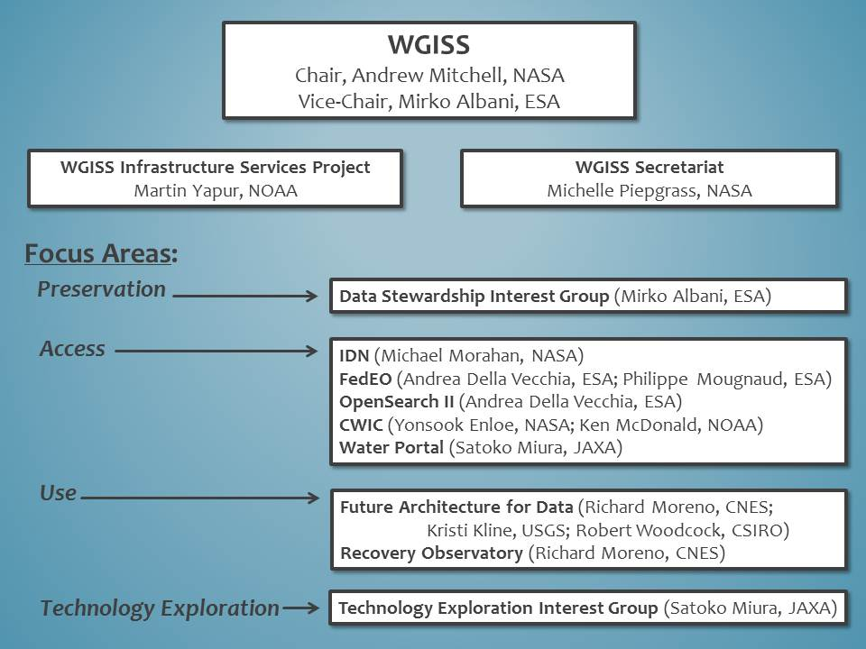
New WGISS Organization

Slide 3
CEOS Work Plan 2016-2018
Virtual endorsement of the CEOS 2015-2017 Work Plan will officially occur on 23th March 2015
In the CEOS Work Plan 2016-2018,
New as of 2016:
OUT-7: Data Cube infrastructure development
Status: WGISS will support the SEO in the development of a general CEOS Data Cube infrastructure
CARB-9: GFOI Data Services Pilot Projects for Kenya and Colombia
Status: WGISS will support the SEO in the delivery of Data Services Pilot Projects (based on the Data Cube architecture) for Kenya and Colombia.
VC-25 Increase the visibility of land surface imaging data holdings
Status: WGISS will work in conjunction with the LSI-VC to ensure relevant datasets are visible through WGISS Interoperable Standards.

Slide 4
CEOS Work Plan 2016-2018
In the CEOS Work Plan 2016-2018,
Pre-existing
DATA-2: Full representation of CEOS Agency datasets in the IDN and accessible via CWIC/OpenSearch
Status: WGISS began discussions with the following Australian centers in order to get their data accessible via WGISS interoperable standards (i.e. IDN, CWIC). (Geosciences Australia / CSIRO / Bureau of Meteorology /Australian National University &National Computational Infrastructure)
DATA-7: Study on future data architectures
Status: The WGISS Future Access of Data (FAD) subgroup is participating in the CEOS Future Data Architectures Study Team. WGISS will host a 1-2 day(s) "Future Data Architecture" Workshop during WGISS 42 in Sept 2016. WGISS is contributing to Section #5 ‘Review of relevant CEOS & agency activities & ambitions’ (WGISS efforts on Big Data & Cloud Computing)
VC-1: List of Relevant Datasets from VCs
Status: WGISS hasn’t received any updated list from the VCs. This will be discussed during SIT 31.

Slide 5
CEOS Work Plan 2016-2018
In the CEOS Work Plan 2016-2018,
Pre-existing
CARB-08-35 – The CEOS Carbon Subgroup (recommended in Carbon-Action-38) will develop guidelines for appropriate data use of satellite data and data products. This will require improved interaction between the carbon cycle community and the satellite community; comprehensive review of the current use of data products, including current data limitations; and reconciliation of methodological differences and spatial compatibility. Such interactions may include co-sponsorship of joint workshops targeting specific data needs and investment in community product assessments, especially for key in comparison exercises.
Status: WGISS is identified as lead for this action although it does not evenly fit within WGISS duties/expertise. As suggested by the CEOS SIT Chair (Briggs), WGISS will offer to host a Carbon Workshop for the CEOS Carbon Subgroup.

Slide 6
2016 GEO Work Program
In the 2016 GEO Work Program,
WGISS has been added as a contributor to the Foundational Task GD-7 Subtask 2 ‘GCI Development’ and GD-2 ‘GCI Operations’.
As contributors, WGISS will:
continue to advocate for CEOS agency mission data to be contributed to the implementation of the GEOSS via the WGISS interoperable systems and standards (e.g. IDN, CWIC, and FedEO). As more CEOS data providers adopt WGISS supported standards (e.g. OGC CSW 2.0.2 and CEOS OpenSearch Best Practices) these data providers holdings will be made discoverable via these systems.
maintain the website titled ‘Connected data assets’ to provide up-to-date metrics for IDN, CWIC and FedEO.
contribute to this activity through the WGISS Technology Exploration Interest Group which serves as a forum for the exchange of technical information and lessons-learned about current and trending software technologies, services, and other internet-based software technologies.

Slide 7
SIT Technical Workshop 2016
31st Strategic Implementation Team Meeting
19th-20th April 2016
ESA/ESRIN, Frascati, Italy
Copernicus Sentinel Data Uptake
Report on the latest ground and space infrastructure developments.
Opportunity for CEOS VCs/WGs/initiatives with an interest in exploitation of Sentinel data to report on their experience and any issues and recommendations to optimise access and exploitation of the data.
Session 9: Copernicus Sentinel Data Uptake and Application
Sentinels Space and Ground Segment Status (EC/ESA) | 13:45 – 14:30 45m
Inputs from CEOS Initiatives (VCs, WGs, AHTs etc.) on Access and Uptake of Sentinel Data (SIT Chair Team compilation) | 14:30 – 15:15 45m

Slide 8
SIT Meeting 2016
SIDE MEETINGS (18th April 2016)
Meeting | Time | Contact | Location
Future Data Architectures | 09:00 – 12:30 | CEOS Chair | Magellan
CEOS and UN SDGs | 10:00 – 12:00 | A Held (CSIRO) | Cook
GEO Global Agriculture Monitoring | 13:00 – 17:00 | B Doorn (NASA) | Room D
LSI-VC | 13:00 – 17:00 | J Lacey (USGS) | Room H
Non-meteorological Applications for Next Generation Geostationary Satellites | 13:30 – 17:00 | CEOS Chair | Magellan
Water constellation Feasibility Study | 14:00 – 16:00 | TBC (JAXA) | Cook
CEOS SEC | 17:00 – 18:00 | CEOS Chair | Magellan

Slide 9
Plenary Changes
A dedicated discussion time has been added to the agenda for many sessions to allow appropriate time for feedback.
A future proposal is to shorten the five day meeting to a three-day high level (Plenary) meeting, and a two-day workshop dedicated to a particular area (Sentinel, data access formats, cloud computing). These workshops provide the opportunity to advertise and invite others to participate, even from outside community.
Joint WGISS meetings with other CEOS WGs/VCs/ad Hoc Groups. WGISS dedicated side meetings at CEOS SIT and Plenary meetings to attract Chair/Vice Chair of groups.
Proposal to initiate a series of monthly webinars for various Technology Exploration Topics

Slide 10
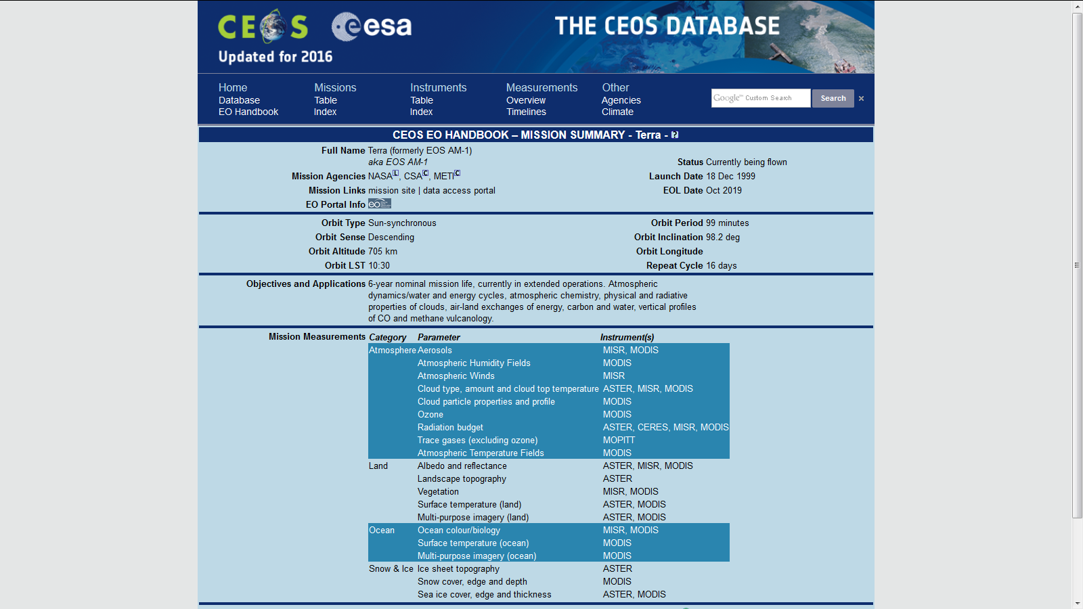
WGISS Support & Outreach
Alignment of IDN/MIM keywords and CEOS EO Handbook and the Data policy portal
Some links exist from the MIM to the data policy/access portal but some links are missing and the context (search criteria) are not passed in the linkage.
http://database.eohandbook.com/database/missionsummary.aspx?missionID=204

Slide 11
WGISS Support & Outreach
Initiate dialog with other WGs, VCs, Ad-hocs
Requesting one-on-one meetings with VC/WG/adHoc team members to access their needs with regards to WGISS capabilities.
WGCV
WG Climate
WGCapD
WG Disasters
GEOGLAM
GFOI
LSI VC
ACC
Ocean Color Radiometry
Precipitation
WGCapD
SST
Ocean Surface Topography
Ocean Surface Vector Winds

Slide 12
WGISS Support & Outreach
WGISS should get involved in more outreach activities.
Something similar to the “Faces of CEOS” video could be developed for WGISS activities. One video could be produced for each of focus area. The one presented at CEOS Plenary was very well received. These can also be pointed to WGCapD and the VCs.
WGISS Interoperability Video shown at 2015 CEOS Plenary
This video demonstrates the search and access of satellite data across multiple CEOS agencies by making use of a common set of commonly defined WGISS interoperability standards. https://youtu.be/xWkuDxGdRjs

