Slide 1
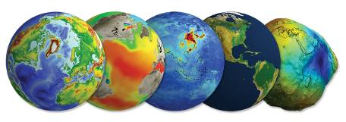
Data Stewardship Interest Group
ESA-NASA Joint Effort for Historical Data Recovery
WGISS-41 Meeting
Canberra, Australia – 14-18 of March, 2016
Dawn Lowe, NASA - Mirko Albani, ESA

Slide 2
Need
Historical Data Recovering
Climate applications are requiring more and more to extend critical long-term science observation back in time through recovery and use of historical data sets.
Notes:
Scanning Multichannel Microwave Radiometer (SMMR)

Slide 3
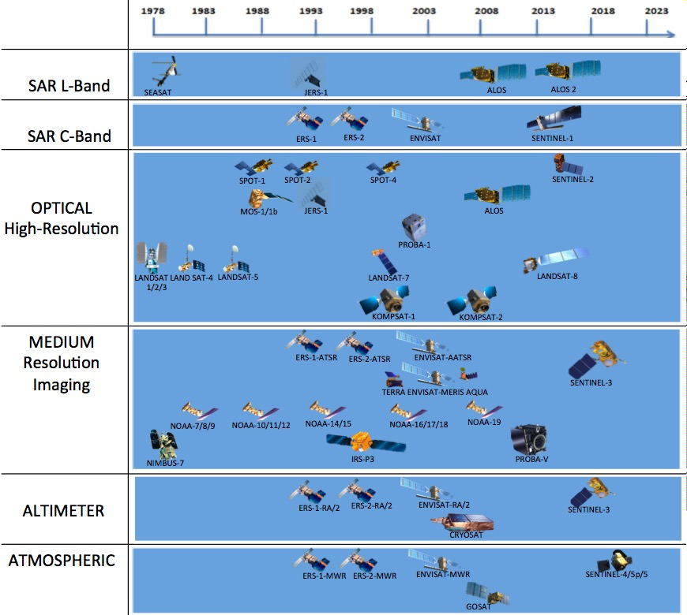
ESA Long Time Data Series (excerpt)
Covered by LTDP
Covered by LTDP+

Slide 4
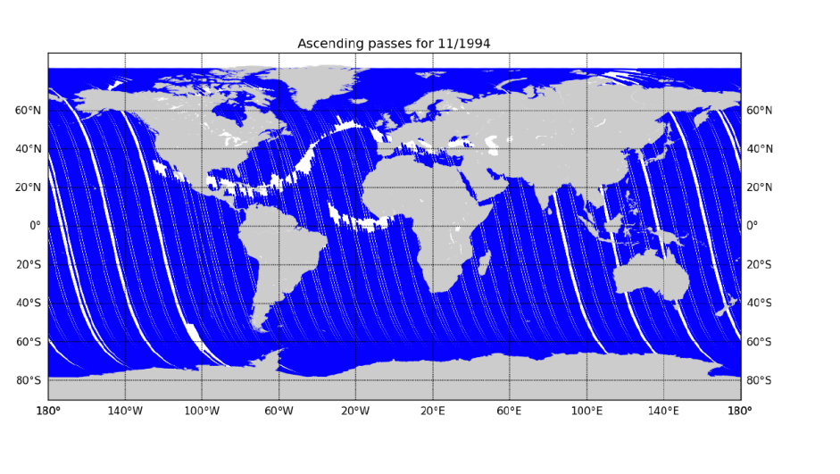
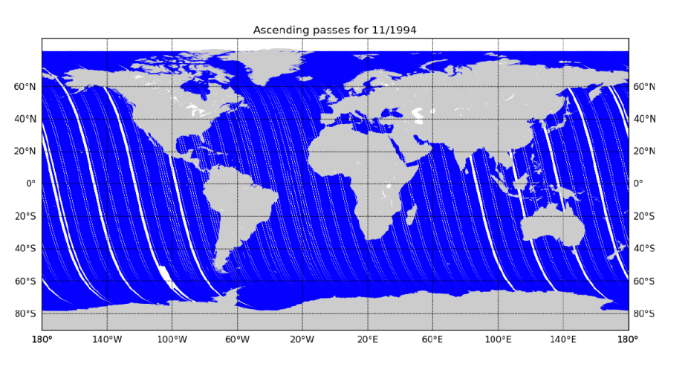
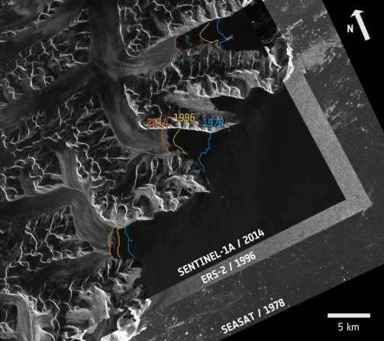
ESA data recovery activities (examples)
→ ERS-1/2 Level-0 LBR Instruments Data Consolidation & Master Dataset Generation
Phase 1 (Completed)- Consolidation & Gap analysis
Phase 2 (On-going): Data transcription and gap filling
→ SEASAT SAR data recovery:
Greenland glaciers as seen by 3 generations of radar missions

Slide 5
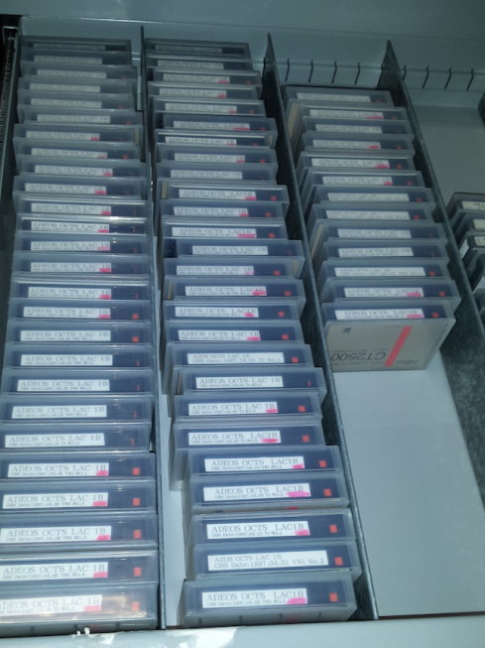
Heritage datasets to be addressed in the coming months
Nimbus-7
Coastal Zone Color Scanner (CZCS)
Nov 1978 – Jun 1986
Marine Observation Satellites MOS-1 & MOS-1b
MESSR (Multi-Spectral Electronic Self-Scanning Radiometer)
VTIR (Visible and Thermal Infrared Radiometer)
Feb 1987 – Nov 1995 & Feb 1990 – April 1996
Adeos-1
OCTS (Ocean Colour and Temperature Scanner)
Aug 1996 – Jun 1997
SPOT-1 & SPOT-2
Feb 1986 – Dec 1990 & Jan 1990 – Jun 2009
HRV (High Resolution Visible) & HRVIR (High Resolution Visible IR)
Priority order being confirmed with ESA Climate Change Initiative (CCI) representatives

Slide 6
“LTDP+” Programme: 2017-2021
ESA “LTDP+” Programme will support the recovery, preservation, access and valorization of heritage data of European interest.
Long Term Data Preservation (LTDP)
Secure preservation of ESA scientific heritage data assets and their associated information
Prevent loss of data from (non-ESA) missions at preservation risk and judged of European interest
Mission to Heritage Data (M2HD)
Ensure accessibility to users relying on latest ICT as expected by users
Ensure continuous quality improvement of EO heritage data for continuity with current & future missions for multi-disciplinary applications and broader data use
Generation and management of Fundamental EO Data Records (Level-1) using ESA and MSs National archived data complemented with current ones, to better respond to societal challenges
(LTDP+)

Slide 7
NASA MEaSUREs Program
Making Earth Science Data Records (ESDRs) for Use in Research Environments
An ESDR is defined as a unified and coherent set of observations of a given parameter of the Earth system, which is optimized to meet specific requirements in addressing science questions. These records are critical to understanding Earth System processes, to assessing variability, long-term trends, and change in the Earth System, and to provide input and validation means to modeling efforts.
Climate Data Records (CDRs) are a particular case of ESDRs

Slide 8
MEaSUREs Summary
30 Projects selected as a result of 2006 call for proposals
Most started in 2008 (start dates ranged from January 1, 2008 to April 1, 2009)
Most were 5-year projects and completed now
27 Projects selected as a result of 2012 call for proposals
Most started in 2013 (start dates ranged from January 1, 2013 to February 1, 2014)
Atmospheric Composition (3)
Carbon Cycle and Ecosystems (7)
Climate Variability and Change (13)
Earth Surface and Interior (3)
Water and Energy Cycle (1)

Slide 9
MEaSUREs and DAACs
MEaSUREs Program funds investigators to generate ESDRs starting with relatively mature algorithms
Algorithms to be used for generating ESDRs must be certified by community through processes managed by Program Scientists and Program Manager
Products generated by MEaSUREs Projects will be stored and distributed to users from the projects for their duration
“Final versions” of products will be migrated to a designated DAAC for archiving and distribution

Slide 10
Sample Highlights
Following slides from MEaSUREs PI’s illustrate a few of the ESDR products being developed

Slide 11
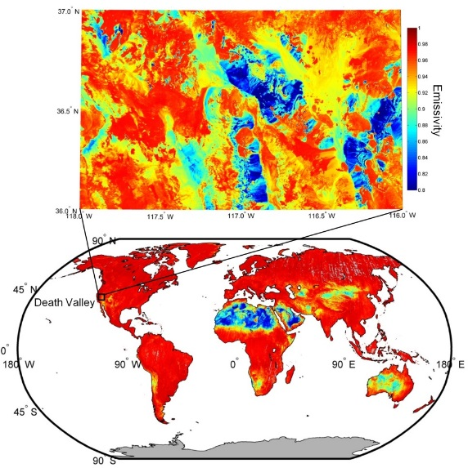
ASTER Global Emissivity Database (GED) released
The MEaSUREs Unified Emissivity ESDR depends on ASTER GED
A Unified and Coherent Land Surface Temperature and Emissivity (LST&E) Earth System Data Record (ESDR) for Earth Science
Recently NASA/JPL released the most detailed emissivity map of the Earth's surface at 100 m spatial resolution termed the ASTER Global Emissivity Database (ASTER GED)
ASTER GED is being used to improve estimates of Earth's surface temperature, atmospheric water vapor, net longwave radiation, and in validation studies with other satellite sensor products and ground surface data.
The ASTER GED provides an average emissivity over a 9 year period from 2000-2008 of the surface at ~100 m spatial resolution for the five ASTER thermal infrared bands from 8-12 µm.

Slide 12
Strong Variation in Ice Flow in Greenland
Greenland Ice Mapping Project
The project uses data from the international constellation of SARs and Landsat to measure ice-flow velocity in Greenland. The data represent an important baseline data set in advance of the NISAR mission.
Data have revealed an unexpected degree of variability in ice flow. Glaciers are changing speeds rapidly and, although some glaciers have slowed, on average the speed of glaciers in Greenland has increased by >30% over the last decade.
Significant because increased glacier flow discharges more ice to the ocean, increasing the rate of sea level rise, which the IPCC has identified as the major source of uncertainty in sea level projections.

Slide 13
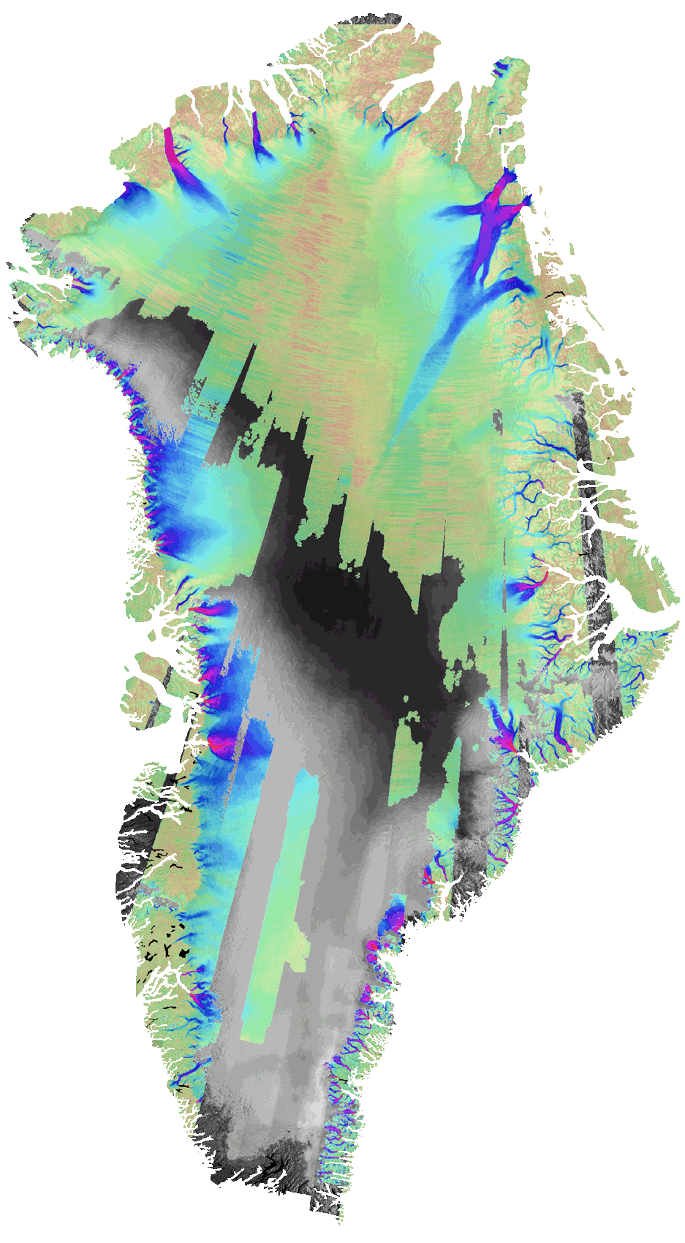
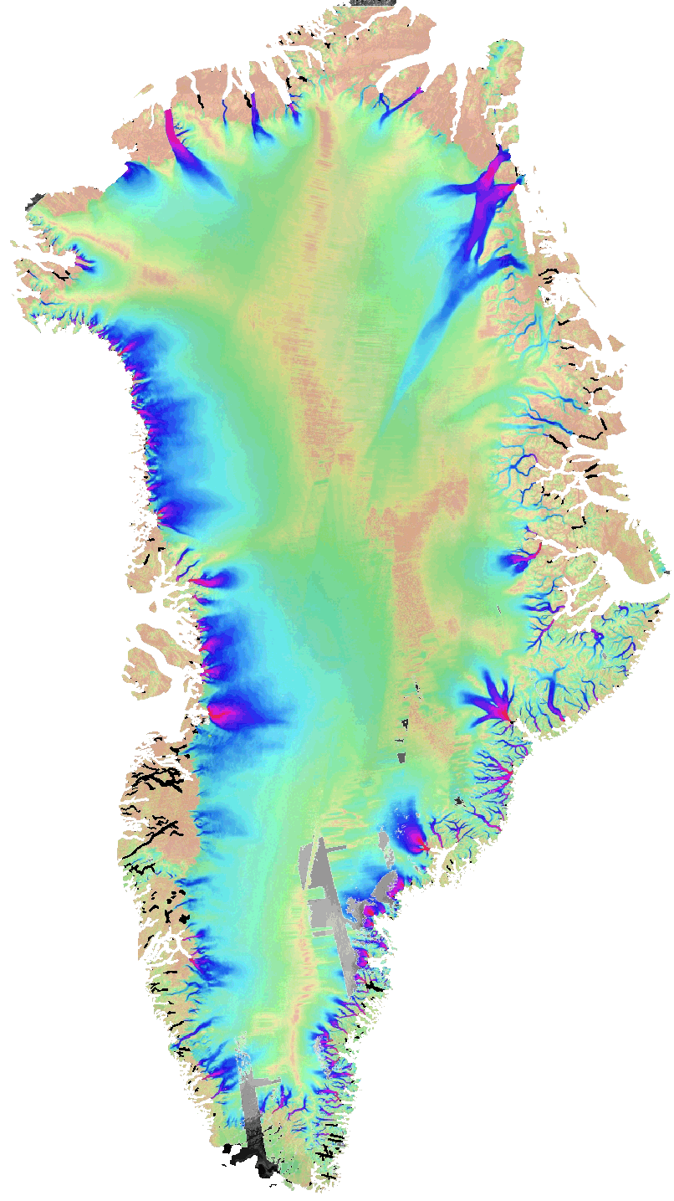
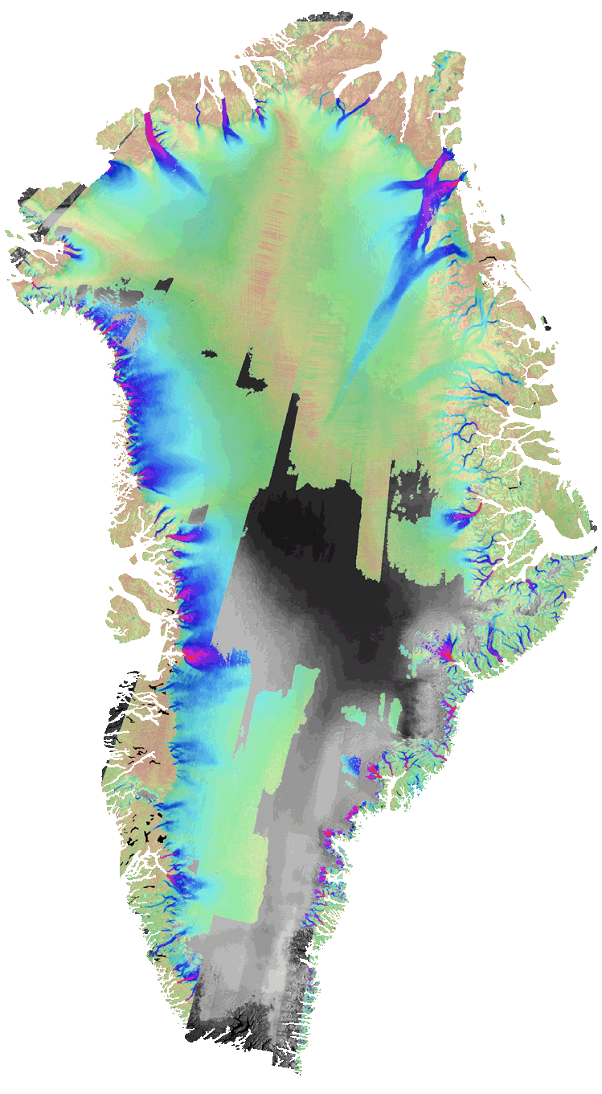
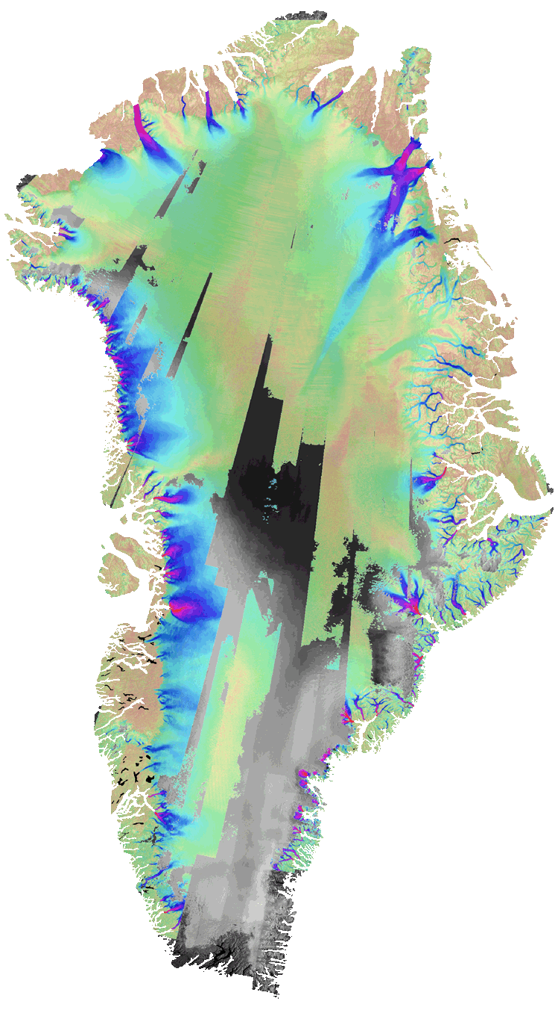
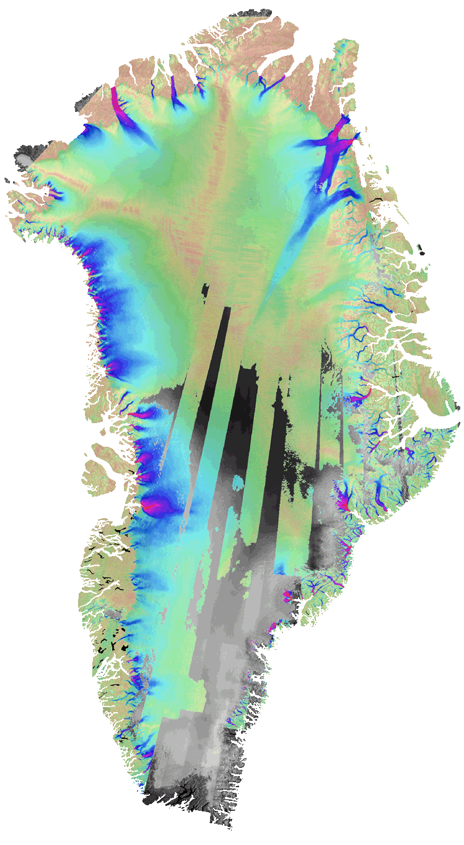
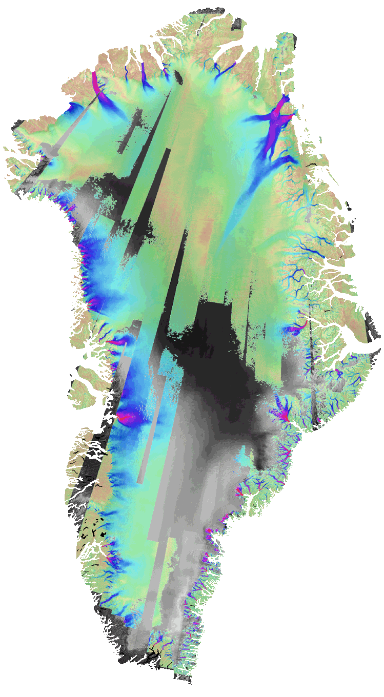
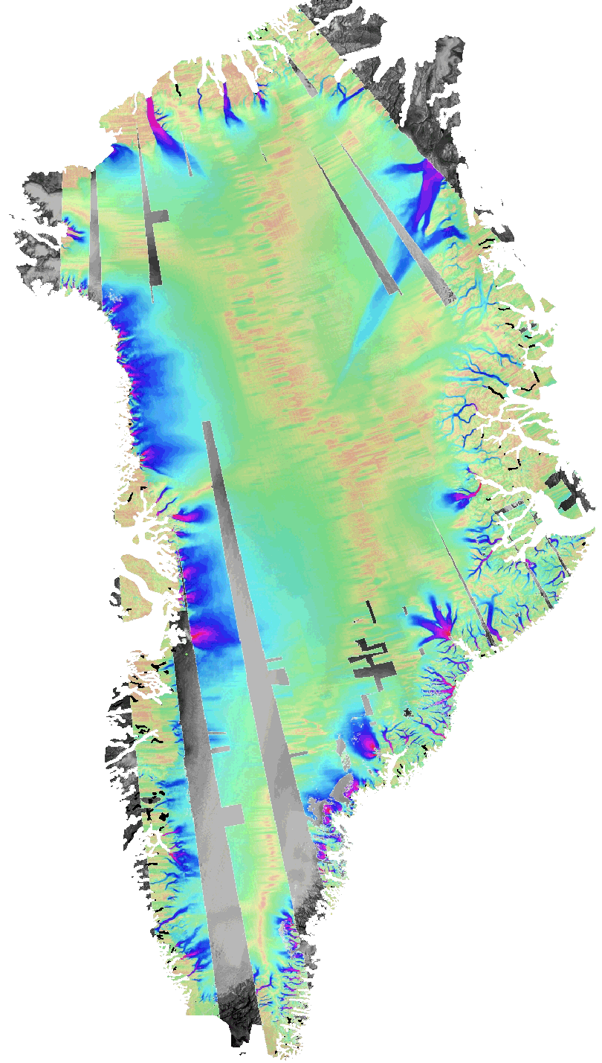
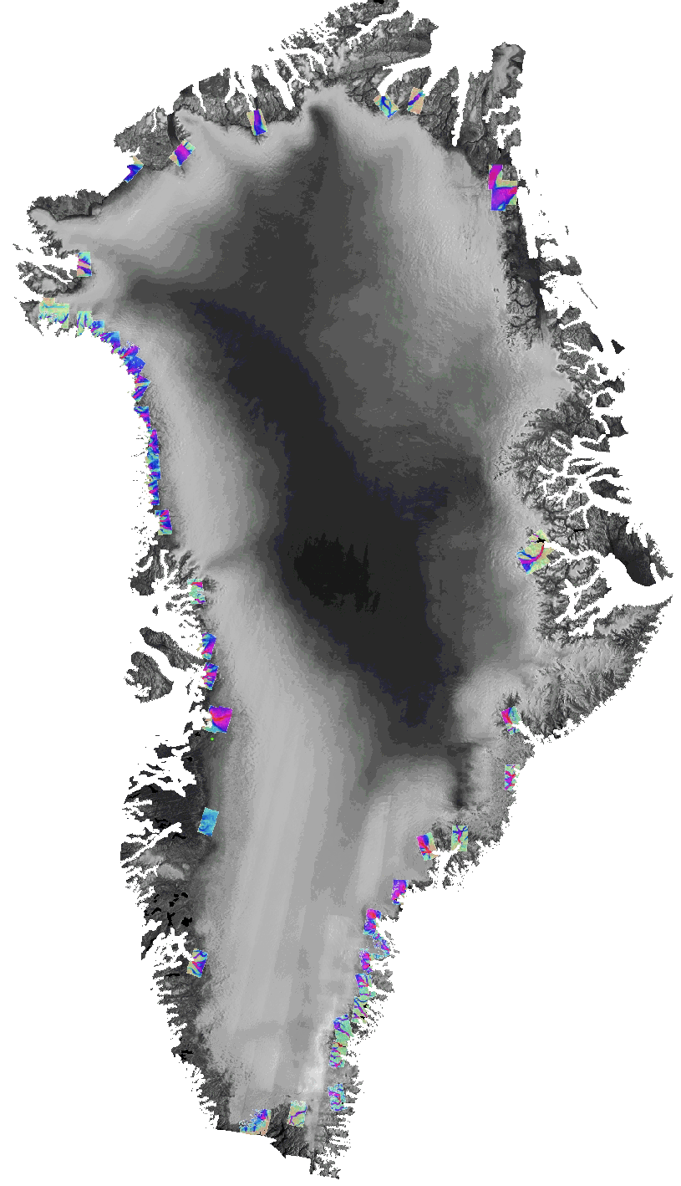
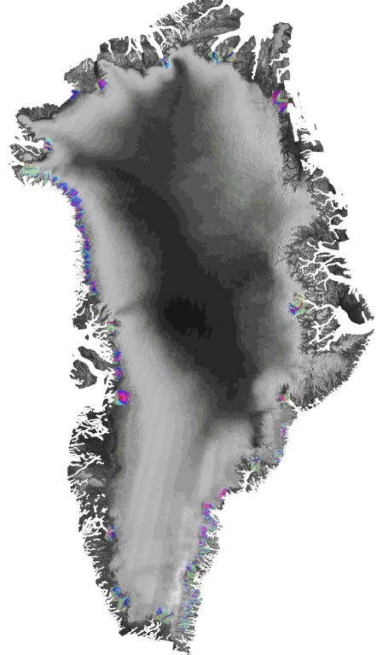
Time Series Enabled by an International Constellation
2000/1
Multi-Year Composite
2005/6
2006/7
2007/8
2008/9
2009/10
2010/11
2011/12
Canadian Space Agency’s RADARSAT 1
Greenland Ice Mapping Project
JAXA ALOS
DLR’sTSX

Slide 14
NASA – ESA Joint Activities
Discussions have been started between ESA and NASA, as part of their bilateral cooperation activities, for the identification and recovery of high priority datasets starting from the following initial set:
NIMBUS-7
SEASAT
HCMM
Objective is to recover and possibly harmonise the identified data sets (when complementary data holdings available):
Uniqueness & Completeness analysis;
Format alignment;
Reprocessing campaigns;

Slide 15
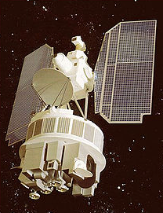
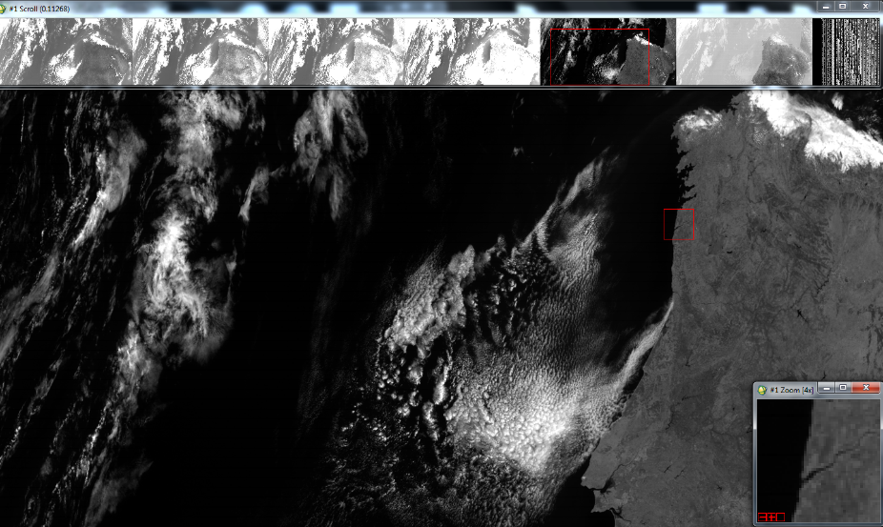
EXAMPLE: Nimbus-7 CZCS ESA Data holdings
Operational Period: October 1978 – June 1986
ESA data holdings from Coastal Zone Colour Scanner (CZCS) sensor:
Volume: 120 GB of Level-1 and Level-2 data
Timeframe: 09/11/1978 to 22/04/1986
Acquisition stations: Maspalomas (MP), Lannion (FR)
Spatial coverage: Europe, NW Africa, NE Atlantic Ocean

Slide 16
EXAMPLE: Detailed Nimbus-7 CZCS ESA Data Holdings
ESA Nimbus-7 Data
Data Type | Size | No. of products | Notes | Coverage
AUX | 122 MB | - | - | NW Africa Europe NE Atlantic Ocean
L1 MP* | 36.9 GB | 3211 | L1 Maspalomas (received Nov 2013)
L1 MP+FR | 66.1 GB | 6319 | L1 Data from both Maspalomas (MP: 2021 products) and Lannion (FR: 4298 products)
L2 | 15.9 GB | 1321
Total | 119 GB | 10851
*This was labelled as Level-0 Maspalomas data, by the station. However, ESA internal analysis suggests that this actually represents Level-1 data
ESA Nimbus-7 CZCS Datasets Coverage
Year | 1978 | 1979 | 1980 | 1981 | 1982 | 1983 | 1984 | 1985 | 1986
Level 1 MP | No data | 1 May - 21 Nov (large gaps) | Jan – Apr (large gaps) | No data | All year (with gaps) | All year (with gaps) | All year (some gaps) | All year (few gaps) | Only March and April
Level 1 MP+FR | 9 Nov - 30 Dec (few days gaps) | 7 Jan - 8 Dec (some gaps) | All year (with gaps) | All year (with gaps) | All year (with gaps) | Aug to Oct | All year (with gaps) | Apr-July, Oct, Dec | No data
Level 2 | No data | No data | No data | Only May and June | May to Aug, Dec | June to Dec | All year (with gaps) | No data | No data

Slide 17
EXAMPLE: Nimbus-7 CZCS ESA Data Holdings Issues and Next Steps
L0 data and software/processor not available at ESA.
ESA CZCS data holdings cannot be regenerated/reprocessed. Approximately 50% of L1 and L2 products are unique and should be preserved in the long term (together with the knowledge).
Data quality is good (similar to NASA), but temporal coverage is scattered, sometimes whole months and even years (particularly for the L2) are missing.
Existing tools (e.g. SeaDAS, BEAM) cannot be used to open ESA Nimbus CZCS data holdings.
All data types are readable with ENVI, however, this is not a straightforward process: the header information has to be inserted or a header file has to be created and used as input.
Planned activities: cooperation with NASA to understand how the ESA CZCS data holdings can be improved and to discuss a possible harmonization/alignment of the NASA and ESA datasets in order to achieve a consistent, consolidated Nimbus-7 CZCS dataset.
Notes:
Uniqueness Analysis: the ESA Nimbus-7 dataset consists of unique data at all levels (~50% overall) when compared to data available at NASA OBPG http://oceandata.sci.gsfc.nasa.gov/CZCS/
Quality Analysis: ESA CZCS products are of a quality similar to that of the NASA products in terms of anomalies.

Slide 18
New possible datasets
Data Set | Mission(s) | Sensor(s) | Mission Owner | Data Set Location
Ozone profiles from 30 to 110 km | EURECA | ORA | ESA | Belgian Institute for Space Aeronomy (TBC)
Grille vertical profiles | Spacelab 1; ATLAS-1 | Grille (Infrared Spectrometer) | Spacelab 1: NASA-ESA ATLAS-1: NASA | Belgian Institute for Space Aeronomy (TBC)
Deuterium and Hydrogen atomic concentrations | ATLAS-1 | ALAE | NASA | Unknown (Sensor Owner: CNRS)
Solar spectral irradiance | Spacelab 1; EURECA; ATLAS missions | SOLSPEC | Spacelab 1: NASA-ESA EURECA: ESA ATLAS missions: NASA | Institut Pierre Simon Laplace (TBC)
ESMR data sets from the polar regions | Nimbus-5 | ESMR | NASA | NASA (NSIDC - National Snow & Ice Data Center) (TBC)
ESMR Imagery of Brightness Temperature on 70 mm Film | Nimbus-5 | ESMR | NASA | GSFC - Goddard Earth Science Data and Information Services (GES DISC) (TBC)
SeaSat SMMR data | SeaSat | SMMR | NASA/JPL | JPL Physical Oceanography DAAC (TBC)

Slide 19
Proposal of DSIG joint activity: “Heritage Data Recovery”
→ Discussion on joint activities started in Europe (LTDP WG) and between ESA and NASA;
Proposal:
Define and implement these activities as part of DSIG joint projects in cooperation among CEOS agencies.
Way Forward:
Identification of heritage data sets of interest to be recovered:
Location and status
Format, Volume, etc.
Prioritization based on uniqueness, applications, needs, impact, etc.
Define approach and start data recovering, harmonization, reprocessing, discovery, access, preservation, valorisation
Comments ? Actions ?

Slide 20
Thank you for your attention !!!

Slide 21
ORA - Ozone Profiles
Data Set: Ozone profiles from 30 to 110 km
Mission: EURECA (European Retrievable Carrier)
Mission owner: ESA
Data Set Instrument/Sensor: ORA (Occultation Radiometer Instrument)
Data Set Location: Belgian Institute for Space Aeronomy (tbc)
Storage Media: unknown
Data/Products Format: unknown
Temporal Coverage: August 1992 - April 1993 (tbc)
Geographical Coverage: Global (tbc)
More Info: http://nssdc.gsfc.nasa.gov/nmc/experimentDisplay.do?id=1992-049B-10
Point of Contact: Simon Chabrillat, Belgian Institute for Space Aeronomy simon.chabrillat@aeronomie.be; simonc@oma.be
Next Step: ESA to contact Simon Chabrillat for more information regarding data set location, storage media and format.

Slide 22
Grille Vertical Profiles
Data Set: Grille vertical profiles between 15 and 150 km
Mission(s): Spacelab 1 (STS-9), ATLAS-1 (STS-45)
Mission(s) owner(s):
Spacelab 1: NASA-ESA
ATLAS-1: NASA
Data Set Instrument(s)/Sensor(s): Grille (Infrared Spectrometer)
Data Set Location: Belgian Institute for Space Aeronomy (tbc)
Storage Media: unknown
Data/Products Format: unknown
Temporal Coverage:
28/11/1983 to 08/12/1983 (Spacelab 1)
24/03/1992 to 02/04/1992 (ATLAS-1)
Geographical Coverage: Global
More Info: http://nssdc.gsfc.nasa.gov/nmc/experimentDisplay.do?id=ATLAS1%20%20%20-06
Point of Contact: Simon Chabrillat, Belgian Institute for Space Aeronomy simon.chabrillat@aeronomie.be; simonc@oma.be
Next Step: ESA to contact Simon Chabrillat for more information regarding data set location, storage media and format.

Slide 23
ALAE - Deuterium and Hydrogen atomic concentrations
Data Set: ALAE - Deuterium and Hydrogen atomic concentrations
Mission: ATLAS-1 (STS-45)
Mission owner: NASA
Data Set Instrument/Sensor: ALAE (Atmospheric Lyman-Alpha Emissions)
Instrument/Sensor Owner: CNRS, France
Data Set Location: unknown
Storage Media: unknown
Data/Products Format: unknown
Temporal Coverage: 24/03/1992 to 02/04/1992
Geographical Coverage: Global (mesosphere, thermosphere, exosphere)
More Info: http://nssdc.gsfc.nasa.gov/nmc/experimentDisplay.do?id=ATLAS1%20%20%20-13
Point of Contact:
Jean-Loup Bertaux (Principal Investigator), CNRS, bertaux@aerov.jussieu.fr
Simon Chabrillat, Belgian Institute for Space Aeronomy simon.chabrillat@aeronomie.be; simonc@oma.be
Next Step: ESA to contact Belgian Institute for Space Aeronomy and CNRS to identify storage, location and format.

Slide 24
SOLSPEC - Solar spectral irradiance
Data Set: Solar spectral irradiance measurements from space
Mission(s): Spacelab 1, EURECA, ATLAS missions (STS-45, STS-56; STS-66)
Mission(s) owner(s):
Spacelab 1 (STS-9): NASA-ESA
EURECA (STS-46 and STS-57): ESA
ATLAS-1 (STS-45, STS-56; STS-66 missions): NASA
Data Set Instrument/Sensor: SOLSPEC
Instrument/Sensor Owner: CNRS, France
Data Set Location: Institut Pierre Simon Laplace - https://www.ipsl.fr/ (tbc)
Storage Media: unknown
Data/Products Format: unknown
Temporal Coverage: unknown
Geographical Coverage: Sun (global)
More Info: http://solspec.projet.latmos.ipsl.fr/SOLSPEC_GB/Background.html
Contact: http://solspec.projet.latmos.ipsl.fr/SOLSPEC_GB/Contact.html
Next Step: ESA to contact CNRS/ISPL and Belgian Institute for Space Aeronomy to confirm data set location, and identify storage media, format and temporal coverage.

Slide 25
Nimbus-5 ESMR - Data sets from the Polar regions
Data Set: Nimbus-5 ESMR data from 1972-1976
Mission: Nimbus-5
Mission owner: NASA
Data Set Instrument/Sensor: ESMR (Electrically Scanning Microwave Radiometer)
Data Set Location: NASA - NSIDC (National Snow & Ice Data Center) (tbc)
Storage Media: unknown
Data/Products Format:
Nimbus-5 ESMR Polar Gridded Sea Ice Concentrations: HDF
Nimbus-5 ESMR Daily Polar Gridded Brightness Temperatures: 2-byte integer flat-binary
Temporal Coverage:
Nimbus-5 ESMR Polar Gridded Sea Ice Concentrations: December 1972 - December 1976 (daily and monthly averages)
Nimbus-5 ESMR Daily Polar Gridded Brightness Temperatures: December 1972 - May 1997 (data are averaged daily)
Geographical Coverage: North and South Polar Regions (25 km gridded resolution)
More Info: https://nsidc.org/data/docs/daac/nsidc0009_esmr_seaice.gd.html; https://nsidc.org/data/docs/daac/nsidc0077_esmr_tbs.gd.html
Contact: NSIDC User Services, National Snow and Ice Data Center, nsidc@nsidc.org
Next Step: The Climate Change Initiative would be interested in Nimbus-5 ESMR data at swath level. NASA/NSIDC to provide some further information regarding the availability of this data, but also the location, storage, format, etc.

Slide 26
Nimbus-5 ESMR - Brightness Temperature Imagery
Data Set: Nimbus-5 ESMR Imagery of Brightness Temperature on 70 mm Film
Mission: Nimbus-5
Mission owner: NASA
Data Set Instrument/Sensor: ESMR (Electrically Scanning Microwave Radiometer)
Data Set Location: NASA GSFC - Goddard Earth Science Data and Information Services (GES DISC)
Storage Media: unknown
Data Set Volume: approx. 500 MB per TAR file containing 5 MB images
Data/Products Format: JPEG 2000 (TAR containing JPEG 2000 images)
Temporal Coverage: 11/12/1972 to 09/05/1973
Geographical Coverage: Global (90.0 N to -90.0 S; 180.0 E to -180.0 W)
More Info: http://go.nasa.gov/1OZYrZT
Contact: GES DISC HELP DESK SUPPORT GROUP, help-disc@listserv.gsfc.nasa.gov; James Edward Johnson (Technical Contact), James.Johnson@nasa.gov
Next Step: “Get Data” links are broken. NASA/GSFC (GES DISC) to confirm if this data are available and if so, where. NASA to also confirm whether these data are daily averaged or brightness temperatures at swath level, as the latter is of high interest to the Climate Change Initiative.

Slide 27
SeaSat SMMR Data
Data Set: SeaSat SMMR Data (Level 2)
Mission: SeaSat
Mission owner: NASA/JPL
Data Set Instrument/Sensor: SMMR (Scanning Multichannel Microwave Radiometer)
Data Set Location: JPL Physical Oceanography DAAC - https://podaac.jpl.nasa.gov/
Storage Media: 1600bpi Magnetic Tapes
Data Set Volume: 381 magnetic tapes (1600 bpi)
Data/Products Format: Level 2.0 (Unknown format)
Temporal Coverage: 07/07/1978 to 10/10/1978
Geographical Coverage: SW Extent: 72S, 180W; NE Extent: 71N, 180E
More Info: http://rainbow.ldeo.columbia.edu/data/nasaentries/nasa3315.html; http://nsidc.org/data/docs/daac/seasat_platform.gd.html
Contact: JPL User Service Office, podaac@shrimp.jpl.nasa.gov
Next Step: According to the information retrieved from http://rainbow.ldeo.columbia.edu/data/nasaentries/nasa3315.html, SeaSat SMMR should be on magnetic tapes at JPL. NASA to confirm this and provide some further details regarding this data set. Are there other SMMR product levels available?

