Slide 1
Data Stewardship Interest Group
ESA – EO Data Stewardship Maturity Matrix
WGISS#41 Meeting, Canberra, (AUS)
14–18 March, 2016
Mirko Albani, European Space Agency

Slide 2
Outline
Review of Maturity Matrices relevant to Long Term Preservation and Data Stewardship
EO Data Stewardship Maturity Matrix versus DMP Implementation Guidelines
Next steps

Slide 3
Maturity Matrices and Models
Maturity models/matrices are used to measure “levels of maturity” addressing the needs of specific domains. Examples:
Capability Maturity Model Integration (CMMI)
Levels of Maturity of Digital Repositories (e.g. ISO 16363)
Climate Data Record Maturity Matrix (CDRMM)
ESA TECHNOLOGY READINESS LEVELS (TRLs)
ESA Scientific Readiness Levels (SRL)
Maturity Matrix for Long-Term Scientific Data Stewardship (2015, Ge Peng and Jeffrey L. Privette) covers the full scientific data lifecycle
Notes:
Capability Maturity Model Integration (CMMI) is a process improvement training and appraisal program and service administered and marketed by Carnegie Mellon University (CMU) and required by many DoD and U.S. Government contracts, especially in software development. CMU claims CMMI can be used to guide process improvement across a project, division, or an entire organization. CMMI defines the following maturity levels for processes: Initial, Managed and Defined.
CMMI currently addresses three areas of interest:
Product and service development — CMMI for Development (CMMI-DEV),
Service establishment, management, — CMMI for Services (CMMI-SVC), and
Product and service acquisition — CMMI for Acquisition (CMMI-ACQ).
Climate Data Record Maturity Matrix (CDRMM): Bates and Privette, 2012
TECHNOLOGY READINESS LEVELS (TRLs): Standard which measures the maturity of new technologies
Scientific Readiness Levels (SRL): FOR SPACE APPLICATIONS

Slide 4
Maturity Matrix for Long-Term Scientific Data Stewardship: key Components areas

Slide 5
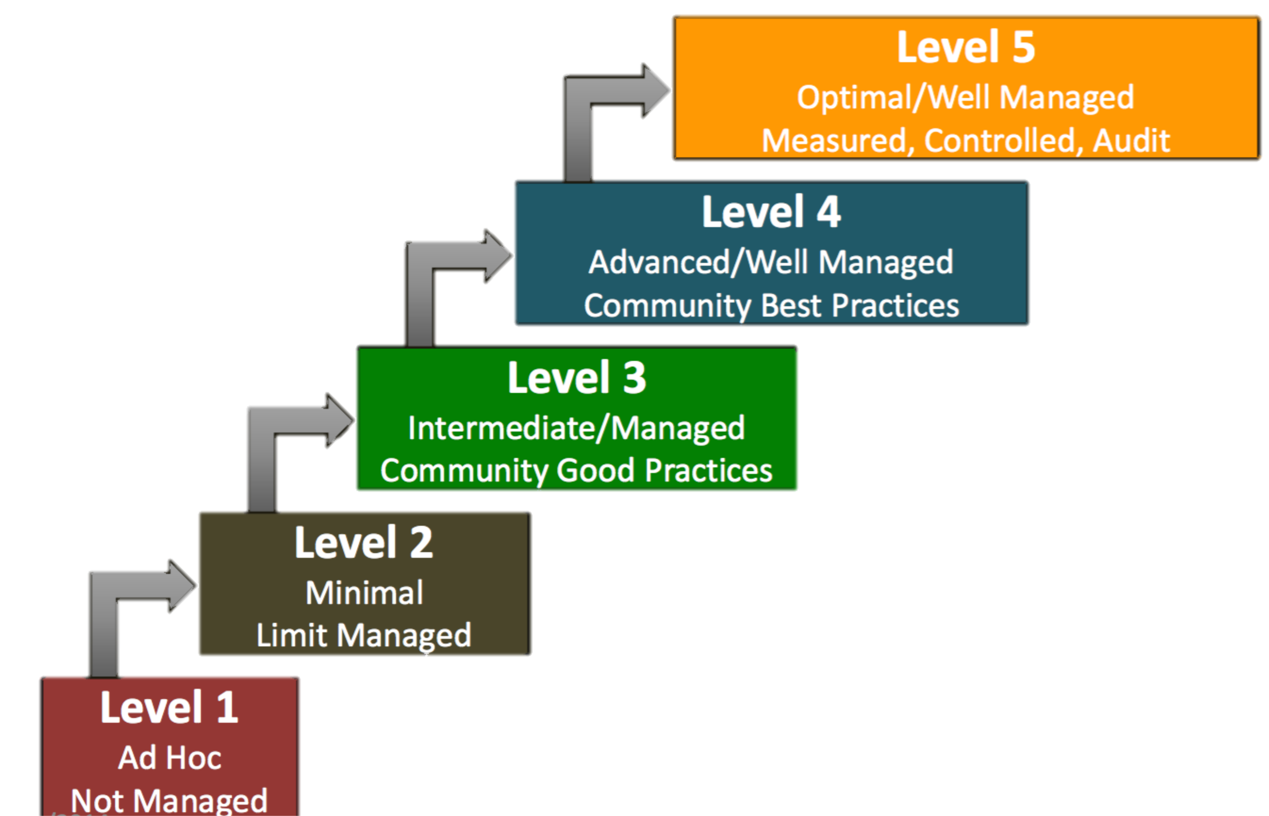
Levels of Maturity Matrix

Slide 6
Maturity Matrix for Long-Term Scientific Data Stewardship – 2015, Ge Peng and Jeffrey L. Privette
Defines 9 key components of scientific data stewardship
Defines a five-level progressive maturity scale for each component, representing Ad Hoc, Minimal, Intermediate, Advanced, and Optimal stage
Defines the activities needed to reach a specific level for each component
Enables a consistent measure of the stewardship practices applied to diverse products
It can be used to create a stewardship maturity scoreboard of dataset(s) and a roadmap for scientific data stewardship improvement or to provide data quality and usability information to users, stakeholders, and decision makers.

Slide 7
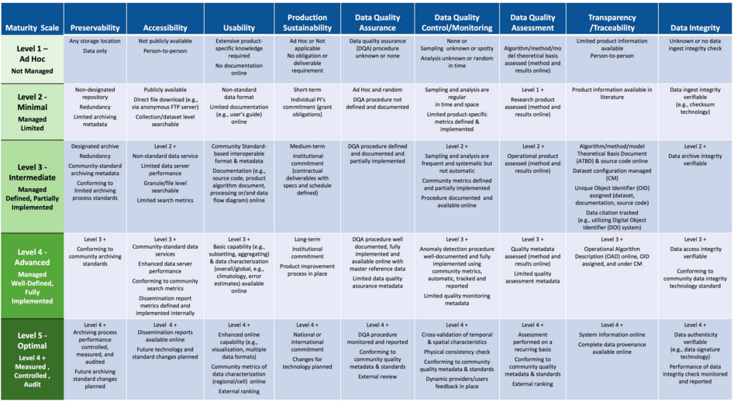
Maturity Matrix for Long-Term Scientific Data Stewardship – 2015, Ge Peng and Jeffrey L. Privette
Notes:
Preservability: it focuses on assessing practices associated with data storage for resilience requirements, i.e., backup or a duplicate copy in a physically separate facility for disaster recovery, and on compliance to community-accepted archive practices and metadata standards. Preservability metadata are necessary for file storage and retrieval purposes only. They include a unique identifier for the dataset, file naming convention, file size, data volume, and, if available, a unique identifier for the collection- level metadata record associated with the dataset. The file naming convention is treated in this paper as being more relevant to preservability; however, the implication of defined file naming conventions on data usability and interoperability should also be considered when determining file naming conventions.
Accessibility: The maturity of the accessibility key component will focus on whether users can easily find and access data online. It measures whether a dataset is searchable and discoverable for collection only or to the granule level.
Usability: it deals with how easily users are able to use the data and learn whether the data are suitable for their own data requirements. It is closely tied to online documentation availability (e.g., Quick starter guide, Users’ guide, or Readme file), file format for interoperability, online data customization and visualization capability, and data characterization. It strives to alleviate the users’ burden of learning about and understanding the data.
Production Sustainability: it is addressed in terms of various degrees of commitment for and associated requirements on the product. Here, it is assumed that the commitment is backed by the necessary financial support. At maturity level 5, changes for technology in data production should be routinely incorporated into planning for continued, sustained stewardship.
Data Quality Assurance (DQA): is a set of activities or procedures focused on defect prevention to be followed in order to ensure product quality during development. Data quality screening (DQS) is a set of activities intended to ensure the source data are clean. DQS is a commonly used procedure for identifying missing or redundant records.
Data Quality Control/ Monitoring: is a set of activities taken to evaluate the product to ensure that it conforms to the required specifications. It is product-oriented and focuses on data anomaly detection. It is usually carried out after the product is created or at each major milestone of the product development and processing cycle.
Data Quality Assessment: is a set of activities designed to ensure that the products are scientifically sound (i.e., building the right thing), by carefully evaluating the product, usually by comparison with similar well-established and validated observations or data product(s).
Transparency /Traceability: The focus here is on the level of availability of information about the product and how it was created, the level of practices associated with management of documents, source code, and system information, and whether data and publication citations were tracked, such as by utilizing a Digital Object Identifier (DOI) system.
Data Integrity: Data integrity refers to the validity of data, i.e., the accuracy and consistency of data over its entire lifecycle. The Data integrity component in this version of the stewardship maturity matrix primarily assesses the practices applied to datasets to ensure the data files are free of intentional or unintentional corruption during data transfer, ingest, storage, and dissemination and to ensure data authenticity at access.
Level 5 is Level 4 + other things

Slide 8
Applicability in the Earth Observation Domain
Data Stewardship Maturity Matrix:
Might be adopted to facilitate and improve CEOS WGISS Data Stewardship activities and achievements.
Need to be adapted to take into account specific Earth Observation requirements and already existing Best Practices. E.g. appraisal activity should define the level to be reached for each maturity matrix component for a specific mission/dataset based for example on:
Mapping versus final user exploitation capabilities (e.g. Level 2 for general users and Level 4 for Climate Change scientists);
Mapping vs. data preservation commitments and budgets, responsibilities and preservation requirements (e.g. ESA vs TPM missions holdings).
Different Mission Datasets might have different targets and lead to different Maturity level ratings.

Slide 9
EO Data Stewardship Maturity Matrix utilization versus DMP Implementation Guidelines

Slide 10
EO Data Stewardship Maturity Matrix versus DMP Implementation Guidelines
An exercise has been performed to verify the compatibility of the Data Stewardship Maturity Matrix wrt GEO DMP Principles and guidelines.
Each DMP Principle has been mapped into Maturity Matrix Components and the rating obtained through DMP implementation derived.
This exercise has allowed also to identify possible areas of improvement for the Data Management Principles.

Slide 11
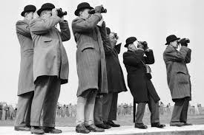
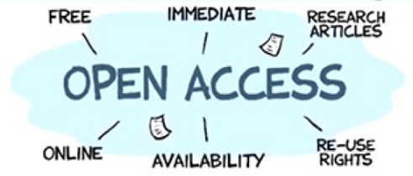
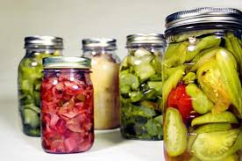
GEOSS DMP Principles
The value of Earth observations are maximized through data life-cycle management based on ten principles supporting five themes.
DISCOVERABILITY
DMP-1: Data and metadata will be discoverable
ACCESSIBILITY
DMP-2: Data will be accessible via online services
USABILITY
DMP-3: Encoding DMP-4: Documentation
DMP-5: Traceability DMP-6: Quality
PRESERVATION
DMP-7: Preservation DMP-8: Verification
CURATION
DMP 9: Review and reprocessing
DMP 10: Persistent and resolvable identifiers
Notes:
Discoverability
DMP-1 Data and all associated metadata will be discoverable through catalogues and search engines, and data access and use conditions, including licenses, will be clearly indicated.
Accessibility
DMP-2 Data will be accessible via online services, including, at minimum, direct download but preferably user-customizable services for visualization and computation.
Usability
DMP-3 Data will be structured using encodings that are widely accepted in the target user community and aligned with organizational needs and observing methods, with preference given to non-
proprietary international standards.
DMP-4 Data will be comprehensively documented, including all elements necessary to access, use, understand, and process, preferably via formal structured metadata based on international or community- approved standards. To the extent possible, data will also be described in peer-reviewed publications referenced in the metadata record.
DMP-5 Data will include provenance metadata indicating the origin and processing history of raw observations and derived products, to
ensure full traceability of the product chain.
DMP-6 Data will be quality-controlled and the results of quality control
shall be indicated in metadata; data made
available in advance of quality control will be
flagged in metadata as unchecked.
Preservation
DMP-7 Data will be protected from loss and preserved for
future use; preservation planning will be for the
long term and include guidelines for loss
prevention, retention schedules, and disposal or
transfer procedures.
DMP-8 Data and associated metadata held in data
management systems will be periodically
verified to ensure integrity, authenticity and
readability.
Curation
DMP-9 Data will be managed to perform corrections
and updates in accordance with reviews,
and to enable reprocessing as appropriate;
where applicable this shall follow
established and agreed procedures.
DMP-10 Data will be assigned appropriate
persistent, resolvable identifiers to enable
documents to cite the data on which they
are based and to enable data providers to
receive acknowledgement of use of their data.

Slide 12
DMP Guidelines and key Components mapping
DMP Implementation Guidelines | Stewardship Maturity Matrix Key Components
DMP-1: Discoverability | Accessibility
DMP-2: Accessibility | Accessibility
DMP-3: Encoding | Usability
DMP-4: Documentation | Usability
DMP-5: Traceability | Transparency /Traceability
DMP-6: Quality | Data Quality Control/ Monitoring Data Quality Assessment Data Quality Assurance
DMP-7: Preservation | Preservability
DMP-8: Verification | Data Integrity
DMP-9: Review and reprocessing | Production Sustainability
DMP-10: Persistent and resolvable identifiers | Transparency /Traceability

Slide 13
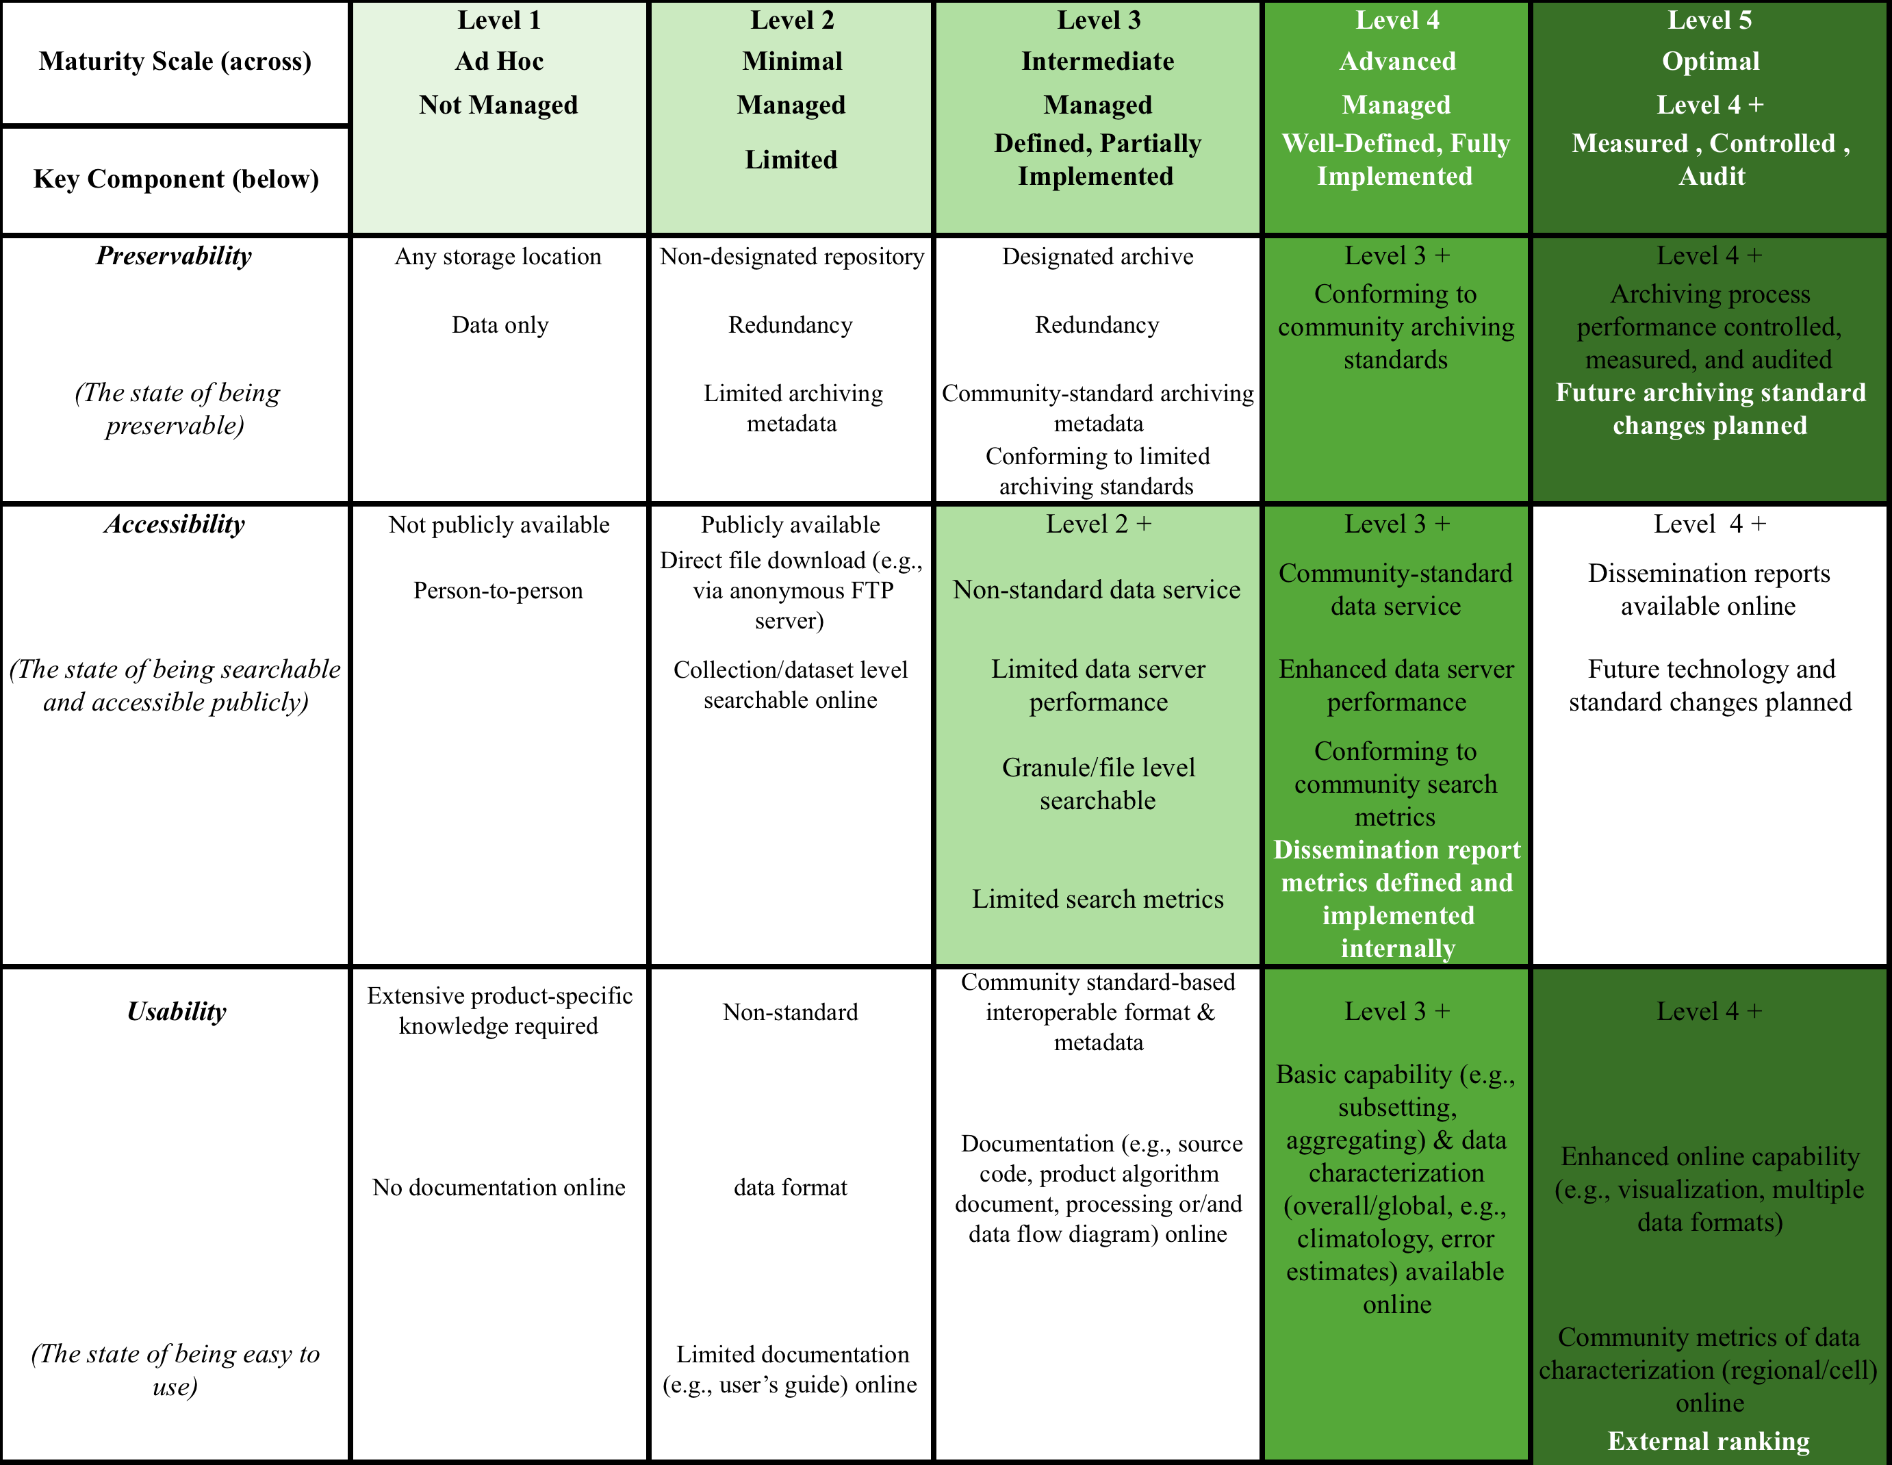
DMP Maturity Matrix Assessment

Slide 14
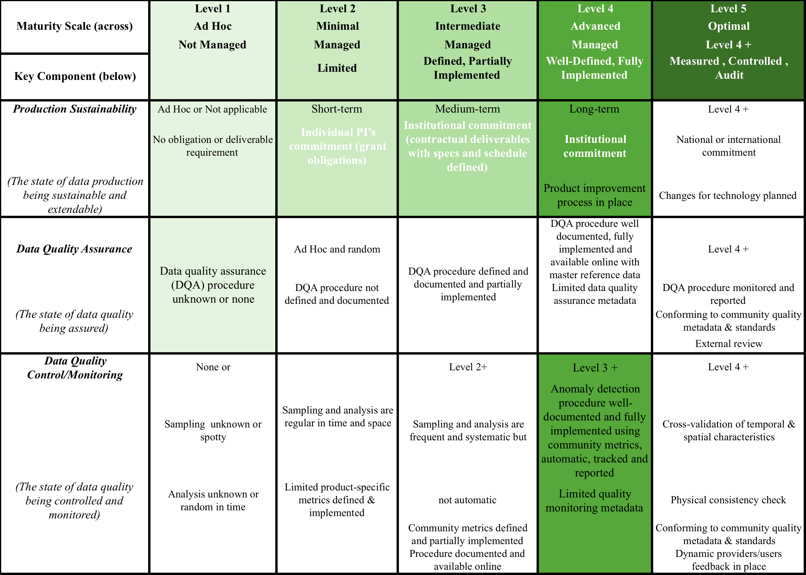
DMP Maturity Matrix Assessment

Slide 15
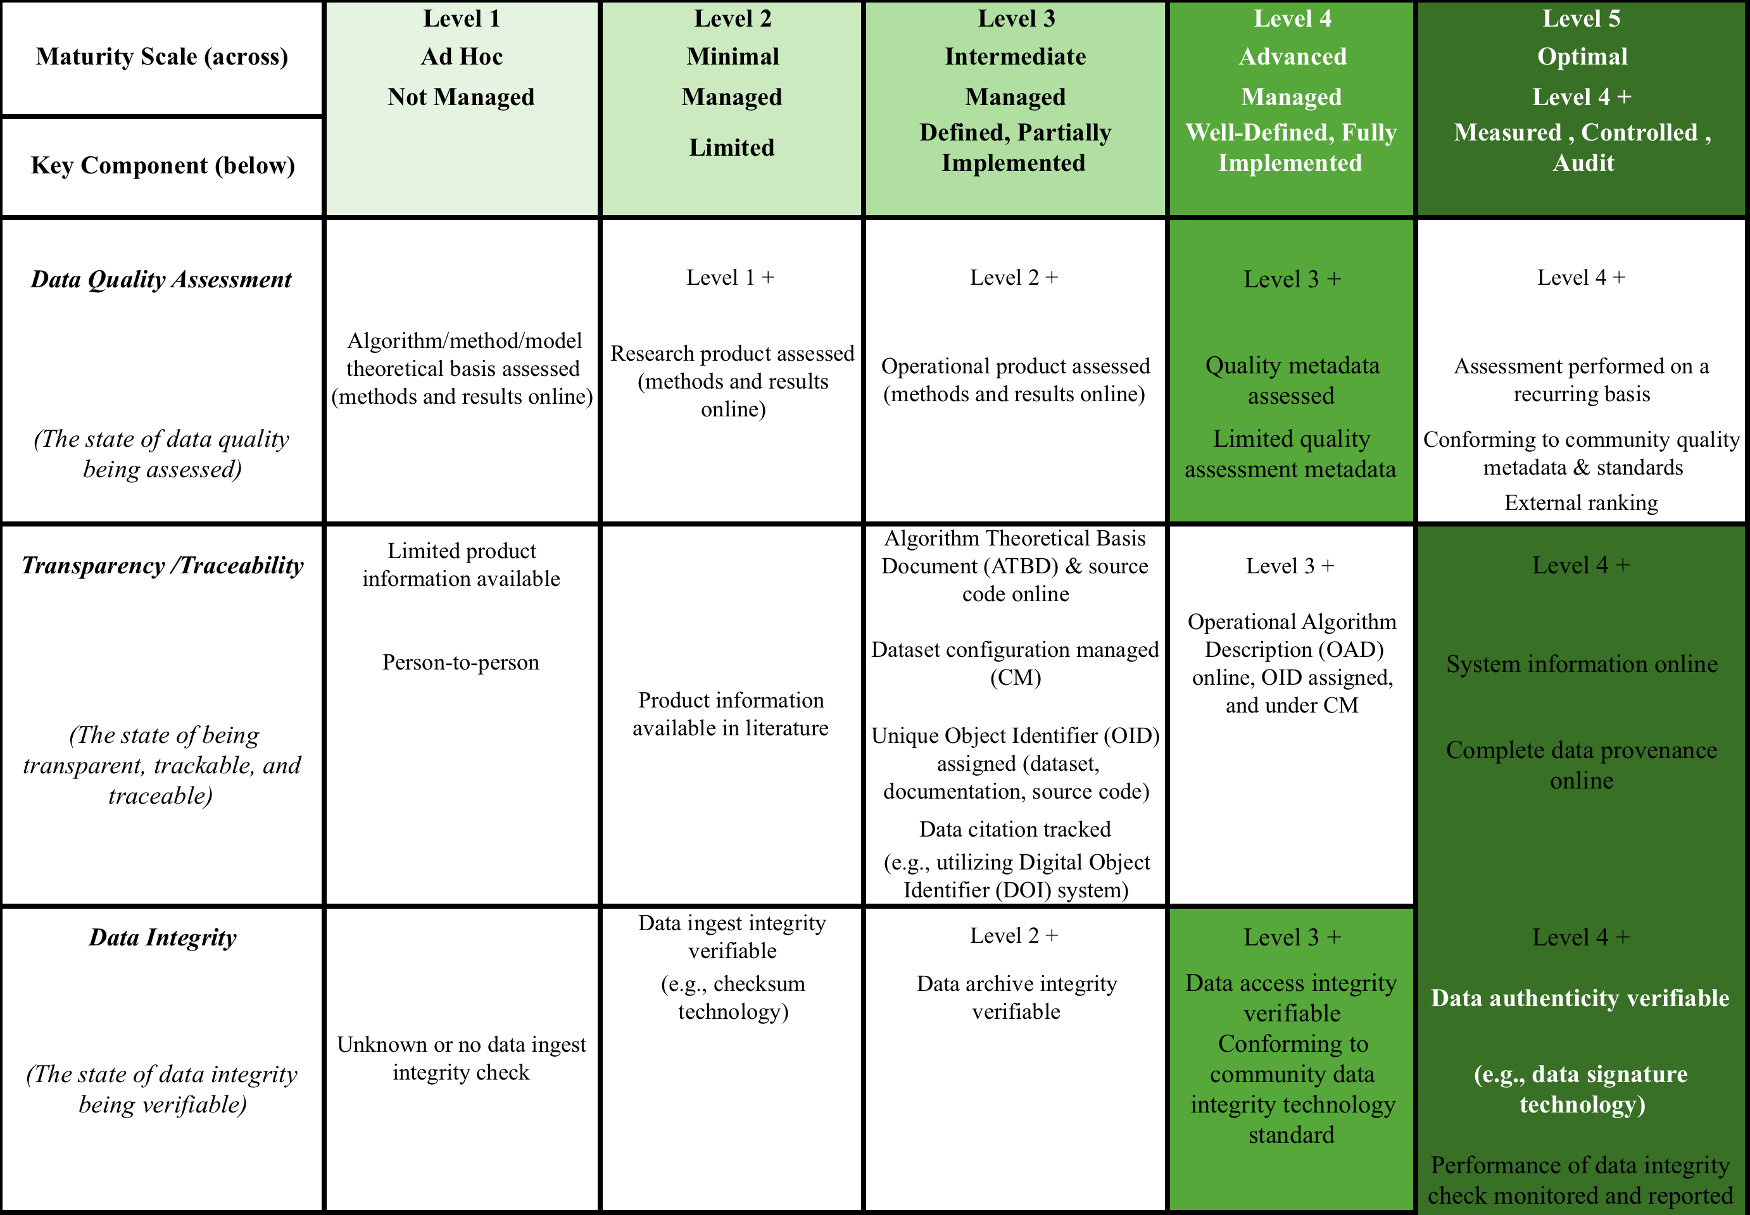
DMP Maturity Matrix Assessment

Slide 16
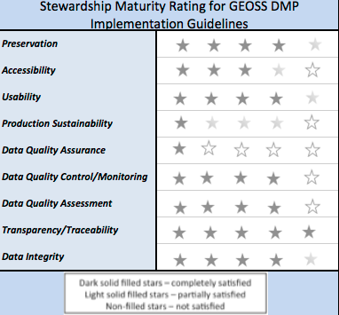
Assessment results and Rating
Data Stewardship Maturity Matrix is highly compatible with GEO DMP Principles.
Possible areas of improvement for the Data Management Principles identified.

Slide 17
Next Steps
Proposed Next Steps:
Collection of comments and suggestions from WGISS members on maturity matrix
Consolidation of CEOS EO Data Stewardship Maturity Matrix and inclusion in the WGISS Stewardship process (when, how)
WGISS Review and possible adoption

Slide 18
Thanks for your attention

Slide 19
References
http://tinyurl.com/DSMMtemplate
http://www.slideshare.net/gepeng86/scientific-data-stewardship-maturity-matrix
https://www.jstage.jst.go.jp/article/dsj/13/0/13_14-049/_article

