Slide 1
WGISS-41: IDN Report
Michael Morahan
CEOS WGISS-41 Meeting
Canberra, Australia
March 14-18, 2016

Slide 2
Outline
Review WGISS-40 Action item
What’s new:
  DIF-10
  DocBUILDER
  3rd Generation Search
Provide IDN usage metrics

Slide 3
WGISS40 Action Item Review
Action Item WGISS-40-13: Michael Morahan to give a presentation on the process for translating DIF9 to DIF10 at WGISS-41
  Process:
4
1
4
  Contacts for Request:
  gsfc-gcmduso@mail.nasa.gov
  Michael.P.Morahan@nasa.gov
5
2
5
6
3
Notes:
* consider question "will IDN providers be expected to migrate from DIF9 to DIF10?
----- Meeting Notes (2/5/16 11:49) -----
remove (ongoing)
Main bullet
----- Meeting Notes (2/5/16 14:57) -----
support

Slide 4
DIF-10 and New DocBUILDER

Slide 5
What’s new: DIF-10
DIF-10 is UMM-C compliant
Supports six new required fields (Related URL, Platform/Instrument, Temporal Coverage, Spatial Coverage, Project, Metadata Dates)
Supports eight new fields (Version, Version Description, Metadata Association, Metadata Dates, Additional Attributes, Product Level Id, Collection Data Type, Product Flag)
Restructured DIF-9 fields to better describe the datasets
  Platform > Instrument > Sensor hierarchy
  Organization > Organization_Type (ARCHIVER, DISTRIBUTOR, ORIGINATOR, or PROCESSOR)
  PersistentIdentifier
  Spatial_Coverage
Additional compatibility with ISO

Slide 6
What’s New: DocBuilder for DIF-9 and DIF-10
Import and export metadata to and from the IDN
Provides readily configured support for different formats and rules
Provides inline QA validation of field content, syntax and verification of controlled keywords
Customized QA rules that comply with the UMM-C
Implemented new user interface, file menu, field-to-field editing, collapsible fields, tool-tips, and documentation
Download/upload metadata records to/from desktop

Slide 7
DocBUILDER: Step 1
Notes:
* consider question "will IDN providers be expected to migrate from DIF9 to DIF10?

Slide 8
DocBUILDER: Step 2
Notes:
* consider question "will IDN providers be expected to migrate from DIF9 to DIF10?

Slide 9
DocBUILDER: Step 3
Notes:
* consider question "will IDN providers be expected to migrate from DIF9 to DIF10?

Slide 10
DocBUILDER: QA Feedback
Notes:
* consider question "will IDN providers be expected to migrate from DIF9 to DIF10?

Slide 11
DIF-10 and DocBUILDER Resources
DIF-10 writer's guide: http://gcmd.gsfc.nasa.gov/DocumentBuilder/defaultDif10/guide/index.html
DIF-10 schema:http://gcmd.gsfc.nasa.gov/Aboutus/xml/dif/dif_v10.2.xsd
DocBUILDER link: http://gcmd.nasa.gov/collaborate/docbuilder.html
GCMD Release announcement:http://gcmd.nasa.gov/learn/release_announcement_10.html
Notes:
* consider question "will IDN providers be expected to migrate from DIF9 to DIF10?

Slide 12
3rd Generation Search Interface

Slide 13
3rd Generation Search Interface Objectives
Utilize the Common Metadata Repository (CMR) as the back-end - the authoritative source for all GCMD/IDN metadata.
Build upon the current search interface with new functionality designed to increase search precision and/or recall.
Incorporate search, refinement and sort functionality on one page.
Include additional options for search, refinement, and display that captures user requests over the years.
Offer an interdisciplinary approach for the discovery of and access to Earth science data and related services.

Slide 14
New Keyword Search Interface
3rd Generation:
All features available from one page
Enhanced free-text search and keyword tree functionality
Searches Common Metadata Repository (CMR)
No longer need to navigate the keyword drill-down

Slide 15
Free-Text Search
Free-Text searches all indexed fields for a term
When free-text search terms match GCMD controlled keywords, they are highlighted in the keyword “tree”

Slide 16
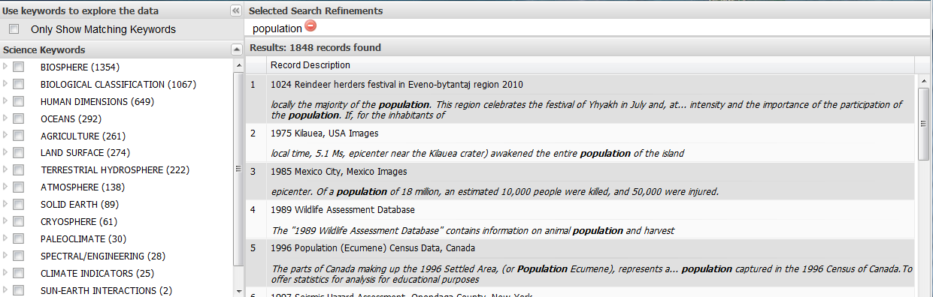
Browse Keyword Hierarchy
Uncheck to browse, search, and/or refine by the entire GCMD/IDN keyword hierarchy

Slide 17
Keyword Search Results and Display
Search Result: Atmosphere AND Earth Observation Satellites
Metadata “Pretty View”

Slide 18
Sorting Keyword Search Results
Choose which information is displayed
Customize the sort results
Hover Here to Select Sort Options
Sort by Temporal Coverage

Slide 19
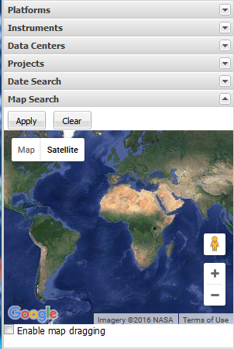
Additional Options for Search and Refinement
Search and/or Refine by Platform, Instrument, Data Centers, Projects, Date Search, and Spatial Coverage

Slide 20
Provide Feedback
http://gcmd.nasa.gov

Slide 21
GCMD/IDN Search Evolution
1st Generation Search
2nd Generation Search
3rd Generation Search

Slide 22
Metrics

Slide 23
IDN Statistics Page
Stats:
    CEOS DIF counts
    CEOS DIFs by Parameters
    CEOS DIFs by Source_Name Bucket (Platform Type)
    CEOS DIFs by IDN_Node
    CEOS DIFs by Data Center
http://idn.ceos.org/idn-resources/stats_ceos_dif_count.pdf
Notes:
Last Day of Harvest was May 3

Slide 24
IDN Site Usage:
February 2015 – February 2016
 | Counts
Total Visits | 27,806
Average Daily Visits | 71
Average Monthly Visits | 2,139
Total Views | 61,685
Average Daily views | 157
Beta IDN Site usage
Total Page Views: 83,240
Total Visits: 14,437
* IDN Site and Beta IDN Site Metrics collected by different software
Notes:
CEOS IDN Web Sites: Executive Dashboard August 1, 2014 - August 31, 2015

Slide 25
IDN Usage by Continent:
February 2015 – February 2016
Number of Visits (Total Visits=27,806)
1368
2403
4127
661
497
284
Other users: 18466
25
Notes:
Asia, North America, Europe, Africa, South America, Australia

Slide 26
IDN Usage by Country
February 2015 – February 2016
Top 10 Countries:
1. United States = 1879
2. India = 1240
3. Korea, Republic of = 492
4. China = 440
5. Canada = 354
6. Iran = 336
7. Australia = 284
8. United Kingdom = 257
9. France = 197
10. Indonesia = 195
26
Notes:
From gcmdsrv1

Slide 27
Number of New IDN Metadata Records
DIFs
Months

Slide 28
Number of IDN Records Updated
DIFs
Months

Slide 29
Number of IDN Records Deleted
DIFs
Months

Slide 30
Number of CEOS Metadata Records
-2.4% decrease for the year
DIFs
Months

Slide 31
IDN CSW Usage:
February 2015 – February 2016
 | Counts
Total Visits | 16,635
Average Daily Visits | 41.77
Total Views | 1,058,669
Average Daily views | 2,303
31
Notes:
Get last % different

Slide 32
  Questions
  Michael.P.Morahan@nasa.gov

