Slide 1
Committee on Earth Observation Satellites
CWIC Community
Client Development
Martin Yapur & Ken McDonald WGISS-41
Canberra, Australia
March 17, 2016

Slide 2
Topics
Motivation
Why do we need community clients?
Approach
How can we facilitate their development?
Current/Planned Partners
With whom will we collaborate?
Relationship to GEO
How is this similar and related to GEOSS initiatives?

Slide 3
CWIC Development
Infrastructure Services
Brokered discovery/search/access to diverse set of satellite data from a set of data provider partners
Prototype clients
Both CSW and OpenSearch
Broaden offerings
New data partners
Additional data collections
Support Operations
Hosting CWIC operations
Status checking
CWIC Clients
(CSW/OpenSearch)
CWIC Server
(Mediator, Connectors)
CWIC Data Partners

Slide 4
CWIC Community Clients
Generic CWIC Clients
Provide common discovery/access to all CWIC partner holdings
Provide fixed set of search/access services across all collections
Specialized Community Clients
Limit search domain to specific discipline or area of interest
Enable integration of CWIC satellite data with other data types
Provide other enhanced search/access services
Combination of Generic and Community Clients
Maximizes utilization and benefits of CWIC infrastructure

Slide 5
Community Client Efforts
CWIC Team has always encouraged community client development
Published CWIC Client Developers Guide
Some success to date
Land Surface Imaging (LSI) Portal
One issue identified and mitigated
CWIC is one of two WGISS brokering capabilities (other being FedEO)
CWIC discovery/access did not present all CEOS data
CEOS OpenSearch interface enables community clients common access to both CWIC and FedEO
Now is a good time for renewed effort

Slide 6
2016 Community Client Initiative
CWIC Team to take more proactive approach in development of CWIC clients
Identify partners (VCs, WGs, CEOS Projects, etc.) who are interested in developing clients
Explore/analyze past efforts at client development that might provide reusable tools/approaches
Undertake joint efforts with selected partners
NOAA has identified some resources to support CWIC side of these efforts
Initial interest from the GHRSST Project
Preliminary discussions underway
Team open to other ideas/suggestions

Slide 7
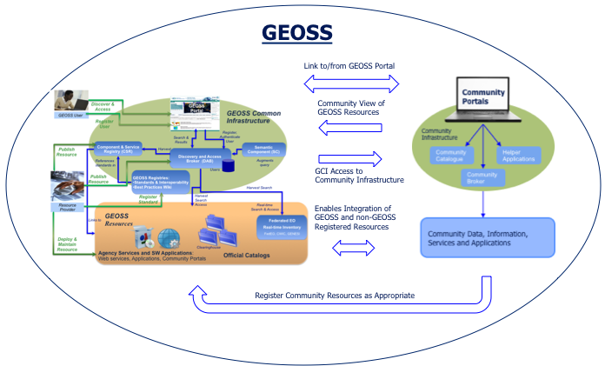
GEOSS Community Portals
CWIC client initiative similar to a GEO effort
GEOSS Community Portals Subtask is under the GEOSS Development (GD-07) Task
GEOSS CP Team comprised of GEOSS Common Infrastructure (GCI) Providers and Community Representatives
Idea is to maximize utilization of GCI by promoting and enabling development of community portals/clients and leveraging community infrastructure capabilities
Opportunity for WGISS – GEO collaboration

Slide 8
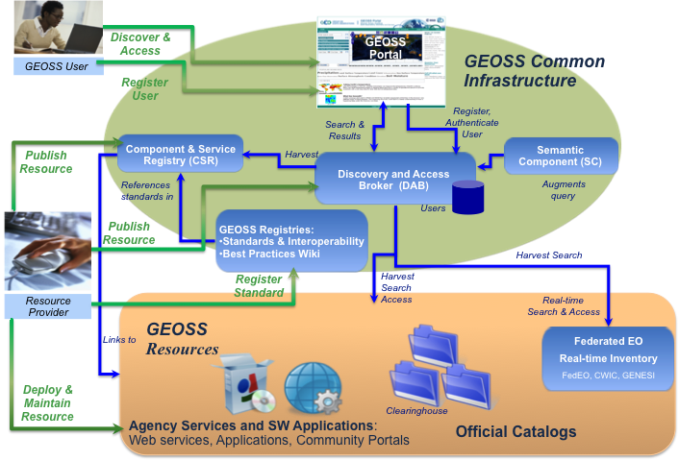
CEOS as a GEOSS Community
GEOSS
CEOS
Link to/from GEOSS Portal
IDN-
CWIC-FedEO
Clients
Community View of
GEOSS Resources
WGISS
Common
Infrastructure
IDN
CWIC
GCI Access to
Community Infrastructure
FedEO
Enables Integration of
GEOSS and non-GEOSS
Registered Resources
CEOS Agency Systems
Register Community Resources as Appropriate

