Slide 1
OpenSearch validation
WGISS-41
Doug Newman (NASA Earthdata – Raytheon)
The material is based upon work supported by the National Aeronautics and Space Administration under Contract Number NNG15HZ39C

Slide 2
Agenda
Using the web application
Using the web service

Slide 3
Concept
Supply an OSDD location
Validation tool performs a series of tests to measure compliance of OpenSearch API
Split by specifications, extensions and best practices
Success – what you gain
Failure – what you lose
More than just your OSDD. Searches are performed to test two-step etc.

Slide 4
What we can validate
☑ OpenSearch Specification
Geo extension
Time extension
ESIP Best Practices
Parameter extension
Relevancy extension
OGC Extensions
CEOS Best Practices
CEOS Developer Guide

Slide 5
Limitations
‘More than just your OSDD. Searches are performed to test two-step etc’
How do we do that?
We use the example query in your OSDD
So chose your example query wisely and as exhaustively as possible.

Slide 6
Web application

Slide 7
Via CWICSmart
https://api.echo.nasa.gov/cwicsmart/validations

Slide 8
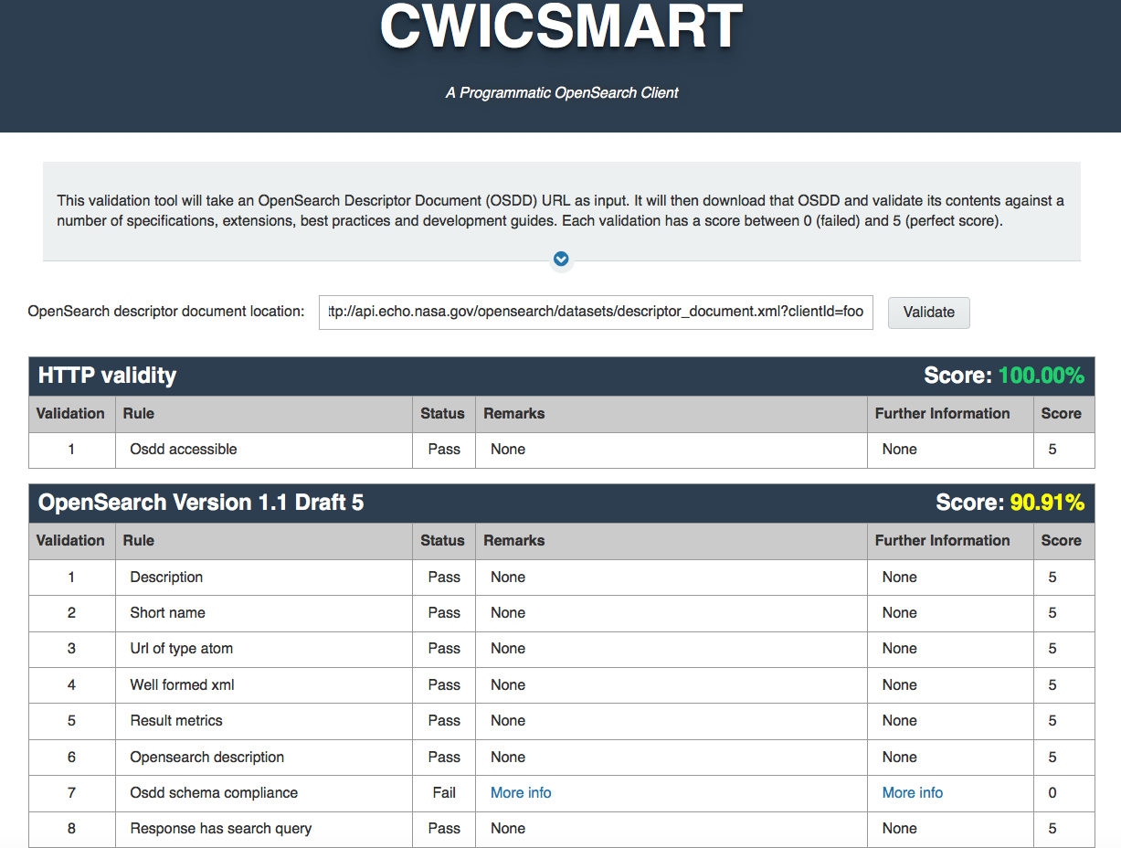
Via CWICSmart

Slide 9
Web service

Slide 10
Via CWICSmart
https://api.echo.nasa.gov/cwicsmart/api-docs
for swagger documentation
(in XML and JSON format)

Slide 11
Coming soon…

Slide 12
Open sourcing
Run tests against developing, non-public APIs
Extend validations to new standards etc

Slide 13
Questions?
Notes:
Thank you very much

Slide 14
This material is based upon work supported by the National Aeronautics and Space Administration under Contract Number NNG15HZ39C.

