Slide 1
GEO and GEOSS 42nd CEOS WGISS Osamu Ochiai Paola De Salvo GEO Secretariat 19 September 2016 Frascati, Italy

Slide 2
Unique Time in GEO’s History
Transition to next decade 2016-2025
Recognition of GEO’s convening power – Members, POs, Development Banks, Foundations, emerging Commercial Sector
Evolution & Recognition of Policy Mandates
New Strategic Plan with new programmatic mechanisms – community activities, foundational tasks, initiatives and flagships

Slide 3
Governance
GEO Plenary
103 Member Countries, 103 Participating Organizations, 12 Observers
GEO Executive Committee
Africa: Egypt, Senegal, South Africa
Americas: Colombia, Mexico, United States
CIS: Armenia, Russia
Asia/Oceania: Australia, China, Japan, Korea
Europe: EC, Finland, France, Germany
Observers from Program Board: CEOS, GOOS, WMO
GEO Programme Board
Oversees the establishment of the multi-year GEO Work Programmes
42 members from GEO Members and Participating Organizations
GEO Secretariat

Slide 4
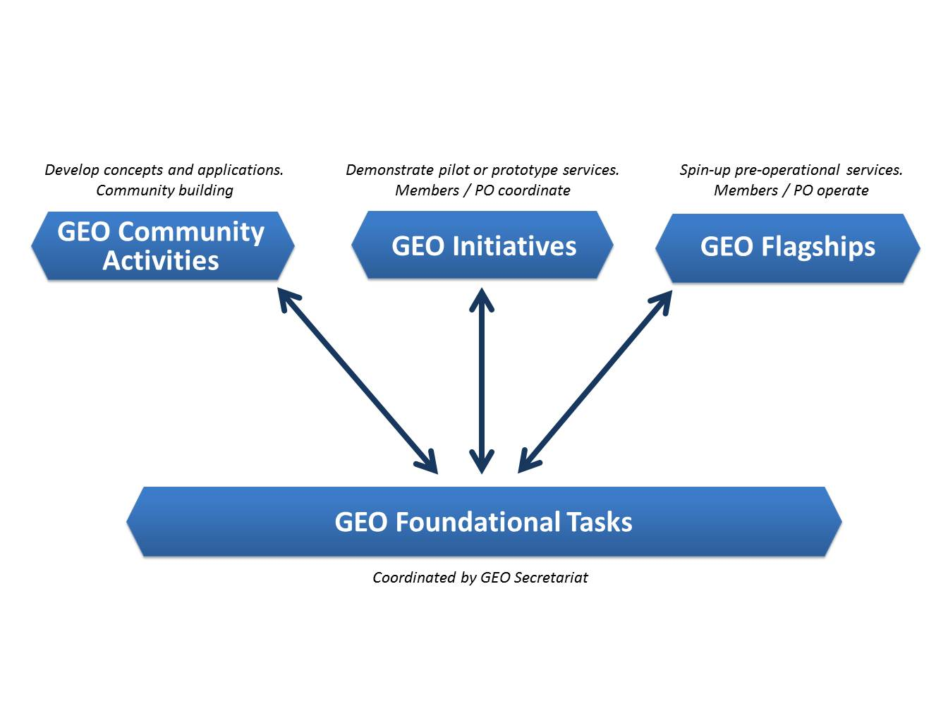
Four Types of GEO Implementation mechanisms

Slide 5
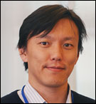
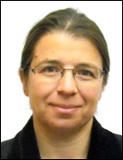
Foundational Tasks – Current List
GD | GEOSS Development and GCI Operations
GD-01 | Advancing GEOSS Data Sharing principles
GD-02 | GCI Operations (including access to Knowledge)
GD-03 | Global Observing and Information Systems (new) (includes systems like WIGOS. GCOS; …. And reference datasets)
GD-04 | GEONETCast Development and Operations
GD-05 | GEOSS satellite Earth Observation Resources (includes advocacy for continuity)
GD-06 | GEOSS in situ Earth Observation Resources (includes inclusion of citizens’ observatories) (includes advocacy for continuity)
GD-07 | GCI Development (includes development of Data Management guidelines)
GD-08 | SBAs processes: Systematic determination of user needs / observational gaps
GD-09 | Knowledge Base development
GD-10 | Radio-frequency protection
GD-11 | Utilization of Communication Networks
CD | Community Development
CD-01 | Capacity Building coordination
CD-02 | Reinforcing engagement at national and regional level
CD-03 | Assess the benefits from EOs and of their socio-economic value
SO | Secretariat Operations
SO-01 | Management and Support
SO-02 | Communication and Engagement
SO-03 | Monitoring and Evaluation
SO-04 | Resources Mobilization

Slide 6
Foundational Task prioritization by GEO Program Board
GCI Operation (GD02) will remain the Foundational Task.
Perform GCI Components operations (GEOSS Portal, GEO DAB, Registries)
Maintain partnership with Data and Service Providers and improve these Providers discoverable and accessible
Connect new providers which are relevant to Flagships and key members and participating organizations
Collect requirements and feedback from User Communities and Stakeholders
GCI Development (GD07) will likely be moved to an Initiative.
Develop a GEOSS Architecture based on documented and emerging user requirements
Develop and test new GCI functionalities, solutions, and components
Develop a process to implement the Data Management Principles Guidelines for providers
Promote the advancement of GEOSS interoperability through the Standards and Interoperability Forum (SIF)
Develop the Community Portal Recommendations

Slide 7
GEOSS Implementation requires: Data Sharing Principles
Full and Open Exchange of Data
Data and Products at Minimum Time delay and Minimum Cost
Free of Charge or Cost of Reproduction
Notes:
See slide text

Slide 8
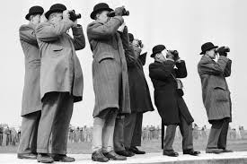
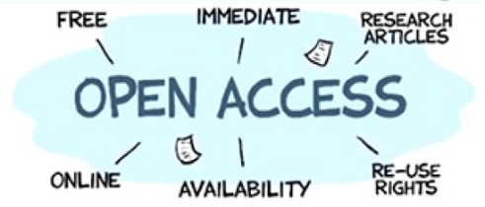
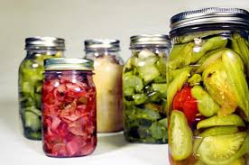
Data Management Principles Strategy
The value of Earth observations are maximized through data life-cycle management based on ten Principles supporting five themes.
DISCOVERABILITY
DMP-1: Data and metadata will be discoverable
ACCESSIBILITY
DMP-2: Data will be accessible via online services
USABILITY
DMP-3: Encoding DMP-4: Documentation
DMP-5: Traceability DMP-6: Quality
PRESERVATION
DMP-7: Preservation DMP-8: Verification
CURATION
DMP 9: Review and reprocessing
DMP 10: Persistent and resolvable identifiers

Slide 9
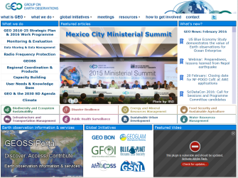
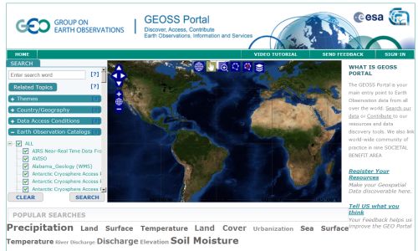
Climate/Weather
Cryosphere
GEO
Website
International Providers
Biodiversity
Disasters
GEO
Website
Energy
Geology/Soil
GEOSS
Portal
Environment
Health
Ocean
Satellites
Discovery and
Access Broker (DAB)
Water
Regional & National Providers
Australia
Brazil
Canada
Chile
China
France
Germany
Japan
Italy
New Zealand
Norway
Private sector providers
Switzerland
USA
Russia
South Africa
Spain
…
… more than 100 public providers…

Slide 10
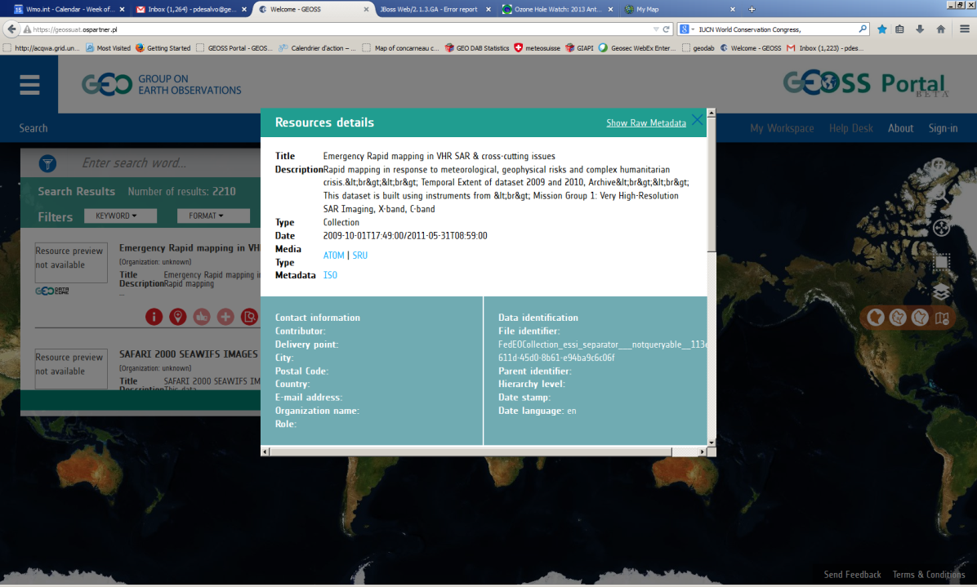
Examples of potential issues
Data accessibility is among the main issue mainly in the FEDEO catalog (vary from provider to provider)
Need of better metadata (lack of contacts – lack of keywords, do not enable good discoverability and usability of the data)

Slide 11
Proposal to work further
CEOS WGISS to identify a PoC to discuss further for improving CEOS agencies assets discoverable and accessible through IDN, CWIC and FedEO
The GEO Sec, GEOSS Portal and DAB team PoCs are following:
GEO Secretariat
Paola De Salvo, pdesalvo@geosec.org
Osamu Ochiai, oochiai@geosec.org
GEOSS Portal
Joost Van Bemmelen, Joost.van.Bemmelen@esa.int
Guido Colangeri, g.colangeli@rheagroup.com
DAB team
Stefano Nativi, stefano.nativi@cnr.it
Mattia Santoro, mattia.santoro@cnr.it

Slide 12
Data Provides Side event in the GEO-XIII Plenary
November 7th 2016
GEO-XIII Plenary venue, St. Petersburg, Russia
Objectives
Establishing a two-ways dialogue with data providers to improve the discoverability, accessibility and usability of GEOSS resources.
Data providers already contributing to GEOSS and new data providers, flagships and initiatives and users are invited and encouraged to participate to ensure that the key objectives of the workshop are met.
Help the GEO community define priorities and shape the agenda of a more comprehensive event to be held in early 2017.
Draft agenda
Implementing the GEO Data Management Principles
Options and procedures for certification of data providers
Process for new data providers to engage with GEO
Discussion and way forward

Slide 13
GEO-XIII Plenary
9-10 November 2016
St. Petersburg, Russia
Thank you

