Slide 1
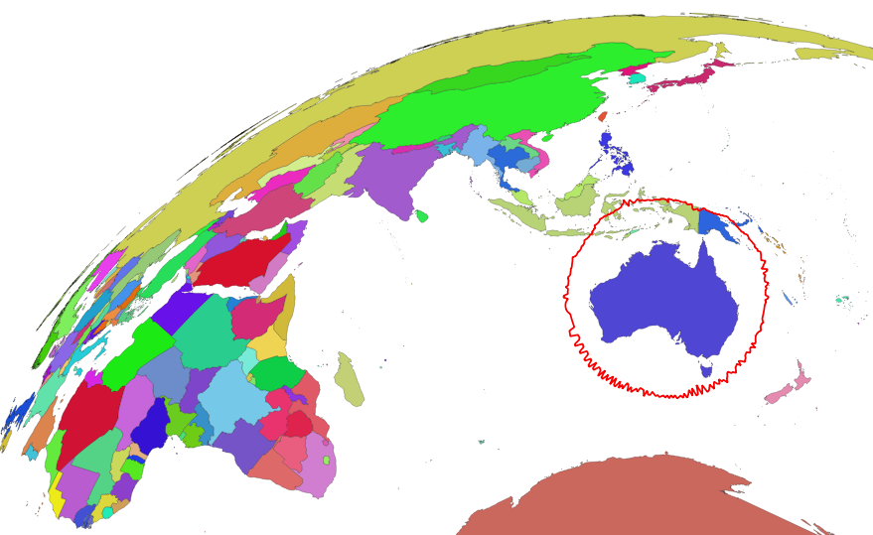
Australian Geoscience Data Cube
Agency Report
Simon Oliver - AGDC
David Hudson - Copernicus
Matthew Purss - DGGS
Vincent Rooke - DAF

Slide 2
Overview
Copernicus Regional Hub
AGDC Program
Initial Beta Release
How to get involved
Roadmap
OGC DDGS Standard Development
GA Ground Station
Landsat Ground Station Refurbishment
Certification

Slide 3
Copernicus Regional Hub

Slide 4
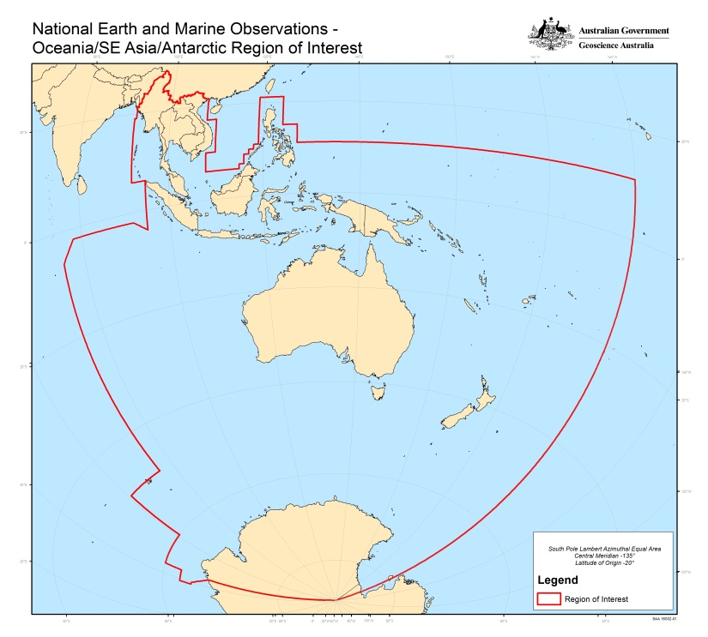
Australia’s Regional Copernicus Data Access/Analysis Hub
An integrated ‘Team Australia’ approach to
Support government information requirements.
Support the broader objective of enhancing access to satellite Earth observation data by research, industry and civil society.
Facilitate collaboration between Australians, Europeans and inhabitants of the South-East Asia-South Pacific region in exploitation of Earth observation data.
Benefits for: Australia, the region, EC/ESA/EUMETSAT, and the global satellite EO community.
All Sentinel Products For
Supporting
Consortium
Partners
Collaborators

Slide 5
Australia’s Regional Copernicus Data Access/Analysis Hub
ESA
IntHub
EUMETCAST
Terrestrial
GEANT/AARNET
Partnerships
(pay-per-use)
Master Repository (NCI)
Delivery for:
Australia
Region
Regional Portal
(a la ‘SciHub’)
Original Format Data Files
(HSM Storage)
Agreed Standards
Interoperable
Services
(e.g. Thredds)
R&D for:
Research/Academia
Civil Society
Government
Industry
Australia and Region
Analysis-Ready Data
(Lustre/spinning disk)
Cloud and HPC (Petascale)
Industry Exploitation
Operational Products
Deep National Archives
(Government Systems)

Slide 6
Australia’s Regional Copernicus Data Access/Analysis Hub
Pulling S1/2/3 and rearranging it into 5 deg by 5 deg directories every one hour
Working to incorporate S1 precise ephemeris and S3-Marine from EUMETCAST into the process
Working on ARD S2
http://dapds00.nci.org.au/thredds/catalogs/fj7/catalog.html
http://www.copernicus.gov.au/regionaldatahub

Slide 7
Australian Geoscience Data Cube

Slide 8
AGDC v2 Programme
Initial release of beta implementation on NCI HPC is complete
Regular 2 weekly releases - packaged and deployed
Backlog Landsat processing nearly complete + Landsat NBAR Terrain Illumination Correction
Derivative products currently being processed (biophysical parameters - NDVI, Fractional Cover - Latest cloud free pixel)
Looking at stackability - ways to make non precision corrected data accessible to Data Cube
Educating users: Workshop series
Data Cube Pipeline
Data Cube
Notes:
1. MODIS (and AVHRR) dot point(s)
Refining our acquisition, management and processing workflows for MODIS with a view to Collection 6: Australian L1A archive for NRT and swath-based ocean and terrestrial products, and; USGS/LPDAAC C5 and C6 selected products for global and Australasian applications.
Refactoring our national archiving, calibration and “stitching” activities for Australian-acquired AVHRR towards a low-maintenance and sustainable system and resource.

Slide 9
AGDC v2 Pipeline
Sen2Cor index support
Sentinel-2 NBAR under active development
utilizing the Landsat NBAR framework
incorporating some components of sen2cor / different algorithm
Beta Sentinel-1 preprocessing code also available
https://github.com/benjimin/s1prepro
Not in production - testing only
Sentinel Toolbox (SNAP 4.0) software
Enabling additional input data protocols
OpenDAP, S3….
Collection Management provenance included
Spectral Ignorance (spectral response included in AGDC)
Notes:
1. MODIS (and AVHRR) dot point(s)
Refining our acquisition, management and processing workflows for MODIS with a view to Collection 6: Australian L1A archive for NRT and swath-based ocean and terrestrial products, and; USGS/LPDAAC C5 and C6 selected products for global and Australasian applications.
Refactoring our national archiving, calibration and “stitching” activities for Australian-acquired AVHRR towards a low-maintenance and sustainable system and resource.

Slide 10
Foundation concepts - Properties of data
Context data:
Elevation Models, Geological Surveys, composites
Time-series data:
Repeated observations of a inter-comparable measurements
Stackability:
Spatial and spectral alignment:
Observations are coherent spatially and temporally (positioning well characterised and representing inter-comparable / calibrated measurements).

Slide 11
Foundation concepts: datasets
Product type | Database record (“Indexed”) | Datacube can access data | Typically... | Custodian
Referenced (Unknown/Inaccessible location) | ✔ | ❌ | Recorded in provenance | owner
Unmanaged (Accessible location) | ✔ | ✔ | External data (eg. Scene GeoTIFFs) | owner
Managed (Writable location) | ✔ | ✔ | Data created within the datacube (eg. reprojected from external data) | agdc

Slide 12
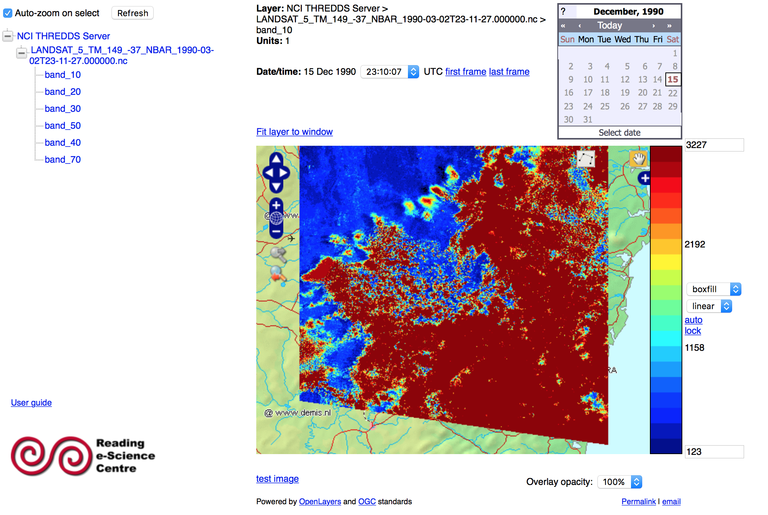
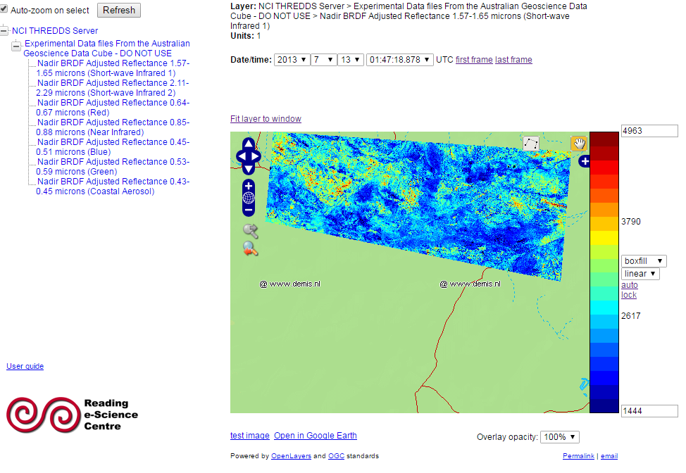

Slide 13
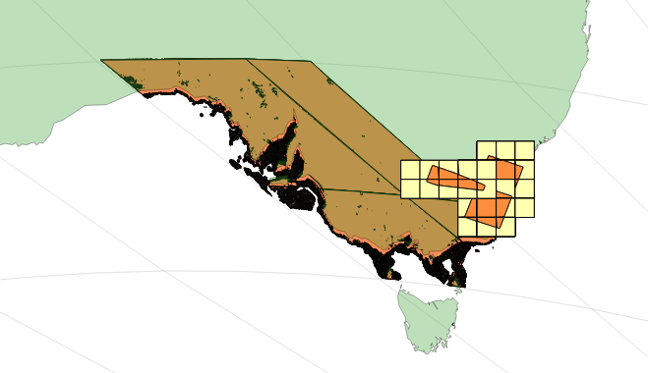
Products supported in code
Products:
SRTM DEM
Himawari 8
MODIS
Sentinel-2 L1C / S2A
GA Landsat Surface Reflectance
USGS Landsat Surface Reflectance
BoM Rainfall
Supported and Tested Projections:
EPSG:4326 WGS 84
EPSG:3577 Australian Albers Equal Area
MODIS Sinusoidal
...Other proj4 supported CRS will work too

Slide 14
Products in production AGDC now
32 distinct products
Product types (eCAT and NCI DMPs equivalent):
Landsat NBAR/T (Surface Reflectance)
Landsat Pixel Quality
Landsat Fractional Cover - in review
Landsat NDVI (Greenness) - in review
Rainfall (BoM gridded rainfall)
Elevation

Slide 15
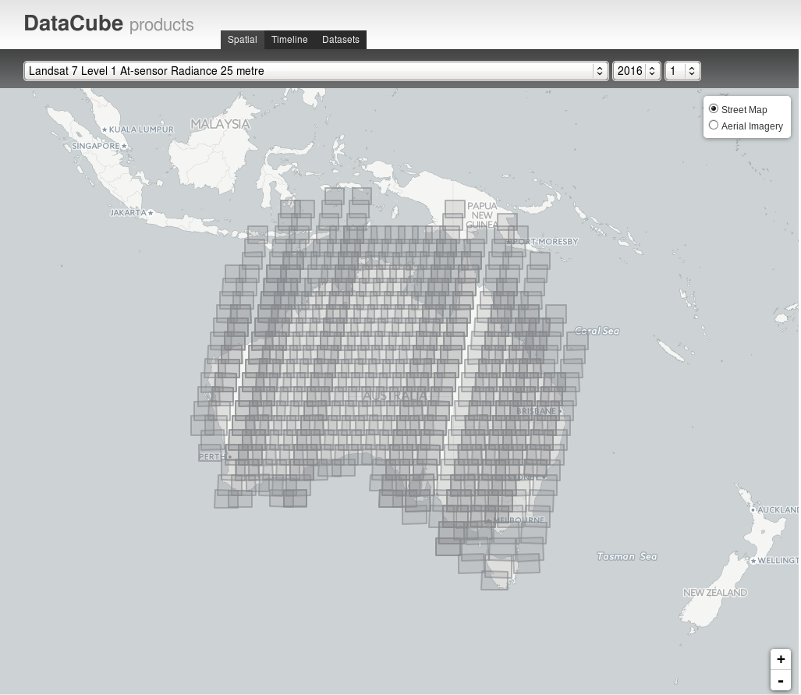
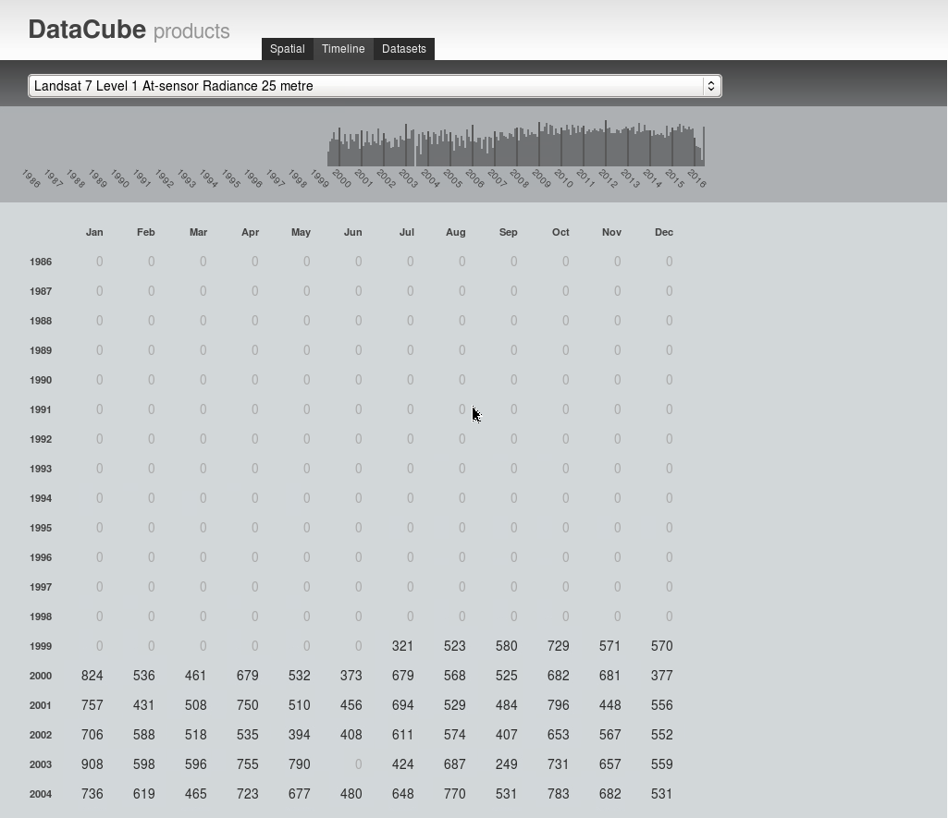
Dashboard (alpha) - browse available data
$ module use /g/data/v10/public/modules/modulefiles/ $ module load agdc-py3-prod $ /g/data/v10/public/run-dash.sh & $ firefox http://127.0.0.1:8080/

Slide 16
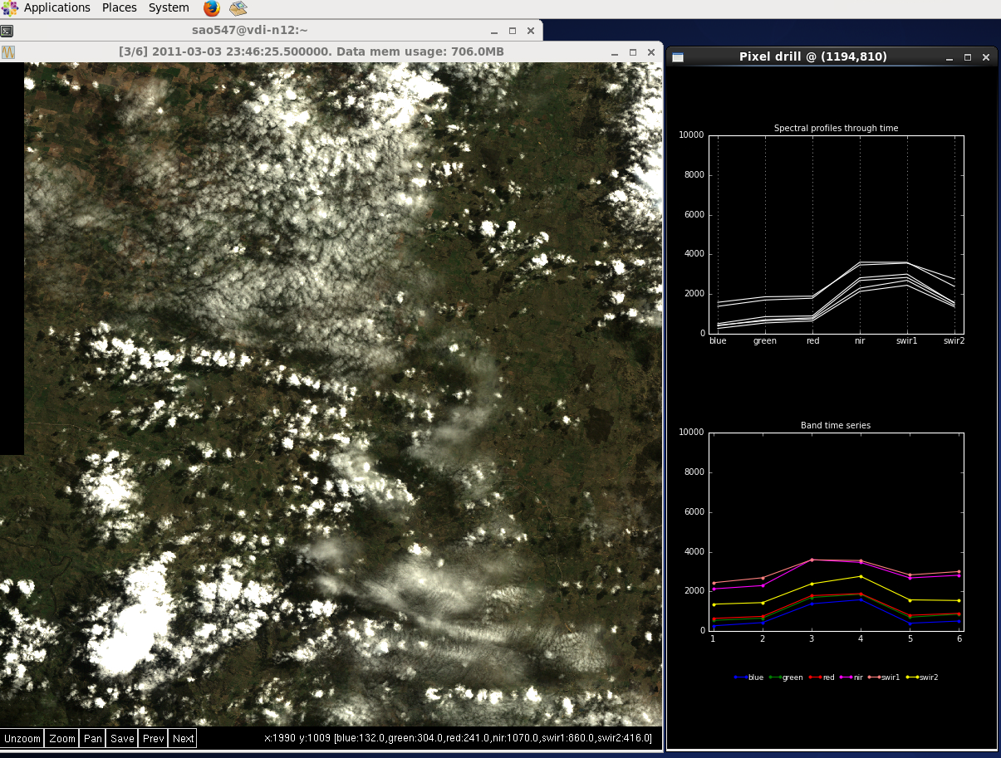
Pixel drill and image viewer
$ module load agdc-py3-prod
$ wget https://raw.githubusercontent.com/data-cube/agdc-v2/stable/apps/pixeldrill/pixeldrill
$ chmod +x pixeldrill
$ ./pixeldrill -p ls5_nbar_albers
Also see python glue library

Slide 17
VDI - Jupyter notebooks
The Jupyter Notebook is a web application that allows you to create and share documents that contain live code, equations, visualizations and explanatory text.
Uses include: data cleaning and transformation, numerical simulation, statistical modeling, machine learning and much more.
No requirement for high level python developer skills
Simplified interface for development - a playground for exploring the datacube

Slide 18
Generalised analysis flow
Identify product of interest
dc.list_products()
Load data for a spatio-temporal range of interest
landsat = dc.load(product='ls5_nbar_albers', x=(149.25, 149.35), y=(-36.25, -36.35), time=('2010-01-01', '2011-01-01'))
landsat.blue.plot(col='time', robust='True', cmap='terrain')

Slide 19
Generalised analysis flow
Create a mask to filter data
pq = dc.load(product='ls5_pq_albers', x=(149.25, 149.35), y=(-36.25, -36.35), time=('2010-01-01', '2011-01-01'))
good_pixels = masking.make_mask(pq, cloud_acca='no_cloud')
good_pixels.pixelquality.plot(col='time', robust='True', cmap='Greys')

Slide 20
Generalised analysis flow
Apply filter functions / masks to obtain required data
landsat_cloud_free = landsat.where(good_pixels.pixelquality)
landsat_cloud_free.blue.plot(col='time',robust=True, cmap='terrain')

Slide 21
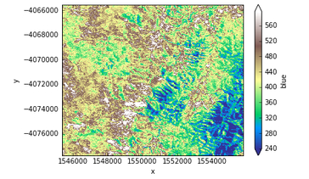
Generalised analysis flow
Apply analysis
landsat_cloud_free.blue.median(dim='time').plot(robust=True, cmap=’terrain’)

Slide 22
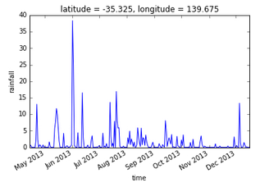
Generalised analysis flow
Output data
rain.rainfall.sel(latitude=-35.30712, longitude=139.69163, method='nearest').plot()

Slide 23
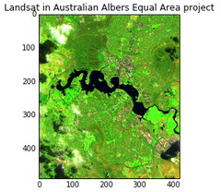
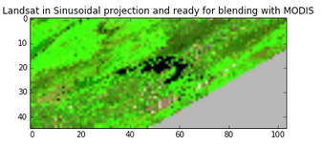
Reproject dataset (indexed or ingested)
landsat = dc.load(product='ls5_nbar_albers', x=(149.25, 149.35),y=(-35.25, -35.35), time=('2010-01-01', '2011-01-01'), output_crs=’EPSG:4326’, resolution=(-0.00025, 0.00025))

Slide 24
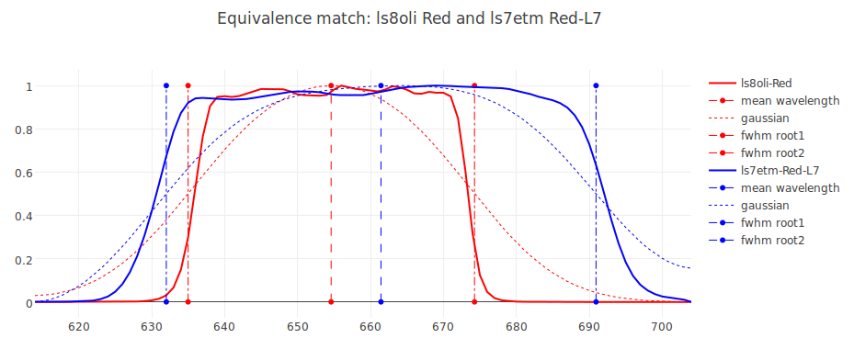
Sensor ignorance - under construction
Spectral equivalence Synthetic band creation (from mean and FWHM) Covariance of metrics (refine & remove) Relative Spectral Response in storage/product definition Spectral feature in storage type and alias to aid initial band discover for cross walk between sensors

Slide 25
Communication
Mailing list (production environment announcements)
To subscribe go here: http://eepurl.com/b-f_L1
Help, feedback and discussion
Slack (informal discussion / help)
Github (external users: raise issues, bugs)
JIRA (internal users: raise issues, bugs)
Speak to / email us simon.oliver@ga.gov.au +61262499770

Slide 26
Discrete Global Grid Systems

Slide 27
Standardising Discrete Global Grid Systems
Why Standardize DGGS?
The diversity, incongruity and lack of standardized applications of global grid infrastructures limits the development of accurate analysis tools for Big Earth Data
March 2014 – OGC established a Standards Working Group to address this problem
The OGC DGGS Core Standard defines:
A concise definition of the term Discrete Global Grid System as a spatial reference system;
The essential characteristics of a conformant DGGS; and,
The core functional algorithms required to support the operation of a conformant DGGS.

Slide 28
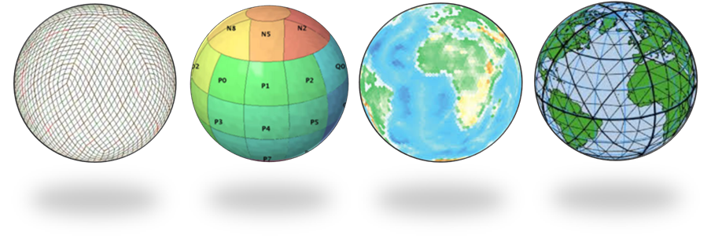
A “New” Framework for a New Era
A Discrete Global Grid System (DGGS) is a Digital Earth reference model
DGGS are designed to be information grid systems, not navigational grid systems
OGC defines a DGGS as:
“…a spatial reference system that uses a hierarchical tessellation of cells to partition and address the globe. DGGS are characterized by the properties of their cell structure, geo-encoding, quantization strategy and associated mathematical functions.”

Slide 29
OGC Discrete Global Grid Systems (DGGS) SWG
DGGS an important part of the future versions of Datacube
OGC DGGS SWG to begin elaboration of Extension Standards to the DGGS Core Standard
Anticipated Extensions include:
Interoperability interface protocols for OGC Web Services (e.g. WCS, WCPS, WCTiles, etc…) to facilitate DGGS-to-DGGS communication and processing
3D (and higher dimensional) DGGS Specifications
Best Practice Guide

Slide 30
Standardising Discrete Global Grid Systems

Slide 31
Antenna Upgrade

Slide 32
Geoscience Australia - Alice Springs Ground Station
Alice Springs Ground Station consists of 3 antennas
9m Datron Antenna, X-Band downlink, S-Band TT&C
9m Viasat Antenna, X-Band downlink (antenna will be operational November 2016)
2.4m ES&S Antenna, X/L-Band Downlink
Satellite acquired and services provided;
real-time (S-Band)
Landsat-8 TT&C (Tracking, Telemetry and Commanding)
Landsat-7 telemetry downlink
near-time (X/L-Band)
NPP-Suomi, Aqua, Terra, NOAA-18, NOAA-19 for Sentinel bushfire hotspots
post-pass (X-Band)
Landsat-7, Landsat-8 real-time (over Australia) and playback satellite imagery

Slide 33
Alice Springs Ground Station - Recent Projects
LGN - Landsat Ground Network (Operational by November 2016)
Alice Springs will be one of three ground stations (USGS and DLR) to acquire Landsat-8 real-time and playback imagery while performing TT&C (tracking, telemetry and commanding) for USGS and NASA
Alice Springs has completed its TRR (Test Readiness Review) in July 2016
Landsat-7 real-time and playback imagery has been collected from Alice Springs since 2002
RMS (Reception Management System) upgrade in progress to streamline scheduling of all satellites to all available assets, including antennas and baseband equipment

Slide 34
Alice Springs Ground Station - Recent Projects
9m Datron antenna major upgrade (Completed & Operational from May 2016)
New gearbox/motors for all axes
New X-Band and S-Band feeds (TT&C - Uplink and Downlink capabilities)
Dual polarisation X-Band Downconverter
1+1 SSPA + S-Band up/down converters
New control servos and ACU
New Cortex Quantum baseband CRT-Q (S-Band) and HDR-XXL (X-Band)

Slide 35
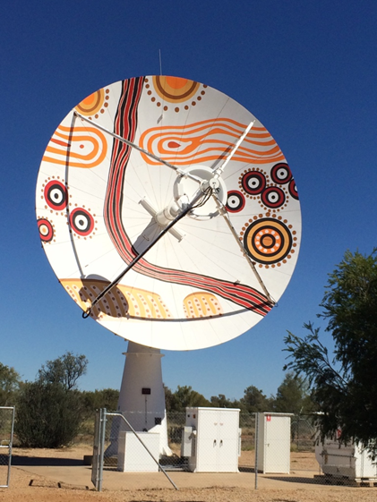
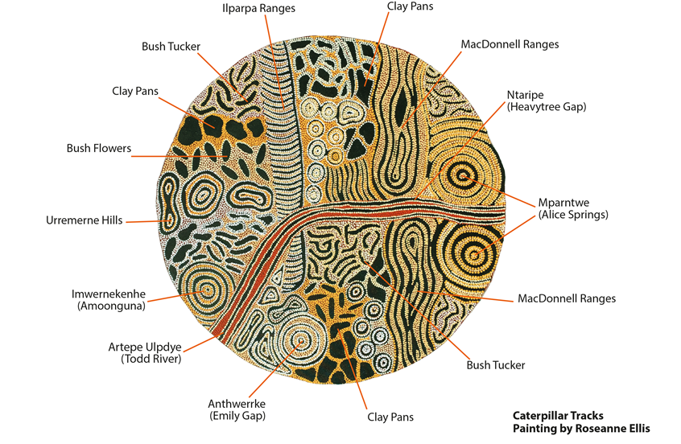
Alice Springs Ground Station - Recent Projects
Notes:
Artwork initiated by Geoscience Australia (Guy Roal, Branch Head of Observatories and Science Support) and commissioned by CAT (Centre for Appropriate Technology) a local Aboriginal corporation that Geoscience Australia has a relationship with. This artwork captures the analogy of the local Aboriginal peoples interpretation of the topographic view of Alice Springs onto an antenna which captures satellite real-time imagery of the changing topographic landscape of Alice Springs.

Slide 36
Future: WGISS involvement
Data Cubes
Discrete Global Grid Systems - OGC SWG and implications for AGDC evolution
Spectral response repository / standardisation

Slide 37
Io sono finito
Domande?....

