Slide 1

CEOS Data Cube use of
Cloud Computing
Brian Killough
CEOS Systems Engineering Office (SEO)
WGISS-42 Meeting
September 20, 2016

Slide 2


Our Vision
What is our vision for the use of Cloud Computing for the CEOS Data Cube?
Deployment – Data Cubes can be deployed (built) “in the cloud” with existing cloud-based data or user data. Takes advantage of rapid processing for the ingestion process.
Hosting – Data Cubes can be hosted (stored) for temporary use or permanent use. As storage is the most costly cloud computing element, “on demand” Data Cubes are a good choice
Processing – Data Cubes can use cloud-based processing to take advantage of flexible parallel processing methods and idle machines. This could be a cost paid by users, if hosting is provided by the cloud server company.

Slide 3

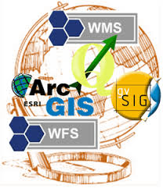
Current Use
How do we currently use Cloud Computing for the CEOS Data Cube?
Amazon Web Services (AWS) – The SEO won a research grant in March 2016 to obtain $45,000 credits for prototype testing of Data Cubes. We plan to investigate these elements ...
Deployment: Compare Data Cube ingestion times using AWS data and user uploaded data.
Hosting: Test block-based (EBS), object-based (S3) and glacier archive storage of data and Data Cubes
Processing: Test “on-demand” and “spot” processing instances (EC2) to optimize operations and costs.
Web Mapping Services (WMS): Test remote connections to a Data Cube using an API to allow QGIS or ArcGIS functions.

Slide 4

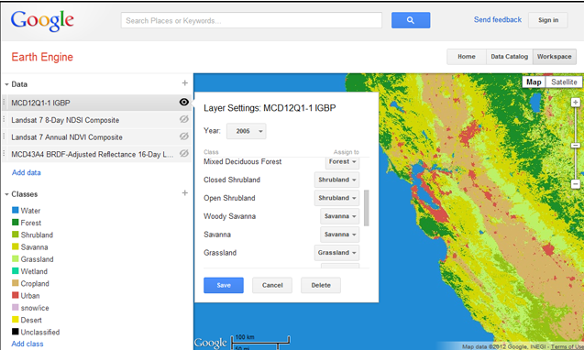
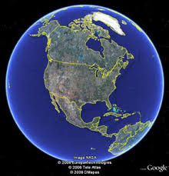
Why not use
Google Earth Engine?
PROS
Free, open, global datasets
Powerful analysis tools for
Javascript and Python
Datasets are growing daily ...
Adding Sentinel-1 and Sentinel-2 recently
CONS
Commercial dependency ...
Will it be sustained for the future?
Limited time and spatial scales
Cloud-based computing only ... No options for hubs or local computing solutions
Google “owns” all of the data. Users prefer control and ownership.
Missing datasets

Slide 5
What data is available from Google and Amazon?
Mostly Level-1 data, but some recent efforts to provide pre-processed Level-2 products by Google (Landsat and Sentinel-1).

Slide 6
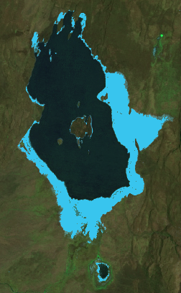
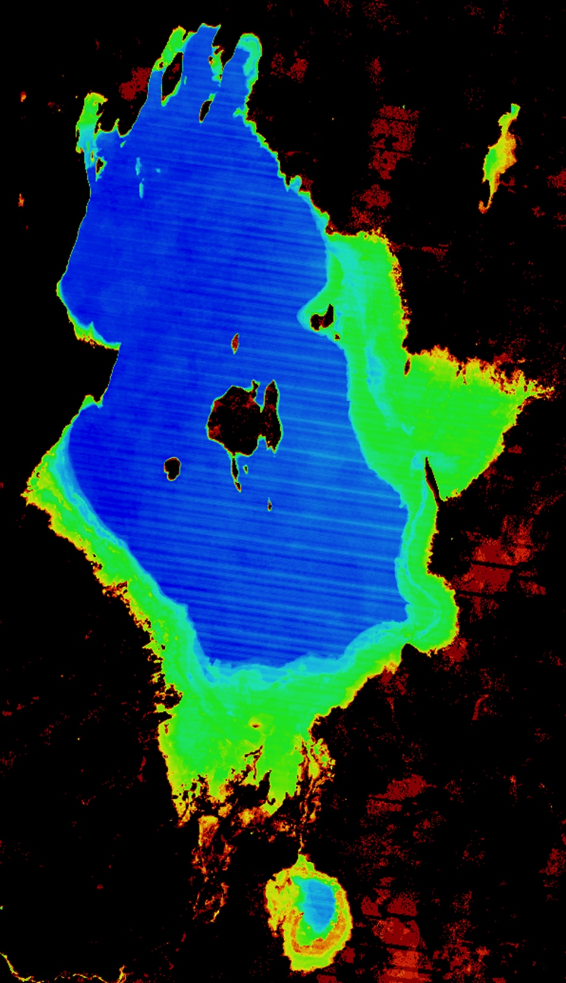
Google Earth: Aqua Monitor
The Data Cube water detection results (right) were compared with the Google Earth Engine Aqua Monitor APP (left) (http://www.aqua-monitor.appspot.com)
The Aqua Monitor results, also based on Landsat data, look nearly the same! Light Blue pixels show where land has been changed into surface water over the time series
(2005 thru 2015).
How is a Data Cube better?
The Landsat data is “analysis-ready” and atmospherically corrected, which leads to more accurate results. The user has access to all of the pixel-level information for any portion of the time series. The output shows the existence of water at any time during the analysis period.

Slide 7

Questions for WGISS
The Data Cube project is planning to develop a Future Data Architecture (FDA) prototype project where Data Cubes will be tested. This project would certainly test cloud-computing. How might WGISS get involved?
Does WGISS have any specific advice or thoughts on the use of cloud-based resources to support Data Cube deployment, storage and processing?
Does WGISS know of any other (e.g. Microsoft) cloud-based computing resources that may be interested in providing free credits for testing the CEOS Data Cube architecture?

