Slide 1
WGISS-42: IDN Report
Michael Morahan
CEOS WGISS-42 Meeting
ESRIN (European Space Research Institute) Frascati, Italy
September 21, 2016

Slide 2
Outline
Updates to IDN Home Page and Search Interface
Overview of GCMD Keywords and Governance Process
IDN Metadata QA Evaluation and Assessment
IDN Usage Metrics and Metadata Record Counts

Slide 3
Updates to IDN Home Page and Search Interface

Slide 4
New IDN Home Page Objectives
Enable access to IDN Resources from the main page.
Offer multiple methods to search content
Free text
Keyword drill-down
Subset by specific CEOS agencies
Search by CEOS MIM Keywords (with GCMD reference table)
Access to GCMD/IDN keyword lists.
Maintain ceos.org look and feel.

Slide 5
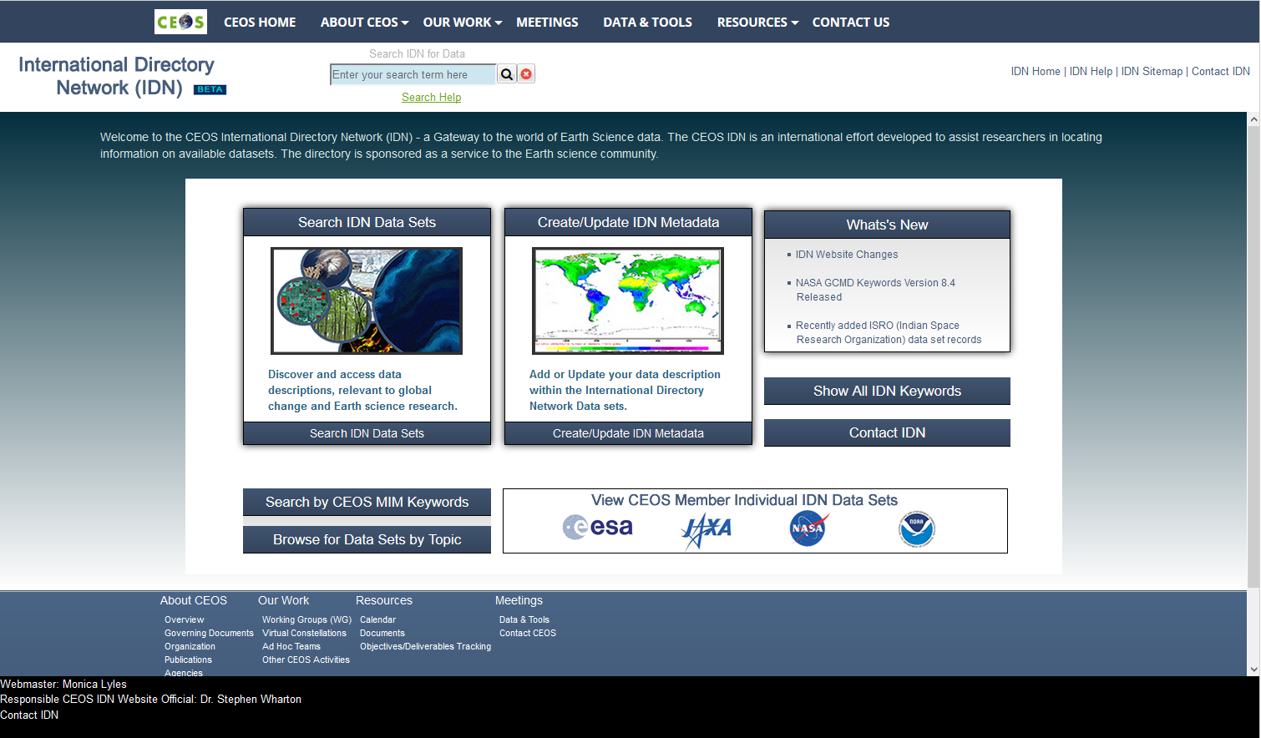
New IDN Home Page
Freetext Serch
Help
New Developments
Access to all GCMD Records
Keywords
MIM Keywords
CEOS Agencies
Drill Down

Slide 6
New Search Interface Objectives
One page search, refinement and sorting.
Improved search precision and recall via new functionality design.
Interdisciplinary search capabilities through the selection of multiple facets.
Enhanced sorting capabilities by allowing users to add sortable columns to the search results area.

Slide 7
New Keyword Search Interface
Enhanced Sorting by Columns
Interdisciplinary Search with Facets
CMR Results

Slide 8
Update on IDN CSW Service

Slide 9
IDN CSW Service
The GCMD/IDN CSW service will be replaced by a new CMR CSW service this fall. A forwarding service will be temporarily set-up to send users to the new service.
This change will have no impact on CSW users.
New CMR CSW API References:
API Overview:
https://cmr.earthdata.nasa.gov/csw
CSW Capabilities:
https://cmr.earthdata.nasa.gov/csw/collections?request=GetCapabilities&service=CSW&version=2.0.2
9

Slide 10
GCMD Keywords Introduction and Evolution

Slide 11
Introduction To GCMD Keywords
Hierarchical set of controlled keywords covering the Earth science disciplines.
Used for categorizing Earth science data and services in a consistent and comprehensive manner, allowing for the precise searching of collection metadata and subsequent retrieval of data and services.
Follows a governance process which defines the procedure for recommending additions, modifications, and/or deprecations to the keywords; and the process by which the user community will be informed of changes.

Slide 12
Keyword Requirements
A set of controlled keyword requirements are used when determining what constitutes a well-curated keyword list.
Applicable to an established science discipline and practical to a broad range of users and metadata providers.
Composed of conventional terminology that is functional and understandable by the international community.
Should not overlap with keywords that already exist.
Frequently searched for in free-text searches, but that are not already part of the existing keywords are often good candidates for new keywords.
Commonly populated in the uncontrolled Detailed Variables field will be considered for inclusion into the controlled GCMD keywords.
Applicable to existing or forthcoming Earth science data/metadata (e.g. a new project, instrument, mission, or collaboration).
Parallel in scope at any level of the hierarchy.
All chosen topics, terms, and variables, at any level within the hierarchy, must be distinctive - minimizing overlap as much as possible. This will ensure a concise keyword list.
Should be logically/semantically correct.

Slide 13
Keyword Types
Keyword Sets (…) indicates number of keyword levels
Earth Science Keywords (7) Earth Science Services Keywords (5)
Data Centers (4) Projects (2)
Platform/Instrument/Sensor (3) Locations (6)
Vertical Data Resolution (1) Temporal Data Resolution (1)
URL Content Type (2) Chronostratigraphic Units (5)
Horizontal Data Resolution (1)

Slide 14
Keyword Structures
Example Keyword Structure for Earth Science Keywords (7 Levels)
Keyword Level Example
Category Earth Science
Topic Atmosphere
Term Clouds
Variable Level 1 Convective Clouds/Systems (Observed/Analyzed)
Variable Level 2 Cumulus
Variable Level 3 Cumulus Congestus
Detailed Variable Towering Cumulus (Uncontrolled Keyword)
Example Keyword Structure for Platform/Instrument/Sensor (3 Levels)
Keyword Level Example
Platform Short Name Terra
Instrument Short Name MISR (Multi-Angle Imaging SpectroRadiometer)
Sensor Short Name AN (Charge Coupled Devicebased Pushbroom Nadir Viewing Camera A)

Slide 15
Keyword Structures
Example Keyword Structure for Data Centers (4 Levels)
Keyword Level Example
Data Center Type Government Agencies-Non-USA
Country India
Agency IN/ISRO
Agency Division IN/ISRO/MOSDAC (Meteorological and Oceanographic Satellite Data Archival Centre)
Example Keyword Structure for Locations (6 Levels)
Keyword Level Example
Location_Category Ocean
Location_Type Atlantic Ocean
Location_Subregion1 North Atlantic Ocean
Location_Subregion2 Mediterranean Sea
Location_Subregion3 Adriatic Sea
Detailed_Location Gulf of Trieste

Slide 16
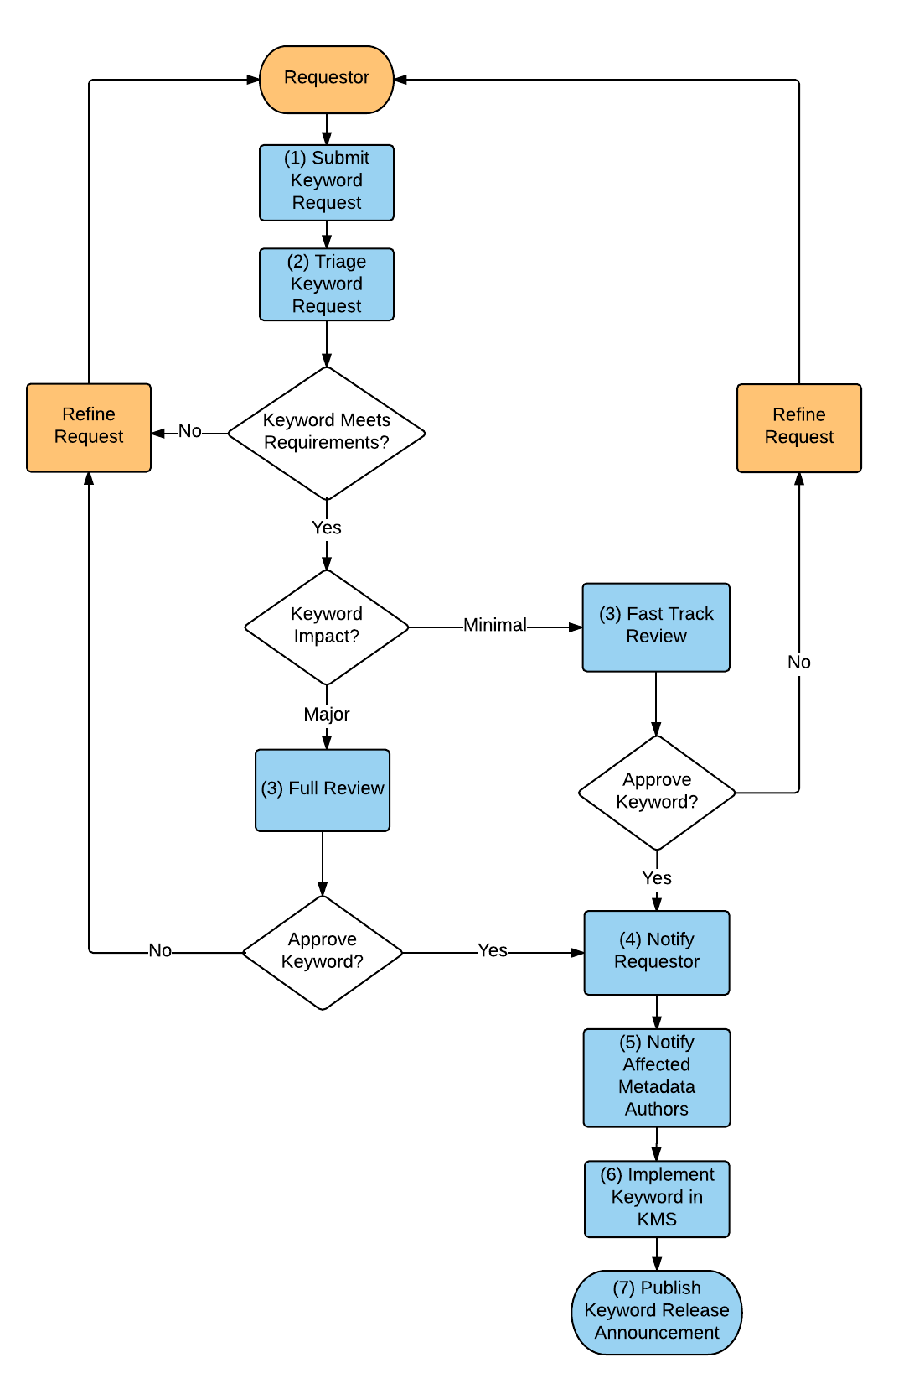
Keyword Governance Process
The Keyword Governance Process is derived from the now public Keyword Governance document (version 1.0):
https://earthdata.nasa.gov/files/KeywordsCommunityGuide_Baseline_v1_SIGNED_FINAL.pdf
Governance Purpose:
Provide the community with a comprehensive resource that describes the governance structures and process for reviewing proposed changes.
Give an overview of the structure of the keywords, requirements and recommendations to consider when requesting keyword changes, and instructions for submitting change requests.
Diagram describes the end-to-end process of a keyword from initial request, triage, approval, notification, and implementation.

Slide 17
Request and Triage
Keyword requests come from users, metadata providers (including CEOS members), and/or science coordinators.
Science Coordinators perform keyword triage, which includes conducting a keyword impact assessment and making sure the keyword complies with the keyword requirements.
by a change

Slide 18
Review
Following triage, the keyword request is either refined, put on a fast track review, or put on a full review.
The ESDIS Standards Office (ESO) facilitates a full review of the keywords with subject matter experts (SME’s).
Notes:
Pre-vetted with Steve for ESIP

Slide 19
Keyword Implementation
Following the approval of the keywords by the ESO, the requestor and affected metadata providers are notified of the changes.
Keywords are updated in the Keyword Management System (KMS) and published by the science coordinators.
A keyword release announcement is published by the science coordinators.

Slide 20
Keyword Releases
Science Keyword Release | Science Keyword Topics | Date
Version 8.2 | (Atmosphere, Ecosystem, Terrestrial Hydrosphere, and Locations ) | March 2016
Version 8.3 | (Water Vapor, Water Quality/Chemistry, and Ecosystems) | August 2016
Version 8.4 | (Atmosphere > Atmospheric Phenomena and Atmosphere > Atmospheric Radiation) | August 2016
What’s Next:
Keyword Release 8.5 - March 2017
Continue to release new and updated keywords on a semi-annual basis.
If you have keyword recommendations, please contribute through the Keyword Community Forum: http://earthdata.nasa.gov/gcmd-forum

Slide 21
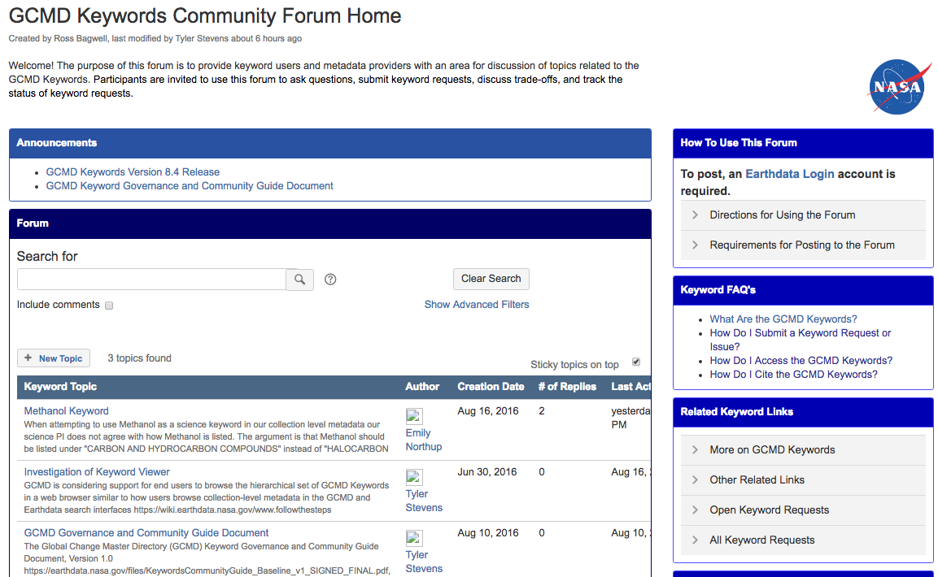
Keyword Community Forum
http://earthdata.nasa.gov/gcmd-forum
Announcements for
new releases and documents
Help for using the forum
Search for keyword
topic of interest
Keyword FAQ’s
Submit new keyword topic
Existing keyword topics

Slide 22
Keyword Resources
GCMD Keyword Directory
Go here to download Keywords in XML, SKOS or CSV format:
http://gcmd.nasa.gov/subset/idn/keywords.html
GCMD Keyword RESTful Web Service
Go here for Machine-to-Machine access to the Keywords:
http://gcmdservices.gsfc.nasa.gov/kms/capabilities?format=html
Documentation:
http://gcmd.nasa.gov/Connect/docs/kms/KeywordManagementServiceAPI.pdf
Keyword Forum
Go here to follow keyword recommendations, upcoming versions or to supply your own recommendations:
http://earthdata.nasa.gov/gcmd-forum

Slide 23
IDN Metadata QA Evaluation and Assessment

Slide 24
Curation Objectives
Ensure that metadata are Compliant, Accurate, Complete and Intelligible (CACI) for effective data discovery and access.
Support development of standards, rules, and tools to enhance curation effectiveness and efficiency.
Support broader community awareness and participation in the curation process.
Support greater interoperability and broader utilization of curation resources.

Slide 25
Automated QA Rules
Purpose:
Check collection-level metadata for compliance with the CMR Metadata Model for Collections.
Support additional quality assurance (QA) checks to ensure high-quality and accurate metadata.
Apply the QA rules to single or multiple records.
Checks:
Required and recommended fields/values, valid keywords, proper syntax of temporal and spatial values, and functioning links.
Rule Sets:
Written for each format (DIF9, DIF10 and ECHO). There are currently 54 rule types across 6 rule categories with the new types developed as unique use cases are identified.
Tools:
The QA Viewer, QA Triage Tool, and docBUILDER are driven by the rule sets and assess the completeness and quality of metadata.

Slide 26
QA Rule Categories and Examples
Required Field Check
Checks for presence of required fields as defined by schema
Example: All required fields should be included in the metadata
Controlled Keyword Check
Checks that content of field match a valid keyword
Example: Science Keywords, Platforms Projects should be KMS valids
Broken Link Check
Checks for broken URL links
Example: Checks broken links in Related_URL Field
Character Check
Checks number, type, pattern of characters that are allowed within a field
Example: Don’t include the letter “V” in the Version Field
Syntax Checks
Checks for valid syntax in a field/record
Example: Date field should follow YYYY-MM-DD or YYYY-MM-DDTHH:MM:SS
Miscellaneous Checks
Additional checks including conditional checks, contains checks and if a field exists
Example: Entry ID and Entry Title should not be exactly the same

Slide 27
Manual Review
A manual review is needed to complete the quality assessment, examine the automated quality assurance (QA) report, identify high priority QA errors, and to ensure that metadata is accurate, clear, complete, concise and understandable.
(Partial) Checklist for Manual Review
Identify patterns of errors or omissions
Review all content for conciseness and readability
Verify that facets and other controlled keyword values are consistent and suitable for the data set
Verify corrected URLs
Check appropriateness of URLs
Check for formatting that may be incompatible with external clients

Slide 28
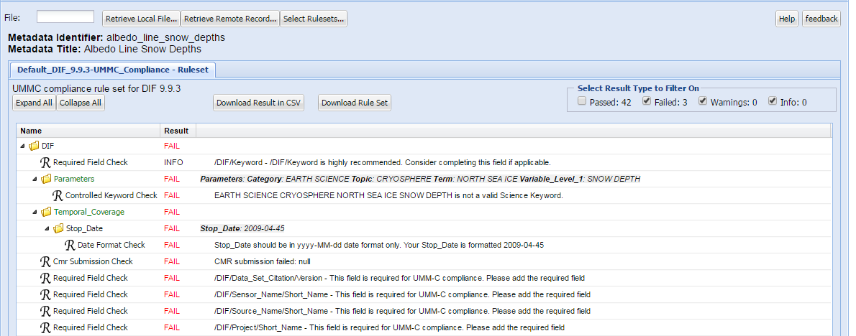
QA Viewer – Reporting Per Record
The QA Viewer performs a customizable suite of QA checks against a metadata record and produces field-by-field human-readable error messages.
docBUILDER QA is carried out by the QA Viewer
(http://gcmd.nasa.gov/collaborate/docbuilder.html)
QA Viewer
Notes:
Demo Record: Geospatial_Watershed_Data_NGEE_Arctic

Slide 29
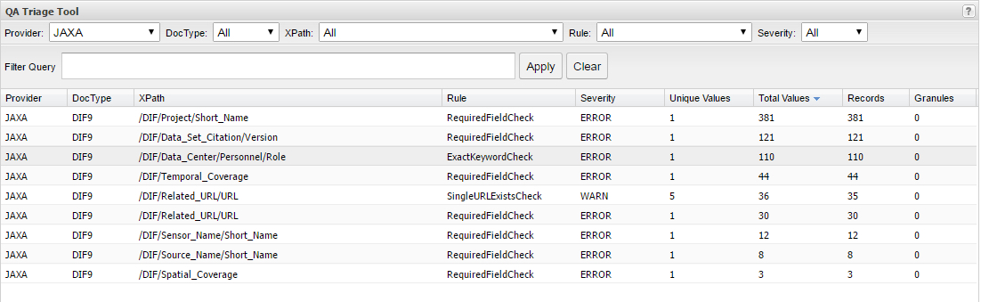
QA Triage Tool – Reporting and Triage of All Records
Applies automated QA rules to all records in the IDN, identifies erroneous values and affected records, and subsets results by provider, doc type, error type and xpath.
The IDN team can provide metadata authors triage reports of their metadata from the QA Triage Tool.
QA Triage Tool

Slide 30
Process for Making Recommendations to Providers
Analyze QA triage report summary of results by format, field, data provider or error type.
Check for False Positives
Identify recommended updates
Find and Replace Value
Add Value for Missing Required Fields
Add Value
Potential New Keyword
Potential Broken Link
Needs Additional Review
Work with Provider
(Others as Appropriate)
Check for possibility of breakage to collection or granule records
Include manual review report (based on manual review checklist)

Slide 31
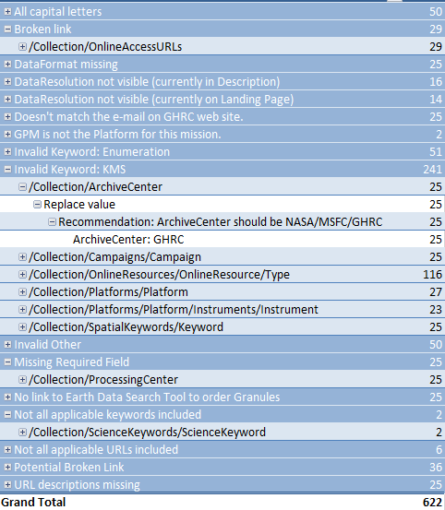
Triage Reports – Provider Summary
The overview report provides a per provider summary of the triage results and recommendations (automated and manual).
Reports can be generated for all providers in the IDN.
Answers Questions Such As:
What is the most common error observed?
Which fields (xpaths) have the most errors?
What recommendations will fix the most records?
What records are affected?

Slide 32
Conclusions
Both automated and manual metadata checks are needed to ensure high-quality metadata.
Automated checks can free up time to focus on making fixes and identify where additional manual review is needed.
When the automated QA process first started, it took over a week to generate a report; now it takes hours.
QA Triage reports can inform providers of recommended changes. Let us know if you are interested.

Slide 33
IDN Metrics

Slide 34
IDN Site Usage: August 2015 – August 2016
 | Counts
Total Visits | 19,688
Average Daily Visits | 50
Average Monthly Visits | 1,514
Total Page Views | 41,906
Average Daily views | 106
Beta IDN Site usage | Counts
Total Visits | 4,102
Total Page Views | 14,031
* IDN Site and Beta IDN Site Metrics collected by different software

Slide 35
IDN Usage by Continent: August 2015 – August 2016
Number of Visits (Total Visits=19,696)
Other users: 12783
N. America = 1811
Europe = 1029
Asia = 2998
UK = 158
Russia = 105
Canada = 243
France = 189
Germany = 153
United States = 1449
Italy = 149
S. Korea = 317
Algeria = 52
China = 316
Japan = 80
Mexico = 58
India = 847
Thailand = 93
Nigeria = 68
Ethiopia = 54
Colombia = 54
Peru = 103
Africa = 526
Brazil = 94
Australia = 192
S. America = 357
South Africa = 74
Top 10 Countries (Visits):
1. United States = 1449
2. India = 847
3. Korea, Republic of = 317
4. China = 316
5. Iran = 267
6. Canada = 243
7. France = 169
8. Indonesia = 162
9. United Kingdom = 158
10. Germany = 153
35

Slide 36
Questions
Michael.P.Morahan@nasa.gov

Slide 37
Background

Slide 38
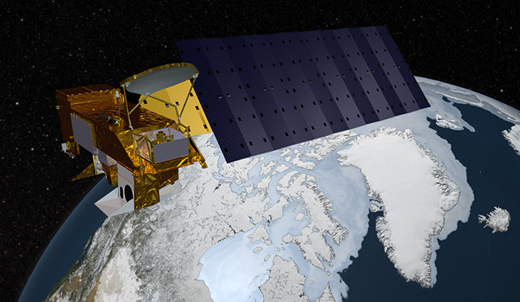
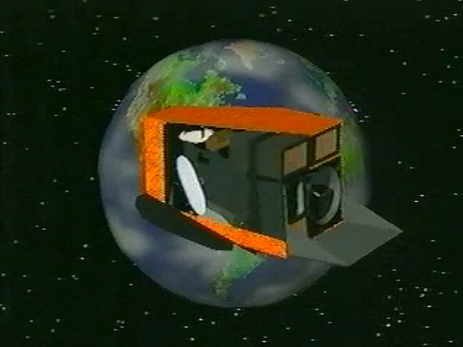
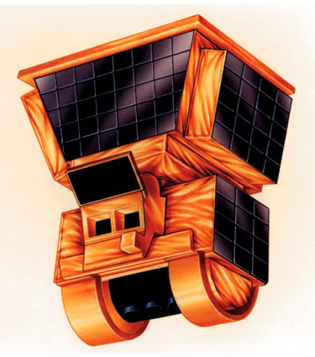
Platform-Instrument-Sensor (P-I-S) Ontology
An ontology relating Earth Observation Satellites to their associated instruments and sensors, utilizing existing GCMD keywords.
Accessible via KMS RESTful Service
Applied in docBUILDER metadata authoring tool (suggests instruments based on platform selected)
Platform: Aqua
Instrument: MODIS
Instrument: Ceres

Slide 39
Ontology Implementation
Keyword Manager allows keywords to be linked and related via unique identifiers known as UUIDs. Keywords are represented as SKOS Concepts (RDF).
Platform: Aqua
(UUID: ea7fd15d-190d-43f3-bdd3-75f5d88dc3f8)
Relationship Strength: 1.0
Relationship Strength: 1.0
Instrument: MODIS
(UUID: 2878f334-35dc-47a7-a3ae-8c5da1adccd3)
Instrument: CERES
(UUID: a9bd961e-1063-4f37-99b6-ecd77aa9eb40)

Slide 40
GCMD Translator API
Restful API for accessing existing GCMD translators
Two types of translators
ISO Translators
Convert ISO records to DIF-9
Adapter Translators
Convert between DIF-9 and DIF-10
Supported formats include:
DIF9, DIF10, ECHO10, ISO, ISO_CNES, ISO_ESA, ISO_EUMETSAT, ISO_IOOS, ISO_NOAA, ISO_NOAA_NCDC, ISO_NOAA_NODC, ISO_SWEDISH_NADC, ISO_GEOSS_CORE, ISO_GEOSS_CORE_NRT
Status: pre-alpha (internal testing)

