Slide 1
Unified Metadata Model-
WIGOS/CGMS Mapping
Sept 21st, 2016
The material is based upon work supported by the National Aeronautics and Space Administration under Contract Number NNG15HZ39C

Slide 2
Agenda
Introduction to CMR Unified Metadata Model
Comparison of Unified Metadata Model with WIGOS and CGMS UML Data Models
Detailed Analysis of mappings: WIGOS->UMM and CGMS->UMM
Discussion of similarities/differences

Slide 3
Unified Metadata Model (UMM)
What is the purpose for the Unified Metadata Model (UMM)?
The UMM provides a common metadata model to unify legacy systems (i.e. GCMD, ECHO) with new systems (i.e. CMR).
How does the UMM support Interoperability?
In the context of the CMR, the UMM enables legacy systems to interoperate to enable continued support to user groups who depend on these systems. In the future, UMM will support a wider range of systems, and has been enhanced to support better interoperability.
Systems interoperate in a variety of ways: data governance, data exchange, data discovery, data archiving/storage.
The UMM is subdivided into several sub-models:
      UMM-Collection
      UMM-Granule
      UMM-Variable
      UMM-Services
      UMM-Visualization
The UMM supports interoperability of legacy systems, and additionally supports interoperability of other national and international systems.
It contains metadata representing several key entities associated with EOS data: Collection, Granules, Variables, Services, Visualization

Slide 4
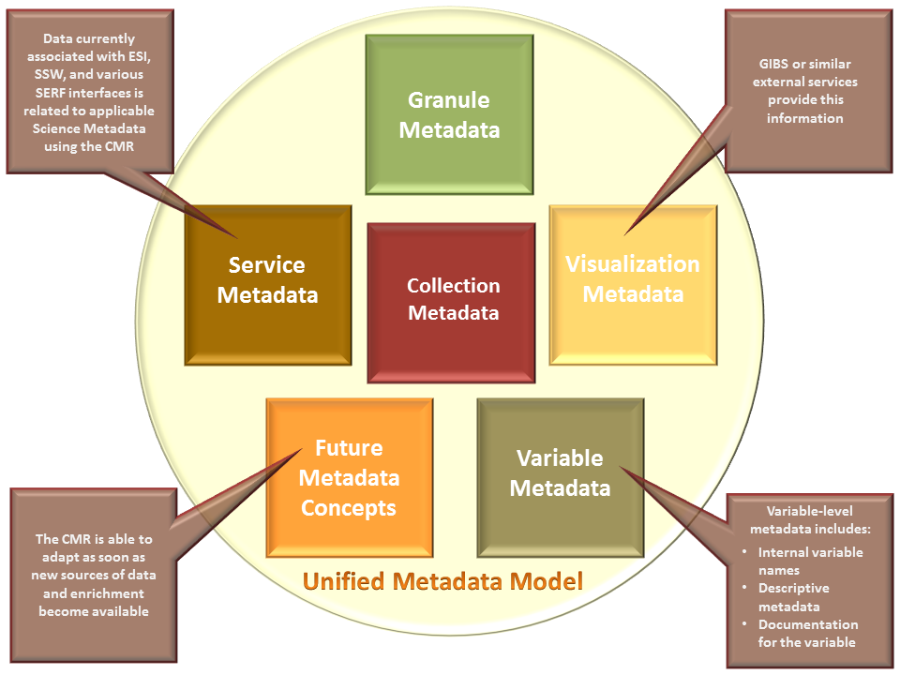
Unified Metadata Model

Slide 5
WIGOS Metadata Model

Slide 6
Comparison of Unified Metadata Model with WIGOS UML Data Model
High-level comparison
METADATA INFORMATION
  MetadataDate not present.
DATA IDENTIFICATION
  (UMM-C->ShortName is at the collection level. WIGOS->observer_variable/measureand appears to be at the variable level - clarification sought).
MEASUREMENT/VARIABLE
  UMM-Var/Variable/Name maps to observed_variable/measurand.
  UMM-C/Description maps to WIGOS->purpose_of_observation.
  UMM-C does not have a mapping for WIGOS->environment.
DESCRIPTIVE KEYWORDS
DISTRIBUTION INFORMATION
TEMPORAL INFORMATION
  UMM-C->Temporal Extent maps to temporal_extent, however we are not clear as to what level of detail there is in the definition of the WIGOS fields and whether it allows for PrecisionOfSeconds, and PeriodicDateTimes to be defined.
SPATIAL INFORMATION
  UMM-C->SpatialExtent maps to spatial_extent however we are not clear as to what level of detail there is in the definition of the WIGOS fields in terms of definition of horizontal extents including: bounding box, polygons, also vertical extents.
ACQUISITION INFORMATION
  UMM-C->Platform maps reasonable well to WIGOS->Station/Platform.

Slide 7
Clarification of mappings:
WIGOS->UMM
QUESTIONS
It appears that the WIGOS Metadata Model is centered on the observed variable. Is there a concept of data set, or collection level in this model? For example, how are observed variables grouped over the timeline of a campaign? Are there a set of files available for a specific variable, e.g. ozone, or CO2, etc.? Are they all considered to be of the same ”standard” file structure, or do data sets of the same observed variable become versioned over time, perhaps with different file structures? How would the observed variable (files) be organized in the archive?
How are the observed variables named? Are the names full-length science names, e.g. carbon_dioxide_concentration or abbreviated names, e.g. CO2_conc.?
Has the distribution of the data sets of the observed variables been considered? It is important to checksum the files, and hold details of the files, e.g. size, units, checksum values, in the metadata?
For the purposes of improving interoperability with other systems, has the ISO Metadata standard been considered, in terms of mapping to an ISO 19115 metadata model?
How would the archive be searched? What use cases are expected for searching for observed variable data? What keywords are expected to match the fields in the metadata model, and which fields are expected to be the target of these searches?

Slide 8
CGMS Metadata Model

Slide 9
Comparison of Unified Metadata Model with CGMS UML Data Model
High-level comparison
METADATA INFORMATION
  MetadataDate not present.
DATA IDENTIFICATION
  (UMM-C->ShortName is at the collection level. CGMS->Product_Information/Product_Name/ appears to be at the collection level – clarification sought).
MEASUREMENT/VARIABLE
  UMM-Var/Variable/Name does not map to anything in the CGMS model.
  UMM-C/Description maps to CGMS->Product_Information/Product_Description.
DESCRIPTIVE KEYWORDS
  CGMS->Product Access Guide Domains shows a hierarchy of various science keyword categories. Potentially these map to UMM-C->ScienceKeywords. (Need clarification on how these keywords are stored in the CGMS metadata, or target fields in the metadata, if employed during a search).
DISTRIBUTION INFORMATION
  UMM-C->Distribution maps to Product_Distribution fields.
TEMPORAL INFORMATION
  UMM-C->Temporal Extent maps to Temporal_Extent, however we are not clear as to what level of detail there is in the definition of the CGMS fields and whether it allows for PrecisionOfSeconds, and PeriodicDateTimes to be defined.
SPATIAL INFORMATION
  UMM-C->SpatialExtent maps to SpatialCoverage however we are not clear as to what level of detail there is in the definition of the CGMS fields in terms of definition of horizontal extents including: bounding box, polygons, also vertical extents.
ACQUISITION INFORMATION
  UMM-C->Platform maps well to CGMS->Spacecraft_Information.

Slide 10
Clarification of mappings:
CGMS->UMM
QUESTIONS
What is the level of granularity of the Product_Information? Is it at the observation level, i.e. collection, granule or variable level? How is the information grouped over time? How is the data structured in the files? Does the concept of variables exist in the model? How do measurements/variables become part of the product?
Has the method of observation been considered in the metadata model? How is the procedure for sampling/capturing the product preserved for future reference? Could this change over the course of time of a campaign? How can this method be associated with the data products? Does this have a bearing on the data quality?
Are there levels of processing in the production of the data product? Is there a standard algorithm or code base used in the production of the data product? How can this become versioned along with the product?
On the topic of Product Access Guide Domains, we have noted the use of various science keyword categories. How are these categories mapped to the observed data product in the metadata? How would the archive be searched? What use cases are expected for searching for observed variable data? Which fields are expected to be the target of these searches?
Where is there more detail on the function of the Realtime Access, Offline Access, and View Access classes and how these are functionally differentiated in the archive system?
For both WIGOS and CGMS:
What overlap exists between the WIGOS and CGMS metadata models? How are the two models meant to operate together in a larger archive? For example, are there any metadata relationships between, say the Product_Information in the CGMS and the observed variables in the WIGOS? How are these relationships documented, and furthermore, how are these implemented in the catalog?
Besides the WIGOS and CGMS metadata models which are described fully in the published documents, is there any other documentation which helps detail any interoperability considerations between the two systems? For example, are the any studies which map the two metadata models to, say ISO 19115? Are there any other elements of the metadata models, which perhaps are surfaced in the search tools, or data gateways, which we can gain further insights to help in making the WIGOS and CGMS collections interoperable with the IDN collections?

Slide 11
Discussion of similarities/differences
Similarities
  Spatial Information
  Temporal Information
  Acquisition Information
Differences
  Variable level information in WIGOS
  Product level information in CGMS (potentially at Collection level – clarification sought)
Next Steps:
Hold discussions between teams representing each model to resolve outstanding issues and determine whether any changes are necessary to the models to promote interoperability between the systems.

Slide 12

This material is based upon work supported by the National Aeronautics and Space Administration under Contract Number NNG15HZ39C.

