Slide 1
Data Stewardship Interest Group
WGISS-42 Meeting
ESA Heritage Data & Knowledge Preservation
ESA-ESRIN, Frascati 19-22 September, 2016

Slide 2
Presentation Outline
Heritage Data Programme (LTDP+)
Assets (Data Record, Associated Knowledge and Hardware) Repatriation – Migration Project
Heritage EO Assets Permanent Exhibition
Preservation Status for Heritage ESA/TPM Missions
ERS Mobile Application

Slide 3

Valorise the past to better understand the future
Heritage Data Programme

Slide 4
Background
ESA space science heritage data represent a unique, valuable, independent and strategic resource owned by ESA Member States.
The issue of preserving and keeping accessible these data assets was:
  Recognised for the first time at ESA CMIN in 2008: funding of LTDP as special project in Earth Observation as part of the ESA Level of Resources (LoR).
  Enlarged to all heritage data from space at ESA CMIN in 2012: funding of Long Term Data Preservation (LTDP) basic activity as part of the ESA LoR.
  The restricted budget envelope approved in 2012 forced the LTDP activity to focus during 2013-2016 on a very limited set of requirements:
    Preventing the unrecoverable loss of unique ESA heritage data holdings
    Providing basic access and perform data valorisation activities for a selected subset of Earth Observation data
    Maintaining international cooperation on data preservation at a collaborative level

Slide 5
Heritage Data Programme (LTDP+)
Heritage Data Preservation, Discoverability & Valorisation
→ proposed at CM16 as Basic Activity in the ESA LoR
If funded at a sufficient level the LTDP + activity will allow consolidating and extending LTDP programme achievements to:
  secure state-of-art preservation of all ESA heritage data assets and associated information, and to prevent loss of data from (non-ESA) missions at risk and judged of European interest
  ensure continuous quality improvement and valorisation of data from a growing number of Earth Observation missions to maximise usability and impact, to provide continuity with current & future missions, and to enable multi-disciplinary applications
  ensure heritage data discoverability and accessibility to users relying on latest ICT technology to facilitate exploitation and broader data use
It will consist of Joint Activities coordinated by D/EOP and of Specific Implementation Activities for each participating directorate managed and carried out independently

Slide 6
LTDP+ Earth Observation Specific Implementation Activities
39 Earth Observation heritage missions (~330 Instruments datasets) will be fully covered by LTDP+ from 2017 onwards including major missions like ERS, Envisat, ALOS and Landsat series.
EO heritage data volume will increase from 5.4 Petabytes (PB) in 2017 to about 8 PB in 2021 based on current assumptions on missions lifetime.
[2017-2021]
Envisat
ERS-1/-2
GOCE
European assets from Landsat, ALOS, AVHRR, etc…
D/EOP specific implementation activities are organised in two main blocks both of which reflect central ambitions of the current EO Ground Segment Evolution Strategy and EO-Innovation Europe
Heritage Data Long Term Preservation
Heritage Data Discoverability and Valorisation
1.Data preservation
2.Data improvement
3.Data discoverability

Slide 7
Data & Knowledge Repatriation
(Migration Project)

Slide 8
Scope & Objectives
One of the pillars of the ESA EO Ground Segment Evolution Strategy is the shift towards a service based implementation of core Ground Segment functions (e.g. for archiving, reprocessing, dissemination, etc).
ESA Archiving function:
A transition from the previous set-up based on a set of different Processing & Archiving Centers (PACs) and Stations throughout Europe towards a Data Archiving Service outsourced to industry is ongoing.
Current contracts with PACs and stations related to ERS/Envisat, Earth Explorers and TPM data archiving, processing and dissemination are being progressively closed.
Migration Project Objective:
Ensure repatriation to ESA of all EO data records, their associated knowledge, heritage media of interest and valuable HW assets.
Ensure transition into new ESA EO GS operational concept.

Slide 9
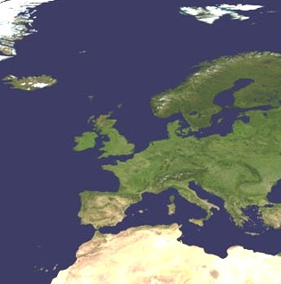
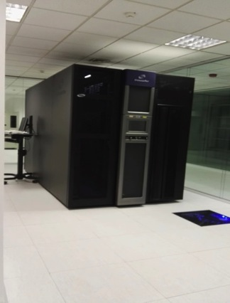
ESA Archives Rationalization
National Archiving centres shared by ESA
Assets: Data Records
Master and Cold Back-up Archive
Tromso
Kiruna
Sodankila
Farnborough
Data Archiving Service (DAS)
West Freugh
Neustreltz
Brest
DLR, Oberpfaffenhofen
Data Archiving Service
CNES, Toulouse
ESRIN
Matera
Maspalomas
ESRIN Cold Back-up Archive
Notes:
Data and Knowledge Preservation
Preserve any mission acquired data & associated knowledge as humankind asset.
With the assumption/awareness that one can never anticipate the exploitation value of the data asset in the future.
Preservation to be addressed in all EO mission phases; incremental approach for past/current missions, systematic planning/approach for future ones.
Several activities have been started in the Earth Observation domain aimed at preventing the unrecoverable loss of unique ESA heritage data and associated knowledge holdings:
Comprehensive review of the ESA historic archive completeness, including the availability of data associated provenance and context information.
2) Started rationalization of the ESA historical archives, the transcription and ingestion into robotic tape libraries of data available as unique copy on old media, and performing the recovery, consolidation, reprocessing and access provision to high priority heritage EO missions datasets (including some which were no more accessible and exploitable).
3) Pilot curation projects started for high priority instruments datasets (e.g. ERS ATSR and MWR, AVHRR).

Slide 10
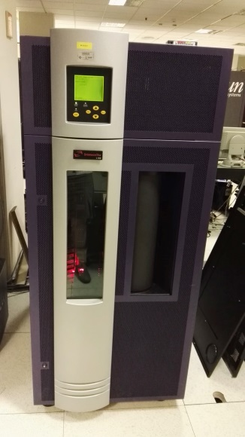

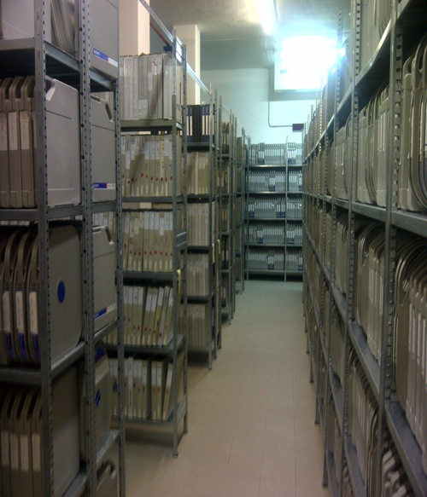
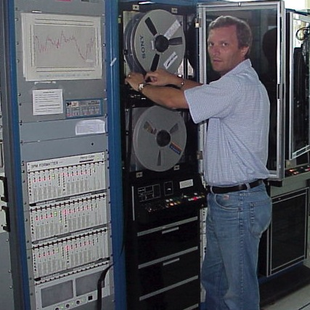

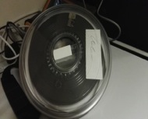

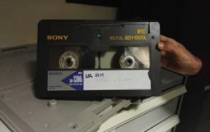
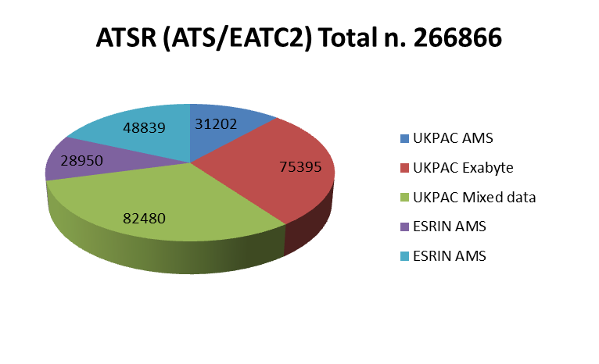
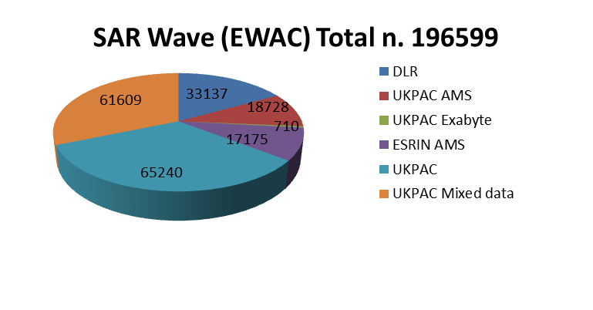
Heritage EO Assets Recovery, Consolidation and Preservation

Slide 11

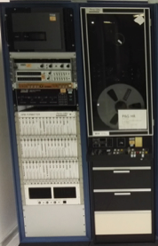
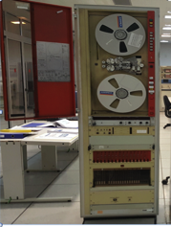

Heritage EO Assets Recovery, Consolidation and Preservation
National Archiving centres shared by ESA
Assets: Data Knowledge,
Heritage Media and HW of interest.
Master and Cold Back-up Archive
Tromso
Kiruna
Sodankila
Farnborough
West Freugh
Neustreltz
Brest
DLR, Oberpfaffenhofen
Data Archiving Service
CNES, Toulouse
ESRIN
Matera
ESRIN
Maspalomas

Slide 12

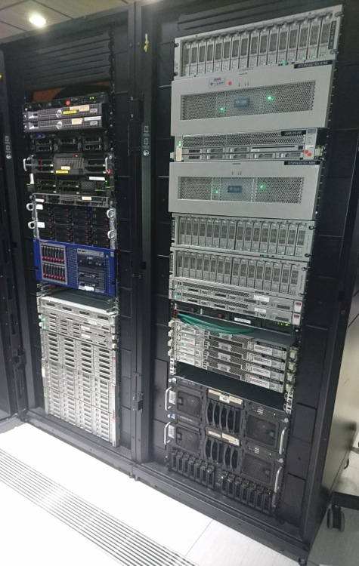
Knowledge Management System (KMS)
“EO Knowledge Management System (KMS) aimed at facilitating the tracking, management and preservation of the ESA EO data assets associated knowledge (e.g. documents, auxiliary data, software tools).
Conversion to FITS format will be carried out in future to ensure harmonization within the preservation layer whilst maintaining capability to provide information to users in the requested format using open source conversion tools (e.g. from FITS to TIFF, PDF, JPG, JPG2000)
Notes:
Knowledge metadata have been defined and information from different sources (e.g. ESA facilities, support contractors, personal archives) is being ingested in the Disk Based Storage System to ensure availability of a comprehensive source of information for any possible ESA internal and external use. EO associated knowledge is stored in the system in heterogeneous native formats which are also provided on-demand to authorised users.

Slide 13
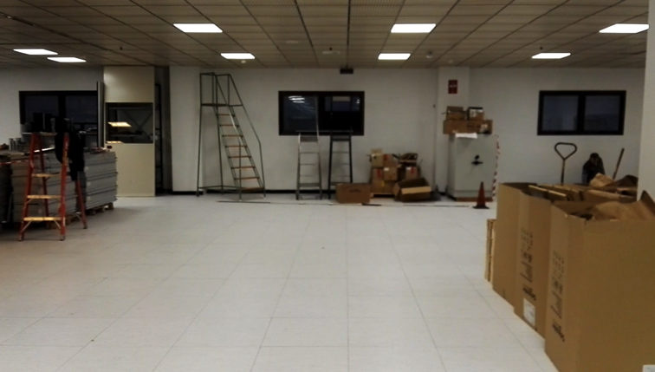
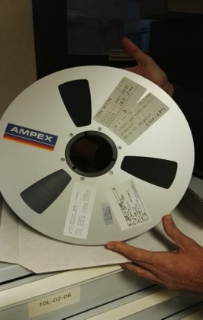
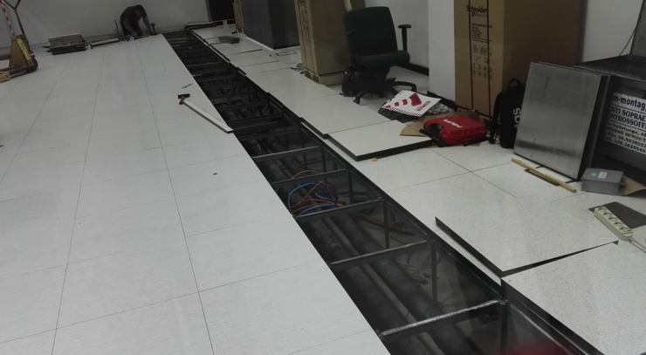

ESRIN Heritage Media Archive

Slide 14
Heritage EO Assets
Permanent Exhibition

Slide 15

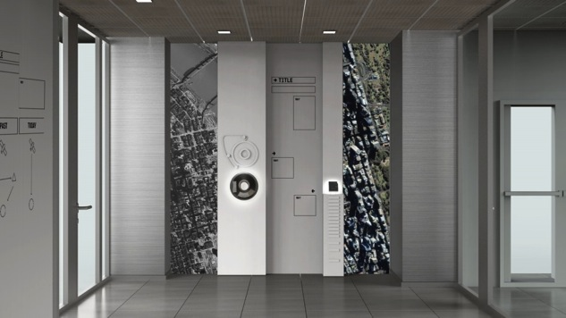
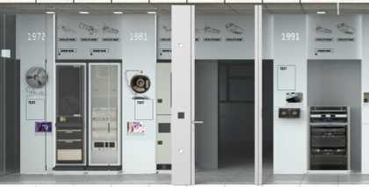

Permanent Exhibition Project
AREA 1
AREA 2

Slide 16
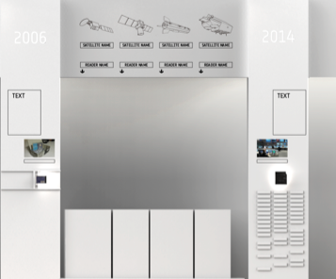
Permanent Exhibition Project:
AREA 2
5 Temporal Milestones identified with a representative satellite for each time period:
1976-1983 Meteosat-1
1984-1990 Landsat TM (4)
1991-2000 ERS-1
2001-2008 Envisat
2009-Today GOCE
For each Milestone the technology evolution is shown in terms of hardware, Media, Catalogue, photos.

Slide 17
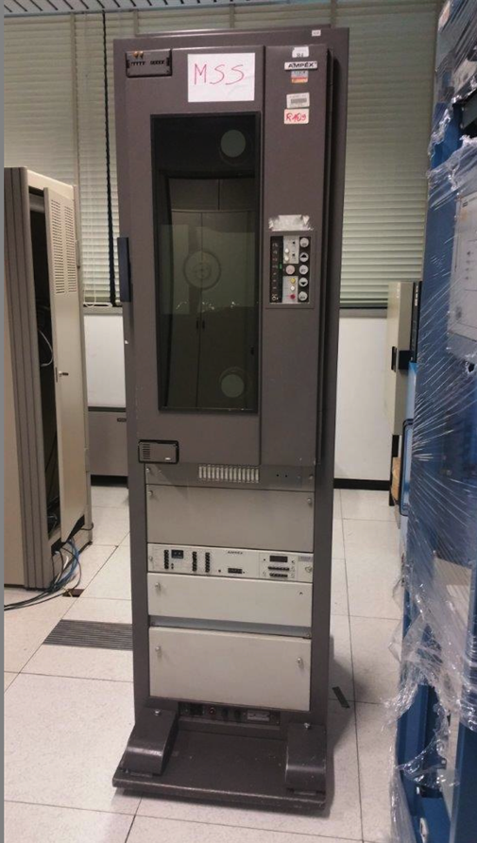
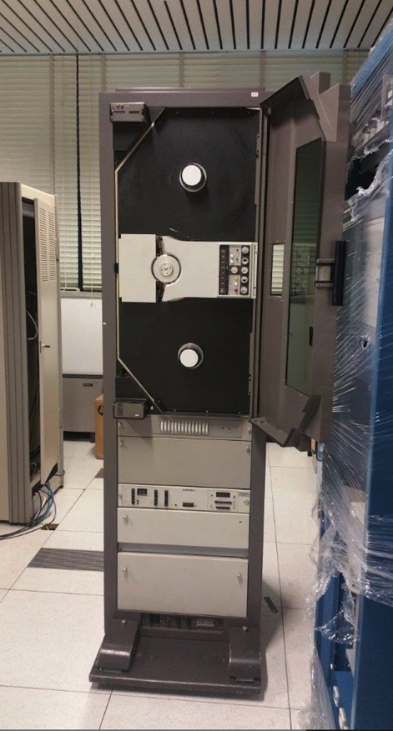
Examples of Heritage hardware

Slide 18
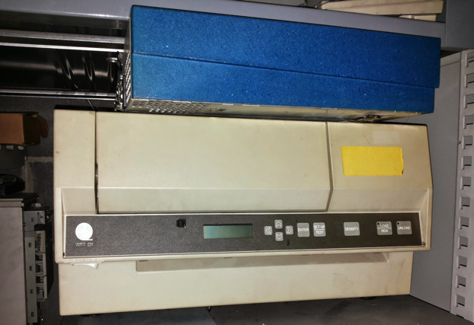
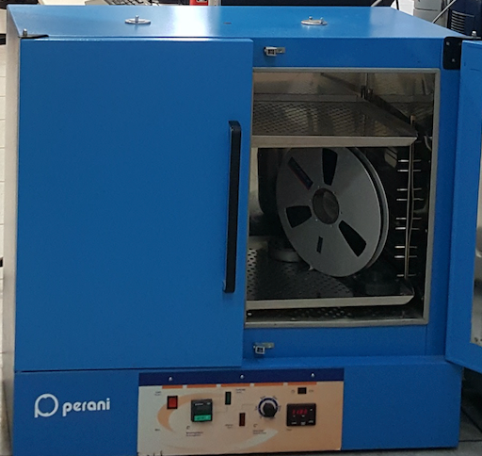
Examples of Heritage hardware

Slide 19
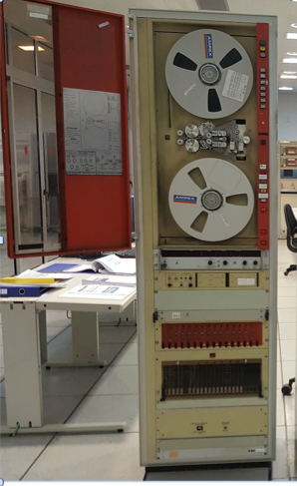
Examples of Heritage hardware

Slide 20
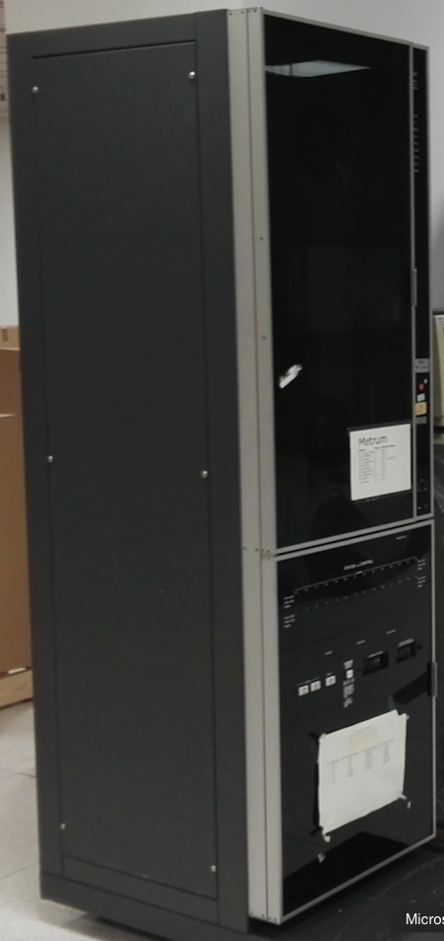
Examples of Heritage hardware

Slide 21
Preservation Status for Heritage ESA/TPM Missions

Slide 22
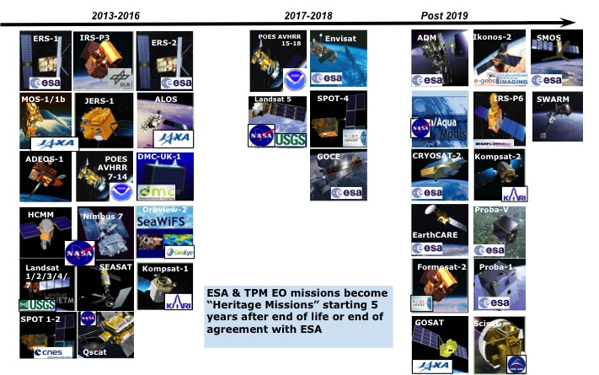
Missions Covered in the Heritage Data Programme

Slide 23
Data Preservation Evaluation Criteria
PRESERVATION CRITERIA |  | Ref. to DSIG Core Documents
EO Mission/Sensor Dataset APPRAISAL and ASSESSMENT | Determine Dataset Value (Appraisal) liaising with Designated User Community, Assess Dataset Status, Decide on Preservation or Purging; If Preserved Perform Tailoring of Core Preservation Documents, and define EO Dataset specific requirements. | EO Data Preservation Guidelines Theme 1 Level A and Theme 8 level A; Preserved Data Set Content; Preservation Workflow
EO Mission/Sensor Dataset COLLECTION & REPATRIATION | Consolidate tailored inventory and collect Datasets composing items (incl. associated knowledge) | Preservation Workflow
EO Mission/Sensor Dataset CONSOLIDATION | Consolidate L0 Data Records and associated knowledge: Gap Filling, Provenance Info, Quality Indicators, Metadata generation | Preservation Workflow; EO Data Set Consolidation Process
EO Mission/Sensor Dataset ARCHIVING & PRESERVATION | Ensure Datasets Integrity, Security, Availability; Ensure management capability | EO Data Preservation Guidelines Theme 1 Level B, Theme 2-3-4 Level A, Theme 5 Level A & B
REPROCESSING or ON-DEMAND PROCESSING IMPLEMENTATION | Higher level products bulk generation and archival or ensure capability to generate on-demand. Provenance Info, Quality Indicators, Metadata generation | EO Data Preservation Guidelines Theme 7 Level A & B
EO Mission/Sensor Dataset DISCOVERABILITY | Ensure Data Records and information is discoverable by end users | EO Data Preservation Guidelines Theme 6 Level A
EO Mission/Sensor Dataset ACCESSIBILITY | Ensure Data Records and information is accessible by end users + Reporting Setup + User Registration | EO Data Preservation Guidelines Theme 6 Level A

Slide 24
Overall Preservation Status for Heritage TPM Missions
PRESERVATION CRITERIA | 0 – 25 % | 25 – 50 % | 50 – 75 % | 75 – 100 %
APPRAISAL & ASSESSMENT
COLLECTION & REPATRIATION
CONSOLIDATION
ARCHIVING & PRESERVATION
REPROCESSING or ON-DEMAND PROCESSING IMPLEMENTATION
DISCOVERABILITY
ACCESSIBILITY
Legend:
Completed
Ongoing/Planned
On hold; n/a; To be defined

Slide 25
SeaSat Status
PRESERVATION CRITERIA | 0 – 25 % | 25 – 50 % | 50 – 75 % | 75 – 100 %
APPRAISAL & ASSESSMENT |  |  |  | Completed
COLLECTION & REPATRIATION |  |  |  | Completed
CONSOLIDATION |  |  |  | Completed
ARCHIVING & PRESERVATION | Associated Knowledge Preservation Completed (PDSC MGM System) | Test EO-SIP Ingestion for CSA successful | Full dataset EO-SIP Ingestion (Cold Back-up Archive) | Completed
REPROCESSING or ON-DEMAND PROCESSING IMPLEMENTATION |  |  | Reprocessing Completed | Reprocessed Dataset has been delivered
DISCOVERABILITY | URD Approved | Mission and Product details webpages created and aligned | Key documents uploaded | Full alignment to reprocessed dataset. Discovery via ESA catalogues (EOLI, Static Map)
ACCESSIBILITY | URD Approved | Planned via LDS (DISSHarm) | LDS Configured | Full reprocessed dataset accessible with fast registration via Earth Online

Slide 26
JERS-1 Status
PRESERVATION CRITERIA | 0 – 25 % | 25 – 50 % | 50 – 75 % | 75 – 100 %
APPRAISAL & ASSESSMENT |  |  |  | Completed
COLLECTION & REPATRIATION |  |  |  | Completed
CONSOLIDATION | No consolidation foreseen. Only reprocessing of WILMA to CEOS format |  |  | Completed
ARCHIVING & PRESERVATION | Full data set copy in Cold Back-up Archive (non-EO-SIP format) | Test EO-SIP Ingestion for CSA successful |  | Full dataset ingestion when EO-SIPs available
REPROCESSING or ON-DEMAND PROCESSING IMPLEMENTATION |  | Test Data Set Reprocessing Validation Completed |  | Complete reprocessing of all OPS and SAR data to EO-SIP products
DISCOVERABILITY | URD Approved |  | Full alignment to reprocessed dataset | Currently not discoverable via ESA catalogues
ACCESSIBILITY | URD Approved | Planned via DISSHarm LDS | LDS Configuration | Currently not accessible
Associated Knowledge Preservation ongoing
(PDSC MGM System)
Reprocessing of OPS data completed. SAR reprocessing ongoing
Mission Page aligned Product details page requires minor update

Slide 27
Nimbus-7 CZCS Status
PRESERVATION CRITERIA | 0 – 25 % | 25 – 50 % | 50 – 75 % | 75 – 100 %
APPRAISAL & ASSESSMENT |  |  | All ESA data is to be preserved | Completed (50% data is unique)
COLLECTION & REPATRIATION |  |  |  | Completed
CONSOLIDATION |  | Draft EO-SIP Specialisation Completed |  | ESA dataset Completed. Contacted NASA for further cooperation
ARCHIVING & PRESERVATION | Associated Knowledge Preservation Completed (PDSC MGM System) | Full data set copy in Cold Back-up Archive (non-EO-SIP format) | Test EO-SIP Ingestion into CSA was successful | EO-SIP Ingestion (TBC)
REPROCESSING or ON-DEMAND PROCESSING IMPLEMENTATION | N/A (processor unavailable)
DISCOVERABILITY |  | Mission Page aligned | Product details page requires minor update | Not discoverable via ESA catalogues
ACCESSIBILITY | Not accessible to users via ESA systems

Slide 28
HCMM Status
PRESERVATION CRITERIA | 0 – 25 % | 25 – 50 % | 50 – 75 % | 75 – 100 %
APPRAISAL & ASSESSMENT | ESA Data Holdings: 18, 1600 bpi CCTs |  |  | Completed
COLLECTION & REPATRIATION |  |  |  | Completed
CONSOLIDATION | Identify available CCT readers at ESA facilities as part of Phase-Out Project for possible transcription. Extract and read the data from the tapes (if available CCT readers). ESA has very few products. TBC if to keep or send to NASA/discard
ARCHIVING & PRESERVATION |  | Associated Knowledge Preservation Completed (PDSC MGM System) | Data not archived at ESA facilities | Data not ingested in robotic libraries
REPROCESSING or ON-DEMAND PROCESSING IMPLEMENTATION | No reprocessing foreseen. ESA has 7-12 unique scenes, whereas the NASA HCMM dataset includes approximately 48,000 frames. NASA was contacted for possible cooperation.
DISCOVERABILITY | Not discoverable via ESA Catalogues
ACCESSIBILITY | Not accessible to users via ESA systems

Slide 29

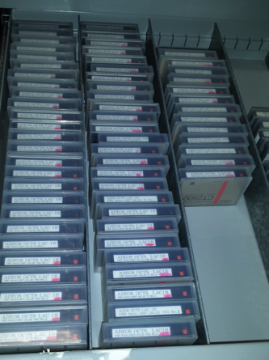
Heritage datasets addressed in the coming months
NOAA AVHRR
  1987-2011
Nimbus-7
  Coastal Zone Color Scanner (CZCS)
  Nov 1978 – Jun 1986
Marine Observation Satellites MOS-1 & MOS-1b
  MESSR (Multi-Spectral Electronic Self-Scanning Radiometer)
  VTIR (Visible and Thermal Infrared Radiometer)
  Feb 1987 – Nov 1995 & Feb 1990 – April 1996
Adeos-1
  OCTS (Ocean Colour and Temperature Scanner)
  Aug 1996 – Jun 1997
SPOT-1 & SPOT-2
  Feb 1986 – Dec 1990 & Jan 1990 – Jun 2009
  HRV (High Resolution Visible) & HRVIR (High Resolution Visible IR)
Priority order being confirmed with CCI representatives

Slide 30
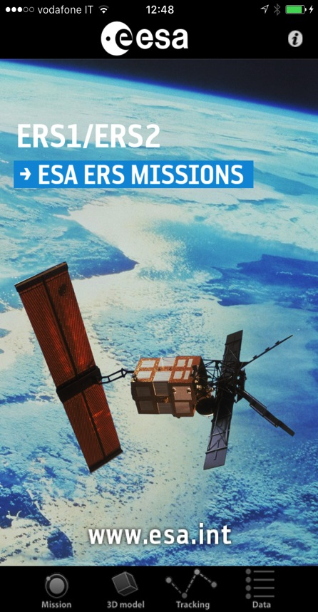

ERS-1/2 Mobile App
Notes:
There are a number of organizations in the space industry that are today are using iPhones and iPad not only as a communication tool but also in their business processes. If one goes on App Store one can find more than 400,000 applications, with many productivity applications available.
If at the beginning the iphone was seen as a nice tool to have, today it is really becoming a business mobile device and the question we asked ourselves about a year ago was how could we use this opportunity for a satellite mission and of course for CryoSat.
ESA with the group of Fulvio and Science in ESTEC have already developed tools, which go into this direction, and today I would say that as ESA we are building an interesting portfolio of ESA apps, which hopefully will bring us to an international event in January.
All this is in my challenging and very important for ESA and especially for its promotion to the general public.
Let’s us now go to Cryosat

Slide 31

ERS-1/2 – Mobile App
Objectives
Promotion/outreach of the ERS Heritage Mission to the general public and scientific community.
Main Features
Description of mission objectives, ground segment data flow, satellites and instruments including 3D models, application areas.
Animations and satellites flight simulation.
Visualization of ERS-1/2 Radar Altimeter (RA) and ATSR L1 products on a 3D map.
Download of ERS-1/2 RA and ATSR L1 products in a local user environment (via DropBox).
Available for Android and iOS
Contract (ACS Rome): Development, maintenance, server infrastructure hosting.

Slide 32
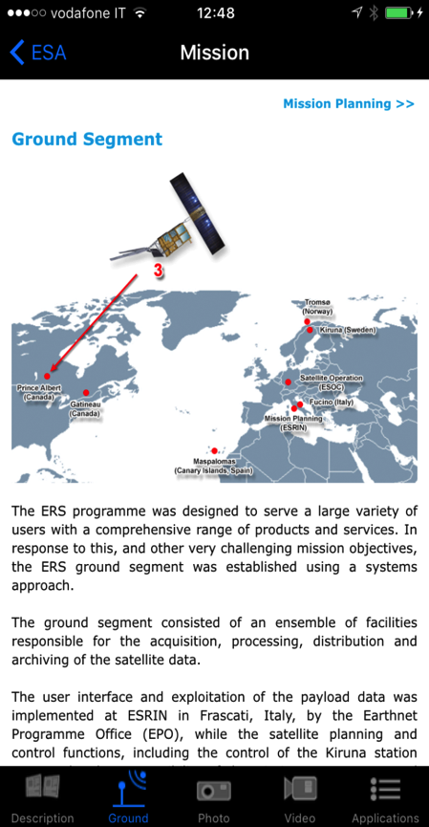
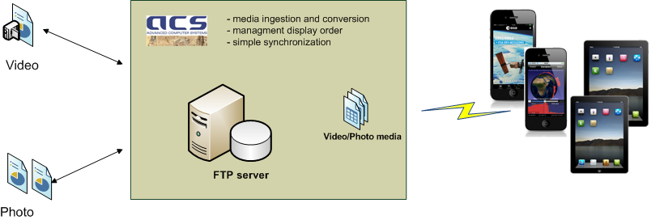

ERS-1/2 – Mobile App Menu
Mission Description Session
Mission description, photos and videos.
New contents available in the mobile with no App version updating on Apple Store and Google Play.
Ground Segment multiple stages description.

Slide 33
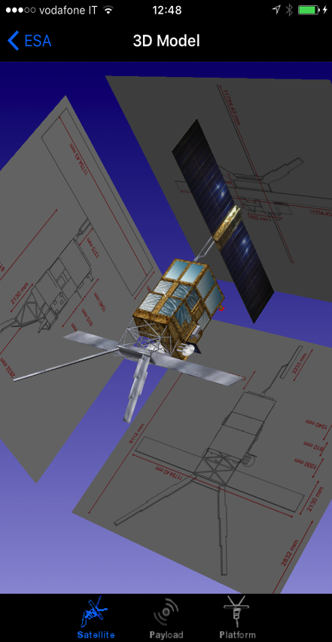
ERS-1/2 – Mobile App Menu
3D Model Session
3D interactive CAD model inspection (with satellite dimensions).
Visual inspection of main hardware and devices on board.
Link to satellite’s instrument and equipment descriptions.

Slide 34
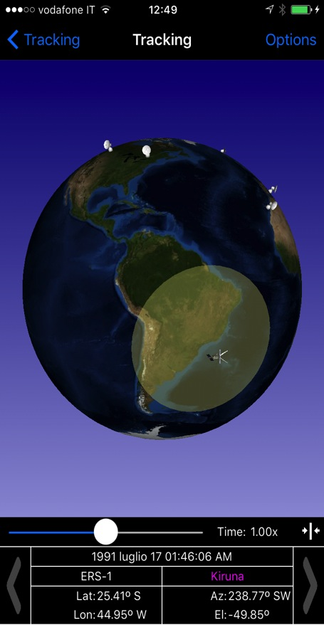
ERS-1/2 – Mobile App Menu
Tracking Session
Historical satellite position by propagation in an interactive 3D environment.
Selection of date and time for flight simulation.
Flashing of station involved in the acquisition along the satellite orbit.

Slide 35
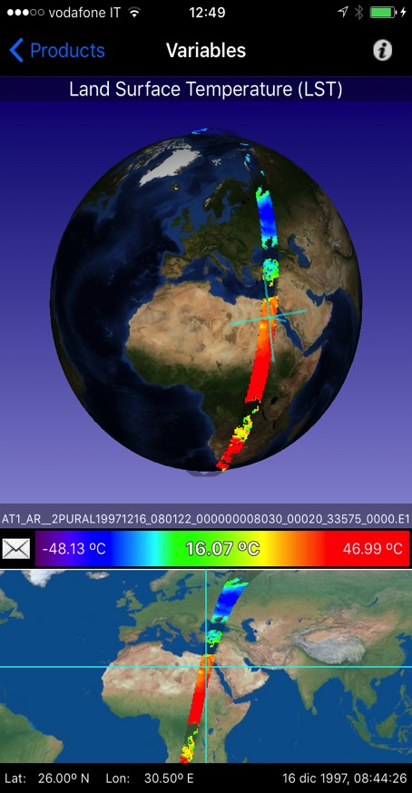
ERS-1/2 – Mobile App Menu
Data Session
Radar Altimeter (RA) and Along Track Scanning Radiometer (ATSR) instruments products variables (e.g. Sea Surface Temperature, Land Surface Temperature, Significant Wave height, etc..) selection and visualization along the selected satellite orbit.
Exporting products and variables information and images through e-mail.
Downloading selected L1 products through DropBox (after login through ESA Single Sign On).

Slide 36


ERS-1/2 – Mobile App: Architecture
ATSR and RA L1 products were downloaded from ESA and a back-end process extracted specific variables to be displayed on the mobile device (through FTP with Mobile Product Server).
User can order the full L1 product through the mobile App; product retrieved from ESA (FTP) and downloaded in DropBox (Socket Protocol).

Slide 37

ERS-1/2 – Mobile App
Links for Download:
Apple's App Store
https://itunes.apple.com/it/app/esa-ers/id1059438540?mt=8
Google Play https://play.google.com/store/apps/details?id=it.acsys.android.esaersapp&hl=it
Next Steps under consideration
Adding visualization and downloading of products related to other ERS-1/2 instruments.
Extension to ENVISAT Mission
Live Demo during coffee break
(Ask Sergio and Marco)

Slide 38
  Thanks for your attention

Slide 39
