Slide 1
CNES DATA CUBE
ERWANN poupart
software ground system ENGINEER at CNES, Toulouse, France
Responsible for CNES COPERNICUS DATA processing architecture

Slide 2
outline
First data cube experimentations
Lessons learnt
perspectives

Slide 3
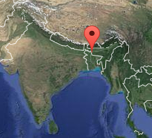
First datacube experimentation in 2016
Flood detection and Flood prevision in India:
Australian Geoscience Data Cube V1
Integration of CESBIO algorithms into AGDC framework
Experimentation of machine learning (apache spark) algorithm for the flood prevision use case
Five Data Cube ingesters were built:
S1 IW GRD data (res = 25m)
NOAA precipitation forecasts
Actual SMOS L3 moisture data (res = 25 km), percentile precipitation and percentile moisture statistic data (Colorado University)

Slide 4
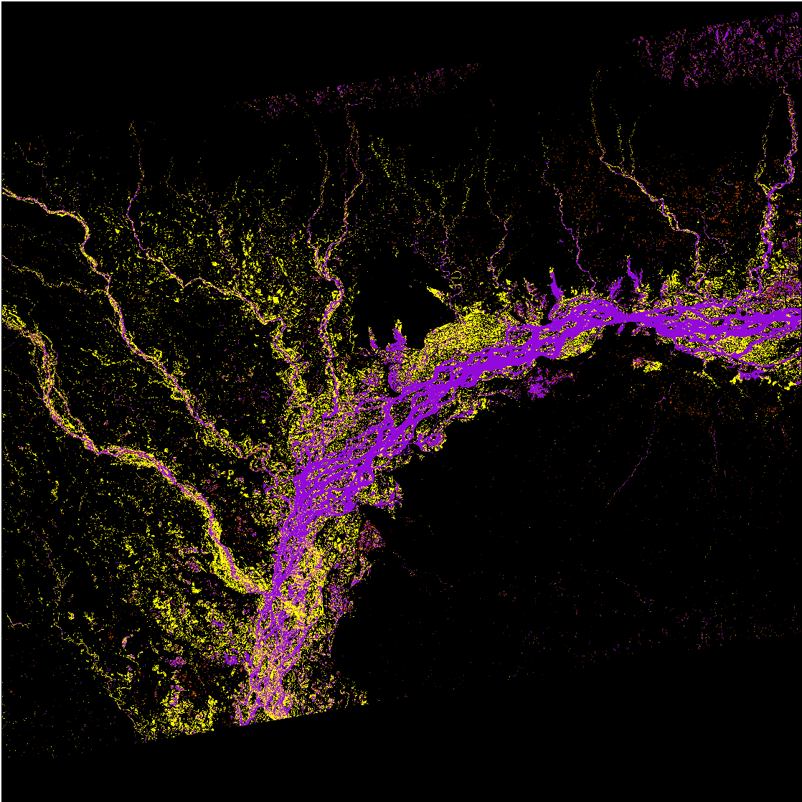
First data cube experimentation in 2016
Flood detection with data cube:
One reference image has to be defined
Automatic thresholds computation for each image in the time series
Recognition of permanent water areas, flooded/dried areas, permanent dried areas
Lessons learnt: interesting results

Slide 5
First data cube experimentation in 2016
Flood risk forecasting with data cube:
Precipitation risk computation
Soil moisture flood risk computation
Result : 5-class probability of a flood event (worldwide)
no risk, low, medium, high, very high risk
At SMOS resolution (25 km)
Machine learning experimentation (Spark, MLLib library) comparing previsions with observations
Lessons learnt: Further developments are necessary
Difficulties to handle heterogeneous resolutions from SMOS and Sentinel1 data

Slide 6
First data cube experimentation in 2016
Lessons learnt summary:
Very interesting concept. However, how to ease the use of heterogeneous data with heterogeneous resolutions ? What size of data cube tiles ?
Some other points about performance that came out the study:
May be deprecated now ? File access parallelisation ? Python HDF5 vs Python GDAL binding, compression methods, etc.
BIDS’16 conference: Flood forecasting and monitoring using Sentinel-1 and SMOS satellites: A supervised and predictive modeling David Bastide (Capgemini), Jérôme Gasperi (CNES), Yann Kerr (CESBIO), Richard Moreno (CNES), Pierre Villard (Capgemini)

Slide 7
second data cube experimentation in 2017
Jupyter notebook experimentation and comparative study:
AGDC V2. Using Sentinel-2 data
Main goal : Focus on jupyter notebook to show prototyping capabilities using Sentinel-2 data. Comparison with some Google Earth Engine capabilities, etc.
A prototype has been built:
AGDC V2 installed natively on one physical node of CNES HPC cluster,
Jupyter notebook server « docker-installed » on one frontal processing linux server
Possible demonstration … but it takes some time
This prototype is currently being used to study how to use CNES Orfeo ToolBox (opensource processing library of remote sensing images) in the AGDC framework

Slide 8
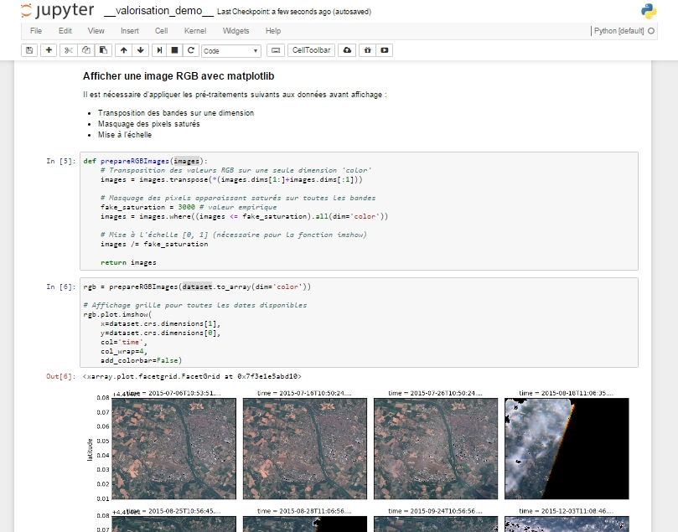
second data cube experimentation in 2017
Jupyter notebook screenshot:

Slide 9
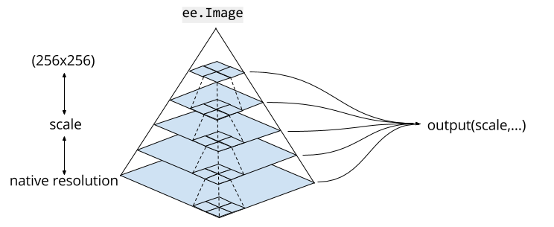
perspective
Future use of Data cube:
Data Cube concept is a good concept,
What about the idea of a Pyramidal Data Cube concept ?
Goal : To ease the processing of multi-resolution data
This concept does already exist in Google Earth Engine and is called “scale of analysis” which is the resolution used for the data processing. The scale at which to request inputs to a computation is determined from the output
CNES has planned a study on this topic that should start at the beginning of 2018
Machine learning in the area of image data classification is also in our plans

Slide 10
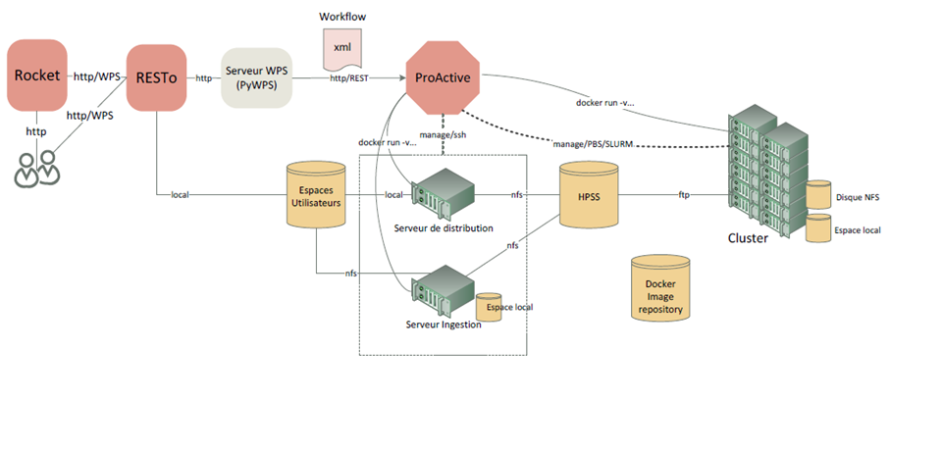
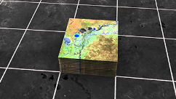
perspective
Data Cube server
Data Cube consumer
process
CNES COPERNICUS DATA processing architecture

