Slide 1
Moderate Resolution Sensor Interoperability (MRI) Framework
Content developed by: Gene Fosnight
Presented by: Brian Killough
Report to WGISS on LSI-VC-3

Slide 2
Moderate Resolution Sensor Interoperability (MRI)
This initiative addresses the CEOS strategic objective to encourage complementarity and comparability among the increasing number of Earth observing systems in the moderate resolution class for both optical and SAR sensors and the data received from them.
The deliverables …
A framework paper for moderate (10-100m) resolution interoperability will document radiometry, geolocation, per-pixel metadata, and image metadata characteristics relevant for multi-sensor interoperability that affect the analysis, and the search and discovery of space data.
A Landsat / Sentinel-2 paper will identify and summarize lessons learned affecting the interoperability of Landsat and Sentinel-2 suitable for use as a user guide.
Notes:
This presentation will take about 10 minutes following which there is time for discussion
LSI-VC

Slide 3
MRI Framework
The MRI Framework is an LSI-VC activity closely tied to the CEOS Analysis Ready Data for Land (CARD4L) specification and will evolve in parallel to the CARD4L specification.
CARD4L identifies threshold and target information needed for fully analysis-ready products
The MRI team will work closely with WGCV, WGISS and with the thematic communities to identify case studies to advance and implement the CARD4L specification.
The focus of the MRI framework is on multi-sensor interoperability.

Slide 4
MRI Coordination

Slide 5
LSI-VC, WGCV and WGISS
The MRI initiative provides a framework within which interoperable solutions can be identified and documented.
LSI-VC agencies work with GEO and other user communities, such as GFOI and GEOGLAM, to evaluate and implement solutions. FDA pilot projects seek to exploit these opportunities.
The WGCV is instrumental in coordinating the calibration and validation of sensors
The WGISS is versed in metadata standards that describe image data for use in analysis and for search and discovery

Slide 6
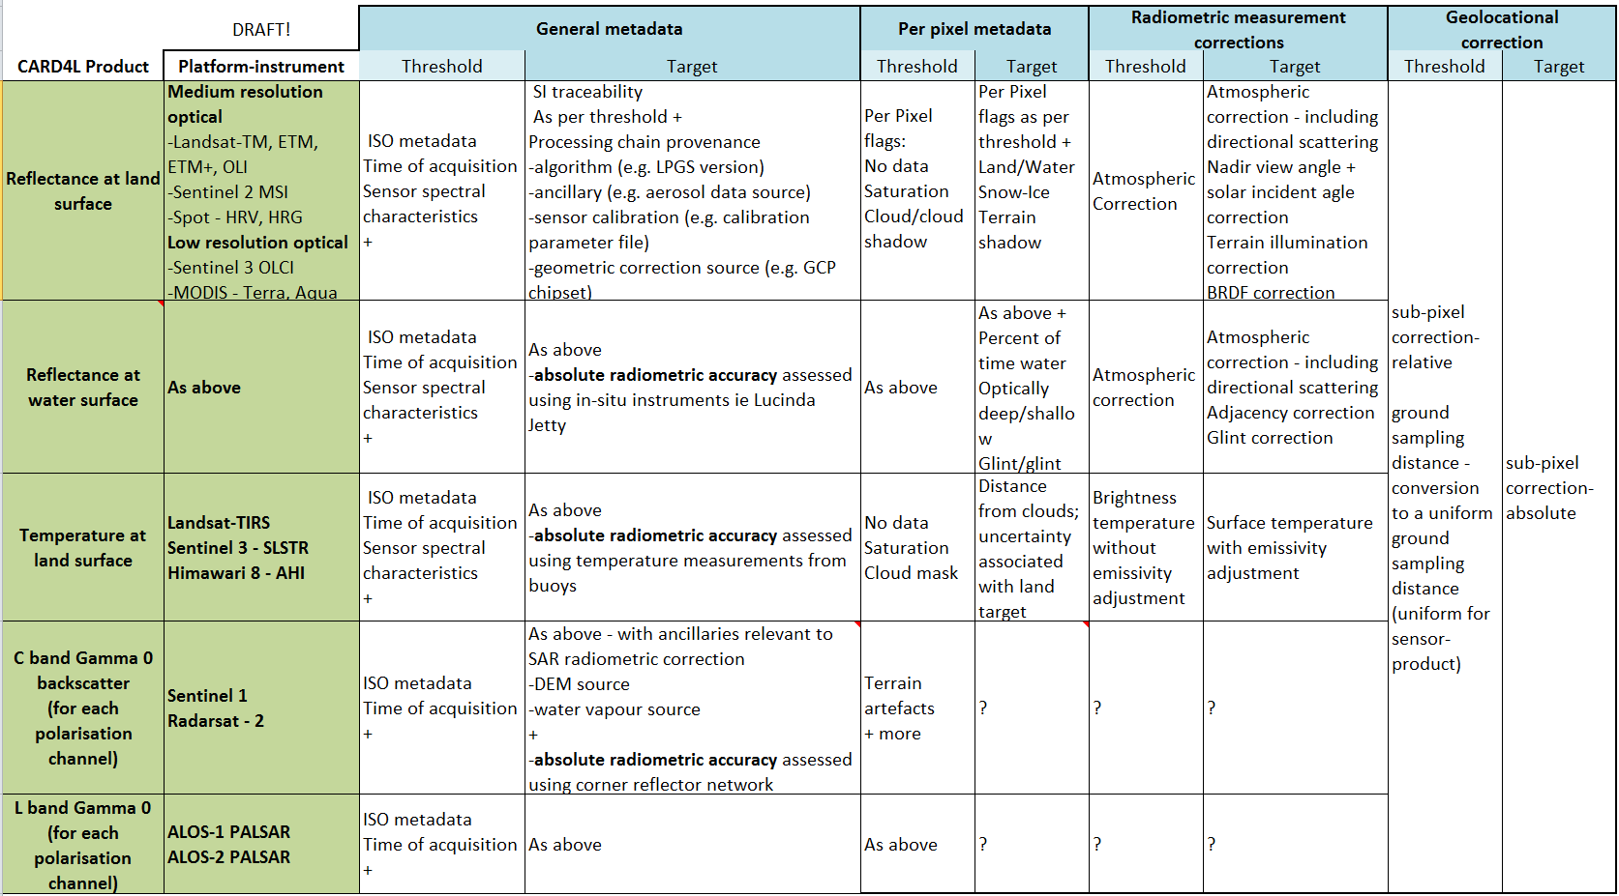
Framework: MRI and CARD4L
Examples …
CARD4L specifies the pixel size and RMSE.
MRI describes the consequences of different pixel sizes and RMSE
CARD4L specifies the spectral response
MRI describes the consequences of different spectral responses
Notes:
This table illustrates the type of structure that we are thinking of
Update the table.
Link the spreadsheet to the requirements process that LSI-VC.
We have responses from JAXA, CSA, ESA and NASA indicating willingness to participate in a SAR team to progress ARD for SAR, a call will go out including through WGCV.
The work on ARD is likely to feed into further work on FDAs: There is a demand for implementations of ARD and demonstration datasets for use in FDA.

Slide 7
General Metadata
Adopt common OGC or ISO metadata standard
Product-specific metadata are constant for all images in the product line (e.g. pixel size, grid, accuracy)
Image-specific metadata are specified for each image (e.g. geolocation accuracy, cloud cover)
General metadata are compared between products to establish interoperability using MRI guidelines

Slide 8
Per Pixel Metadata
Interoperability issues include documented algorithms and accuracies for
Cloud cover and shadow
Land, water and vegetation
Terrain shadow
Atmospheric model inputs, including aerosols
Saturation and other data quality

Slide 9
Geolocation
Interoperability issues
Different pixel sizes
Spatial RMSE
Reference grid and accuracy
DEM and accuracy

Slide 10
MRI Implementations
Cooperation among agencies is needed to support interoperability.
Adopt Standards
OGC/ISO metadata standards
Shared reference grids and DEMs
Reflectance and atmospheric models
Common general and per pixel metadata
Compensate for differences
Pixels sizes
Spectral band differences
Spectral band availability
The MRI initiative supports Future Data Architecture studies and studies at agencies evolving implementation strategies. These strategies may be physical higher level products or models designed to use well defined lower level products as inputs.

Slide 11
MRI Case Studies
The MRI case studies will provide multi-sensor applications guidance for the user community.
The user community is rapidly transitioning to surface reflectance, surface temperature, and gamma-naught SAR products.
The user community is slowly transitioning to the analysis of deep and dense multi-sensor time series stored as data cubes.
The 2017 MRI initiative case study deliverable will provide a user guide providing lesson learned for the interoperable use of Landsat and Sentinel-2 data.

Slide 12
Schedule
Presentation of framework for endorsement at LSI-VC-3 on 20 March 2017
Presentation of work plan at SIT-32 in April 2017
Initial presentation of 2017 results at LSI-VC-4 and SIT Workshop in September 2017
Presentation of 2017 results at CEOS Plenary in October 2017

Slide 13
The MRI Team
Co-leads
Team members
Gene Fosnight | USGS | USGS chair team co-lead, Landsat, LSI-VC, SDCG
Cindy Ong | CSIRO | WGCV co-lead, imaging spectroscopy
Richard Moreno | CNES | WGISS co-lead, Copernicus
Jeff Masek | NASA | Landsat Sentinel-2 Case study, LSI-VC
Zoltan Szantoi | JRC | Landsat Sentinel-2 Case study, LSI-VC
Adam Lewis | GA | LSI-VC, FDA, CARD4L
Paul Briand | CSA | LSI-VC, GEOGLAM, SAR
Yves Crevier | CSA | SDCG, GEOGLAM, SAR
Brian Killough | NASA | SEO, LSI-VC, SDCG, FDA, CARD4L
Debajyoti Dhar | ISRO | Optical/SAR data fusion
Takeo Tadono | JAXA | LSI-VC, CARD4L, SAR
Amanda Regan | EC | User needs for satellite constellations
Nigel Fox | UKSA | WGCV IVOS
Kurt Thome | NASA | WGCV
Andy Mitchell | NASA | WGISS
Kerry Sawyer | NOAA | Represent SIT vice chair
Kevin Gallo | NOAA | LSI-VC, LPCS data integration
Eric Wood | USGS | Represent USGS Chair Team

