Slide 1
GeoJSON(-LD) Encoding of Granule Metadata
CEOS WGISS Meeting #44
Y. Coene (Spacebel)
O. Barois, A. Della Vecchia (ESA)
26/09/2017

Slide 2
Outline
Design Approach – OGC 17-003 "GeoJSON(-LD) encoding for EO Products"
Work Performed
Next Steps
GeoJSON(-LD) encoding for EO Collections ?
Conclusion

Slide 3
Outline
Design Approach – OGC 17-003 "GeoJSON(-LD) encoding for EO Products"
Work Performed
Next Steps
GeoJSON(-LD) encoding for EO Collections ?
Conclusion

Slide 4
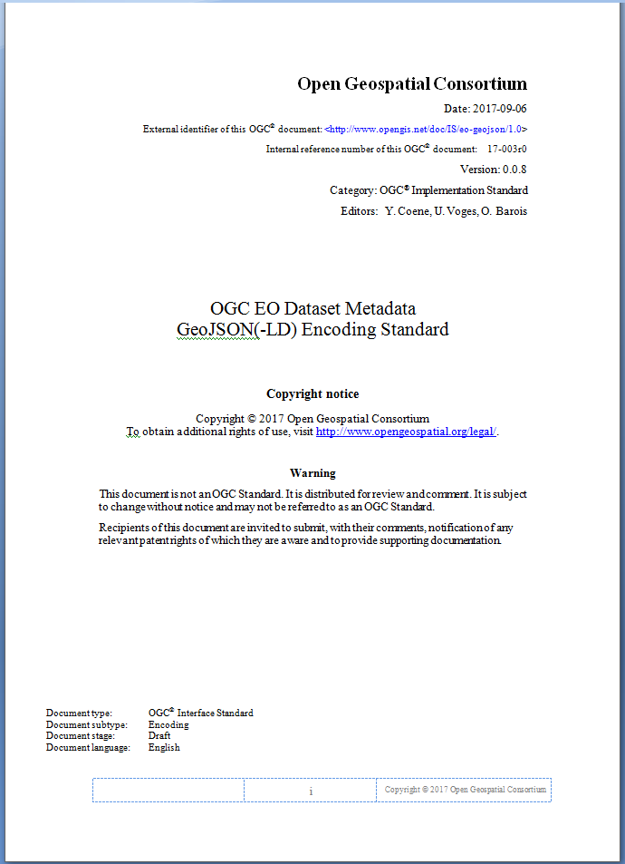
Reminder - Design Approach
Encoding for conceptual models:
UMM-G, OGC 10-157r4
Standards-based:
GeoJSON (RFC 7946) Feature
OWS Context (OGC 14-055r2)
Multiple use cases:
Product from one or more acquisitions (planned, acquired or archived) from one or multiple sensors
GeoJSON to JSON-LD

Slide 5
Design Approach
Simple encoding model
Structured as per GeoJSON and OGC 14-055r2 (OWC)
Presented using "JSON Schema draft 4"*
Implicit "units of measure" (SI system units)
Properties organised as:
acquisitionInformation
productInformation
(*) https://github.com/json-schema-org/json-schema-spec/wiki/Specification-Links

Slide 6
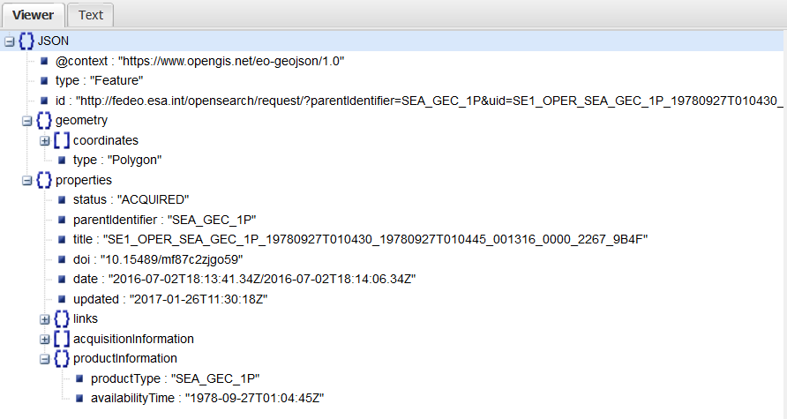
Design Approach – Simple encoding*
Encoded as GeoJSON Feature, with "geometry" and "properties"
(*) Visualised with http://jsonviewer.stack.hu/

Slide 7
Outline
Design Approach – OGC 17-003 "GeoJSON(-LD) encoding for EO Products"
Work Performed
Next Steps
GeoJSON(-LD) encoding for EO Collections ?
Conclusion

Slide 8
Work Performed – Draft 12
CEOS WGISS System Level Team Telco – 1 March 2017
Draft document OGC 17-003 v0.0.2 presented
Document distributed for comments
OGC TC Delft (Netherlands) – 22 March 2017
Presentation during EO Product Metadata and OpenSearch SWG
Document update published on OGC Portal inside "EO Product Metadata and OpenSearch SWG" folder.
Version 0.0.7, Draft 12 – 21/06/2017
https://portal.opengeospatial.org/?m=projects&a=view&project_id=442&tab=2&artifact_id=73992

Slide 9
Work Performed – Draft 13
CEOS WGISS System Level Team Telco – 24 August 2017
Draft document OGC 17-003 v0.0.7 review
Document previously distributed for comments
Document update published on OGC Portal inside "EO Product Metadata and OpenSearch SWG" folder
Version 0.0.8, Draft 13 – 06/09/2017
https://portal.opengeospatial.org/?m=projects&a=view&project_id=442&tab=2&artifact_id=73992
OGC TC Southampton (UK) – 13 September 2017
Presentation during EO Product Metadata and OpenSearch SWG

Slide 10
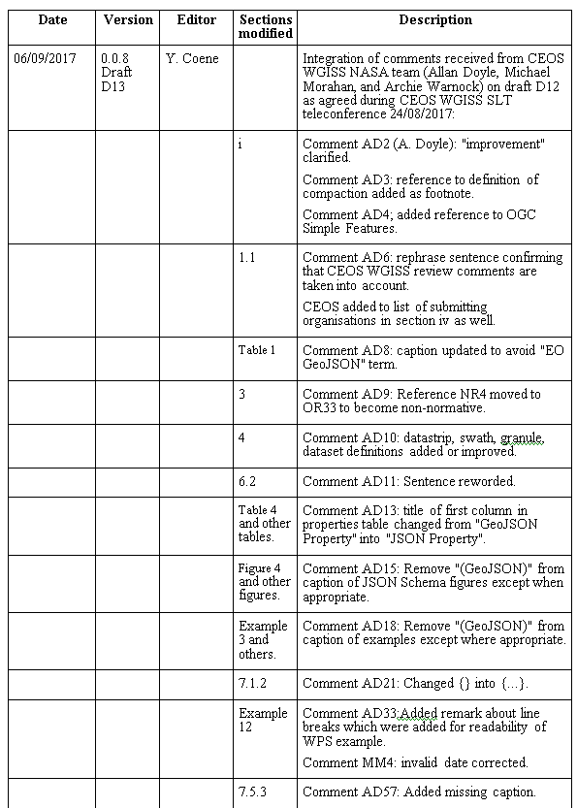
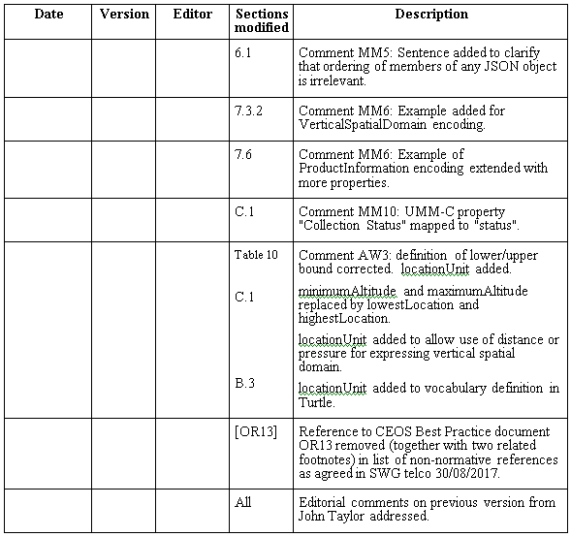
Work Performed – CEOS WGISS SLT
Implementation of document review comments by CEOS WGISS members and NASA

Slide 11
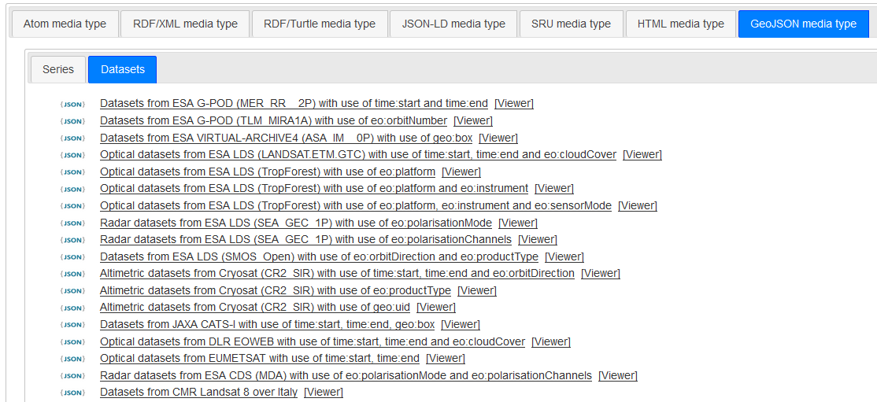
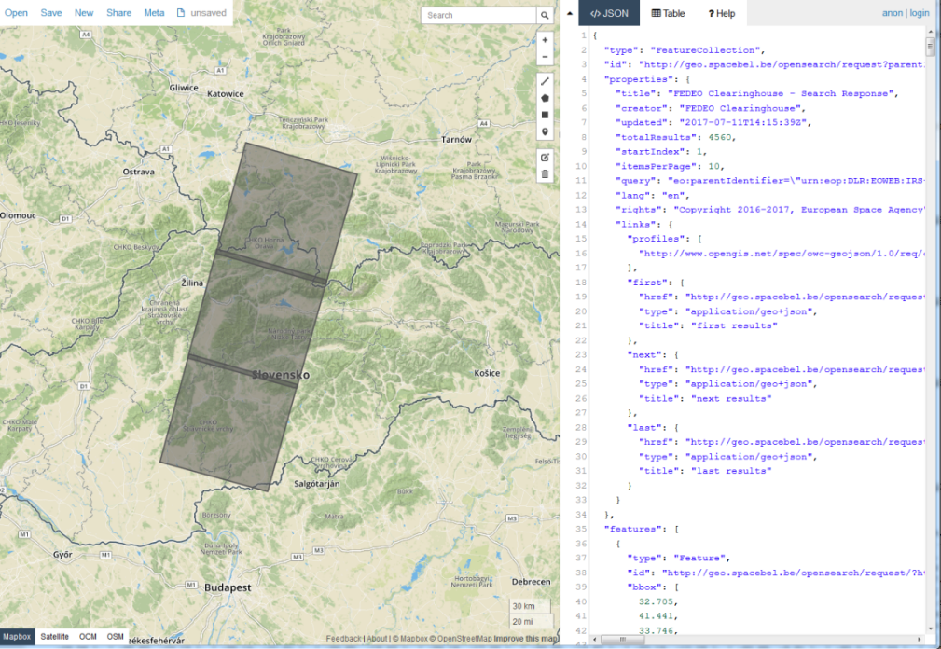
Work Performed - OGC Testbed 13
http://geo.spacebel.be/opensearch/readme.html

Slide 12
Outline
Design Approach – OGC 17-003 "GeoJSON(-LD) encoding for EO Products"
Work Performed
Next Steps
GeoJSON(-LD) encoding for EO Collections ?
Conclusion

Slide 13
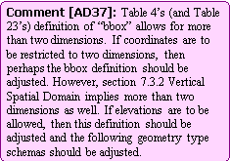
Open Comments - 3rd dimension for BBOX
Review comments not yet fully closed:
AD14, AD37 – Disposition agreed with comment author
Notes:
To close this comment, the description will be updated to mention an array of length 4 in all cases instead of 2*n.

Slide 14
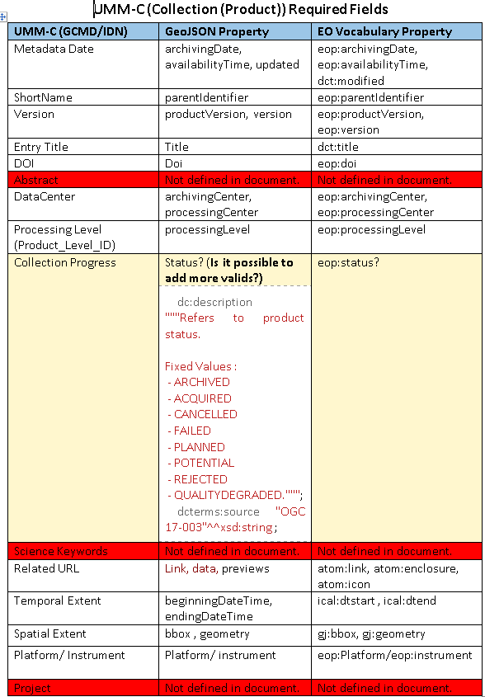
Open Comments – Collection Metadata
MM-05 (NASA) – Collection metadata encoding
MM-06 (NASA) – Collection metadata encoding
Notes:
Preliminary Answer to MM-05: Propose to define a separate document for GeoJSON(-LD) encoding of Collection metadata (possibly aligned with the GeoDCAT-AP specification work ongoing at OGC) as proposed further in this presentation.
Preliminary Answer to MM-06: same as MM-05. This new document should include trceability (mapping) to UMM-C metadata model.

Slide 15
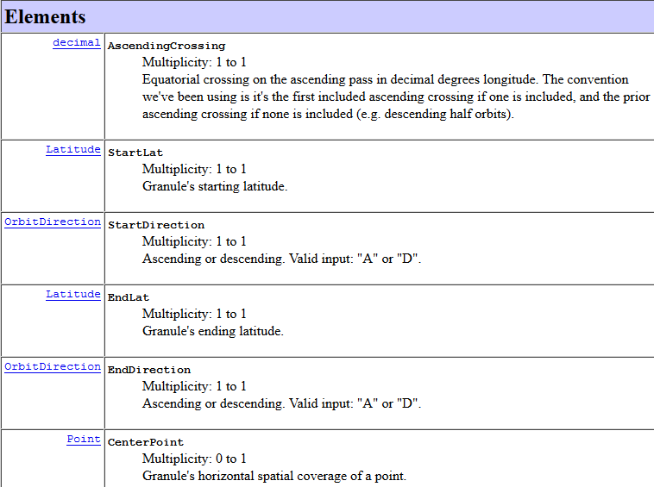
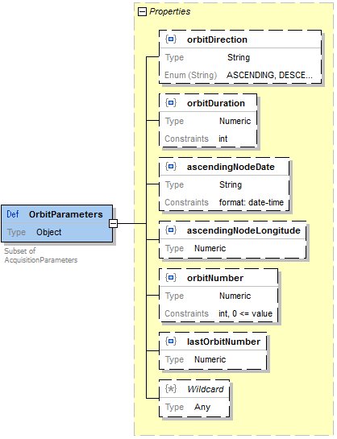
Open Comments – Orbit Parameters
JG-01 (NASA) – Orbit Parameters and Collection Metadata (5/9/2017)
Notes:
Andrea: can you put back the original slide ? It showed the mapping between the ECHO elements and the OGC 17-003 element already existing. Only difference is the "need" for two different "orbitDirections".
JG-01 Part 1: Granules
Propose to discuss this at next WGISS SLT teleconf. The ECHO elements mentioned for Granules do not correspond to the UMM-G elements (orbit parameters). The only element missing to have full mapping to ECHO Orbit Parameters seems to be the need for two directions (at start and end). If this is considered necessary (does not exist in UMM-G?), then the endDirection could be added as optional. ESA has no need for this additional attribute.
JG-01 Part 2: Collections
See answers to MM-05 and MM-06 – to be considered in a separate document dedicated to Collection Metadata.

Slide 16
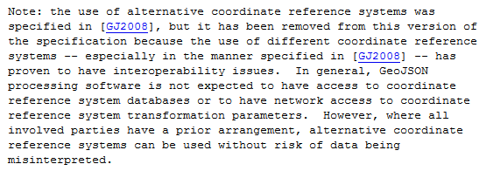
Open Comments – Coordinate Reference System
JG-02 (NASA) – CRS and Collection Metadata (5/9/2017)
Analysis:
Notes:
Proposed answer:
- The coordinate system could be a property in the Geo-JSON(-LD) collection metadata description (separate document to be written).
This solution is inline with the latest GeoJSON : this information in the Collection metadata is then the "prior arrangement between involved parties" (See slide) about the alternative coordinate system to be used for interpretation of the coordinates Granules metadata.
We do not recommend adding back the "crs" in the Granule Metadata which was present in the obsolete version of GeoJSON.
Note that this issue is not limited to the actual metadata. If an OpenSearch interface is used for searching metadata, there is currently no way to pass a geographical constraint using a specific CRS. How does the author of the comment sees this use case ? Need to extend the OpenSEarch capabilities in OGC 10-032r8 ? This would go against the intended simplification of the catalog interface.

Slide 17
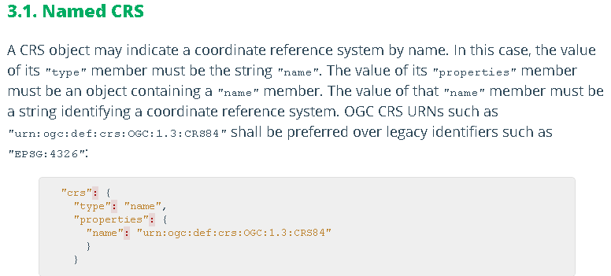
Open Comments – Coordinate Reference System
"crs" member existed in obsolete GeoJSON specification. Removed in RFC 7946.
Notes:
The above is not recommended. See answer on previous slide. Propose to identify the CRS in the Collection Metadata.

Slide 18
Outline
Design Approach – OGC 17-003 "GeoJSON(-LD) encoding for EO Products"
Work Performed
Next Steps
GeoJSON(-LD) encoding for EO Collections ?
Conclusion

Slide 19
Next Steps
Treat open comments (above)
Orbit parameters
CRS
Consider GeoJSON(-LD) encoding of EO collection metadata
Finalise ongoing standardisation track at OGC
Current target: March 2018.

Slide 20
Outline
Design Approach – OGC 17-003 "GeoJSON(-LD) encoding for EO Products"
Work Performed
Next Steps
GeoJSON(-LD) encoding for EO Collections ?
Conclusion

Slide 21
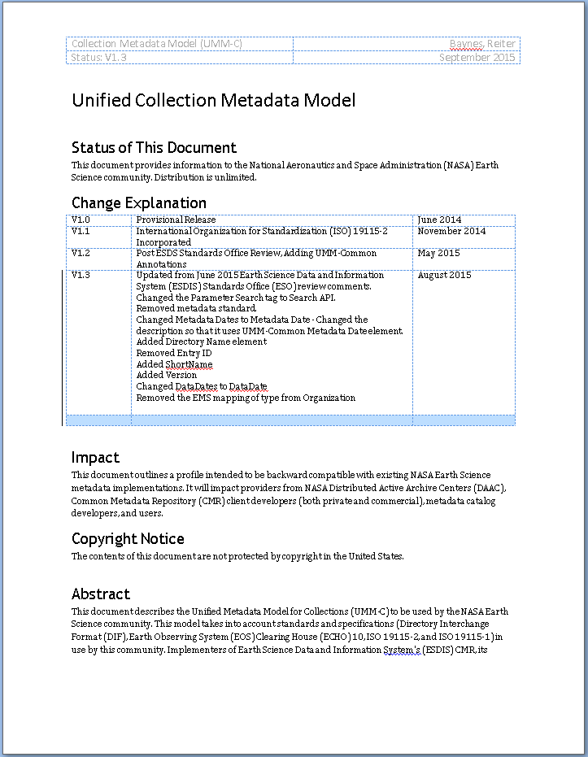
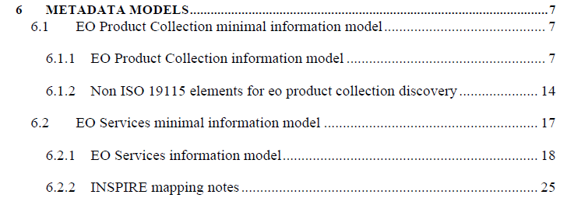
Collection Metadata - Approach
Additional document about "EO Collection Metadata" using similar approach and presentation as OGC 17-003?
Traceability to:
NASA UMM-C Model
OGC 11-035r1 Chapter 6 (ISO19115, INSPIRE)

Slide 22
Collection Metadata - Approach
Design approach
JSON encoding
Based on GeoJSON
Based on OGC 14-055r2 (OWC)
JSON-LD encoding
Convergence with GeoDCAT-AP ?
Both linked through @context ?
Design issues
GeoDCAT encodes GeoJSON geometry as "string"
@context mapping requires similar structure, cannot convert a string into an object or vice-versa.

Slide 23
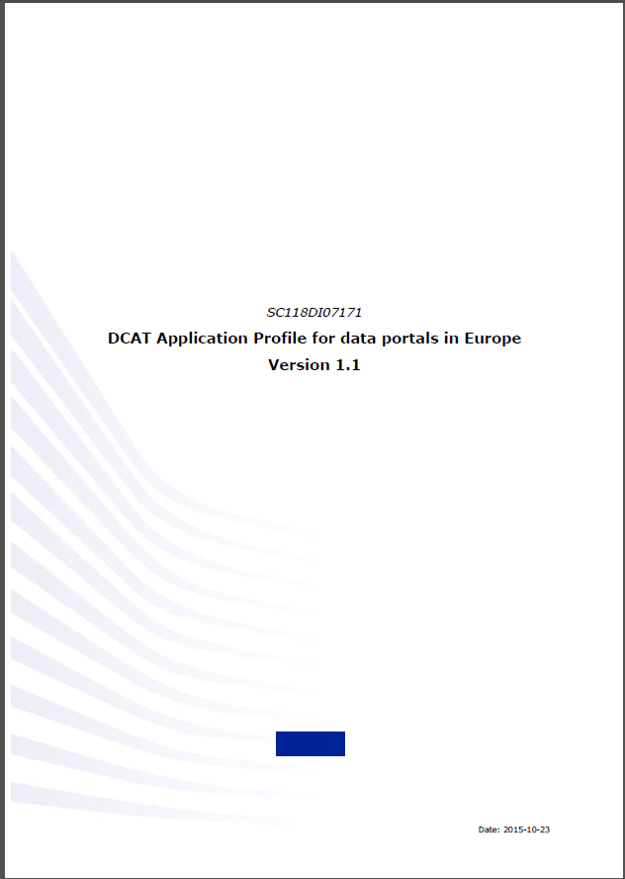
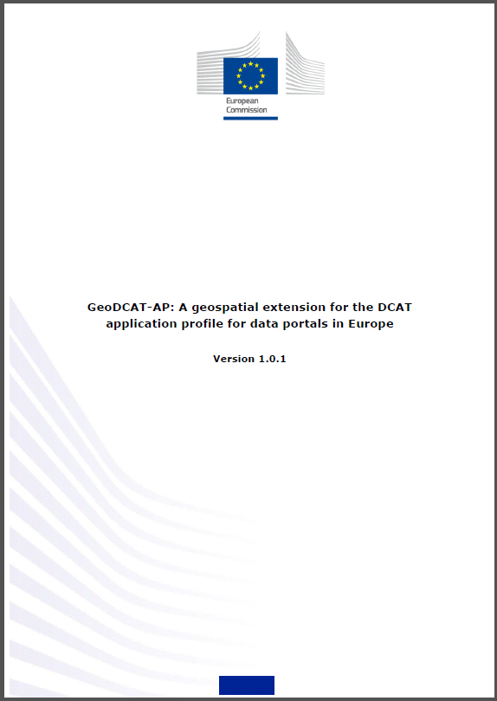
Collection Metadata - Approach
Convergence with GeoDCAT-AP @OGC ?
Started as « Ad-hoc » (June 2016). Now permanent sub working group of Metadata DWG

Slide 24
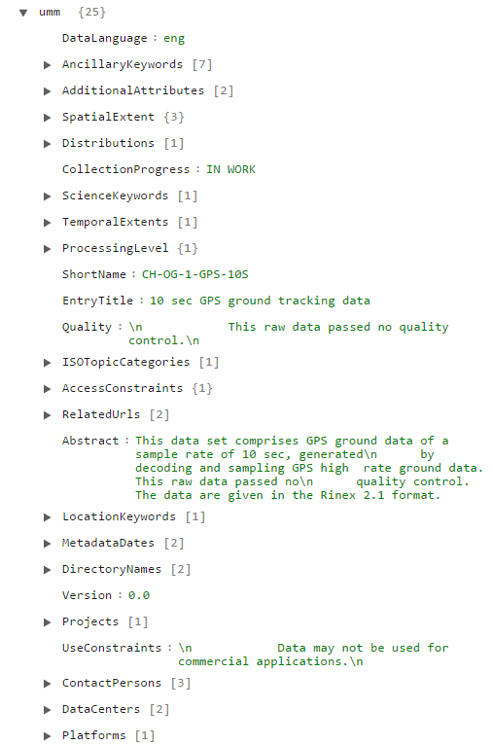
Collection Metadata - Input
Other available inputs:
OGC 16-074 (Uses W3C DCAT)
NASA CMR JSON: https://cmr.earthdata.nasa.gov/search/site/search_api_docs.html#json
NASA CMR UMM-JSON: https://cmr.earthdata.nasa.gov/search/site/search_api_docs.html#umm-json
Notes:
There are various implementations that exist to represent Collection Metadata using JSON or JSON-LD. Some of them already are based on W3C DCAT and they are useful input to arrive to an agreed representation of Collection metadata, possibly based on GeoDCAT-AP.
The CMR

Slide 25
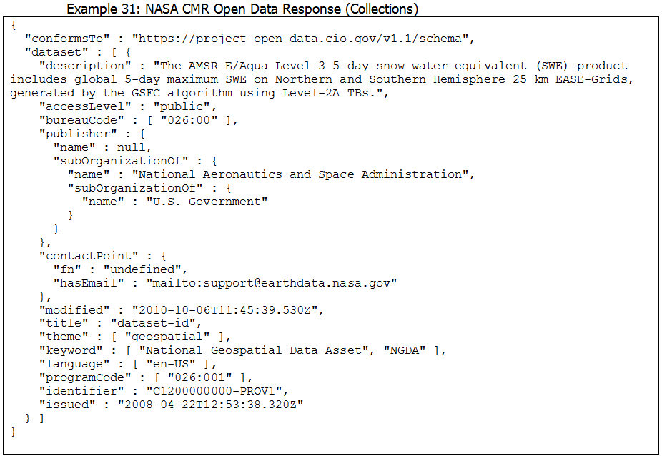
Collection Metadata - Inputs
NASA CMR OpenData JSON-LD (based on W3C DCAT)
https://project-open-data.cio.gov/v1.1/schema/
Notes:
The CMR OpenData responses are based on W3C DCAT already with proprietary properties added …

Slide 26
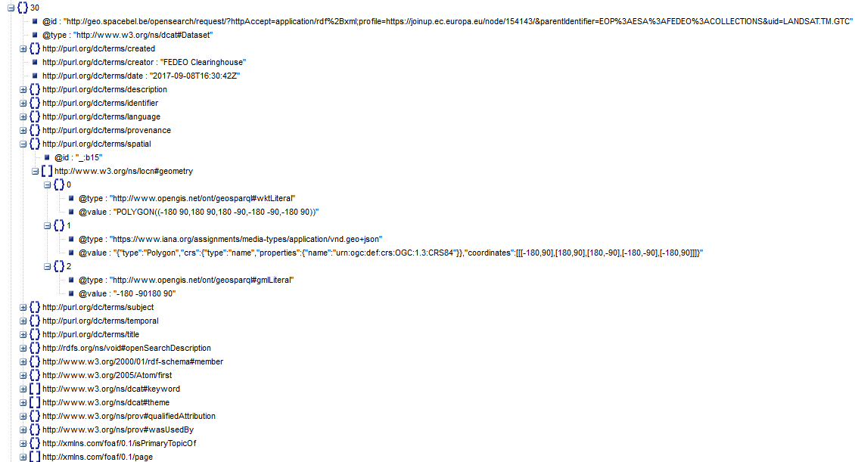
Collection Metadata - Inputs
Other inputs:
http://geo.spacebel.be/opensearch/request/?httpAccept=application/rdf%2Bxml;profile=https://joinup.ec.europa.eu/node/154143/&parentIdentifier=EOP%3AESA%3AFEDEO%3ACOLLECTIONS&uid=LANDSAT.TM.GTC
Notes:
The GeoDCAT-AP originates from JRC (organisation behind INSPIRE in Europe). In a recent "INSPIRE Hackaton" event (September 2017), there was a quick demonstrator build to make available FedEO Metadata (from FedEO and NASA CMR) for Collections and Granules in GeoDCAT-AP format… This experiment identified already a number of issues with the GeoDCAT-AP specification that will need to be addressed by OGC to align it better with GeoJSON… The experiment has also confirmed a wider interest in this metadata format.
The experiment was supported by the "DataBio" BigData Lighthouse project funded by the European Commission.
See https://www.databio.eu/en/.

Slide 27
Conclusion
Few remaining comments on OGC 17-003.
CEOS WGISS review comments were integrated.
Most remaining comments are about coverage of EO Collection metadata which was originally out-of-scope.

