Slide 1
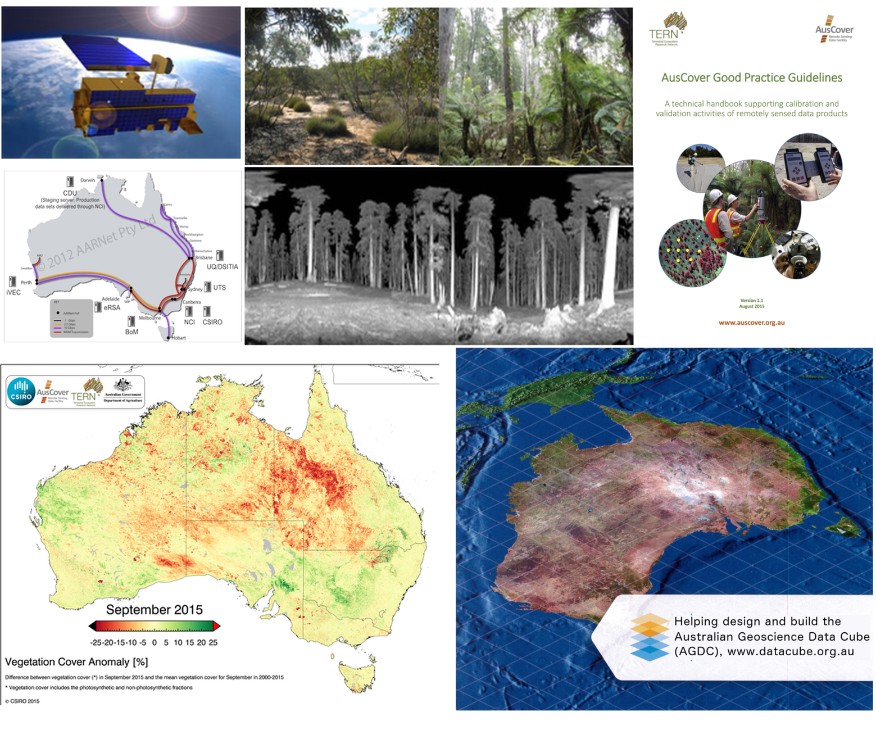
AusCover
Remote Sensing Data Facility
Overview
Alex Held – AusCover Facility Director
Matt Paget – AusCover data and systems coordinator
CSIRO Land and Water, Canberra

Slide 2
Relevance to CEOS & WGISS
A network of scientists and practitioners who use and integrate CEOS data to develop EO products for Australian needs (Govt, NRM, research).
CEOS data suppliers
user
TERN AusCover
contributors
user
Australian users
supplier
supplier
Provenance through networks
Consistent information and data services for users
Relationships to international networks inc. agency contribs
What can these ‘value-add’ networks do for CEOS (feedback expertise and validation data)?

Slide 3
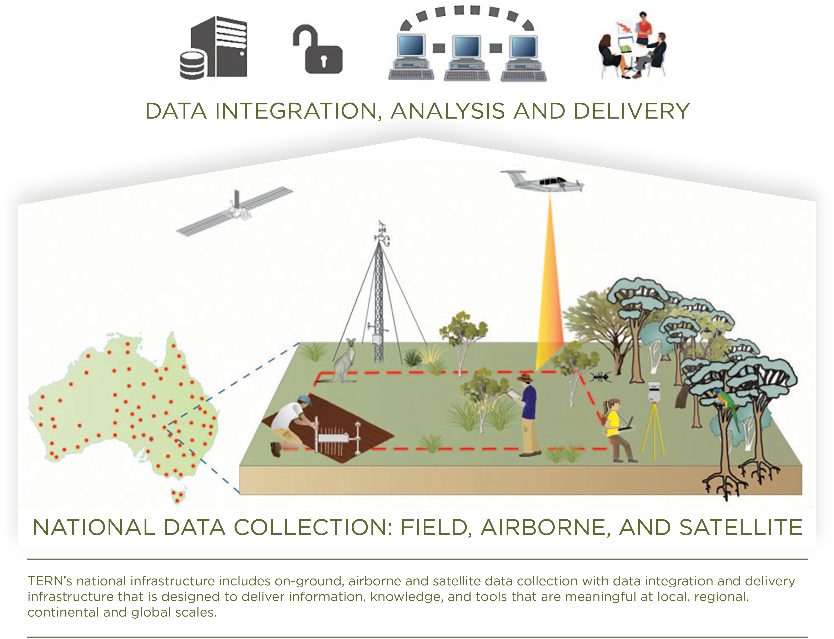
Terrestrial Ecosystem Research Network
www.tern.org.au
Biophysical
AusCover
OzFlux
Coasts
Soil grid
Ecological
AusPlots
Transects
Supersites
Ecoinformatics
Integration
Modelling and scaling
Analysis and synthesis
TERN Data Discovery Portal
  Connects ecosystem scientists and enables them to collect, contribute, store, share and integrate data across disciplines
  Funded since 2009 by the National Collaborative Research Infrastructure Strategy (NCRIS)
Research
communities

Slide 4
TERN 2.0 – Draft (2018/19+)
  Too many facilities that don’t appear to work together.
  New funding with 10 year plan to focus on integration (data products and services). Earth observation is given special mention.
Four pillars
Data systems
Targeted
monitoring
Surveillance
sampling
Landscape
processes
Portal
Informatics
Facility data teams
Supersites
OzFlux
AusPlots
Transects
AusCover
Soil grid
Modelling
Centralised
Spatial scale

Slide 5
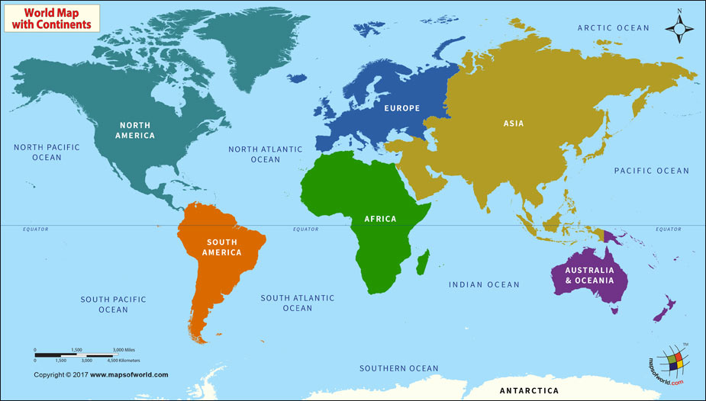
Similar international initiatives
CNERN
National Ecosystem Research Network of China
ESFRI, anaEE, PEEN etc
Research infrastructure, ecosystem analysis, ecosystem networks
JaLTER
NEON
National Ecological Research Network
KEON
PhLTER
SAEON
S.Africa Ecological Research Network
TERN
Terrestrial Ecosystem Research Network

Slide 6
What does TERN AusCover do?
Remote Sensing Data Delivery Backbone
Issues of data formats, interoperability, data-policy
Physical storage, efficient delivery to end-users etc.
Priority Data Products
Nationally-consistent, standard biophysical data products
Metadata and technical support documents
Specialised space-borne, airborne & in-situ research-grade data
High-performance data processing and management
Ground Validation Program and Instrumentation
Set national standards & field validation protocols
TERN sites, vegetation structure, LiDAR and hyperspectral
International Benchmarking (e.g. CEOS WGCV)
Knowledge Brokering and User Engagement
End-user requirements, survey, communications
Website, workshops, etc.

Slide 7




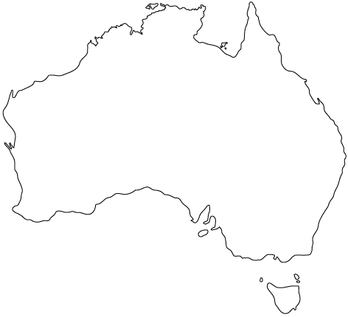













TERN AusCover Team & Network
Securing Data and Collaborations
via Links to International Agencies and Networks
Darwin Node
Stefan Maier (CDU)
Brisbane Node
Stuart Phinn (UQ)
Kasper Johansen UQ)
Peter Scarth (UQ)
Perth Node
Peter Fearns (Curtin)
Sydney Node
Alfredo Huete (UTS)
8 Regional Nodes
12 Institutions
28+ Researchers and Students
..over 500 TBytes of
ground, airborne and
satellite data
Adelaide Node
Megan Lewis (Adel. U.)
Canberra Node
Alex Held (CSIRO)
Medhavy Thankappan (GA)
Melbourne Node
Ian Grant (BoM)
Simon Jones (RMIT)
Hobart Node
Arko Lucieer (U Tas)

Slide 8
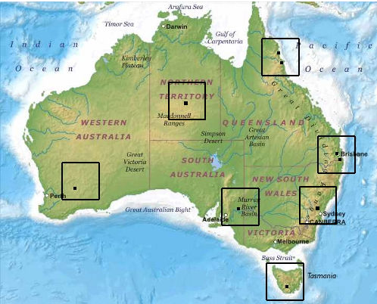
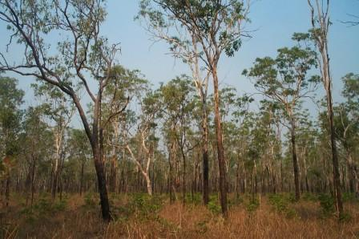
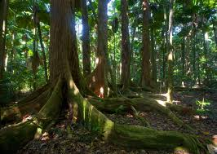
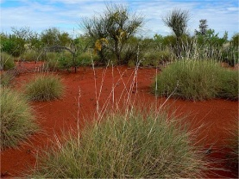
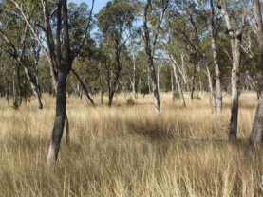
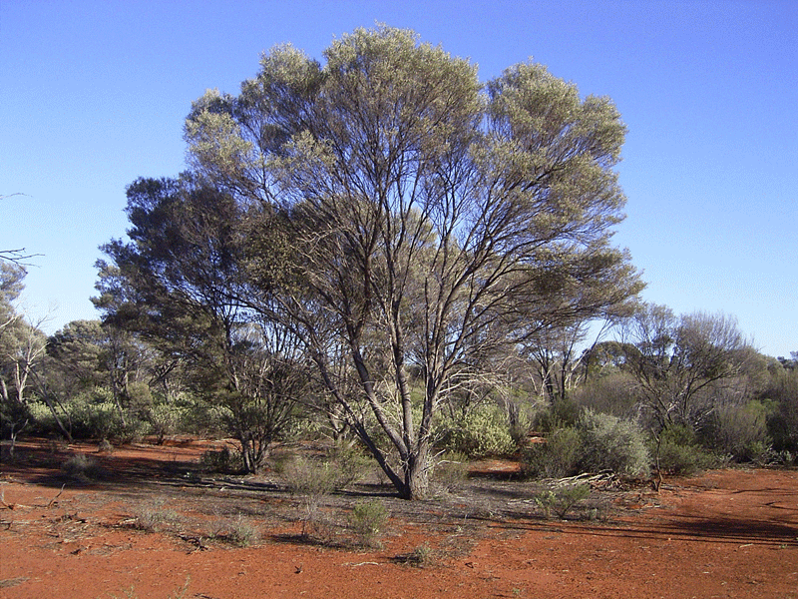
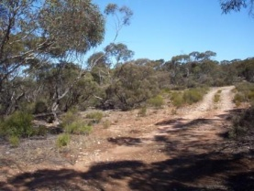
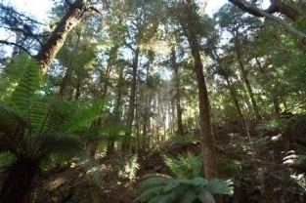
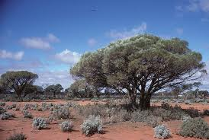
Field, Airborne and UAS Data Collection for Validation
Tropical Savanna
Rain Forest
Spinifex Hummock Grassland
Eucalypt Open Woodland
Mulga Shrubland
Acacia Shrubland
Mallee
Tall Eucalypt Forest

Slide 9
Data products, systems and services
Data themes
  Land cover and Phenology
  Fire dynamics and impact
  Vegetation structure and biomass
  Surface reflectance and LST
  Field survey data
  Airborne and UAS
Applied / Integration
  Mangrove monitoring
  Biomass maps
  Soil moisture
Satellite data sources
  Landsat, Sentinel-2
  MODIS, VIIRS, Sentinel-3
  Sentinel-1, NovaSAR
  AVHRR, MetOp
  Himawari-8, SMAP
Data systems and services
  File formats, Metadata
  Storage and data systems/services
  Open and free, No login
  OGC protocols, Programmable access
  Extensible nationwide system. Contributors manage their own data/metadata
Common (open) platforms
  Research infrastructure (NCRIS facilities)
  International current best practice
  THREDDS, DAP, Geoserver, Point clouds
Guides & information
  Field data collection protocols
  Website and Wiki
Expert network, wealth of knowledge
  Multiple specialties, Multiple institutions
  International committees and collaborations

Slide 10
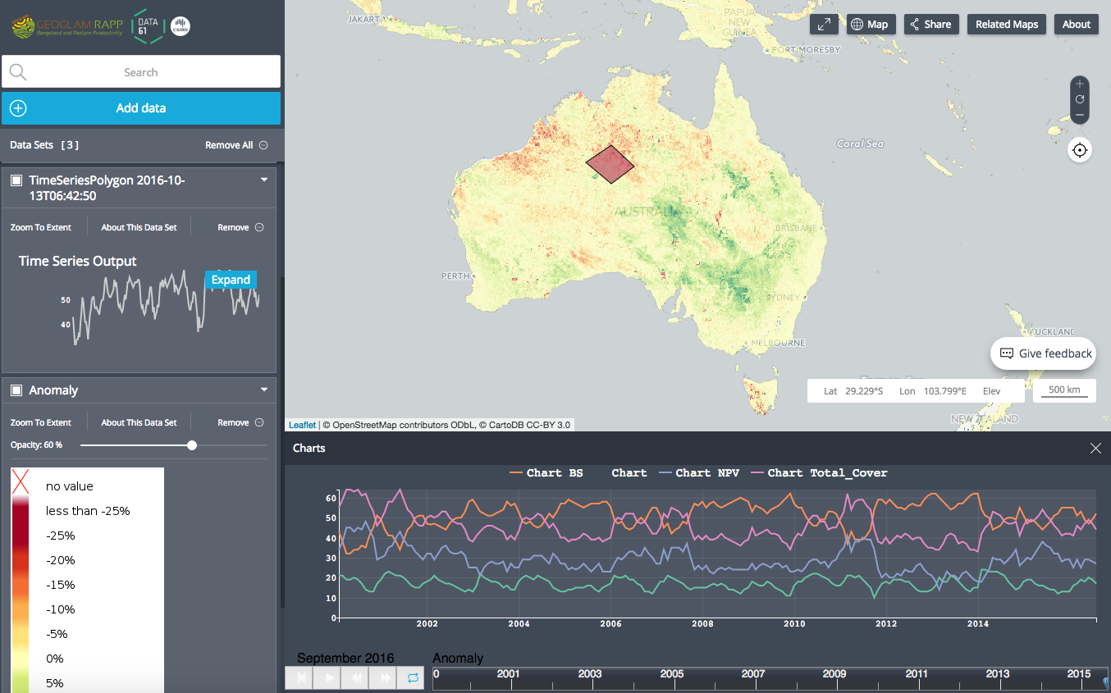
New features
APIs
  Subsetting
  Format translation
  Web Processing Services
Operational services
  High availability (e.g., AWS)
  for selected products and
  services
Field data portal
  Easier to find, access and use
  Point clouds visualisation
  and access
Future architectures
  Transition data products to data cube
    ARD, Re-use algorithm, On-the-fly
  Point cloud processing and products
  Authoritative products (Govt programmes)
GeoGLAM, http://map.geo-rapp.org

Slide 11
Messages
User metrics
  Beyond downloads to usage (relevance, impact)
  CEOS <> Network <> Users
CWIC - Australia
  Well established metadata harvesting and aggregation
  National POC
Integrated systems design
  Scale and flexibility > sustainability and capacity
Focus on service and delivery
  Open standards everywhere
  Allow others to build portals for their domain
Integration of research and operational programmes
  Pathway from research to operational products/services
  Joint support for validation programmes
  Address near-term needs using current knowledge (1-2 yrs) and mid-term requirements with research (3-5 yrs)

Slide 12
Remarks
What can TERN AusCover do for CEOS/WGISS and vice versa?
Research sector
  R&D – science and systems
    THREDDS, Geoserver, Point clouds
    Data cubes
  Building communities and networks
  Trialing and testing
Operational agencies
  EO data for Govt and public good
  Very large archives and processes
WGISS
  Encourage consistency in services
  Identify emerging themes and encourage agencies to meet future user needs
3-5 years
Faster response to Users
> limited operational capability
1-2 years
> Transition mature or widely used products and services to Operational agencies

Slide 13
TERN AusCover contact details
  www.auscover.org.au
  auscover@tern.org.au
  Alex Held, CSIRO Canberra alex.held@csiro.au
  Stuart Phinn, U. Queensland stuart.phinn@uq.edu.au
  Matt Paget, CSIRO Canberra matt.paget@csiro.au
  Megan Lewis, U. Adelaide megan.lewis@adelaide.edu.au
  Peter Scarth, UQ & DISITI, Brisbane peter.scarth@uq.edu.au

