Slide 1
NASA Agency Report
Presented to the
CEOS WGISS
September 28, 2017
Dawn R. Lowe
Andrew E. Mitchell
ESDIS Project, NASA/Goddard Space Flight Center

Slide 2
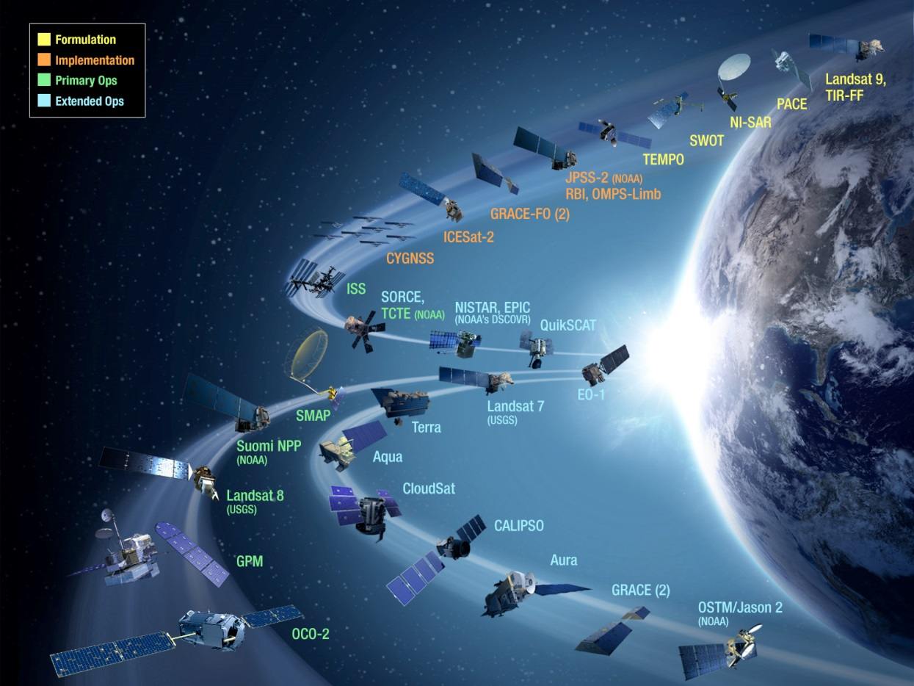
Extensive Data Collection
Started in the 1990s, EOSDIS today has 11,000+ data types (collections)
    Land
        Cover & Usage
        Surface temperature
        Soil moisture
        Surface topography
    Atmosphere
        Winds & Precipitation
        Aerosols & Clouds
        Temperature & Humidity
        Solar radiation
    Ocean
        Surface temperature
        Surface wind fields & Heat flux
        Surface topography
        Ocean color
    Cryosphere
        Sea/Land Ice & Snow Cover
    Human Dimensions
        Population & Land Use
        Human & Environmental Health
        Ecosystems

Slide 3
Data Sources
Type | Example Missions
Satellite/on-orbit Missions | Terra, Aqua, Aura, Suomi-NPP, SORCE, GPM, GRACE, CloudSat, CALIPSO, etc.
Airborne missions | IceBridge, Earth Ventures (5+ missions), UAVSAR, etc.
In Situ Measurement missions | Field campaigns on land (e.g., LBA-ECO) and in the ocean (e.g., SPURS)
Applications support | Near-real time creation and distribution of selected products for applications communities
Earth Science Research support | Research products from efforts like MEaSUREs. This also includes data from older, heritage missions (prior to EOS Program) that the DAACs rescue – e.g., Nimbus, SeaSat

Slide 4
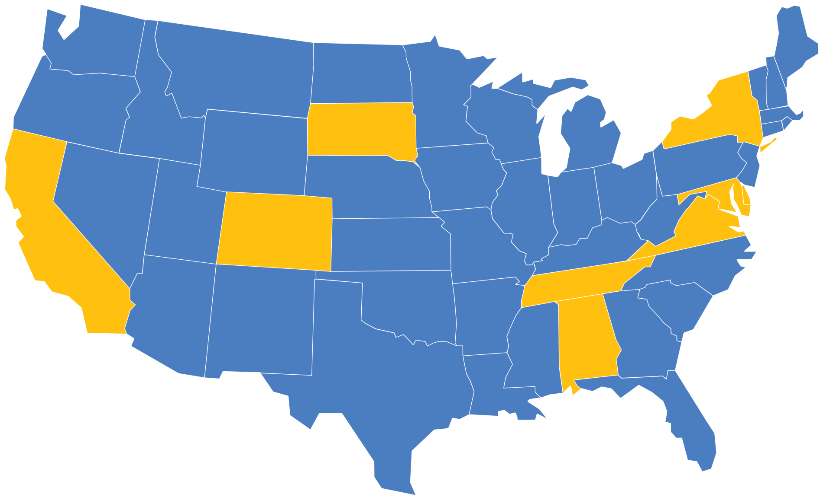
Distributed Active Archive
Centers (DAACs)
Alaska Satellite
Facility DAAC
SAR Products, Sea Ice,
Polar Processes,
Geophysics
Socioeconomic Data and Applications Center
Human Interactions,
Land Use, Environmental Sustainability,
Geospatial Data
Goddard Earth Sciences
Data and Information
Services Center
Global Precipitation, Solar Irradiance,
Atmospheric Composition and Dynamics, Global Modeling
Land Processes
DAAC
Land Cover, Surface
Reflectance, Radiance,
Temperature, Topography,
Vegetation Indices
National Snow and Ice Data Center DAAC
Frozen Ground, Glaciers,
Ice Sheets, Sea Ice,
Snow, Soil Moisture
Crustal Dynamics Data Information System
Space Geodesy, Solid Earth
Ocean Biology
DAAC
Ocean Biology,
Sea Surface
Temperature
Physical
Oceanography DAAC
Gravity, Sea Surface Temperature, Ocean Winds, Topography, Circulation & Currents
LaRC
Atmospheric
Science Data
Center
Radiation Budget,
Clouds, Aerosols,
Tropospheric
Chemistry
Level 1 and
Atmosphere
Archive and
Distribution
System (LAADS)
MODIS Level-1
and Atmosphere
Data Products
Global Hydrology
Resource Center DAAC
Hazardous Weather,
Lightning, Tropical Cyclones and
Storm-induced Hazards
Oak Ridge National Laboratory DAAC
Biogeochemical Dynamics, Ecological Data, Environmental
Processes

Slide 5
Total EOSDIS Accumulated Data Archive Volume (Petabytes)
Trend: 2000-2017 (at the end of Jul 2017)
Addition of OB.DAAC (2.7 PB)
MODIS reprocessing
Addition of
AQUARIOUS and ICEBRIDGE
products
Addition of
GPM and ALOS PALSAR products
Addition of
Data from
MODAPS
Deletion over 2 PB in ASF due to consolidation and transition
Addition of
ICESAT
product
Landsat-7 Data
Migrated from
LPDAAC to USGS
Deletion of
MODIS
Collection 4
Products

Slide 9
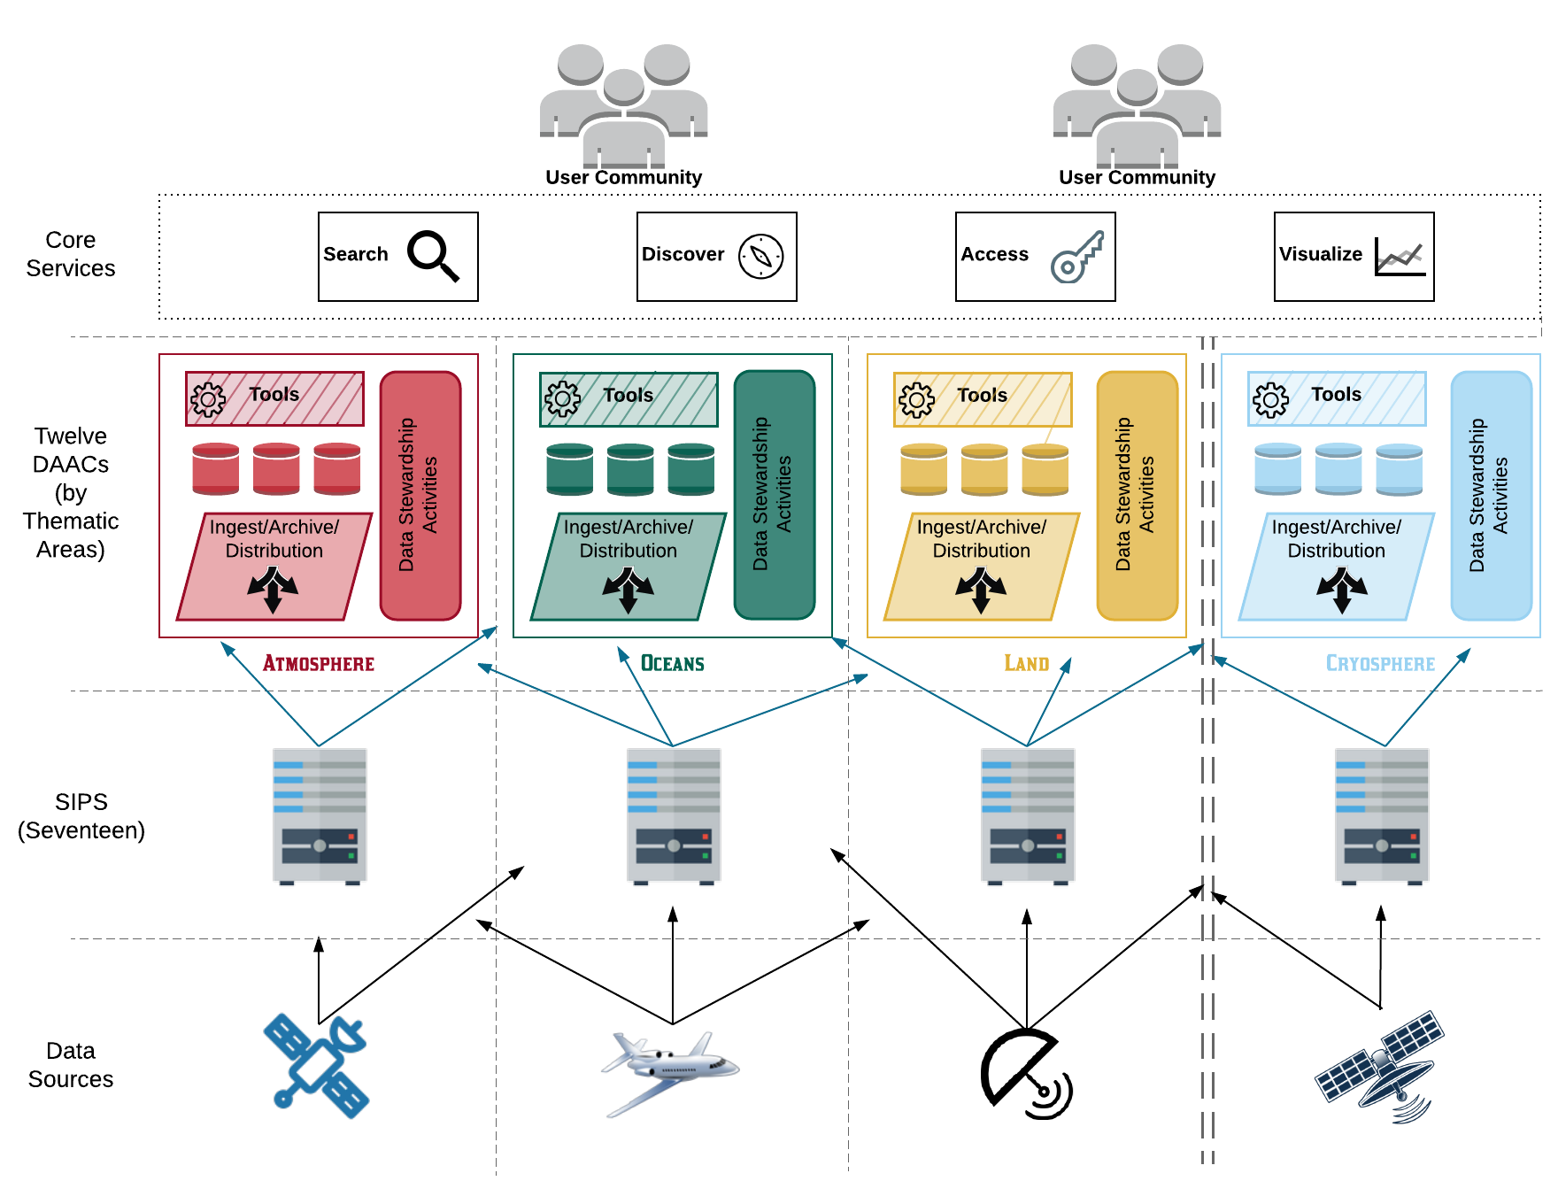
Current Architecture
+
-
Optimized for archive, search and distribution
Uneven levels of service and performance
Expert user support
Significant time to coordinate interfaces
Easily add new data products and producers
Limited on-demand product generation and end-user processing capabilities
Predictable
Duplication of storage
Duplication of services and software

Slide 10
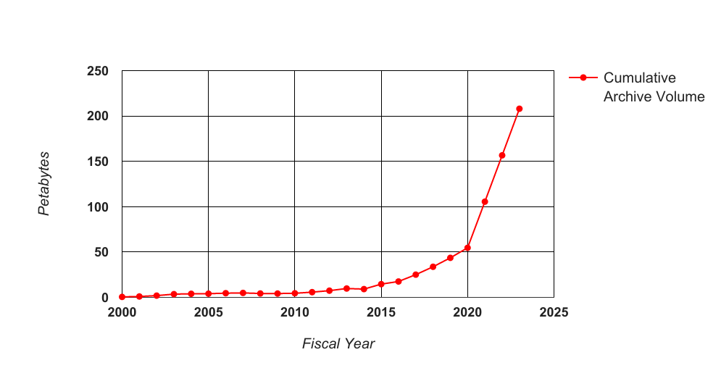
EOSDIS Archive Is Expected to Grow Substantially
You are here
Notes:
The main contributors to this inflection point are NISAR, launching in 2021, providing an estimated 84 TB/day and SWOT at 19 TB/day. Suggest the following slide as a backup slide.

Slide 11
EOSDIS New Missions - next 5 years
Missions | Launch Date | Daily Data Volume GB/day | DAAC(s)
Sentinel-5P | Sept 21, 2017 | 626 | GES DISC
JPSS-1 | Nov 10, 2017 | 1,700 | GES DISC, OB, LP, NSIDC, LAADS, ASDC
TSIS on ISS | Nov 28, 2017 | .541 | GES DISC
ECOSTRESS on ISS | NET Aug 2017 | 630 | LP
GRACE FO | Feb 2018 | .019 | PO
Sentinel-3B | Apr-Jun 2018 | 939 | OB, LAADS
OCO-3 on ISS | 2018 | 38 | GES DISC
ICESat-2 | Sept 2018 | 804 | NSIDC
GEDI on ISS | Dec 2018 | 35 | LP
MAIA | Sept 2020 | 77 | ASDC(TBD)
CLARREO-PF on ISS | March 2021 | 385 | ASDC(TBD)
SWOT | Apr 2021 | 19,900 | PO
TEMPO | Dec 2021 | 1,700 | ASDC
NISAR | Dec 2021 | 86,000 | ASF
JPSS-2 | 2022 | 1,700 | GES DISC, OB, LP, NSIDC, LAADS, ASDC
PACE | Jun 2022 | 3,500 | OB
TOTAL |  | 118 TB/day

Slide 12
Long Term Vision: EOSDIS Is Migrating Science Archives to the Cloud for Improved Efficiency and Expansion End-User Analysis Capabilities
Large Volume Data Storage
EOSDIS Data Management
Co-located Earth observation and model data stored
together in inexpensive
Web Object Storage
Catalog
Science archive business logic leverages cloud-provided generic data handling services
Archive
Search
Ingest
Data
Compute
Access
Scalable Compute
Provision, access, and terminate based on need
End-User Applications
Processing
Science community brings algorithms to the data.
Application
Analytics
Cloud Native Compute
A variety of powerful cloud compute services supports diverse science use cases

Slide 13
EOSDIS Cloud Evolution (ExCEL) Project
Initiated in March 2016
Series of Prototypes and Pilot Projects to evaluate feasibility of operating DAACs and EOSDIS core services in Amazon Web Services (AWS)
  NASA Compliant General Application Platform (NGAP) –infrastructure to provide secure, cloud-based platform for application hosting, resource management, and system administration
  Cumulus – Lightweight Framework for data ingest, archive, distribution
  Getting Ready for NISAR (GRFN) – prepare for large data volumes expected from the NISAR mission, using data from Sentinel-1B as a NISAR surrogate
  Successful Pilot Projects: Earth Data Search Client (EDSC) and Common Metadata Repository (CMR) have been deployed and are operational in AWS

Slide 14
Core Capability Mapping to ExCEL Prototypes
GRFN
Mapping EOSDIS technical foundational capabilities to ExCEL project prototype activates
Cumulus
Data
Ingest
Data
Ingest
Data
Archive
GIBS
Data
Archive
Data Distribution
Operational in AWS
EDSC
CMR
Data Distribution
Data Distribution
Data Management
Data Management
Data Management
Data Management
Data Management
Processing
Earthdata Search Client, data search
Common Metadata Repository
Global Imagery Browse Services
Prototype addressing core EOSDIS DAAC
Getting Ready for NISAR
14

Slide 15
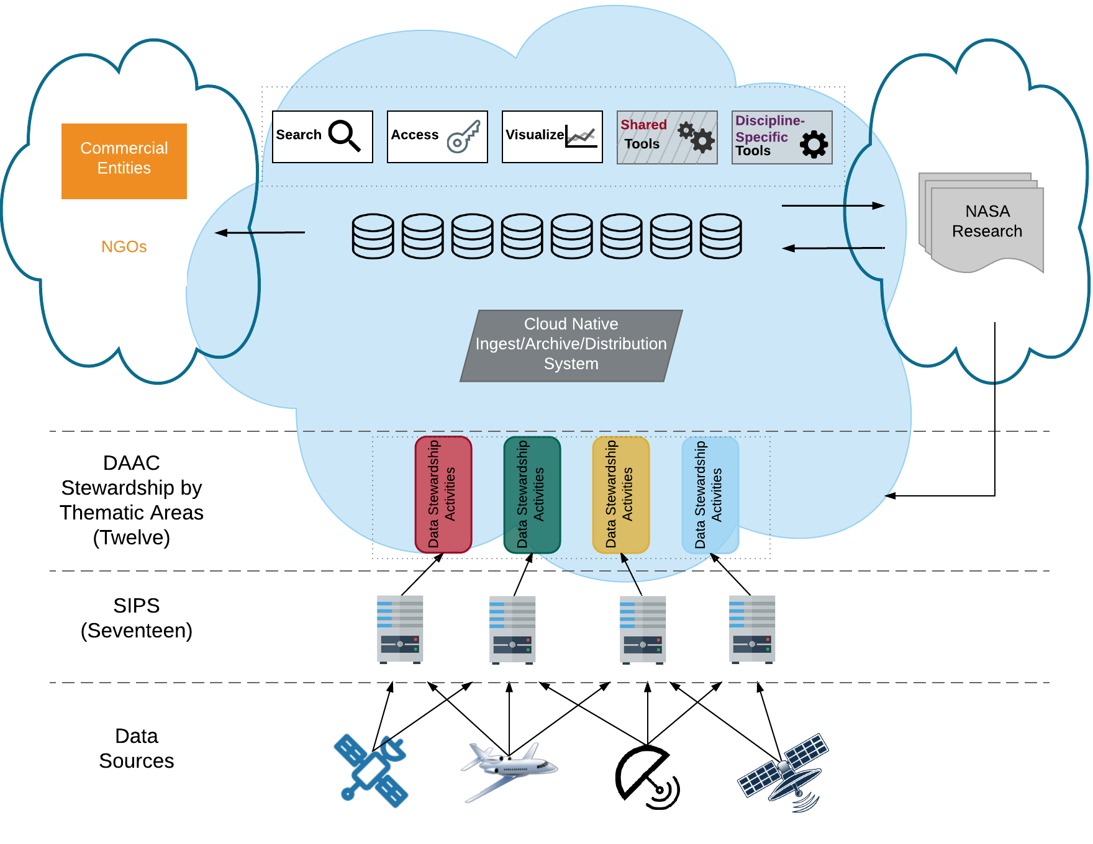
Simplified Commercial Cloud Architecture
+
-
Processing next to data – buy by the yard for anyone
Development coordination
Cost management
No duplication of data - Data available to all DAACs and users
Business processes and skillsets
Expert user support
Vendor lock-in
Easily add new data producers
Apply new technology more easily

Slide 16
Future Focus
  GRFN : continue prototype to demonstrate automated end-to-end processing and distribution system, and potential for on-demand processing to reduce storage costs
  Cumulus:
    Operate GHRC and LPDAAC data streams in parallel to existing systems to gain more insight into advantages and issues
    Merge GIBS into Cumulus
    Devise and implement an EOSDIS-wide development paradigm
  Address Risks and Challenges, e.g.:
    How to avoid unbound Egress costs
    Vendor lock-in risks
    Organizational and business management challenges

Slide 17
Summary
  Results-to-date from prototype activities have resolved a number of issues relative to operating NASA data systems in commercial cloud environments.
  Efficiency and increased functionality have been demonstrated for DAAC and core functionality.
  Additional work is needed to begin “operationalizing” systems, including:
    Continued development of cloud optimized software
    Implementation of cost-capped egress
    Retooling workforce skillset and processes

