Slide 1
“PRESERVATION DOMAIN”
Data Stewardship Interest Group
WGISS-44 Meeting – RADI, Beijing, China
25–28 September, 2017
Mirko Albani, European Space Agency

Slide 2
Background and Purpose
WGISS accomplishes its Data Preservation and Curation efforts through the Data Stewardship Interest Group (DSIG)
Purpose of the activities:
Enable the sharing of agency investigations, developments, experiences and lessons learned relating to EO data stewardship
Draft common cross-agency best practices or guidelines of data stewardship for possible adoption by WGISS
Sponsor technical exchanges and the conduction of Joint Activities and/or Pilot Projects on specific data stewardship topics
Establish and maintain a CEOS “Data Purge Alert” service
Contributing to GEO and Standardization activities

Slide 3
DSIG session
Overview and Updates
Session: Report on Agencies Stewardship Activities
  Long Term Archive: Infrastructure & Processes
ESA Archive Technology and Solution Workshop
WGISS Data Stewardship Maturity Matrix
DSIG Standards

Slide 4
Recovery of historical datasets – initial draft list to be investigated
Data Set | Mission(s) | Sensor(s) | Mission Owner | Data Set Location
Ozone profiles from 30 to 110 km | EURECA | ORA | ESA | Belgian Institute for Space Aeronomy (TBC)
Grille vertical profiles | Spacelab 1; ATLAS-1 | Grille (Infrared Spectrometer) | Spacelab 1: NASA-ESA ATLAS-1: NASA | Belgian Institute for Space Aeronomy (TBC)
Deuterium and Hydrogen atomic concentrations | ATLAS-1 | ALAE | NASA | Unknown (Sensor Owner: CNRS)
Solar spectral irradiance | Spacelab 1; EURECA; ATLAS missions | SOLSPEC | Spacelab 1: NASA-ESA EURECA: ESA ATLAS missions: NASA | Institut Pierre Simon Laplace (TBC)
ESMR data sets from the polar regions | Nimbus-5 | ESMR | NASA | NASA (NSIDC - National Snow & Ice Data Center)
ESMR Imagery of Brightness Temperature on 70 mm Film | Nimbus-5 | ESMR | NASA | GSFC - Goddard Earth Science Data and Information Services (GES DISC)
SeaSat SMMR data | SeaSat | SMMR | NASA/JPL | JPL Physical Oceanography DAAC
WGClimate requested to help in identifying additional datasets of interest for ECVs generation (and extension back in time) which were acquired in the past but are not accessible today.

Slide 5



Report on Agencies Stewardship Activities
  Long Term Archive: Infrastructure & Processes
  Archive Infrastructure and technology
  Monitoring tools
  Archive volume, missions, coverage
  Archiving flows and processes
  Data format/packaging for long term archive
  Management of the relevant associated knowledge
  Volume and Trend
  AOB

Slide 6
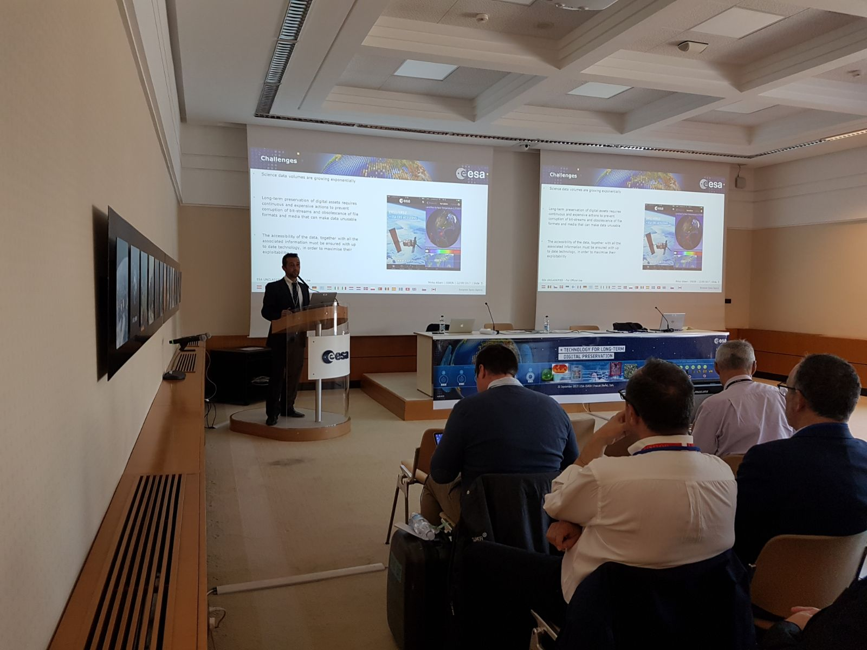
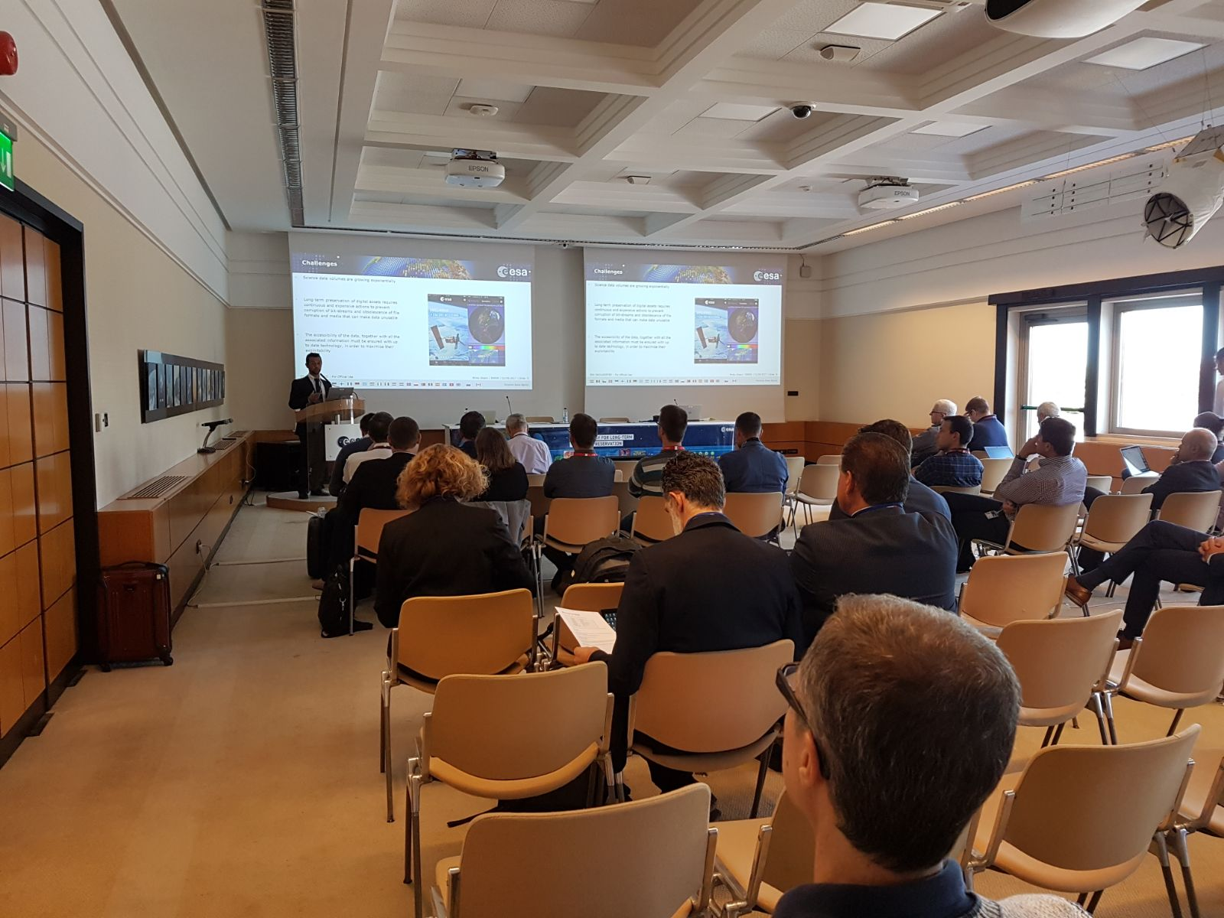
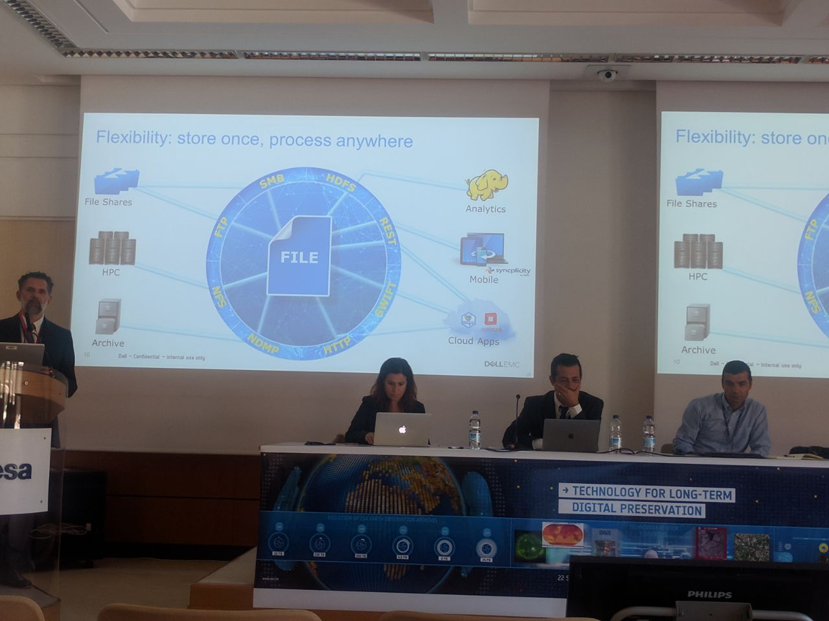
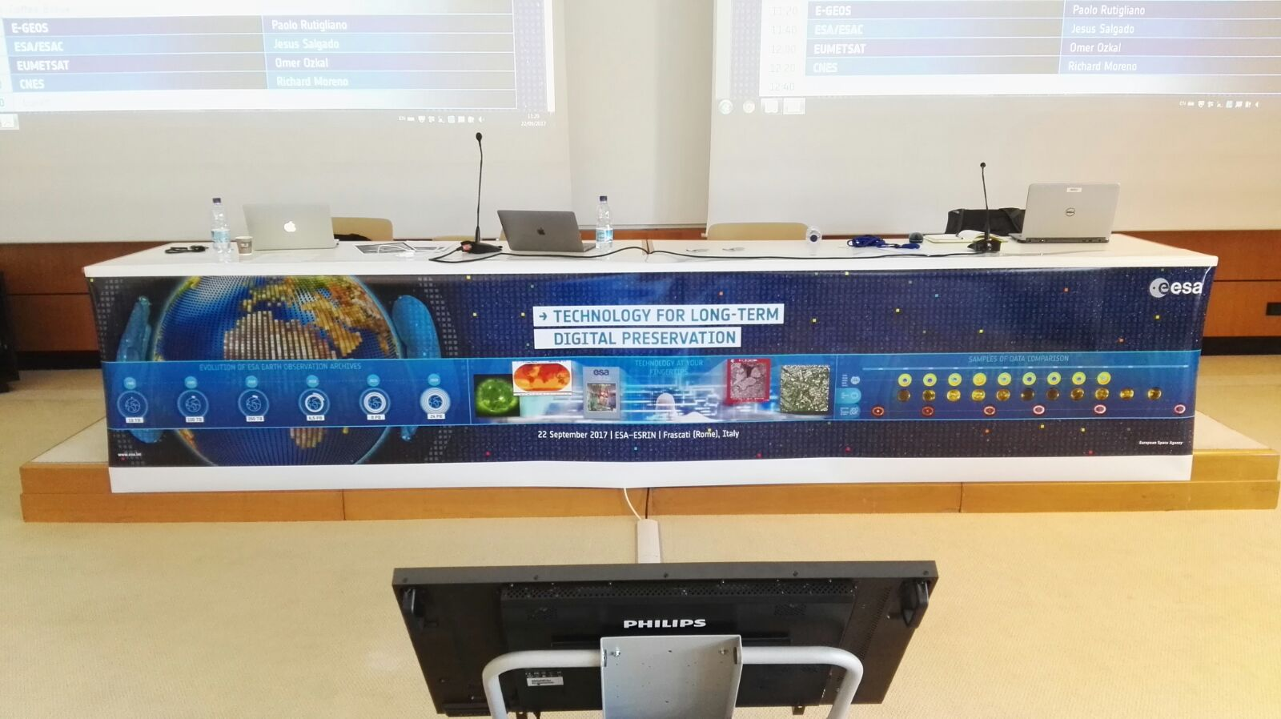
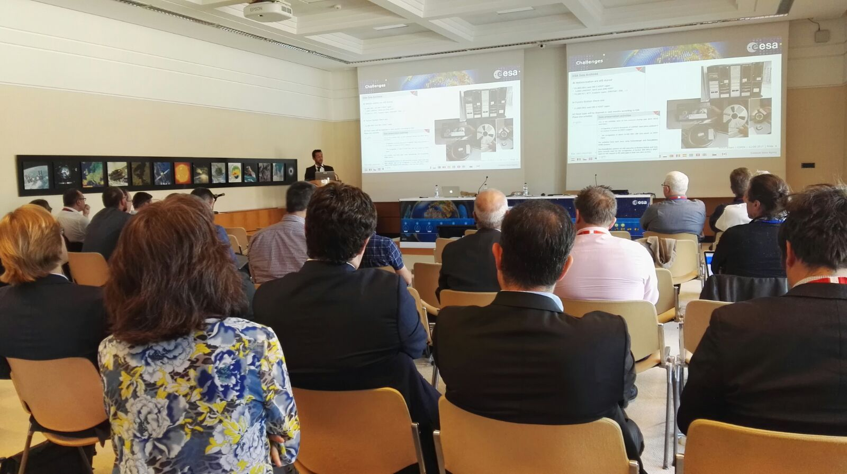
ESA Archive Technology and Solution Workshop
Technology for Long Term Digital Preservation

Slide 7
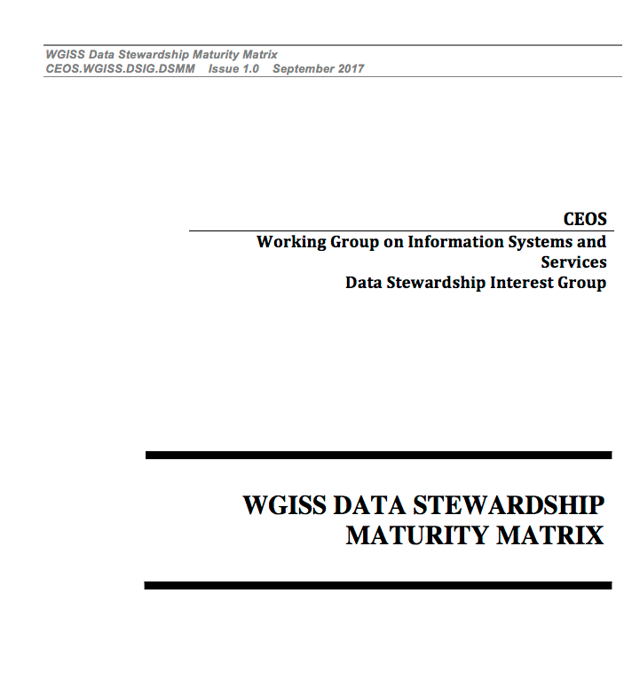
WGISS Data Stewardship Maturity Matrix

Slide 8
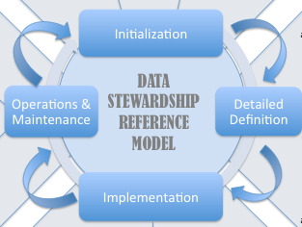
DSIG Standards

Slide 9
Data Purge Alert

Slide 10
U.S. Geological Survey (USGS) EROS Center
Intention to Dispose of the National Aerial Photography Program (NAPP) Black-and-White from Color Infrared Film Collection
NAPP was coordinated by the USGS as an interagency project to acquire cloud-free aerial photographs at an altitude of 20,000 feet above mean terrain elevation. Coverage over the conterminous United States includes both black-and-white (BW) and color infrared (CIR) aerial photographs.
The NAPP program, which was operational from 1987 to 2007, consists of more than 1.3 million images.
Film to be disposed is a full copy of the existing color-infrared one.
Film is not contained in the USGS Earth Explorer finding tool.
If a user needs black-and-white imagery, they can now create their own from the color-infrared easily.
None of the film has been scanned, nor is it planned to be scanned.
This collection consists of 2,427 rolls and 326,639 frames. All of the film is on the standard 9-inch by 9-inch frame size. The media is polyester safety film base. Metadata is available for each frame.
Point of Contact: John Faundeen, USGS faundeen@usgs.gov.

Slide 11
Data Stewardship Related Conferences

Slide 12


BIG DATA 2017 Conference with PV session
28th – 30th of November 2017
30th of November

Slide 13

PV 2018
http://www.ceda.ac.uk/contact/pv2018/

Slide 14


PV 2018 - Poster

Slide 15

PV 2018 – Flyer 1/2

Slide 16

PV 2018 – Flyer 2/2

Slide 17
DSIG Actions Management

Slide 18
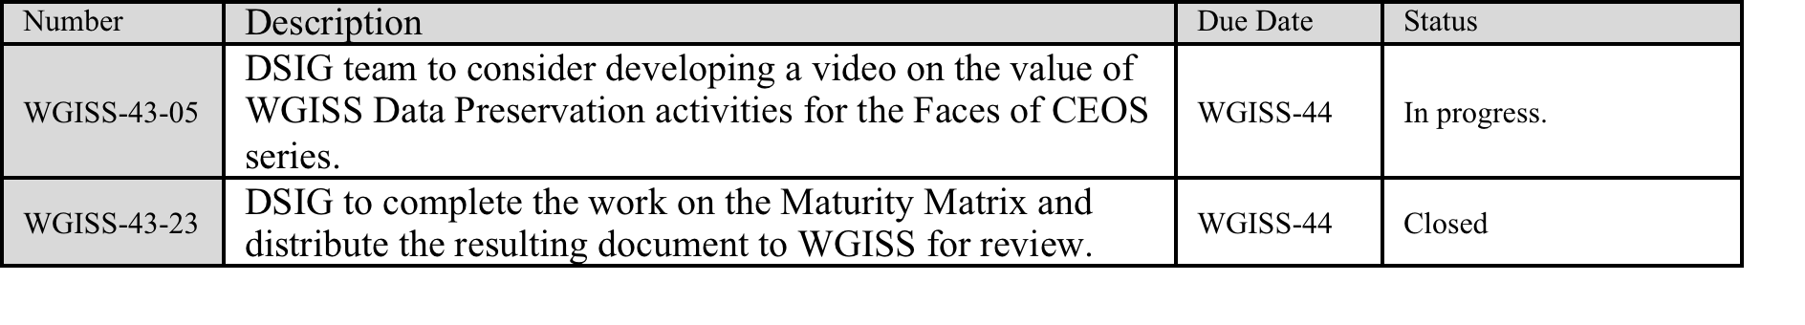
Actions on DSIG

Slide 19

WGISS-43-05
Storyboard and Baseline Video on the value of WGISS Data Preservation activities circulated
LTDP Standard Video
One Feedback received to include images of some ancient manuscripts from India, China, Japan and Egypt as example of “humankind cultural heritage”
NEXT STEPS: proceed with video preparation

Slide 20
WGISS-43-23
Draft Release circulated to WGISS on 11th of September 2017
Feedbacks received on 15th of September 2017
Internal discussion on 21st of September 2017
Final Version issued on 26th of September
DEDICATED PRESENTATION

