Slide 1
CWIC Connectors to Data Providers in China CWIC Development Team 2018

Slide 2
Two data providers in China
Two data providers
ChinaGEOSS
China NRSCC

Slide 3
ChinaGEOSS – brief
ChinaGEOSS is a national satellite remote sensing data facility of National Remote Sensing Center of China (NRSCC), under the Ministry of Science and Technology, China
Intend to provide discovery of and access to all satellite remote sensing data in the governmental data centers of China.
The ChinaGEOSS is broker, using system of system architecture
Four interfaces: data query, data, metadata, and data planning
Toolkit to connect to the data/metadata
More than 35 million of metadata/data records.
About100 high quality datasets: Data are harvested and stored at their central storage.
Those data sets can be shared with international users immediately
A mirror site of ChinaGEOSS is considered to be established at Chinese University of Hong Kong to facilitate the international access.
New satellite data are joining the network.
Its GeoPortal: metadata and data
Metadata are open access. Not all available to GeoPortal.
Standards: not sure (claim to support ISO metadata and OGC standards).

Slide 4
ChinaGEO – Satellite/sensors (1/3)
FY3A (FY means wind and cloud. It is a meteorological satellite)
MERSI
VIRR
FY3B
MERSI
VIRR
FY3C
MERSI
CBERS-01
CCD
CBERS-02
CCD

Slide 5
ChinaGEO – Satellite/sensors (2/3)
CBERS-02B
CCD
GF1 (GF means high resolution)
WFV1
WFV2
WFV3
WFV4
HJ1A (HJ means environment)
CCD1
CCD2

Slide 6
ChinaGEO – Satellite/sensors (3/3)
HJ1B
CCD1
CCD2
GLASS
LAI
ABD
LST
FAPAR

Slide 7
Snapshot of data status by the end of 2017
Granules at the end of 2017
[ 10 satellites 1127838 items]
FY3A(99305)
FY3B(133883)
FY3C(34572)
CBERS-01(10)
CBERS-02(2603)
CBERS-02B(69)
GF1(725)
HJ1A(421)
HJ1B(510)
GLASS(855740)

Slide 8
CWIC ChinaGEO Connector Development Status(1)
Meeting with the chief engineer of NRSCC and her team at GEO Plenary gets initial agreement for ChinaGEOSS to participate in CWIC
Initiated first bi-lateral teleconference of technical teams on 11/14/2017
Technical exchanges on CWIC connection have been going on since then
NRSCC has requested to sign a MOU between NRSCC and CEOS for ChinaGEOSS to join CWIC
Draft MOU has been sent to NRSCC and discussion on MOU is going
No problem with the MOU content but questioning who should sign the MOU on CEOS side – waiting for NRSCC’s official request.
Notes:
There are three options for access their data (Option 1 is accessible with planned harvest, Option 2 is for human user, Option 3 is still in development and its stability needs to be tested when the service back after March 20.) Option 1.The global metadata harvesting mode：As we mentioned above, the web service interface is used for the metadata sharing mechanism with GEODAB. They can harvest global metadata in batch processing and republish the metadata catalog to the GEO portal. Option 2.The human-computer interaction mode: This mode is used on the China GEOSS portal (http://www.chinageoss.org/en/query.html). International users can select satellite, sensor and spatial-temporal range conditions to query the metadata result. Option 3.The API query interface mode. It consists of query, getalldescription and closequery three features. Firstly, the user should pass a query condition of an XML string and obtain the ID (QueryID) of the query result. If the query fails, the ID is null. Secondly, the user pass the QueryID and a maximum number (N) of returns to getalldescription. They can get the N query results expressed as an XML string in a sequential manner. Thirdly, the query is ended when the number of query results returned is less than N.

Slide 9
CWIC ChinaGEO Connector Development Status(2)
Three access options
Option 1.The global metadata harvesting mode
Option 2.The human-computer interaction mode
China GEOSS portal (http://www.chinageoss.org/en/query.html)
Option 3.The API query interface mode
CWIC will test this mode first
If this one does not work, option 1 will be implemented

Slide 10
CWIC ChinaGEO Connector Development Status (2)
Initial access to ChinaGEO dataset through protected interface (API)
No dataset support
No support on spatial/temporal constraints
No total matches reported
No support on retrieving metadata for specific granule
Service stability needs to be tested and verified
ChinaGEOSS intends to set up a mirror site at Chinese University of Hong Kong to improve the stability and accesibility

Slide 11
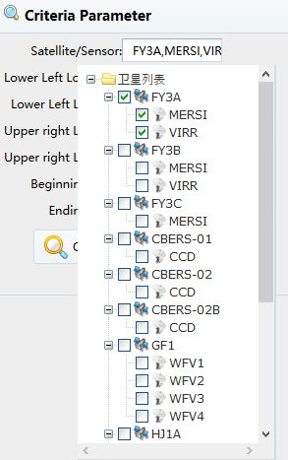
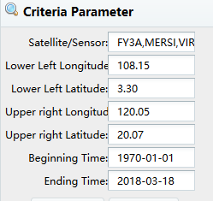
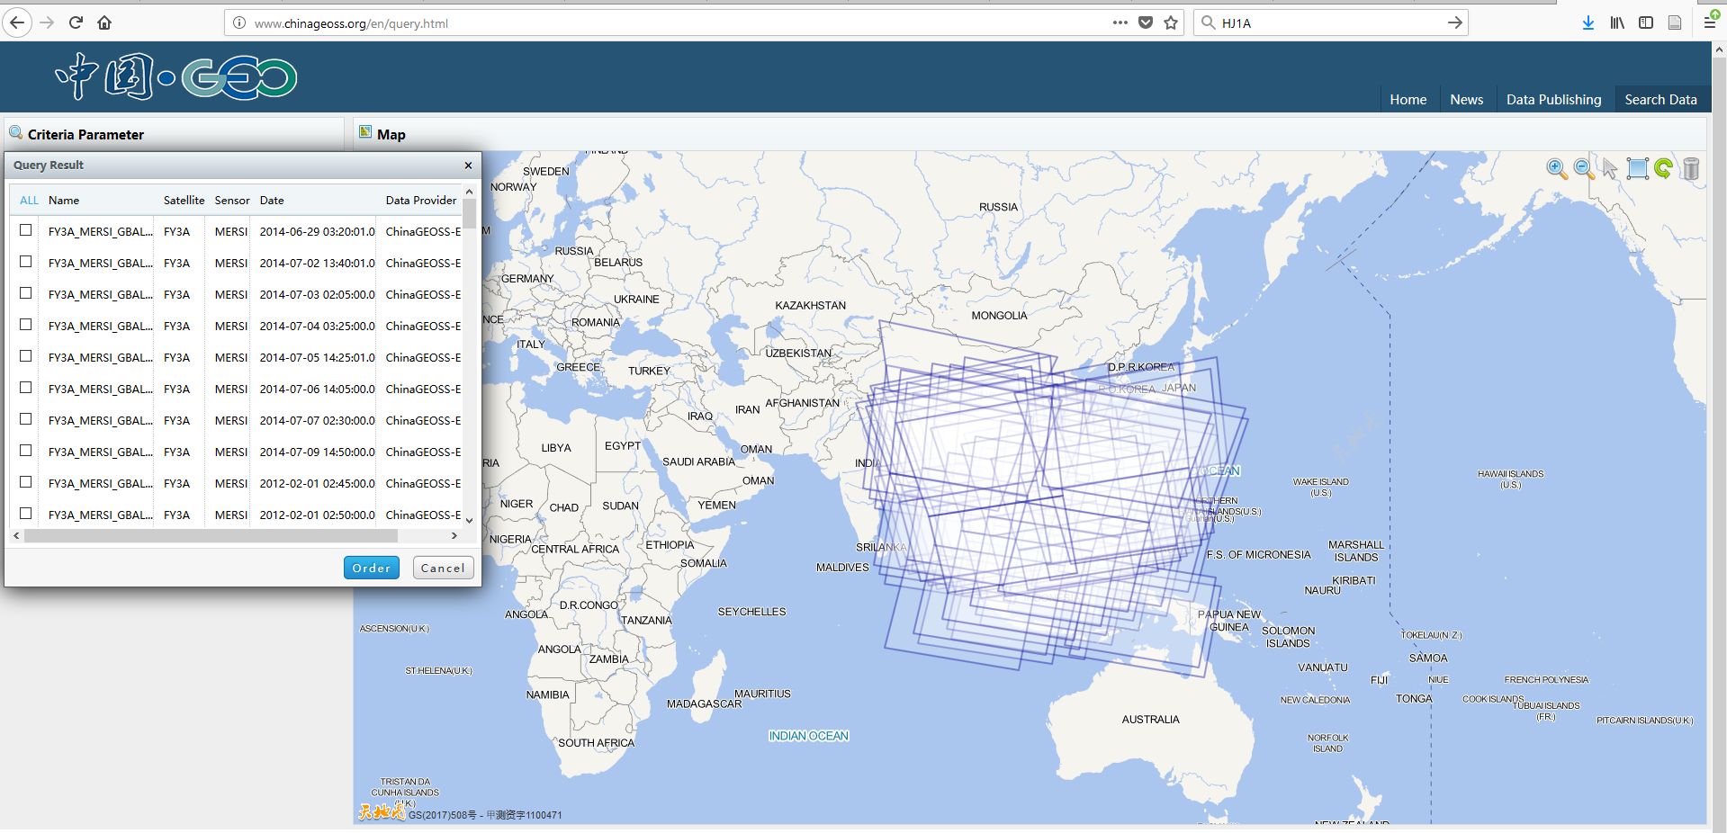
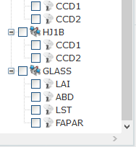
CWIC ChinaGEO Connector Development Status (3)
ChinaGEO GeoPortal supports searches
http://www.chinageoss.org/en/query.html
The API service by ChinaGEO would support similar capabilities for directly relayed search from CWIC Connector

Slide 12
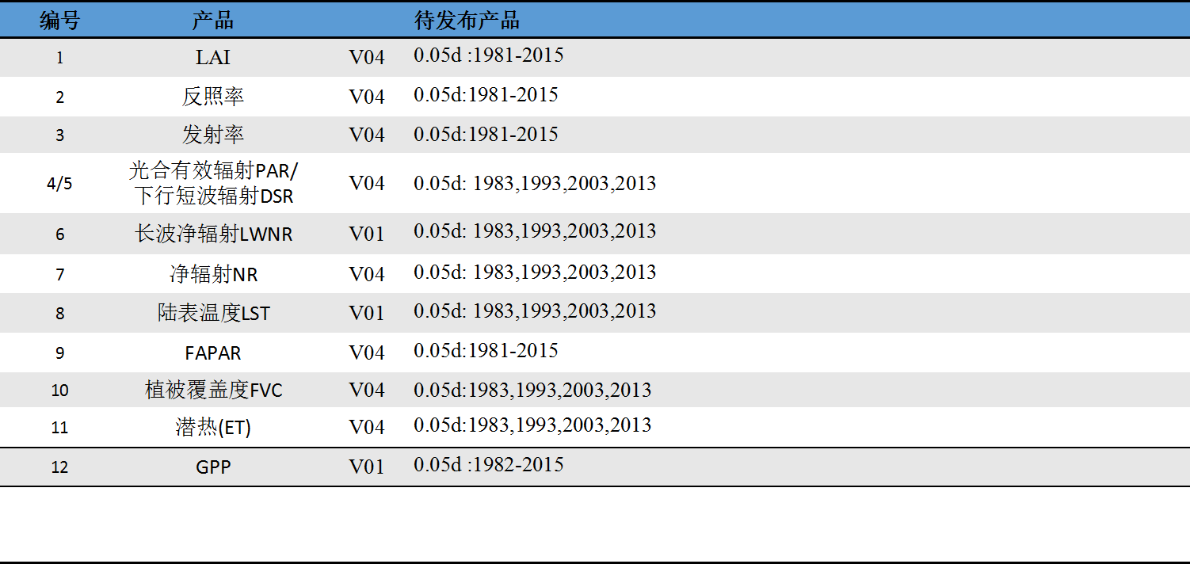
China NRSCC - brief
Global Change Data Processing and Analysis Center (est. 1/10/2011)
Funded by China NRSCC to produce global annual land ecological products freely availabe to worldwide users
Multiple Data source, Multiple algorithms, long-term data product
Currently has 12 products (1981-2016)

Slide 13
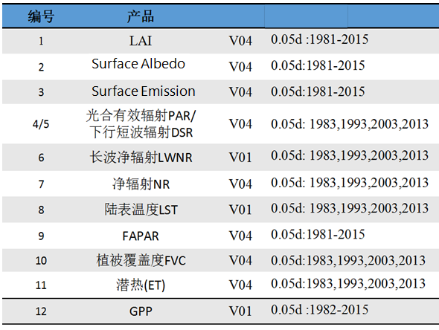
China NRSCC - products
12 products
Global products
Product since 1981

Slide 14
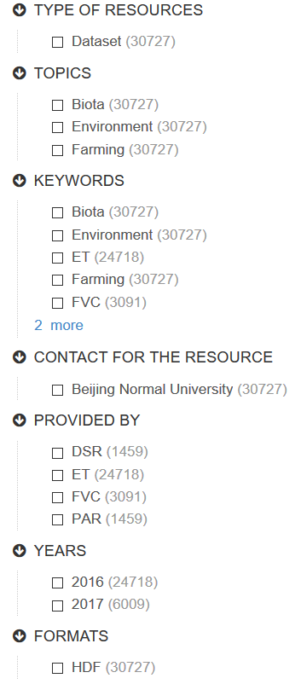
China NRSCC – API and current snapshot
More than 30727 granules are registered in the NRSCC CSW catalog (last visited 3/18/2018)
Four datasets are registered
DSR
ET
PAR
FVC
API
CSW interface
Support both Dublin Core and ISO Profile
ISO profile is complete with metadata

Slide 15
CWIC China NRSCC Connector Development Status
CWIC Connector NRSCC implementation
Completed in March 2018
Deployed into DEV server of CWIC for integration testing
Six datasets registered in IDN
Issue
Integration testing revealed that datasetId mismatching
short-name | concept-id
NRSCC_GLASS_ET | C1458427035-SCIOPS
NRSCC_GLASS_FVC | C1458427261-SCIOPS
NRSCC_GLASS_Albedo | C1451572871-SCIOPS
NRSCC_GLASS_DSR | C1458380697-SCIOPS
NRSCC_GLASS_LAI | C1458427894-SCIOPS
NRSCC_GLASS_PAR | C1458428050-SCIOPS

Slide 16
Back
End of the main slide
After this – back slides

Slide 17
Reference – FY-3
FY-3 (FengYun-3) 2nd Generation Polar Orbiting Meteorological Satellite Series
Spacecraft | Launch (projected launch) | LTDN (Local Time on Descending Node) | Mission Service Type
FY-3A | May 27, 2008 | 10:00 hours | R&D (Experimental)
FY-3B | Nov. 04, 2010 | 13:30 hours | R&D (Experimental)
FY-3C | Sept. 23, 2013 | 10:00 hours | Operational mission with MWHS-II (upgrade) and GNOS (new) instruments

Slide 18
Reference – FY-3 - Instruments
Instruments
MERCI (Medium Resolution Spectral Imager) (I, II)
VIRR (Visible and Infrared Radiometer)
Instrument name | No of bands /channels | Spectral range | IFOV/line (pixels/scan line) | Spatial resolution at nadir (km) | Swath width (km)
VIRR (Visible and Infrared Radiometer) | 10 | 0.43-12.5 µm | 2048 | 1.1 | 2800
MERSI (Medium Resolution Spectral Imager) | 20 | 0.41-12.5 µm | 2048/8192 | 1.1/0.250 | 2800

Slide 19
Reference – FY-3 - MERCI
18 Bands
Channel No | Center wavelength (µm) | Bandwidth (µm) | Spatial resolution (m) | Noise-equivalent reflectance (%), ΔT at 300 K | Dynamic range (max reflec., max T) | Primary use of data
3 | 0.650 | 0.05 | 250 | 0.4 | 100% | Land/cloud/ aerosols boundaries
4 | 0.865 | 0.05 | 250 | 0.45 | 100%
1 | 0.470 | 0.05 | 250 | 0.45 | 100% | Land/cloud/ aerosols properties
2 | 0.550 | 0.05 | 250 | 0.4 | 100%
5 | 11.50 | 2.50 | 250 | 0.54 K | 330 k
19 | 1.640 | 0.05 | 1000 | 0.08 | 90%
20 | 2.130 | 0.05 | 1000 | 0.07 | 90%
6 | 0.412 | 0.02 | 1000 | 0.1 | 80% | Ocean Color/ Phytoplankton/ Biogeochemistry
7 | 0.443 | 0.02 | 1000 | 0.1 | 80%
8 | 0.490 | 0.02 | 1000 | 0.05 | 80%
9 | 0.520 | 0.02 | 1000 | 0.05 | 80%
10 | 0.565 | 0.02 | 1000 | 0.05 | 80%
11 | 0.650 | 0.02 | 1000 | 0.05 | 80%
12 | 0.685 | 0.02 | 1000 | 0.05 | 80%
13 | 0.765 | 0.02 | 1000 | 0.05 | 80%
14 | 0.865 | 0.02 | 1000 | 0.05 | 80%
15 | 0.905 | 0.02 | 1000 | 0.10 | 90% | Atmospheric water vapor
16 | 0.940 | 0.02 | 1000 | 0.10 | 90%
17 | 0.980 | 0.02 | 1000 | 0.10 | 90%
18 | 1.030 | 0.02 | 1000 | 0.10 | 90%

Slide 20
Reference – FY-3 - VIRR
10 Bands
Spatial resolution: 1.1 km on a swath of 2800 km (FOV=±55.4º)
Channel | Spectral range (µm) | Noise Equivalent Reflectance (%) or NEΔT (at 300 K) | Dynamic range (% or K)
1 | 0.58-0.68 | 0.1% | 0-100%
2 | 0.84-0.89 | 0.1% | 0-100%
3 | 3.55-3.95 | 0.3 K | 180-350 K
4 | 10.3-11.3 | 0.2 K | 180-330 K
5 | 11.5-12.5 | 0.2 K | 180-330 K
6 | 1.58-1.64 | 0.15% | 0-90%
7 | 0.43-0.48 | 0.05% | 0-50%
8 | 0.48-0.53 | 0.05% | 0-50%
9 | 0.53-0.58 | 0.05% | 0-50%
10 | 1.325-1.395 | 0.19% | 0-90%

Slide 21
Reference - CBERS
CBERS-1 (China-Brazil Earth Resources Satellite) - 1st Generation Satellite Series
Spacecraft | Launch Date | Comment
CBERS-1 (ZY-1 FM1) | Oct. 14, 1999 | The spacecraft operated until Aug. 2003
CBERS-2 ZY-1 FM2) | Oct. 21, 2003 | The spacecraft was retired in late 2007 when imagery from CBERS-2B was available
CBERS-2B (ZY-1 FM2B) | Sept. 19, 2007 | The spacecraft is operational in 2010 — but was retired on May 10, 2010 due to a power failure.

Slide 22
Reference – CBERS - CCD
HRCC (High Resolution CCD Camera)
Spatial resolution: 20 m
Parameter | Band | Wavelength | Radiance (W/m² sr) |  | SNR (dB)
 |  |  | Maximum | Minimum | Maximum | Minimum
MS band | B1 B2 B3 B4 | 0.42-0.52 µm 0.52-0.59 µm 0.63-0.69 µm 0.77-0.89 µm | 28.7 30.1 25.9 35.6 | 4.6 3.7 2.4 2.7 | 48 50 48 52 | 32 31 26 29
PAN band | B5 | 0.51-0.73 µm | 55.6 | 9.0 | 53 | 37

Slide 23
Reference – GF-1
GF-1 (Gaofen-1) High-resolution Imaging Satellite / CHEOS series of China
Launch: The GF-1 spacecraft was launched on April 26, 2013 on a CZ-2D (Long March -2D) vehicle from the JSLC (Jiuquan Satellite Launch Center) in northwest China.
Orbit: Sun-synchronous orbit, altitude 645 km, inclination = 98º, LTDN (Local Time on Descending Node) = 10:30 hours, revisit frequency of ≤4 days.

Slide 24
Reference –GF-1 - WFV
Instruments
WFI (Wide Field Imager)
Imager type | Pushbroom with TDI capability
Spectral bands | B1/blue: 0.45-0.52 µm B2/green: 0.52-0.59 µm B3/red: 0.63-0.69 µm B4/NIR: 0.77-0.89 µm
GSD (Ground Sample Distance) at nadir | 16 m
Swath width at nadir | 830 km
Detector type | CCD array

Slide 25
Reference – HJ-1
HJ-1 (Huan Jing-1: Environmental Protection & Disaster Monitoring Constellation)
Launch: A Long March-2C (CZ-2C) launch of two spacecraft, HJ-1A and HJ-1B, took place on Sept. 5, 2008 (UTC). The launch site was TSLC (Taiyuan Satellite Launch Center), located in the northwest part of the Shanxi Province, China.
Orbit: Sun-synchronous circular orbit, altitude = 650 km, inclination = 97.95º, LTDN (Local Time of Descending Node) equator crossing at 10:45 hours.
HJ-1A and HJ-1B are in a coplanar orbit with a phasing of 180º.

Slide 26
Reference – HJ-1 - CCD
WVC (WIDE View CCD Cameras)
Satellite | Instrument | Bands | Spectral range | Resolution | Swath width | Repeat cycle
HJ-1A | WVC | 4 | 0.43-0.90 µm | 30 m | 700 km | 4 days
HJ-1B | WVC | 4 | 0.43-0.90 µm | 30 m | 720 km | 4 days
Instrument | CCD detector (pushbroom type)
Spectral bands (4), µm | B1=0.43-0.52, B2=0.52-0.60, B3=0.63-0.69, B4=0.76-0.90
Spatial resolution | 30 m
Swath width | 360 km x 2 = 720 km (double swath observation provided by parallel camera mounts)
Aspect angle | 31º
SNR (Signal-to-Noise Ratio) | ≥ 48 dB
Data quantization | 8 bit
Design life | ≥ 3 years
Notes:
Each satellite has two WVC

Slide 27
Reference - GLASS
Global LAnd Surface Satellite (GLASS) product
Leaf Area Index (LAI),
shortwave broadband albedo (ABD)
Land Surface Temperature (LST)
Fraction of Absorbed Photosynthetically Active Radiation(FAPAR).
References
10.3390/rs5052436
10.1080/17538947.2013.805262

