Slide 1
ECV IDN analysis

Slide 2
913 ECV total considered
CURRENT ECV
417
FUTURE ECV
204 not in IDN
4 in IDN via CNES
288 in IDN via CWIC
a) 496 out of 913 considered
b) 417 out of 913 not considered because these are future collections.
c) 288 out of 496 on IDN granule/product accessible via CWIC infrastructure
d) 204 out of 496 not on IDN
e) 4 out of 496 on IDN granule/product accessible via CNES infrastructure

Slide 3
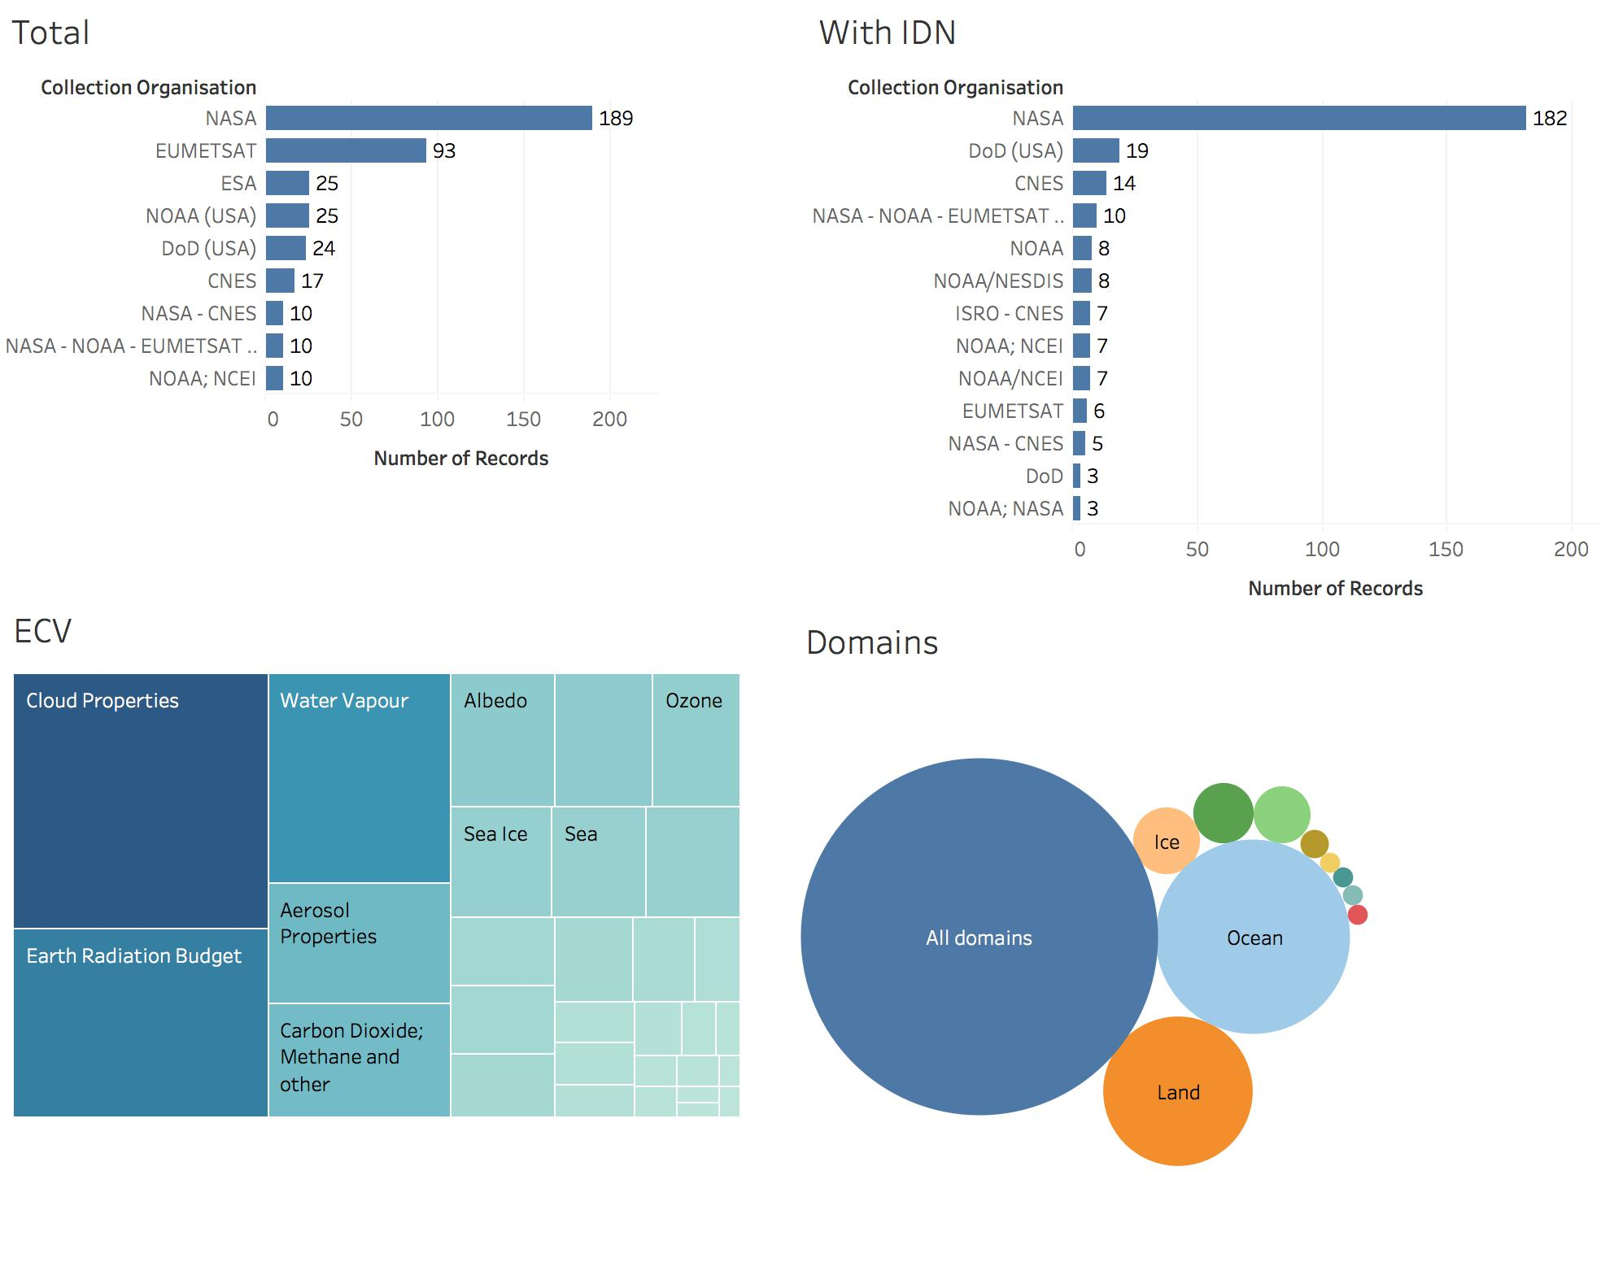

Slide 4
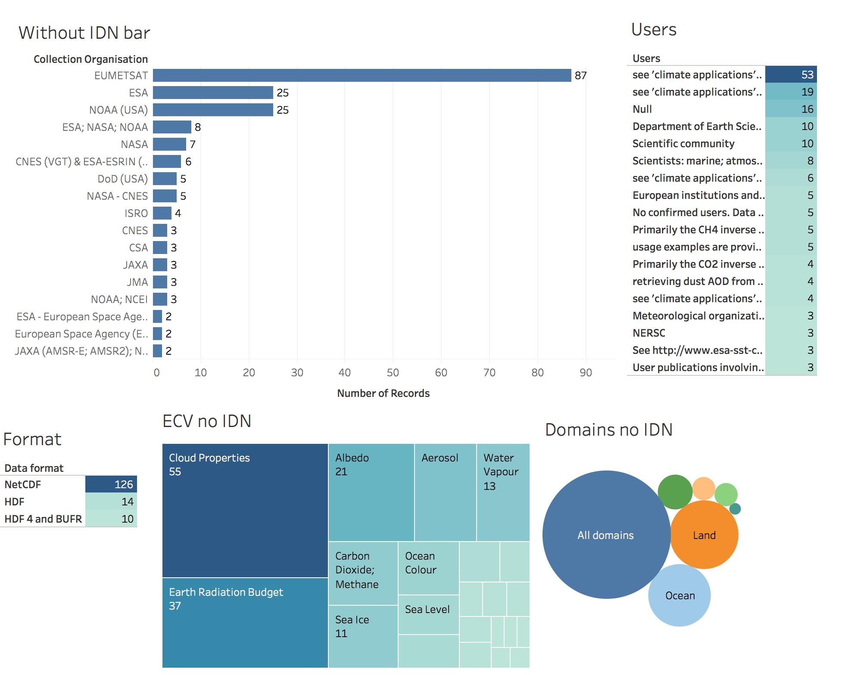

Slide 5
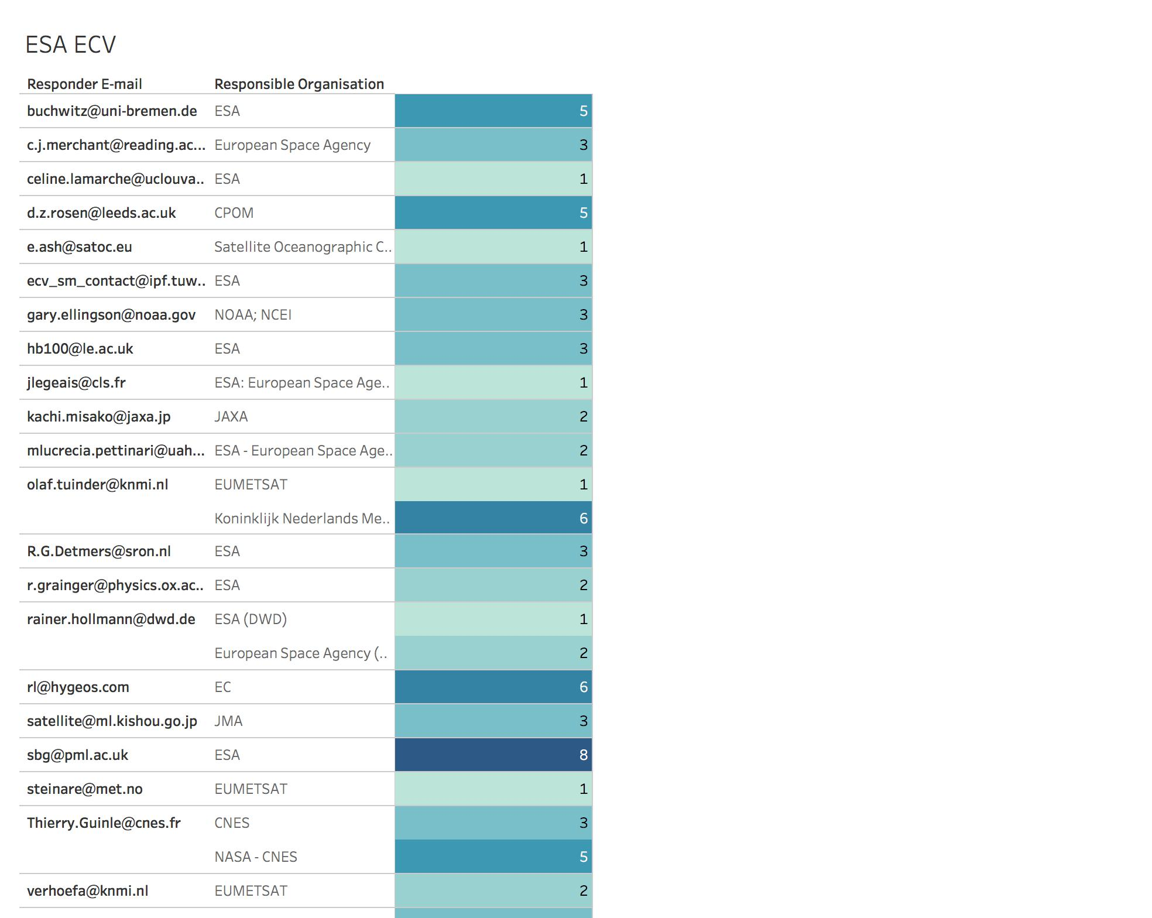
25 email sent
204 datasets
7 answers containing:
request of more details on registration process and infrastructure
information about obsolescence of the requested datasets

