Slide 1
Federated Earth Observation (FedEO)
CEOS WGISS Meeting #45
A. Della Vecchia, D. Guerrucci, M. Albani (ESA)
Yves Coene (Spacebel)
09/04/2018

Slide 2
Outline
Introduction
Recent Activities
  eoPortal OpenSearch Client Update
  Catalogue/Gateway Improvements
Metrics
Future Activities
  ESA catalogue
  FedEO system scalability
  Exploitation Infrastructure

Slide 3
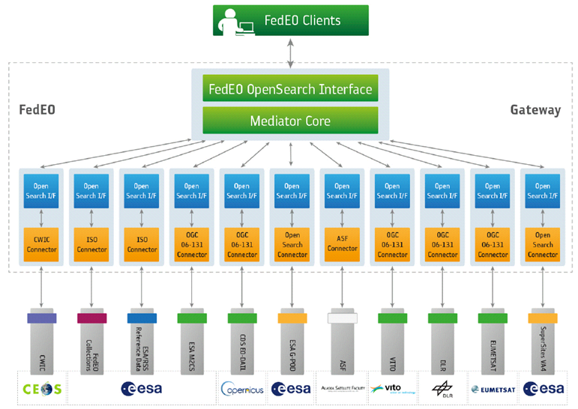
FedEO: Federated Earth Observation Gateway System
FedEO = Federated Earth Observation missions access
The FedEO system provides a unique entry point to a growing number of scientific catalogues and services for, but not limited to, EO European and Canadian missions.

Slide 4
Software Components
Architecture:
  Modular
  Used separately or combined
Interfaces:
  Standard OGC/CEOS interfaces
Documentation:
  SRS, SDD, SCF (incl. Installation instructions)
Main components:
  A1 – FedEO eoPortal Client a.k.a. "OpenSearch Client“
  B2 – OpenSearch Gateway
  B3 – Dataset Series Catalogue a.k.a. "Collection Catalogue"
  B4 – Dataset Catalogue a.k.a “Granule Catalogue”

Slide 5
Architecture Overview
FedEO is based on highly modular SW architecture.
ESA installation provides a full E2E scenario
Visualization Layer
Client
Metadata Layer
Gateway
Collection Catalogue
Product Catalogue
Data Layer
Collection Metadata Ingestion Tool
Product Metadata Ingestion Tool

Slide 6
Outline
Introduction
Recent Activities
  eoPortal OpenSearch Client Update
  Catalogue/Gateway Improvements
Metrics
Future Activities
  ESA catalogue
  FedEO system scalability
  Exploitation Infrastructure

Slide 7
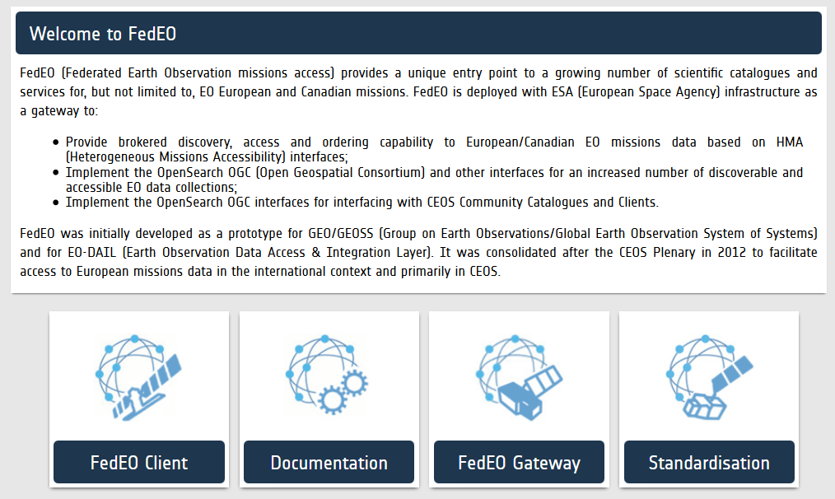
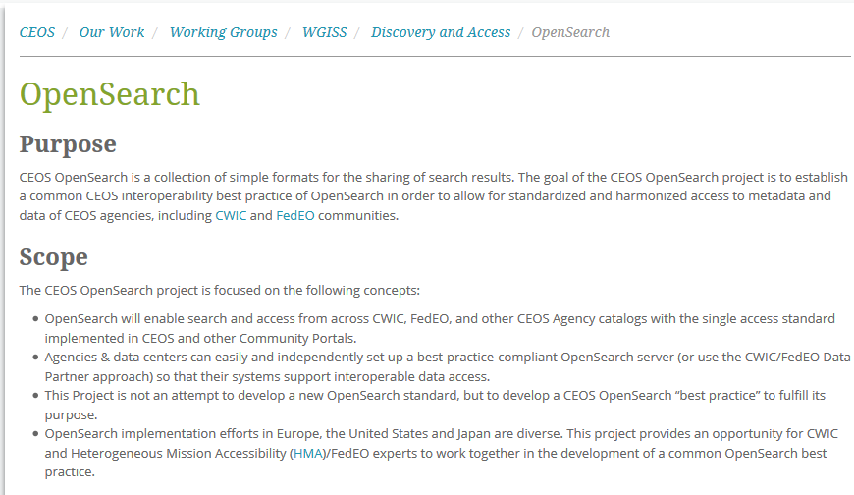
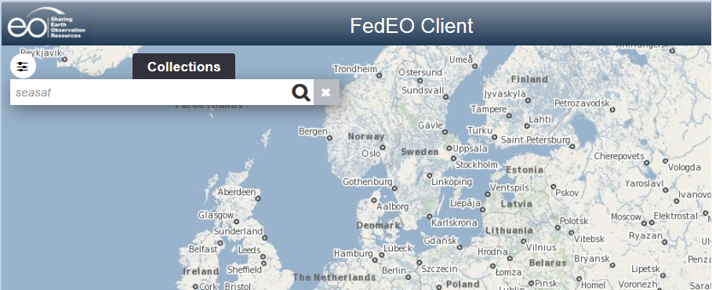
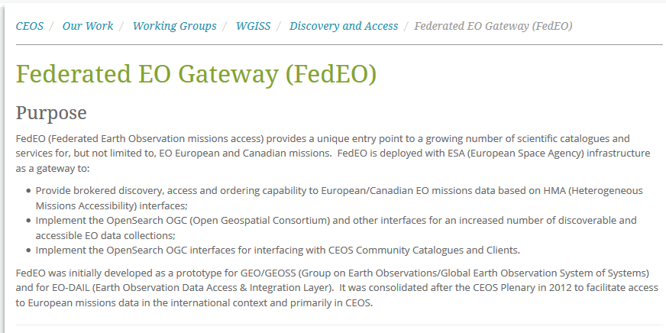
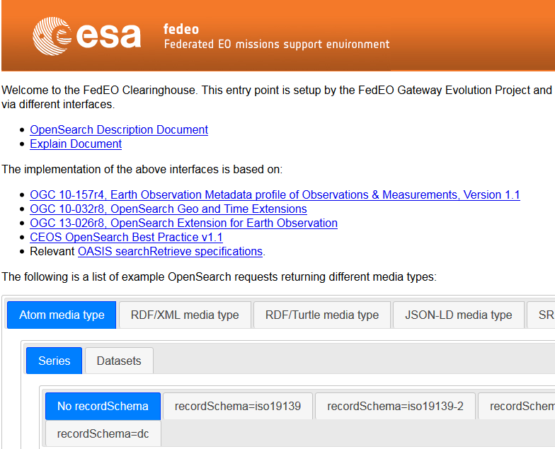
Client – FedEO Landing Page

Slide 8
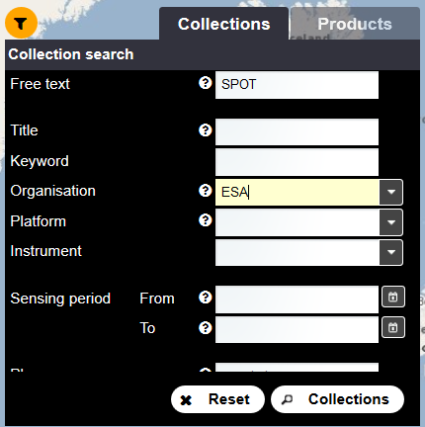
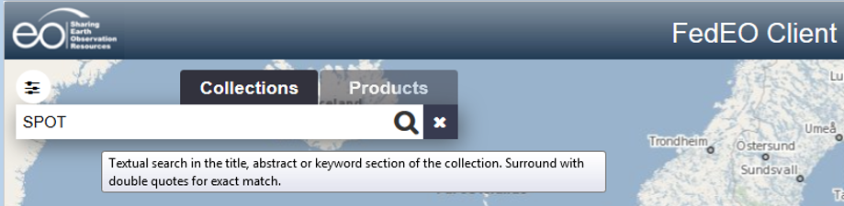
Client – Search
Advanced Search way OSDD
Synchronization way OSDD
Basic Search way OSDD
Tooltip message received from the gateway OSDD.gateway OSDD

Slide 9
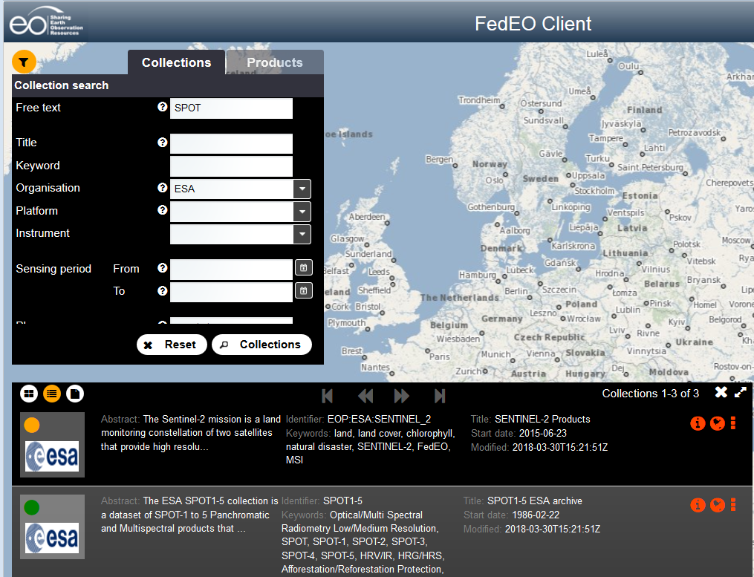
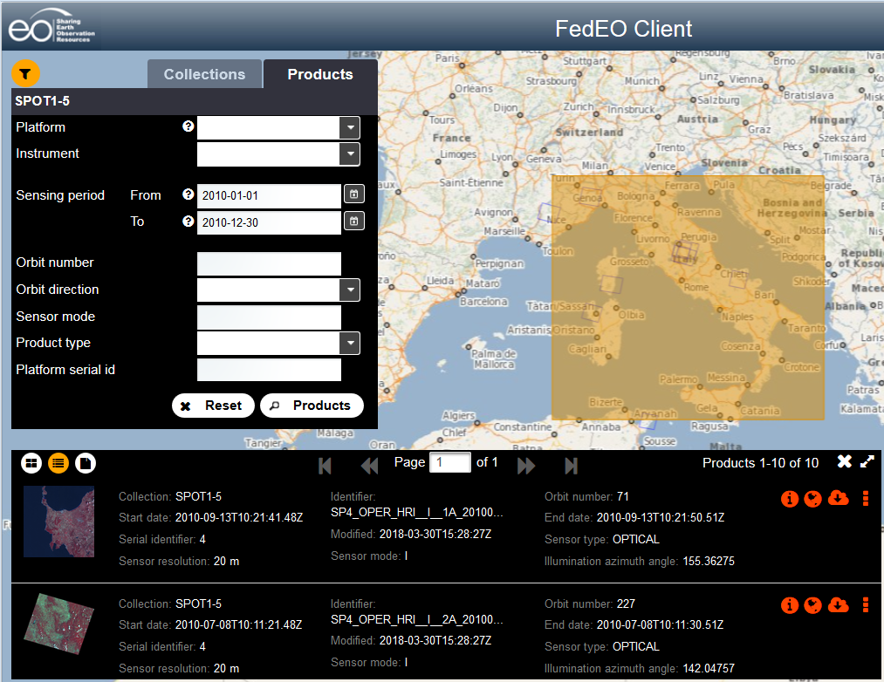
Client – TABs
Easier switching between
Collections
Products search
Thanks to the tabs

Slide 10
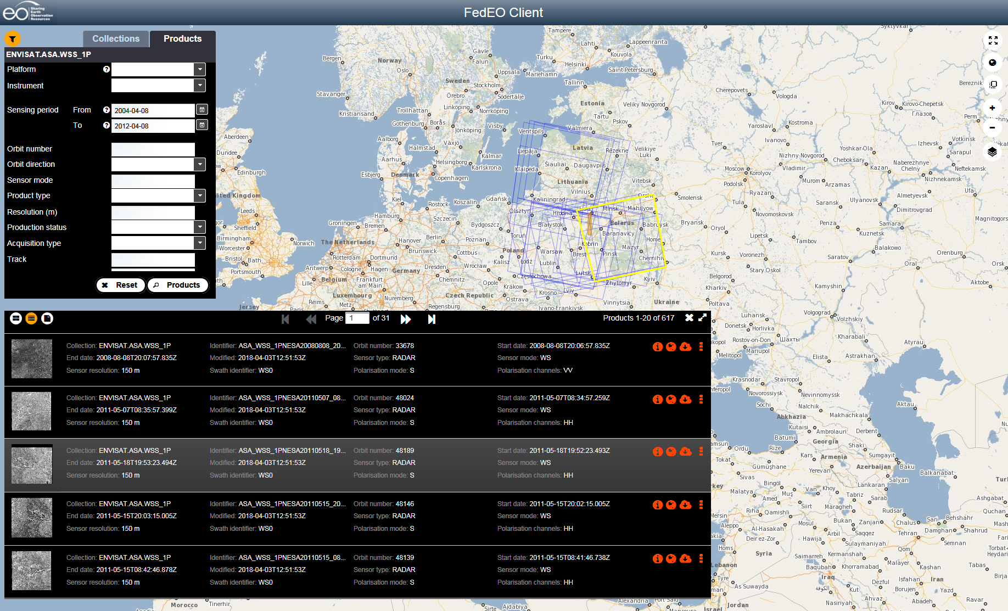
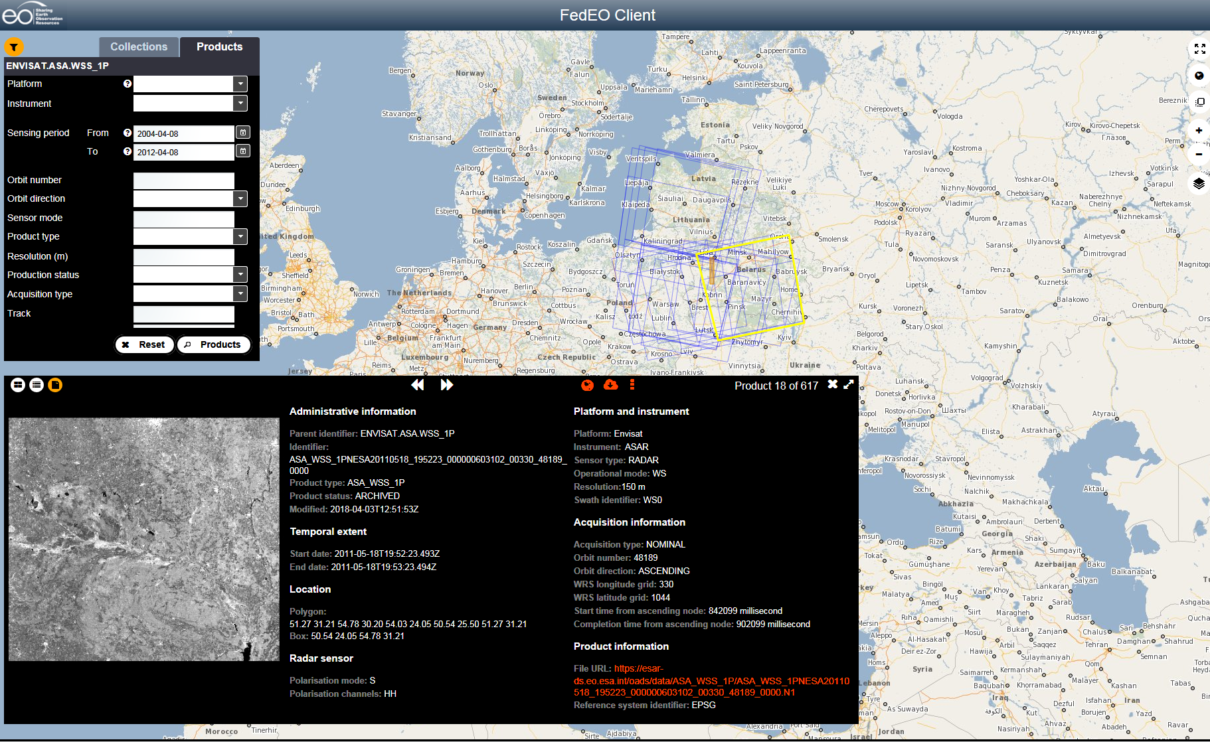
Client –Product Search
Products list
Products access

Slide 11
Gateway
  Support for virtual dataset series (defined at OSGW configuration level)
  OSGW now supports the OpenSearch metalink 3.0 and 4.0 media types for dataset metadata discovery
  OSGW provides an OpenSearch GeoJSON interface for dataset series metadata and dataset metadata discovery [OGC 17-047] & [OGC 17-003]
  OSGW supports the “strict” parameter to return exceptions in case a submitted search parameter is not supported by server
  OSGW returns an “up” atom:link in case of dataset search allowing to retrieve the corresponding dataset series metadata
  Improvement of the OSGW OSDD with configurable title attribute to provide explanation on some search parameters, explanation that could be displayed by a client to help the user

Slide 12
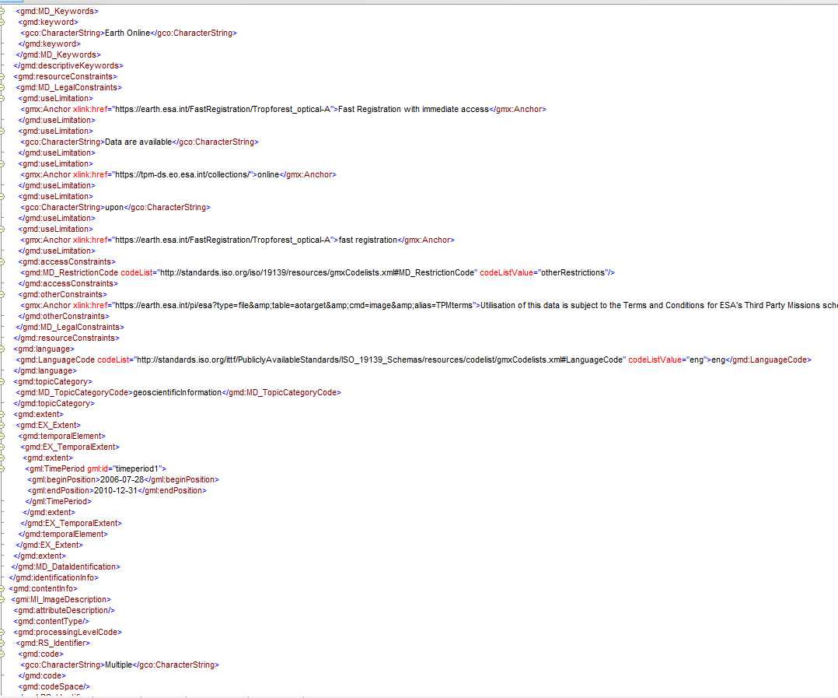
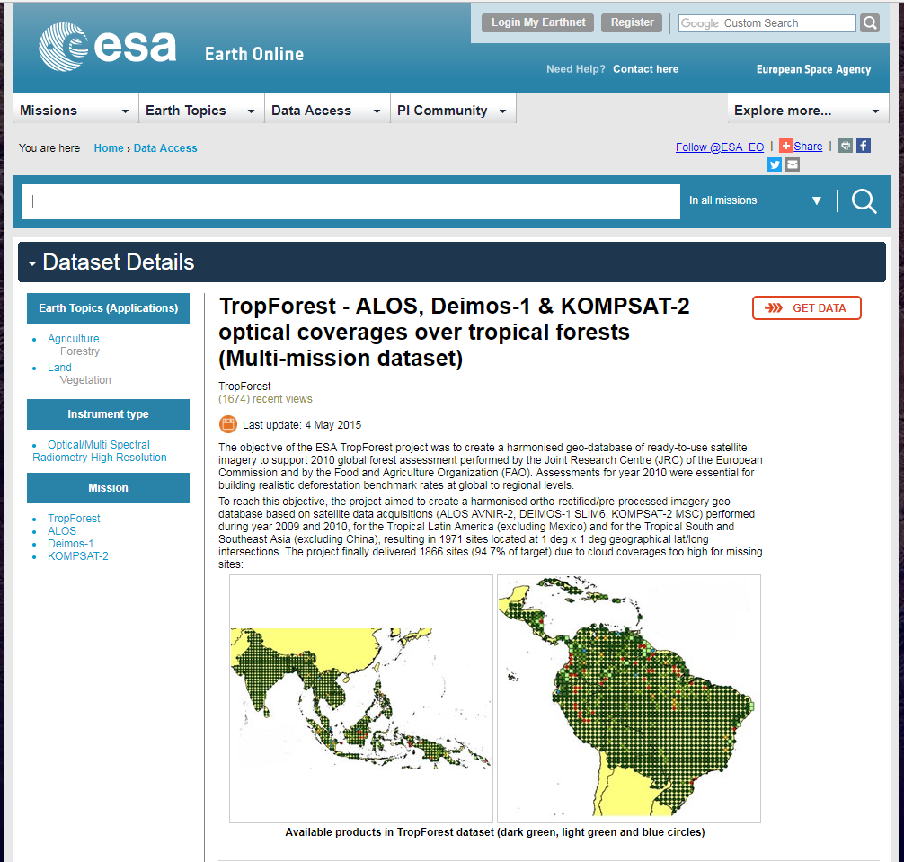
Collection Catalogue
  Content updated:
  Removal of collections: G-POD, VA4, SMOS, CSCDA, EO-DAIL
  OADS ISO Collections automatically generated from Earth-Online.

Slide 13
Metadata Editor
  New in FedEO (Initial Version)
  Dataset Series Administration tool interacting with the FedEO Dataset Series catalog (B3)
  It allows to upload, retrieve, edit, create dataset series (ISO format) in the (B3) catalog.
A5: Metadata
Editor
B3: Dataset Series Catalog
Administrator
IF-OSGW-SERIES-MD
Admin local file system
Editor workspace
Apache Solr Repository
Dataset Series
Metadata Files
Dataset Series
Metadata Files

Slide 14
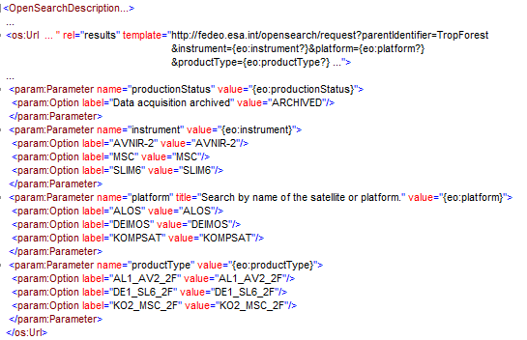
B4 – Product Catalogue
  Product Catalogue Dynamic OSDD (New)
  Specific OSDDs for a given parentIdentifier (dataset series) are generated based on the catalogue content.
  OpenSearch Parameters are present in the URL template if corresponding values are present in the catalogue for a particular parentIdentifier.
  For relevant parameters (productType, sensorType, acquisitionType…), OSDD publishes the possible values based on the content of the catalogue as parameter extension.
  OSDDs are cached and regenerated after new harvesting

Slide 15
Outline
Introduction
Recent Activities
  eoPortal OpenSearch Client Update
  Catalogue/Gateway Improvements
Metrics
Future Activities
  ESA catalogue
  FedEO system scalability
  Exploitation Infrastructure

Slide 16
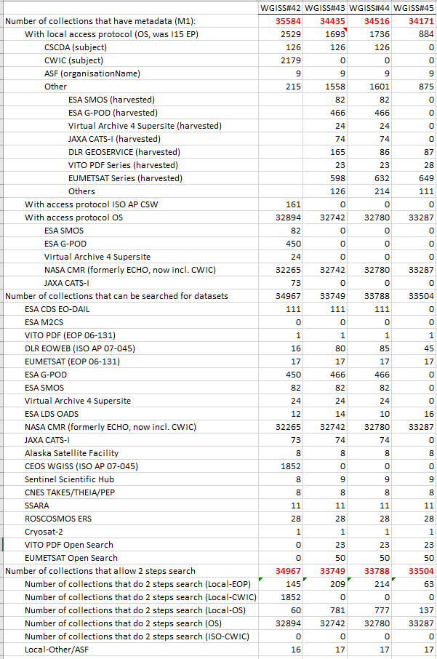
Metric at WGISS-45
Collections accessible through FedEO
Operational by end 4/2018
Notes:
  G-POD (466), VA4 (24), ESA SMOS (82), EO-DAIL (111) collections have been removed (not operational, no access to granules)
  JAXA CATS-I not available till 5/04/’18 (74 collections)

Slide 17
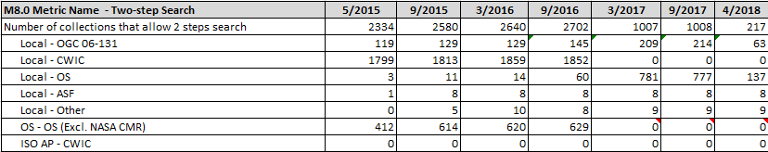
Metrics
Two Step search:
  Local FedEO Collection Catalog is now OpenSearch (SolR-based) replacing I15 EP.
  CWIC collections no longer harvested
  NASA CMR/CWIC not counted in metrics below

Slide 18
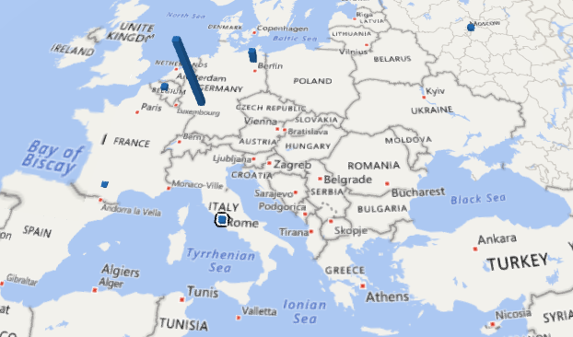
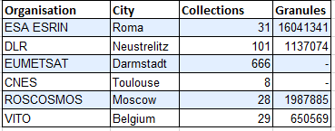
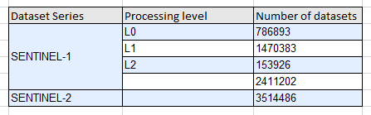
Metrics - Collections

Slide 19
Outline
Introduction
Recent Activities
  eoPortal OpenSearch Client Update
  Catalogue/Gateway Improvements
Metrics
Future Activities
  ESA catalogue
  FedEO system scalability
  Exploitation Infrastructure

Slide 20
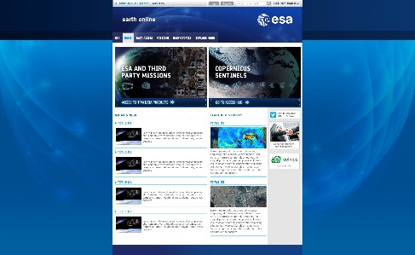

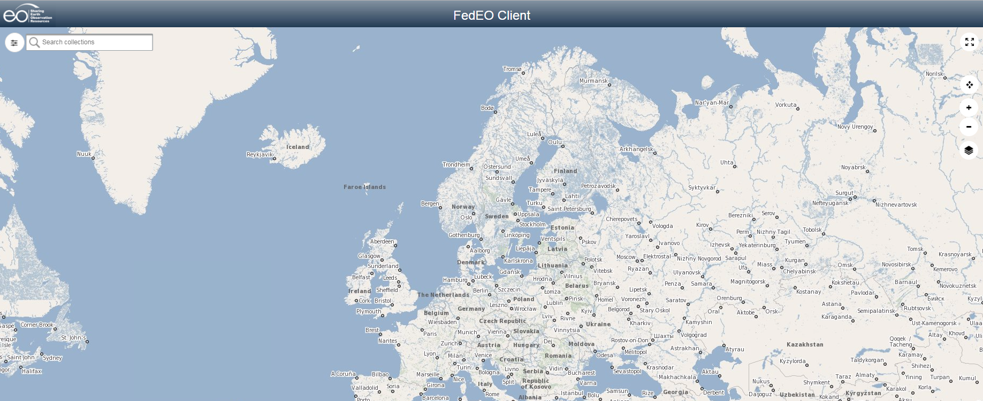
ESA Catalogue
ESA Earth OnLine Landing Page
Google Search
External Client
Visualisation Layer
ESA Gateway &
Collection Catalogue
Catalogue interfaces publicly available
OGC OpenSearch Specification
CEOS OpenSearch Best Practice
Metadata Layer
Copernicus Sentinel-1/2/3
ESA
Third Party & Earth Explorer & Heritage Missions - Product Catalogues
CEOS EO Data
Data Layer
Sentinel Data Repository
LANDSAT
SPOT
OCEANSAT
TROPFOREST
SEASAT
IKONOS
ERS SAR
ENVISAT ASAR
SMOS
CRYOSAT-2
Data Repository
Data Repository
Data Repository
NASA Repository

Slide 21
CEOS
Data Assets
FEDEO CLIENTS
EU CLIENTS
US CLIENTS
OpenSearch Interface
FedEO@ESA Gateway
CEOS IDN / CMR
FedEO
Internal
Collection
Catalogue
FedEO Internal
Product Catalogue
CMR Granule
(Dataset)
Catalogue
IDN Collection
Catalogue
(IDN/CWIC/
GEOSS)
ESA
Presentation Layer
EUMETSAT
SO-CAT
(client part)
Web Pages
Catalog view
EOLI
ngEO
(client)
SO-CAT
Visualizer
New clients
MEA Client
Metadata Layer
Visualisation Std I/F
(WCS, WMS)
ESA Cross Collection OpenSearch Interface
DLR
Open Search i/f
Open Search i/f
Open Search i/f
….
Open Search i/f
Visualisation Server
TPM-1
Metadata Repository
TPM-1
Metadata Repository
TPM-1
Metadata Repository
EE-1
Metadata Repository
Harvester
Harvester
Harvester
Harvester
Data Layer
Quick looks, cloud mask, snow, …
OADS
….
CNES
ESA Catalogue

Slide 22
FedEO Scalability - Context
FedEO components proposed to realize ESA catalogue
Prototyping Activity to be closed by Sept 2018
Thousands of potential users – concurrent users
Heterogeneous collections from Third Party Missions (e.g., IKONOS, SPOT) Heritage Missions (e.g., ENVISAT ASAR, MERIS, ERS-1/2 SAR) and Earth Explorer Missions (e.g., SWARM, SMOS) – Enhanced internal metadata model
40M entries (excluding Sentinel 1/2/3) to be managed – Performant product catalogue
There is a need for an horizontal architecture, both for addressing the search engine scalability and the web applications load balancing, preserving current functionalities

Slide 23
FedEO Scalability - Technology
Scale by adding new nodes (HW & SW). No change to existing FedEO software components, but deploy differently
Technology
Standalone Solr replaced with SolrCloud (= same Solr package with alternative configuration/deployment)
Zookeeper for configuration information and distribution management
Docker container platform for an easy and fast deployment
Kubernetes for automating deployment, horizontal scaling, native management of containers

Slide 24
FedEO Scalability - Preliminary Results
Hardware
Google cloud hardware profiles
  Std-2
  Std-4
Configuration from 1 (1N) to 9 nodes (9N)
n nodes means: n virtual machines with 1 search engine (Solr) and 1 catalog Web application

Slide 25
FedEO Scalability - Preliminary Results
Product metadata ingestion (higher is better)
#records present have little impact on ingestion speed
std-4 hardware has big impact on ingestion speed (for same
#nodes)

Slide 26
FedEO Scalability - Preliminary Results
Response Time (lower is better)

Slide 27
Federated Exploitation Infrastructure
Data & Services Discovery
Collection Catalogue / Product Catalogue / Service Catalogue (e.g., visualisation, data access, processing, etc..)
Data Visualisation
(e.g., WMS, WMTS, APIs, etc…)
Enhanced EO Products Access & Exploitation
(Data Cube via WCS, WCPS, APIs, etc..)
Data Processing
Processing Environment (e.g., WPS, WMTS, APIs, Jupiter, VMs…)
MAPS
MAPS
MAPS
Coverage
Coverage
Coverage
Data Products Access
(FTP, HTTP, Ordering, Subscription, fast download protocol, VMs)
EO
XX
YY
Long Term data preservation
RO-1
RO-2
RO-3

Slide 28
FedEO Current Operational Set-up
FedEO Client Portal
https://eoportal.org/web/eoportal/fedeo
http://eoportal.spacebel.be:8090/web/eoportal/fedeo
FedEO Readme Web Page
http://fedeo.esa.int/opensearch/readme.html
geo.spacebel.be/opensearch/readme.html
FedEO OpenSearch Description Document (OSDD)
http://fedeo.esa.int/opensearch/description.xml
geo.spacebel.be/opensearch/description.xml
FedEO documentation and information
https://wiki.services.eoportal.org/tiki-index.php?page=FedEO
http://ceos.org/ourwork/workinggroups/wgiss/access/fedeo/
ESA RSS/SSE Team in charge of FedEO Routine Operations: SLA based on working hours (not 24/7)

