Slide 1
WGISS Connected Data Assets April 9, 2018 Yonsook Enloe

Slide 2
Session Agenda
WGISS Connected Assets Status
IDN and ECV Status
FedEO Update
CWIC Update
China (NRSCC) and ChinaGEOSS Status
Carbon Portal and Strategy Demonstration
OGC Documentation Specs
OGC 17-003
OGC 13-026r9
CEOS OpenSearch Project Report
Conformance Test Document and OGC Docs
Data Asset Enhancement – Synergies with FDA

Slide 3
From the WGISS Workplan
Discovery and Access
The WGISS Connected Data Assets include the International Directory Network (IDN), FedEO (Federated Earth Observation Gateway), and CWIC (CEOS WGISS Integrated Catalog). WGISS- supported standards are now used to search and access data from thousands of collections and hundreds of millions of inventory records, with additional data collections and inventory records from CEOS Agencies being added daily to this integrated system.
The WGISS Connected Data Assets also provide access to CEOS Agency datasets through their integration with the GEOSS (Global Observation System of Systems) Common Infrastructure (GCI). More and more, CEOS Agencies continue to adopt the WGISS-supported standards and make their data discoverable via the WGISS Connected Data Assets.
The WGISS Connected Data Assets System Level Team provides coordination and oversight of the operations and evolution of this integrated system and also provides technical support for CEOS partners that offer access to data and to client partners that connect to the data sources

Slide 4
Connected Data Assets

Slide 5
WGISS Assets Metrics
Discoverable collections (via IDN) – over 32,000+
Over 15,000+ GEOSS Data Core
Searchable Granules – over 296+ million (more added daily from live missions)
Contributing Agencies: ESA, NASA, NOAA, USGS, ISRO, INPE, EUMETSAT, CNES, …
Additional Agencies working on connecting data assets: ChinaGEOSS, China (NRSCC), NOAA One-Stop
Additional data partners welcome!

Slide 6
Outreach to Tool Developers
Need outreach to potential tool developers
Easily understandable outreach material needed
One page flyer targeting tool developers
Soft copy of the flyer will be kept on the WGISS website
Local printing
Advertise the url http://wgiss.ceos.org/access
Work with CEOS SEO and CEOS CEO to distribute one page flyer
WGISS Reps can distribute this flyer at conferences and meetings

Slide 7
Wgiss.ceos.org/Access
Discovery and Access webpage on the WGISS website provides background information and links to
IDN
CWIC
FedEO
CEOS OpenSearch
Provides a help email address for more info and technical help
Access-SysTeam-Help@wgiss.ceos.org

Slide 8
Do you develop software tools
for the distribution and analysis of environmental data?
CEOS WGISS can help you include data collected from the vantage point of space!
30,000+ data collections that are discoverable with over 5500+ data collections that are searchable and data downloadable.
Visit http://wgiss.ceos.org/access to learn how to start accessing and using our data!
CEOS is an international organization enabling partnership and collaboration across governmental agencies that develop and operate earth-observing satellites.
The 60+ CEOS member agencies currently operate 153 satellites that produce data useful for a broad set of applications.
The Working Group for Information Systems and Standards (WGISS) brings together experts in satellite data management and services to develop common internet-based standards that facilitate discovery, search, and access to data served by the CEOS agencies.
ATMOSPHERE LAND SURFACE AGRICULTURE OCEANS BIOSPHERE CLIMATE INDICATORS CRYOSPHERE HYDROSPHERE SOLID EARTH TERRESTRIAL HYDROSPHERE

Slide 9
Do you develop software tools
for the distribution and analysis of environmental data?
CEOS WGISS can help you include data collected from the vantage point of space!
30,000+ data collections that are discoverable with over 5500+ data collections that are searchable and data downloadable.
Visit http://wgiss.ceos.org/access to learn how to start accessing and using our data!
CEOS is an international organization enabling partnership and collaboration across governmental agencies that develop and operate earth-observing satellites.
The 60+ CEOS member agencies currently operate 153 satellites that produce data useful for a broad set of applications.
The Working Group for Information Systems and Standards (WGISS) brings together experts in satellite data management and services to develop common internet-based standards that facilitate discovery, search, and access to data served by the CEOS agencies.
ATMOSPHERE LAND SURFACE AGRICULTURE OCEANS BIOSPHERE CLIMATE INDICATORS CRYOSPHERE HYDROSPHERE SOLID EARTH TERRESTRIAL HYDROSPHERE

Slide 10
WGISS Work Plan Deliverables
How-To Guides to tag datasets in the IDN for granule search via CEOS OpenSearch
Review and update FedEO How-To Guides for Data Partner and Client Partner
Review and update CWIC How-To Guides for Data Partner and Client Partner
Produce How-To Guides to become WGISS Client Partner that describes how to connect and search for data in the IDN, FedEO, and CWIC

Slide 11
Integration with GEOSS
The WGISS Connected Data Assets integration with GEOSS continues
IDN registered in the GEOSS Yellow Pages
Email and Telecon discussion about adding “IDN” to the GEO Web Portal → “GCMD/IDN”
FedEO and CWIC accessible from Geo Web Portal and integrated via GEO DAB
Continued participation in the GEO Data Providers workshop
WGISS Connected Data Assets webpage on the WGISS webpage display metrics → this info given to the GEO Sec team

Slide 12
Global Change Master Directory
2011
2016
GCMD CSW
Updated Brokering using CMR
Protocols: CSW + OpenSearch
Protocols: CSW
GWP Label: NASA Global Change Master Directory

Slide 13
CWIC
2013
2014
2017
Updated Brokering using CMR OS
Added using IDN CSW for collection Harvest and CWIC OS Distributed second level search
Updated second level OS URL
Protocols: CSW + OpenSearch
Protocols: CSW + OpenSearch
Protocols: OpenSearch
GWP Label: CEOS WGISS Integrated Catalog (CWIC)

Slide 14
FedEO
2013
2015
Added FedEO OS
Updated OS URLs
Protocols: OpenSearch
Protocols: OpenSearch
GWP Label: Federated EO Gateway (FedEO) - CEOS

Slide 15
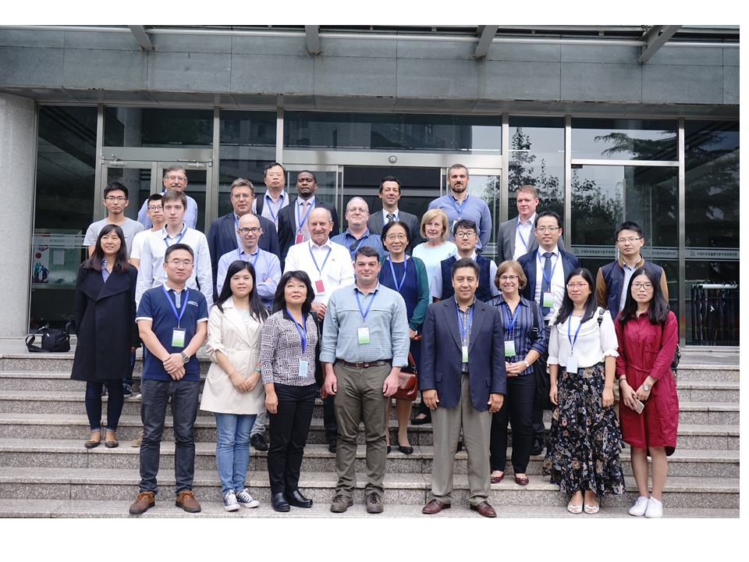
System Level Team
Created an integrated system team to coordinate and oversee the WGISS integrated system and standards:
Coordinate operations, maintenance and evolution activities (e.g. for infrastructure, standards adoption, etc).
On-board new data partners
Provide technical support for client partners
Monitor the health of the federated system and report outages and errors etc. to the partners
Test all the components of the federated system, including end to end search and data access
Work with data and client partners to identify and resolve system and component bugs
Provide support for metrics collection
Image Source: http://professionbiz.com/archives/7347

Slide 16
Towards a WGISS Federation
Data collection registration at the IDN using the IDN keywords; Info about how granule search is supported will be included in the data collection registration; Tag for granule access;
Data partners need to support 1 of the 2 supported WGISS standards
CEOS OpenSearch Best Practices (v 2)
OGC CSW 2.0.2
All searchable data must have a data access path
Data download
Data order (free or with cost)
Email order (free or with cost)
Servers must have high availability (99%?)
A technical POC needed for each data partner

Slide 17
Client Partners
Clients can offer search and access to all the satellite data available through the WGISS Federation
Clients can offer search and access to a limited subset of data available through the WGISS Federation along with other services through tagging (e.g. CWIC, FedEO, LSI, Carbon,…)
Clients can offer support for a 2-step search
Discovery through collection search using platform, instrument, science keywords, etc. (IDN). The IDN data record will contain info about how granule search is supported
Search granule metadata at data partners via CWIC, FedEO, Independent servers
All granule search results will contain links to data access

Slide 18
Recent and Future Happenings
Came to agreement on the resolution of the interoperability issues and documented those in the CEOS OpenSearch Best Practices document
Team review of OGC 17-003 (OpenSearch-EO GeoJSON Response Encoding Standard) completed
Team review of OGC 13-026r9 (OpenSearch Extension for EO) completed
FedEO data collections being registered in the IDN
FedEO datasets registered in the IDN will be tagged
OS access to FedEO datasets in IDN will be directed to FedEO
ECV collections will be registered in the IDN (Mirko contacting data providers)
Continuing integration with GEOSS
CWIC Smart Client Validator for CEOS OS conformance testing
Conformance Test document led by ESA
Will be producing WGISS Client Partner Guide

