Slide 1
WGISS Client/Carbon Portal Demonstration

Slide 2
The WGISS Carbon Community Portal
The Objectives
To enable carbon community to find their interested data in the CEOS agency collections brokered by both CWIC and FedEO
To allow searching and accessing data within collections using CWIC and FedEO with keywords, spatial and/or temporal constraints
To provide common discovery and access of all CWIC partner holdings targeting at the Carbon Community

Slide 3
Step 1 Search
Collection Search

Slide 4
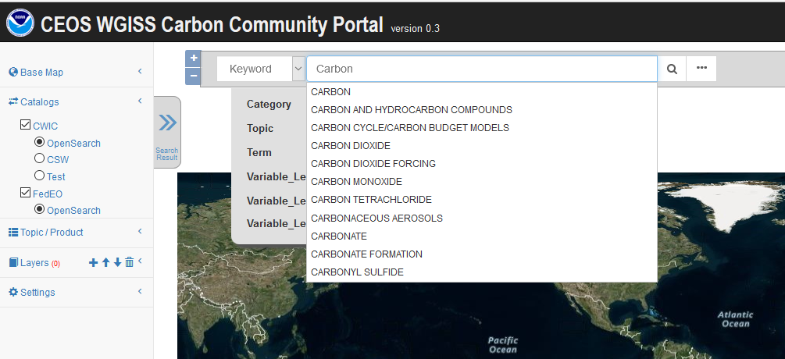
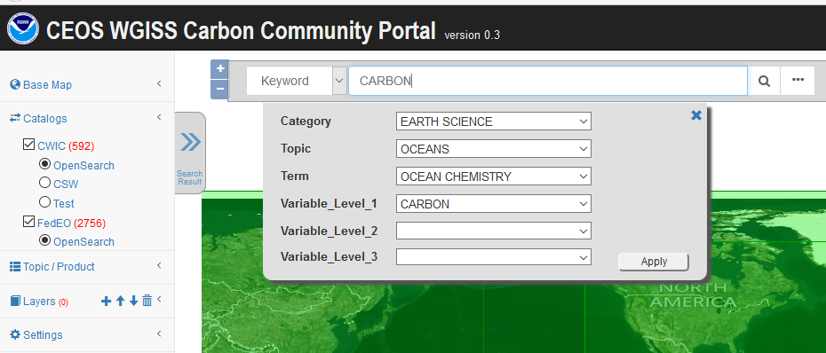
Collection Level Search (1)
Enter keywords
Keyword autocompletion
GCMD taxonomy hierarchical context

Slide 5
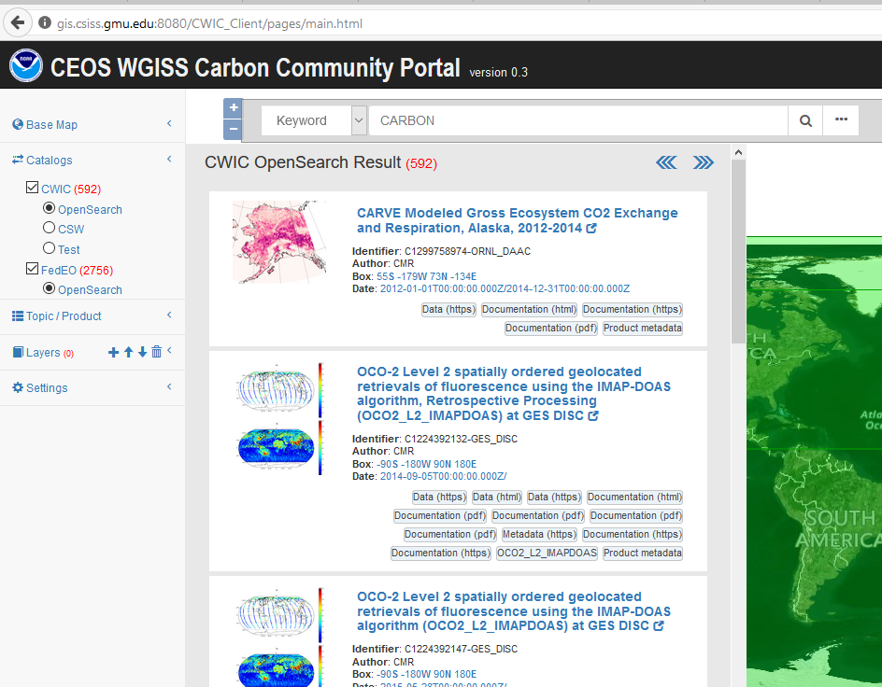
Collection Level Search (2)
Collection results matching the keywords

Slide 6
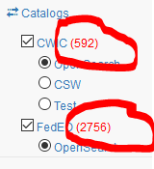
Collection Level Search (2)
Collection results matching the keywords
Total record number from both CWIC and FedEO (e.g. 592 matches from CWIC and 2756 collections from FedEO that matches “CARBON”)

Slide 7
Collection Level Search (2)
Collection results matching the keywords
Total record
First page of 10 matches shown with details (e.g. identifier, author, bounding box, date, links to data/metadata)

Slide 8
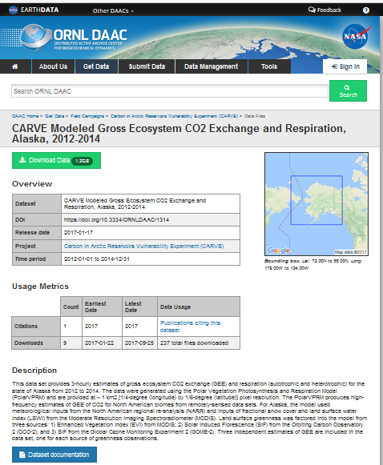
Collection Level Search (2)
Collection results matching the keywords
Total record
First page of 10
All links are active that brings up linked page /metadata/data

Slide 9
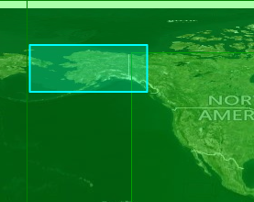
Collection Level Search (2)
Collection results matching the keywords
Total record
First page of 10
All links
Spatial coverage is highlighted on map when clicking on bounding box (e.g. the first collection is for Alaska)

Slide 10
Collection Level Search (2)
Collection results matching the keywords
Total record
First page of 10
All links
Spatial coverage
Temporal coverage is shown on timeline when clicking on date range

Slide 11
Collection Level Search (2)
Collection results matching the keywords
Total record
First page of 10
All links
Spatial coverage
Temporal coverage
Click on the title of collection to start the granule level search ( if applicable)
Click it to start
granule level search

Slide 12
Step 2 Search
Granule Search

Slide 13
Granule Level Search (1)
Search granule within collection
Click on the title of the collection to start the granule level search (e.g. “OCO-2 Level 2 spatially ordered geolocated retrievals of fluorescence....”)
Click it to start
granule level search

Slide 14
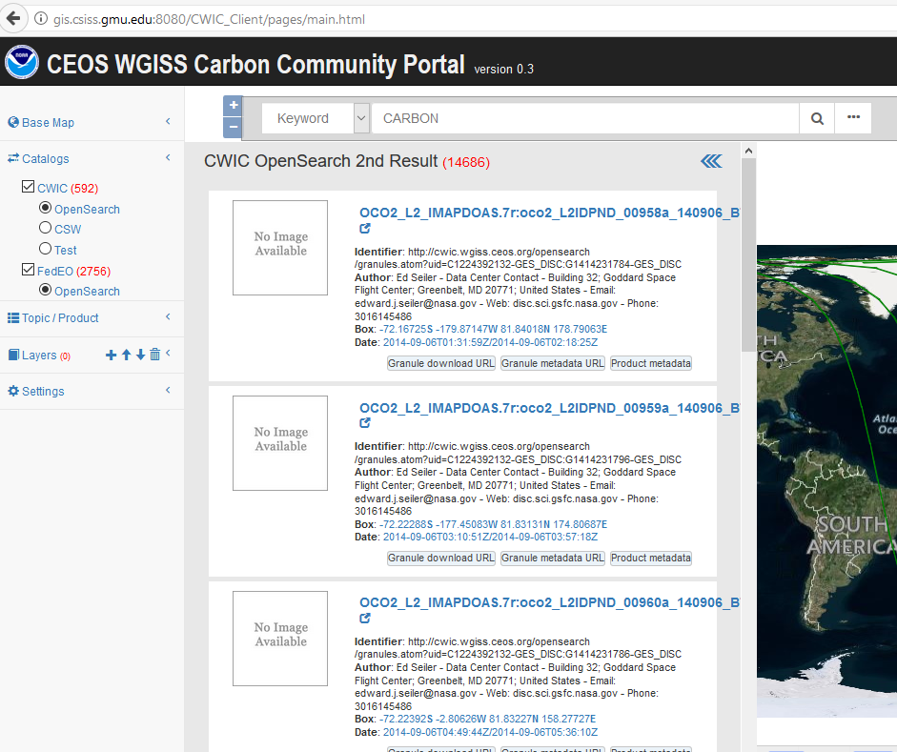
Granule Level Search (2)
Granules of the collection meeting spatial/temporal constraints
All granules
Filtered by spatial constraint
Filtered by temporal constraint

Slide 15
Granule Level Search (3)
Granules
Total number of granules
More than
14K granules found

Slide 16
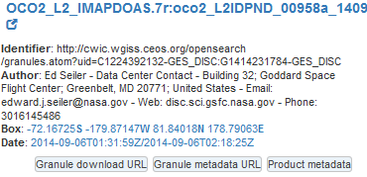
Granule Level Search (3)
Granules
Total number
First page of 10 granules shown with details (e.g. identifier, author, bounding box, date, and links to data/metadata/ document)

Slide 17
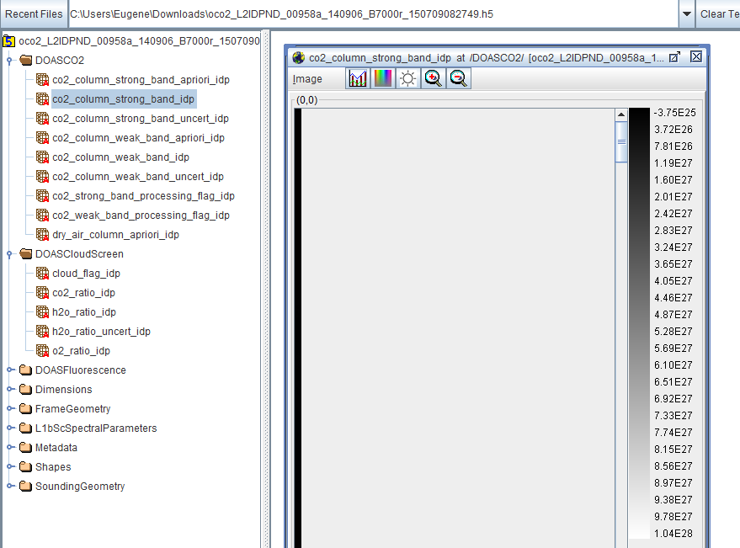
Granule Level Search (3)
Granules
Total number
First page
All links are active that allows to access description page /metadata/data (e.g. the data can be downloaded, displayed, and shown using HDFViewer)

Slide 18
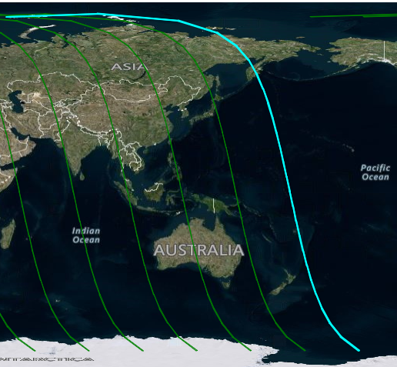
Granule Level Search (3)
Granules
Total number
First page
All links
Spatial coverage can be highlighted on map view when clicking on the bounding box (e.g. the first record is a swath covering one strip from north to south)

Slide 19
Granule Level Search (3)
Granules
Total number
First page
All links
Spatial coverage
Temporal coverage can be highlighted on the timeline when clicking on date (e.g. the first record is covering a period on Sept. 6, 2014)

Slide 20
Spatial and/or Temporal Constraint
Search and access data within space and time constraints

Slide 21
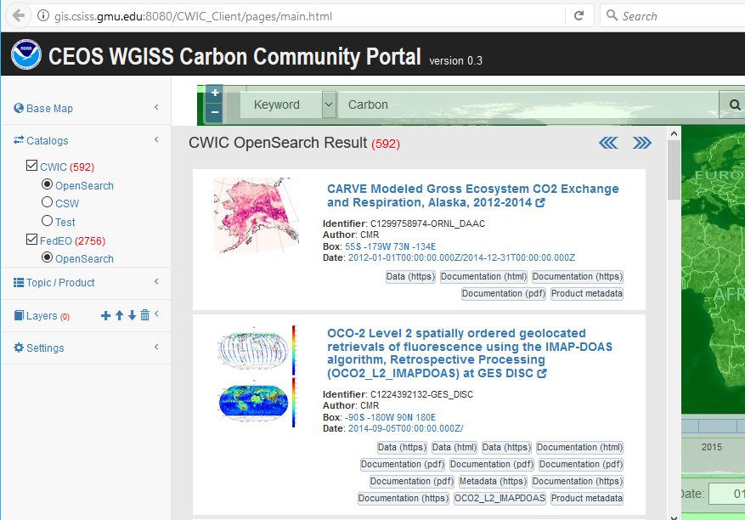
Spatial Constraint (1)
Collections
Use keyword = “carbon”
Before
CWIC: 592
FedEO: 2756

Slide 22
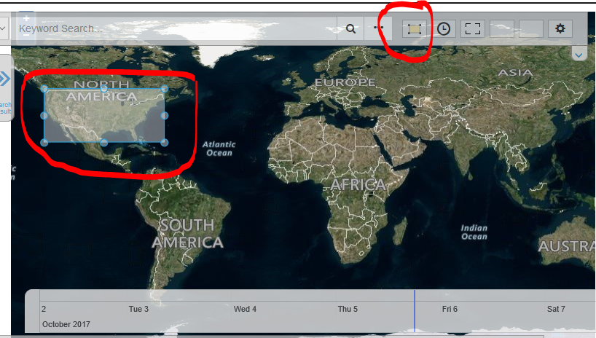
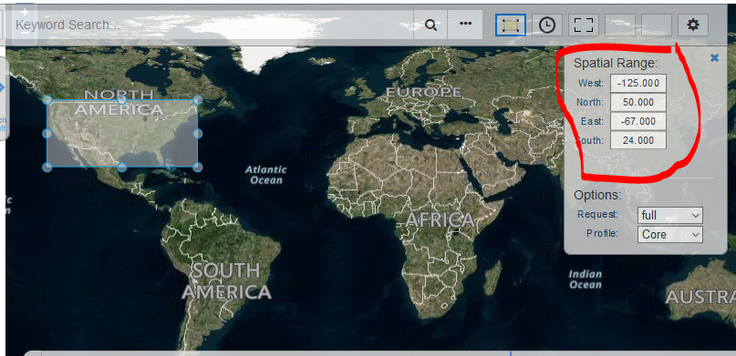
Spatial Constraint (2)
Collections
Use keyword = “carbon”
Before
CWIC: 592
FedEO: 2756
Turn on spatial Constraints
Button to on/off
Change the bounding box by dragging or editing the value in constraint form
Click to turn on or off
Spatial constraint
Click to turn on or off
The constraint form

Slide 23
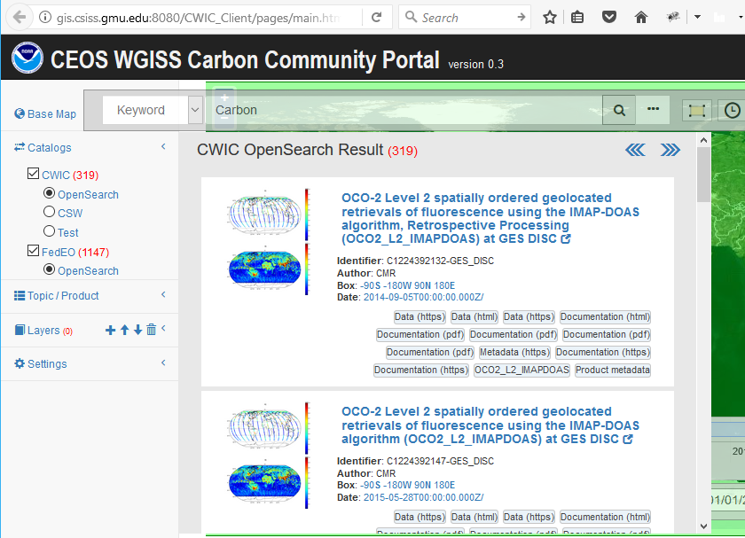
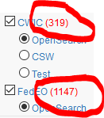
Spatial Constraint (3)
Collections
Use keyword = “carbon”
Before
CWIC: 562
FedEO: 2756
Turn on spatial Constraints
[-125, 24,-67,50]
After
CWIC: 319
FedEO: 1147

Slide 24
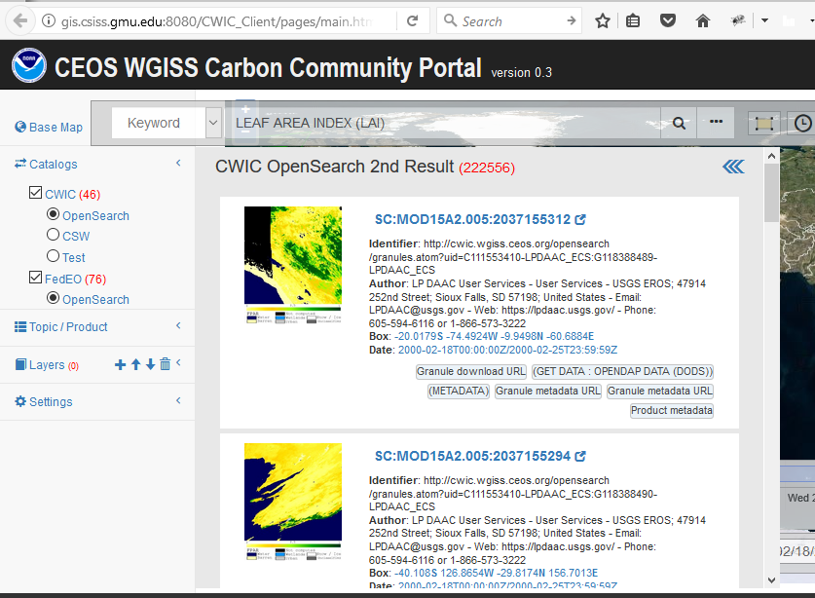
Spatial Constraint (4)
Granules
Search
Use keyword = “LEAF AREA INDEX (LAI)” for collection level search
Choose dataset “MODIS/Terra Leaf Area Index/FPAR 8-Day L4 Global 1km SIN Grid V005”
Before
Matching granules: 222556

Slide 25
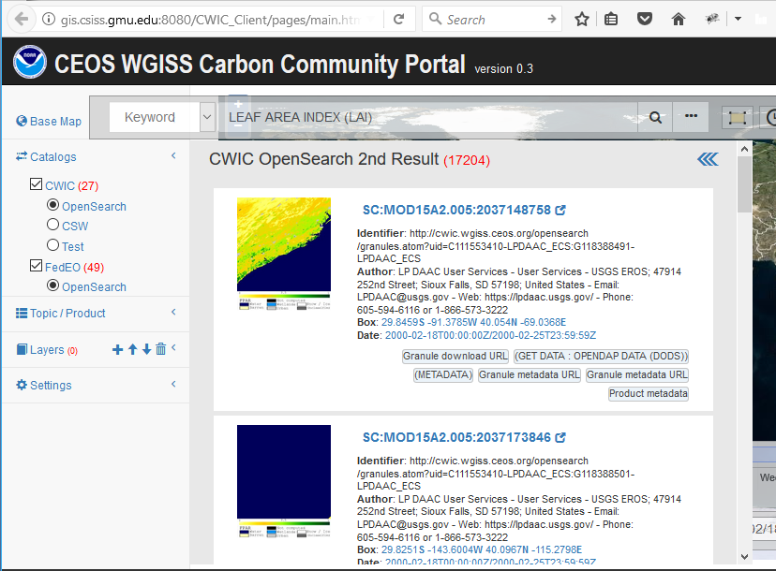
Spatial Constraint (5)
Granules
Search
Before
Matching granules: 222556
Turn on spatial Constraints
[-125, 24,-67,50]
After
Matching granules: 17204

Slide 26
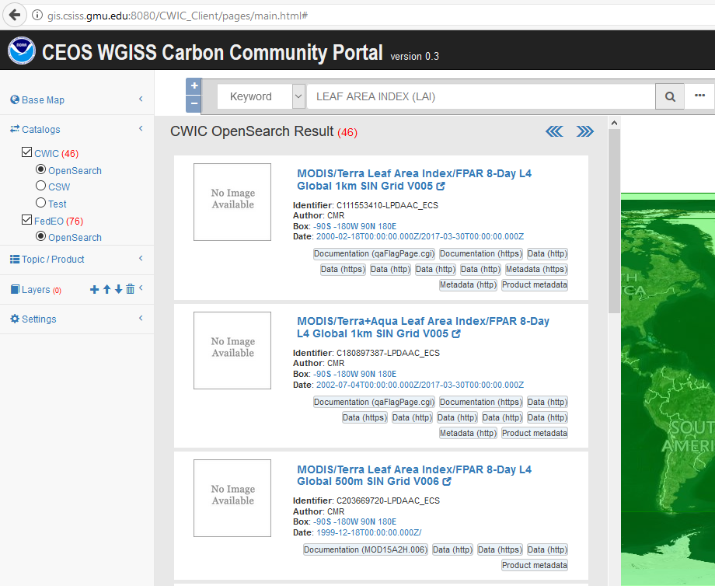
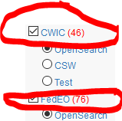
Temporal Constraint (1)
Collections
Use keyword = “LEAF AREA INDEX (LAI)”
Before
CWIC: 46
FedEO: 76

Slide 27
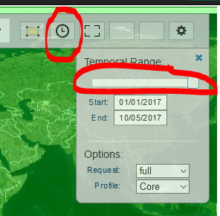
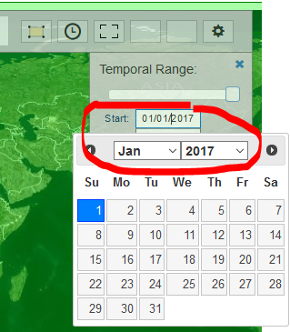
Temporal Constraint (2)
Collections
Use keyword = “LEAF AREA INDEX (LAI)”
Before
CWIC: 46
FedEO: 76
Turn on temporal Constraints
Button to on/off
Change the time range by using time bar or time picker
Toggle button to turn on/off
Temporal constraints
Dragging start or end
Time mark on the bar
Edit the time range
Using time picker

Slide 28
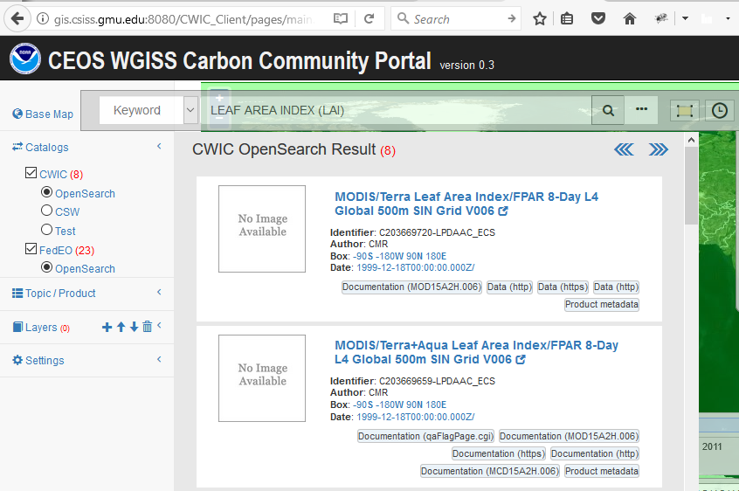
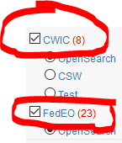
Temporal Constraint (3)
Collections
Use keyword = “LEAF AREA INDEX (LAI)”
Before
CWIC: 49
FedEO: 76
Turn on temporal Constraints
1/1/2017-10/5/2017
After
CWIC: 8
FedEO: 23

Slide 29
Temporal Constraint (4)
Granules
Search
Use keyword = “LEAF AREA INDEX (LAI)” for collection level search
Choose dataset “MODIS/Terra Leaf Area Index/FPAR 8-Day L4 Global 1km SIN Grid V005”
Before
Matching granules: 222556

Slide 30
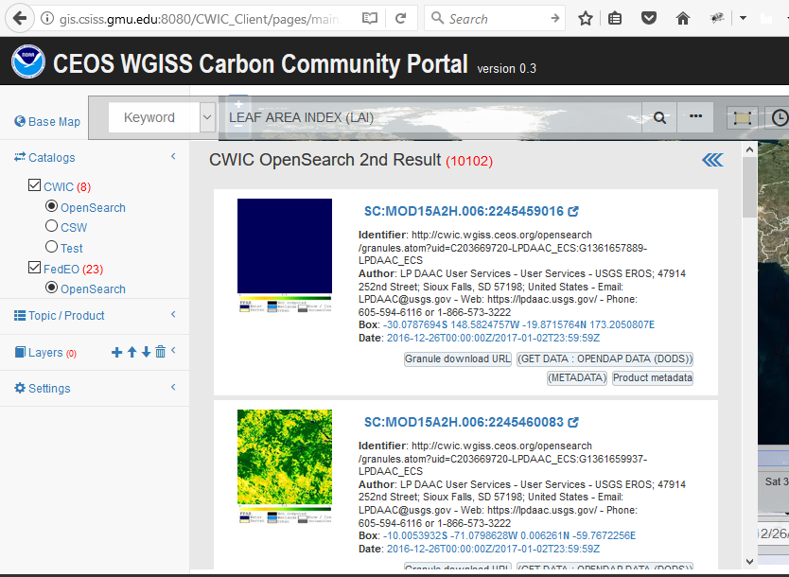
Temporal Constraint (5)
Granules
Search
Before
Matching granules: 222556
Turn on spatial Constraints
1/1/2017-10/5/2017
After
Matching granules: 10102

Slide 31
Carbon Special Interest Regions
Search and access data with predefined carbon regions
Notes:
TransCom:
http://transcom.project.asu.edu/transcom03_protocol_basisMap.php
http://transcom.project.asu.edu/images/smoothmap2_final_2.jpg
ECV
http://cci.esa.int/sites/default/files/06_CCI-Colocation2015_ECVInventory-1.1.pdf
http://ceos.org/document_management/Working_Groups/WGClimate/Meetings/WGClimate-6/WGClimate_ECV-Inventory-Questionnaire-Guide_v2-2_Feb2016.pdf
RECCAP
http://www.globalcarbonproject.org/reccap/

Slide 32
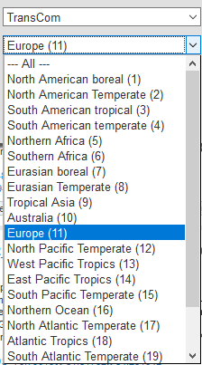
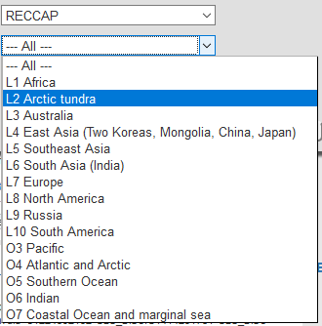
Carbon Study Regions
Special regions
Global
RECCAP (REgional Carbon Cycle Assessment and Processes) regions
TransCom (The Atmospheric Tracer Transport Model Intercomparison Project) regions

Slide 33
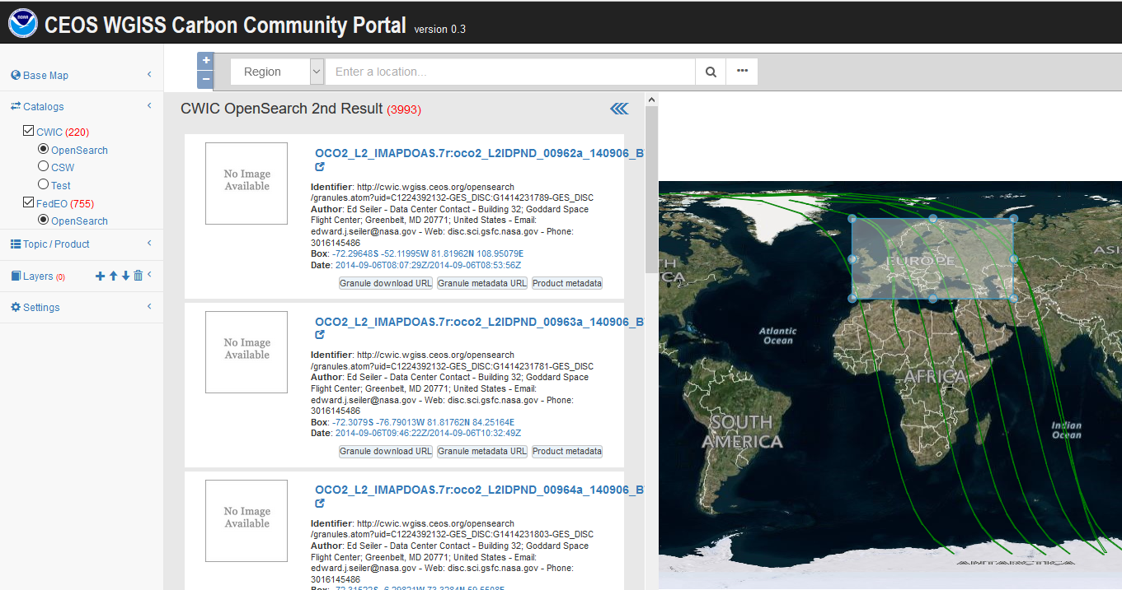
TransCom – Europe region -
Special region search
TransCom – Europe region

Slide 34
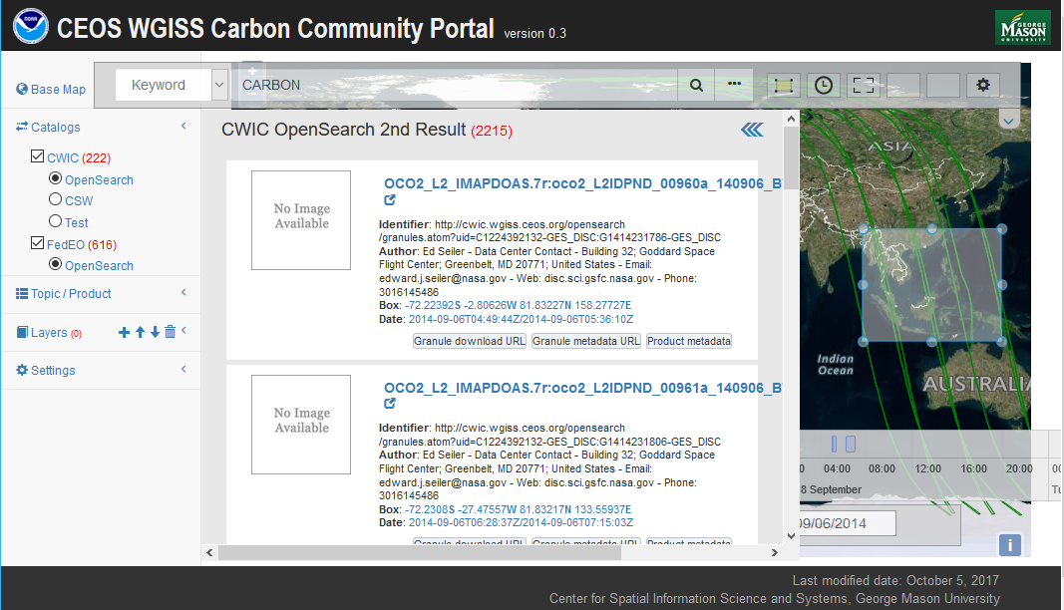
RECCAP – L5 Southeast Asia region -
Special region search
RECCAP – L5 Southeast Asia region

Slide 35
Carbon Special Interest Topic
Search and access data with predefined carbon topics

Slide 36
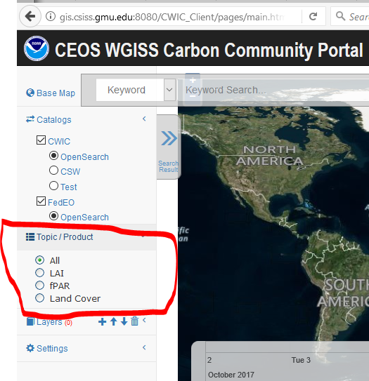
Carbon Topics
Special topics or interest area for carbon community
Predefined, topic-filtered search
Selectable in the left panel
Check and then do the search

Slide 37
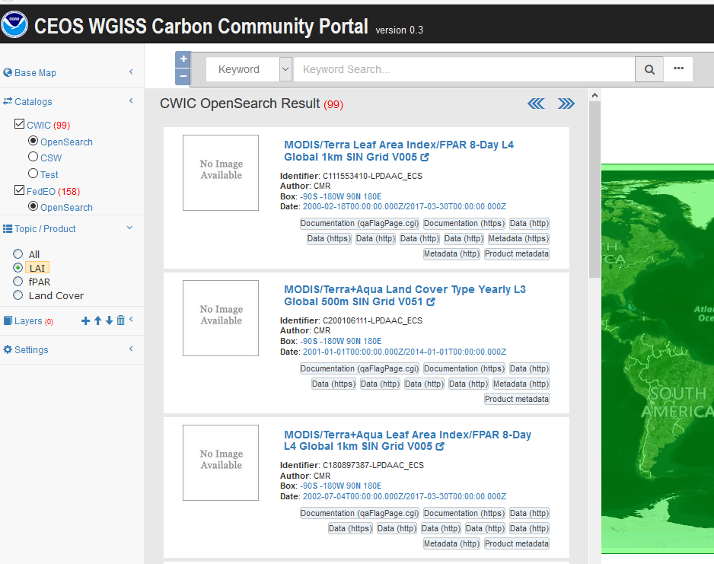
Carbon Topic - LAI
Special topics or interest area for carbon community
Predefined, topic-filtered search
Special topic: LAI (Leaf Area Index)

Slide 38
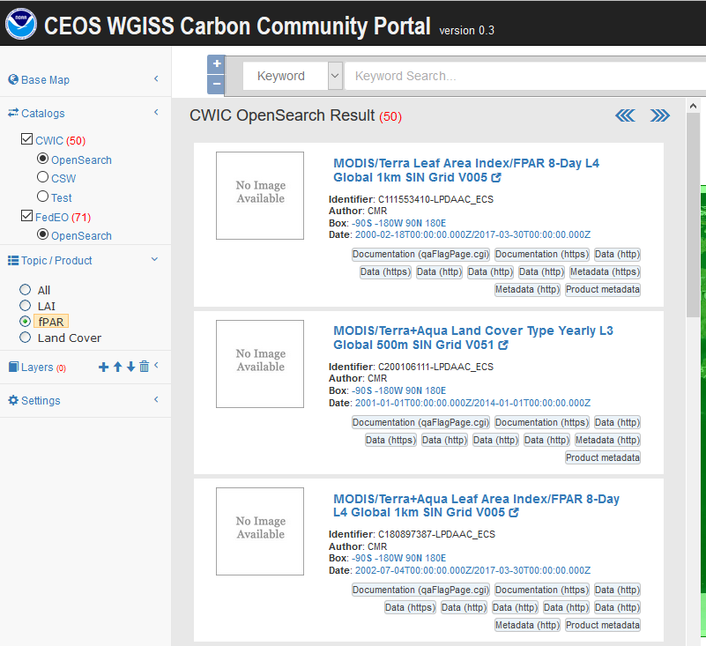
Carbon Topic - fPAR
Special topics or interest area for carbon community
Predefined, topic-filtered search
Special topic: fPAR (Fraction of Photosynthetically Active Radiation)

Slide 39
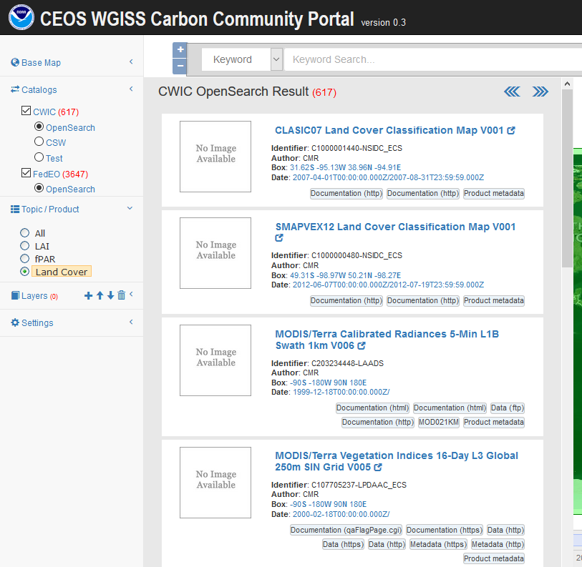
Carbon Topic – Land Cover
Special topics or interest area for carbon community
Predefined, topic-filtered search
Special topic: Land Cover

Slide 40
Visualization and Analytics
Data collection found from CWIC

Slide 41
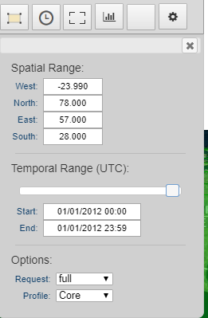
Discover, access, and display coverage (CWIC)
Spatial constraint: e.g. Region->Topic (RECCAP)->Region (L7 Europe)
Temporal constraint: 1/1/2012 00:00 (begin) - 1/1/2012 23:59 (end).
Topic constraint: Select Topic-> All
Keywords: MOD11A1 DAILY
Specific interest data collection: e.g. MODIS/Terra Land Surface Temperature/Emissivity Daily L3 Global 1km SIN Grid V006

Slide 42
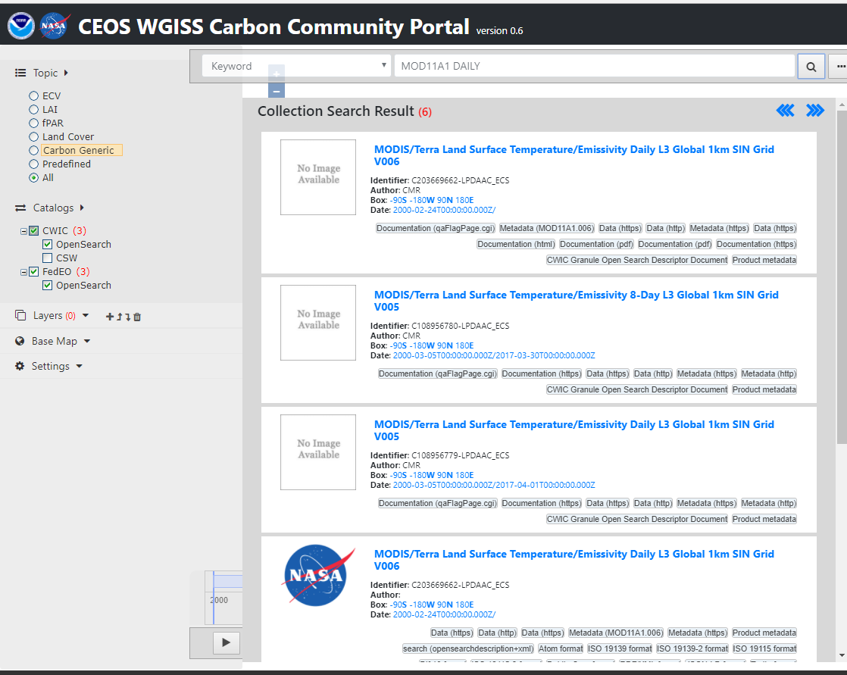
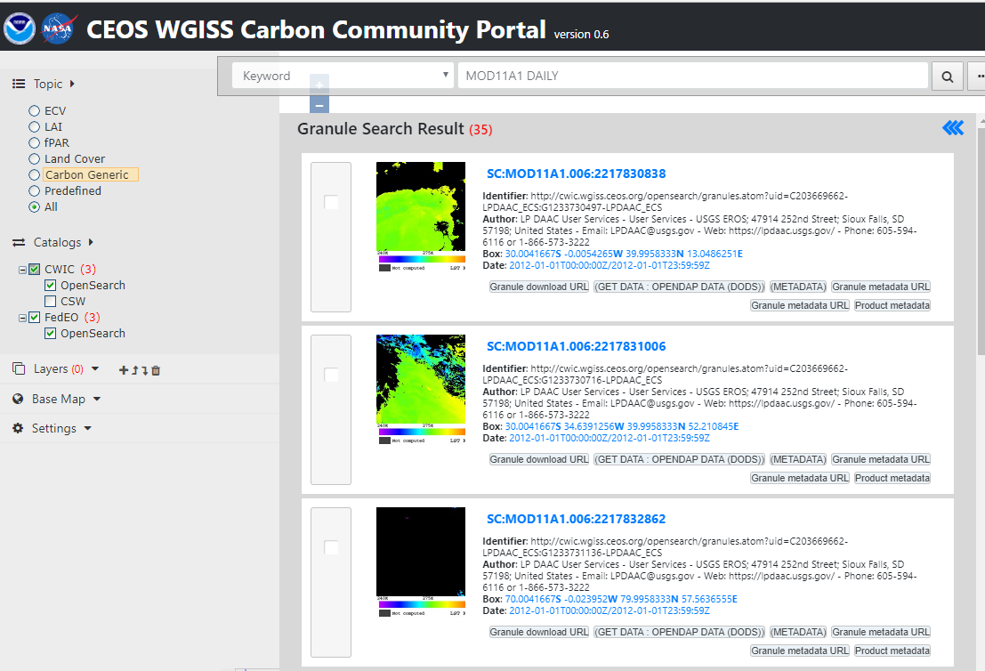
Discover, access, and display coverage (CWIC)
Specific interest data collection: e.g. MODIS/Terra Land Surface Temperature/Emissivity Daily L3 Global 1km SIN Grid V006
The first one in the list
Choose the collection
Select all granules by paging through all the matching 35 records

Slide 43
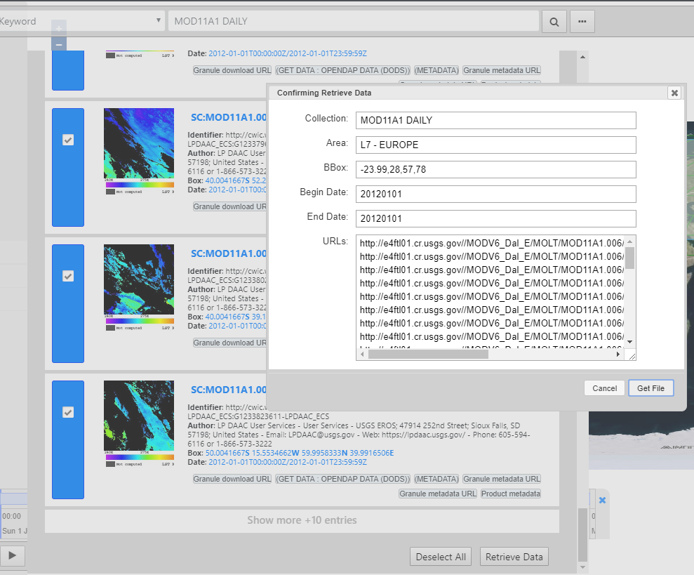
Discover, access, and display coverage (CWIC)
Retrieve all selected granules
All granules will be processed and mosaicked at the server
The mosaic data can be downloaded

Slide 44
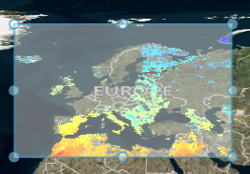
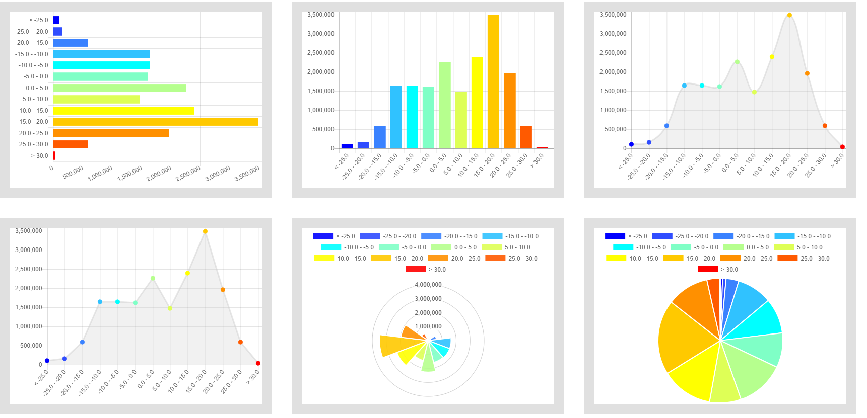
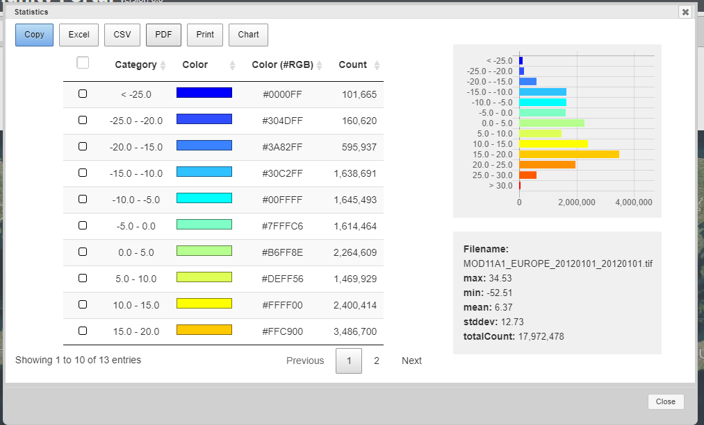
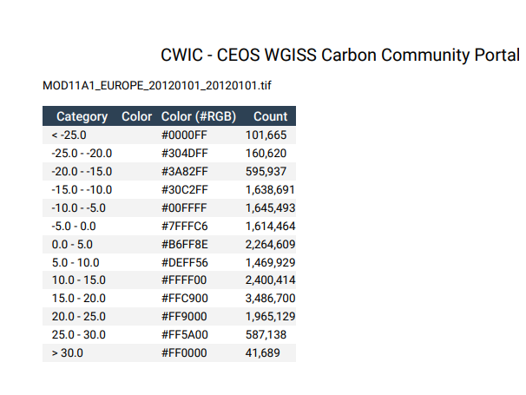
Discover, access, and display coverage (CWIC)
The mosaic data can be added as a layer for visualization
Statistics can be calculated
Export to CSV, PDF, Excel
Print/copy

Slide 45
Visualization and Analytics
Data collection found from FedEO

Slide 46
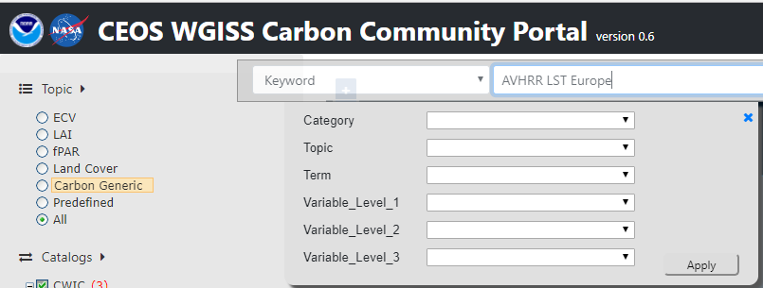
Discover, access, and display coverage (FedEO)
Spatial constraint: e.g. Region->Topic (RECCAP)->Region (L7 Europe)
Temporal constraint: 1/1/2012 00:00 (begin) - 1/1/2012 23:59 (end).
Topic constraint: Select Topic-> All
Keywords: AVHRR LST Europe
Specific interest data collection: e.g. AVHRR - Land Surface Temperature (LST) - Europe, Daytime

Slide 47
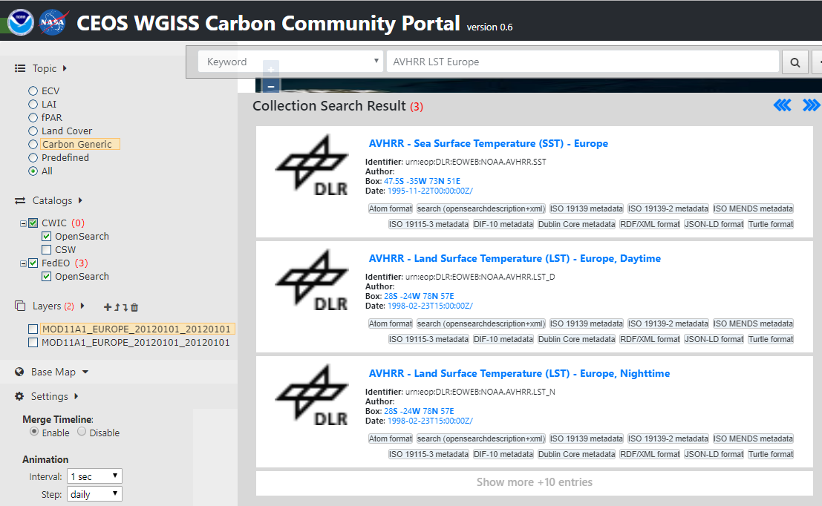
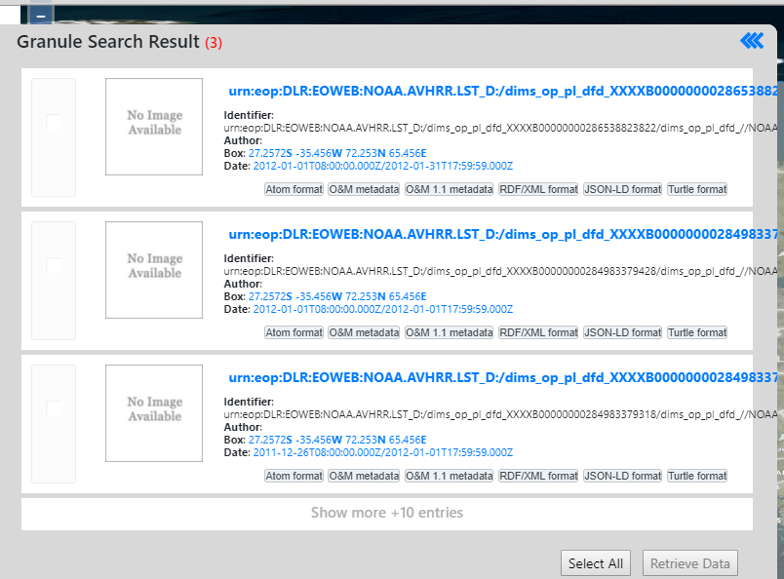
Discover, access, and display coverage (FedEO)
Specific interest data collection: e.g. AVHRR - Land Surface Temperature (LST) - Europe, Daytime
The second one in the list
Choose the collection
Select all granules

Slide 48
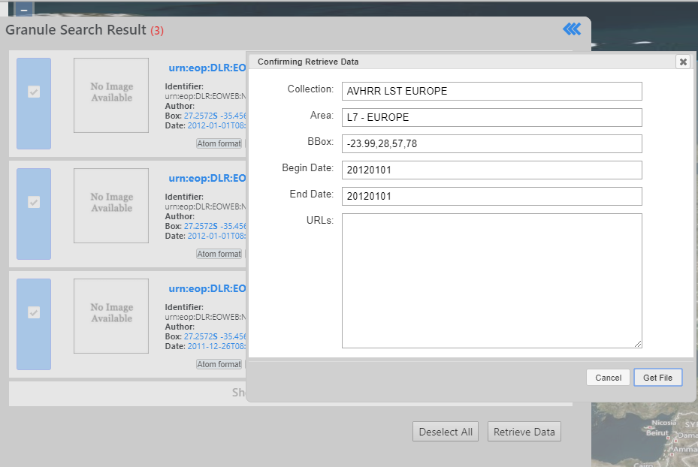
Discover, access, and display coverage (FedEO)
Retrieve all selected granules
All granules will be processed and mosaicked at the server
The mosaic data can be downloaded

Slide 49
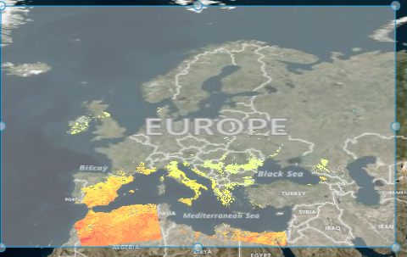
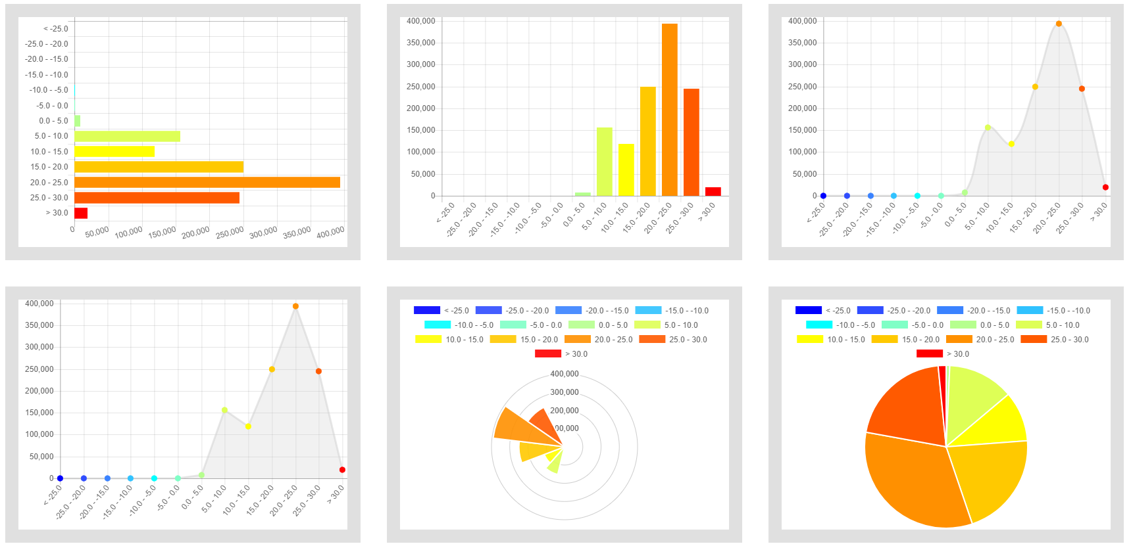
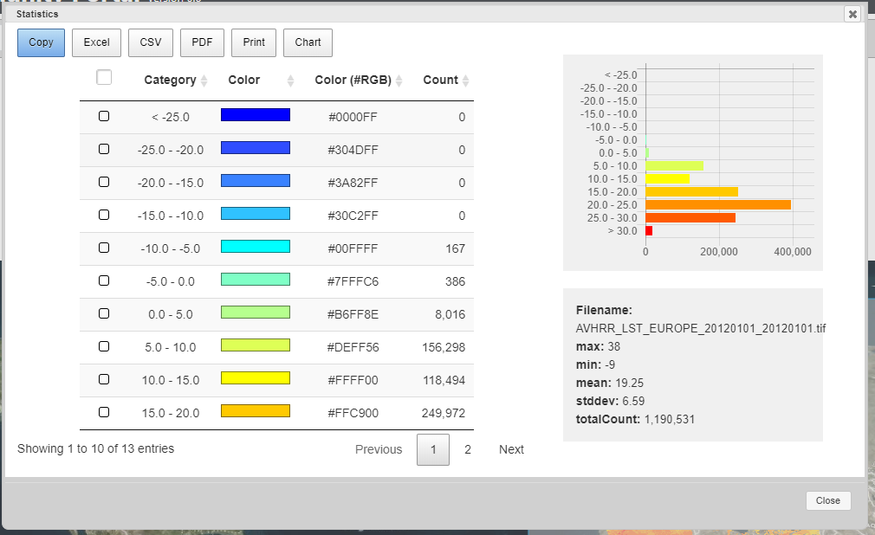
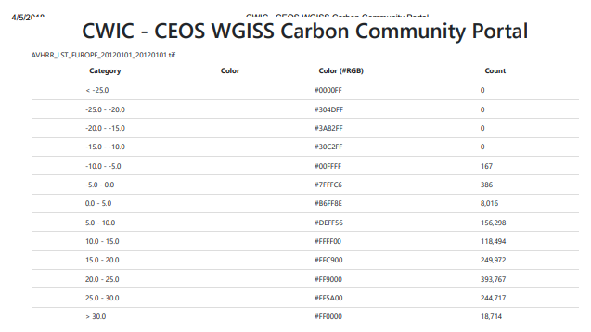
Discover, access, and display coverage (FedEO)
The mosaic data can be added as a layer for visualization
Statistics can be calculated
Export to CSV, PDF, Excel
Print/copy

Slide 50
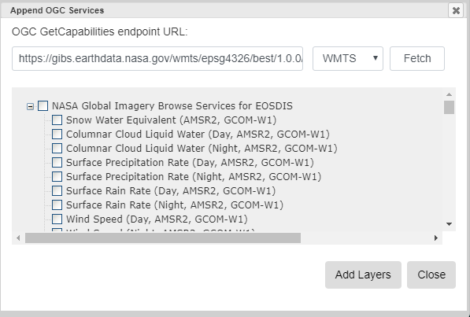
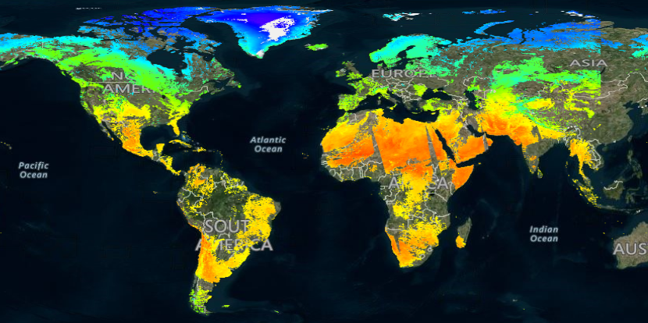
Display default layer from NASA GIBS
Access and display default layer – current day or the latest
Fetch from the GetCapabilities
Total renderable layers are 687
E.g. Land Surface Temperature (Day, MODIS, Aqua)

