Slide 1
OGC Documents Status:
OGC 13-026r9, OGC 17-003, OGC 17-047
CEOS WGISS Meeting #45
Yves Coene (Spacebel)
O. Barois, A. Della Vecchia, M. Albani (ESA)
09/04/2018

Slide 2
Outline
Activity overview
Results
Conclusion
Future work

Slide 3
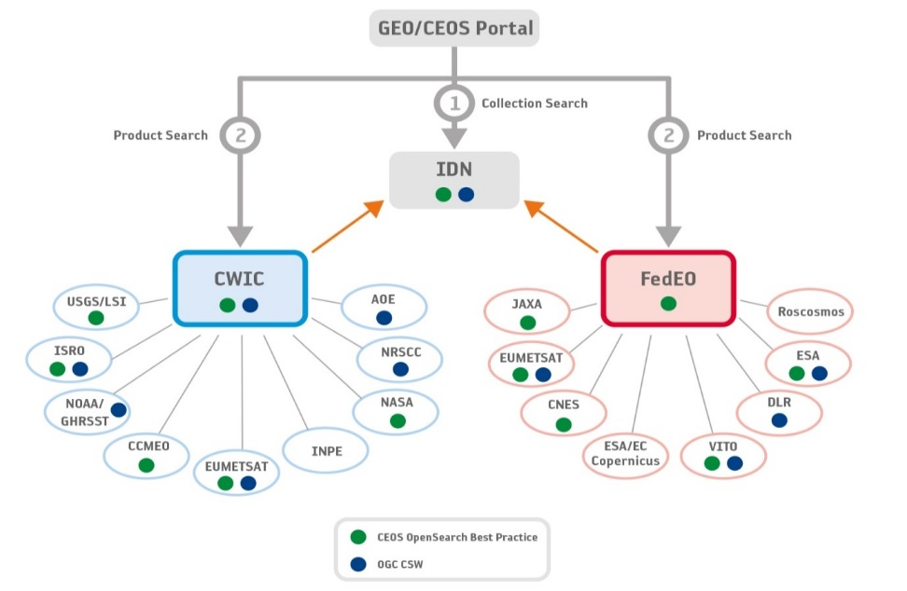
Activity Background
  Goal: Thousands of EO dataset series from all over the world federated by NASA, ESA, CEOS, GEOS, but …
  Issues to be addressed:
  Original specification OGC 13-026r8 incomplete, lack of coherence -> extensive “CEOS Best Practice” needed
  Poor interoperability of search results
  (different metadata models)
  Atom/XML not well suited for
  Web client consumption
  Need for linking EO resources to
  services “bring user to data”
  paradigm (Exploitation Platforms)

Slide 4

Activity
Initiative by EUMETSAT (via con terra) and ESA (via Spacebel, CGI) to evolve the standard.
  Reactivate OGC EO-PMOS SWG
  In close collaboration with CEOS WGISS members
Status
  February 2017 - EO-PMOS SWG reactivated
  Many SWG teleconferences and meetings at OGC TCs …
  More than 100 CEOS WGISS review comments addressed…
  Package of results submitted to OGC Architecture Board (OAB) - February 2018
  Presentation in Plenary in anticipation of future vote – March 2018
  OAB to give permission for public comment
  TC to give permission to start a vote

Slide 5
Activity Results
3 specifications
Including:
Revised
XML
GeoJSON
New
OGC 13-026r9
EO Extension OpenSearch
Request
Atom/XML Response
OGC 17-047
OpenSearch GeoJSON(-LD) Response Encoding
GeoJSON Response
JSON-LD Response
Search request
Search Response
New
EO Metadata format
OGC 17-003
EO Product Metadata GeoJSON(-LD) Encoding Standard
GeoJSON Metadata
JSON-LD Metadata
EO Vocabulary
    OGC 17-047 JSON Schema file, JSON-LD @context
    OGC 17-003 JSON Schema file, JSON-LD @context
    OGC 17-003 OWL EO vocabulary

Slide 6
Outline
Activity overview
Results
  OGC 13-026r9: EO Extension for OpenSearch
  OGC 17-047: OpenSearch GeoJSON(-LD) Response Encoding
  OGC 17-003: EO Product Metadata GeoJSON(-LD) Encoding
Conclusion

Slide 7
Earth Observation Extension (OGC 13-026)
EO related OpenSearch (OS) query parameters
  For searching EO Collections (e.g. sensorType)
  For searching EO Products (e.g. orbitNumber)
  mapped to typical EO metadata models (e.g. 10-157r4, ISO19115)
  use OGC 10-032r8 for spatial and temporal filters
Defines OpenSearch EO response elements
  Atom/XML format is mandatory
OSDD includes URL template(s): kind of queries, response formats
  Uses OpenSearch Parameter extension to annotate.

Slide 8

Main Improvements OGC 13-026r8 to r9
Considered CEOS BP
  as optional requirements, BP´s can mandate implementation
Search Parameters
  Clarifications/corrections: e.g. dateTime values, startIndex / startPage
  Improved text parameters search: “exact search” vs “substring search”, ranges and sets, custom searches
  Extensions: e.g. relativeOrbitNumber,lastOrbitDirection, accessedFrom, sort
ATOM Response
  Alignment with OWS Context and OpenSearch-Geo (OGC 10-032r8)
  “atom:feed”: minimum bbox envelope, updated, paging / totalResults,… (clarifications/ corrections, spec reference (extension)
  “atom:entry”: envelope (GeoRSS Simple vs GeoRSS GML + multi-polygon support), updated, alternate link, content, browse images (clarifications/corrections), links (e.g. to documentation), offerings, resource type (dataset, collection,..) (extensions)

Slide 9
Main Improvements OGC 13-026r8 to r9
Requirements / Requirement Classes / Conformance Classes / Abstract Test Suite (ATS)
  Requirements aggregated to 1 Core + 23 Optional Conformance Classes
  36 Conformance Tests
Update of general sections and explanations
New appendices: mapping CEOS-BP with Requirements, improved metadata examples incl owc:Offerings

Slide 10
Outline
Activity overview
Results
  OGC 13-026r9: EO Extension for OpenSearch
  OGC 17-047: OpenSearch GeoJSON(-LD) Response Encoding
  OGC 17-003: EO Product Metadata GeoJSON(-LD) Encoding
Conclusion

Slide 11


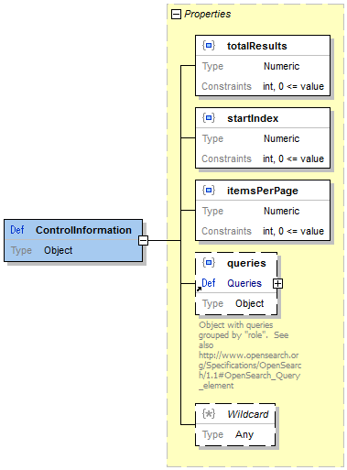
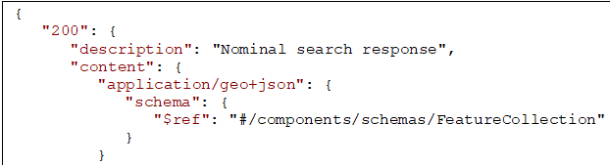
OGC 17-047 Concepts
GeoJSON: search results are “FeatureCollection”s
  1st level search: EO Collections (dataset series)
  2nd level search: EO Products or acquisitions (granules, datasets)
OWS Context: search results are “context” documents (OGC 14-055r2)
  Linking EO data and OGC services in a given context..
JSON encoding defined using
  JSON Schema draft 4 (i.e. “OpenAPI Element”-ready)
JSON-LD encoding defined (implicit @context document)

Slide 12
Outline
Activity overview
Results
  OGC 13-026r9: EO Extension for OpenSearch
  OGC 17-047: OpenSearch GeoJSON(-LD) Response Encoding
  OGC 17-003: EO Product Metadata GeoJSON(-LD) Encoding
Conclusion

Slide 13
OGC 17-003 Concepts
Simplified model for EO product metadata
  Flexible: few mandatory attributes
  Open: custom attributes can be added
Opportunity to map existing conceptual models on neutral JSON model also agreed inside CEOS
  EOP-O&M (OGC 10-157r4)
  Unified Metadata Model (UMM-G) from NASA
JSON encoding defined using
  JSON Schema draft 4 (i.e. “OpenAPI Element”-ready)
JSON-LD encoding defined (implicit @context document)
EO vocabulary items defined, reusing existing vocabularies where possible.
  Cross domain consumption: including RDF etc…

Slide 14
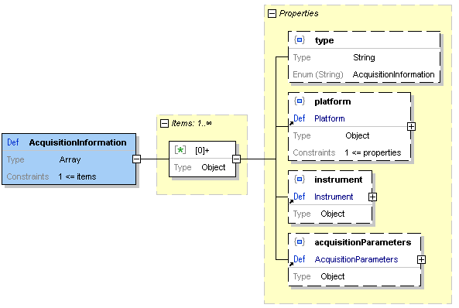
OGC 17-003 Concepts
Simplified EO Product Metadata Model
  Array of acquisition related metadata
  (satellite, instrument, acquisition date,
  orbit, sensor mode, look angles, swath, …)
  Product related metadata (product type, version,
  size, quality, cloud coverage,…)
  Links to resources (Download URL, Quicklook URL, Visualisation via WMS/WMTS, on demand processing/transformations via WPS,…)
Use cases
  Products from one acquisition
  Synergetic Products from several acquisitions and/or sensors
  Acquisition only (catalogues showing mission planning information)

Slide 15
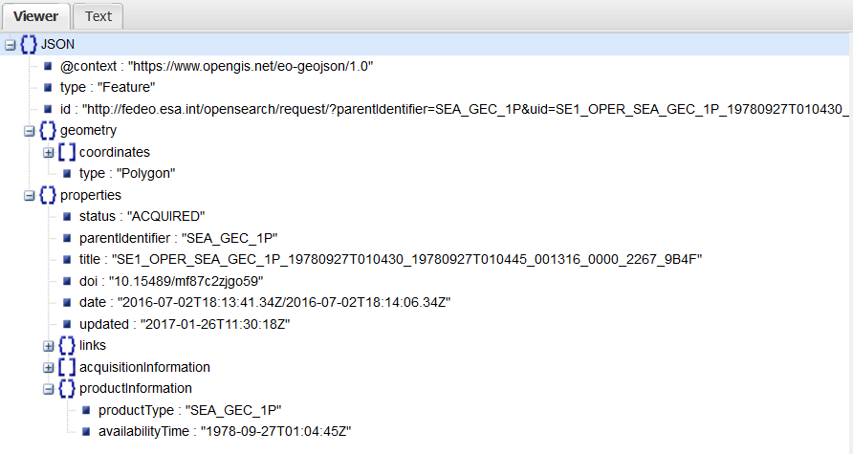
OGC 17-003 Example
(*) Visualised with http://jsonviewer.stack.hu/

Slide 16
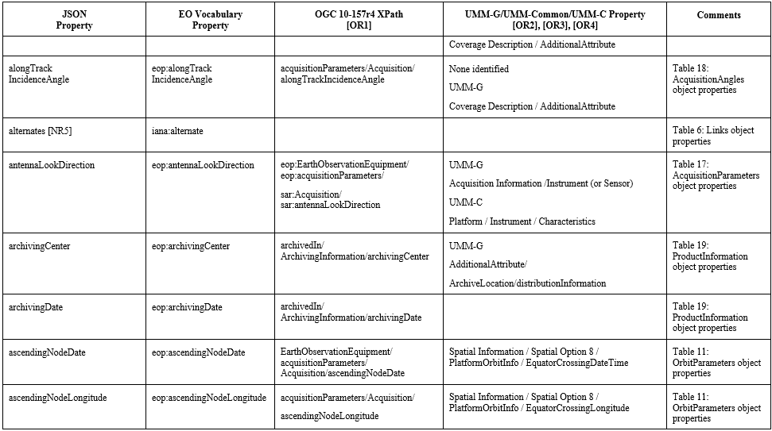
EO Vocabulary Mapping
Single Annex with mappings, GeoJSON as entry-point

Slide 17
Outline
Activity overview
Results
  OGC 13-026r9: EO Extension for OpenSearch
  OGC 17-047: OpenSearch GeoJSON(-LD) Response Encoding
  OGC 17-003: EO Product Metadata GeoJSON(-LD) Encoding
Conclusion

Slide 18
Conclusion
SWG addressed weakness identified at start:
  “Original specification OGC 13-026r8 incomplete, lack of coherence
  -> extensive “CEOS Best Practice” needed”
    Incoherencies addressed, better descriptions, improvements, …
    CEOS Best Practices integrated into document when relevant
  “Poor interoperability of search results (different metadata models)”
    OGC 17-003 as neutral JSON model covering main OGC 10-157r4 and UMM-G properties. Agreed inside CEOS community.
  “Atom/XML not well suited for Web client consumption”
    JSON alternative for original XML/Atom approach (in OGC 17-047 and OGC 17-003) in separate specifications. Reference implementation in ESA FedEO.
  “Need for linking EO resources to services “bring user to data
  paradigm” (Exploitation Platforms)”
    OGC Web Context (OWC) encoding used in both Atom and JSON encodings and many examples included…

Slide 19
Timeline – Next Steps
2/2017: EOP SWG reactivated, Initiated documents (13-026r9, 17-003)
3/2017: TC Delft (presentation of rationale, targets, first results...)
4/2017-9/2017: Work done, splitted off GeoJSON(-LD) encoding (17-047)
09/2017: TC Southampton, status presentation, discussion of CRs
09/2017-01/2018: Fixed all CRs, ATS, examples, other improvements…
02/2018: SWG votes to release candidates standards for OAB review
03/2018: in case of acceptance OAB may give permission for public comment
03/2017-04/2018: 30-day public comment period
03/2018: OGC TC Orleans: SWG summary presentation of specs in Closing Plenary (10 min), Request for e-vote (during public comment, so TC gives permission to start vote once public comment ends and public comments (if any) are addressed)
05/2018: SWG to modify candidate standard based on comments and resubmit
06/2018: TC adoption vote 45 days, and 2 weeks day IPR review period.

Slide 20
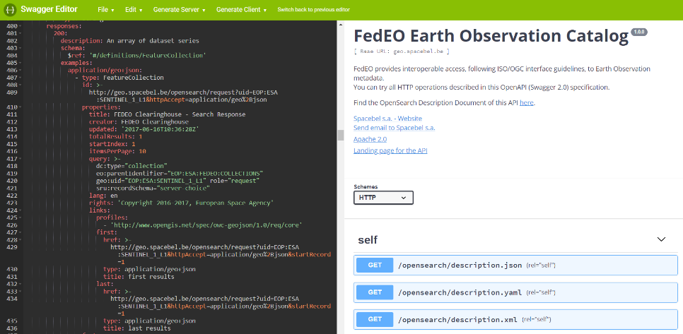
Future work
First draft of OGC 17-084: GeoJSON(-LD) Encoding for EO Collection Metadata
  alignment with GeoDCAT-AP
Complete migrate from XML to JSON
  From OSDD to JSON encoding of API description based on OpenAPI

