Slide 1
Knowledge Management System
- Information Preservation Process-
WGISS#46- 22-October 2018
Rosemarie Leone (ESA)

Slide 2

ESA DIGITAL AGENDA FOR SPACE INFORMATION MANAGEMENT POLICY
High Level Classification of ESA’s Information:
“Space Data+” as far as processed and managed by ESA
  Instrument Data from ESA Spacecraft & Third Party Satellites
  Telemetry Data and auxiliary data about satellite and instruments
  Campaign Data, Calibration & Validation Data
  Higher level data derived from the above data types
Software and IT tools in use for ESA
ESA’s Technical Information
Technical and Managerial Information and Reports from Industry
Technical and Scientific Information and Reports from Scientists
ESA Management Information
Personal Data
Addressed by LTDP+ for the EO Data and Associated Knowledge, being extended to others (Joint Activities)
Space 4.0 in Europe will strongly depend on the appropriate management of the huge value in space data and information held and shared by ESA and its partners across member states with industry and with the science communities.
Notes:
Different stakeholders for who the different types of data have value e.g.
• Satellite Data for Data Users and Services;
• Technical knowledge for ESA-Projects, MS, Industry and Science;
• Management Data for ESA-Executive & MS;
LTDP has addressed with international partners the information highlighted in the slide and drafted in cooperation with them Best Practices and procedures defining the why/what/how/for how long to preserve and make accessible those items. These are being applied at ESA and other agencies.

Slide 3

Leveraging on more than 10 years of LTDP Programme Mission Statements
FEDERATION AND
INTEROPERABILITY
DISCOVERABILITY/ACCESSIBILITY
EXPLOITATION
Distributed Catalogues Federation; Exploitation Platform; Virtual research Environment
OCR and full indexing; Elastic Search; Discovery Metadata; Pattern recognition; Machine Learning; Open and Linked Data; Semantic Web; Big Data Analytics
OPEN SCIENCE
DIGITAL PRESERVATION
Knowledge Management; Information Life cycle management; Record Management; Security, Ethics; Certification; Reward and Incentives
Multiformat digitalization technology and scanning system; Archiving; Preservation Management; File Formats; Metadata Management
Sustainability of ESA SPACE mission data long term preservation, discoverability, access and adding value objectives in support to ESA Strategy, LTP and SDG.

Slide 4
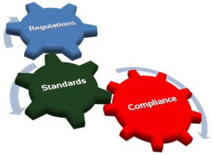
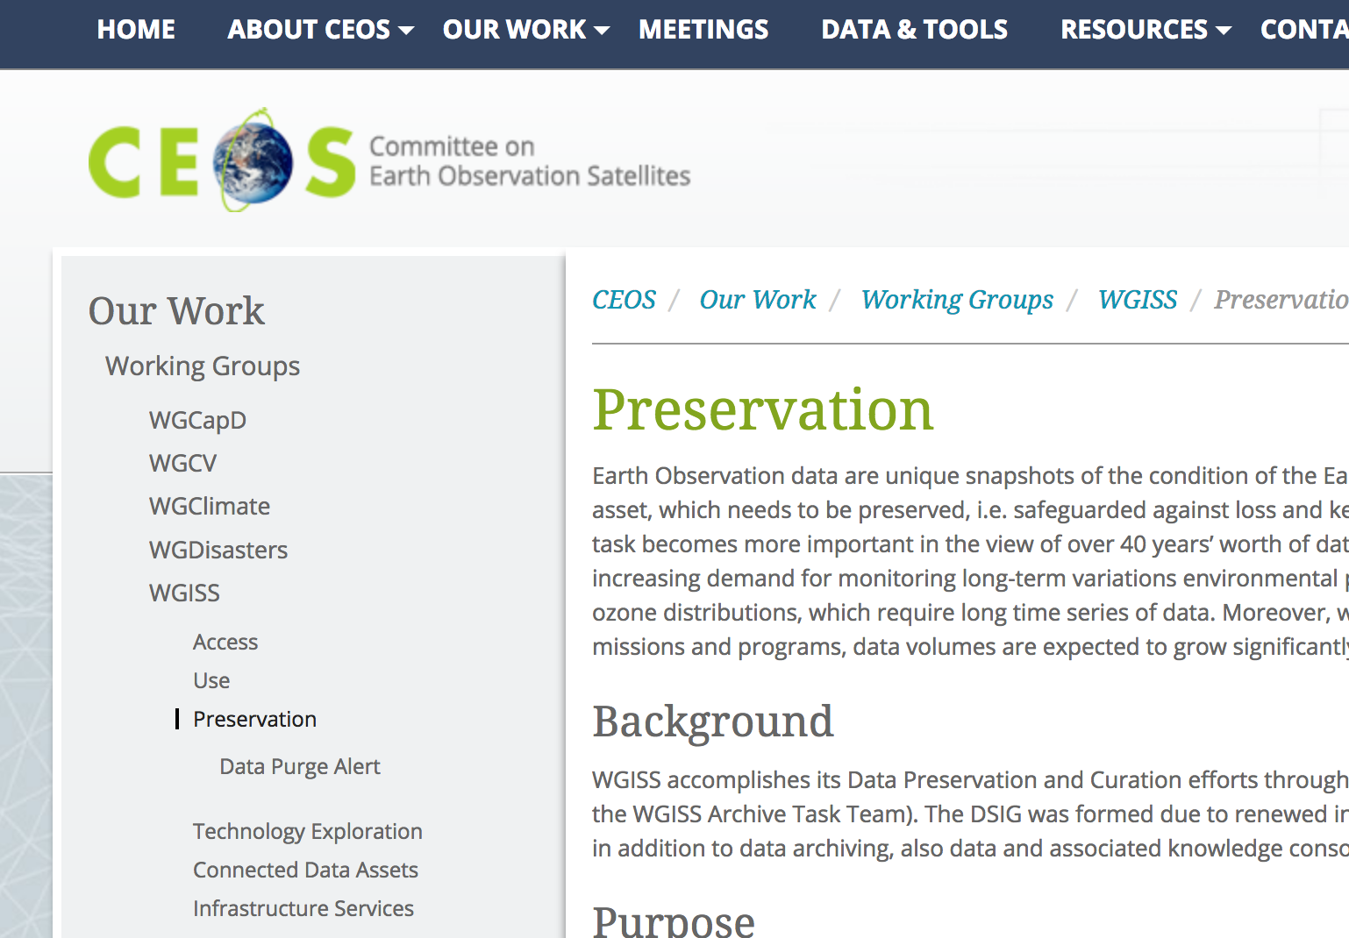
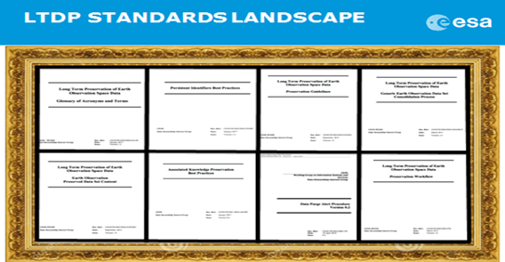
STANDARDS AND BEST PRACTICES
Define Policy, Guidelines, Best Practices and Standards applicable to the Long Term Data Preservation, Discovery and Access Strategy Goals
  CCSDS Data Archive and Interoperability WG
  ISO Standards
  CEOS Best Practices for Long Term Data Preservation
  OGC Interoperability Standards
  Maturity Matrix
  Research Data Life Management
  Data Management Plan
BUSINESS STRATEGY TO BE SUCCESS
View More

Slide 5
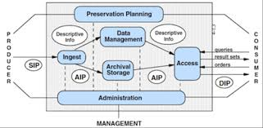
CCSDS OPEN ARCHIVE INFORMATION SYSTEM
DATA ARCHIVE AND INGESTION WORKING GROUP
OAIS Open Archive Information System REFERENCE MODEL
IPELTU: Information Preparation for the Long Term – Appendix A Space Mission Data and Associated Knowledge Check List (generalisation of ISO 19165-2 Part 2: Content specifications for Earth observation data and derived digital products)
Data Archive Architecture Description
Producer Archive Interface Protocol
OAIS-IF Archive Abstraction Layer
Start Consumer Archive Methodology Abstract Specification
Standard for Research Data Management
Green Book of OAIS-IF use cases and separate Blue Books
Area and WG name | CCSDS Ref Nr | Document Title
MOIMS DAI | 647.4 | Data Entity Dictionary Specification Language (DEDSL) - XML Schema
MOIMS DAI | 653.0 | INFORMATION PREPARATION TO ENABLE LONG TERM USE
MOIMS DAI | 650.0 | Reference Model for an Open Archival Information System (OAIS) - 5 year review
MOIMS DAI | 652.0 | Audit and Certification of Trustworthy Digital Repositories. (ISO 16363) - 5 year review
MOIMS DAI | 6xx.0 | Data Archive Architecture Description Document

Slide 6
SPACE MISSION PRESERVATION AND STEWARDSHIP USE CASES GREEN BOOK PROPOSAL
Single Mission: EO Mission Preservation and Curation
Sensors Families Missions Long Term Data Series and Fundamental Climate Records
Space Mission and In situ Data Fusion
Multi Space - Domain Mission Data Cross – Valorisation
From Heritage Mission to New mission conception
New space mission simulation and test bed

Slide 7
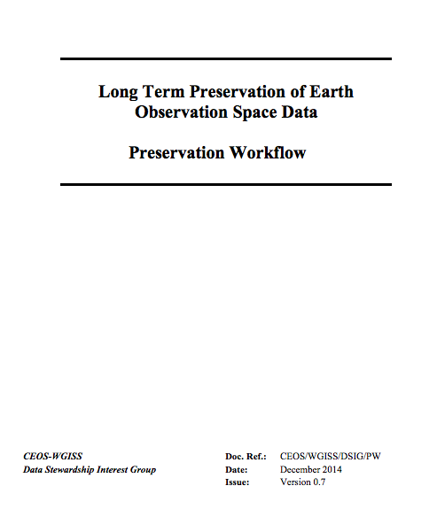
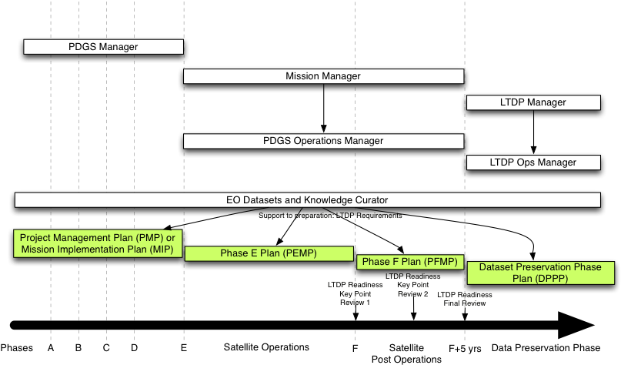

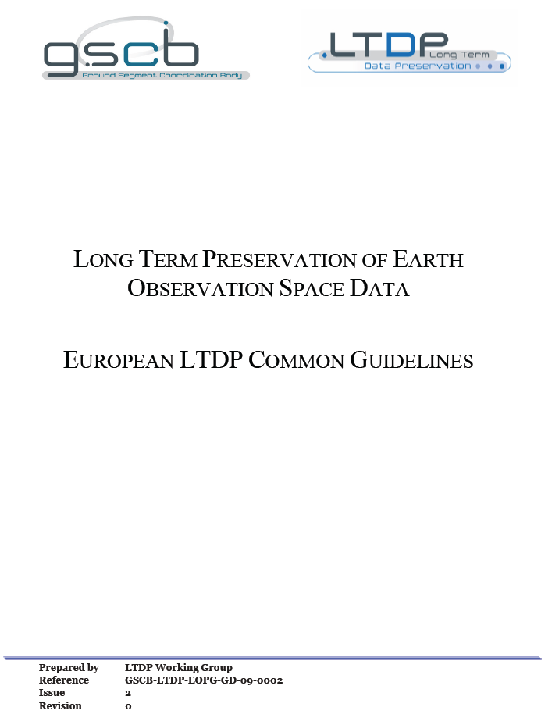












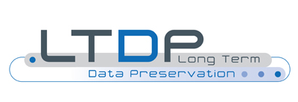



EO MISSION PRESERVATION AND CURATION
European Cooperative Framework
Notes:
Plan and Implement preservation activities in all EO mission phases to capture knowledge at EO data set generation; incremental approach for past/current missions, systematic planning/approach for future ones.

Slide 8
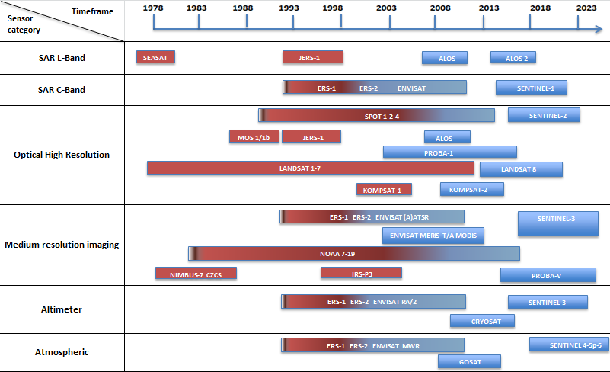

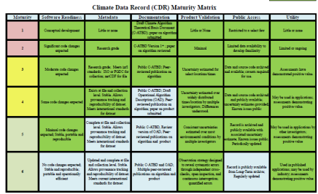
LONG TERM DATA SERIES AND CDR
Experts for optical remote sensing
Experts for
active microwave remote sensing
Users R&D remote sensing
specialists
Experts for
passive microwave
remote sensing
Experts for altimetry
remote sensing
Experts for
atmospheric composition
remote sensing
Experts for
gravimetry sensing
Experts for
magnetism sensing
Experts for scatterometer remote sensing

Slide 9
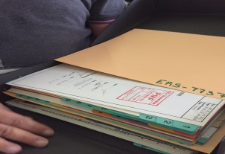
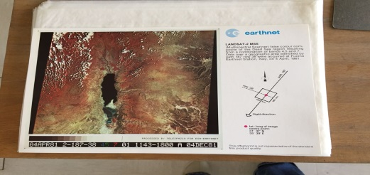
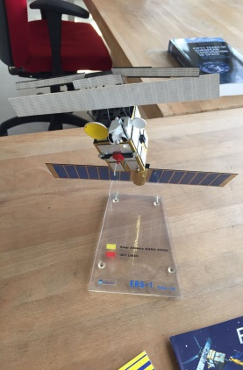
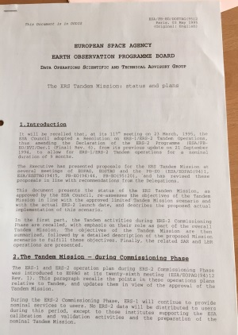
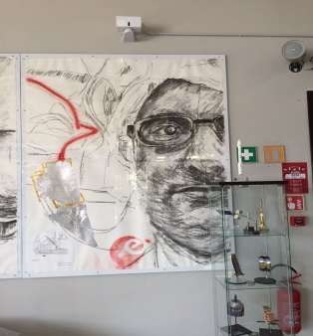
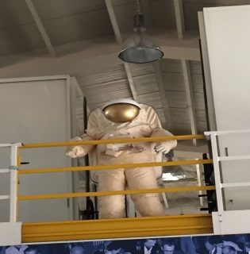
HERITAGE MISSION ARCHIVAL
Text and images on paper and digital documents
Photos,
Video.
Audio
3D CAD
Record Data Base
Software
Physical Objects (3D Scan, 3D/2D Photos) e.g.
  art, pins, events gadgets
  satellite mock-ups, 1:1, 1:10
  comet sample

Slide 10
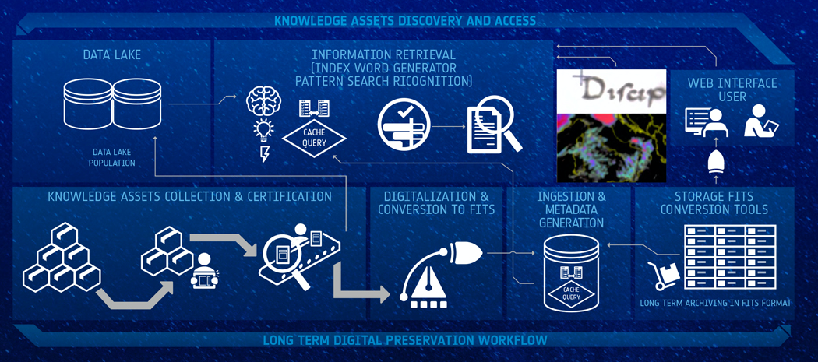
DATA ASSOCIATED KNOWLEDGE MANAGEMENT SYSTEM (KMS) CONCEPT
Notes:
Different stakeholders for who the different types of data have value e.g.
• Satellite Data for Data Users and Services;
• Technical knowledge for ESA-Projects, MS, Industry and Science;
• Management Data for ESA-Executive & MS;
LTDP has addressed with international partners the information highlighted in the slide and drafted in cooperation with them Best Practices and procedures defining the why/what/how/for how long to preserve and make accessible those items. These are being applied at ESA and other agencies.

Slide 11

Innovative Heritage
Management Solution
Maggio 2018

Slide 12
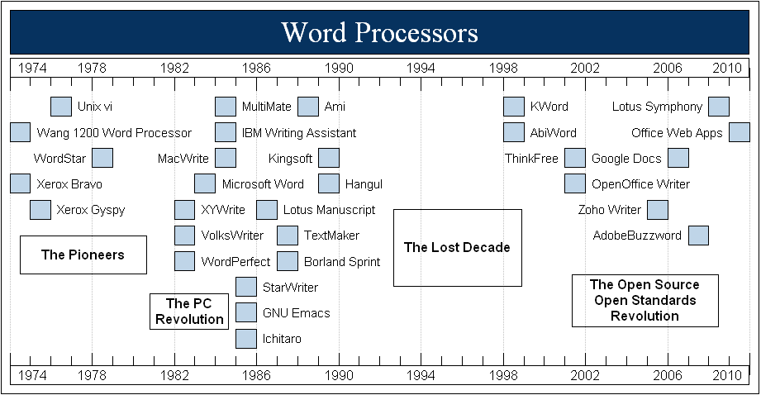
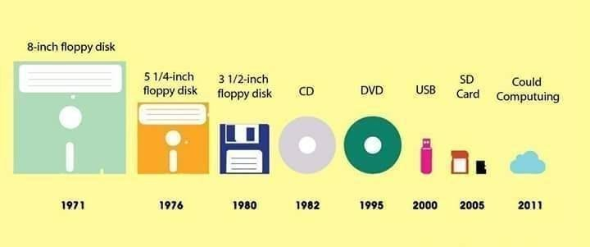
KMS COMPONETS: OMNES
Based on
  Open format FITS (Flexible Image Transport System)
  Open source (Apache Camel, Tesseract, Elastic Search )
  IIIF (International Image Interoperability Framework)
  Dublin Core (metadati per materiali digitali)
  METS (Metadata Encoding Transmission Standard)
  PREMIS (Preservation Metadata Implementation Strategies) e OAIS (Open Archival Information System)
Output Format: JPEG, JPEG2000,TIFF, PDF, etc…

Slide 13
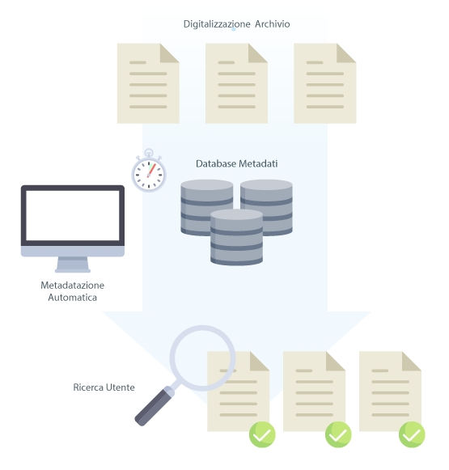
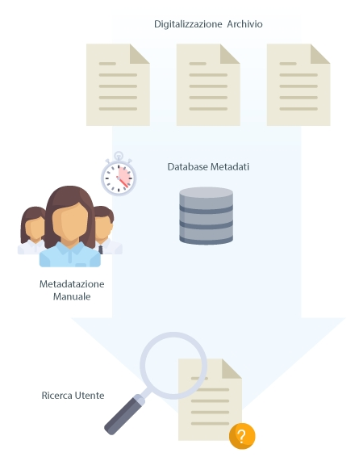
OMNES INGESTION
Traditional Ingestion
Structured Archive
Manual Metadata Entry
Metadata based - search
Fast Data Ingestion
Data lake
Automatic Annotation
Unstructured Data
Ingestion of pre-existing metadata
Metadata and Annotation Improvement

Slide 14
OMNES ARCHITECTURE
Integration Layer
SEARCH SUB-SYSTEM
Authentication Manager
Search
Web
INTEGRATION PMH - IIIF
Indexing Service
Graph DB
Relation Manager
Pre-Ingestion Stage:
Digital Sources
Folder Structure
Data Integration (PMH – IIIF)
Ingestion Manager
IIIF
Viewer
Data Extraction Service
Search Repository
IIIF Repository
OMNES Modules
LTDP SUB-SYSTEM
LTDP
Web
OMNES-LTDP
OMNES-SEARCH
OMNES-IIIF
OMNES-RELATIONS
Conversion Manager
FITS Converter
PREMIS Archive
LTDP Repository

Slide 15
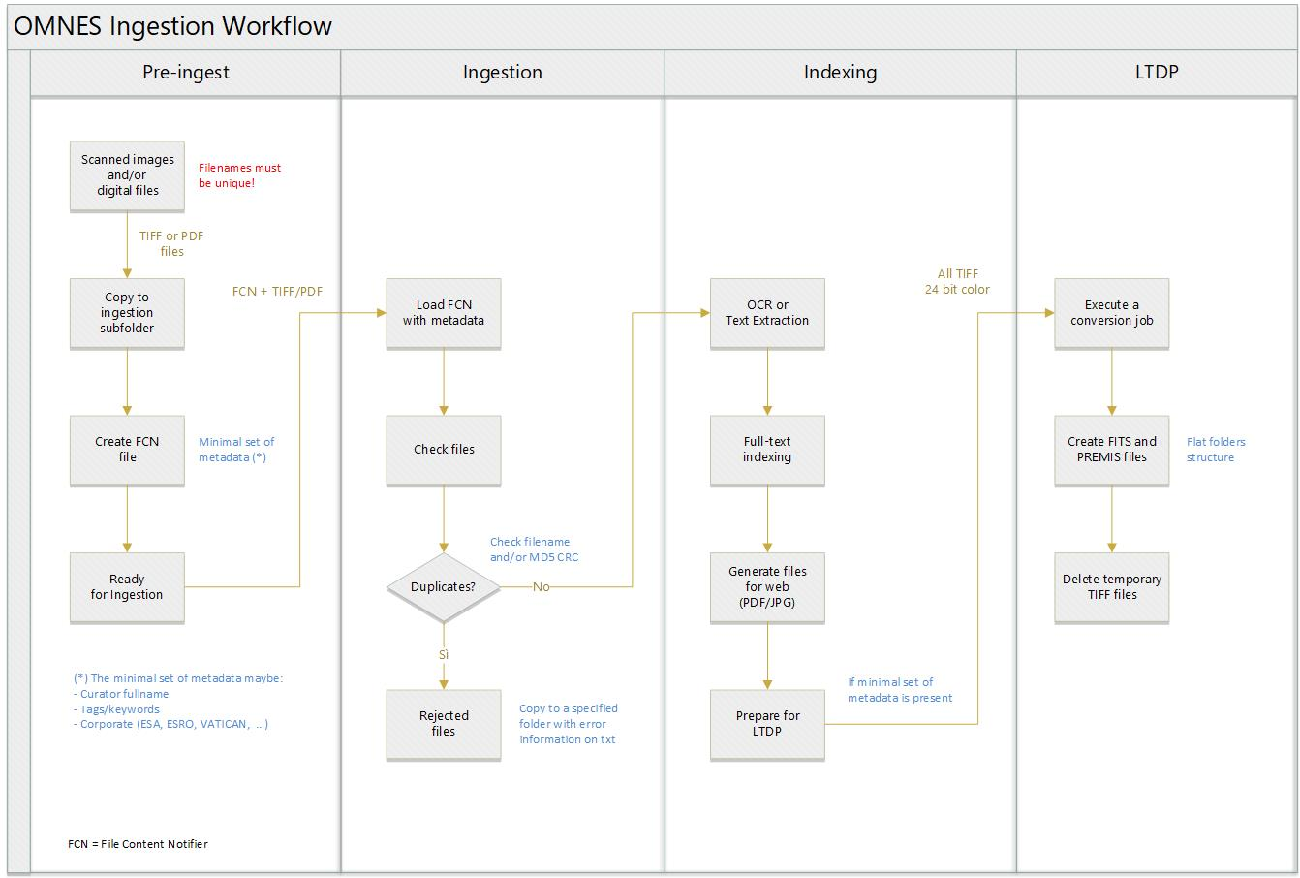
OMNES INGESTION WORKFLOW

Slide 16
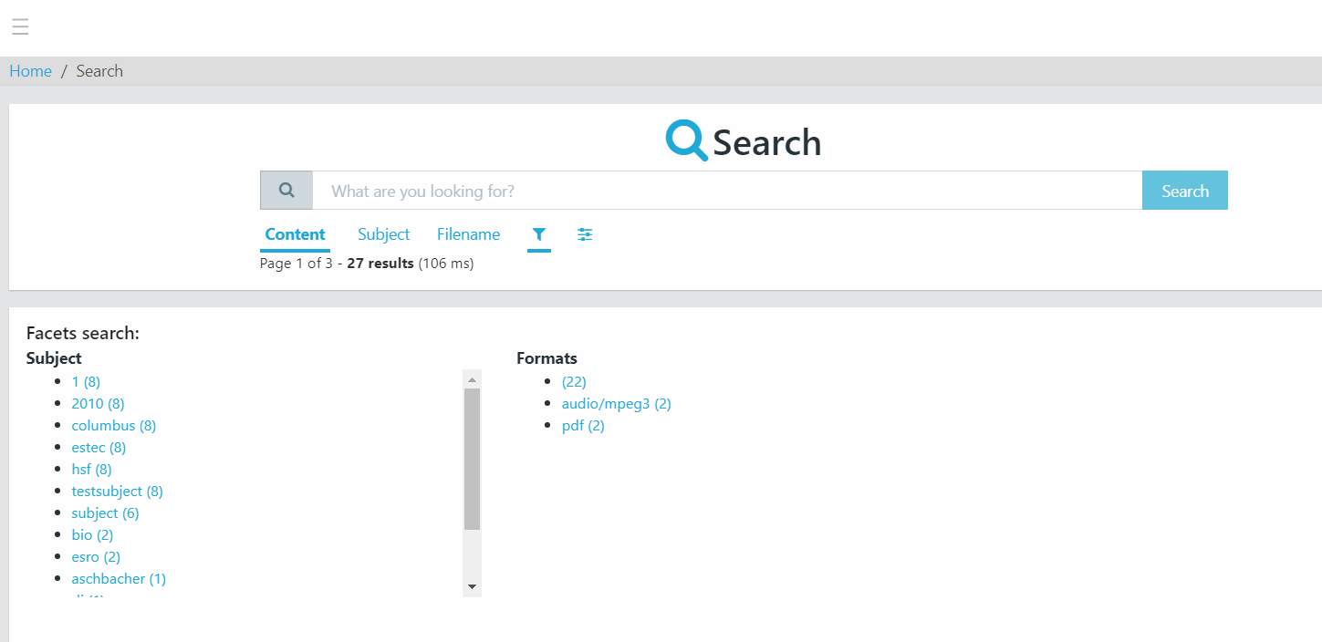

FULL TEXT INDEXING

Slide 17
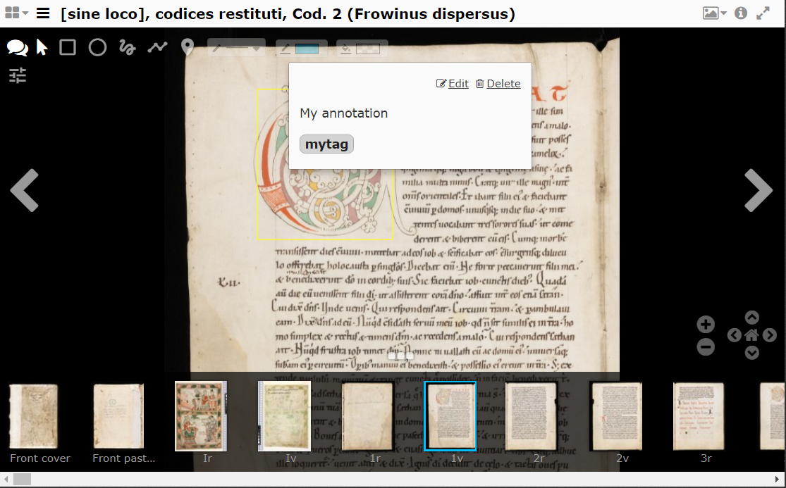
OMNES- INTERNATIONAL IMAGE INTEROPERABILITY FRAMEWORK - IIIF
Biblioteca britannica
Biblioteca Vaticana
Biblioteche della New York University
Europeana
La Bibliothèque nationale de France
Librerie del MIT
Rete bibliotecaria dell'Università di Kyoto
Smithsonian Institution
università di Cambridge
Università di Oxford (Bodleian Library)
Università di Tokyo
Università di Toronto
Università di Yale

Slide 18

COGITO DISCOVER

Slide 19
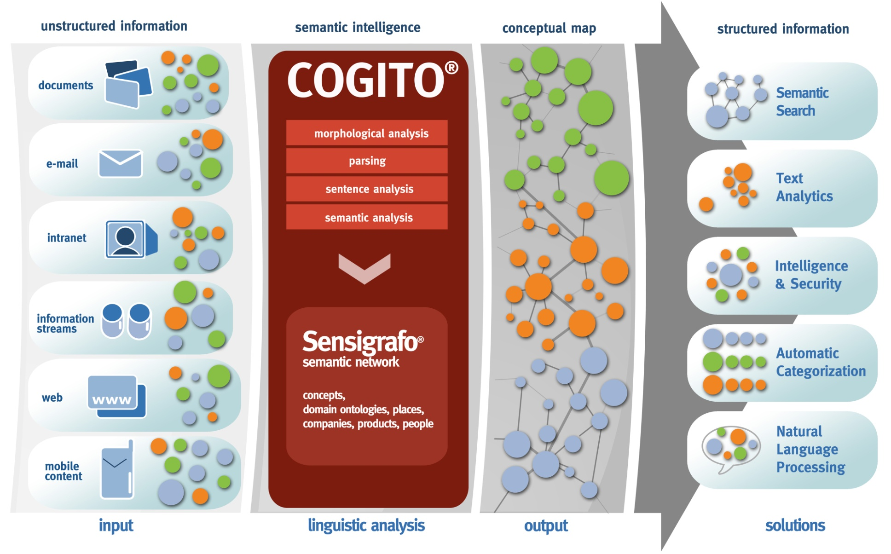
HOW COGITO WORKS

Slide 20
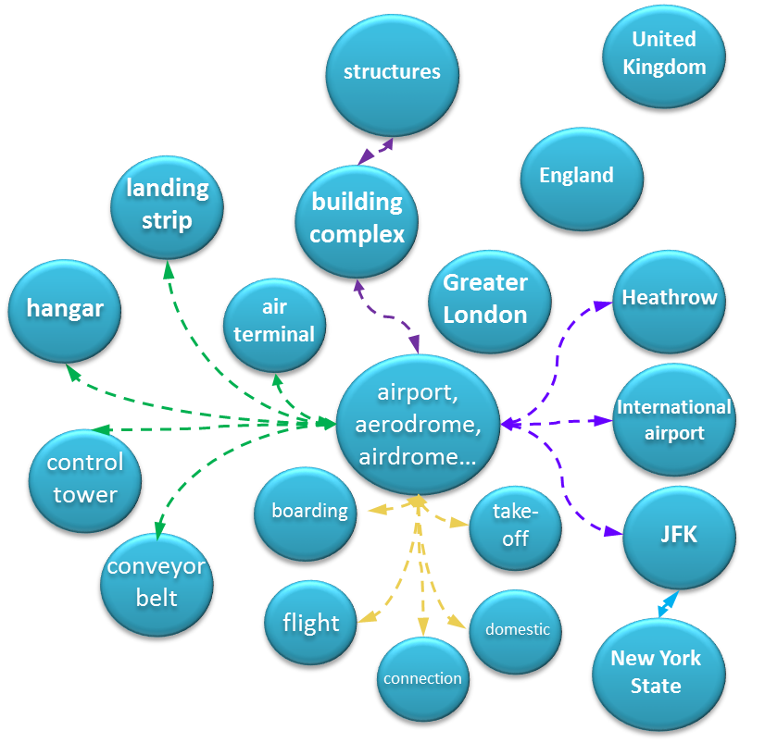

COGITO SOLUTION
COGITO solution reads a text like a human does, deriving meaning from the text as a whole using powerful semantics analysis; cognitive and contextual reasoning and machine learning; and not just applying text analytics and statistical measures.
Natural language text is read and analyzed
And then translated into a cognitive or conceptual map
Natural language text is read and analyzed
And then translated into a cognitive or conceptual map
1
Sentence splitting / parsing
Divide text into words
2
Morphological analysis
Understand word forms (e.g. Verb conjugations)
3
Sentence / logical / grammatical analysis
Understand how words relate to other words, and what their function is in the sentence
4
Semantics analysis / disambiguation
Understanding sentences and texts as a whole, taking into account words synonyms, context, plausibility

Slide 21
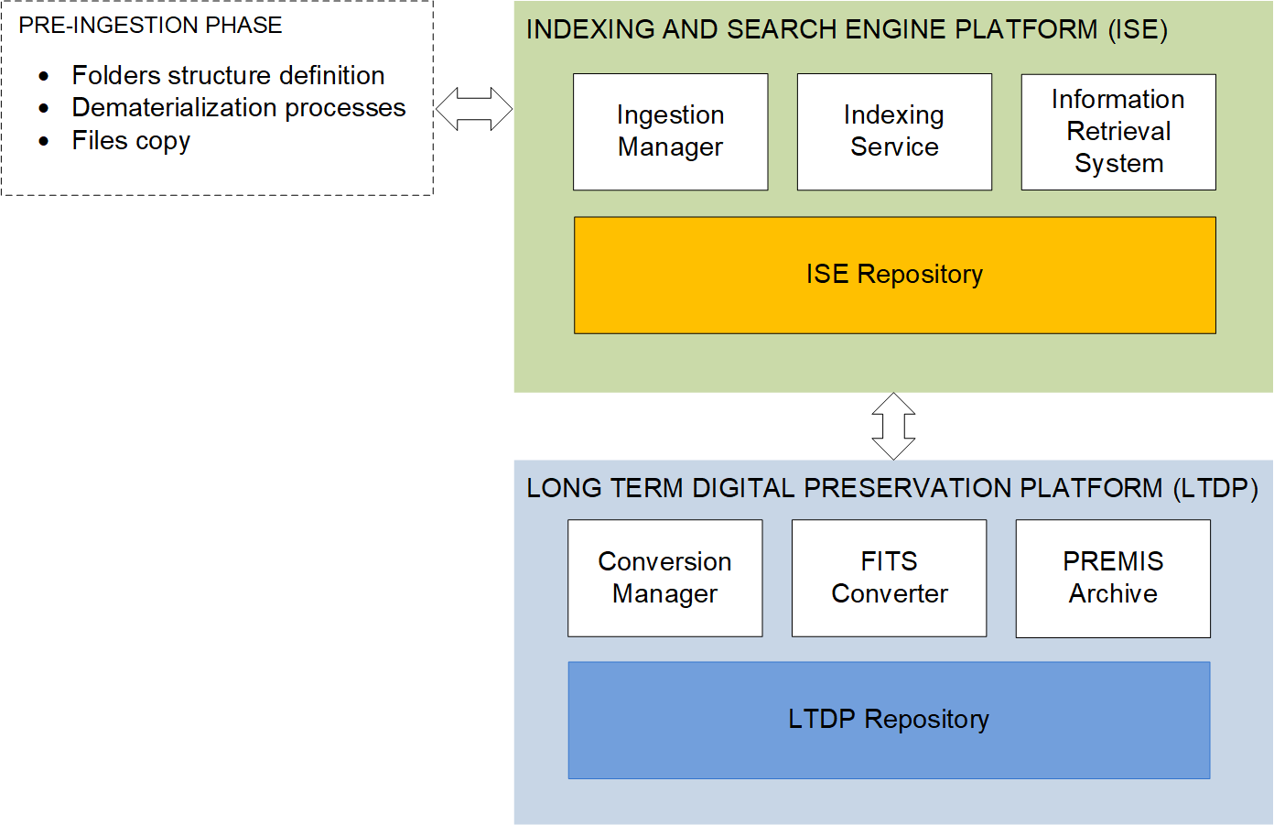



COGITO HIGH -LEVEL SYSTEM ARCHITECTURE
Located under the ISE Platform
the purpose on adding an advanced NLP platform is to enrich with metadata coherent with a standard Language that will add more coherence and guarantee reusability across the organization

Slide 22

HIGH-LEVEL SYSTEM ARCHITECTURE
Stablish as an external service, COGITO® will work seamlessly integrated in the ingestion workflow. The goal will be to work towards a semantically rich index.
The NLP team will stablish 2 basic goals:
Learning to Read: Determining the scope on the new Language to be developed
Reading to learn: building by example the domain expertise until the threshold of “understanding” is reached
Once proved that the domain Language is improving the location on information, others paradigms could be exploit by the NLP technology working cross-organization (by adding more domain layers) or intra-organization (by focusing in improving search interface)

Slide 23



COGITO WOKFLOW
Retrieve document
Retrieve data
Validate data
Map data
Routing
Process
Retrieve document from central repositories
Determine language (scope)
Identify relevant information
Select and capture relevant data per document
Confirm data on:
  Completeness
  Correctness
Update / complete data where needed
Extract data to required output format (e.g. form)
Map document content to existing information where possible
  Automated mapping, based on business rules
  Manual corrections where needed
Route data to the right system for further processing
User interface on COGITO tool
Manual follow up
Solution
Execution update
Robotics
COGITO cognitive processing
Robotics
repository
SPEECH
IMAGE
ANALYTICS
Structured data
Target automation level (percentages to be confirmed)
100% automated
~ 90% - 95% automated
~ 90% - 100% automated

Slide 24
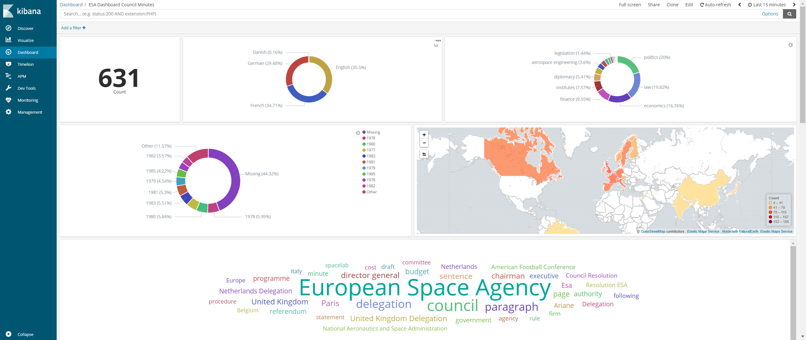
ESA USE CASES
The purpose of this dashboard is just to illustrate in a visual way some of the annotations generated by a standard, out-of-the-box, version of Cogito Discover on a sample of documents provided by ESA (ESA council meeting minutes, CD1).

Slide 25

KNOWLEDGE DISTRIBUTION
Total document count
Distribution by language
Main concepts identified in the documents
Distribution by year
Distribution by country

Slide 26
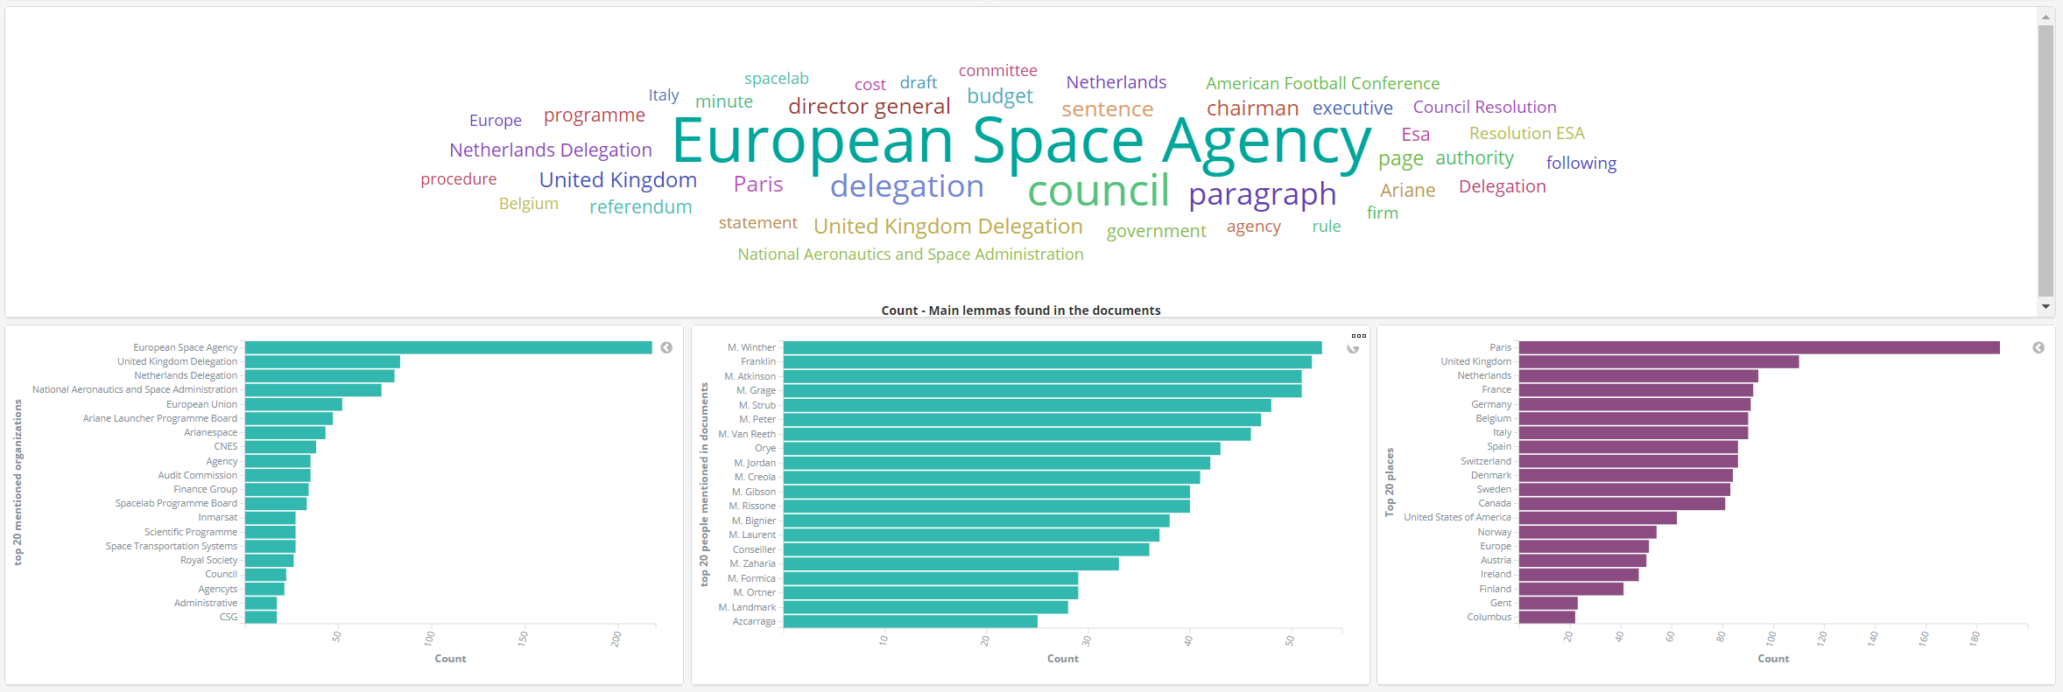
MAIN LEMMAS AND TOP ENTITIES
Sensigrafo domain customization required to optimize performance, e.g. AFC is not American Football Conference in ESA’s sector.
Main lemmas per frequency
Main organizations
Main persons
Main places
Lemma: canonical representations of words

Slide 27
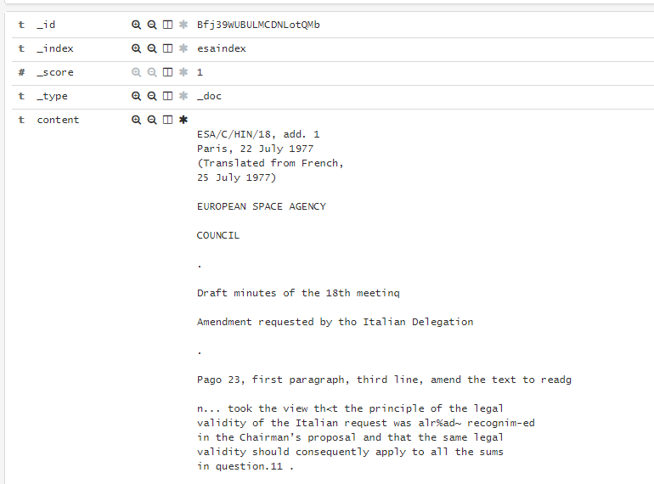
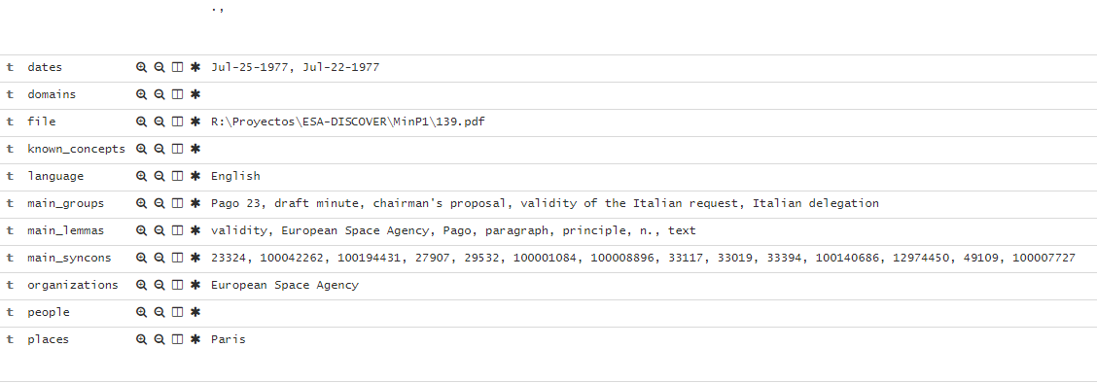
INDEXED DOCUMENT AND RESULTING METADATA
…

Slide 28


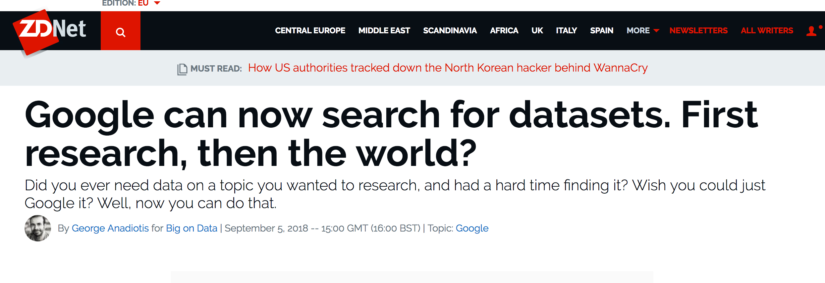
DATA DISCOVERY
Public needs at European, national, regional or local scales, including weather forecasts
Users public services
Policy and societal drivers in areas such as global change and disaster risk management
General public, education, media
International Conventions (e.g. UNFCC)
Multilateral Development Banks (e.g. World Bank)
Web / TV media
Schools, teachers
Value adding industry including SMEs and some represented by EARSC
Users profit-making services
Downstream industry sectors (e.g. Oil & Gas, Renewable energy, Insurance, re-insurance, Mining, Meteo, etc.)

Slide 29
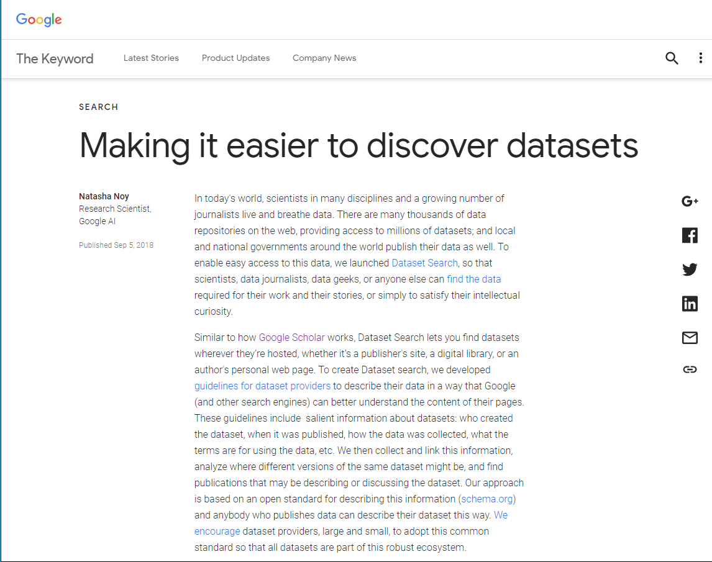
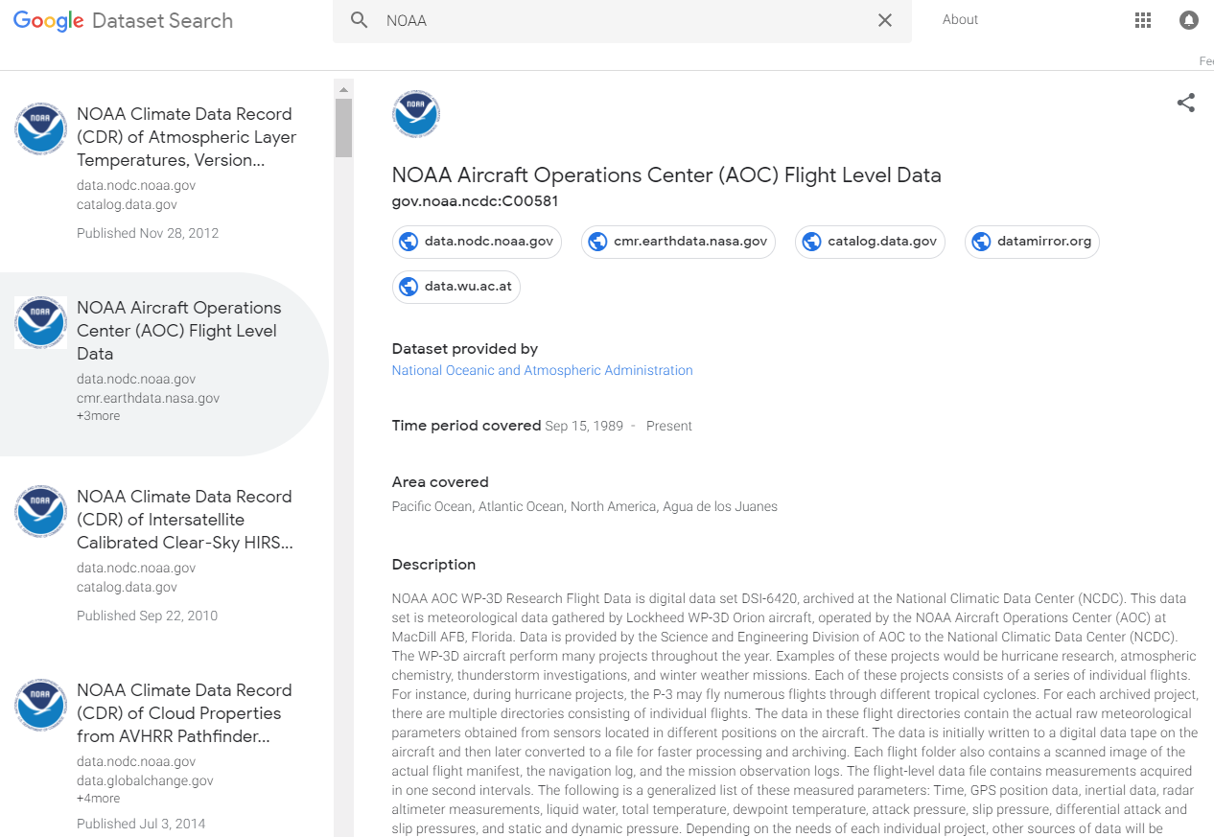
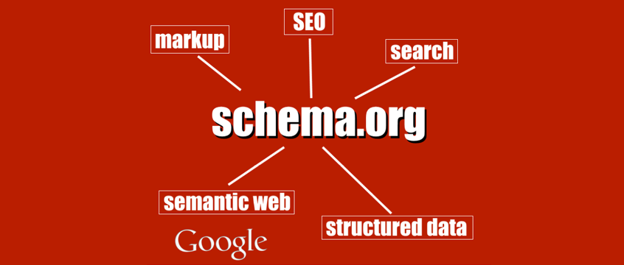
RECENT TRENDS ON DATASET SEARCH

