Slide 1
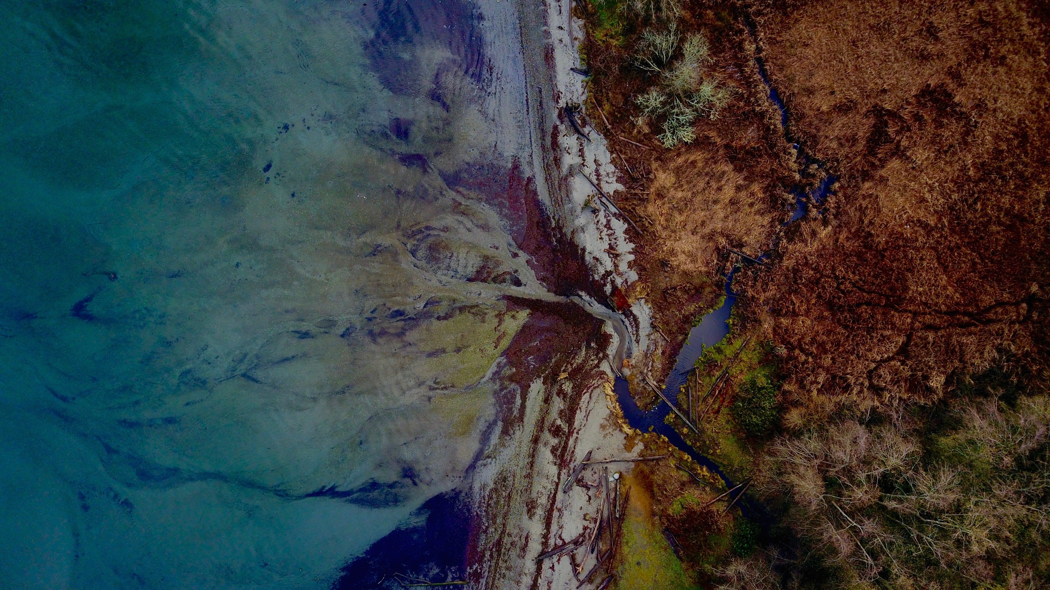
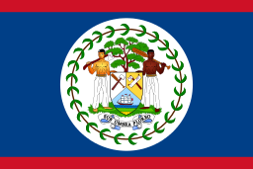
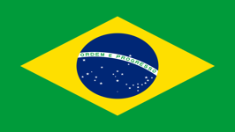
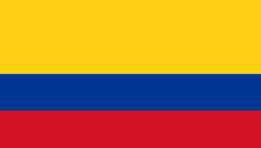
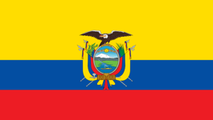
Community Platform Overview
CEOS WGISS/GEOSS Workshop
October 24, 2018
Angélica Gutiérrez-Magness, Chair of the AmeriGEOSS Initiative
Nancy Searby, Foundational Working Group Lead
Rich Frazier, Foundational Working Group

Slide 2
AmeriGEOSS / Background
Conceived in October 2014, launched in November 2015
Is a cooperative effort of the 16 GEO member countries in the Americas that:
Reflects local, national, and regional interests of the GEO country-members for short and long-term planning, development, and implementation aligned with GEO activities.
AmeriGEOSS Members
Non-AmeriGEOSS Members
Is entrenched in the institutional and technical capabilities of its country members and in the resources of other global initiatives available for the benefit of the region.
Argentina
Bahamas
Belize
Brazil
Canada
Chile
Colombia
Costa Rica
Ecuador
Honduras
Mexico
Panama
Paraguay
Peru
United States
Uruguay
Seeks to increase institutional and personal capacity and engage experts, stakeholders, and decision makers in the process of decision making.
16 Member Countries
Observers: Bolivia, Guatemala
Notes:
**Before I dive into the platform let me give you some background informaiton on AmeriGEOSS. AmeriGEOSS is an initiative under the GEO framework––launched in 2015
This is an adaptable framework that can be leveraged for capacity building.
Includes 16 nations in the Americas currently participates
Work with regional and global partners to advance the use of EO data
Develop and leverage member capacities to support stakehoder and decision-maker needs.

Slide 3
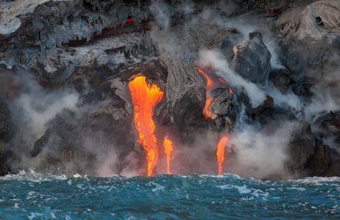
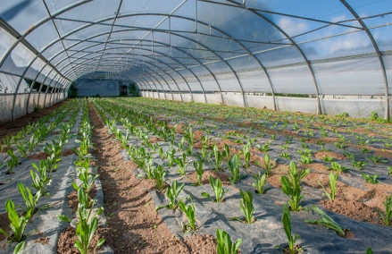
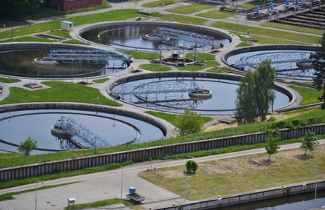
AmeriGEOSS / Background
AmeriGEOSS Initiative is a framework that seeks to promote collaboration and coordination among the GEO Members of the American Continent
The AmeriGEOSS initiative
focuses its efforts in the
four Societal Benefit Areas (SBA’s) selected and prioritized by the Americas Caucus
Biodiversity and
Ecosystem Sustainability
Disaster Resilience
Food Security and
Sustainable Agriculture
Water Resources
Management
Notes:
AmeriGEOSS is a regional initiative that promotes collaboration and coordination among GEO Members of the American Continent.
[Space bar for Animation]
The community is currently focusing its efforts in the following thematic areas
Agriculture
Water
Disaster and
Biodiversity Societal Benefit areas.

Slide 4
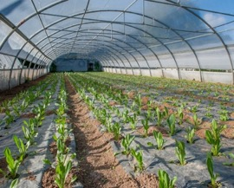
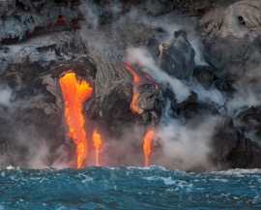
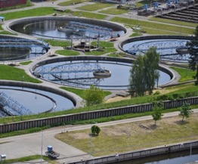
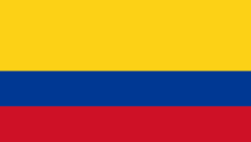
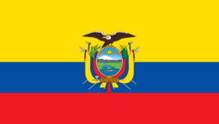
AmeriGEOSS / Platform Purpose / Vision
1
3
The AmeriGEOSS Platform is a regional community resource to promote collaboration and coordination among the GEO members of the American continent.
Communities
Ameri
2
Data
Share, find, discover, learn and participate
Tools
Agriculture
Biodiversity & Ecosystems
Products
Services
Explore news, upcoming events, what’s new and other topics.
Resources
Disasters
Water
Community Platform
Notes:
The AmeriGEOSS Community Platform is an exploitation platform for collaboration and discovery.
This vision is [READ]. Our goal is to leverage Earth Observation data for understand and decision-making
The platform provides Earth Observation access to data, tools, products, services and resources. It allows the AmeriGEOSS community to share, find, discover, learn and participate
The platform also establishes virtual communities for the Agriculture, Biodiversity & Ecosystems, Disasters and Water thematic groups to allow for sharing and collaboration.

Slide 5
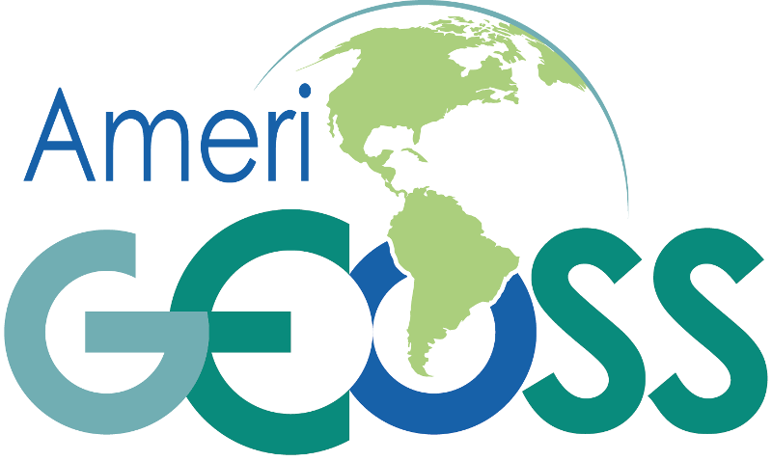
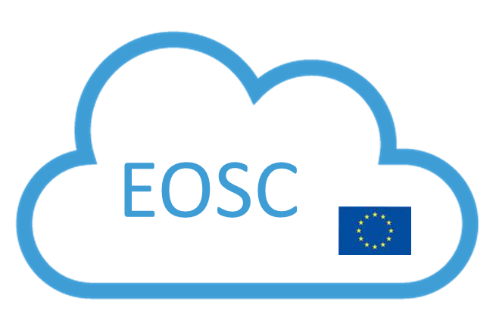
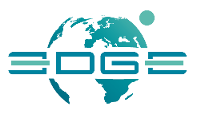
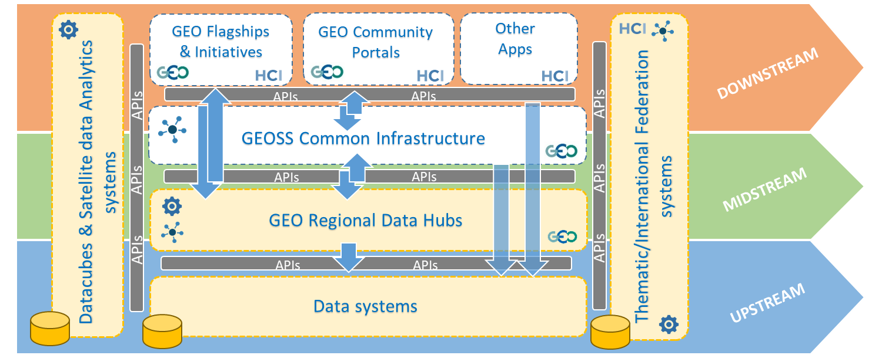
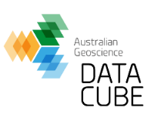
AmeriGEOSS / GEOSS Evolve Architecture Leveraging Systems & Emerging Technologies
Open Systems Platform
1
New Components & Functionalities
API’s
Widgets and Plugins
Views
Portals and Mirrors
More ….
GEOSS Platform
2
Emerging Concepts & technologies
Analysis Ready Data
Data Cubes
Artificial Intelligence
Machine Learning
Decision Ready Data/Tools
Data Cubes and Data Analytics Systems
Landsat ARD
Notes:
The draft architecture recognizes the need to extend the current architecture to support the development of products and services.
The GEOSS platform concept has emerged as the conceptual architecture that can support this goal.
We will have to improve interoperability and support a variety of new user requirements.
Regional Platforms, API’s, widgets, views, portals and plugins are new components and concepts to
support interoperability,
Transformation of data into products and services.
Allow co-creation of products and services. We recognize this new architecture is more evolved and complex we will have to address Governance/coordination challenges

Slide 6
AmeriGEOSS / Conceptual Architecture
1
Users and Stakeholders
Share Discover Access Use Publish
API
Researchers
Analyst
Resource Managers
Responders
Decision-Makers
Communities of Practice
Identify user needs
Gap Analysis
Enrich Metadata
Tag Vocabularies
Curate resources
Harmonize data
Develop products
Data Services
Visualization & Analytics
Collaboration & Decision Support
4
5
6
Data Services
Visualization
Analytics
Tools
Services
Find
Get
Share
Curate
Harmonize
Explore virtual data
Documents
Products
Webpages
Interact
Chart/Graph
Map
Model
Collaboration
Data Marketplace
Knowledge base
Decision Support
Crowd Sourcing
Education & Training
Assessments
Social Media
Alert & Monitoring
Public Private Partnerships
Features, Functions, Services
Curate -> Integrate -> Aggregate -> Conflation
Resource Catalog
2
CURATE
Thematic Datasets
HARMONIZE
Thematic Data & Resources
CO-CREATE
Products & Services
Provider Resources
Resource Providers
Web Interface
Data and Analytics Exchange
Data
Files
Ready-made Datasets and Products
Resource
Repository
Harvest
Validate
Process
Plugins
Extensions
API
Community Platform
Store
Web Interface
Technical Teams
User Requirements
Solution Development
Access Reusable Open Service API’s
National
Regional
Global
DCAT/RDF/XML
CSW, WAF, WMS
RSS/Atom
CSV & JSON
Geoportals/ARCGIS
ISO 19139
ISO 19115
Many others
Enrich
Tag
Group
Social, Economic, Environmental
3
Platform Services
Platform Services
Access and harvest enriched data, products, tools, services
Notes:
Architecture
Initial Users and stakeholder groups – Researchers, Analyst, Resource Managers, Responders, Decision-Makers
Provider Resources
Platform Services – Leverages open source and commercial
Data and Analytics Exchange
Featu
2.

Slide 7
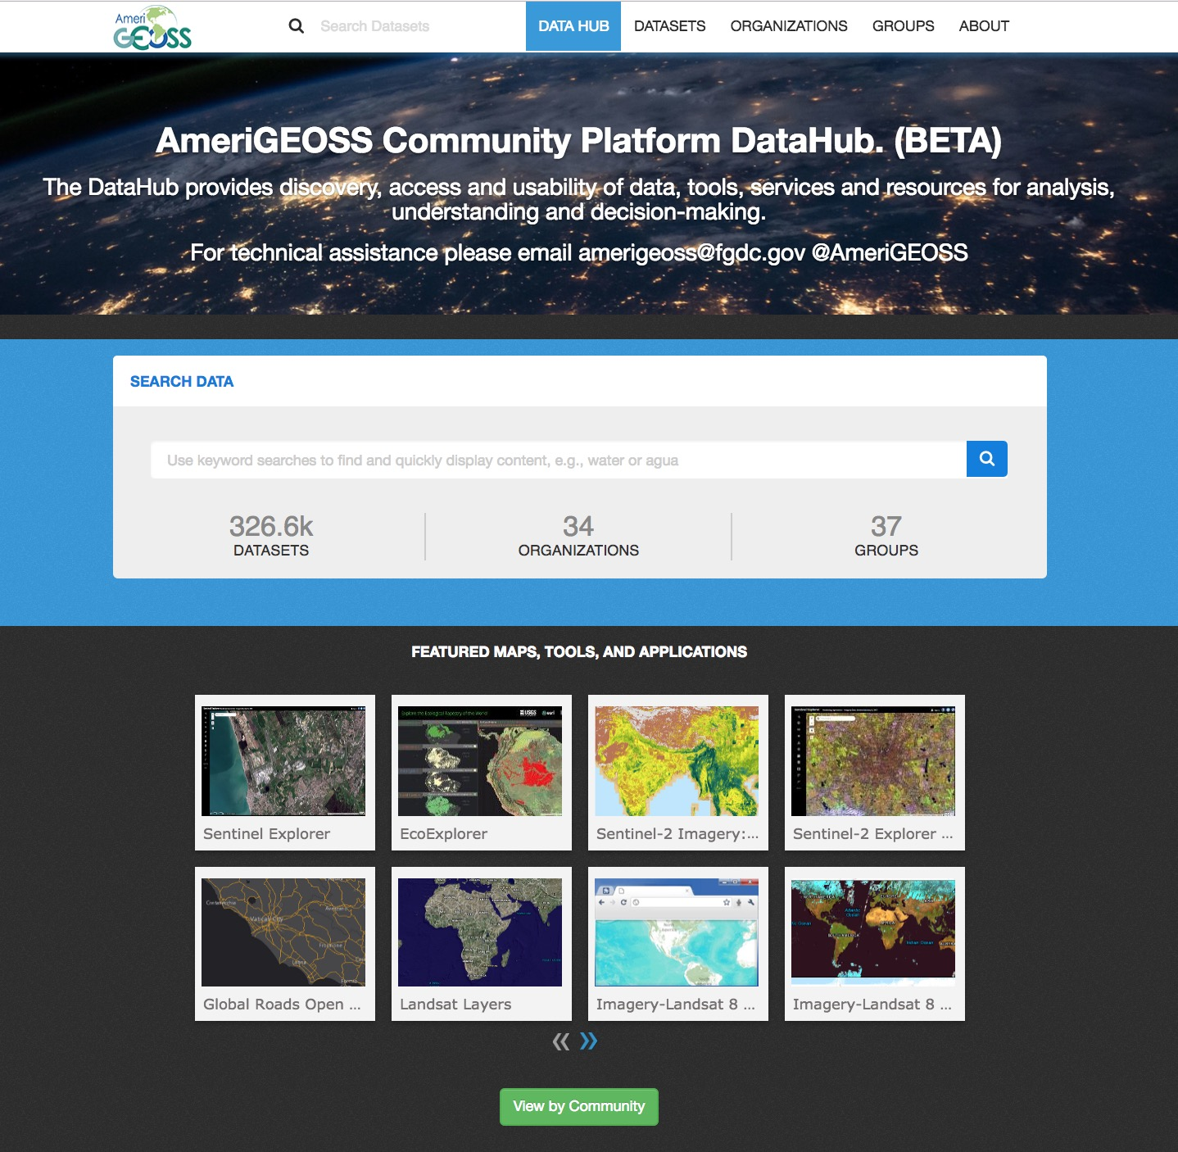
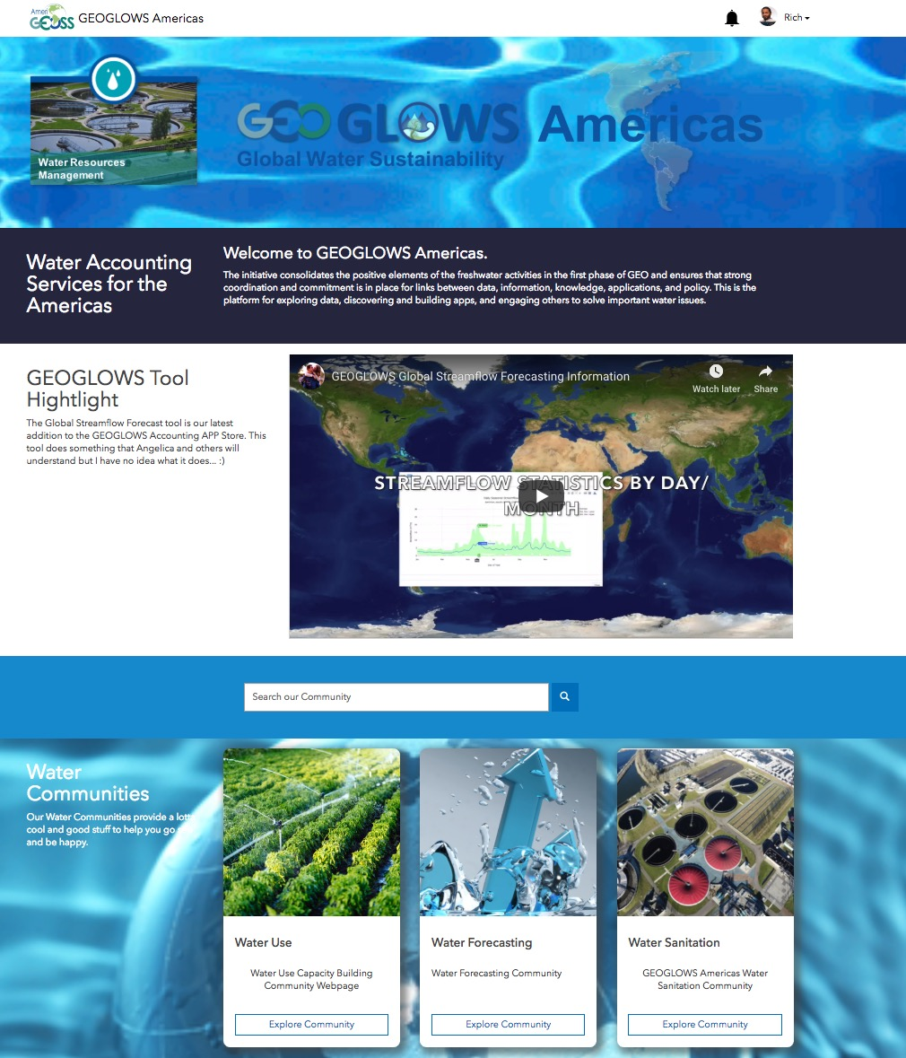
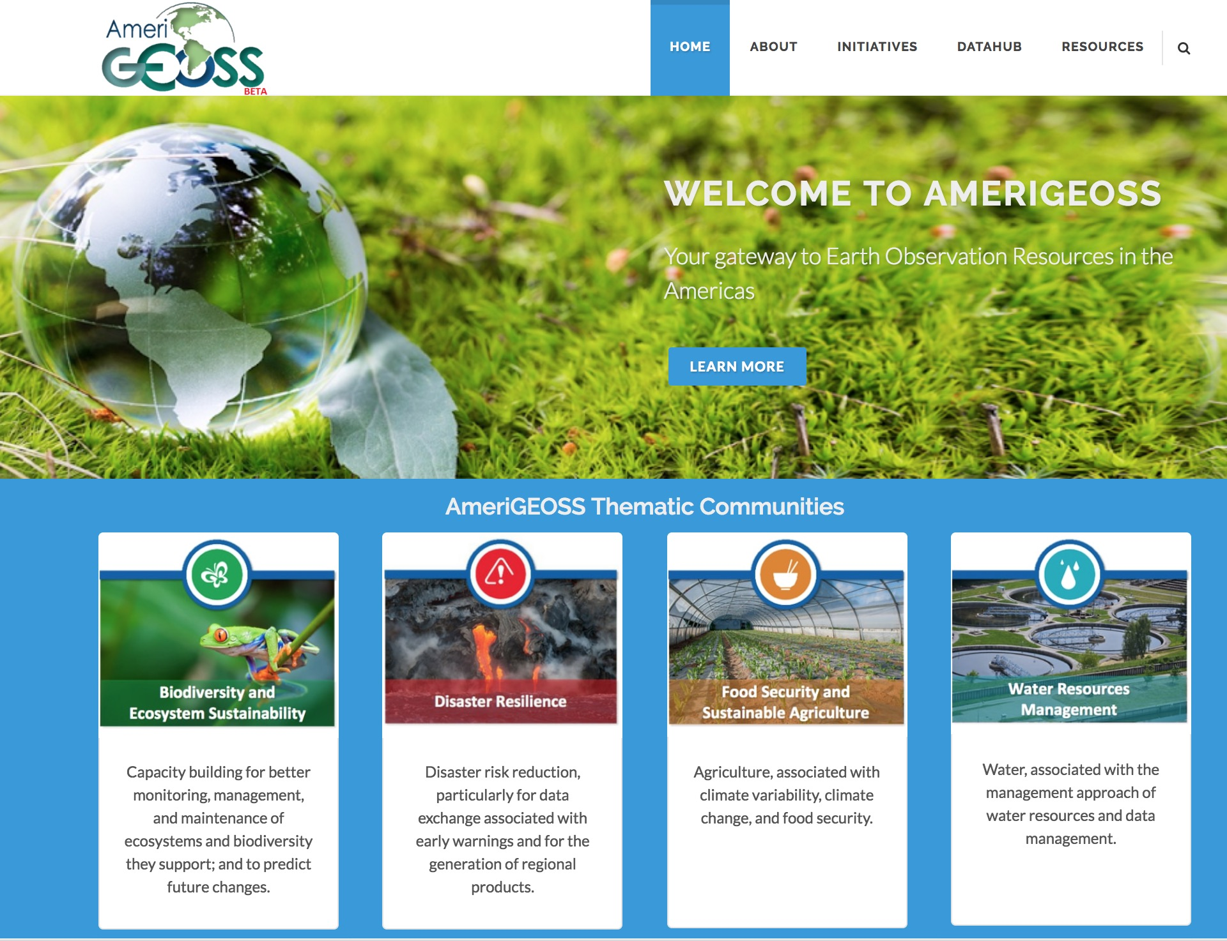
AmeriGEOSS / Platform Overview
Webpage
Collaboration
Analytics and Tools
Data/Knowledge hub
Information about AmeriGEOSS
Find and Use Data & Knowledge
Develop Products & Services
The AmeriGEOSS Community Platform a suite of resources and tools for integrating, synthesizing, analyzing, problem-solving and visualizing geographically enriched data to accelerate understanding and decision-making.

Slide 8
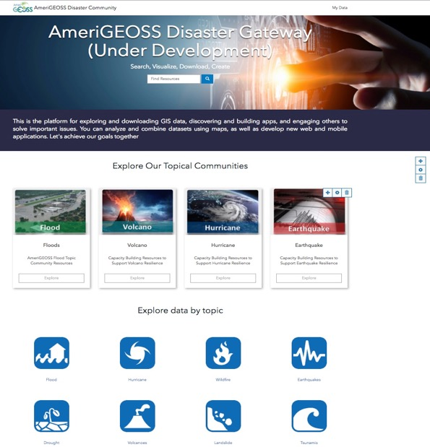
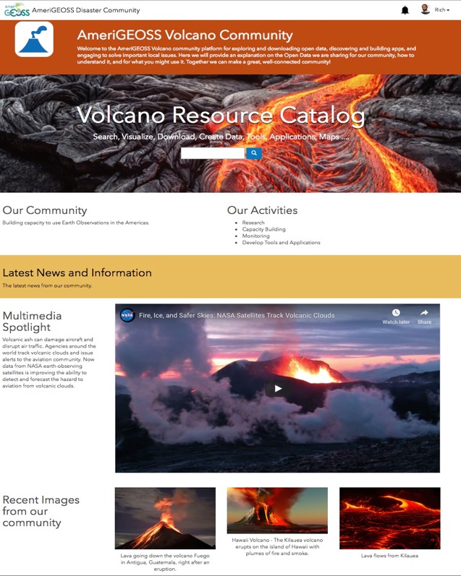
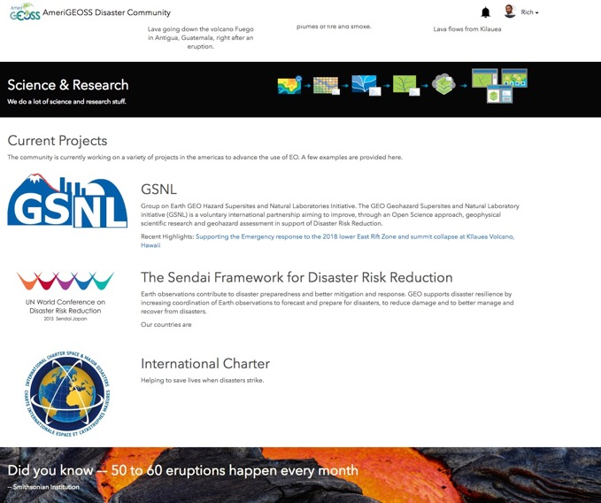
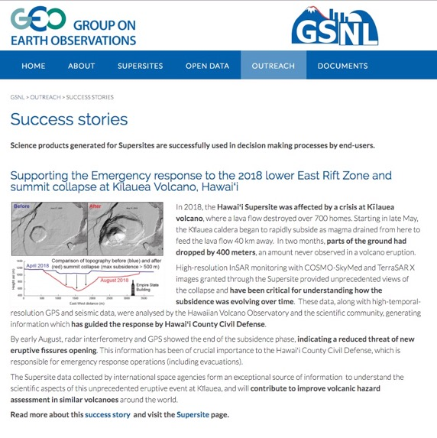
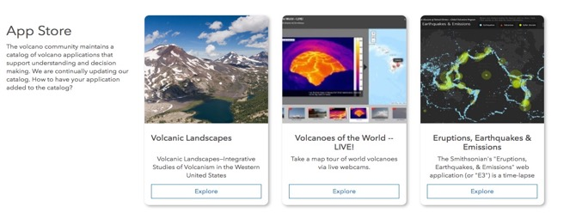
AmeriGEOSS / Platform Overview
Disaster Resilience

Slide 9
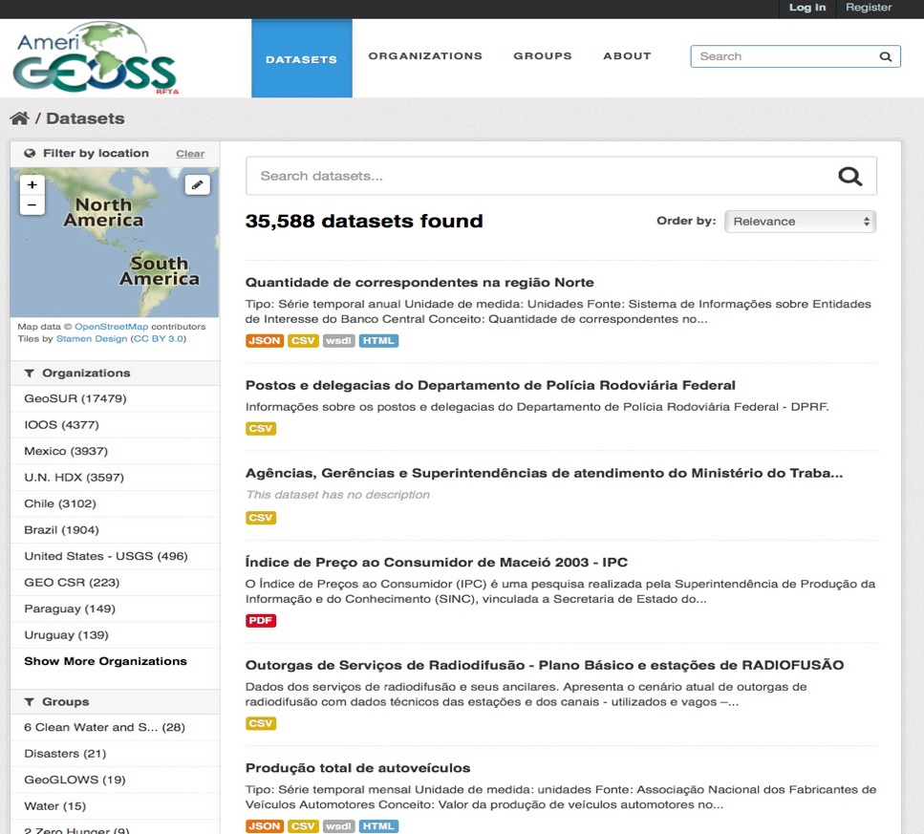
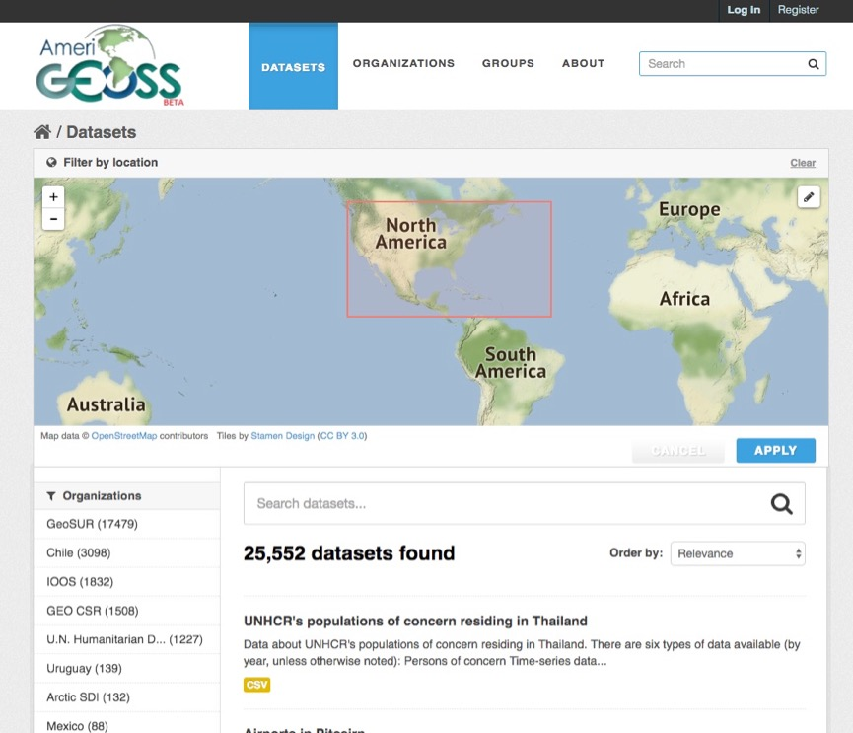
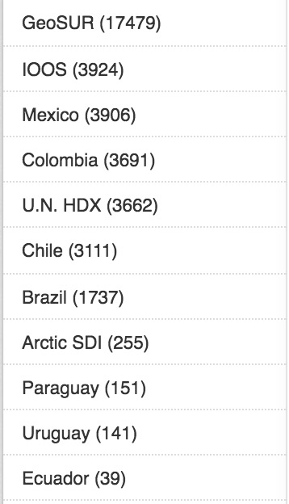
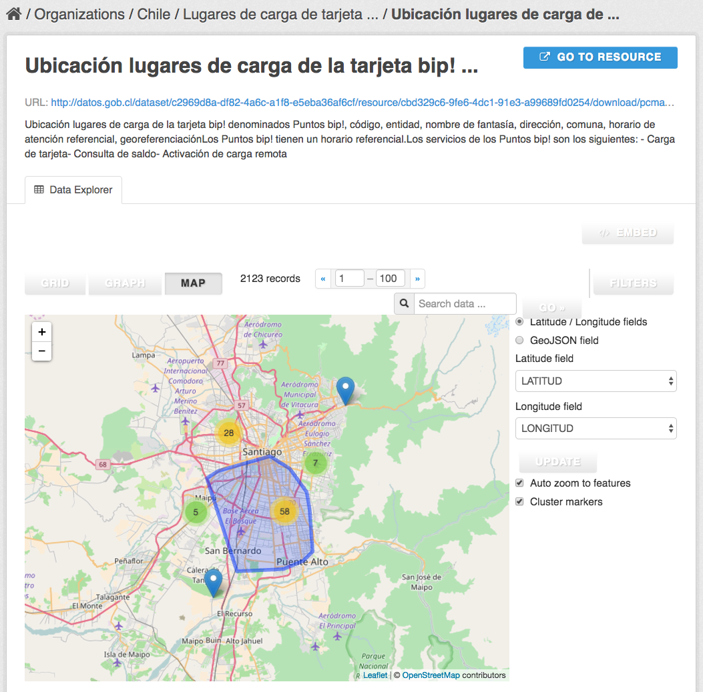
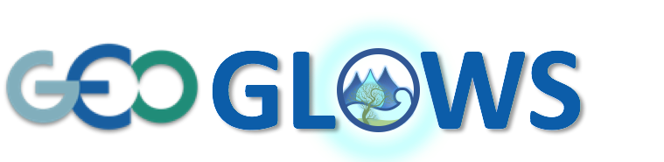
AmeriGEOSS / Platform Capabilities
About AmeriGEOSS Initiatives | Data | Tools | Products | Services | Resources |
Search
- Text¹, Faceted² and Spatial Search³
1
3
Find
- Resources in many Formats⁴
4
Use
- Multi-platform support⁵
2
5
Notes:
The platform provides a variety of methods to search for data, find data in various formats and use the resources from a variety of platforms and devices. The AmeriGEOSS Data-Hub uses the CKAN open source platform to provide access to and link resources in the region.
The search tools allow the user to search and discover resources through several methods:
Keyword text search
Faceted search
Spatial search
Formats - Formats can be searched in the faceted search tool. The search results also presents the available formats so users can more easily find the exact resources they need.
The platform operates on many platforms including desktops, tablets and phones for our user community.

Slide 10
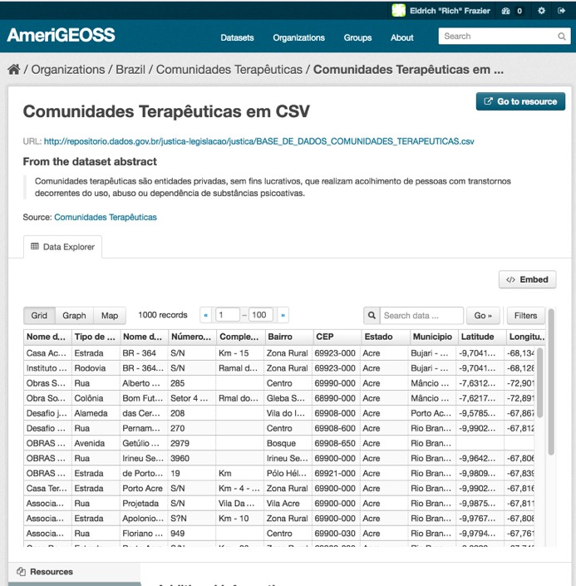
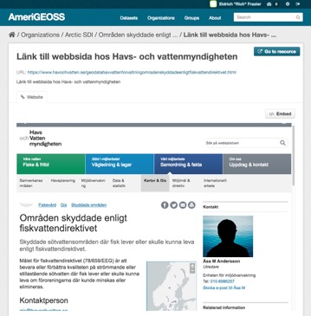
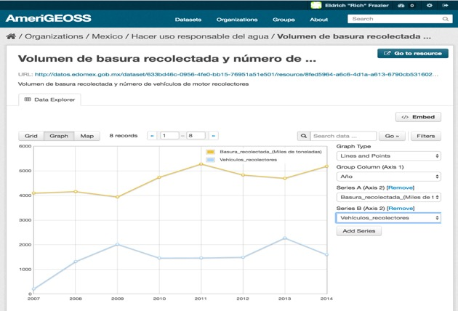
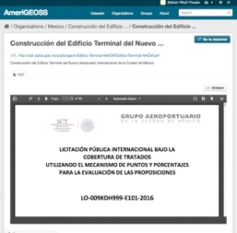
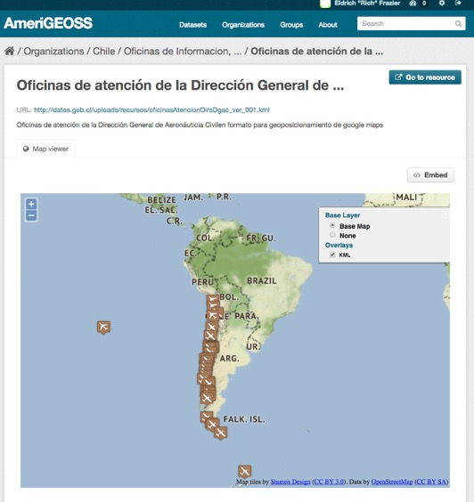
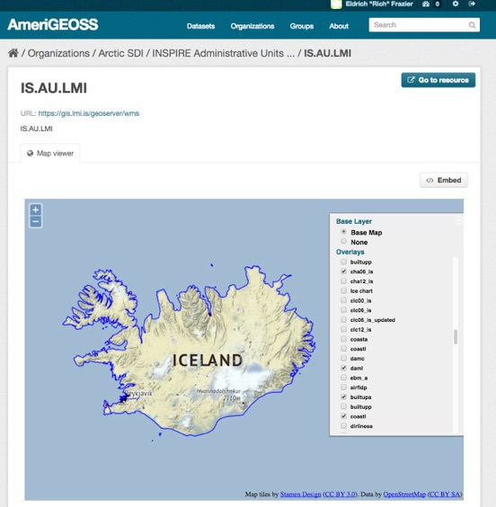
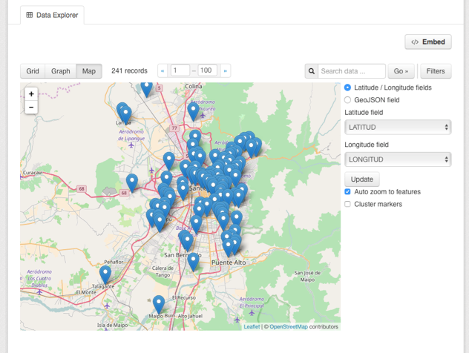
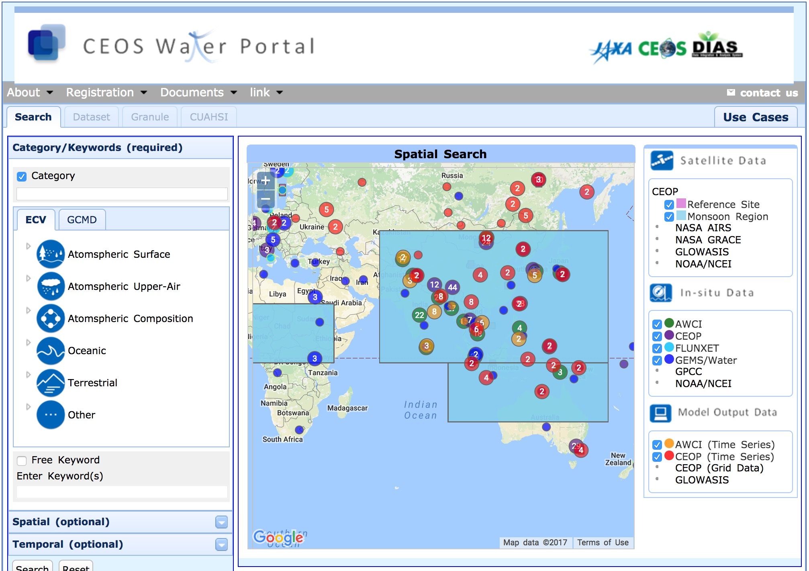
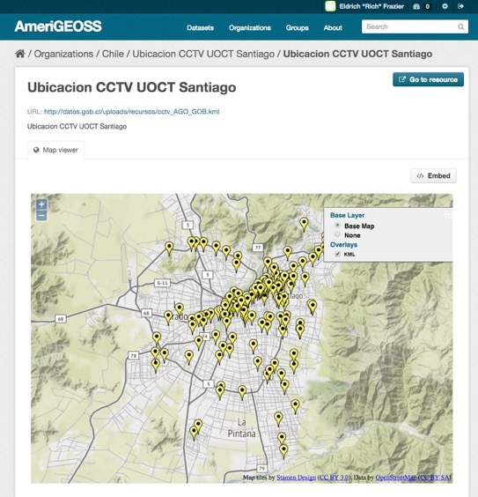
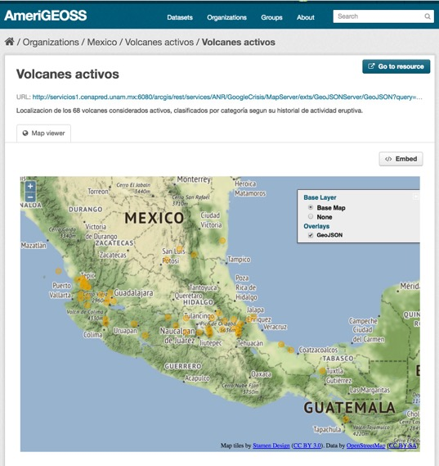
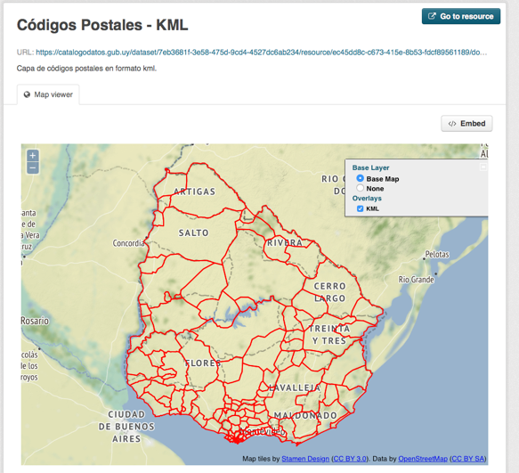
AmeriGEOSS / Platform Capabilities
About AmeriGEOSS Initiatives | Data | Tools | Products | Services | Resources |
Carlos Maia
Luis Miguel
3
Use Reports and Tools
PDF
TXT
PNG
PDF
XLS
CSV
RTF
DOC
HTML
GIF
XLS
1
Interact With Data and Tools
2
Create Graphs, Charts, Maps and More
WMS
WFS
WMTS
GeoJSON
GML
KML
ArcGIS Rest API
GFT
Notes:
The platform provides a variety of methods to search for data, find data in various formats and interact the resources from a variety of platforms and devices. This is one of the most powerful components of the AmeriGEOSS Community Platform. It expands beyond other search-discovery platforms to provide a search-discovery-visualization-exploitation platform!
Users can interact with data and documents. These screenshots demonstrate how the user can discover and interactive with:
Tabular data from Brazil. This query tool allows for sorting, querying and graphing
2) Users can create graphs, charts, maps and more
Map data from Colombia
After a user discovers resources that are of use, they can view reports and dashboards.
Dashboards are collections of related resources grouped together for sharing and collaboration

Slide 11
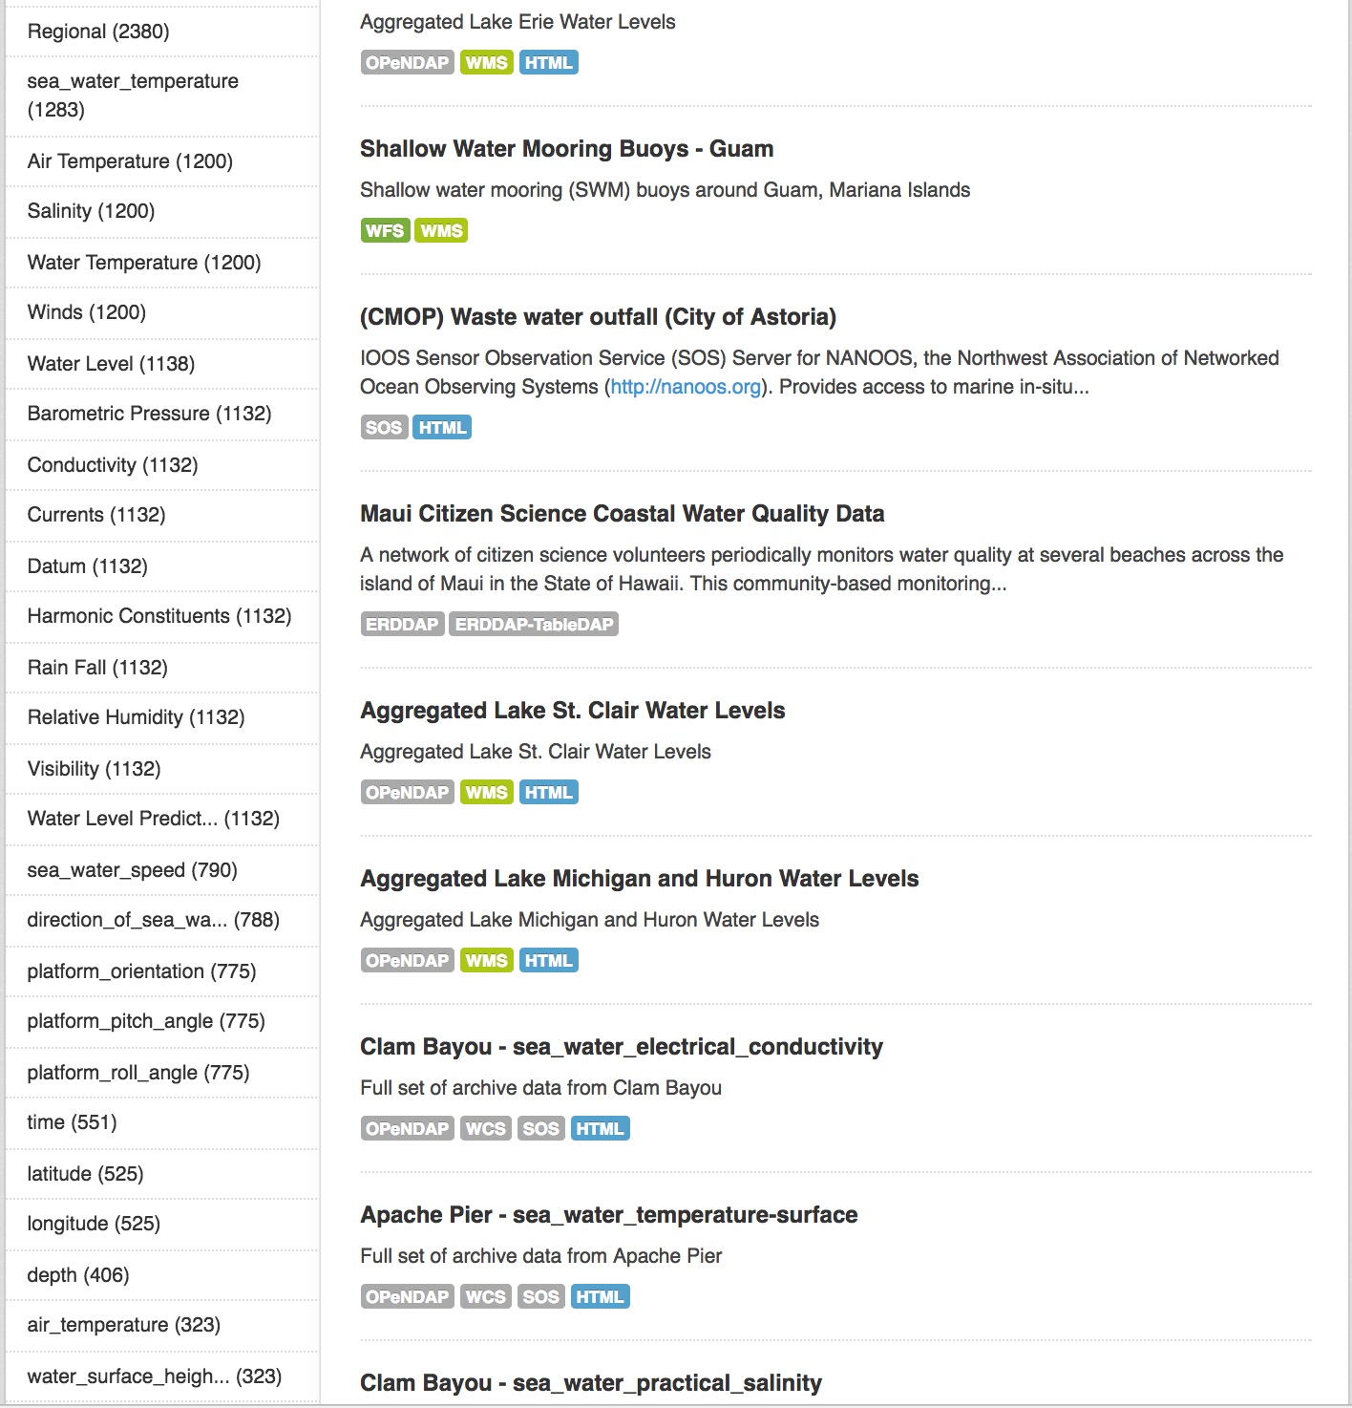
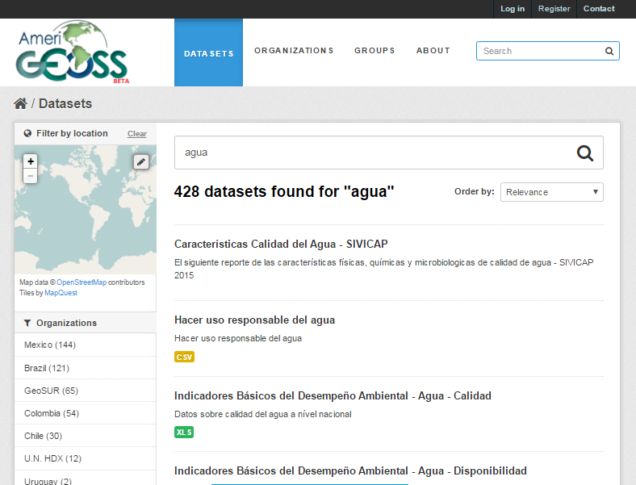
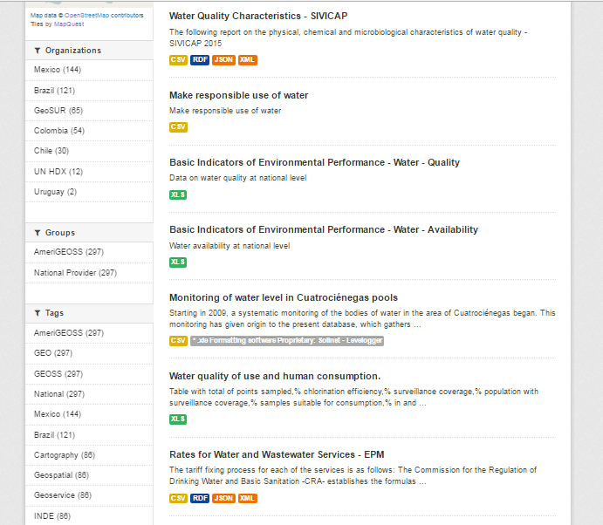
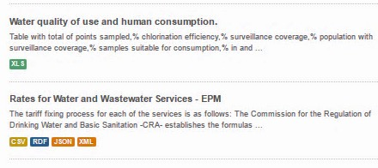
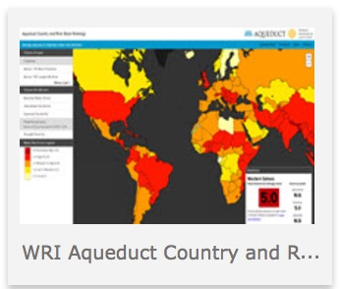
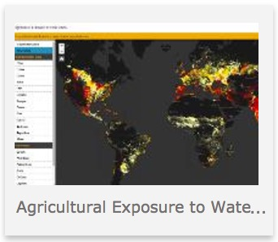
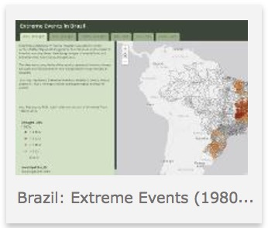
AmeriGEOSS / Platform Capabilities
About AmeriGEOSS Initiatives | Data | Tools | Products | Services | Resources |
Explore Social, Economic and Environmental , Reports, Information, Indicators…..and More
Find Water Data
1
Water Variables
2
3
Water Reports & Indicators
4
Use maps, applications and other analytical tools
CEOS Water Portal
Notes:
One of our community initiatives is GEOGlows. We are initiating efforts to support capacity building to understand water use, water availability, and water quality. The outcomes of these activities will support clean water and sanitation efforts under SDG 6.
[CLICK] - Through the platform a researcher or analyst can find water data
- In this example, I search on aqua and the matching results were provided to me
[CLICK] - Access a variety of hydrometric data to understand variables and
- Using the faceted search tools in the left side panel, I can filter through the results according to the water variables that meet my exact needs
3) [CLICK] - After completing searches, the user can access reports, community developed maps, applications and analytical tools to support understanding and decision-making.

Slide 12
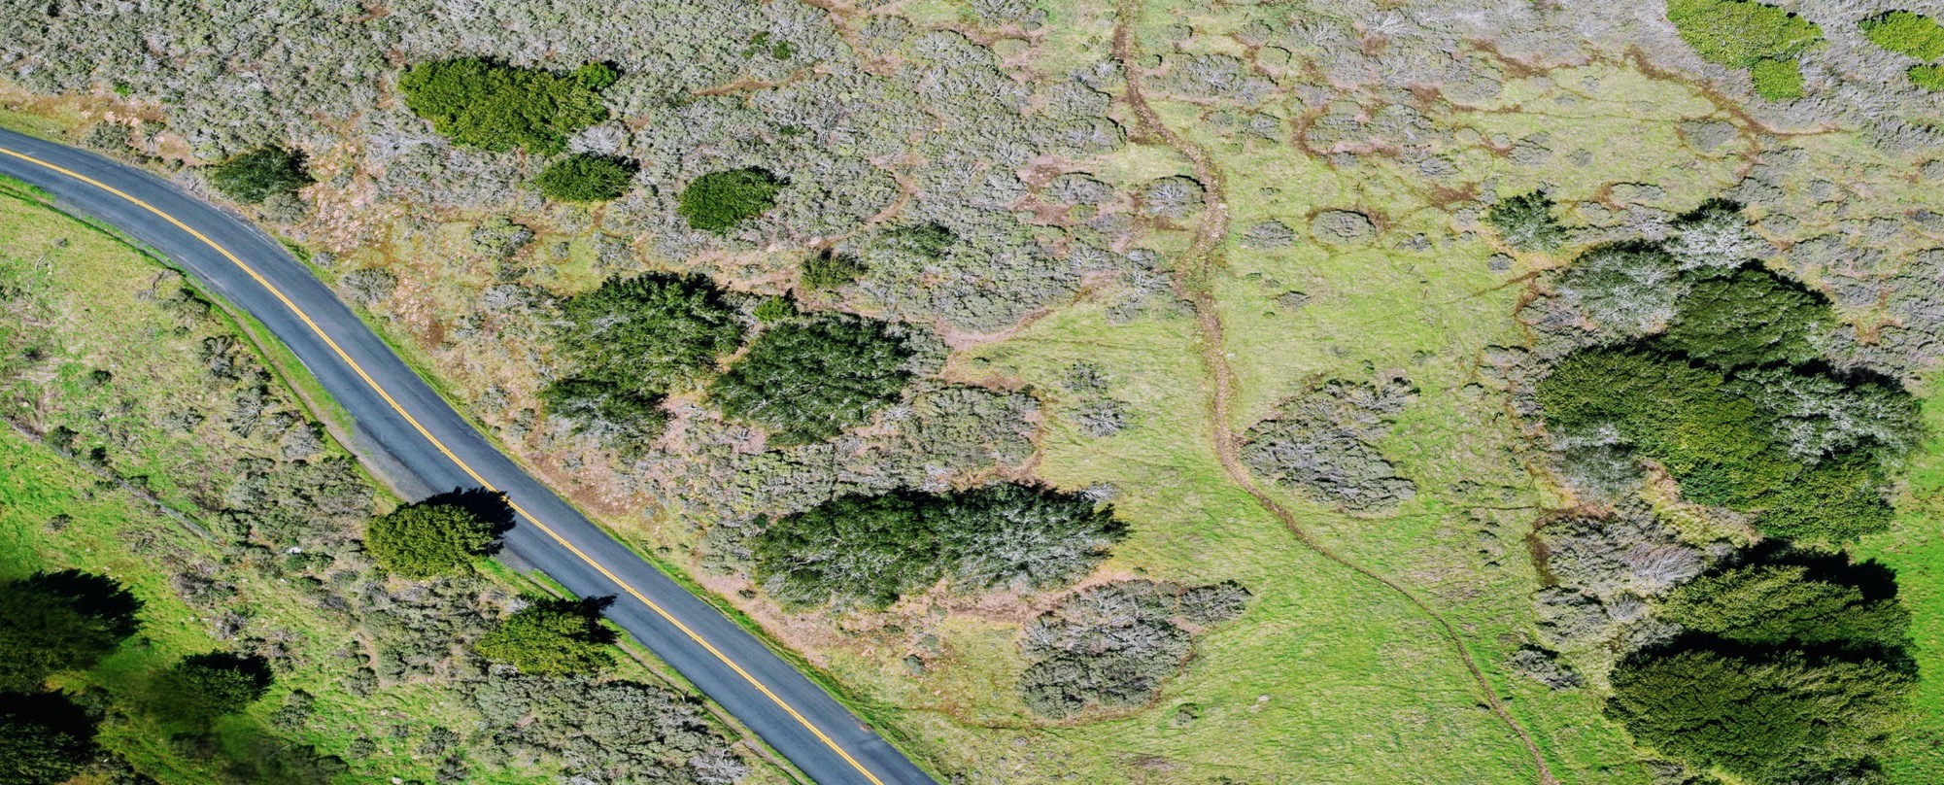
AmeriGEOSS / Implementing Regional GEOSS
Leveraging Systems & Emerging Technologies
Data Cubes and Data Analytics Systems
GEOSS Platform

Slide 13
AmeriGEOSS / Platform Capabilities
Imagery Analytics – Build Capacity in the Region to use Imagery as a resource in Decision Making
Domo Planas
How has the environment changed 1997 – 2017?
Notes:
The AmeriGEOSS community acknowledges that imagery is a powerful resource that can improve understanding and decision-making. We are developing a tool that will allow novice and advanced users to leverage imagery for improve understanding and decision making.

Slide 14
Community Platform Overview
CEOS WGISS/GEOSS Workshop
October 24, 2018
Angélica Gutiérrez-Magness, Chair of the AmeriGEOSS Initiative
Rich Frazier, AmeriGEOSS Foundational Working Group

