Slide 1
SEO Report to WGISS-47
Brian Killough
NASA Langley Research Center CEOS Systems Engineering Office (SEO)
WGISS-47 Meeting
April 29, 2019

Slide 2
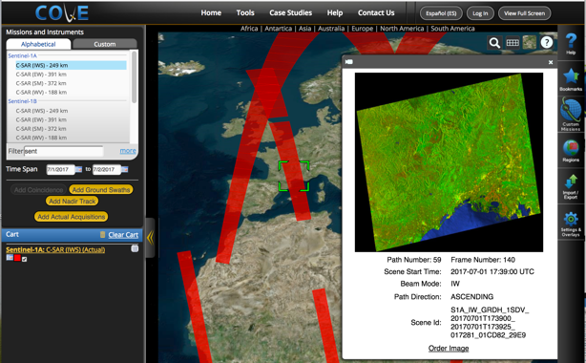
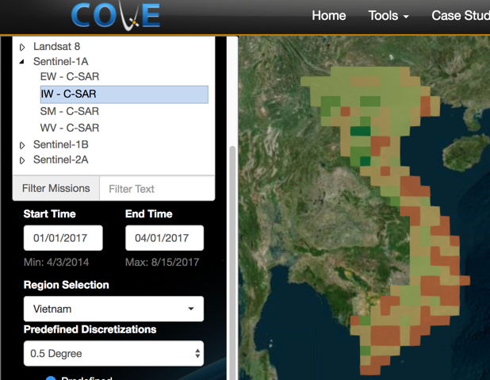
COVE Tool Summary
The CEOS Visualization Environment (COVE) is a browser-based suite of tools for searching, analyzing, and visualizing actual and potential satellite sensor coverage.
COVE is FREE and OPEN for anyone to use! There is a large international user base with 4000+ users.
COVE includes 131 missions and is linked to several mission archives to get metadata and browse images for past acquired data: Landsat-5/7/8, Sentinel-1, Sentinel-2, and CBERS-4.
Coverage Analyzer and Data Browser: New tools for coverage assessments and scene data to support data ordering. www.ceos-cove.org

Slide 3
COVE Status and Plans
The SEO lost our COVE developer in late 2018. Due to the holidays and government shutdown, we were not able to replace this person until March 2019. Our new developer, Kim Brooks is on-board and working.
Shaun Deacon has moved from AMA (contractor) to NASA and is no longer supporting the CEOS project. The rest of the AMA team and the new COVE developer will cover Shaun’s previous work on automated links to mission archives.
For the rest of 2019 ... we plan to complete enhancements to the Coverage Analyzer and Data Browsers tools, improve and increase links to mission archives, add a custom mission capability to support future mission concept studies, improve coverage and revisit calculation products, and add historical cloud coverage reports.
Links to archive databases are a constant issue, as things change on the data provider side. Issues with the Sentinel archives have been resolved. Issues with other missions (e.g. SPOT, Pleaides, Radarsat-2, ALOS, TerraSAR-X, ResourceSAT-2) are more problematic. Our primary focus is to get links to Landsat and Sentinel-1/2 working well, as they are the most desired.
Our COVE tool runs on AWS. With the Landsat and Sentinel datasets moving to AWS S3, we plan to use those archives for our mission metadata and browse images.

Slide 4
Data Flow Issues and Solutions
GOAL: Global (or at least on-demand) Landsat, Sentinel-1, Sentinel-2, and ALOS-PALSAR level-2 analysis-ready data (ARD) in cloud-optimized GeoTIFF (COG) format on AWS-S3. This will support a number of global data cube projects and provide an efficient cloud-based data flow solution.
Landsat ... Level-2 surface reflectance data on AWS-USA-West by the end of 2019 !!!
Sentinel-1 ... Sinergise currently copies global GRD (level-1) to AWS-Frankfurt and converts to COG format since 1.1.2017. This data is registered as an "AWS Open Dataset". We need to get older GRD files (pre 2017) to AWS, which is about 330,000 scenes and 300 TB. CREODIAS and Alaska Science Facility (ASF) are the only groups that hold this data. Once on AWS-Frankfurt, the SEO is planning to fund egeos to expand their CUBEO tool to produce on-demand level-2 gamma-nought backscatter intensity data cubes.
Sentinel-2 ... Level-2A on AWS-Frankfurt: complete archive from ESA (Europe from mid-April 2017) and global since mid Dec 2018. This data is registered as an "AWS Open Dataset". There is a desire to get older global data (Dec 2016 to Dec 2018) processed and added to this archive. There are ~4.1 million scenes. The SEO is evaluating cost and time estimates needed to process this data.
NOTE: The S1 and S2 solutions (above) require AWS to agree to host the data!

Slide 5
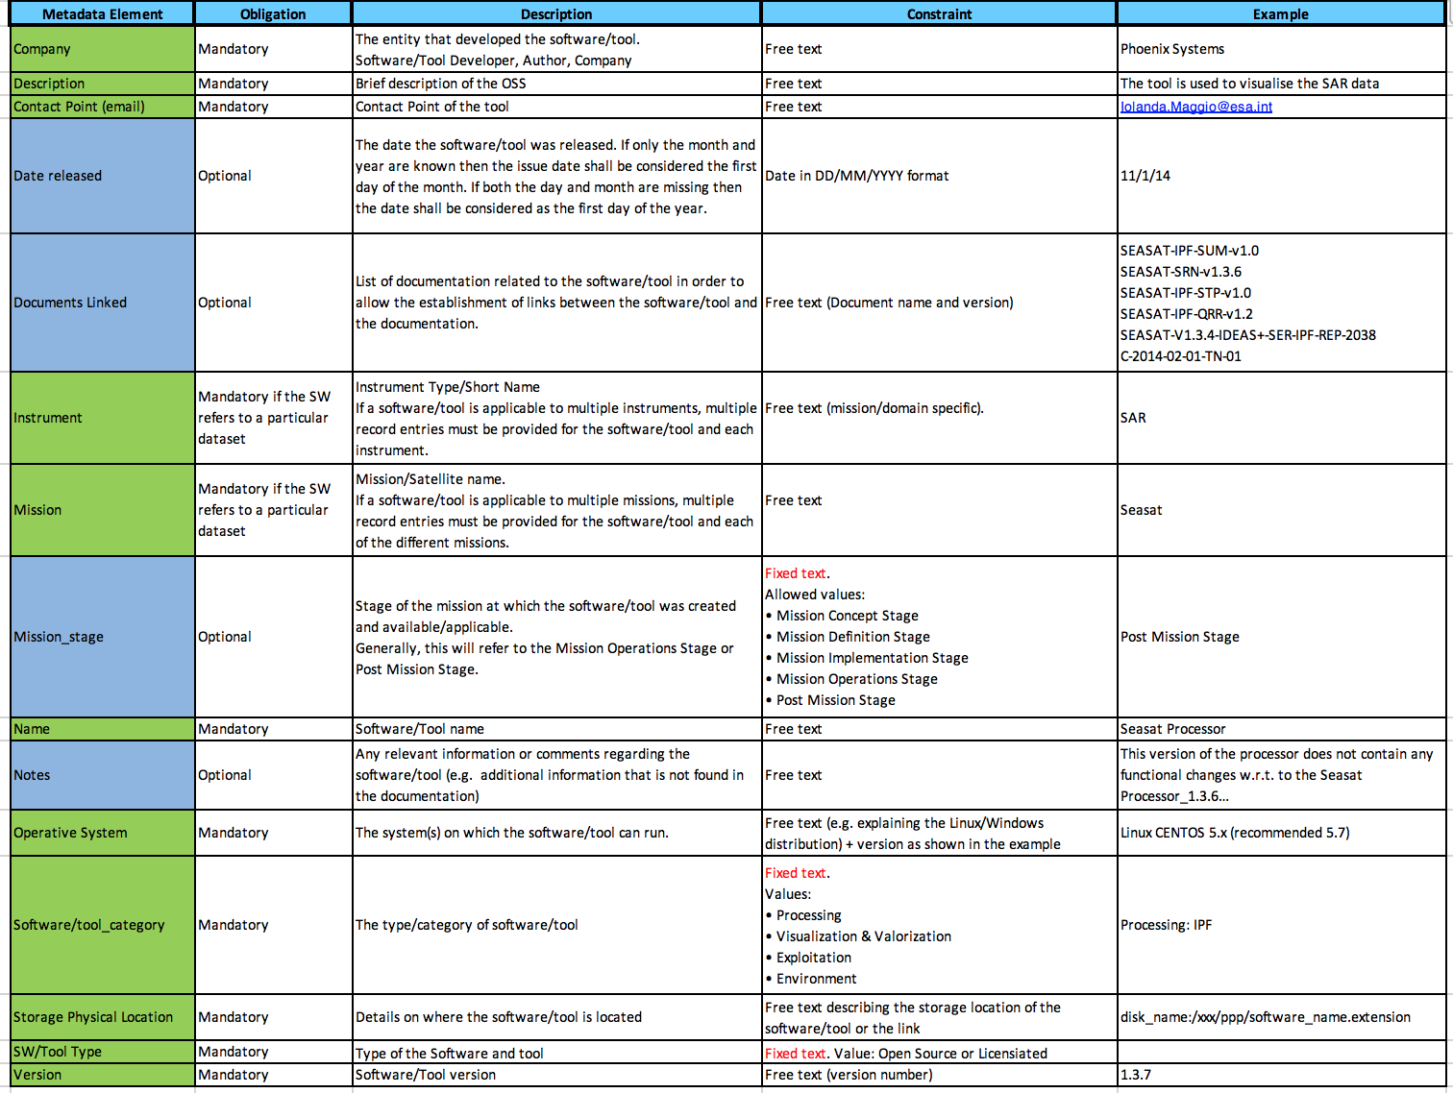
OSS Inventory
The SEO team is working with Lolanda Maggio (ESA) to develop an Open Source Software (OSS) Inventory (CEOS Action FDA-10). Lolanda will report on the details of this task later in the WGISS agenda.
The SEO received a list of 150 OSS items to add to the new database. This data includes name, description, POC, mission, instrument, company, release date, operating system and web location.

