Slide 1
ESA EO Data Preservation System: CBA Infrastructure and its future
LTDP+ Team

Slide 2
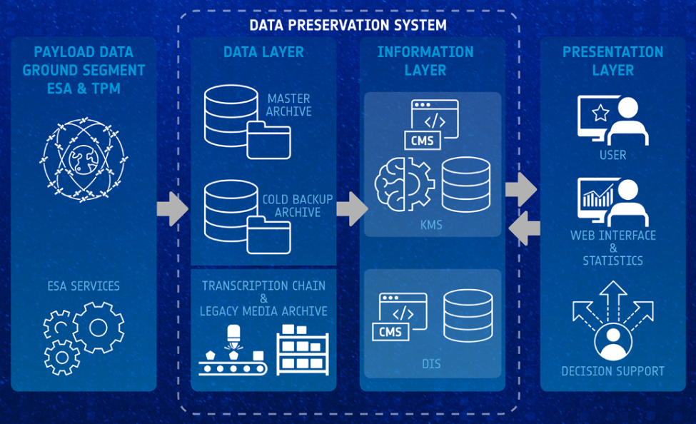
Data Preservation System

Slide 3
Preservation Element Front End (PE-FE)
Data flow between live missions and Data Preservation System via a common Front-end
Cryosat-2
Master Archive
Ingestion report
SMOS
Preservation Element Front-End
Data Information System
AEOLUS
_{TPM}
Cold Back-up Archive
Ingestion report
Data Reprocessing

Slide 4
Master Archive - Data Archive Service (DAS)
Implements the ESA Master Archive through a dedicated service awarded to industry through an open ITT:
Contract Kicked-off in August 2016
4.5 TB of EO consolidated Data
Two copies of the data held > 200 Km apart
Connection to the ESA EO WAN
Checks of the data at all stages from ingestion to delivery
Scalability required for growth of contents
Management of the data information (MetaData) in fully redundant Databases

Slide 5
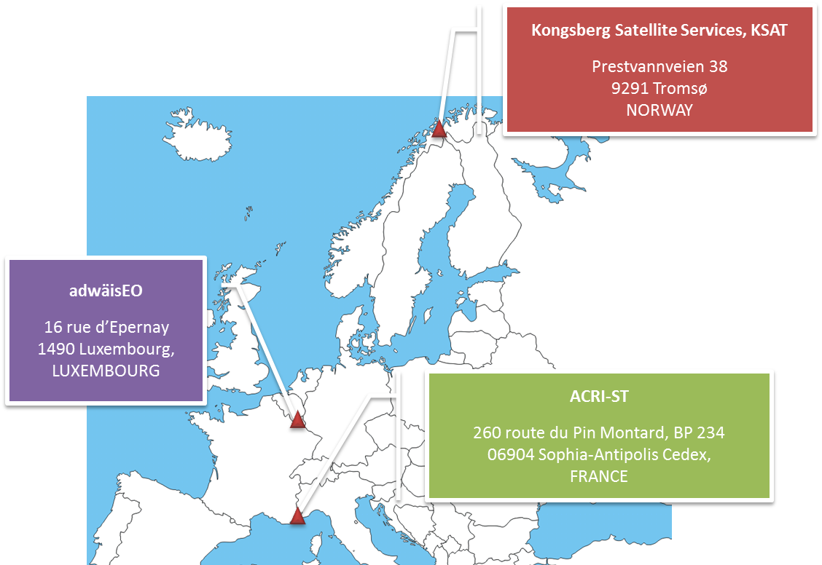
DAS Consortium
The industrial consortium is made of ACRI-ST (FR), adwäisEO (LU) and KSAT (NO), with the following distribution of roles:
ACRI-ST: Data Archiving (and delivery) Service provider – Prime contractor
adwäisEO: data archiving (and delivery) operation provider with its leading edge IT and connected secured infrastructure in Luxembourg
KSAT: data knowledge provider and overall ingestion validation

Slide 6
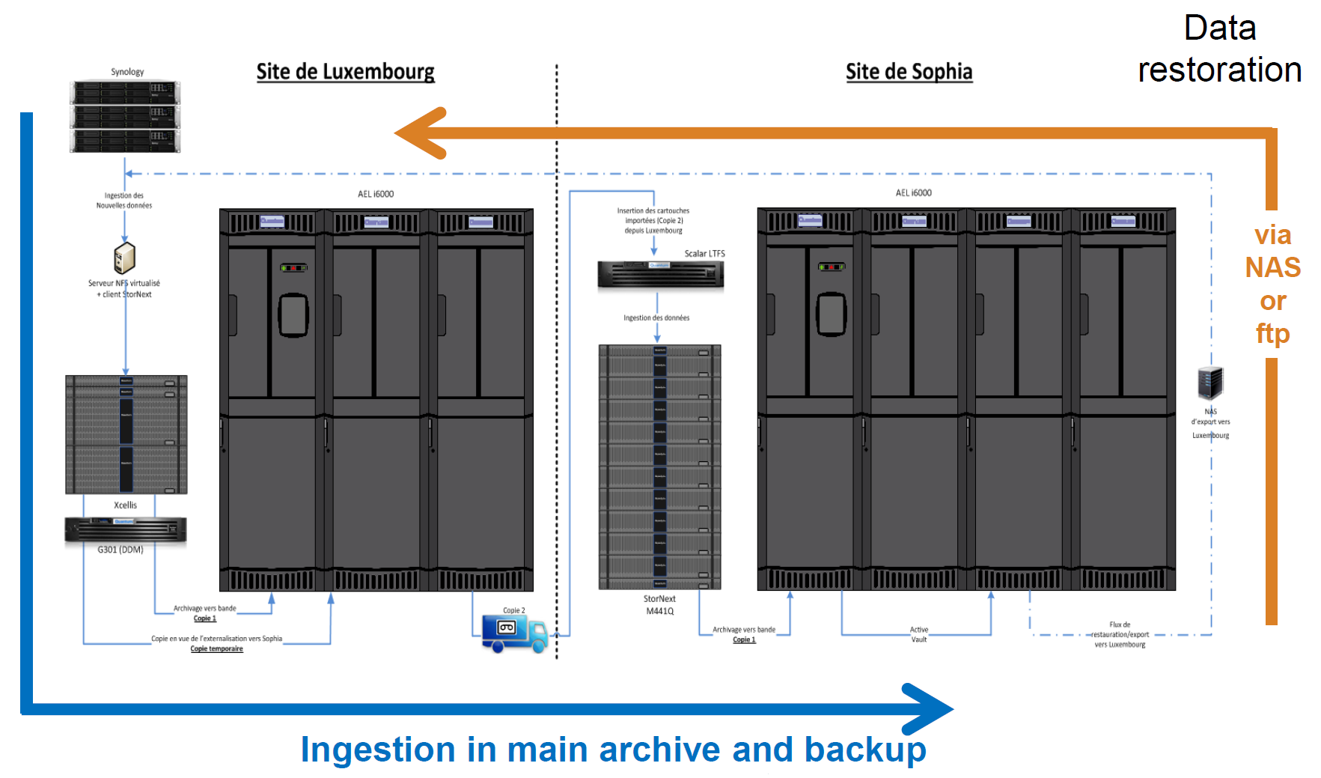
DAS Infrastructure
Data ingestion
Data evolution
Data alignment
Data Management System
Tape transfer to Backup Archive
Data retrieval

Slide 7
DAS Data flow

Slide 8
Cold Back-up Archive (CBA)
Implemented in May 2014
Unique data & Unconsolidated data
PAC and Station Phase-out project data
Inter-directorate disaster recovery archive
Second copy of the Master Inventory
Live mission support to PDGS’s
Odin
Proba-1
SCISAT
Two copies of the data held at ESA premises in Frascati
ESA Internal LAN
Main Tape Library capable of storing 24 Petabytes
Live Mission support
Swarm (started in mid 2014)
Cryosat-2 (started in March 2015)
SMOS (started in May 2016)
AEOLUS (supported at day zero)
EO-SIP, SAFE and Native Format archiver

Slide 9
CBA Figures
Mission | Uncons. | Cons. | Native | EO-SIP | LIVE
ERS-1/2 | X | X | X | X
Envisat | X | X | X | X
Cryosat-2 | X | X | X | X | X
SMOS | X | X | X |  | X
SWARM | X |  | X |  | X
AEOLUS |  |  |  |  | X
Goce | X |  | X
Adeos | X |  | X
ALOS | X | X | X | X | X
GOSAT | X |  | X |  | X
Ikonos-2 | X |  | X | X
IRS-P3 | X |  | X
JERS-1 | X | X | X | X
Kompsat-1 | X |  | X
Landsat-1,8 | X | X | X | X | X
MOS-1,1b | X |  | X
Nimbus | X |  | X
NOAA-7,19 | X |  | X
Oceansat-2 | X |  | X |  | X
ODIN | X |  | X |  | X
PROBA-1 | X |  | X |  | X
QuickSCAT | X |  | X
Rapideye | X |  | X
Scisat | X |  | X |  | X
Seasat | X | X | X | X
SeaStar | X |  | X
SPOT1-2 | X |  | X
TerraSAR | X |  | X
WorldView-1,3 | X |  | X | X
Windsat | X |  | X
Average write a day: 13TB
Peak read a day: 10TB
Amount of Data (JAN 2019) 7.95 Petabyte | Number of Files (JAN 2019) 129,500,000

Slide 10
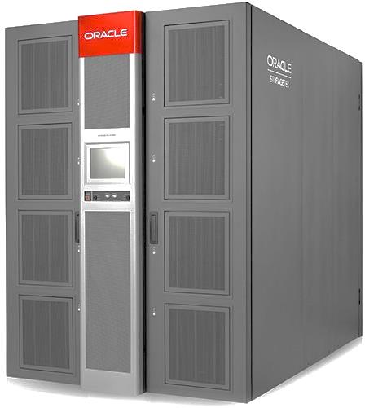
CBA Main Tape Library
STK SL8500
3000 slots
8 T1000D Drives (252 MB/s)
8 Robotic Arms
Fully redundant
16 GB Fibre Connection
SSD Disk based cache
ORACLE HSM driven

Slide 11
CBA Ingestion tool
Bulk Ingestion from local or remote locations
Automated Ingestion from inbox baskets
EO-SIP and SAFE Validation
Metadata extraction
Reporting
Ingestion Confirmation Reports
Data Information System population

Slide 12
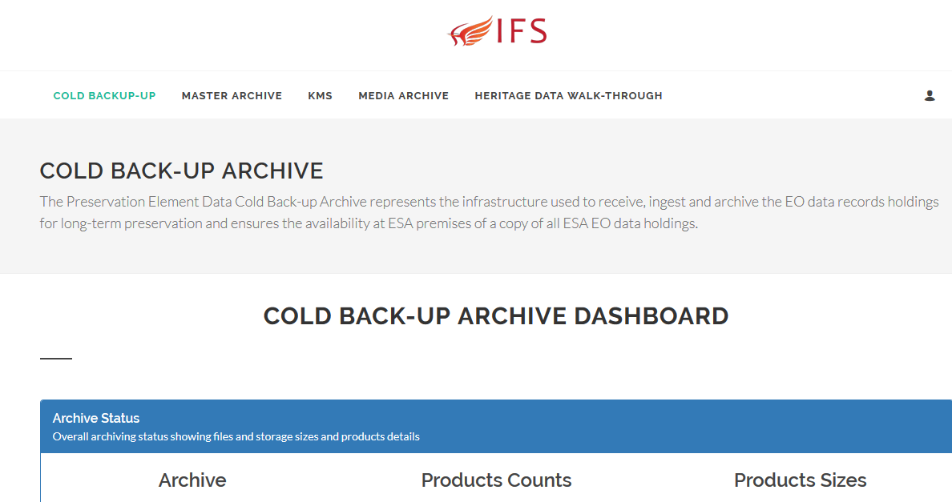
Preservation Element Web Portal
Media Archive
Documentation
Ingestion status reports
Extraction status and Reports
Cold Backup Figures
Link to DAS datasets
Knowledge

Slide 13
CBA Hardware

Slide 14
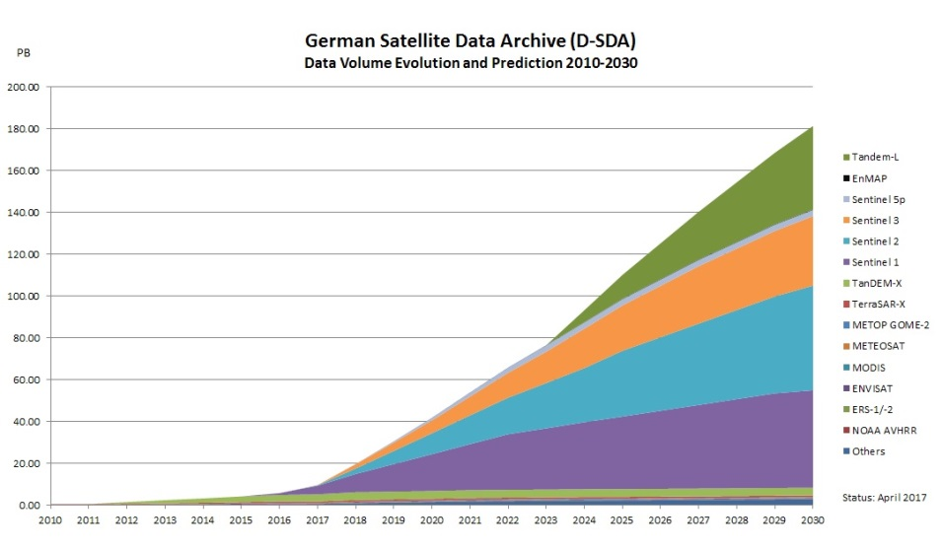
LTDP Working Group #37 – DLR Presentation

Slide 15
Cold Back-up Archive HW enhancements
Migrated technology and data from T10KB to T10KD
Increased number of drives to 8
Implemented 10GB Network
Upgraded FC environment from 8gbp/s to 16gbp/s
Upgraded 1rst tier from mechanical HDD to SSD Disks
Optimized 1st tier – dedicated LUN for iNodes
Implemented Disaster Recovery
Implementation of Business Continuity (1h)
Introduction of 2nd tier (sort of)
Migration to LTO-9
Introduction of object storage node (replace DR library ?)
2014
2015
2016
2017
2018
2019
2020
2021

Slide 16
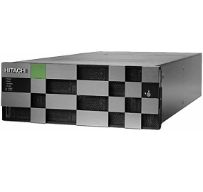
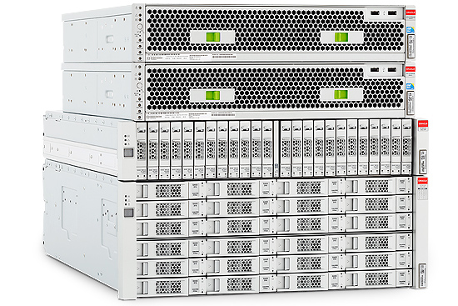
Dedicated LUN for iNodes
RAID
RAID-1
RAID
LUN1
LUN2
LUN3
LUNn
LUN
LUN1
LUN2
LUNn
SAM-FS Master Configuration File
SAM-FS Master Configuration File
iNodes
HSM File-System

Slide 17
Business Continuity

Slide 18
Business Continuity (2)

Slide 19
Business Continuity (3)
Disaster Recovery Library seen as second copy by samfs-remote
Full iNodes dump performed daily
Incremental iNodes dump performed every hour
Live Data
INBOX
LTA
samfs remote sync
Disaster Recovery
Tapes
Inbox
inodes
dump
Disaster Recovery
HSM
Full
inodes
dump

Slide 20
Business Continuity (4)
IP switch
Fully working CBA Environment
Maximum of 59 minutes of data loss

Slide 21
Re-Introduction of 2nd Tier

Slide 22
Large Tape User Group outcome
Technology progress per se is good, but obstacles ahead (NAND, HDD)
Key computing markets in the hand of very few companies
Price/performance advances are slowing down
HDD are a key storage for the foreseeable future, SSDs not cost effective for capacity
Have to closely watch the tape development
There will be NO relevant new storage technologies in the market in the coming few years (e.g. DNA storage)
Holistic view needed for the storage architecture, careful combination of SDD, HDD and Tape to optimize pure storage needs and high throughput I/O

