Slide 1
WMO Stewardship Maturity Matrix for Climate Data (SMM-CD)
– An Update and Possible Collaboration
Ge Peng ¹, William Wright ², Christina Lief ², and
Omar Baddour ²
¹North Carolina State University, Cooperative Institute for Climate and Satellites–NC (CICS-NC) at NOAA’s National Centers for Environmental information (NCEI)
²Commission for Climatology (CCl) of World Meteorological Organization (WMO)
May 1, 2019
The 47th Meeting of the Working Group
on Information Systems & Services
Silver Spring, MD, USA
April 29 – May 2, 2019

Slide 2
World Meteorological Organization (WMO)
Intergovernmental organization,
Specialized United Nations’ Agency (weather, water, and climate) with 192 member countries and territories.
WMO’s Commitments
Open data & data sharing: free exchange of data and data products,
High-quality data, information, and services: science, policy and decision-making support.
WMO fosters international collaboration
Develop technical guidance and standards for the collection, processing, management of data and forecast products.
Notes:
WMO has defined requirements on open data and data sharing; quality and access of the data products;.

Slide 3
Increased data stewardship requirements, especially on the data and products that support scientific findings and policy- and decision-making
– transparent, traceable, reproducible, etc.
Best practices have been established by various countries and programs to ensure scientific and stewardship quality
– standardized practices and procedures are beneficial to Members and global data centers
Notes:
More and more requiremens on those supporting policy and decisions. However, the implementation has been up to individual programs or member countries.

Slide 4
To help its Members address those stewardship challenges, WMO established the High-Quality Global Data Management Framework for Climate (HQ-GDMFC) initiative, under the technical guidance from CCl and Commission for Basic Systems (CBS).
Other Key Sponsors & Stakeholders:
WCRP (World Climate Research Programme);
JCOMM (Joint WMO-IOC Technical Commission for Oceanography and Marine Meteorology);
CHy (WMO Commission for Hydrology);
GCOS (Global Climate Observing System)
Notes:
IOC: Intergovernmental Oceanographic Commission http://www.unesco.org/new/en/natural-sciences/ioc-oceans/high-level-objectives/climate-change/);

Slide 5
HQ-GDFMC
A collaborative Framework that enables an effective development and exchange of high-quality climate data based on reliable underpinning infrastructure at the global, regional, and national levels.
Notes:
It aims at making use of these high-quality climate data needed for developing climate services, for policy and decision making in a variety of applications

Slide 6
HQ-GDMFC
High Quality-Global Data Management Framework for Climate
Manual
on HQ-GDMFC
Matrix
Stewardship Maturity Matrix for Climate Data (SMM-CD)
Catalogue
WMO Catalogue of Climate Data
Goal: consistent guidance on best practices and standards for managing high-quality global climate data
Goal: consistent maturity information of data management, stewardship, and governance practices
Goal: high-quality data source; quick discovery and access of usable and authoritative climate datasets
Discoverable, Accessible, Usable, Authoritative,
High-Quality, and Well-Managed Climate Datasets
Notes:
Reference Manual sets a strong regulatory foundation for consistent definitions, clearly identified data management operations and guidance on related governance and policies.

Slide 7
Stewardship Maturity Matrix for Climate Data (SMM-CD)
A stewardship maturity assessment model in the form of a matrix,
Assessing how well climate datasets are managed and governed.
Maturity Matrix: A sequence of maturity levels representing desired evolution path with progressive stages from a more ad hoc approach to a more managed process.
(Based on Becker et al. 2009, Business & Information Systems Engineering)
SMM-CD has been developed by the members of an International Expert Group on Climate Data Modernisation (IEG-CDM) under the WMO HQ-GDMFC initiative.
Notes:
WMO has defined the requirements on open data and data sharing; quality and access of the data products; More and more requirements on those supporting policy and decisions. However, the implementation has been up to individual programs or member countries.
Largely based on existing maturity models, leverging community best practices and national/international standards.

Slide 8
The Structure of SMM-CD
SMM-CD Category
Data Access | Usability & Usage | Quality Management | Data Management
Discoverability | Data Portability | Quality Assurance & Control | Preservation
Accessibility | Documentation | Quality Assessment | Metadata
 | Usage | Uncertainty Analysis | Governance
 |  | Data Integrity
Aspect
The state or ability to locate (Discoverability) and get to the dataset (Accessibility)
How easily the data product may be understood and integrated by users; the usage and impact of the dataset
The state of quality assurance, control, and assessment; data uncertainty and reliability, and data free from corruption
The state of the dataset preservation, metadata completeness, and governance practices
Notes:
Four categories are agreed on by the SMM-CD Working Group and the members of the expert group.

Slide 9
SMM-CD: Maturity Scale Structure
Level 5: Optimal
Level 4 +
Measured, Controlled, Audited
Open
Managed
Trusted
Level 4: Advanced
Well-Managed; Well-Defined;
Fully Implemented
Level 3: Intermediate
Managed; Defined;
Partially Implemented
Level 2: Minimal
Limit Managed; Not Defined
Level 1: Ad Hoc
Not Managed
Risk
Ad Hoc
Reference Maturity Level Structure
Capability Maturity Model Integration (CMMI)
Levels of Maturity of Digital Repository
Notes:
It is adopted from that of DSMM, which referenced maturity level structure, not the definitions, from CMMI and Level of maturity of digital repository.

Slide 10
The SMM-CD Definitions – Quality Management
Quality Management | Level 1 Ad Hoc Not Managed | Level 2 Minimal Limit-Managed Not Defined | Level 3 Intermediate Managed Defined, Partially Implemented | Level 4 Advanced Well-Managed Well-Defined, Fully Implemented | Level 5 Optimal Level 4 + Measure, Controlled, Audited
Quality Assurance & Control | Ad hoc or no data quality assurance (QA) & control (QC) procedure or information unknown | QA/QC procedure are defined, documented, and partially implemented | QA/QC procedure are well-defined, according to community best practices, documented and fully applied | Level 3 + provision of error statistics published or tracked with results made available online and commutated to data providers; Procedure for user feedback, improvement prioritization in place | Level 4 + Detailed analysis of errors and gaps at space-time unit level: (Station, grid points, daily, monthly and or annual time-scale, etc.) QA/QC procedure monitored.
Quality Assessment | Product quality assessment not done or done internally and information not available | Assessed by Principal Investigator (PI) or data producer; Assessment results available online | Level 2 + Product validation and evaluation done by PI published in peer-reviewed journal | Level 3 + Independent product validation and evaluation published in peer-reviewed journal | Level 4 + The complete product provenance is captured and publicly available
Uncertainty Analysis | Uncertainty estimates not available | Uncertainty estimates presented without explanation | Uncertainty estimates presented with partial explanation | Full uncertainty budget available with all assumptions; Estimates of accuracy of trend available | Full uncertainty assessment published in peer reviewed journal
Data Integrity | Unknown or no data integrity check | Random data integrity check. | Data integrity verified systematically but methodology not commonly known. | Data integrity systematically verified and following well known practices but not necessarily consistent across platforms. | All steps in data integrity check systematically verified and adhering to well-known practices and reported.
(Definitions on Uncertainty Analysis: GCOS secretariat)
Notes:
Either uncertainty analysis has not yet been done or results are not available publicly; just global uncertainty characterization, e.g. +/- x% without further explanation; Some of the underlying assumptions and the method used e.g. “error propagation”

Slide 11
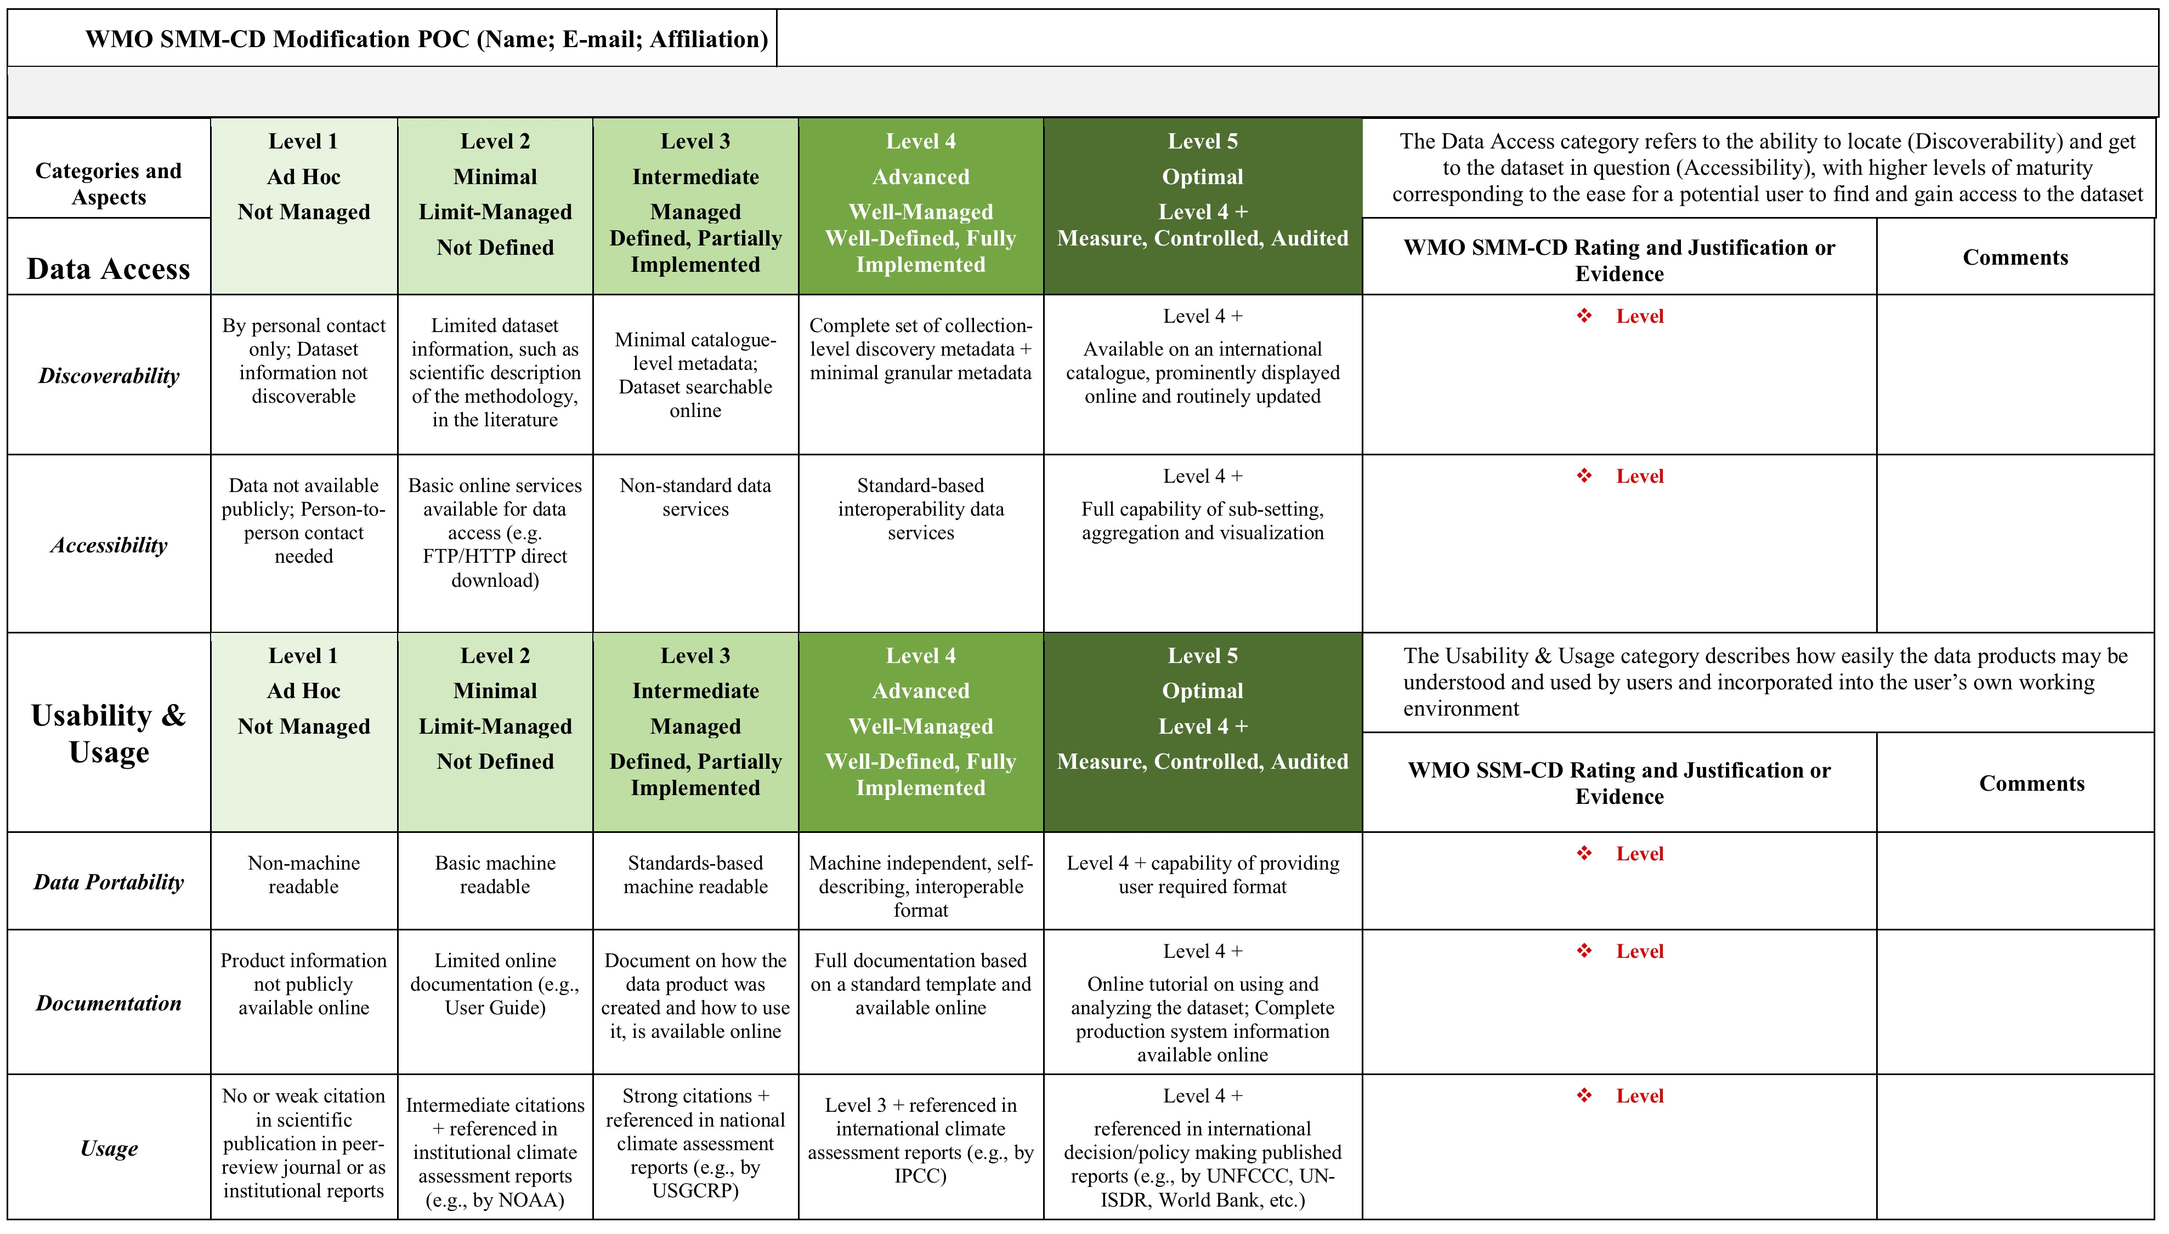
Outcomes
SMM-CD and Guidance Booklet
Internal IEG-CDM team review
External community-wide reviews:
Invited international domain experts (science, data management and stewardship, technology);
GCOS secretariat;
ESIP (Earth Science Information Partner) community – a working session at the ESIP 2018 summer meeting in July 2018
Self- Evaluation Template
Category & Aspects
Ratings, Justifications & Comments
Maturity Criteria
Notes:
We started with one matrix but ended up with three documents.

Slide 12
Current Status
SMM-CD documents have been baselined:
bit.ly/WMO-SMM-CD
bit.ly/SMM-CD-Manual
bit.ly/SMM-CD-Template
The manual on the HQ-GDMFC was sent to WMO Members and all Technical Commissions for review and is on the WMO Cg-18 agenda for approval. The latest draft is available at:
bit.ly/HQ-GDMFC-Manual
Notes:
https://wiswiki.wmo.int/tiki-index.php?page=ET-DDS
https://climexp.knmi.nl/wmo.cgi

Slide 13
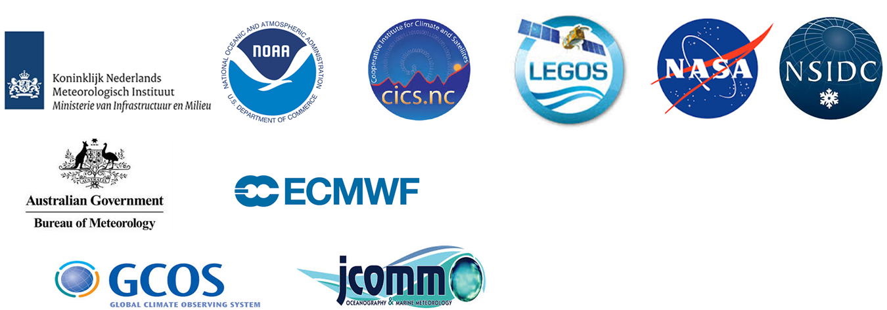
Current Status
18 global datasets identified by IEG-CDM have been assessed by dataset SMEs,
The assessments are currently under review by the WMO CCl Expert Team for Data Development and Stewardship (ET-DDS)
Temperature and Precipitation (ECVs) and Climate Indices | Hydrology and Marine Data | Sea Level ECVs | Sea Ice & Ice Sheets & Glacier ECVs
NOAAGlobalTemp | GRDC | GLOSS | SeaIce-Index
HadCRUT4 | ICOADS | CCI-SeaLevel | GLAS-DEM-500m
GISTEMP | WOD13 | C3S-SeaLevel | GLAS-DEM-1km
GPCC |  |  | Antarctica-GRACE
CoCoRaHS |  |  | Greenland-GRACE
HADEX2 |  |  | GLIMS
(https://wiswiki.wmo.int/tiki-index.php?page=ET-DDS)
Notes:
https://wiswiki.wmo.int/tiki-index.php?page=ET-DDS
https://climexp.knmi.nl/wmo.cgi

Slide 14
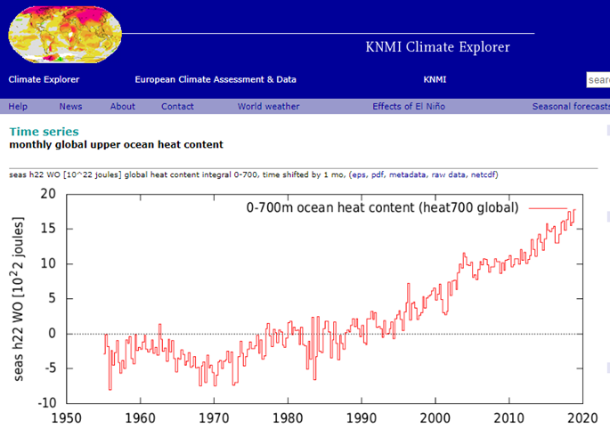
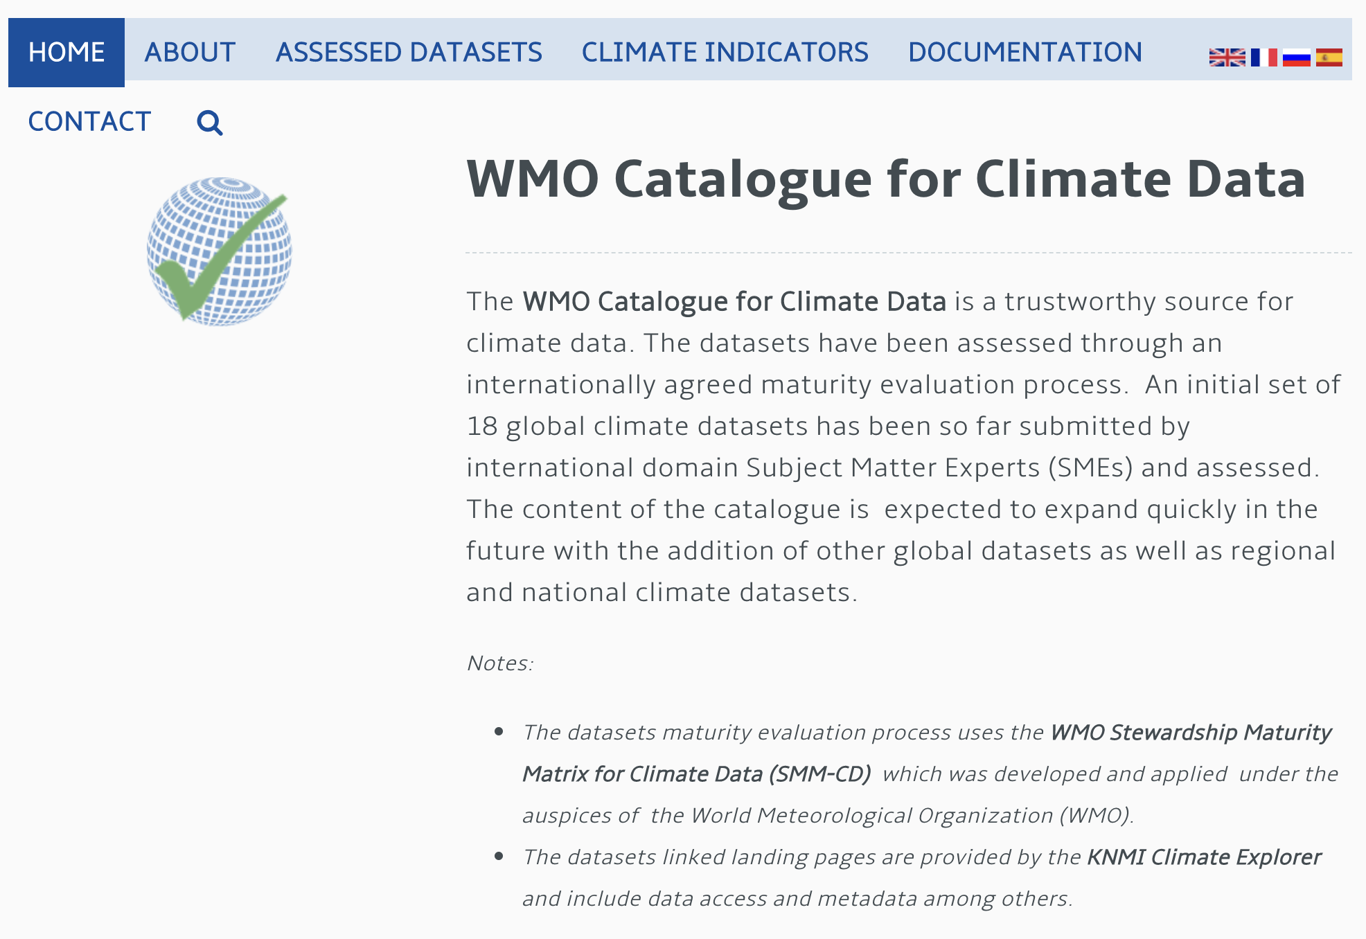
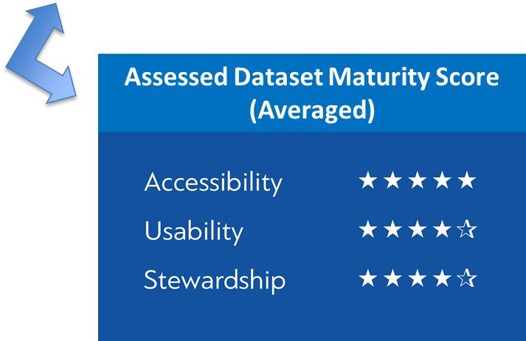
WMO Catalogue For Climate Data
KNMI Climate Explore
(Finalized SMM-CD assessment report available upon request)
Notes:
https://climexp.knmi.nl/wmo.cgi
The WMO Catalogue for Climate Data is at the prototype stage. It will get a WMO.int domain name. It is being developed by KNMI and site in the cloud under the WMO Umbrella. Assessed datasets are linked to the KNMI Climate Explorer for metadata, including assessment scores, and visualization. Finalized assessments forms are available upon request.
KNMI: The Royal Netherlands Meteorological Institute

Slide 15
Takeaway Messages
As a specialized agency in weather, water and climate, WMO needs to enhance collaboration for promoting the use of trustworthy data for decision making;
SMM-CD provides structure and guidance to measuring and improving quality of climate data management and stewardship;
Together with the Manual and Catalogue, the SMM-CD aims to help WMO and its Members establish trustworthiness and improve sharing of high-quality climate datasets and associated information.
Notes:
https://wiswiki.wmo.int/tiki-index.php?page=ET-DDS
https://climexp.knmi.nl/wmo.cgi

Slide 16
Collaboration – Catalogue of Climate Data
Pending the approval by WMO Cg-18:
Adopt the Manual on HQ-GDMFC;
Utilize the SMM-CD to evaluate the maturity of your climate dataset;
Submit the dataset and its SMM-CD assessment to the relevant WMO Committee:
Undergo a review process defined by the WMO Committee:
Scientific quality
Data management and stewardship quality
If recommended, the assessed dataset will be included in the WMO Catalogue for Climate Data.

Slide 17
Collaboration – Across WMO
Consistent approach to data and information management,
Integration of systems for better discovery and sharing of quality information.
Notes:
can not take any formal action on this collaboration

Slide 18
Thank you!
Any Comments or Suggestions?
gpeng@ncsu.edu

Slide 19
Backup Slides

Slide 20
Communication
Presentations on the HQ-GDMFC and SMM-CD
ESIP 2018 Summer Meeting,
ESIP Information Quality Cluster telecon,
EGU 2019,
WMO Staff Briefing,
CCl Executive Council,
CEOS WGISS-46 and WGISS-47 Meetings
CLIMAR–5 (May 7,2019)
The Manual on HQ-GDMFC has been provided to the WMO Members and all Technical Commissions for review
Supportive feedbacks from 12 countries,
Helpful suggestions for improvement – implemented
Notes:
https://wiswiki.wmo.int/tiki-index.php?page=ET-DDS
https://climexp.knmi.nl/wmo.cgi

Slide 21
HQ-GDFMC
A collaborative Framework that enables an effective development and exchange of high-quality climate data based on reliable underpinning infrastructure at the global, regional, and national levels.
Building blocks
Data Management Standards
Defining and promoting data management standards and best practices for ensuring high quality datasets for use in climate policy and services
Data Maturity Assessment
Analyzing the maturity of the climate data management, identifying gaps, and fixing stewardship issues. SMM-CD: a mechanism for allowing compliance to WMO and internationally agreed stewardship standards
3. Access to High Quality Datasets
Enabling a quick discovery and access of high quality datasets using a federated cataloguing service compatible with the WMO Information System and international search engines

Slide 22
The members of IEG-CDM (in alphabetical order)
AICH, Valentin (GCOS)
BADDOUR, Omar (WMO)
BERGERON, Cedric (ECMWF)
BEROD, Dominique (WMO)
BUSSELBERG, Thorsten (DWD)
CAZENAVE, Anny (LEGOS)
DUNN, Robert (Met Office/Hadley Center)
GALLAHER, David (NASA/NSIDC)
GATES, Lydia (DWD)
LIEF, Christina (WMO, lead)
MILAN, Anna (NOAA/NCEI)
PENG, Ge (NCSU/CICS-NC, NOAA/NCEI, SMM-CD lead)
ROBERTS, Kate (BOM)
SIEGMUND, Peter (KNMI)
VERVER, Ge (KNMI)
WRIGHT, William (BOM, retired, now WMO CCl, SMM-CD co-lead)
ZIESE, Markus (DWD)

