Slide 1
A Brief Update on the Activity of the RDA FAIR Data Maturity Model Working Group – An action item from WGISS-46
Ge Peng North Carolina State University,
Cooperative Institute for Climate and Satellites–NC (CICS-NC)
at NOAA’s National Centers for Environmental information (NCEI)
May 1, 2019
The 47th Meeting of the CEOS Working Group on Information Systems & Services
Silver Spring, MD, USA, April 29 – May 2, 2019
Notes:
NOAA – National Oceanic and Atmospheric Administration

Slide 2
FAIR Data Principles
FAIR Data Principles:
Findable: discoverable and locatable,
Accessible: available and obtainable,
Interoperable: human and machine usable,
Reusable: enabling reuse and integration with other data sources.
Gaining traction:
Societies: AGU, EGU, RDA, ESIP, FORCE11, …, etc,,
Publishers: AGU, Nature, Science, Elsevier, Copernicus, Wiley, …, etc.,
Repositories: World Data System, Australian Research Data Commons (ARDC), DataCite, CrossRef, ORCID, …, etc.,
G20 leaders (2016): statement of support.

Slide 3
FAIR Data Principles: Implementation Challenge
Problem:
Wide range of interpretations and implementations of FAIRness
Research Data Alliance – International/Transdisciplinary
Started in March 2013,
Funded by the European Commission (EC), the American National Science Foundation (NSF) and National Institute of Standards and Technology (NIST), and the Australian Department of Innovation (ADI),
Vision: Building the social and technical bridges to enable open sharing and re-use of data,
Approach: Grassroots development with community consensus,
Now: 102 Working Groups & Interest Groups with 8218 members.
RDA FAIR Data MM WG:
Bring together stakeholders,
Build on existing approaches and expertise.
(Source: Case Statement – RDA FAIR Data Maturity Model Working Group; https://rd-alliance.org/)

Slide 4
RDA FAIR Data Maturity Model Working Group
Proposed Scope & Intended Audience
Intended results:
RDA recommendation of core assessment criteria,
Self-assessment model and toolset,
FAIR data checklist.
Timeline:
The Working Group was endorsed by RDA in early January 2019,
Delivery in about 12 months (by the EU Commission meeting)
Entity | Dataset and data-related aspects (e.g., algorithms, tools, and workflows)
Nature | Generic assessment (i.e., cross-disciplines)
Audience | Researchers, data stewards, data service owners, organizations involved in research data and policy makers
(Source: Case Statement – RDA FAIR Data Maturity Model Working Group; 20190403_FAIR_WG_slides_0.08.pdf)

Slide 5
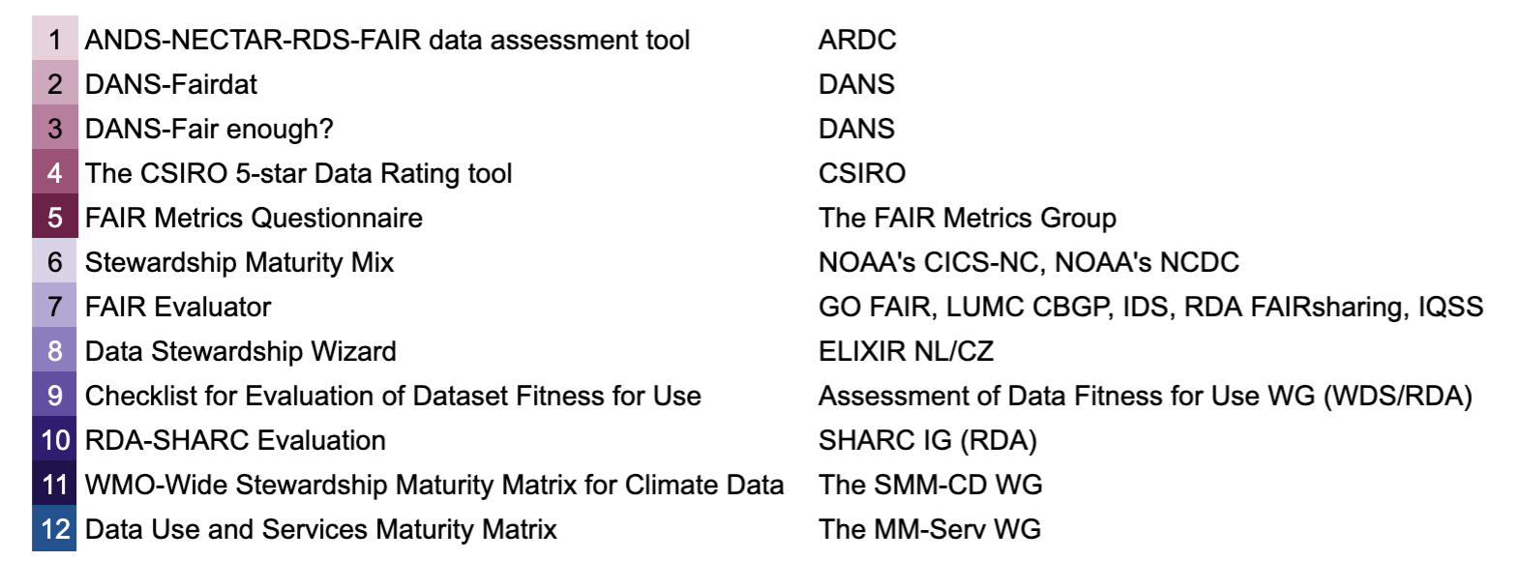
RDA FAIR Data Maturity Model Working Group
Where it is now:
Over 100 WG members – strong EU support:
FAIRsFAIR (10 Mil euro) – EU Open Science Cloud, GoFAIR, …
Analysis of existing FAIR assessment approaches,
Initiated the development of Indicators.
Notes:
I believe that Iolando has recently submitted the WGISS Data Management and Stewardship Maturity Matrix

Slide 6
Additional Resource
RDA FAIR Data MM WG:
https://rd-alliance.org/groups/fair-data-maturity-model-wg
Contact Me:
gpeng@ncsu.edu

