Slide 1
OGC Testbeds 14 and 15
Cristiano Lopes
02/05/2019
WGISS #47, Silver Spring

Slide 2
OGC Testbeds - Recall
Part of the Open Geospatial Consortium (OGC) Innovation Program (IP).
The IP provides global, hands-on, collaborative prototyping for rapid development and delivery of proven candidate specifications to the OGC Standards Program.
A Testbed is a collaborative research and development effort to develop, architect, test, and demonstrate candidate standards for interoperability.
In a Testbed participants collaborate to examine specific geo-processing interoperability questions posed by the initiative’s Sponsors.
Testbeds are all about experimentation and exploration of solutions that can be in the future used for standards.

Slide 3
OGC IP and other OGC Programs
Requirements
Prototype
Implementations
OGC
Innovation
Program
Software
Architecture
Guides &
Tools
Gaps and
Enhancements
Engineering
Reports
Requirements
Requirements
Communications
& Outreach
Adopted Standards
Standards
Program
Compliance Program
Product Implementations
Requirements
Notes:
3

Slide 4





OGC IP - Types of Initiatives
Number of Participants
Testbed
0-3
100-200
Variety
Pilot
Interoperability Experiment
Plugfest
Hackathon
Regular
Ad hoc

Slide 5
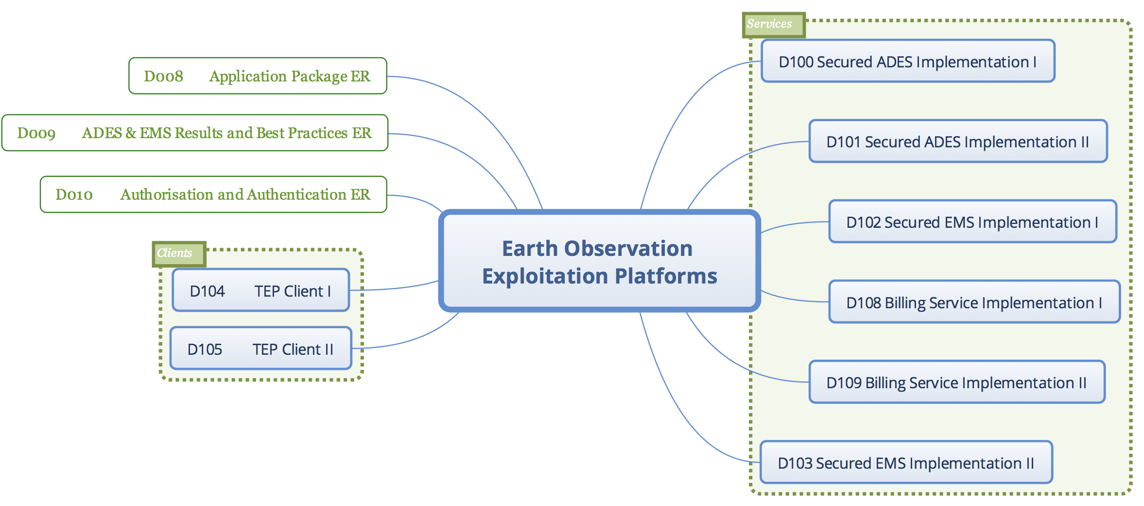
Testbed 14 EOC/EP – Application Portability Extended
See WGISS #45 Presentation for T13-EOC
From Application Packages to Application Chaining
    Simple workflows of Applications
From fully open Exchanges to Secure Commercial Interfaces
    Authentication, Authorisation and Billing

Slide 6




Testbed 14-EOC - Participants

Slide 7
OGC T14-EOC Outcomes
Formal -> Engineering Reports:
OGC Testbed-14: Application Package Engineering Report (18-049r1)
OGC Testbed-14: ADES & EMS Results and Best Practices Engineering Report (18-050r1)
OGC Testbed-14: Authorisation, Authentication, & Billing Engineering Report (18-057)
Informal -> Blog post
OGC’s Testbed-14 conclusion and demo event at ESA/ESRIN
Links to presentations on:
  Summary of Testbed 14
  EOC Thread
  Coverages/WCS for EO Low Level (Swath) data
  Machine Learning in Spatial Data Infrastructures (EO Focused)
  Security in Federated Clouds + Federated Cloud
  WFS3 as an example of new OGC OWS Services

Slide 8
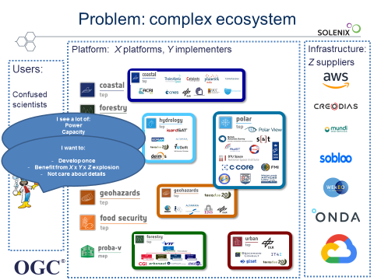

Slide 9
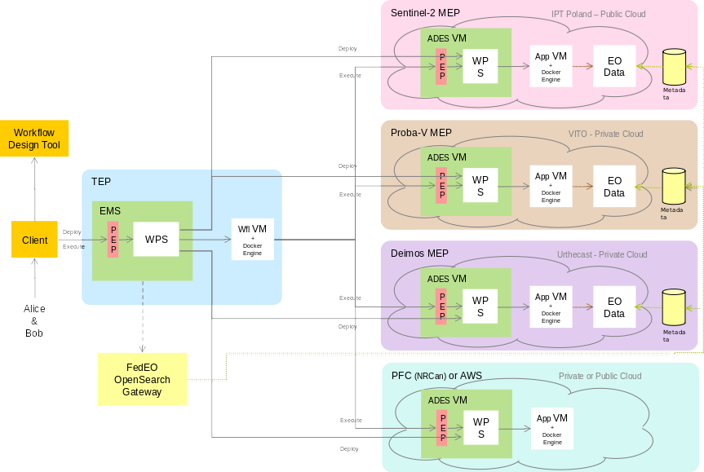
OGC T14-EOC - Scenario

Slide 10
Catalogue Gateway
Objectives achieved by the Gateway:
Discover products data
Execute process close to data
1. Execution request contains collection, area and time of interest.
2. Products are discovered through the FedEO gateway.
New challenge: multiple exploitation platforms.
3. MEP hosting the data as execution target.
MEP
Data
TEP
ADES
ADES
TEP Client
Discovery Query
EMS
Products
MEP
ADES
Discovery
Query
Products
Data
FEDEO OpenSearch Gateway
Products

Slide 11
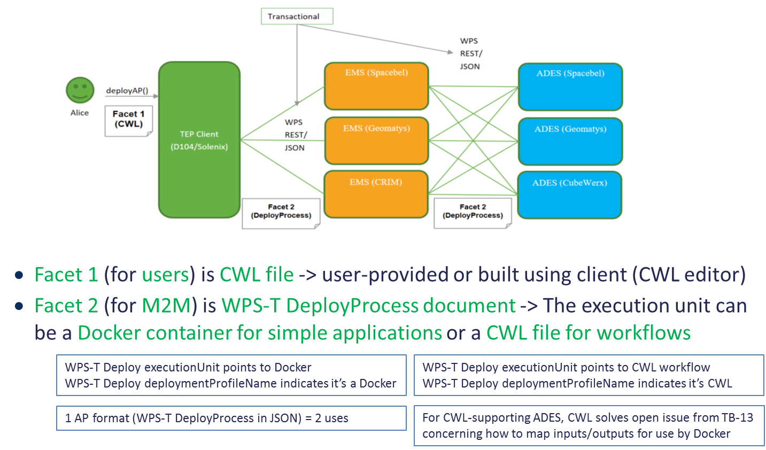
Application Package – Algorithm Portability

Slide 12
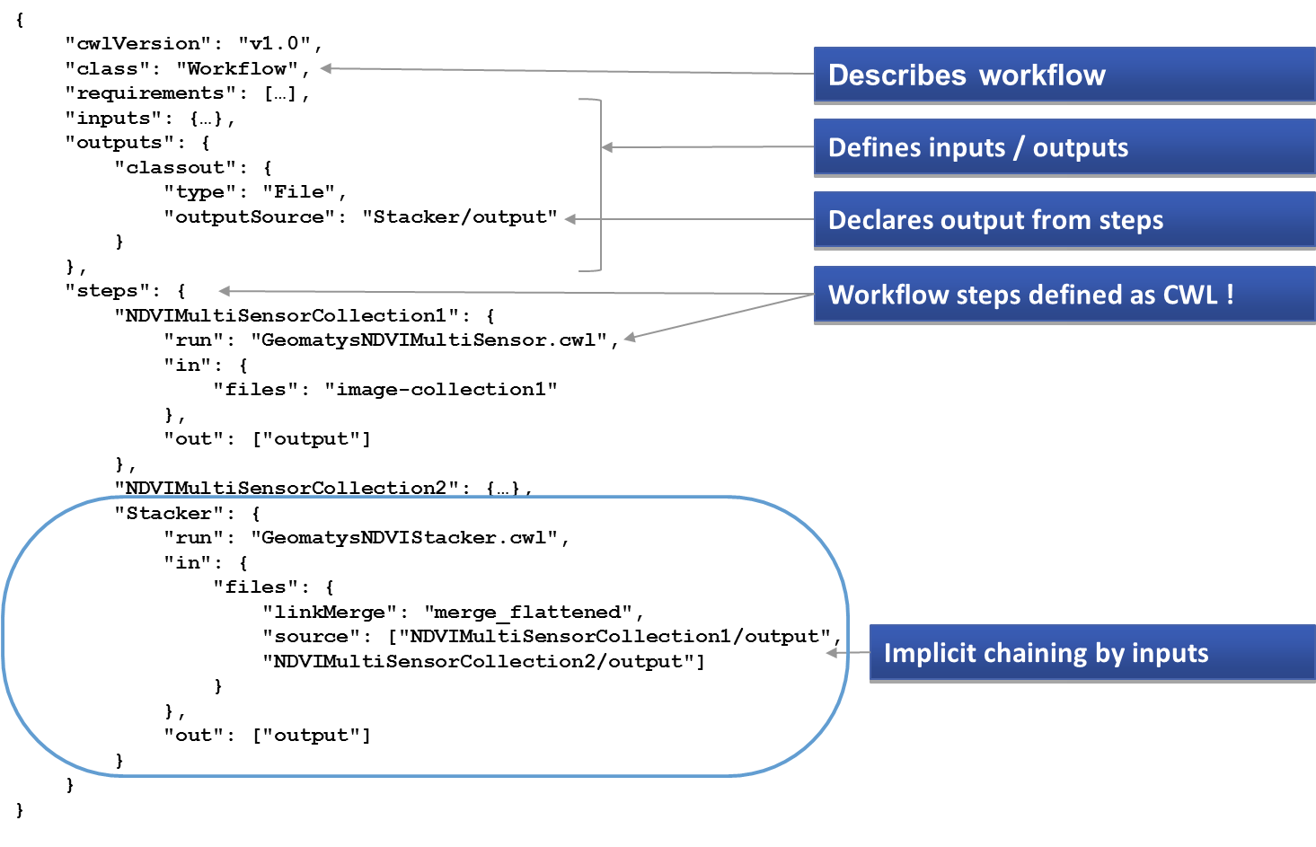
Application Package – Example Workflow/Application

Slide 13
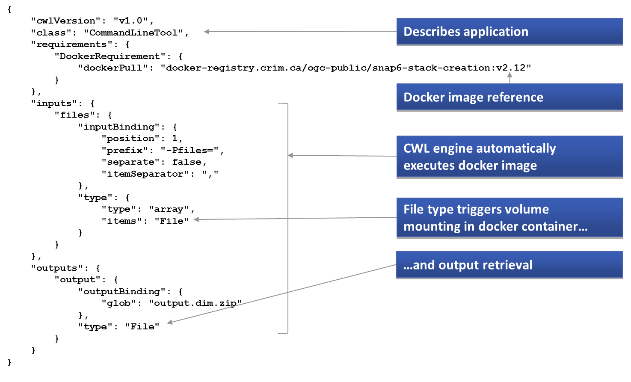
Application Package – Execution via CWL Engine

Slide 14
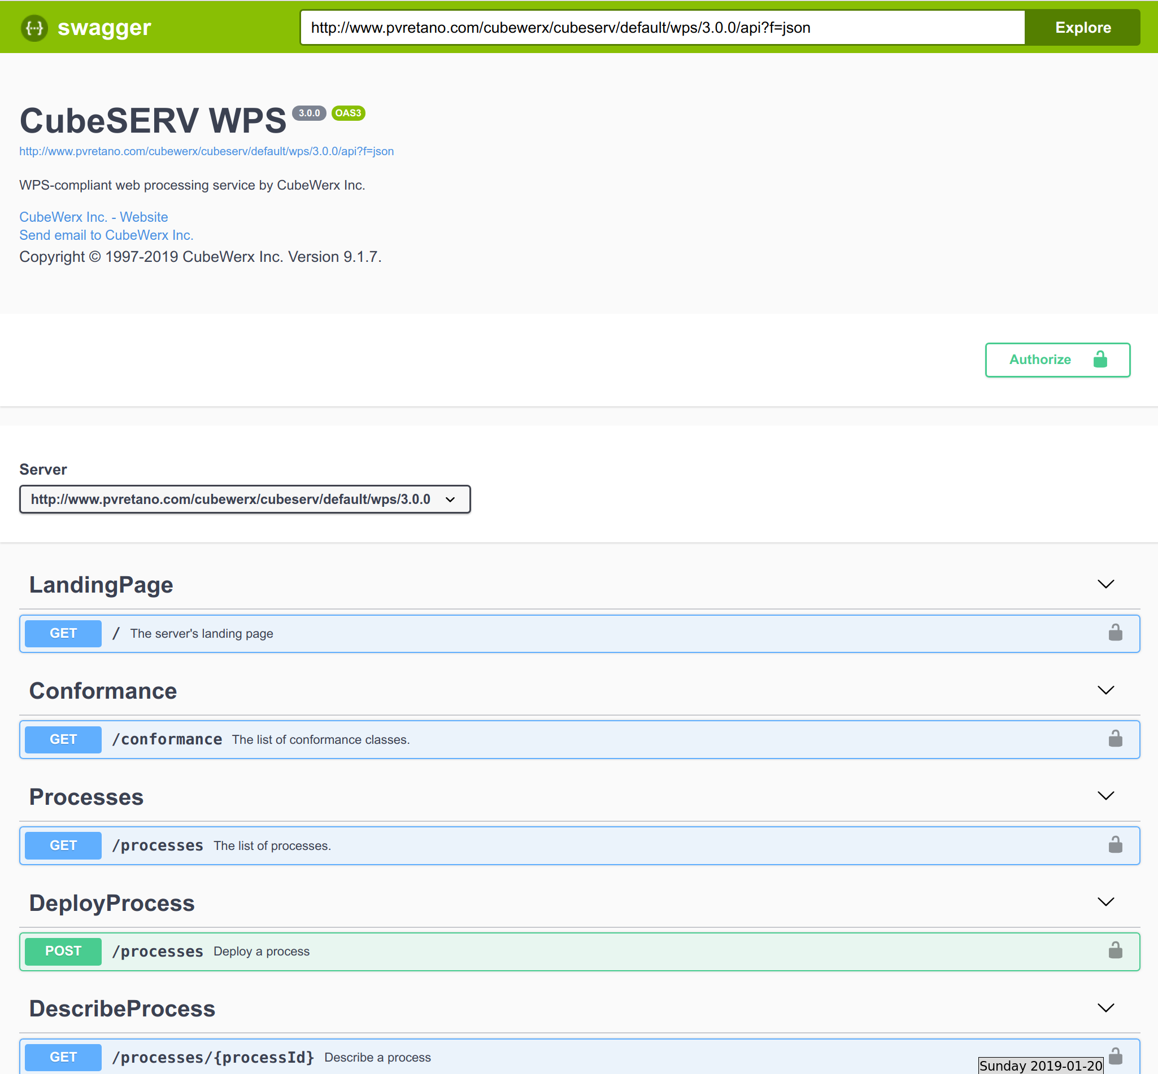
Interfaces → WPS REST/JSON
Based on work already being done by the WPS SWG to define a REST API
Based on the NextGen service pattern defined by WFS 3.0
The API is described using OpenAPI so it is developer and tool friendly
Copyright © 2018 Open Geospatial Consortium
14

Slide 15
Testbed 14-EOC - Achievements
5 different companies working together in the OGC manner, i.e. consensus-based, to:
  Propose and write-down a standard Application Package format (“Application Package” ER)
  Propose a WPS-T JSON/REST API - partly developed in coordination with the WPS 2.0 SWG - and write-down best practices and experiences about the EMS & ADES, two essential components of a EP ( “EMS & ADES Best Practices and Results” ER)
1 client, 3 different EMS and 3 different ADES implementations able to interact in a standardized and interoperable way:
  Using the proposed AP format
  Using the proposed WPS-T REST/JSON API
  Integrating several different TEPs & MEPs, authN/authZ, catalogue in flow
15

Slide 16
Testbed 15-EOPAD – NASA / ESA Sponsorship
Earth Observation Process and Application Discovery aims to define the building blocks through which analytics applications and/or services can be exposed through a Catalogue service.
The following research questions shall be addressed:
How can an application and application data catalog be established without inviting yet another catalog specification?
What are the differences of the various catalog models, their limitations and key characteristics?
How to link apps and data? Are apps by definition bound to a specific data server? If not, how to establish the links between apps and data?
Catalogs pointing to data instances often point to the access interface, but not necessarily to the data itself. How to use catalogs so that an app can dynamically load data from the data source?
How to annotate data sets? Imagine a Quality of Service process that add additional metadata, or a QoS process that develops a scoring or performance value for specific entries
How to support the incremental search process, where users use a sequence of queries to identify their target application?
How to check links between applications (for matching I/O settings) to ensure workflows being executable? How to ensure this aspect across platforms?
How to facilitate access to the actual data using the applications?
How to enable fusion of multiple data and visualization of resulting products?

Slide 17
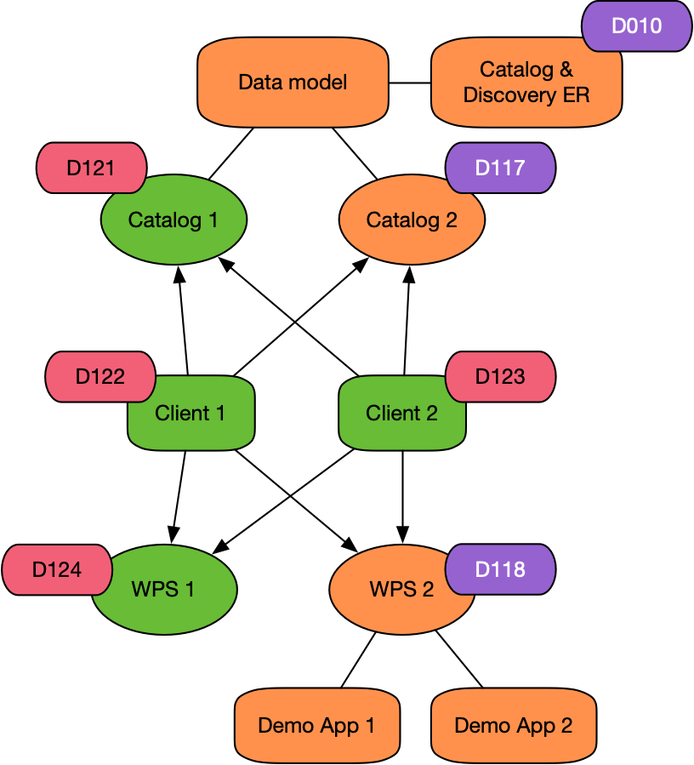
Testbed 15-EOPAD – Use Case + Deliverables
Key Use Cases
  Application lifecycle management by owner/operator
  Application creation/deletion via M2M interaction
  Application discovery
  Support to application and service chaining (workflow definition)
Deliverables
  Catalog & Discovery ER (with Data Model)
  2 * Catalogue
  2 * Clients
  2 * WPS (1 ADES Like, 1 General Service)

Slide 18
Testbed 15 – Other Tasks of Interest
The Machine Learning Task
  Sponsored by NRCan
  Looking at how ML (with EO) can be interoperable through OGC Services (possible links to past EOC work)
Federated Clouds Task
  Sponsored by NGA
  Looking how Federations (sharing of Ids, Resources) can be done, how analytics can be performed (links to past EOC work)
  Security in Federations and Workflows.
OGC CfP: https://portal.opengeospatial.org/files/?artifact_id=82290

Slide 19
Testbed 15-EOPAD – Participants & Schedule
Kick-Off Event | 2-4 April
Initial ER and Component Designs | June
Component Implementations | July
Test definition | July
Test runs | August/ September
Draft ER | September
Final ER | October
ER presented to TC | November
Compusult | Client, WPS
DEIMOS | Client, Server
GMU | Server
Spacebel | ER+Data Model
52 North | WPS

Slide 20
ESA Sponsored Activities in OGC IP
T13
EOC
T14
EOC
T15
EOPAD
?
EOEP Hackathon
EOEP
Pilot/Exp.
T13-EOC/Hackathon
Application Portability
Application Packaging
Application Deployment and Execution
T14-EOC
Application Portability
Workflow (complex applications)
Application/Workflow Deployment and Execution
Quoting and Billing
T15-EOPAD
Application/Service Discovery
Metadata model
Discovery Interface
Management Interface
Upcoming:
EOEP Pilot or Experiment – Consolidation activity, OGC RFI is out
Future/Next Year activities to be defined:
T16?
Others?

Slide 21
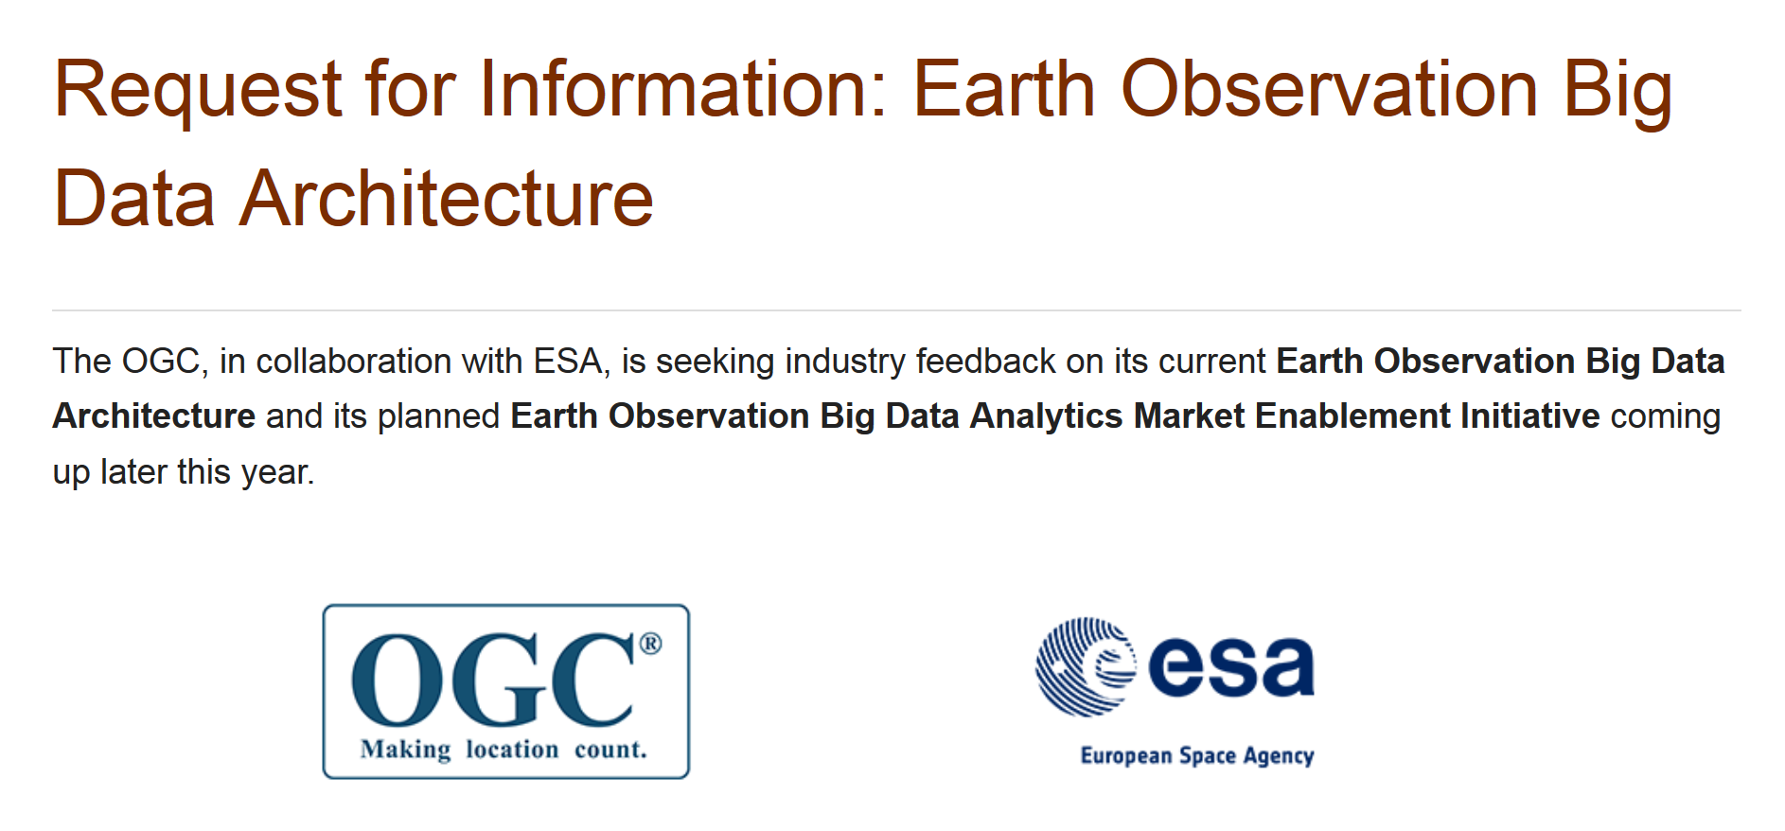
https://portal.opengeospatial.org/files/83548

Slide 22
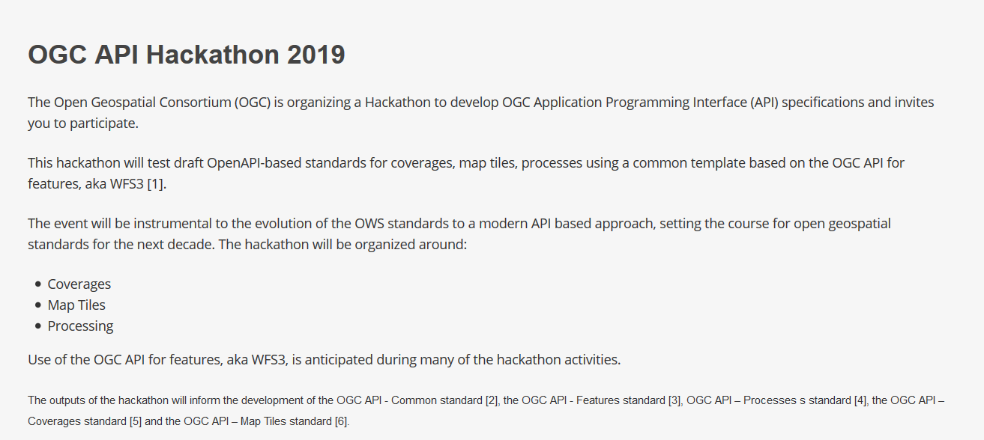
OGC API Hackathon 2019
Hosted by the UK Ordnance Survey in London (Geovation Hub)
June 20th – 21st
https://www.opengeospatial.org/projects/initiatives/oapihackathon19
https://ogc-api-hack2019.eventbrite.com

Slide 23
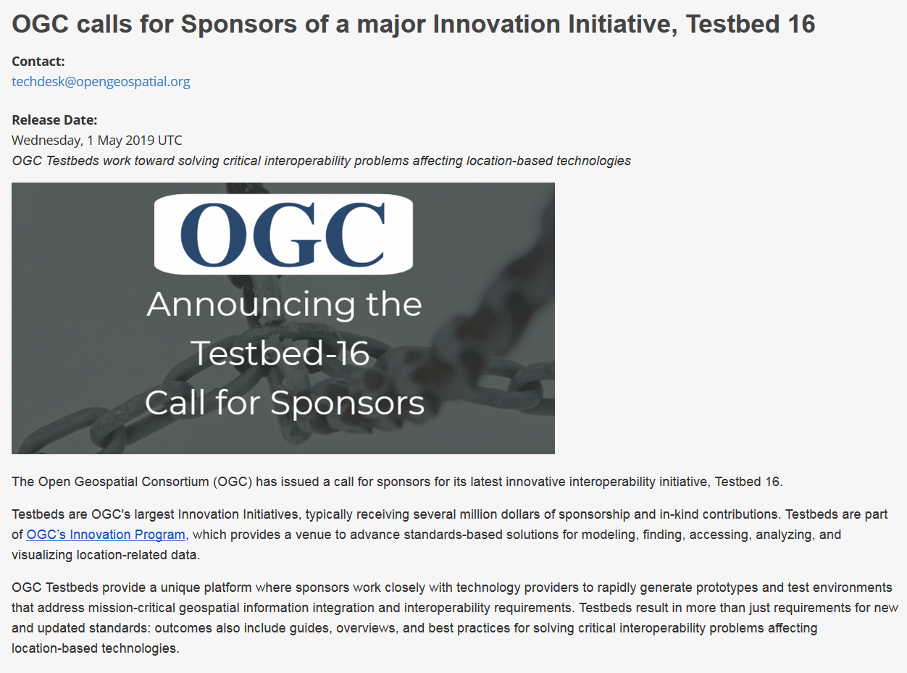
Testbed 16 planning has started.
ESA welcomes ideas for possible collaboration with other CEOS Agencies in this initiative – deadline is September.
http://www.opengeospatial.org/pressroom/pressreleases/2995
http://www.opengeospatial.org/projects/initiatives/t-16

Slide 24
Remarks & Conclusion
ESA is actively working within OGC to experiment, prototype and define standards for EO Exploitation / Analytics, following the OGC Processes (IP to SP)
These activities are highly visible in Industry and several Organisations (from different domains) have demonstrated interest in cooperation.
OGC is right now performing the ground work for its next generation of Web Services, we (CEOS Agencies) have the unique opportunity to influence this according to our needs.
CEOS Agencies should also be aware of the work being done in the OGC IP for ML/AI, Federations/Cloud Use, etc.

Slide 25

Cristiano Lopes
Digital Platforms Section
Earth Observation Programmes
Phone: +39 06 941 80735
Email: cristiano.lopes@esa.int

