Slide 1
OPeNDAP in the Cloud
Adapting an existing web server to S3
James Gallagher
jgallagher@opendap.org
Nathan Potter
ndp@opendap.org
Kodi Neumiller
kneumiller@opendap.org
This work was supported by NASA/GSFC under Raytheon Co. contract number NNG15HZ39C.
This document does not contain technology or Technical Data controlled under either the U.S. International Traffic in Arms Regulations or the U.S. Export Administration Regulations.

Slide 2
Some things to keep in mind...
S3 is a powerful tool for data storage because it
  can hold large amounts of data
  supports a high level of parallelism
S3 is a Web Object Store – it supports a simple interface based on HTTP
S3 stores ‘objects’ that are atomic; they cannot be manipulated as with a traditional file system, except…
It is, however, possible to transfer portions of objects from S3, using HTTP Range-GET

Slide 3
Outline
How we modified the data server (Hyrax) to serve data stored in S3
When serving data from S3, the Hyrax server’s web API is unchanged
Virtual sharding provides a (new) way to aggregate data

Slide 4
Serving Data Stored in S3: Approaches Evaluated
Caching – Similar to ‘S3 file systems’
Subsetting – Based on HTTP Range GET
Baseline – Reading from a spinning disk
All of these ran in the AWS environment

Slide 5
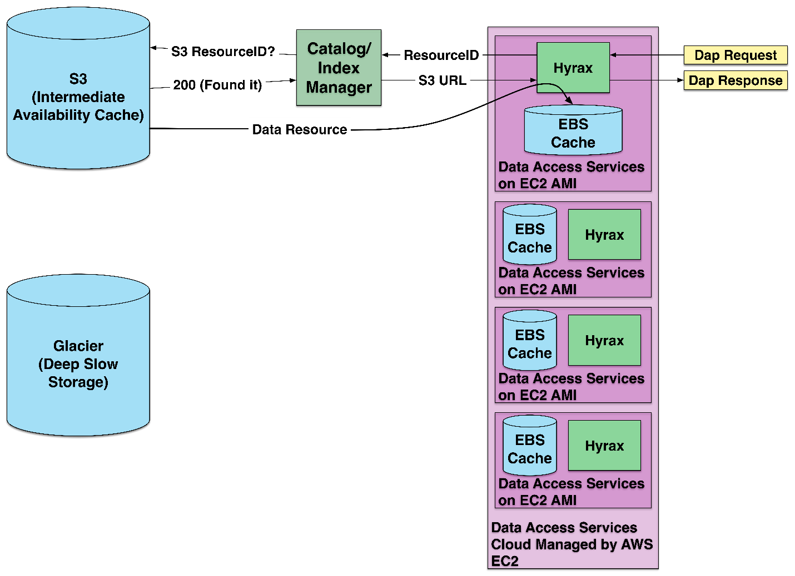
Caching Architecture
Data are stored on S3 as files
Files are transferred from S3 to a spinning disk cache (EBS, EFS)
Data are read from the cached files and returned to clients
Similar in operation to ‘S3 file systems’
Advantages: Works with any file, easy to use with legacy software, files easy to obtain, minimal configuration metadata needed
Disadvantages: Initial cost to transfer the whole file, slower than the subsetting architecture
Notes:
Remember: Data in S3 cannot be accessed as if they are on a traditional file system

Slide 6
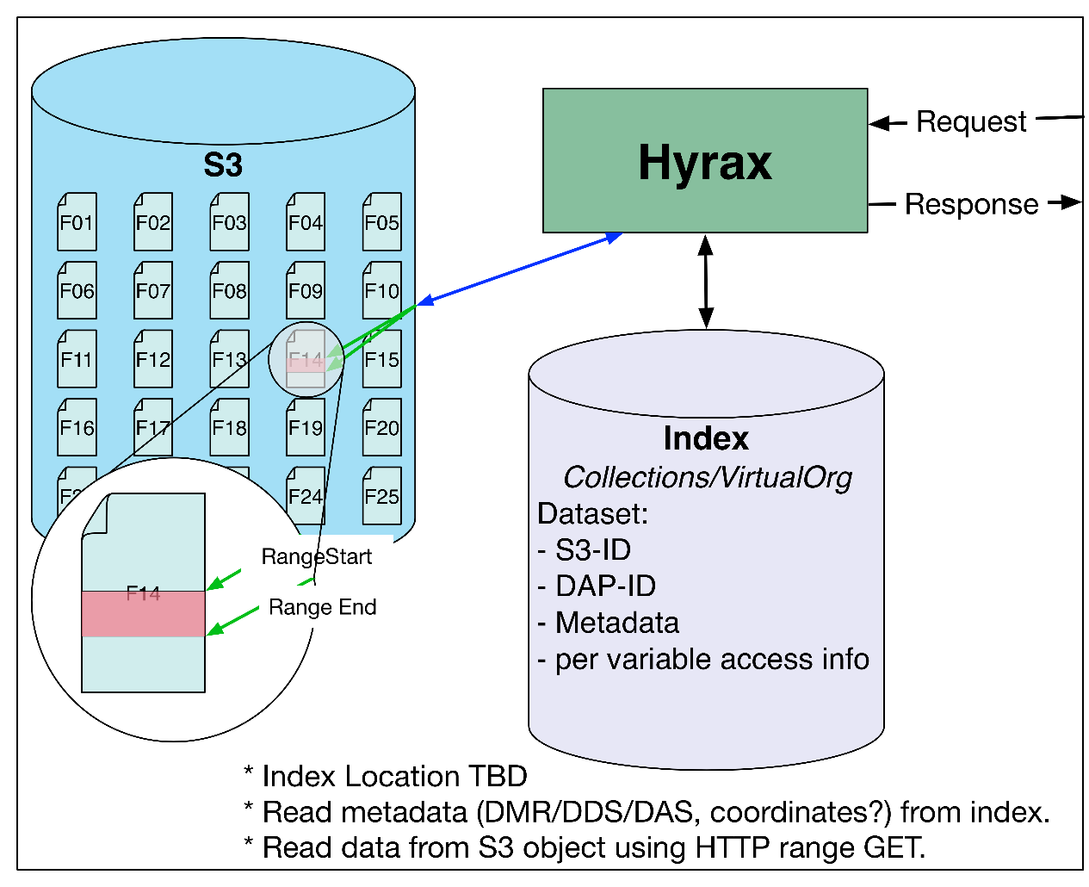
Subsetting Architecture - Virtual Sharding
Data are stored on S3 as files (HDF5)
Data are read from S3 by reading parts (virtual shards) of the file
Virtual Sharding: Break a file into virtual pieces. Each shard is defined by its size and position in the file
Advantages: faster than caching, data cache not needed, only data needed are transferred from S3
Disadvantages: more configuration metadata needed

Slide 7
Optimizations to the Virtual Sharding Approach
Optimize metadata so access to data in S3 is not needed
Read separate shards from data files in parallel
Ensure that HTTP ‘connections’ are reused by using either HTTP 2 or HTTP 1.1 with ’Keep-Alive’

Slide 8
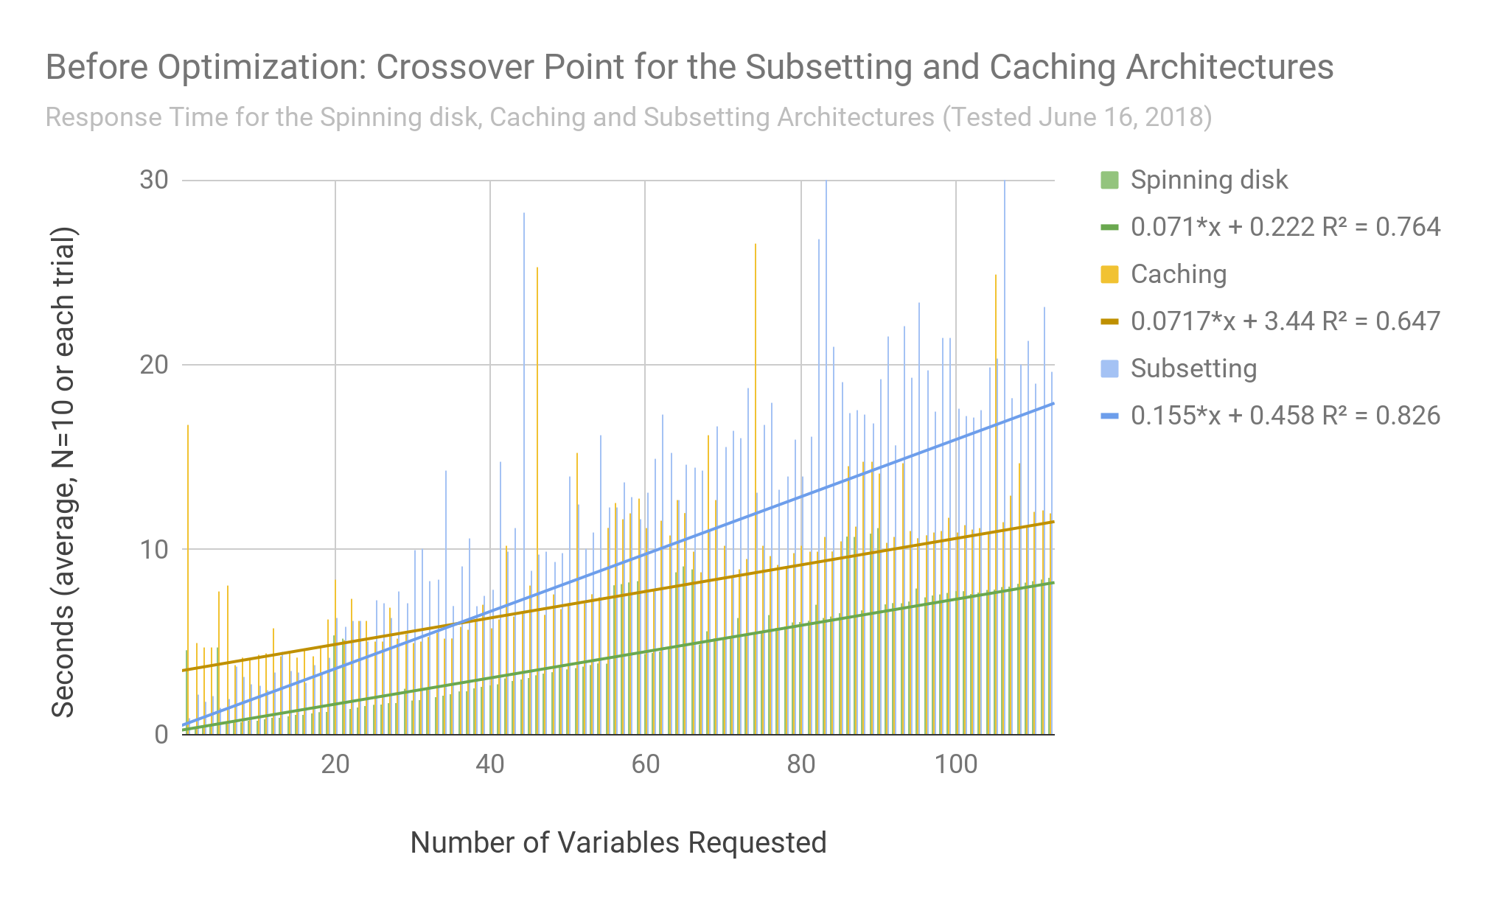
Performance Before Optimizations
Without optimization, caching outperforms the subsetting architecture for some requests*, even though it transfers much more data than needed
*For large HDF5 files with ~1,000 compressed variables, requesting ~40 variables takes longer
Shown: Caching and subsetting (yellow and blue) and access when data are stored on spinning disk (green)

Slide 9
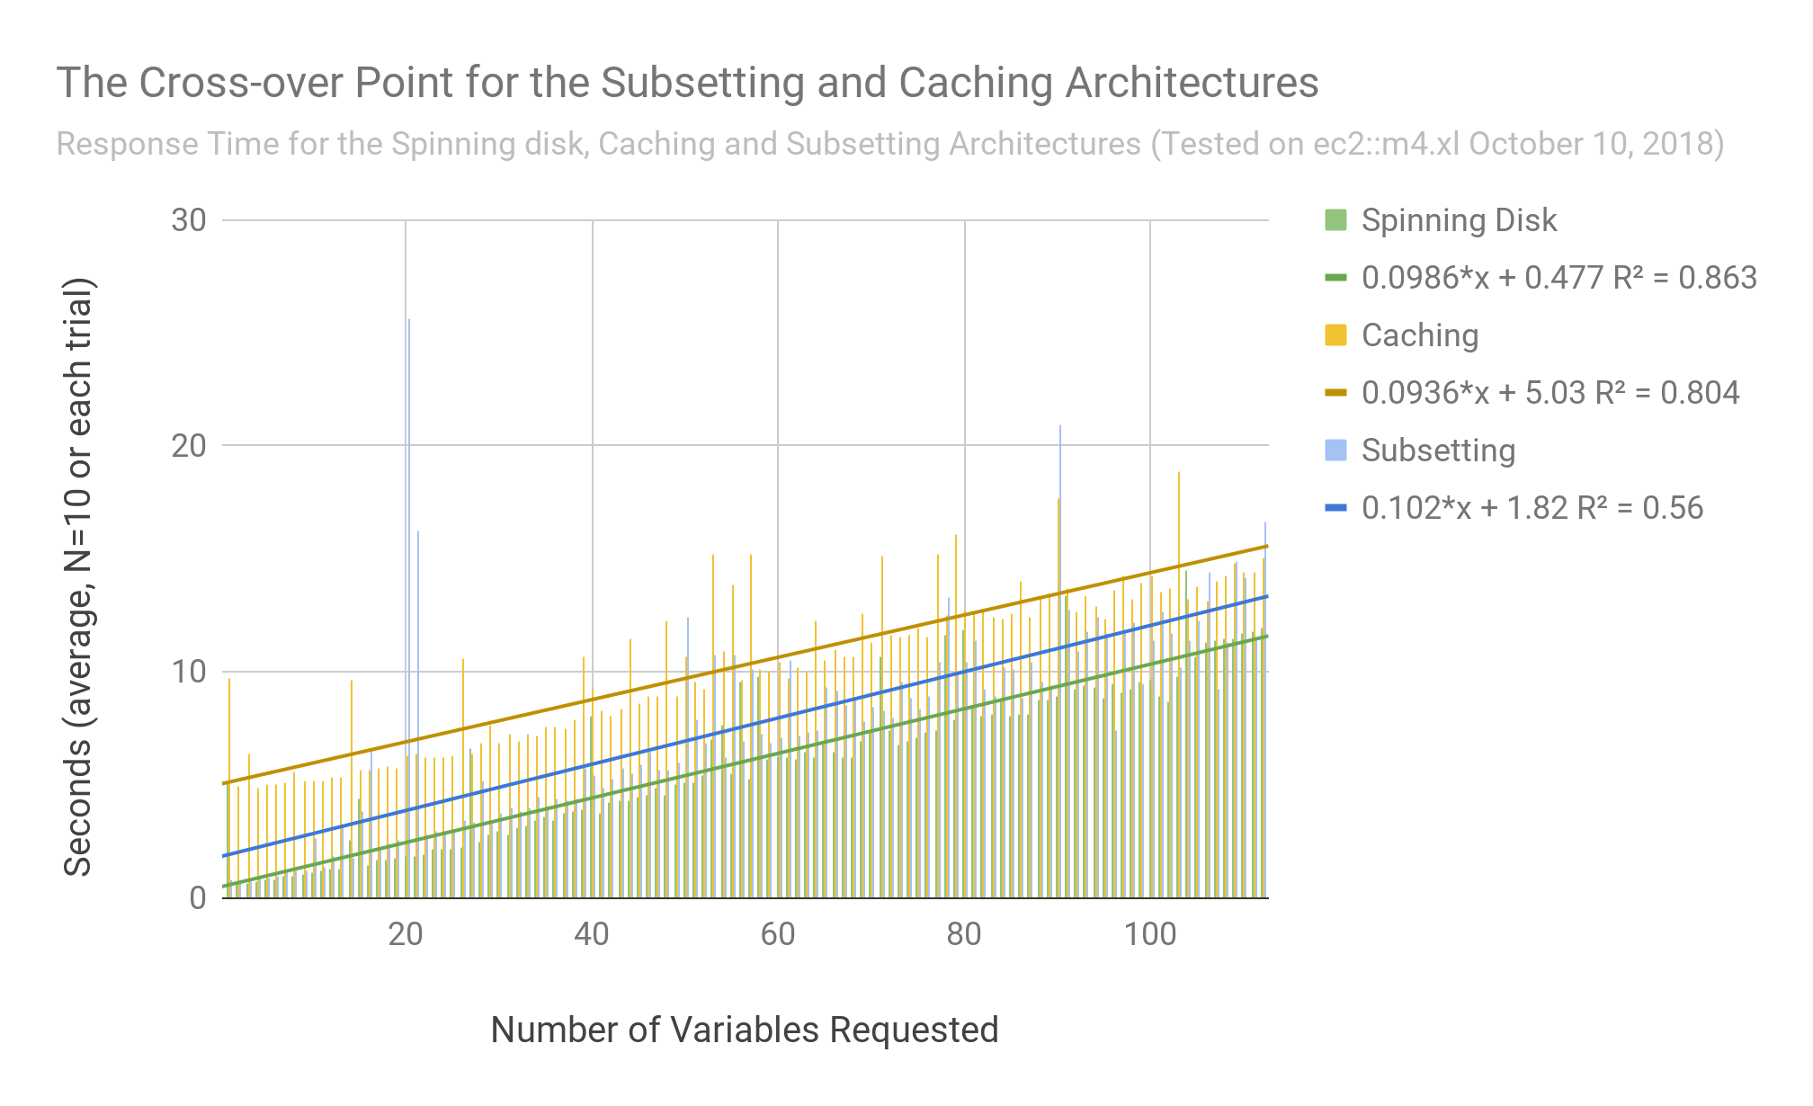
Performance After Optimizations
After optimization the subsetting algorithm performance exceeds the caching algorithm
Shown: Caching and subsetting (yellow and blue) and access when data are stored on spinning disk (green)

Slide 10
Usability of Clients – Web API Consistency
Five client applications were tested with Hyrax serving data stored on Amazon's S3 Web Object Store.
What we tested:
  Access to data from a single file
  Access to data from aggregations of multiple files
Two kinds of aggregations were tested:
  Aggregations using NcML*
  Aggregations using the 'virtual sharding' technique we have developed for use with S3
*NetCDF Markup Language

Slide 11
Clients Applications Tested
Panoply – a Java client; built-in knowledge of DAP¹ and THREDDS² catalogs, uses the Java netCDF library
Jupyter notebooks & xarray – Python (can use PyDAP or netCDF C/Python)
NCO – a C client, C netCDF library
ArcGIS – a C (or C++?) client, either libdap or C netCDF (we're not sure)
GDAL – a C++ client, libdap
¹Data Access Protocol, ²Thematic Realtime Environmental Distributed Data Services

Slide 12
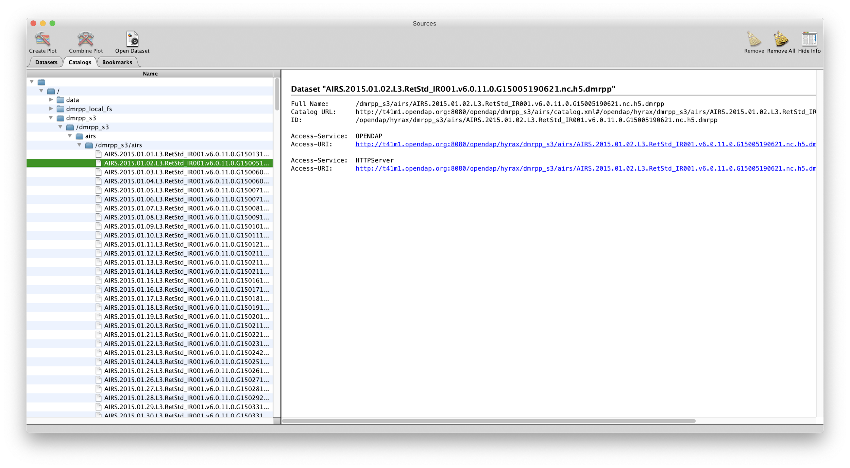
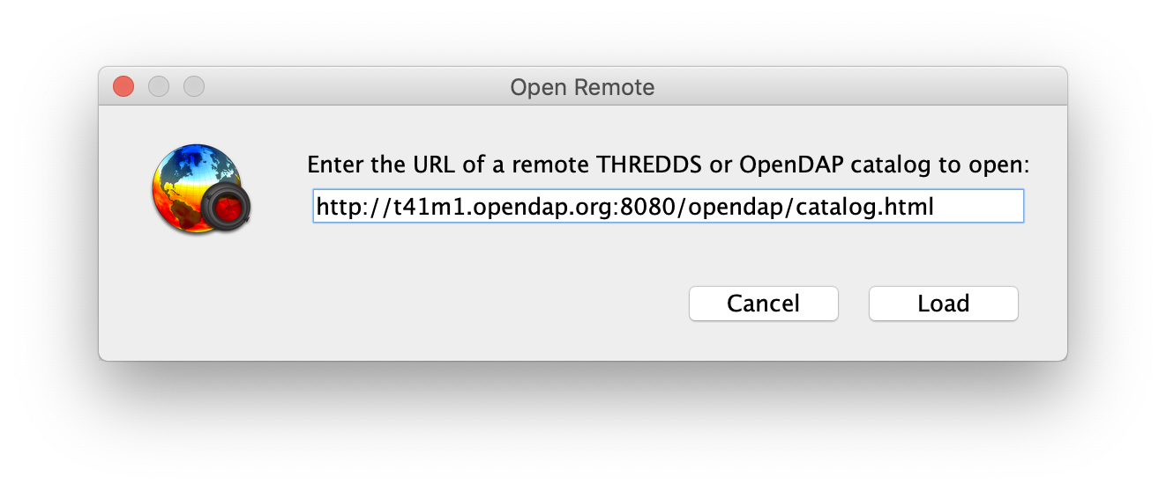
Panoply
See live demo (using 4.0.5, which has some fixes for servers that use Tomcat 8 – nothing to do with DAP or S3)
To open a server's catalog: File-->Open Remote Catalog...
  http://t41m1.opendap.org:8080/opendap/catalog.html

Slide 13
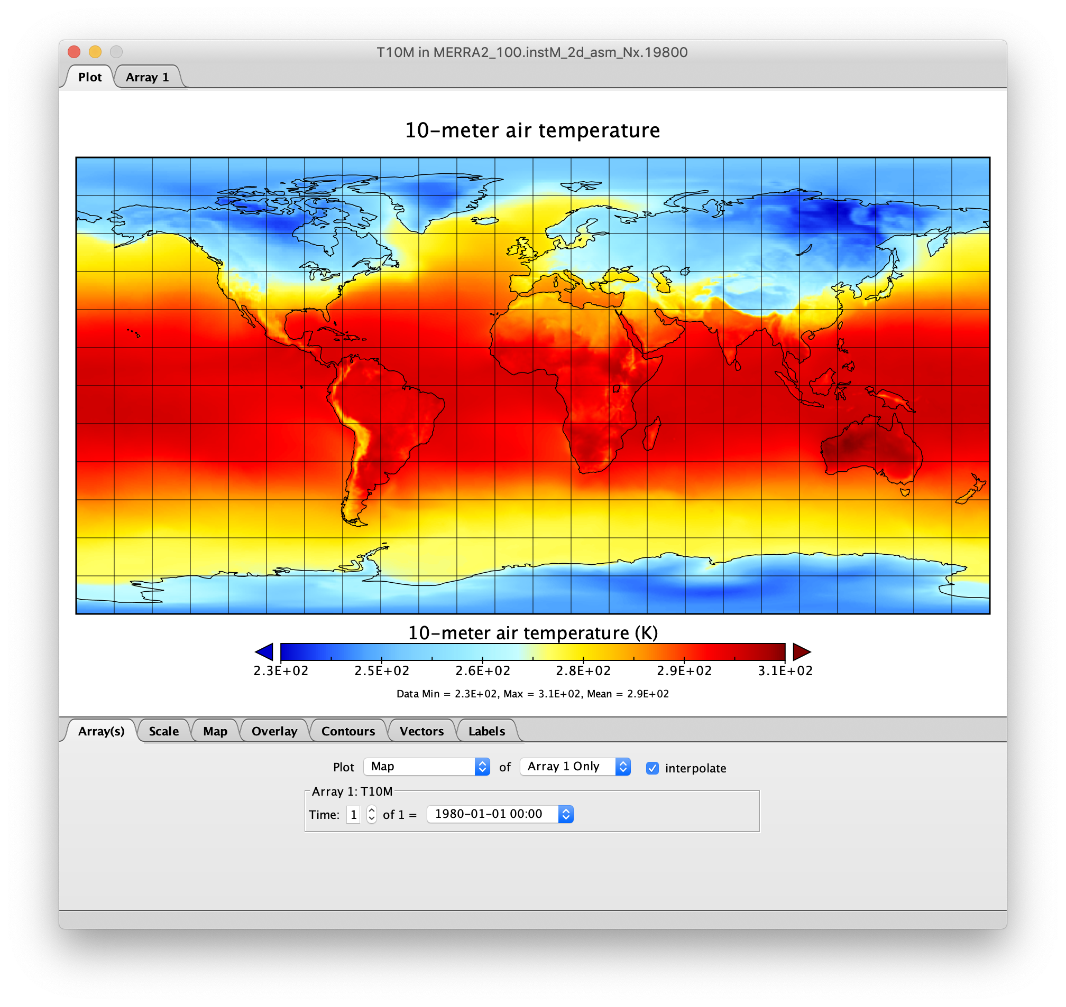
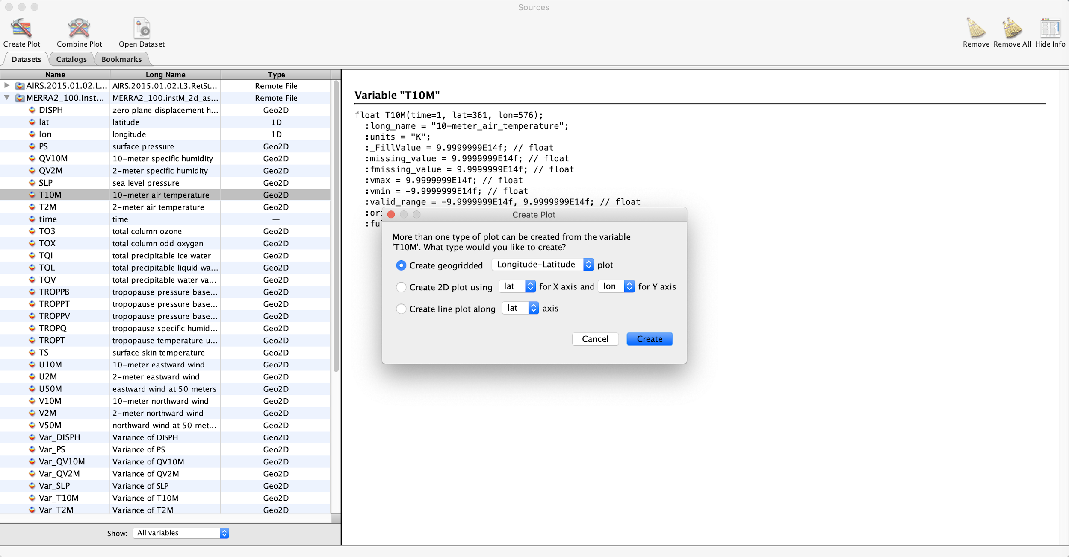
Panoply, continued
To open a single dataset directly: File-->Open Remote Dataset...
  http://t41m1.opendap.org:8080/opendap/dmrpp_s3/merra2/MERRA2_100.instM_2d_asm_Nx.198001.nc4.dmrpp

Slide 14
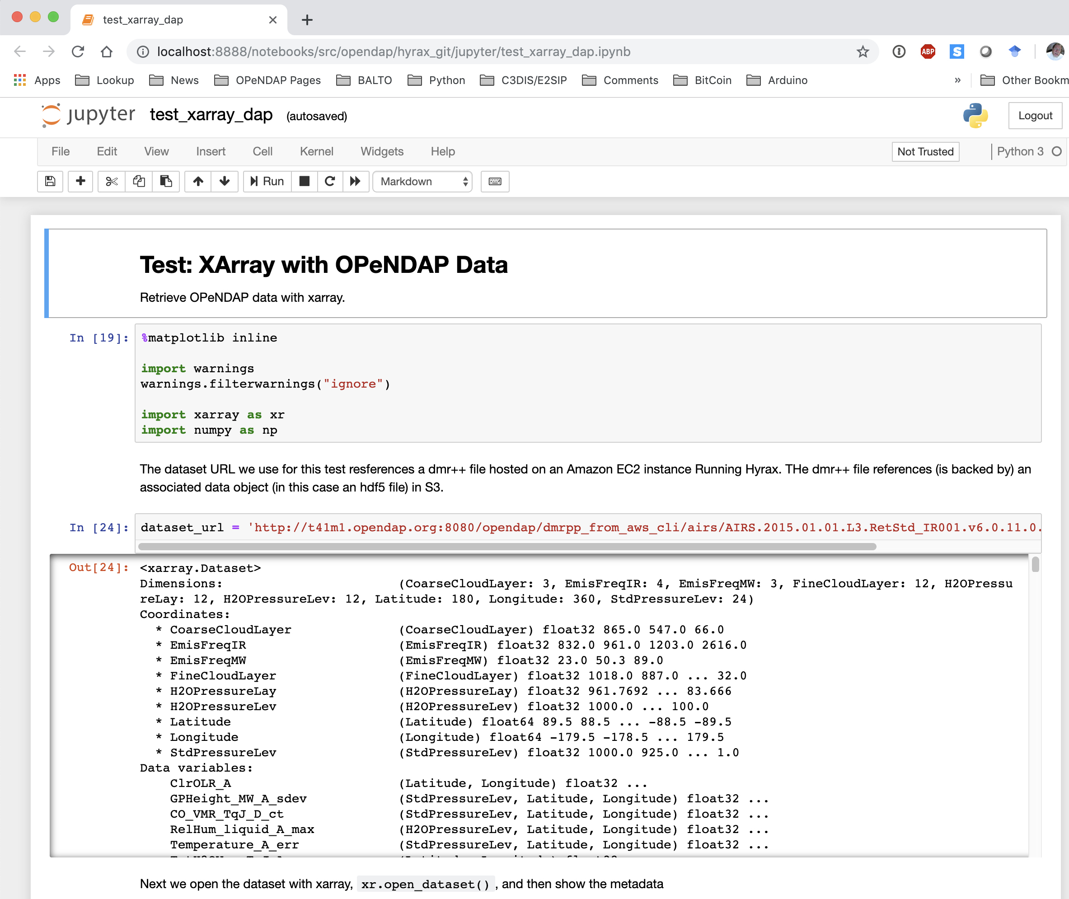
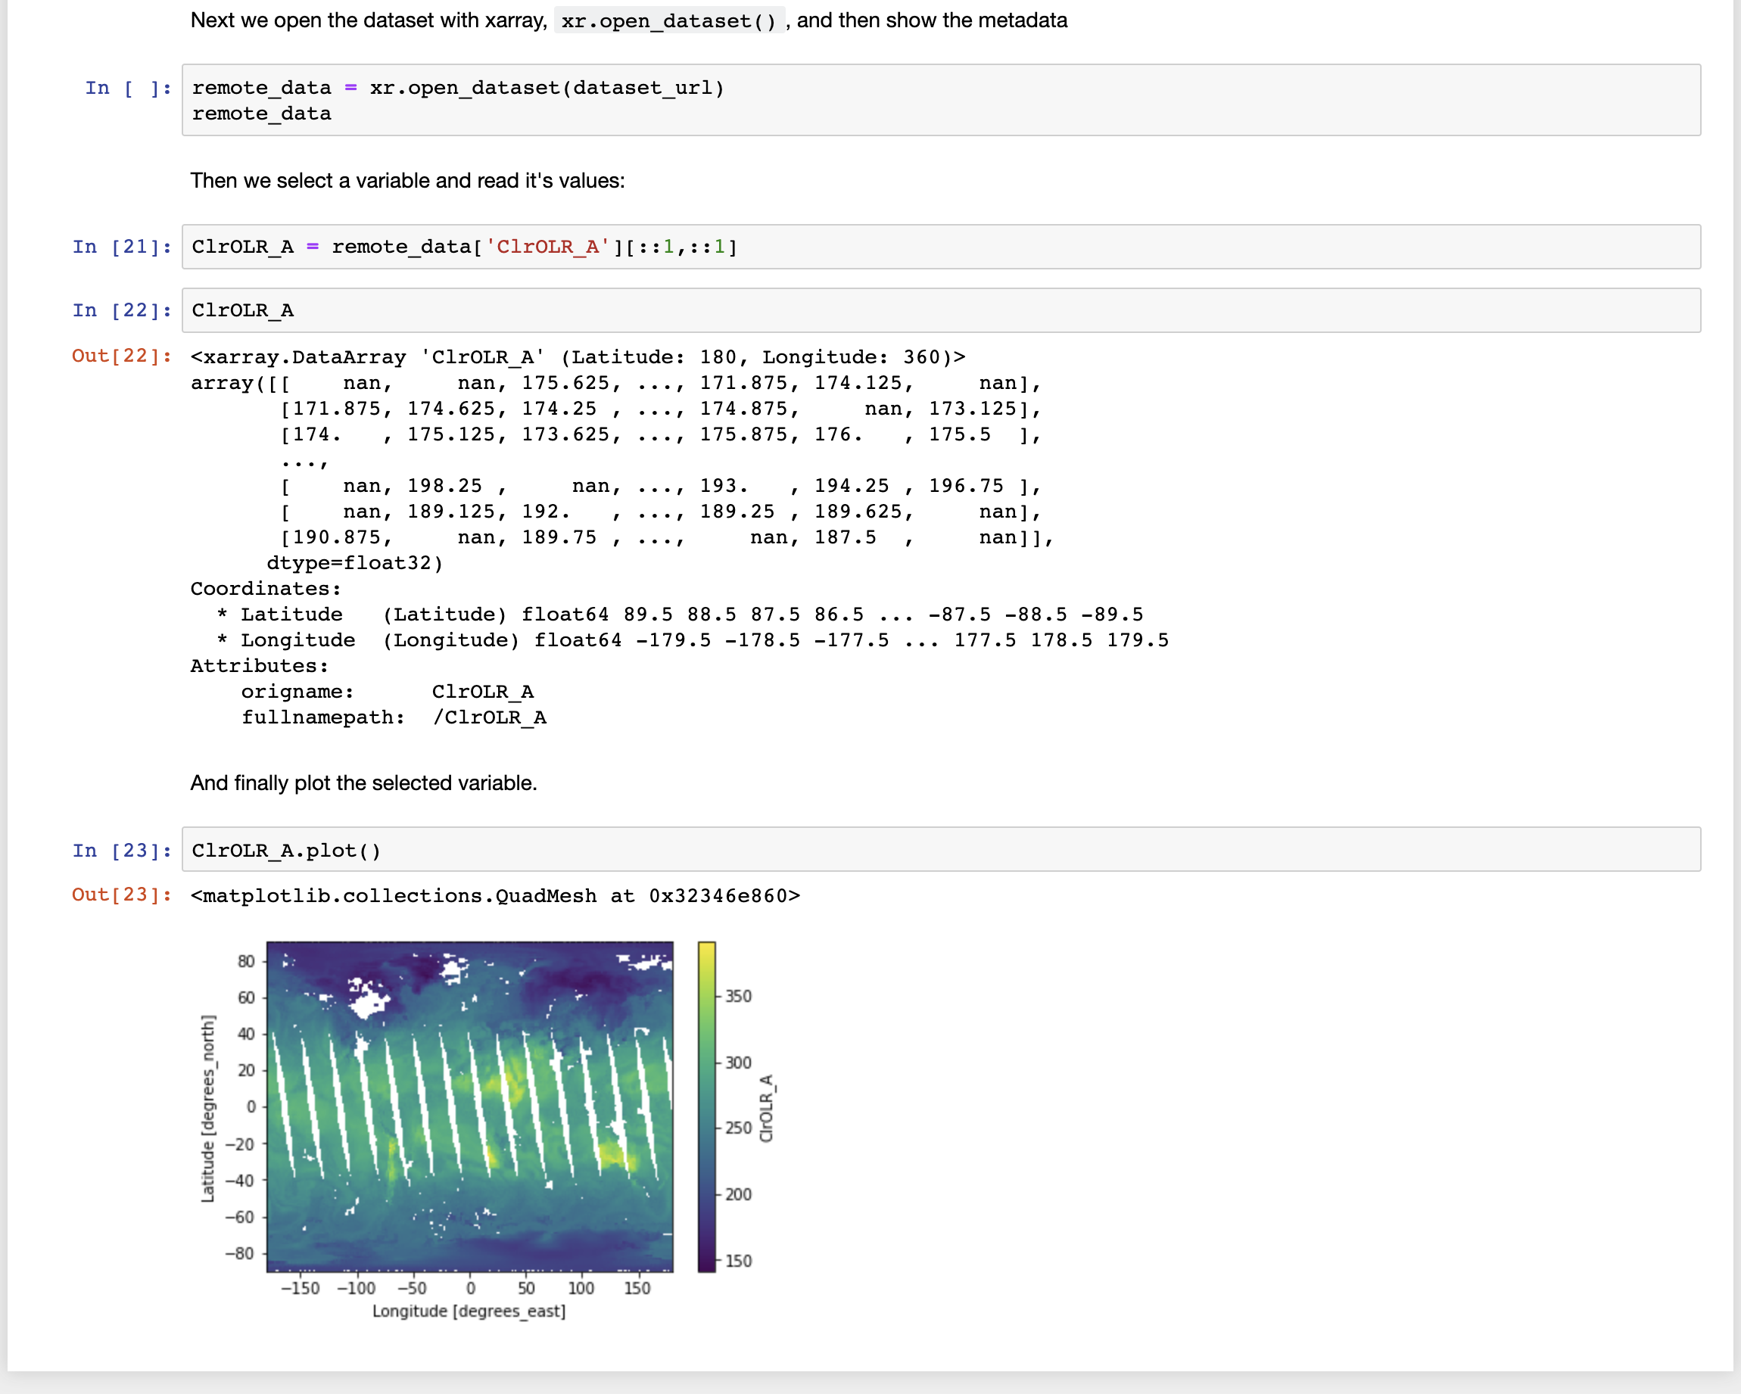
Jupyter notebooks and xarray
Download the notebook from the Jira ticket (HK-380)
Use dataset_url = 'http://t41m1.opendap.org:8080/opendap/dmrpp_s3/airs/AIRS.2015.01.01.L3.RetStd_IR001.v6.0.11.0.G15013155825.nc.h5.dmrpp'
...
Notes:
NB: The URL in the notebook is no longer on t41m1.opendap.org, but the same data file, also staged on S3 is at dataset_url = 'http://t41m1.opendap.org:8080/opendap/dmrpp_s3/airs/AIRS.2015.01.01.L3.RetStd_IR001.v6.0.11.0.G15013155825.nc.h5.dmrpp'

Slide 15
Byproduct: A new way to build data aggregations
Definition: The formation of a number of things into a cluster.
In the Hyrax data server, data aggregations are generally defined using a domain specific language called NcML
We have defined a new tool, called DMR++, to build aggregations using the virtual sharding system with data stored on S3
This new technique is faster in the general case, and can be much faster when a small amount of data from many discrete files much be accessed

Slide 16
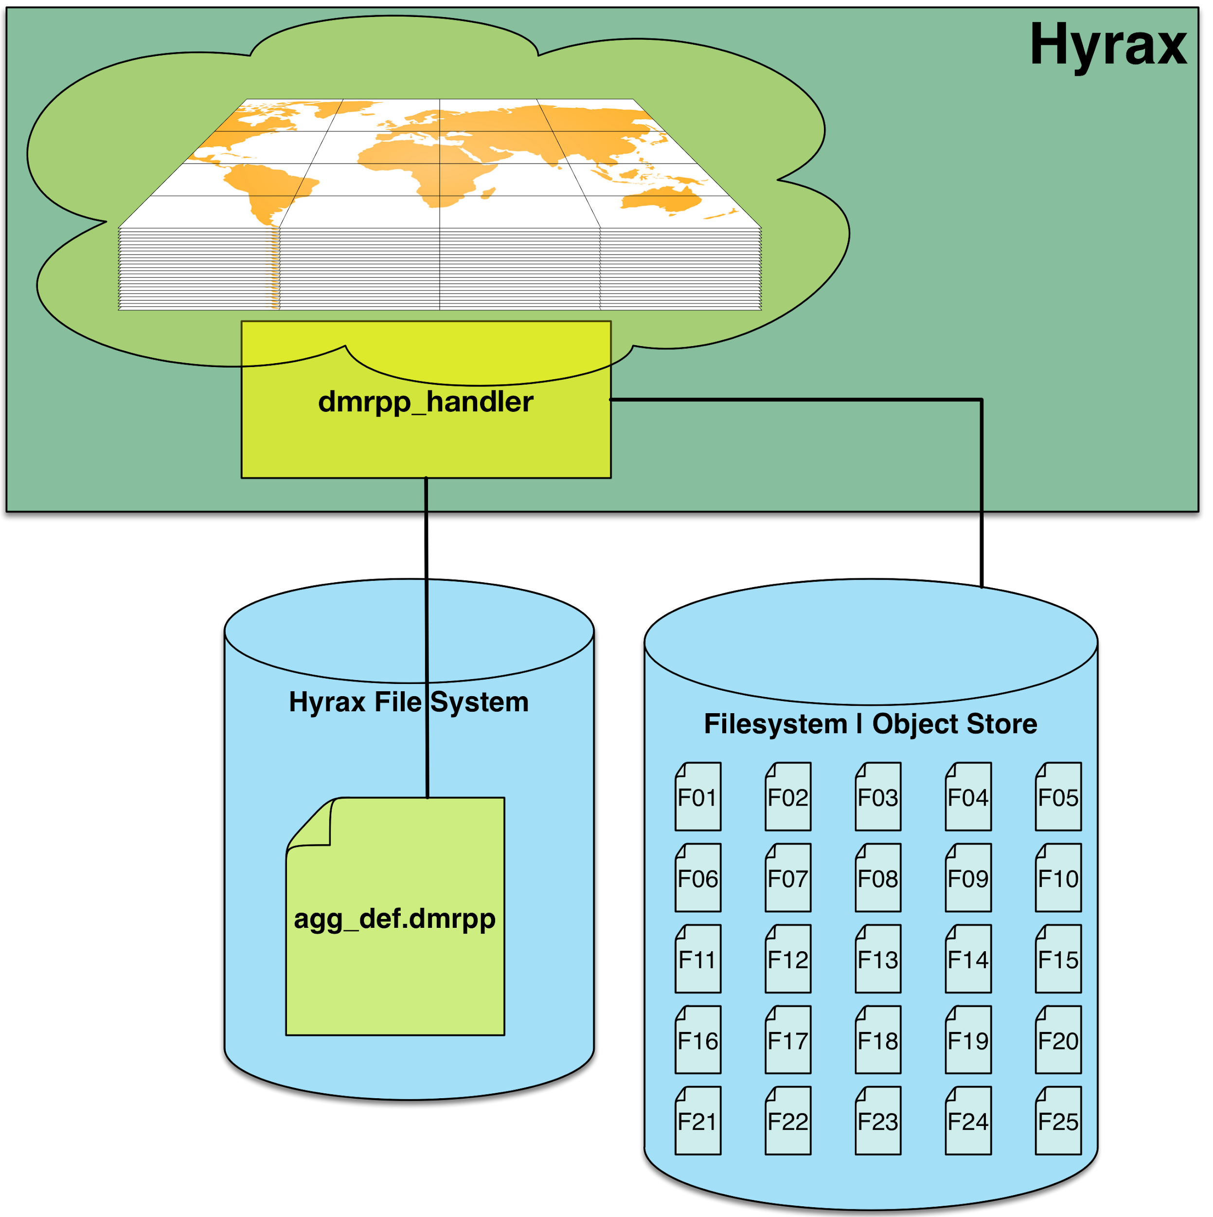
We can use DMR++ to Define Aggregations
Write a single DMR++ file that references all of the data.
This is possible because the 'virtual sharding' technique treats parts of variables as individually addressable 'shards.'

Slide 17
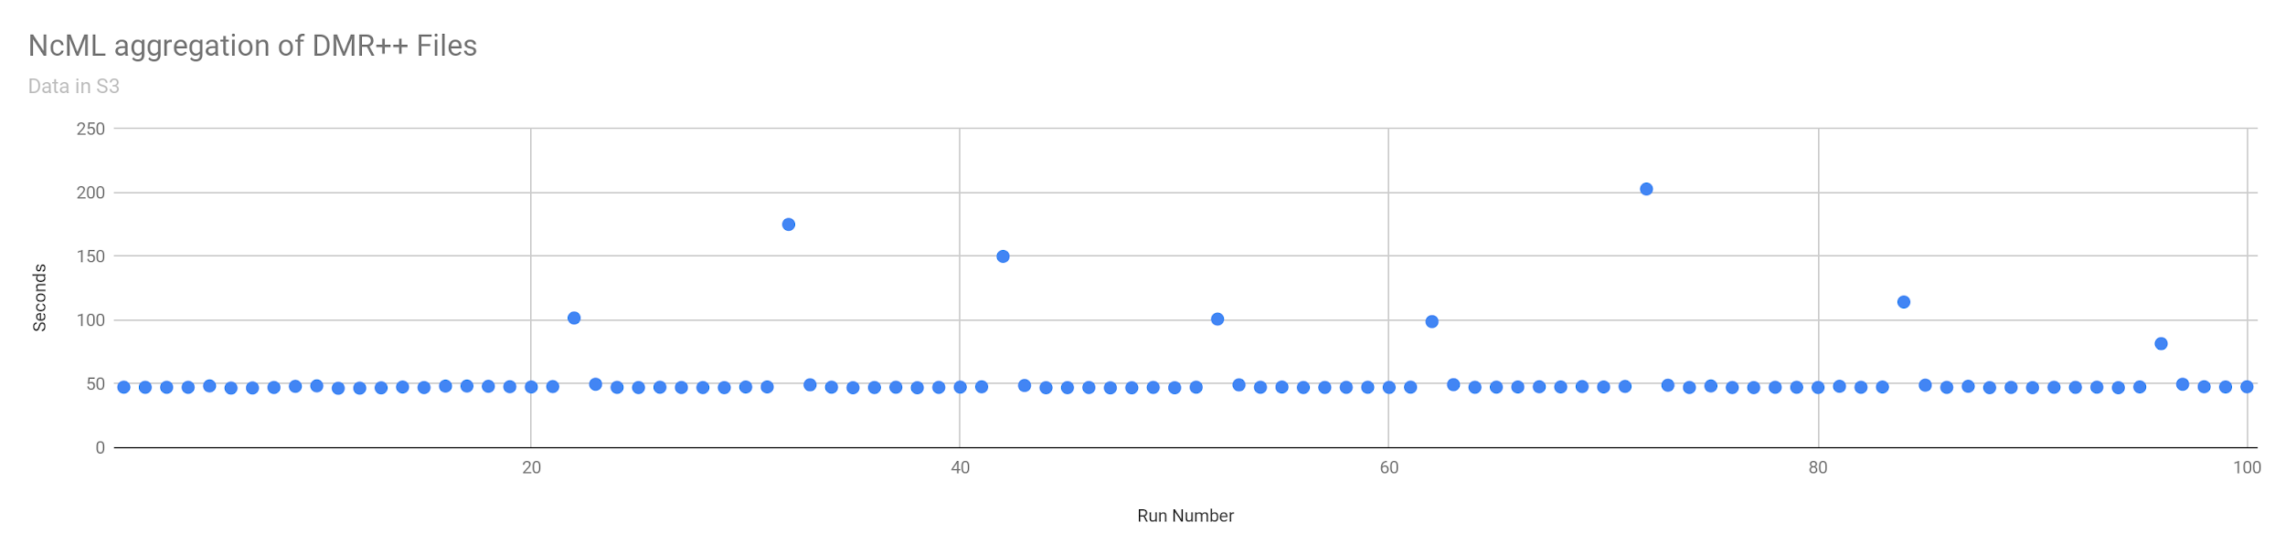
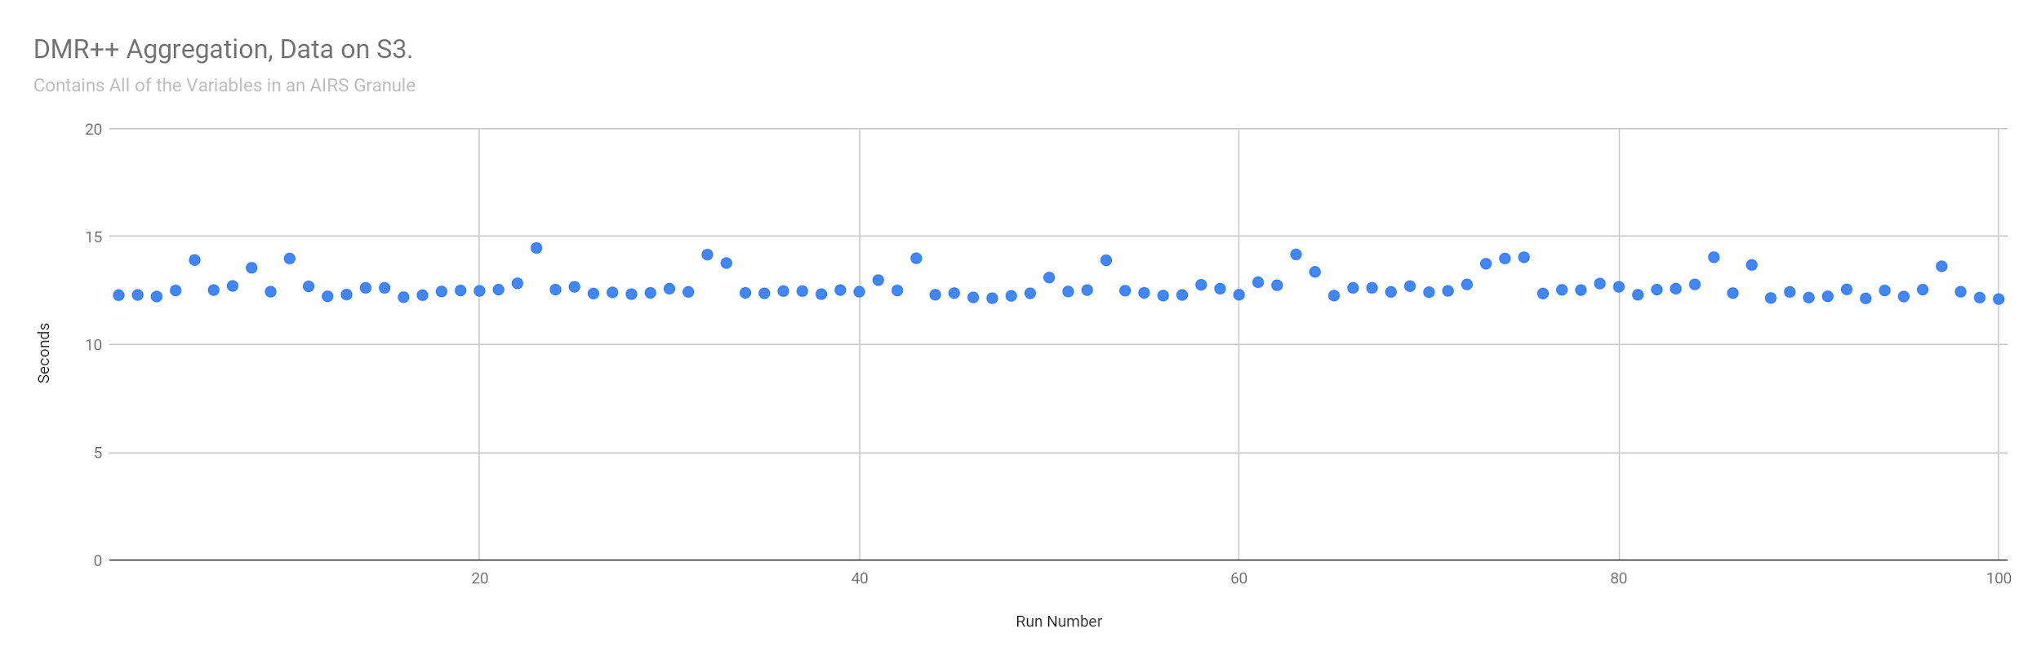
Comparison of NcML vs DMR++ Aggregations
Difference of ~50s versus ~12.5s
Access to one variable for all or 365 days
The aggregation consists of 365 files/objects (one for each day)

Slide 18
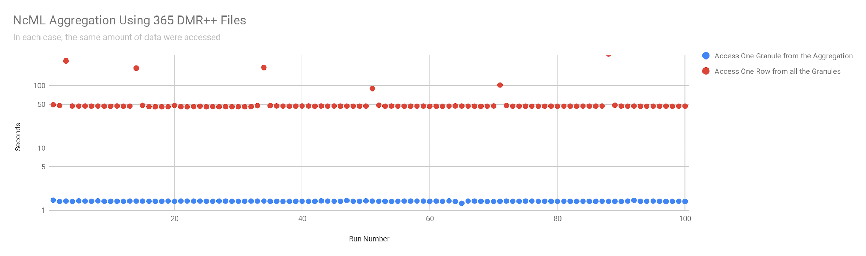
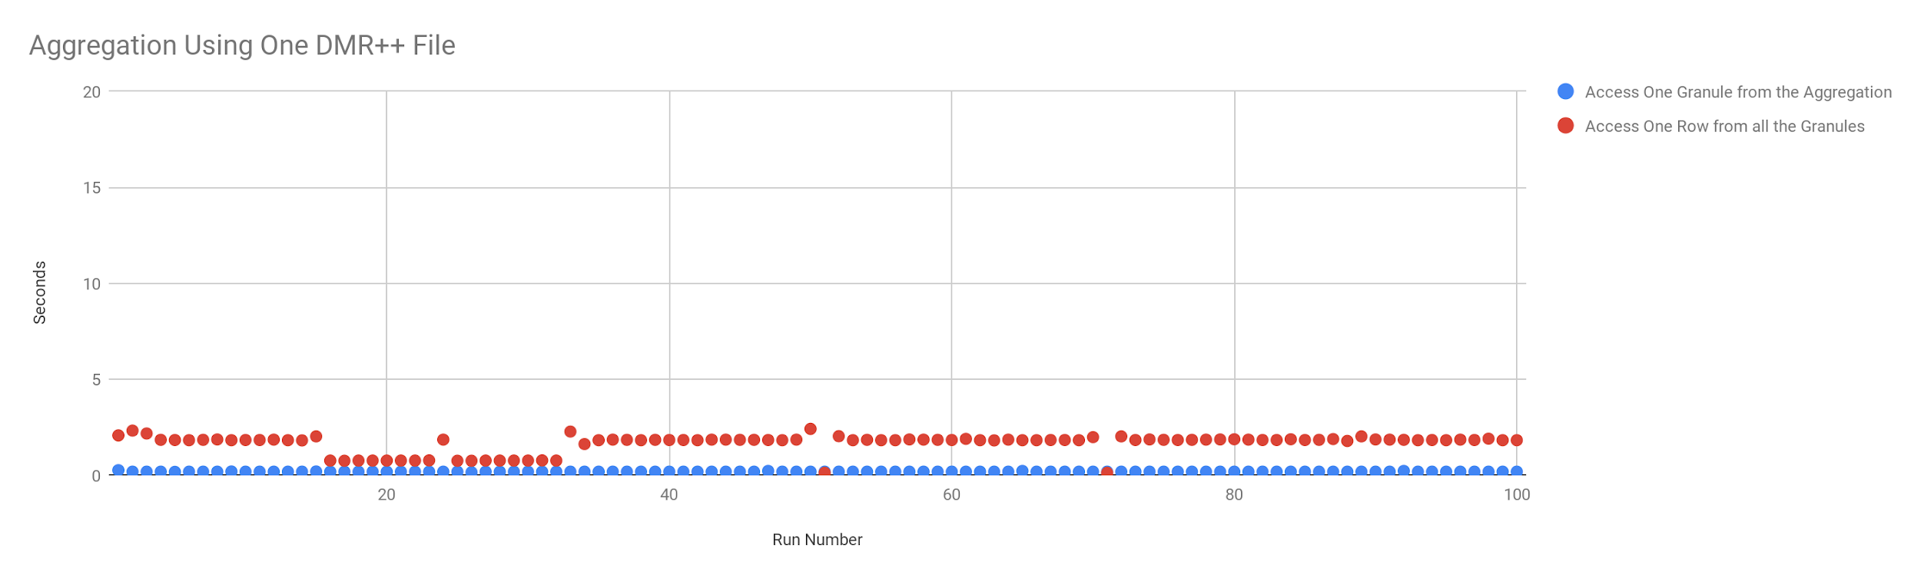
Orthogonal Accesses – NcML versus DMR++
Slicing across the granules shows the main benefit of this technique
The 'sharding' aggregation is significantly faster than our implementation of NcML
Why: Our NcML is processed by an interpreter which iterates over all the needed granule descriptions, while the sharding technique is roughly equivalent to a 'compiled' version of the aggregation

Slide 19
Conclusions
Existing files can be moved to S3 and accessed using existing web APIs
The web API implementation will have to modified to achieve performance on a par with data stored on a spinning disk
Existing client applications work as before
The new implementation provides additional benefits such as enhanced data aggregation capabilities

Slide 20



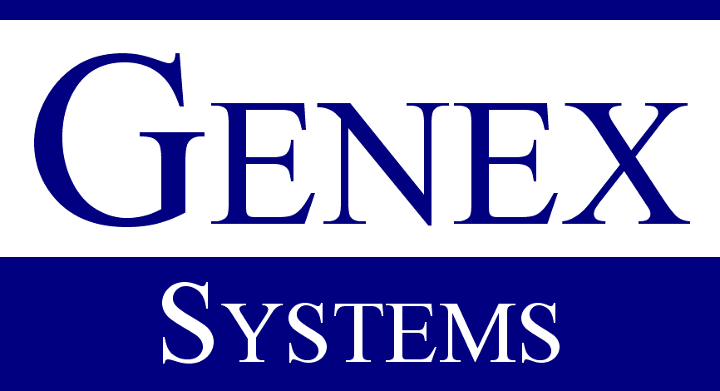
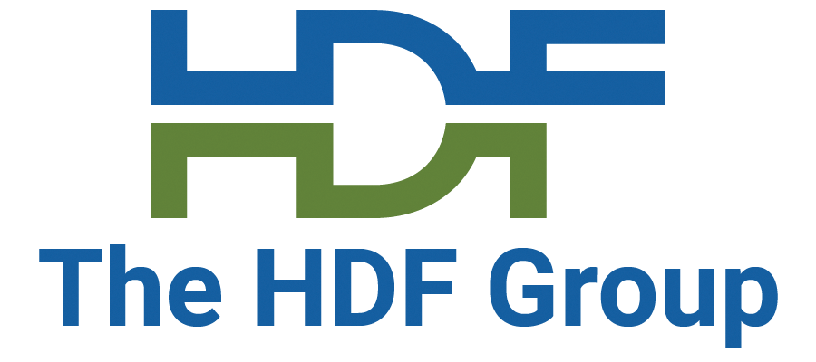

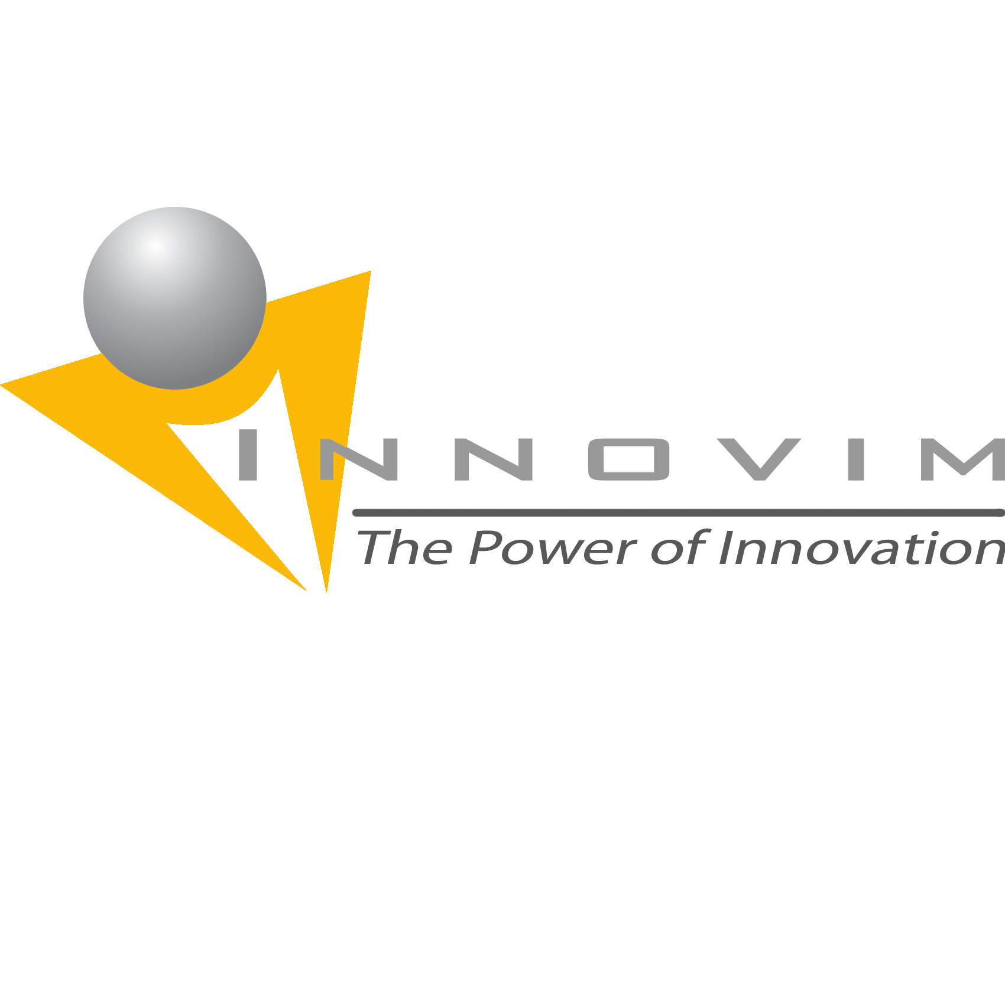

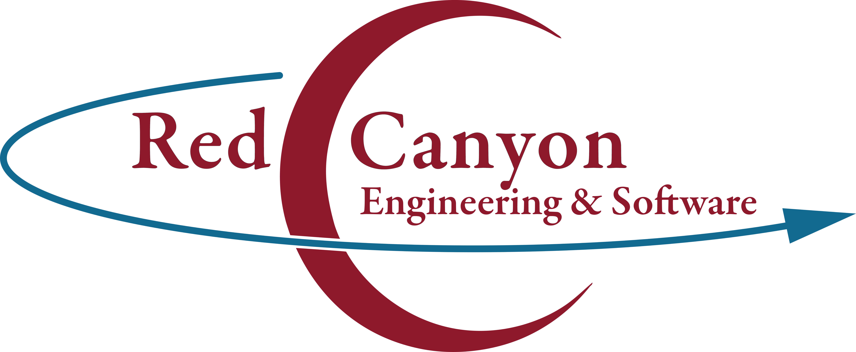

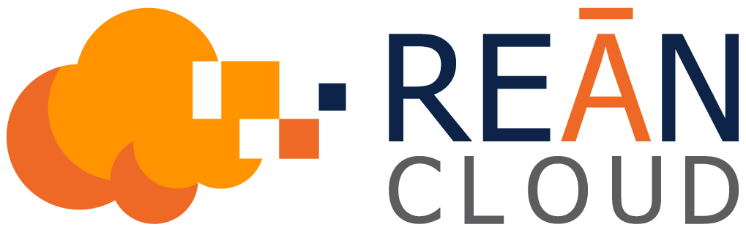

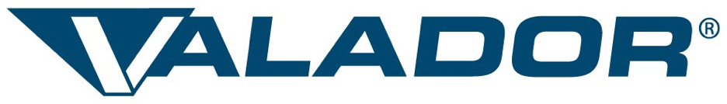
This work was supported by NASA/GSFC under Raytheon Co. contract number NNG15HZ39C.
in partnership with

Slide 21
Bonus Material – Short version
How hard will it be to move this code to Google?
Answer: About 4 hours.
And, we can cross systems, running Hyrax on AWS or Google and serving the data from S3 or Google GCS.
Performance was in the same ballpark
Originally presented at C3DIS, Canberra, May 2019. Four-slide version follows...

Slide 22
Case Study 2: Web Object Service Interoperability
Moving a System to a different cloud provider
Given: Hyrax data server running on AWS VMs, and
Serving data stored in S3
Move the server to Google Cloud VMs and
Serve the data from Google Cloud Store
How much modification will the software and data need?
How long with the process take?
Will the two systems have significantly different performance?

Slide 23
Case Study Discussion
The Hyrax server is compiled C++
The data objects in Amazon S3 were copied to Google GCS
The metadata describing the data objects were copied and
  Case 1: were left referencing the data objects in S3
  Case 2: were modified to reference the copied objects in GCS
No modification to the server software
Time needed to configure the Google cloud systems: less than 1 day
Notes:
*We did find an unrelated issue, so both servers were subsequently built from git. The current publicly released binary images did work correctly with the respective web object stores in both situations.

Slide 24
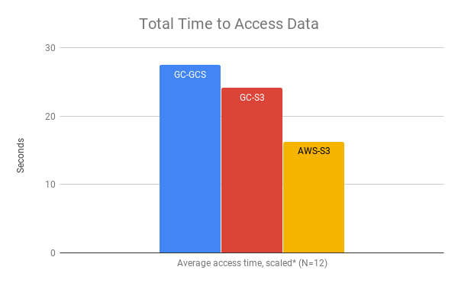
Comparison of Performance
*Times scaled to account for differences in the VM core number

Slide 25
Case Study 2: Discussion
Web object store access used the REST API (i.e., the https URLs)
  Each of the two web object stores behaved 'like a web server'
  Using common interfaces supports interoperability
  Other interfaces might not
Virtual machines
  I used the same Linux distribution; legacy code known to run there
  Switching Linux variant would increase the work
The buckets were public
  Differences in authentication requirements might require software modification

